Slide 1


Grade 11
Term 4 | Study Skills
Lesson 3: Examination-writing skills & personal development goals
Notes:
Slide 1: Good day, Grade 11s. Welcome back to our lesson series on study skills.
In Lesson 2, we discussed study styles and study strategies and how these can help you approach different learning tasks.
Today, we are moving one step further. Knowing your work is important, but you also need to know how to show what you know during an examination.
Have you ever walked out of an examination knowing that you understood the content, but feeling that you did not answer the questions properly? Perhaps you ran out of time, misunderstood an action word or did not provide enough detail.
Today, we will look at examination-writing skills that can help you avoid these problems.
We will also look at personal development goals regarding your studies, health and fitness. These goals can help you work towards both your immediate Grade 11 goals and your longer-term plans.

Slide 2

By the end of this lesson, you should be able to:
Define examination writing skills.
Identify suitable examination-writing skills before, during and after an examination.
Interpret action words and mark allocations to determine how examination questions should be answered.
Complete a personal development plan by identifying a goal, actions, timeframe, obstacles, solutions and a way to monitor progress.
Apply the personal development plan framework to a personal study, health or fitness goal.
Notes:
Slide 2: By the end of this lesson, you should be able to:
Define examination writing skills.
Identify suitable examination-writing skills before, during and after an examination.
Interpret action words and mark allocations to determine how examination questions should be answered.
Complete a personal development plan by identifying a goal, actions, timeframe, obstacles, solutions and a way to monitor progress.
Apply the personal development plan framework to a personal study, health or fitness goal.

Slide 3
Examination-writing skills
These are strategies that help you:
understand questions.
plan and present answers.
manage your time.
communicate your knowledge effectively.
What to do before, during and after an examination.
Notes:
Slide 3: Examination-writing skills
Let’s start with examination-writing skills. What do you think this term means?
Studying is obviously an important part of preparing for an examination, but it is not the only part.
You may know the content very well, but you could still lose marks if you misread the question, misunderstand the action word, run out of time or present your answer unclearly.
Examination-writing skills are the techniques and strategies you use to understand questions, plan and present answers, manage your time and communicate your knowledge effectively during tests and examinations.
We are going to look at what you should do before, during and after an examination.

Slide 4

Before the examination
Follow a realistic study plan
Practise past questions
Revise weak topics
Practise under timed conditions
Know the examination format
Prepare equipment
Get enough sleep
Notes:
Slide 4: Before the examination
Let’s begin with what happens before you enter the examination room.
Think about the night before an examination. Do you want to be searching for a calculator, trying to learn an entire section for the first time and wondering what the paper will look like?
Effective preparation can help you feel more confident and reduce unnecessary stress.
Before an examination:
Study the relevant content thoroughly.
Revise according to a realistic study plan.
Complete practice questions and past examination papers.
Practise answering questions within the allocated time.
Identify and revise topics that require additional attention.
Familiarise yourself with the examination format and instructions.
Make sure that you have the stationery and equipment you need.
Get enough sleep and maintain a balanced routine.
Ask learners to quietly reflect on the following questions: Which of these are you already doing well? Which one do you need to improve before your final examinations?

Slide 5

During the examination
Read the instructions.
Analyse each question.
Identify content, context and action word.
Use the mark allocation.
Manage your time.
Attempt every question.
Present answers clearly.
Manage stress.
Notes:
Slide 5: During an examination
Now imagine that the examination paper is in front of you. What should you do first?
It can be tempting to start writing immediately, especially when you are nervous, but taking a moment to read the instructions can prevent unnecessary mistakes.
Let’s work through the skills you should use while writing.
Check the instructions: Read all instructions before beginning. Check for compulsory questions and sections from which you must choose.
Analyse each question: Read the question again when necessary. Identify the content (the topic), context (the situation in which knowledge must be applied) and action word (how the question must be answered). Highlight or underline this important information.
Use the mark allocation: The marks indicate how much information and detail are required. Provide enough points to earn all the available marks.
Manage your time: Allocate time according to the marks for each question or section. Do not spend too long on one answer, and leave time to check your work.
Attempt every question: Do not leave questions blank. Attempt an answer even when uncertain, as partial marks may be awarded. Never leave out multiple-choice questions.
Present answers clearly: Use the correct numbering, write legibly, follow the required examination format, organise longer answers into paragraphs and keep responses relevant.
Manage stress: Pause briefly, take a few slow breaths and reread the question. Continue with a question you can answer, then return to the difficult question later.

Slide 6
After the examination
Before submitting:
Check that all questions are answered.
Correct obvious errors.
Afterwards:
Reflect on your time management.
Identify difficult content or questions.
Review your marked paper and feedback.
Decide what to improve next time.
Notes:
Slide 6: After the examination
Once you reach the end of the paper, resist the urge to close it immediately. Use any remaining time to ensure that you answered all the required questions and correct obvious errors.
When you leave the exam venue, consider how effectively you managed your time and identify question types or content that you found difficult.
Your reflection should also continue after the marked paper is returned.
Instead of only looking at the mark, ask yourself: Where did I lose marks, and what could I do differently next time? Review marked scripts and feedback to improve your preparation and examination-writing skills.

Slide 7
Understanding action words
Action words tell you how to answer a question.
Always consider:
the action word
the full question
the mark allocation
Different action words require different levels of detail.
Notes:
Slide 7: Understanding action words
We have already mentioned action words, but let’s look at them more closely.
What is the difference between being asked to state, explain and evaluate something?
You might know the topic, but you will not earn all the available marks if you do not respond in the way the action word requires.
Action words tell you how to answer an examination question. Understanding them helps you identify what the question expects and how much detail to provide. The best way to understand action words is to practise applying them to examination questions.
Remember that you must read the action word together with the full question and the mark allocation.
Note to teacher: A list of action words and their requirements is available in the Content Summary.

Slide 8

State TWO examination-writing skills.
(2 × 1) (2)
Notes:
Slide 8: Applying action words
Let’s see how the action word changes the type of answer you need to give.
I am going to show you three questions. For each one, tell me:
What is the action word?
How many marks are available and how will it be allocated?
Question 1: State TWO examination-writing skills. (2 × 1) (2)
What is the action word?
The action word is state.
How many marks are available and how will it be allocated?
Two marks are available. One mark is awarded for each examination-writing skill. No explanation is required because the question only asks you to state the skills.

Slide 9
Explain how time management can help learners during an examination.
(1 × 2) (2)
Notes:
Slide 9: Question 2: Explain how time management can help learners during an examination. (1 × 2) (2)
What is the action word?
The action word is explain.
How many marks are available and how will it be allocated?
Two marks are available. One mark is awarded for the statement and one mark for the explanation of how it could help learners.

Slide 10
Evaluate the effectiveness of completing past papers when preparing for an examination.
(1 × 4) (4)
Notes:
Slide 10: Question 3: Evaluate the effectiveness of completing past papers when preparing for an examination. (1 × 4) (4)
What is the action word?
The action word is evaluate.
How many marks are available and how will it be allocated?
Four marks are available. One mark is awarded for a positive statement, one mark for its explanation, one mark for a possible limitation and one mark for the explanation of the limitation.
Now you will have an opportunity to put this into practice by answering these questions.
Learners to complete Activity 1 (Lesson 1 – Worksheet) where they answer the above questions.
Answers are available in the Lesson 1 – Worksheet MEMO.

Slide 11

Personal development plan
Area
What do I want to improve?
What do I want to achieve?
Actions
What will I do?
Timeframe
By when?
Obstacles and solutions
What could interfere?
Monitoring
How will I track progress?
Goal
Notes:
Slide 11: Personal development goals
We are now moving on to personal development goals regarding your studies, health and fitness.
Think about something you would like to improve. It may be your marks in a subject, your sleeping habits, the way you manage stress or your level of physical fitness.
Having a goal is a good starting point, but a goal becomes more useful when you identify the actions you will take to achieve it.
A personal development plan is a written plan that identifies what you want to achieve and the actions you will take to reach your goals. It may include study, health and fitness goals.
Let’s look at what should be included in your personal development plan.
Area for improvement: The study, health or fitness area you want to develop.
Goal: A short-term and/or long-term goal.
Actions: The steps required to achieve the goal.
Timeframe: A realistic period for completing the goal.
Obstacles and solutions: Possible difficulties and ways to overcome them.
Monitoring: A method for reviewing progress and making adjustments.

Slide 12
Example study goal
Long-term goal:
Become a lawyer.
Short-term goal:
Pass Grade 11 and improve English and History.
Actions:
Follow a study plan.
Revise three times per week.
Complete past examination questions.
Complete the rest of the plan with a partner.
Notes:
Slide 12: Developing a personal development plan
Let’s work through an example of a personal development plan that focuses on studying.
This learner has a long-term career goal, but they also need shorter-term study goals that will help them work towards it.
Long-term goal: I want to become a lawyer.
Short-term study goal: I want to pass Grade 11 and improve my English and History results.
Actions: Follow my study plan consistently; revise English and History three times per week; complete past examination questions.
The learner has identified a goal and possible actions, but we still need to complete the rest of the plan.
Together with a partner, complete the rest of the plan in Activity 2 (Lesson 3 – Worksheet).
After learners have completed the activity, ask one or two pairs to provide feedback. Possible answers are available in the Lesson 3 – Worksheet MEMO.
Remember that short-term study goals should support your long-term education and career goals.

Slide 13
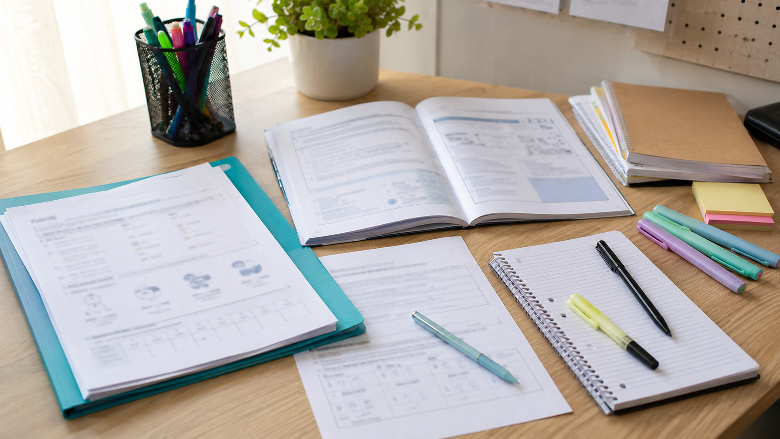
Personal development goal
Notes:
Slide 13: You will now have the opportunity to apply your goal-setting skills by developing a study, health or fitness goal by completing Activity 3 (Lesson 3 – Worksheet). If there is not enough time to complete this activity in class, it must be completed as homework.

