Slide 1


Grade 9
Term 4 | Development of the Self in Society
Lesson 3: Coping techniques
Notes:
Slide 1: Welcome back, Grade 9s. Today is our final lesson on challenging situations.
So far, we have explored different challenging situations and some of their causes. We have also learnt that everyone experiences stress and difficult emotions, but the choices we make during these times can have a lasting effect on our well-being.
In this lesson, we will explore healthy coping techniques, counterproductive coping techniques that can make problems worse and learn how to support ourselves and others.

Slide 2

By the end of this lesson, you should be able to:
Define the term coping techniques.
Distinguish between healthy and counterproductive coping techniques (including drugs and alcohol) and explain their possible effects.
Explain how responsible decision-making and seeking support can help during difficult situations.
Notes:
Slide 2: By the end of this lesson, learners should be able to:
Define the term coping techniques.
Distinguish between healthy and counterproductive coping techniques (including drugs and alcohol) and explain their possible effects.
Explain how responsible decision-making and seeking support can help during difficult situations.

Slide 3
Coping techniques
Actions used to manage stress, difficult emotions and challenging situations.
Healthy techniques
Talking about your feelings
Exercising
Journalling or praying
Counterproductive techniques
Avoid or numb the problem
Provide only temporary relief
May create further problems
Notes:
Slide 3 : Coping techniques are actions people use to manage stress, difficult emotions and challenging situations.
People use different techniques to cope with depression, grief, loss, trauma or crisis. Some people use healthy coping techniques, while others use counterproductive coping techniques.
Healthy coping techniques help people respond positively and support their emotional well-being. They may include crying, talking about your feelings with a friend or counsellor, exercising, journaling, praying, or engaging in creative expression.
Counterproductive techniques refer to actions or behaviours that have the opposite effect to what was intended. These techniques avoid the underlying problem or attempt to numb the pain. They may provide temporary relief but may make the situation worse or create additional problems.
Let's investigate these counterproductive techniques in more detail.

Slide 4

Alcohol and drugs
Some teenagers use alcohol or drugs to escape emotional pain.
Possible effects:
addiction
impaired judgement
unsafe behaviour
damaged relationships
The original problem remains unresolved.
Notes:
Slide 4: Counterproductive coping techniques: drugs and alcohol
Drug abuse: Some teenagers may use drugs to escape emotional pain. However, when the drugs wear off, the original problem remains unresolved. Drug abuse may lead to additional problems such as addiction, health problems, financial difficulties, legal consequences and damaged relationships.
Alcohol abuse: Like drugs, alcohol may temporarily numb emotional pain, but it can worsen low mood and impair judgement. This may lead to risky behaviour, including unsafe decisions, aggression, unprotected sex, driving under the influence or self-harm.

Slide 5
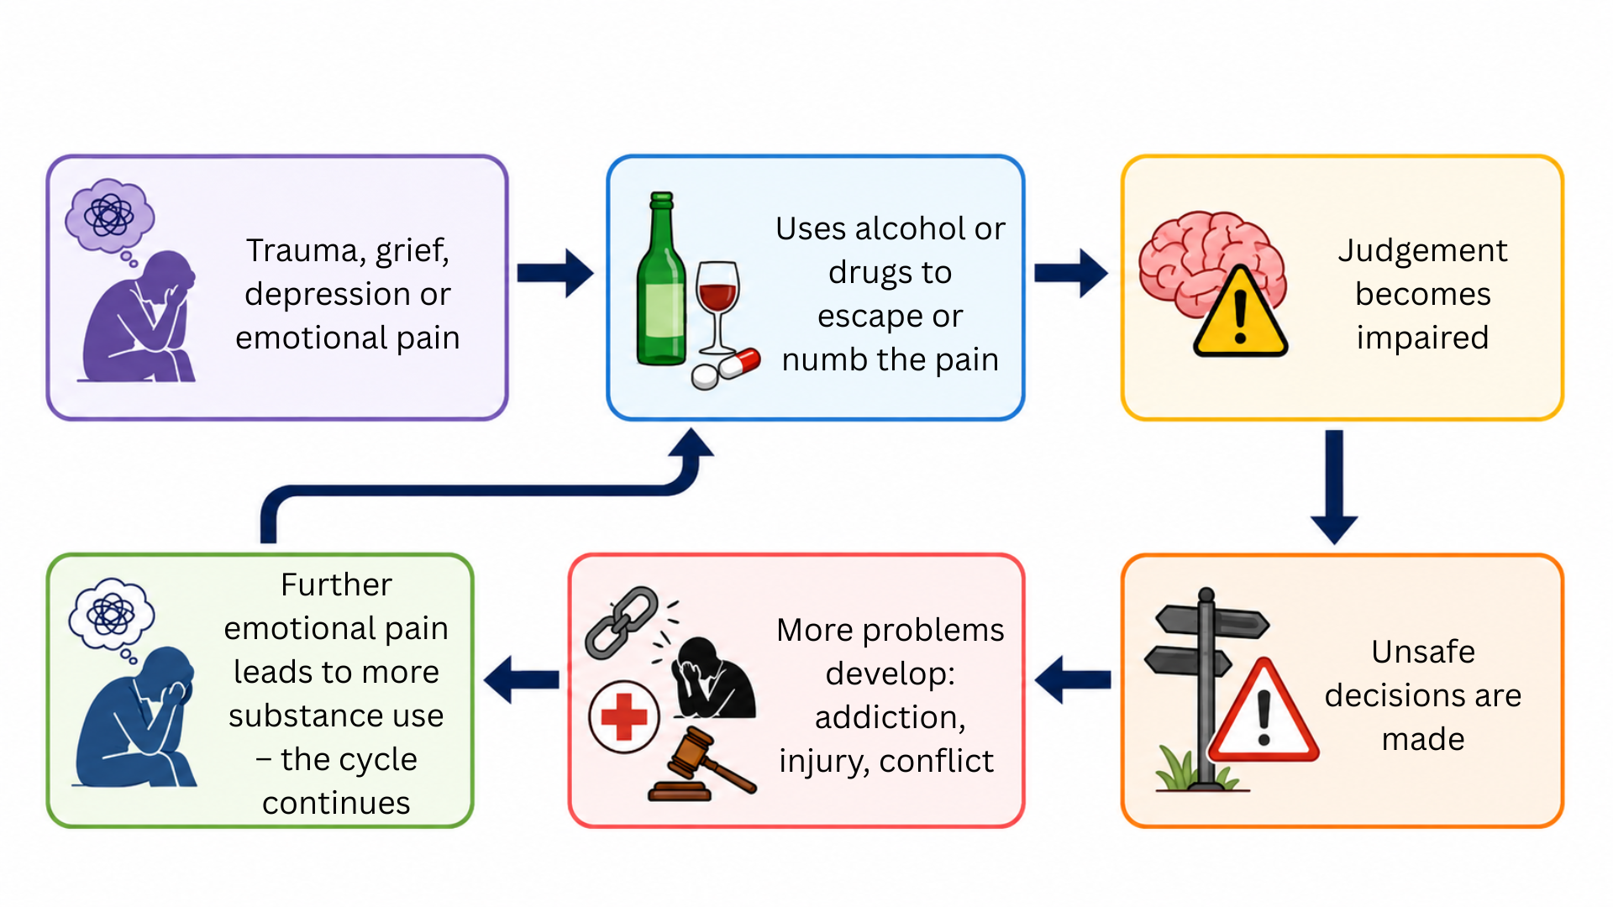
A vicious cycle
Notes:
Slide 5: Alcohol and drug abuse may create a vicious cycle :
A teenager experiences trauma, grief, depression or emotional pain.
They use alcohol or drugs to escape or numb the pain.
Their judgement becomes impaired, which may lead to unsafe decisions.
These decisions create additional problems, such as addiction, injury, conflict or legal trouble.
The new problems cause further emotional pain.
The teenager may use more substances to escape, and the cycle continues.

Slide 6
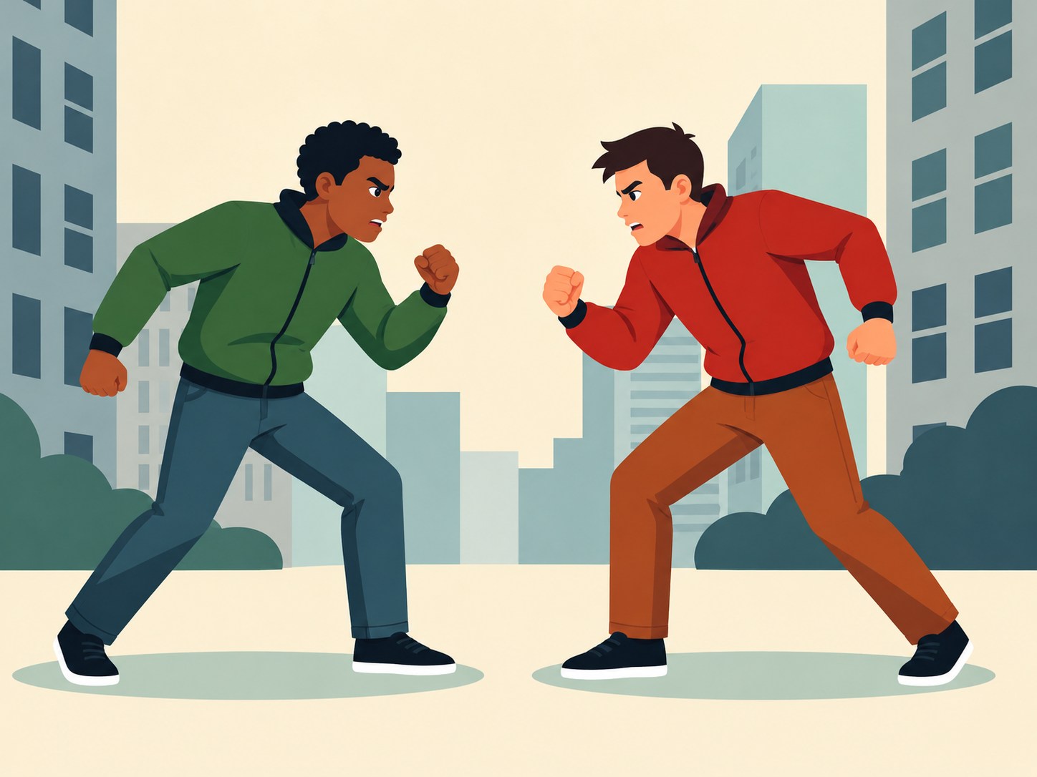
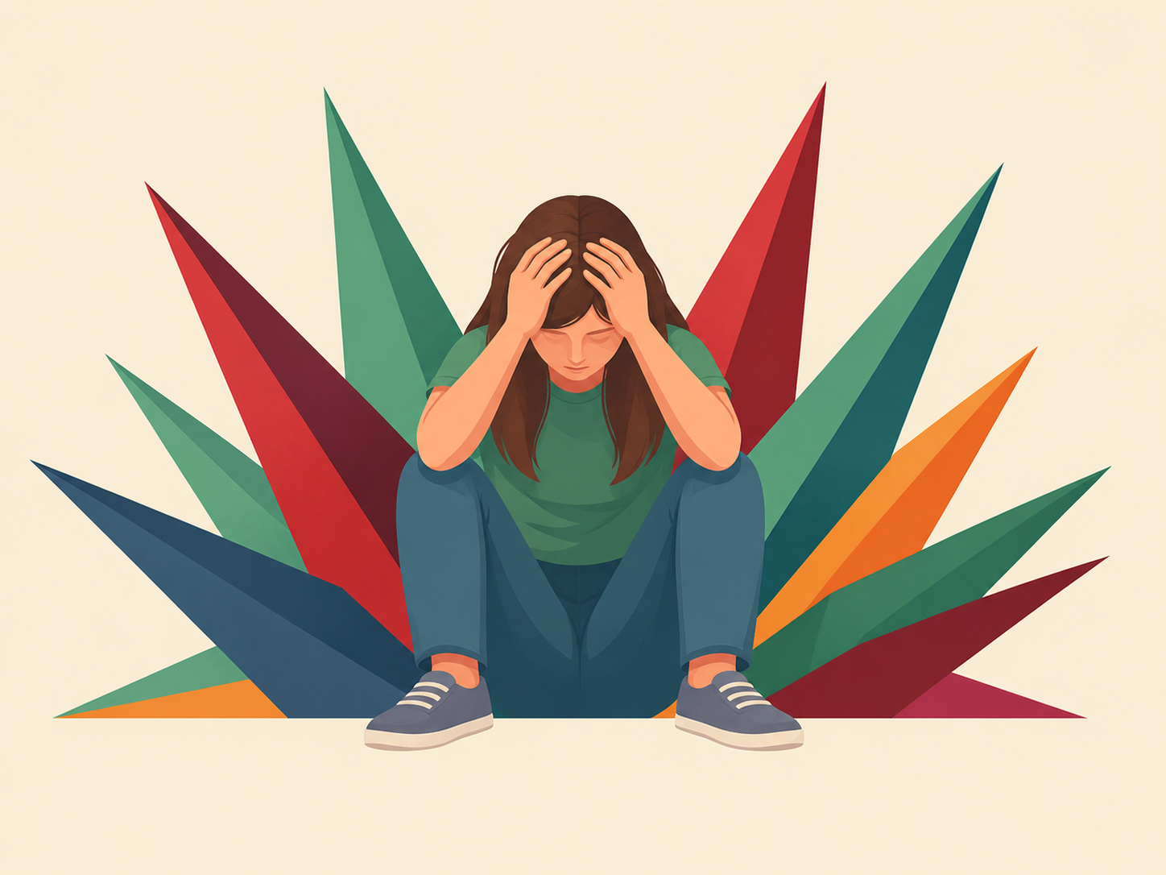
Other counterproductive techniques
Fighting
injury
disciplinary or legal consequences
Self-harm
serious injury
does not solve the underlying problem
Suicidal thoughts
require immediate support
tell a trusted adult immediately
Notes:
Slide 6: Counterproductive coping techniques: fighting, self-harm and suicidal thoughts
Fighting and aggression: Some teenagers express emotional pain through anger or physical aggression. Fighting may cause injury, disciplinary or legal consequences and damaged relationships.
Self-harm: Some teenagers deliberately injure themselves to cope with emotional pain or feel a sense of control. Self-harm is dangerous, may cause serious injury and does not address the underlying problem.
Suicidal thoughts: A person experiencing overwhelming emotional pain may believe that there is no way forward. Suicidal thoughts require immediate support. If you or someone you know is having suicidal thoughts, it is critical to tell a trusted adult immediately and contact a crisis helpline.

Slide 7
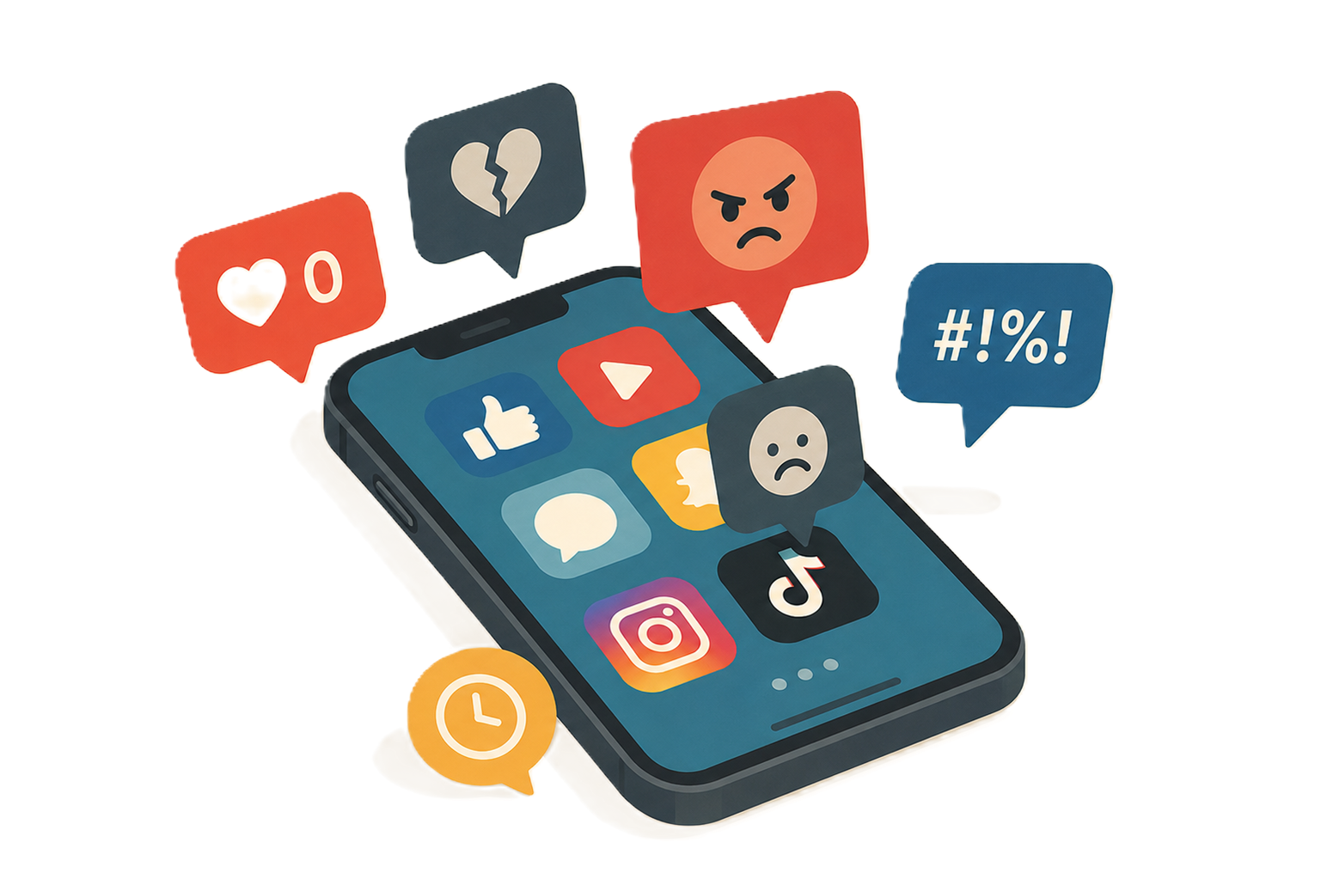
Social media misuse
Reasons for excessive use
distraction from pain
seeking validation
avoiding difficult emotions
Possible effects
stress and anxiety
low self-esteem
disrupted sleep and schoolwork
Notes:
Slide 7: Counterproductive coping techniques: social media misuse
Social media can be a good way to stay connected during a difficult time; however, excessive social media use may become a way of avoiding difficult emotions.
Reasons teenagers may use social media
To distract themselves from pain
To seek validation through likes and comments
To cyberbully others as an outlet for their own pain
Possible effects of excessive social media use
Increased stress and anxiety
Lower self-esteem and confidence
Feelings of loneliness or exclusion
Disrupted sleep, schoolwork and face-to-face relationships
Healthy tip: Use social media in moderation, take regular breaks and make time for offline activities, exercise, hobbies and relationships, especially if you are dealing with a challenging situation.

Slide 8
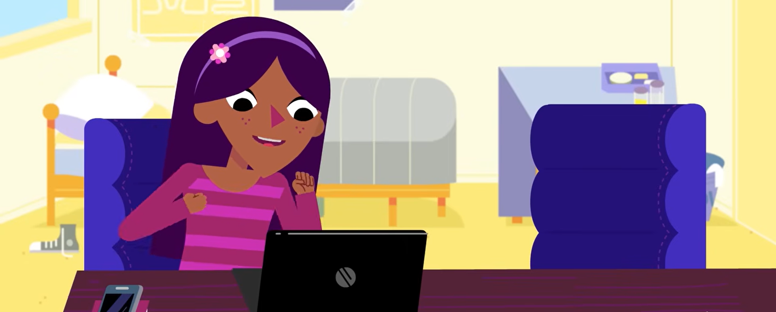
Watch: Social Media: Ways to Stay Healthy https://www.youtube.com/watch?v=YHsxXMeD_AE (2 min 07 sec)
Notes:
Slide 8: Let's watch a video on social media use and how it could help or hinder our mental well-being.
As learners watch the video, ask them to consider:
the positive and negative effects of social media
how social media use may influence mental health
healthy ways to balance online and offline activities.
Watch video
Social Media: Ways to Stay Healthy
https://www.youtube.com/watch?v=YHsxXMeD_AE (2 min 07 sec)

Slide 9

Watch:
Thrive in 5 | Empower Yourself | Healthy vs Unhealthy Coping Strategies https://www.youtube.com/watch?v=QfKCLUFh8xg
(3 min 47 sec)
Notes:
Slide 9: Before we continue, we're going to watch a video that covers some of the coping techniques we've already discussed, as well as a few we have not.
See if you can identify the ones that have not been discussed in the lesson so far.
Watch video
Thrive in 5 | Empower Yourself | Healthy vs Unhealthy Coping Strategies
https://www.youtube.com/watch?v=QfKCLUFh8xg (3 min 47 sec)

Slide 10

Responsible decision-making
Pause before acting
Consider long-term consequences
Choose healthy coping techniques
Recognise when help is needed
Ask for support
Notes:
Slide 10: Responsible decision-making
Using drugs, alcohol and social media as coping techniques is not a responsible decision.
A responsible decision will entail the following:
Pausing before acting impulsively
Considering long-term consequences
Choosing healthy coping techniques
Recognising when we need help
Asking for support

Slide 11

Barriers to seeking help
Lack of knowledge
Financial constraints
Fear of judgement or stigma
Believing they must cope alone
Notes:
Slide 11: Barriers to getting help
Although support is available, some teenagers avoid seeking help. Common barriers include:
Lack of knowledge: Teenagers may not recognise that they are experiencing a mental health difficulty or may believe that they should manage it alone.
Financial constraints: Some families may not be able to afford private mental healthcare, while public services may have long waiting periods.
Fear of stigma: Teenagers may fear judgement from friends, family or community members. They may believe that seeking help is a sign of weakness.
Asking for help is a responsible and courageous decision.

Slide 12
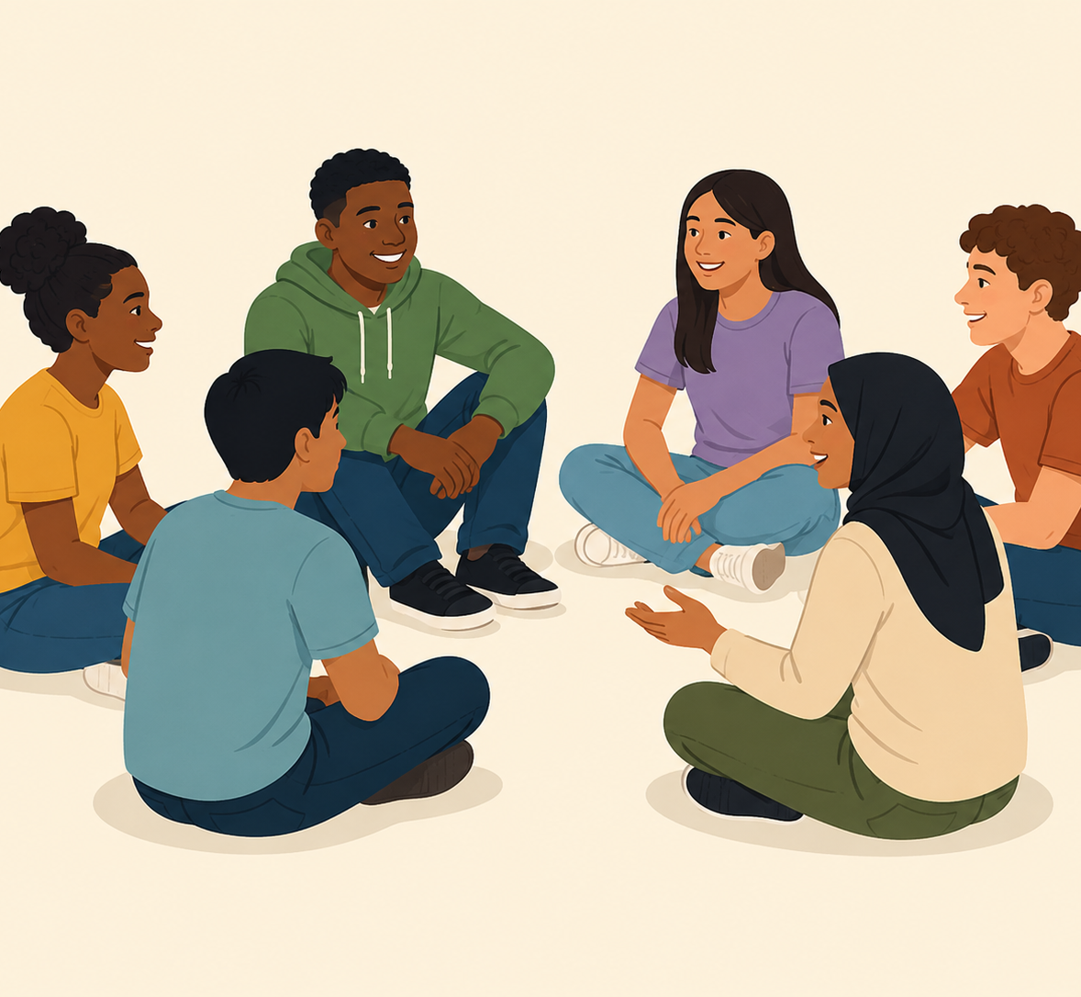
Supporting someone
Listen without judgement.
Show patience and kindness.
Avoid forcing them to talk.
Encourage support from a trusted adult or professional.
Continue including and supporting them.
Notes:
Slide 12: How to help someone in a difficult situation
If a friend or family member seems unusually sad, withdrawn or different from their usual self, your support may make a positive difference. Remember that you cannot solve the situation for them, but you can help them access the support they need.
You can:
listen with kindness and without judgement
show patience and understanding
avoid forcing the person to talk
encourage them to speak to a trusted adult or healthcare professional
continue including and supporting them.
Always tell a trusted adult if someone speaks about self-harm or suicide. Getting help quickly could save their life.

Slide 13
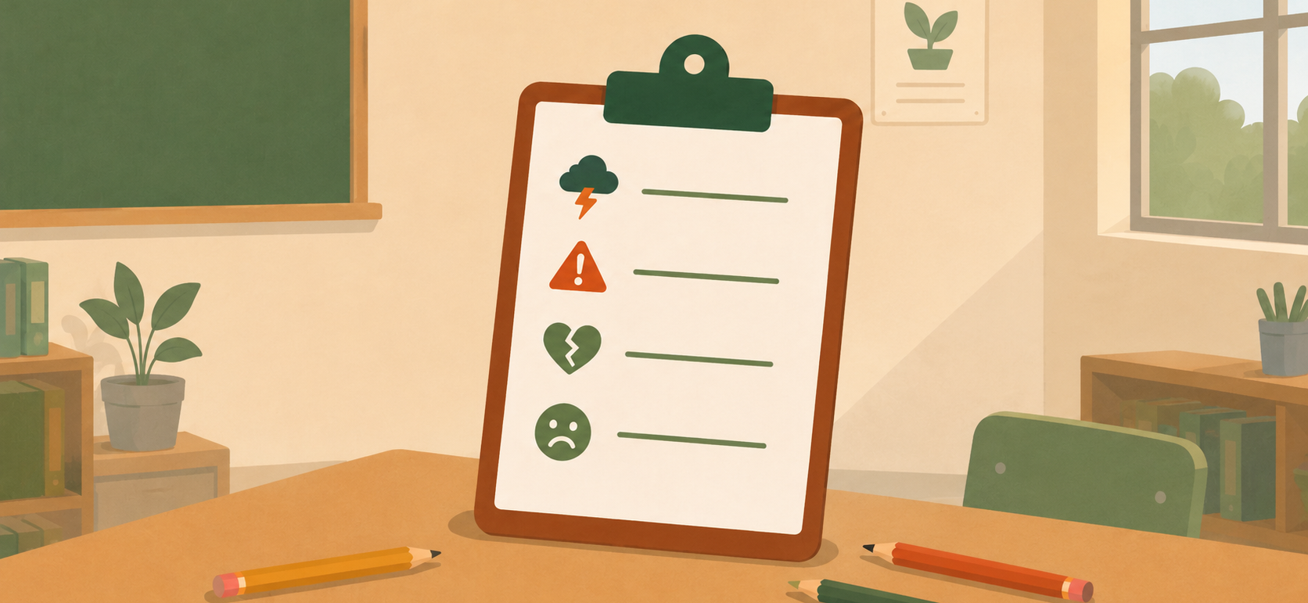
Activities
Notes:
Slide 13: Learners to complete Activity 1 (Lesson 3 – Worksheet).
Answers are available in the Lesson 3 – Worksheet MEMO.
Note to teacher: Learners should also complete Activity 2 (Lesson 3 – Worksheet) as reflection. This could be assigned as homework if class time is limited.
Hand out the Content Summary before learners leave the classroom.

