Slide 1


Grade 9
Term 4 | Development of the Self in Society
Lesson 2: Causes of depression, grief, loss, crisis and trauma
Notes:
Slide 1: Welcome back, Grade 9s. In last week's lesson, we learnt about the emotional and psychological effects of challenging situations, including depression, grief, loss, trauma and crisis.
During our discussions, we mentioned some examples of what could cause these effects.
In today's lesson, we will investigate the causes of depression, grief, loss, trauma and crisis in more detail.
Understanding what may cause these experiences can help us respond to ourselves and others with greater empathy.

Slide 2

By the end of this lesson, you should be able to:
Identify biological, psychological and social factors that may contribute to depression.
Explain how stressful life events can affect a person's mental and emotional well-being.
Describe causes and effects of grief, loss, crisis and trauma.
Notes:
Slide 2: By the end of this lesson, learners should be able to:
Identify biological, psychological and social factors that may contribute to depression.
Explain how stressful life events can affect a person's mental and emotional well-being.
Describe causes and effects of grief, loss, crisis and trauma.

Slide 3
Key terms
Cause
Something that contributes to a condition or experience.
Risk factor
Something that increases the possibility of a problem developing.
A risk factor does not mean that the problem will definitely occur.
Notes:
Slide 3: Let's start by understanding a few key terms.
Cause: Something that contributes to an experience or condition developing.
Risk factor: Something that increases the possibility that a person may experience a particular problem. A risk factor does not mean that the problem will definitely occur.

Slide 4
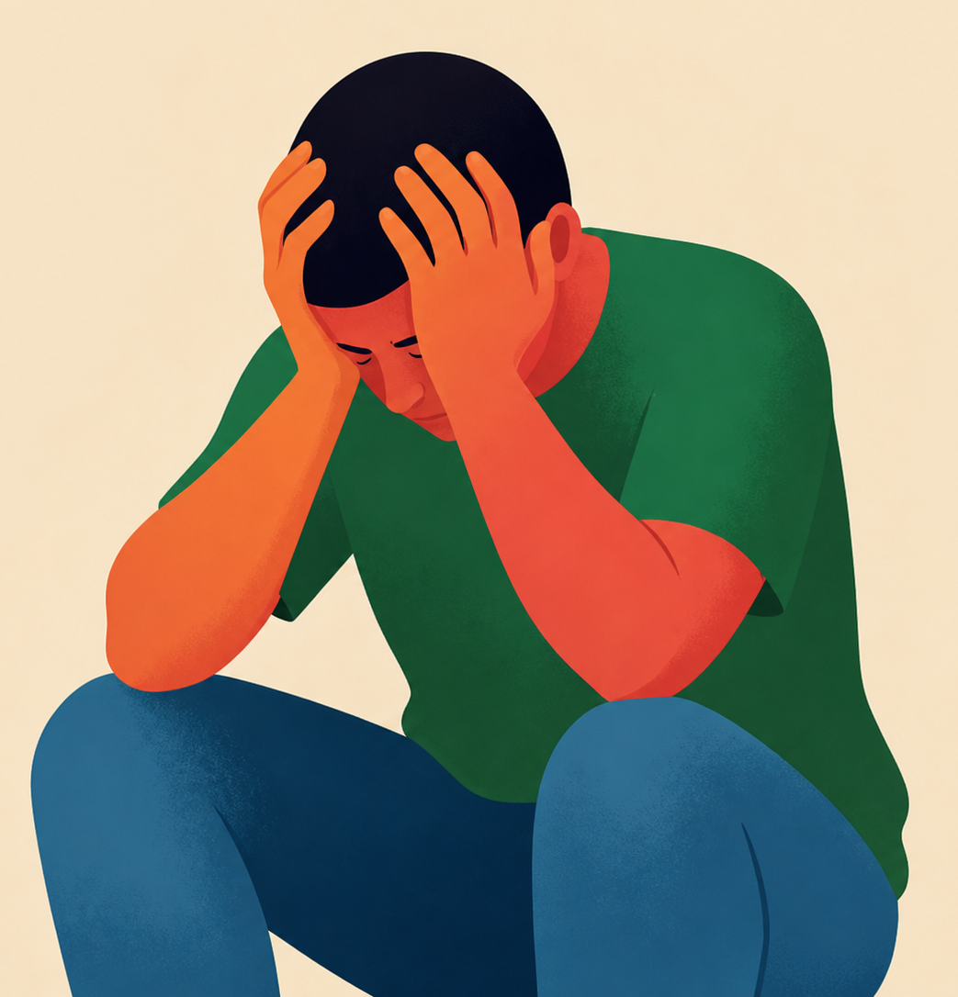
Biological and health-related factors linked to depression
Family history
Hormonal or brain changes
Serious illness or chronic pain
Certain medicines or treatments
Notes:
Slide 4: Let's start by investigating the causes of depression.
Note to teacher: Before giving examples in this section, ask a few learners to share their ideas so that it becomes a discussion instead of a lecture.
Depression usually does not have one simple cause. It can develop through a combination of biological, psychological and social factors.
Biological and health-related factors
Some people may be more vulnerable to depression because of factors connected to their bodies or health.
Factors may include:
A family history of depression or other mental health conditions
Changes in brain functioning or body chemicals
Hormonal changes during adolescence
A serious or long-term physical illness, accompanied by chronic pain
Certain medicines or medical treatments
Having one of these risk factors does not mean that a person will definitely develop depression.

Slide 5
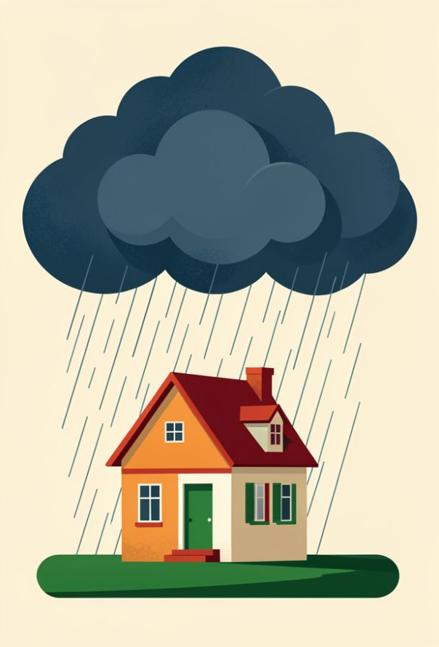
Difficult experiences
Supportive relationships can help protect young people.
Death or loss
Family conflict or divorce
Abuse, neglect or violence
Bullying or cyberbullying
Academic pressure
Financial difficulties
Notes:
Slide 5: Difficult or painful experiences
Stressful life experiences can increase the risk of depression, particularly when several difficulties occur at the same time or continue for a long period.
Examples include:
The death of a family member or friend
Family conflict, separation or divorce
Abuse, neglect or exposure to violence
Bullying or cyberbullying
Academic pressure or repeated failure
Unemployment or financial difficulties in the family
Difficult experiences during childhood and adolescence can have lasting effects on a person’s health and emotional well-being. However, supportive relationships with caregivers, teachers, friends and community members can help protect young people.

Slide 6
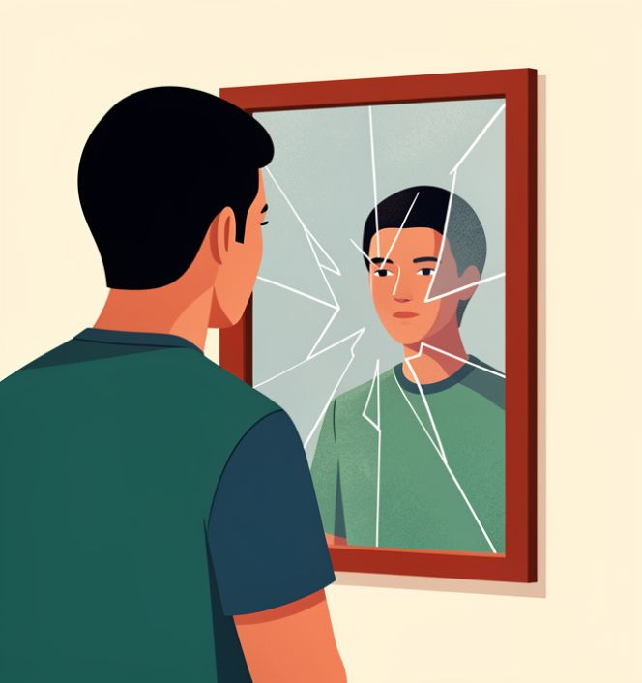
Negative thoughts and low self-esteem
“I am not good enough.”
“Nothing will improve.”
“Nobody cares about me.”
“I always fail.”
These thoughts may develop after criticism, rejection, bullying or failure.
Notes:
Slide 6: Negative thoughts and low self-esteem
A person who constantly thinks negatively about themselves or their future may become more vulnerable to depression. For example, a learner may begin to believe:
"I am not good enough."
"Nothing will ever improve."
"Nobody cares about me."
"I always fail."
These thoughts may develop after repeated criticism, rejection, bullying, failure or comparison with others.

Slide 7
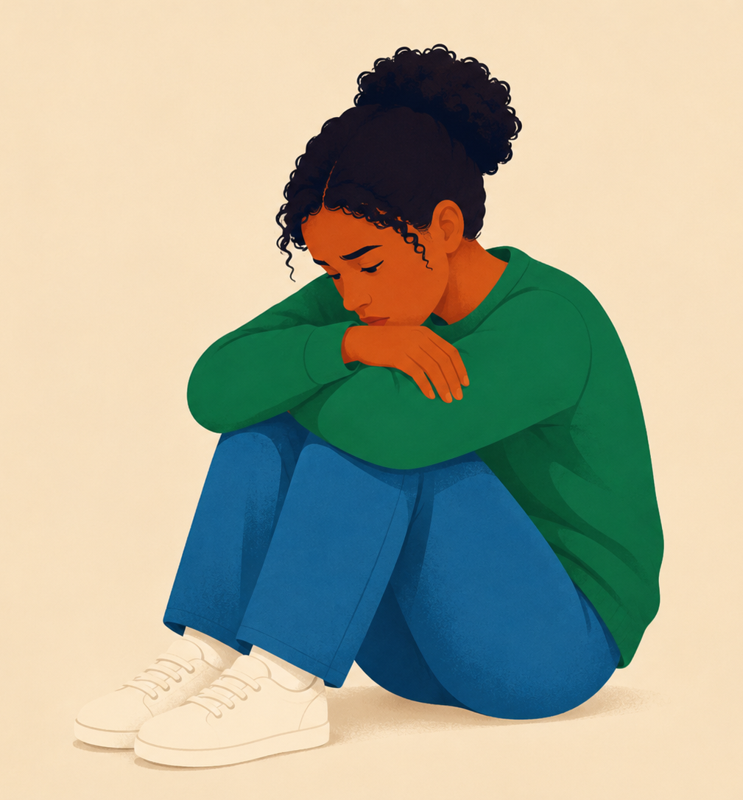
Social pressure and isolation
Loneliness
Difficulty making friends
Online comparison
Rejection by family or peers
Adult responsibilities at a young age
Notes:
Slide 7: Social pressure and isolation
Teenagers often want to feel accepted and included. Depression may be linked to experiences such as:
Feeling lonely or socially isolated
Struggling to make friends
Comparing one’s appearance or lifestyle with people online
Not feeling accepted by family or peers
Carrying adult responsibilities at a young age

Slide 8
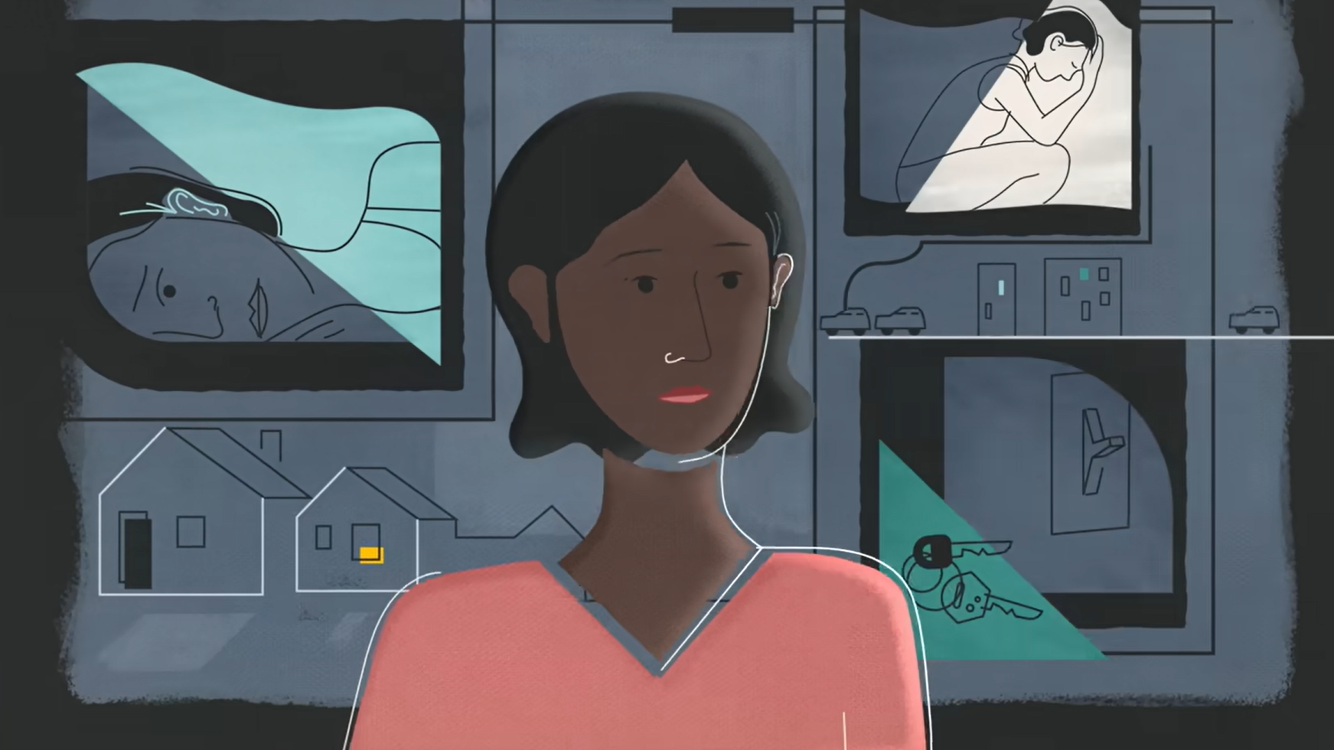
Watch:
How stress affects your brain - Madhumita Murgia https://www.youtube.com/watch?v=WuyPuH9ojCE (4 min 15 sec)
Notes:
Slide 8: Stress is a normal part of life. While short-term stress can help us respond to challenges, long-term stress can affect how the brain works.
Let's watch a video that explains this concept. While watching the video, do not worry too much about the scientific terminology used. Focus on why it is important to recognise stress early and use healthy coping strategies to protect your mental and emotional well-being.
Watch video
How stress affects your brain - Madhumita Murgia
https://www.youtube.com/watch?v=WuyPuH9ojCE (4 min 15 sec)

Slide 9
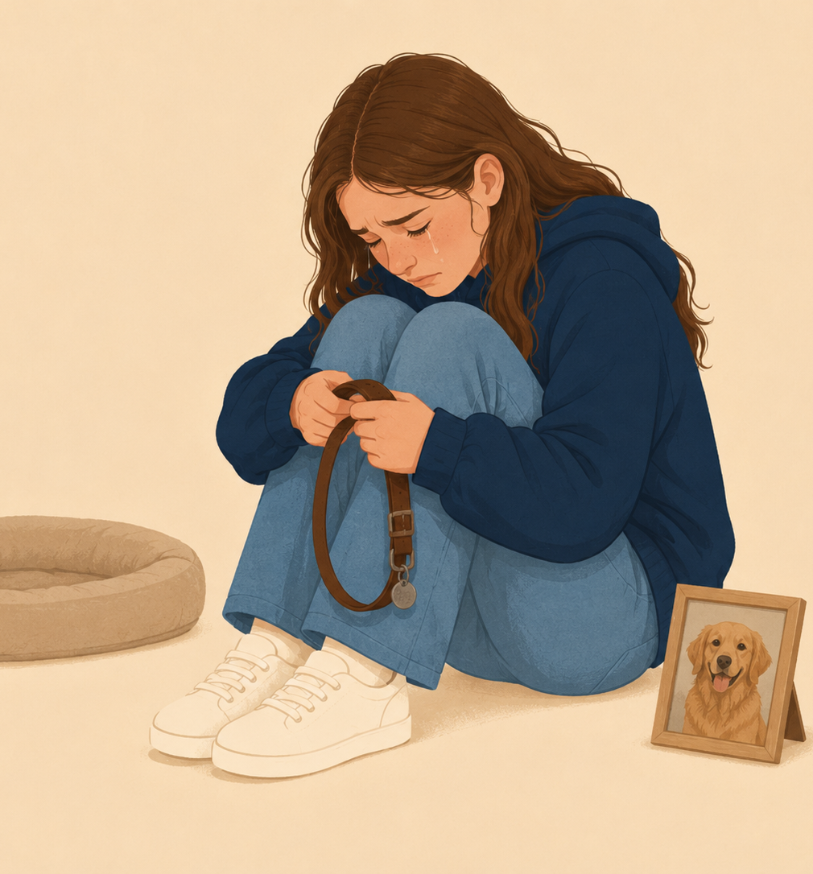
Causes of grief and loss
Grief is a natural response to significant loss.
Loss may include:
the death of a loved one
the end of a friendship
losing a home
Notes:
Slide 9: Now, let's investigate the causes of grief and loss.
Remember, grief is a natural response to loss.
Grief is not exclusively caused by death.
A teenager can grieve the end of a friendship, the loss of a family home, a parent's remarriage, the disappearance of a pet, or the loss of their health.
Any significant loss can trigger the grieving process.
Ask learners to share more examples of loss they can think of.

Slide 10

Watch:
Kids give advice on how to cope with grief | #UniteInMemory | Marie Curie https://www.youtube.com/watch?v=_VurTtRXCEA
(3 min 40 sec)
Notes:
Slide 10: Let's watch a video where young people share their advice on how to cope with grief.
Watch video
Kids give advice on how to cope with grief | #UniteInMemory | Marie Curie
https://www.youtube.com/watch?v=_VurTtRXCEA (3 min 40 sec)

Slide 11

Causes of crises
Academic failure
disappointment, anxiety or hopelessness
Family problems
conflict, divorce, illness or financial difficulties
Bullying and violence
harm to confidence, safety and mental health
Ask for help early. You do not have to cope alone.
Notes:
Slide 11: Now, let's investigate three common causes of crises in teenagers.
Academic failure: Many learners feel under pressure to perform well at school. Failing a test or receiving poor marks can make you feel disappointed, anxious or hopeless.
Remember, one poor result does not define who you are. The most important step is to ask for help early, improve your study habits and keep trying.
Family problems: Conflict at home, divorce, financial difficulties or illness in the family can have a big impact on your emotional well-being. These situations may make you feel worried, angry or confused.
It is important to remember that adult problems are not your responsibility, and talking to a trusted adult can help you manage your feelings.
Bullying and violence: Bullying, whether it happens at school, online or in your community, can affect your confidence and mental health.
Nobody deserves to be bullied. If you are being bullied, tell a trusted adult, seek support from friends and family, and remember that you do not have to face it alone.
Although these challenges can feel overwhelming, they do not have to define your future. Asking for help, making healthy choices and seeking support are the first steps towards overcoming any crisis. Remember, every problem has a solution, and help is always available.

Slide 12
Causes of trauma
Trauma may result from:
Abuse or neglect
Domestic or community violence
A serious accident
A fire, flood or other disaster
Feeling that someone’s safety was threatened
People respond to traumatic events differently.
Notes:
Slide 12: Experiencing loss or crises can cause trauma . During a traumatic event, a person may feel that their life, safety or well-being, or the safety of someone else, was threatened.
Traumatic events include:
Physical, emotional or sexual abuse
Neglect
Domestic or community violence
A serious accident
A natural disaster, such as a flood or fire
Not everyone who experiences a potentially traumatic event develops lasting mental health difficulties.
Added the causes of trauma, just to ensure we cover the ATP fully.

Slide 13
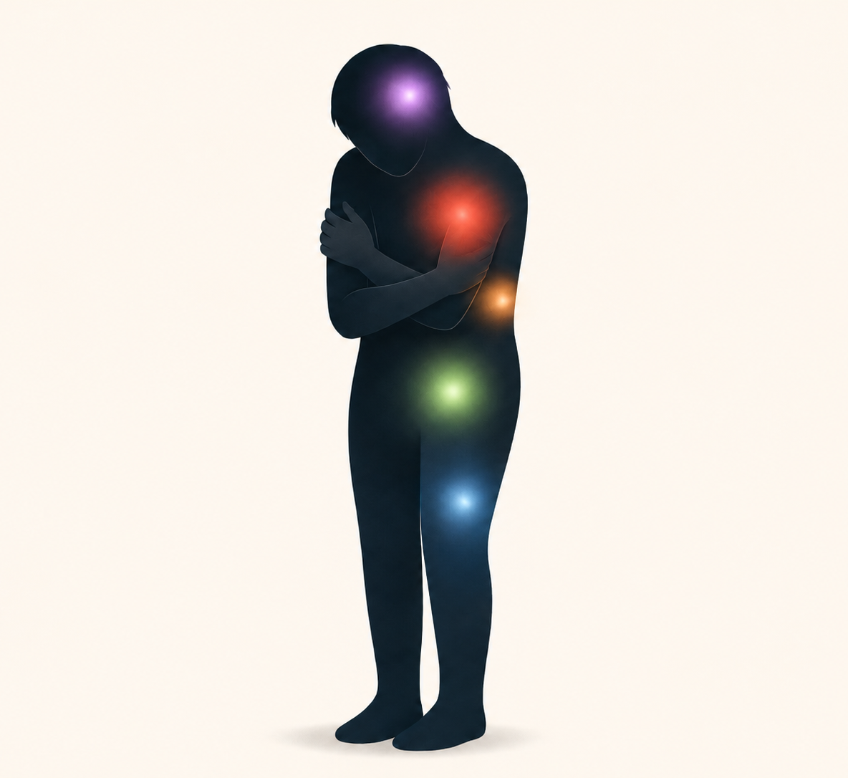
Effects of difficult situations
Emotional effects
anxiety
sadness
anger
Physical effects
headaches
tiredness
sleep or appetite changes
Notes:
Slide 13: The impact of difficult situations
A difficult situation can affect both your emotions and your body.
Emotionally, you may feel overwhelmed, anxious, sad, angry or helpless.
Physically, you may experience headaches, tiredness, difficulty sleeping, changes in appetite or trouble concentrating.
These are normal stress responses. Looking after your mental health can also help protect your physical health. Healthy coping strategies and support from someone you trust can help you recover.

Slide 14
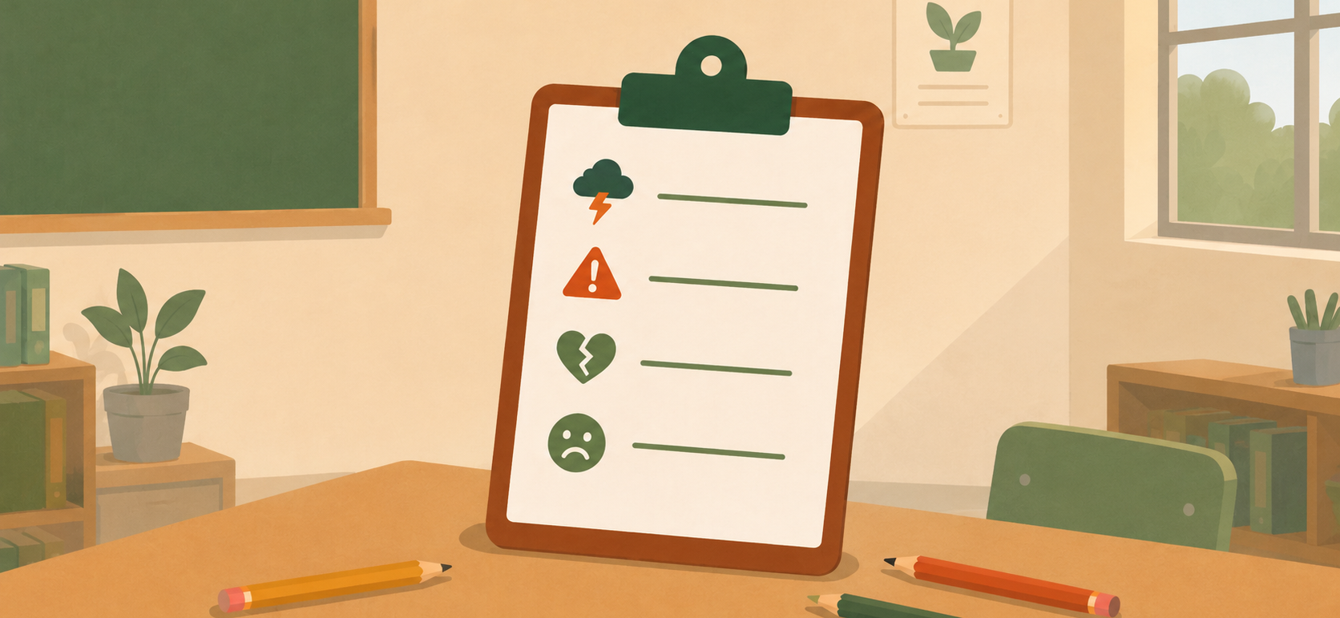
Activities
Notes:
Slide 14: Before we finish, does anyone have any questions about today's lesson? (Allow time for discussion.)
Learners to complete Activity 1 (Lesson 2 – Worksheet) in pairs, followed by Activity 2 (Lesson 2 – Worksheet) individually.
Answers are available in the Lesson 2 – Worksheet MEMO.
Note to teacher: Learners should also complete Activity 3 (Lesson 2 – Worksheet) as reflection. This could be assigned as homework if class time is limited.

