Slide 1


Grade 11
Term 4 | Study Skills
Lesson 1: Study plan, time management & how learning takes place
Notes:
Slide 1: Good day, Grade 11s, and welcome to your final Life Orientation lessons for the year.
Some of the content in this lesson revises knowledge covered in Grade 10. However, improving your study habits requires regular reflection and practice.
In this lesson, we will focus on developing a realistic study plan and using time management and study skills to make it effective.
The timing is ideal because you can apply these skills while preparing for your final examinations.
Remember that your Grade 11 year-end results may be required when you apply to tertiary institutions next year.

Slide 2

By the end of this lesson, you should be able to:
Revise a realistic study plan by including appropriate time-management techniques and personal commitments.
Explain how learning takes place and reflect on the effectiveness of learning.
Apply study-planning, time-management and reflection skills to improve personal learning habits.
Notes:
Slide 2: By the end of this lesson, you should be able to:
Revise a realistic study plan by including appropriate time-management techniques and personal commitments.
Explain how learning takes place and reflect on the effectiveness of learning.
Apply study-planning, time-management and reflection skills to improve personal learning habits.

Slide 3
What is a study plan?
A study plan is a structured schedule that shows:
what you will study
when you will study
how you will study
Helps you manage your time and learning goals.
Notes:
Slide 3: What is a study plan?
Ask learners how they would define a study plan. Allow a few learners to share their ideas before providing the definition.
A study plan is a structured schedule that allocates specific times for studying. It helps you to organise your academic responsibilities, manage your time and work towards your learning goals.
A study plan is more detailed than simply writing "study" in a timetable. It should show what you plan to study, when you will study it and which method you will use.

Slide 4
What should a study plan include?
Assessment and assignment dates
Subjects and topics
Time allocated to each task
Personal commitments
Suitable study methods
Breaks, exercise and sleep
A useful plan is realistic, balanced and flexible.
Notes:
Slide 4: What should a study plan include?
Life can become very busy. You may have two tests in one week, attend sports practice several afternoons, work on a group project, take part in a cultural club meeting and complete household chores. A realistic study plan should take all these commitments into account.
A study plan should include:
Assessment and assignment dates
Subjects and topics that must be studied
The amount of time allocated to each task
Regular commitments, such as school, sport, hobbies and family responsibilities
Suitable study methods for different tasks
Time for breaks, exercise, relaxation and sleep
A useful study plan should be realistic, balanced and flexible enough to be adjusted when necessary.

Slide 5

Revising your study plan
Which methods work well?
What distracts me?
Which topics need more attention?
Have I allowed enough time?
Am I completing planned tasks?
Notes:
Slide 5: Revising your current study plan
To revise a study plan means to review it and make changes that improve its effectiveness.
Ask learners to reflect silently on the questions on Slide 5:
Which study methods help you to understand and remember information?
Which habits or distractions interfere with your studying?
Which subjects or topics require extra attention?
Do you allow enough time for practice and revision?
Are you completing the tasks included in your current plan?
Allow learners to discuss one of their responses with a partner.
Revising a study plan does not mean that the entire plan has failed. You may only need to change one aspect, such as beginning an assignment earlier, studying away from your cellphone or allowing more time for a difficult subject.

Slide 6
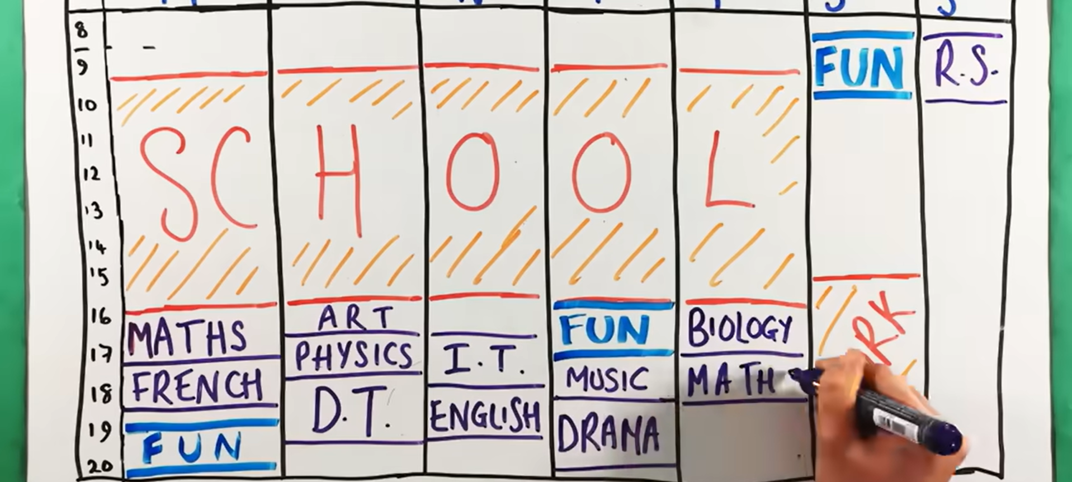
Watch: How To Make An EFFECTIVE STUDY TIMETABLE | Revision Timetable | Productivity bit.ly/4pMU26h (4 min 44 sec)
Notes:
Slide 6: Creating an effective study plan
Before playing the video, ask learners to identify:
one idea they already use.
one change they could make to their current study plan.
Watch video
How To Make An EFFECTIVE STUDY TIMETABLE | Revision Timetable | Productivity
bit.ly/4pMU26h (4 min 44 sec)
Briefly discuss their observations after watching the video.

Slide 7

Time-management skills
Plan ahead
Prioritise tasks
Avoid procrastination
Limit distractions
Divide large tasks into smaller steps
Get enough rest
Reward your progress
Notes:
Slide 7: Time-management skills
Effective time management is an important part of a workable study plan.
Time management is the ability to plan and use your available time effectively. It is especially important for high school learners, who need to balance different subjects, tests, assignments, extracurricular activities and personal responsibilities.
Ask learners to share some of the time management skills they use before going through the following examples:
Plan ahead: Plan your daily and weekly activities. Set realistic goals and use a to-do list, diary or calendar.
Prioritise tasks: Identify which tasks are most urgent, require the most work or need extra attention.
Avoid procrastination: Start tasks early instead of delaying them until the last minute.
Limit distractions: Remove or reduce distractions and concentrate on the task at hand.
Break large tasks into smaller steps: Smaller steps make difficult tasks feel more manageable and less overwhelming.
Get enough rest: Sufficient sleep helps you to concentrate and learn more effectively.
Reward your efforts: Recognise your progress and include time for activities you enjoy.

Slide 8
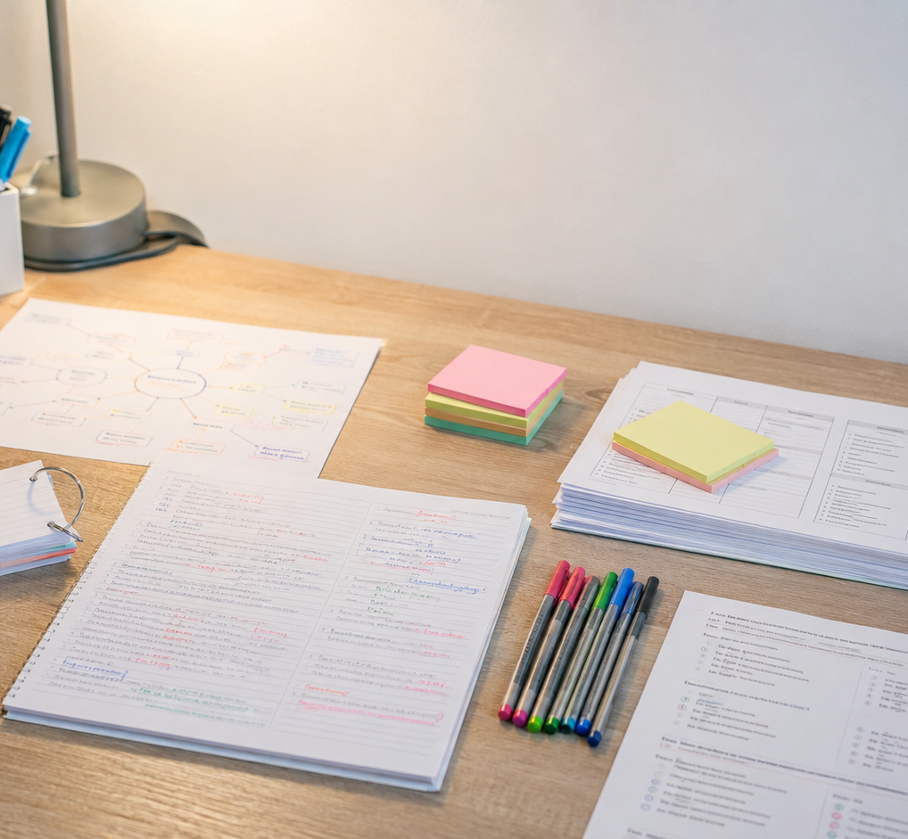
Study skills
Study skills help you:
  understand information.
  remember information.
  apply what you have learnt.
Choose methods that suit the subject and task.
Notes:
Slide 8: Study skills
Study skills are the methods and habits learners use to understand, remember and apply information.
When developing a study plan, it is not enough to allocate time to a subject. You should also decide what you will do during that study period.
Different subjects and tasks may require different study methods. For example, practising calculations may be effective for Mathematics, while summarising, self-testing and answering source-based questions may be useful for other subjects.
It is important to choose a study method according to the subject and task rather than using the same method for everything.
We will discuss this in more detail during Lesson 2.

Slide 9
How does learning take place?
Receiving information
Paying attention
Connecting it to existing knowledge
Storing it in memory
Retrieving and applying it
Notes:
Slide 9: How does learning take place?
Considering how learning takes place is a study skill. This will help us determine whether the strategies we are using are actually helping us to understand, remember and apply information.
Learning takes place when you:
receive information through your senses.
pay attention to and process the information.
connect new information to what you already know.
store the information in your memory.
retrieve and use the information through practice.
Learning is an active process. You need to be involved with the information you are working with.
Practice and repetition strengthen the connections involved in learning. However, effective learning involves more than repeatedly reading the same information. You should actively think about, practise and apply what you are learning.

Slide 10

Use knowledge actively
Explaining ideas in your own words
Connecting new and previous knowledge
Answering questions from memory
Applying knowledge
Discussing content
Correcting mistakes
Reviewing regularly
Notes:
Slide 10: Using knowledge actively
Ask learners to share examples of active learning strategies they could use when learning something new.
Answers may include the following:
Explaining information in your own words
Connecting new information to previous knowledge
Answering questions without looking at your notes
Applying knowledge to examples or problems
Discussing the content with others
Correcting mistakes
Reviewing work regularly over a period of time
Knowledge becomes understanding only when you use it. You do not learn to ride a bicycle by reading about it. You learn by getting on the bicycle, making mistakes, practising and trying again. Learning at school works similarly. The more you participate, think, practise and apply what you learn, the more confident and successful you can become.

Slide 11
Reflect on your learning
What did I understand well?
What was difficult?
Which strategy did I use?
Was it effective?
Did I complete the planned work?
What should I continue or change?
Notes:
Slide 11: Reflecting on the effectiveness of your learning
An important part of learning is reflecting on what you have learnt and how effectively you learnt it. This allows you to adapt your study strategy when something is not working.
After a lesson or study session, consider the following questions:
What did I understand well, and what was difficult to understand or remember?
Which study strategy did I use, and how effective was it?
Did I complete the planned work within the allocated time?
What should I continue doing or change during my next study session or lesson?

Slide 12

Key messages
A study plan organises your responsibilities.
Time management makes the plan workable.
Study skills support understanding and application.
Effective learning requires practice and reflection.
Adjust your plan when it is not working.
Notes:
Slide 12: Conclude the lesson by reinforcing the following points:
A study plan helps you to organise your academic responsibilities, manage your time and work towards your learning goals.
Effective time management is an important part of a workable study plan.
Study skills help learners understand, remember and apply information.
Effective learning requires active participation, practice and reflection.
A study plan should be reviewed and adjusted when it is not working effectively.

Slide 13
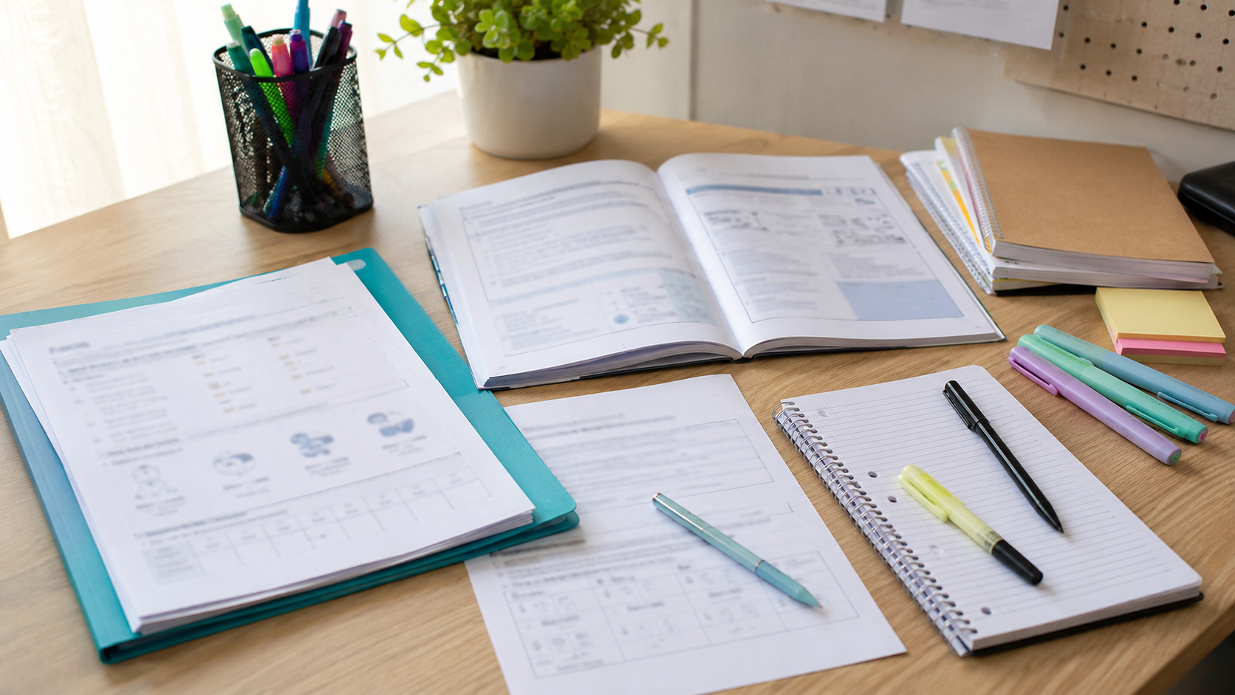
Activities
Notes:
Slide 13: Learners complete Activity 1 (Lesson 1 – Worksheet) by answering the exam-type questions covered during the lesson. Answers are available in the Lesson 1 – Worksheet MEMO.
Learners may then begin Activity 2, Part 1 (Lesson 1 – Worksheet) in class, but must complete it for homework.

