Slide 1
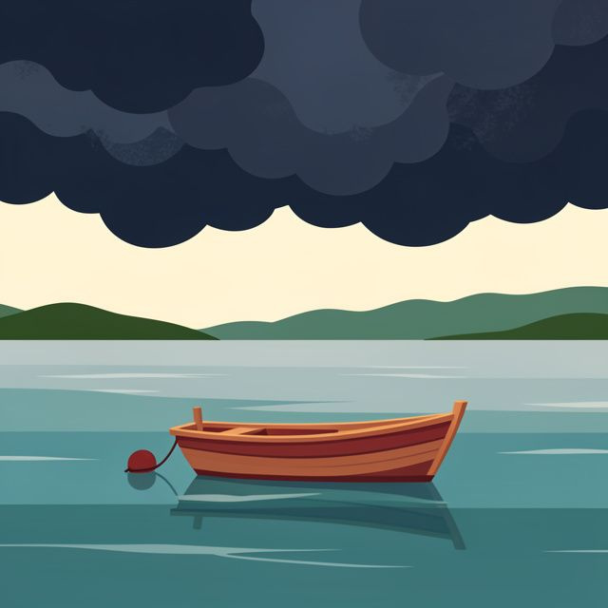

Grade 9
Term 4 | Development of the Self in Society
Lesson 1: Understanding challenging situations
Notes:
Slide 1: Good day, Grade 9s. Life is full of experiences that shape the way we think, feel and behave. Some experiences bring happiness and excitement, while others can be difficult and emotionally challenging.
In this lesson, you will explore important concepts such as depression, grief, loss, trauma and crisis. You will learn how these experiences can affect people differently, recognise healthy ways of responding to emotional challenges, and understand why asking for help is a sign of strength.

Slide 2

By the end of this lesson, you should be able to:
Explain the concept: challenging situation.
Discuss emotional triggers and strategies to deal with them.
Describe trauma (physical and emotional).
Distinguish between sadness and depression.
Discuss the concepts: grief, loss and crisis.
Notes:
Slide 2: By the end of this lesson, learners should be able to:
Explain the concept: challenging situation.
Discuss emotional triggers and strategies to deal with them.
Describe trauma (physical and emotional).
Distinguish between sadness and depression.
Discuss the concepts: grief, loss and crisis.

Slide 3

Challenging situations
A challenging situation requires you to:
Cope with pressure
Solve a problem
Make careful decisions
It may affect you:
Physically
Emotionally
Examples:
loss, divorce, illness, bullying, violence, accidents or crime
Notes:
Slide 3: What is a challenging situation?
A challenging situation is a difficult circumstance that requires a person to use problem-solving skills, make careful decisions or cope with pressure.
Throughout life, every person will encounter challenging situations that affect them both emotionally and physically.
Physically: Changes in sleep, appetite, or energy levels.
Emotionally: Feelings of being overwhelmed, numbness or intense sadness.
These challenging situations are unavoidable. They may differ in how serious they are, how long they last and how they affect each person.
Ask learners to mention examples of challenging situations. Answers might include the following:
Losing a dear friend or family member to death.
Parents getting divorced.
Being diagnosed with a serious illness.
Being constantly bullied at school.
Experiencing domestic violence.
Being in a car accident and seriously injured.
Being the victim of a crime such as a robbery.
Challenging situations can cause difficult emotions, such as sadness, anger, frustration or shock. It is important to recognise these feelings and find healthy ways to express and cope with them.
We will discuss these coping techniques in Lesson 3.

Slide 4

Emotional triggers
An emotional trigger is a reminder of a past challenging experience.
Triggers may include:
Sounds or smells
Images or stories
People or places
Discussions or situations
Notes:
Slide 4: Emotional triggers
Certain reminders, such as our discussion today, or a sound, smell, image, story, place, person, or situation, of a past challenging situation may bring these emotions back suddenly. These reminders are known as emotional triggers.
For example, if you hear someone telling a story about losing a parent and you have also lost a parent, that story may trigger your own grief, causing you to feel suddenly overwhelmed with sadness even though the event happened long ago.
Feeling triggered is a normal response, but we can learn healthy strategies to manage our emotions instead of becoming completely overwhelmed.

Slide 5
Managing emotional triggers
Breathe slowly and deeply
Move to a quiet place
Remind yourself that you are safe
Focus on what you can see, hear or touch
Listen to music or do a calming activity
Talk to someone you trust
Notes:
Slide 5: Managing emotional triggers
Triggers can happen anywhere at any time, but what can we do to deal with them?
When a trigger occurs, you can use the following strategies to regain control of your emotional state.
Breathe slowly and deeply.
Step aside to a quiet place.
Remind yourself: This is just a memory; I am safe right now.
Use a grounding technique (e.g. touching a textured object, counting things you see).
Listen to music, an audiobook or a podcast.
Do an activity you enjoy, like drawing, journaling or reading.
Create a ‘comfort box’ with photos, letters, quotes or objects that calm you.
Write down positive affirmations (“I am safe, I am not alone”).
Talk to a trusted family member or friend.

Slide 6

Trauma
A response to a frightening, dangerous or deeply upsetting event
Physical trauma
Injuries to the body
Emotional trauma
Affects thoughts, feelings and behaviour
Notes:
Slide 6: Effects of challenging situations
Challenging situations can have emotional and psychological effects. Let's take a closer look at what this entails.
Trauma: Trauma is a person's emotional or physical response to an event that is frightening, dangerous or deeply upsetting. Trauma can affect people in different ways, and not everyone will respond to the same event in the same manner. Trauma could be physical or emotional.
Physical trauma: This refers to injuries to the body caused by an accident, violence or another harmful event. These injuries can usually be seen and often require medical treatment, such as broken bones, burns, cuts, bruises or wounds.
Many physical injuries heal over time with the correct medical care. However, recovering from a physical injury may also involve dealing with emotional challenges such as fear, frustration or anxiety.
Emotional trauma : Unlike physical trauma, emotional trauma cannot be seen.
Emotional trauma occurs when a person experiences an event that is so frightening, distressing or overwhelming that it has a lasting effect on their emotional well-being.
A person experiencing emotional trauma may:
struggle to trust others
feel anxious or fearful
experience nightmares or flashbacks
become withdrawn from family and friends
have difficulty concentrating at school
become easily startled or irritable.
These reactions are normal after traumatic experiences. With the right support and, where necessary, professional help, many people recover and learn healthy ways to manage their emotions.

Slide 7
Sadness and depression
Sadness
- A normal emotion
- Often linked to a specific event
- Usually fades with time
Depression
- A medical condition
- Persistent sadness or emptiness
- Loss of interest or motivation
- Affects daily life
Seek professional help if symptoms
continue for more than two weeks.
Notes:
Slide 7: Depression is a medical illness, not simply feeling sad.
It is characterised by persistent sadness and a complete loss of interest in activities that you normally enjoy, accompanied by an inability to carry out daily activities.
The difference between sadness and depression
Sadness: Everyone feels sad at certain times. You might feel sad if you fail a test, fight with a friend or lose someone you love. That sadness is a normal emotional response, and it usually fades with time or when circumstances improve.
Depression is fundamentally different. It is a medical condition that affects your entire mind and body. When you are depressed, the sadness does not lift when good things happen. It persists regardless of circumstances.
Depression can make you feel:
tired all the time, even after a full night's sleep
like you have no energy or motivation
unable to enjoy things you normally like
empty or numb, not just sad
stuck in negative thoughts that don't go away.
It is normal to experience brief periods of intense sadness or low mood after trauma or during grief, but if it persists for more than two weeks, it is essential to seek professional help from a doctor or mental health practitioner.

Slide 8

Grief and loss
Loss
Losing someone or something important
Examples: A loved one, relationship, home, health, etc.
Grief
The emotional response to loss
May include sadness, anger, guilt or despair.
Notes:
Slide 8: Grief and loss
Grief is the normal, natural emotional response to a major loss. It is most associated with the death of a loved one, but it can also be felt by a person living with a serious, long-term illness or a terminal diagnosis.
Grief is not a single emotion; it is a complex mixture of feelings that may include:
Great sadness: A deep, aching sorrow that comes in waves.
Anger: Feeling angry at the situation, at the person who died for "leaving" you, or at the world for being unfair.
Guilt: Wondering if you could have done something differently or feeling guilty for moments when you feel okay.
Despair: A sense of hopelessness about the future without the person or thing you have lost.
Grief is not something you "get over"; rather, you learn to live with it over time. The intensity of grief typically lessens gradually, but it may resurface at unexpected moments (e.g. anniversaries, birthdays, holidays).
Loss refers to the harm or distress that comes from losing something or someone significant.
While it often refers to the death of a person (a parent, sibling, friend or other loved one), loss can also include the end of a relationship, the loss of a home, the loss of health or the loss of a way of life.
Loss is the event itself, while grief is the emotional response to that event.

Slide 9
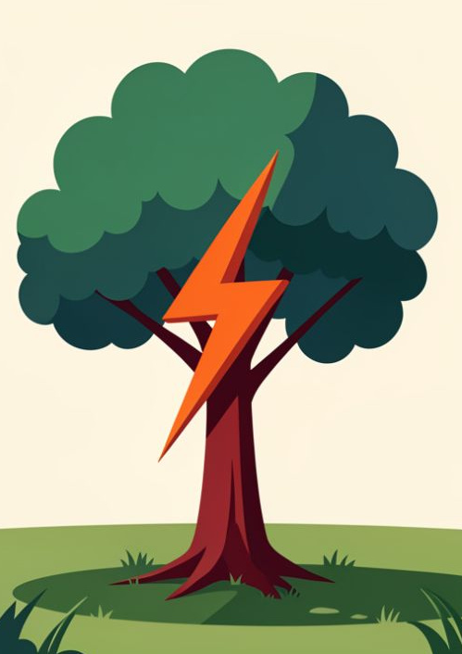
Crisis
A sudden event that requires an immediate response.
Examples:
Failing Grade 9
A serious accident
A fire or flood
Usually temporary, and support can help.
Notes:
Slide 9: A crisis is a sudden, unexpected event that negatively impacts your life, emotions, behaviour, and health. Unlike ongoing challenges, a crisis tends to strike suddenly and demands an immediate response.
For example, failing Grade 9 is a crisis. It is a single event that may create immediate negative consequences, such as shame, fear of returning to school, anger at yourself, and worry about the future.
Other examples of crises include the death of a loved one, a serious accident, a natural disaster (such as a fire or flood), a family suddenly losing their home or income, or experiencing violence.
Although a crisis can feel impossible to overcome, it is usually temporary. Support from family, friends, teachers and healthcare professionals can help people recover and develop healthy ways of coping.

Slide 10

Watch:
Navigating Teen Life | Top 5 Ways to Improve Mental Health https://www.youtube.com/watch?v=h6sh82QbmAw
(1 min 29 sec)
Notes:
Slide 10: We've covered a lot of "heavy" content.
Let's watch a short video to learn five practical ways to support your mental health during everyday pressures as well as more serious challenging situations.
Watch video
Navigating Teen Life | Top 5 Ways to Improve Mental Health
https://www.youtube.com/watch?v=h6sh82QbmAw (1 min 29 sec)

Slide 11
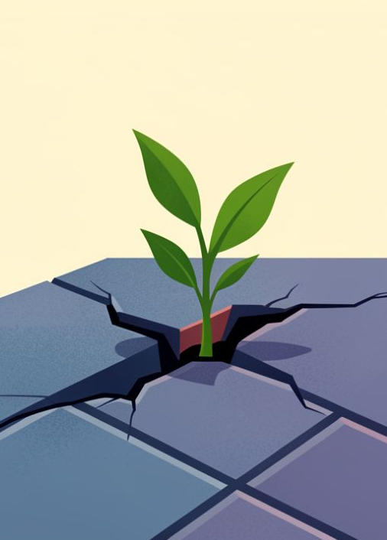
Lesson summary
Challenges affect people differently
Triggers can cause strong emotional reactions
Trauma may be physical or emotional
Depression differs from normal sadness
Loss is the event; grief is the emotional response
A crisis may feel overwhelming, but support can help
Notes:
Slide 11: Let's summarise what we have covered in this lesson:
Everyone experiences challenges differently.
Triggers are reminders of difficult experiences and can cause strong emotional or physical reactions.
Physical trauma affects the body, while emotional trauma affects a person's thoughts, feelings and behaviour.
Depression is a mental health condition and is different from normal sadness.
Grief is the emotional response to loss.
Loss can involve people, relationships, opportunities or possessions.
A crisis is a situation that feels overwhelming, but with the right support, people can recover.
Asking for help is a sign of strength, courage and self-awareness.

Slide 12
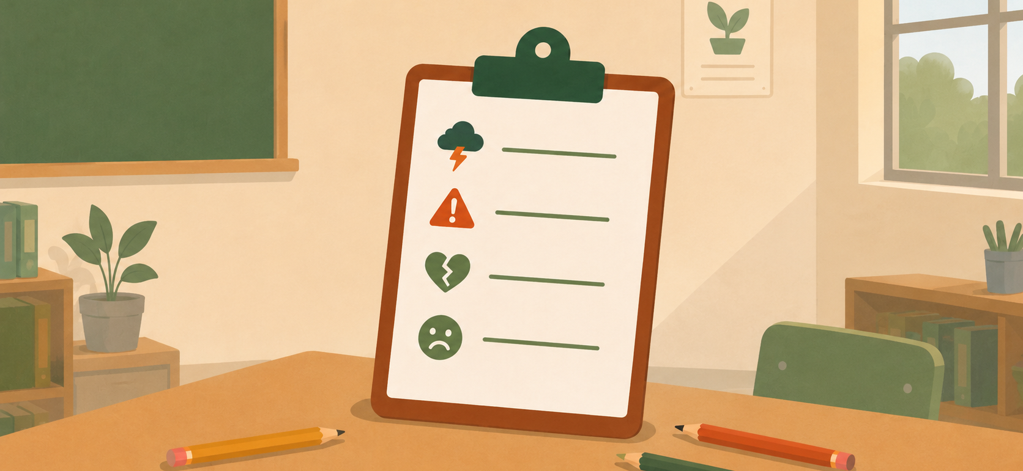
Activities
Notes:
Slide 12: Learners to complete Activity 1 (Lesson 1 – Worksheet).
Answers are available in the Lesson 1 – Worksheet MEMO.
If you have any questions or are unsure about a concept, please don't hesitate to ask. You are welcome to come and speak to me or simply write your questions down so we can discuss them together at a later stage.
Note to teacher: Learners should also complete Activity 2 (Lesson 1 – Worksheet) as reflection . This could be assigned as homework if class time is limited.

