Slide 1


Grade 11
Term 4 | Study Skills
Lesson 4: Revision and consolidation
Notes:
Slide 1: Welcome back, Grade 11s. This is the final lesson in our Study Skills unit.
During the previous lessons, we looked at study plans, time management, study styles and strategies, examination-writing skills and personal development goals.
All these skills can help you prepare more effectively for assessments and examinations.
Today we are going to focus on revision and consolidation.
What do you usually do when you say that you are revising for a test or exam? (Allow a few learners to respond.)
Revision and consolidation are connected parts of the learning process. Together, they help you remember what you have learnt, identify gaps in your understanding and apply your knowledge in assessments.

Slide 2

By the end of this lesson, you should be able to:
Define and distinguish between revision and consolidation.
Identify suitable methods for applying revision and consolidation.
Apply revision and consolidation strategies to selected subjects and topics.
Notes:
Slide 2: By the end of this lesson, you should be able to:
Define and distinguish between revision and consolidation.
Identify suitable methods for applying revision and consolidation.
Apply revision and consolidation strategies to selected subjects and topics.

Slide 3
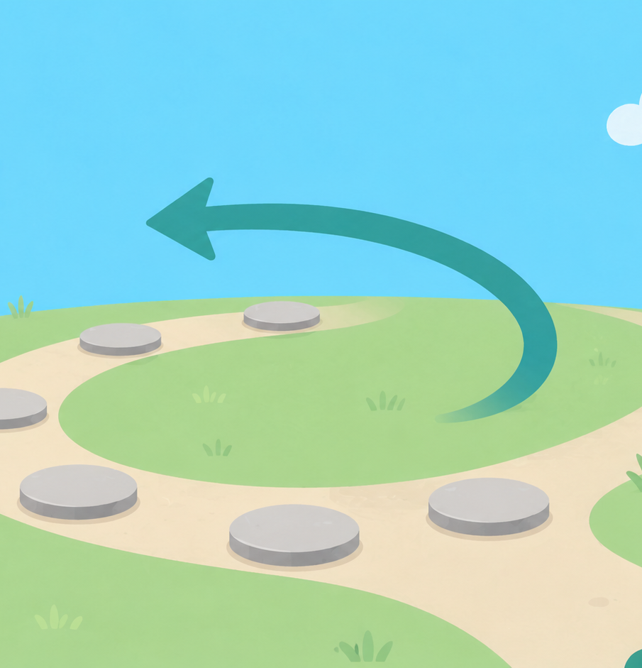
Revision
Revision means returning to work you have already learnt to:
Refresh your memory.
Check your understanding.
Identify gaps.
Prepare for assessment.
Effective revision is active: retrieve, test, practise and correct.
Notes:
Slide 3: Revision
Let’s start with revision. Revision means returning to work you have already learnt to refresh your memory, check your understanding and prepare for an assessment.
Effective revision is active. It requires you to retrieve information, test yourself, practise questions, identify gaps and improve your answers.
Simply reading through the same page several times may feel productive, but it does not always show whether you can remember or apply the content.
Let’s try a quick example. Ask learners to close their notebooks and recall THREE points from the previous Study Skills lesson. (Allow them about 30 seconds to write down the points.)
Ask: Were you able to remember the information without looking at your notes? Which information did you forget? What would you need to revise again?
This is active revision because you had to retrieve information from memory and identify possible gaps.

Slide 4
Revision methods
Recall from memory
Explain in your own words
Use flash cards
Answer practice questions
Explain concepts to someone else
Check and correct mistakes
Revise regularly, not only before examinations.
Notes:
Slide 4: Revision methods include:
Explain the work without looking at your notes.
Write down key points from memory.
Use flash cards for definitions, facts or formulas.
Answer textbook or past examination questions.
Explain the topic to a classmate or study partner.
Check your answers and correct mistakes.
It is important to recognise that revision is an ongoing process. Although it is often associated with preparing for assessments, it should take place consistently throughout the year. Aim to revise your work every week rather than waiting until just before a test or examination.

Slide 5
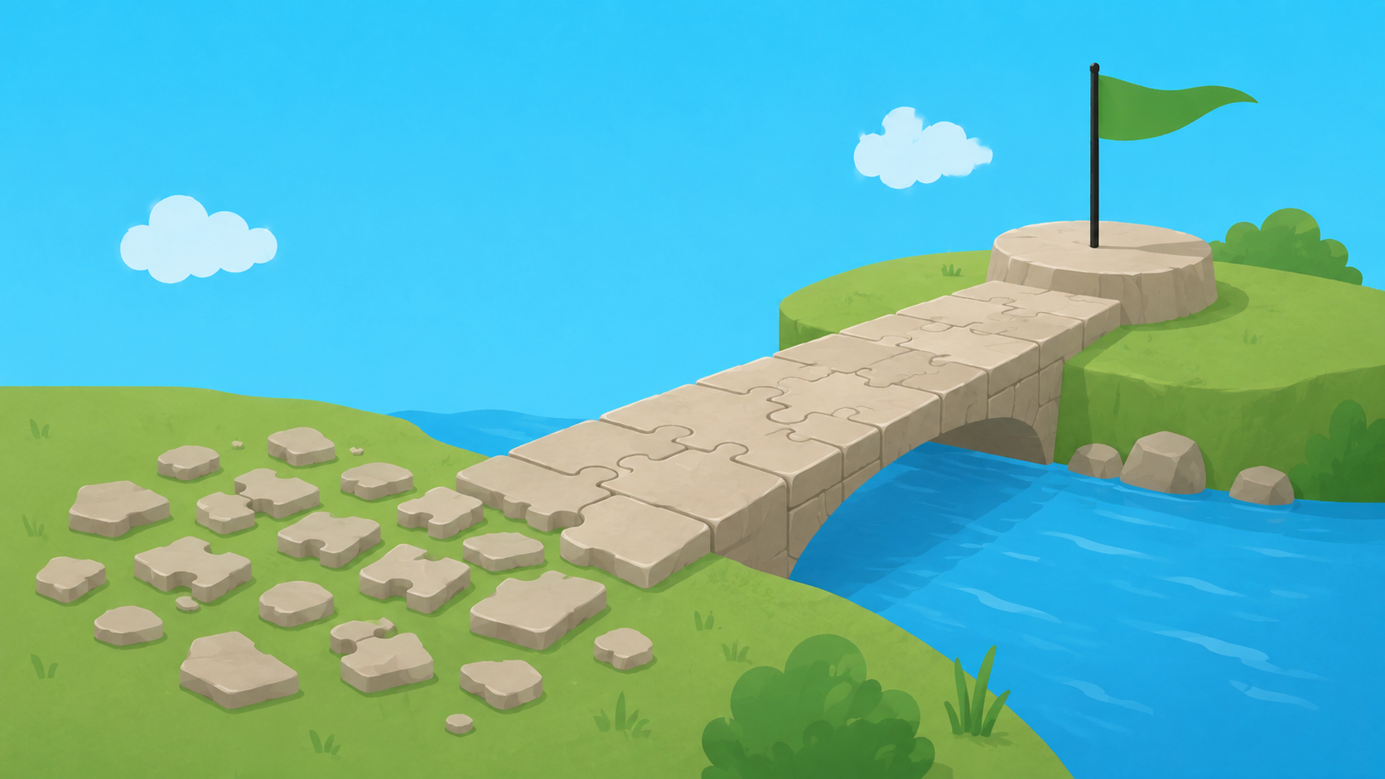
Consolidation
Goal | Method
Organise information | Summaries, mind maps
Connect ideas | Comparison tables
Identify key points | Key-term lists
Explain concepts | Discussion
Apply knowledge | Practice questions
Correct misunderstandings | Review and improve answers
Notes:
Slide 5: Consolidation
Revision helps you check what you remember. Consolidation helps you organise and strengthen what you have learnt so that you can remember, understand and apply it later.
Different consolidation methods may be used for different purposes. Let's look at a few examples.
Organise information clearly: Summaries, mind maps or concept maps
Connect related ideas: Comparison tables
Identify important points: Lists of key terms and definitions
Explain concepts in your own words: Discussions with others
Apply knowledge to examples and questions: Worked examples, practice questions or case studies
Correct misunderstandings: Checking and improving your answers.

Slide 6

Revision + consolidation
Revision
Retrieve information
Test what you remember
Identify gaps
Consolidation
Organise and connect ideas
Correct misunderstandings
Apply knowledge
The same activity can serve both purposes.
Past paper → test yourself → correct mistakes → apply again
Notes:
Slide 6: The relationship between revision and consolidation
Revision and consolidation should not be treated as completely separate processes. They work together when you prepare for an assessment.
Revision helps you retrieve information and identify gaps.
Consolidation helps you organise, connect and apply that information.
The same activity may serve both purposes. It depends on how you use it.
Complete a past examination paper to test what you remember and identify gaps: Revision
Correct the answers, review mistakes and apply the content to new questions: Consolidation
In both examples, the learner completes or works with examination questions. The purpose of the activity is what changes.
When you complete the paper to check what you remember, you are revising.
When you correct mistakes, strengthen your understanding and apply the work again, you are consolidating your learning.
Remembering, understanding and applying information all work together to create effective learning.

Slide 7

Watch:
Study Skills – Revising for exams bit.ly/4w3rhDS (2 min 24 sec)
Notes:
Slide 7: Let's watch a short video about preparing for examinations. The video brings together several study skills from the previous lessons, including planning, time management, choosing suitable study techniques and looking after your well-being.
Watch video:
Study Skills – Revising for exams
bit.ly/4w3rhDS (2 min 24 sec)

Slide 8
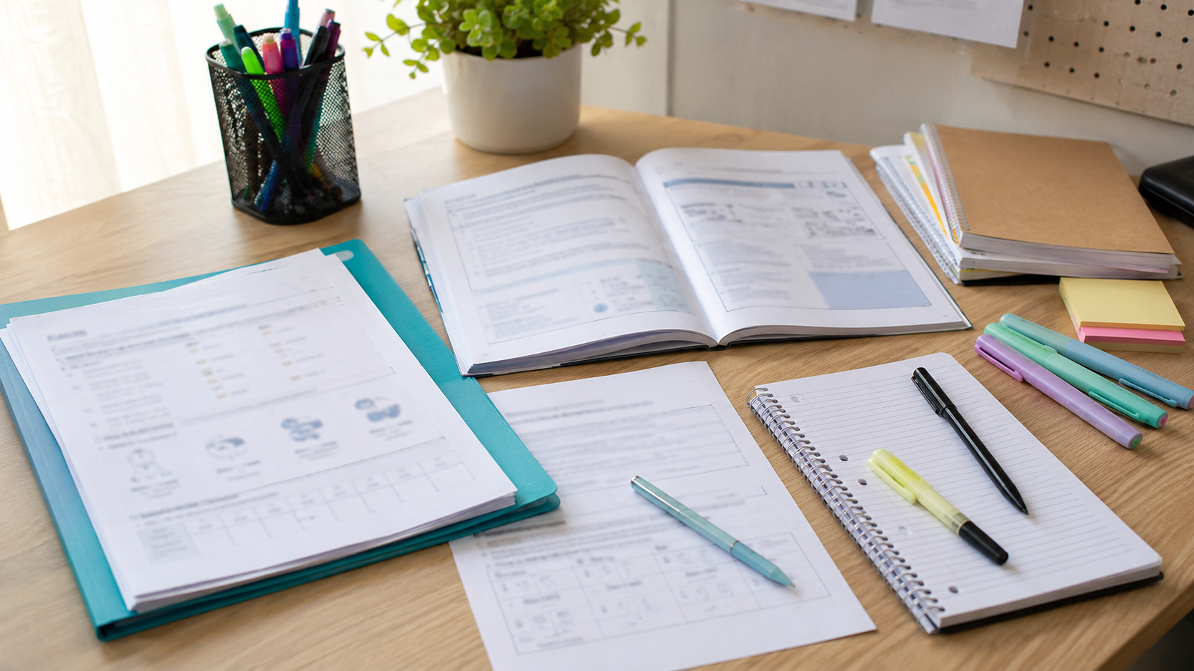
Activities
Notes:
Slide 8: Learners to complete Activity 1 (Lesson 4 – Worksheet) in pairs, followed by Activity 2 (Lesson 4 – Worksheet) individually.
Answers are available in the Lesson 4 – Worksheet MEMO.
Learners can then use the remainder of the lesson to complete Activity 3 (Lesson 4 – Worksheet) where they select a subject and topic to start revising and consolidating for the upcoming examinations. Any sections that are not completed in class must be completed for homework.
Hand out the Content Summary before learners leave the classroom.

