Slide 1


World of Work
Grade 9: Term 3
Lesson 3: Qualities relating to different careers and subjects
Notes:
Slide 1: Good day, Grade 9s. Today, we are starting one of the most important chapters of your Grade 9 year. In the previous lessons, we learnt that there is a strong connection between the subjects you take at school and the career you are thinking about following one day.
As a quick reminder, who can tell me the difference between a job and a career? (Allow for one or two responses.)
Towards the end of this term or at the start of Term 4, many Grade 9 learners will begin the process of selecting the subjects they will take until Grade 12.
Today, we are going to focus on another important part of subject choice: understanding yourself.
When you choose subjects, you should not only think about career requirements. You should also think about your interests, abilities, strengths and weaknesses.
If learners choose subjects without thinking carefully, they may limit some future study or career options. This is why self-knowledge is an important foundation for making good subject choices.

Slide 2
Lesson Objectives
By the end of this lesson, you should be able to:
Understand why self-knowledge is important when choosing subjects linked to future careers.
Explain what interests, abilities, skills, strengths and weaknesses are and how they influence subjects and careers.
Discuss how interests, abilities, strengths and weaknesses can create opportunities or challenges when choosing subjects.
.
Notes:
Slide 2: By the end of this lesson, you should be able to:
Understand why self-knowledge is important when choosing subjects linked to future careers.
Explain what interests, abilities, skills, strengths and weaknesses are and how they influence subjects and careers.
Discuss how interests, abilities, strengths and weaknesses can create opportunities or challenges when choosing subjects.

Slide 3

Why Self-Knowledge Matters
Most people spend about 80 000 hours working.
Good subject choices consider:
External factors
Career requirements
Study requirements
School subject options
Personal factors
Interests
Abilities
Strengths
Weaknesses
Notes:
Slide 3: Most people spend about 80 000 hours of their lives working. What if you spent 40 hours a week doing something you hated? Choosing a career isn't just about a salary; it's about finding a match for who you actually are.
Your Grade 9 subject choices are the first major step toward that 80 000-hour journey.
A good subject choice should be based on both external factors and personal factors.
External factors include career requirements, study requirements and the subjects offered by your school (as discussed in the previous lesson)
Personal factors include your interests, abilities, strengths and weaknesses.
Self-knowledge helps you choose subjects that are more likely to suit who you are and what you may want to do in the future.

Slide 4
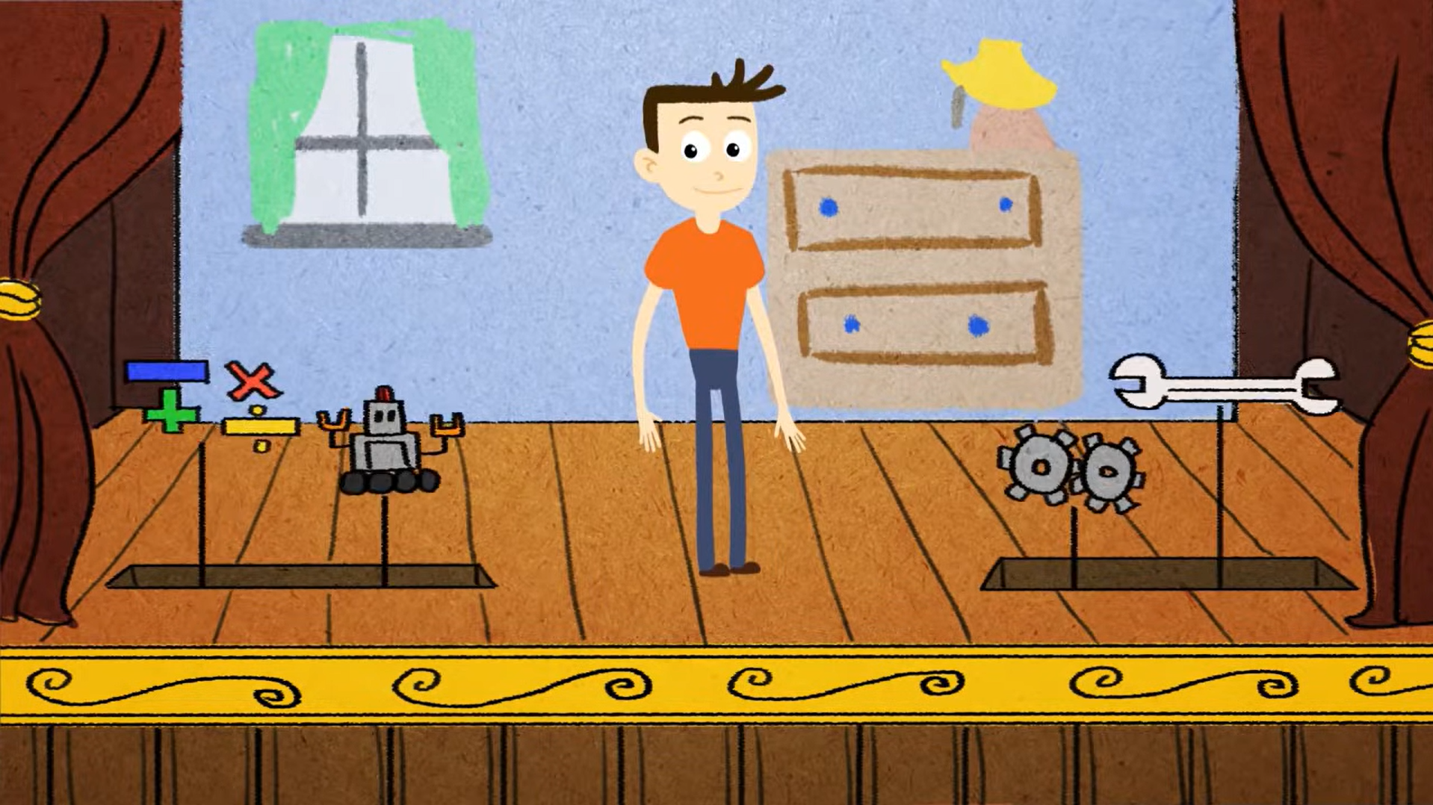
Watch: How to Choose a Career Based on Interests - The Strong Interest Inventory https://www.youtube.com/watch?v=scgqCyxe1QY (1 min 45 sec)
Notes:
Slide 4: Let’s watch a short video on the importance of self-knowledge and future careers.
Watch video:
How to Choose a Career Based on Interests - The Strong Interest Inventory
https://www.youtube.com/watch?v=scgqCyxe1QY (1 min 45 sec)
Now let's start looking at these self-knowledge factors in detail.

Slide 5

Interests
A topic or activity you enjoy learning about, doing or exploring.
Examples:
Helping people
Working with animals
Technology
Sport
Interests can suggest possible careers.
Notes:
Slide 5: Interests
An interest is a topic or activity a person enjoys learning about, doing or exploring.
For example, a learner may be interested in helping people, working with animals, solving problems, designing items, using technology, cooking, sport, business or the environment.
Your interests can give you clues about possible subjects and career fields that may suit you. However, interests should not be the only reason for choosing a subject. You also need to think about your abilities, strengths and the requirements for future study or work.

Slide 6

Abilities and Skills
Ability: Something you do naturally or easily.
Communication
Working with numbers
Skill: Something learned and improved through practice.
Preparing a meal
Using a computer program
Ability + effort + practice = stronger skills
Notes:
Slide 6: Abilities and skills
An ability is a natural or developed capability that helps a person perform certain tasks well or with greater ease.
For example, a learner may have strong abilities in problem-solving, writing, speaking, working with people, working with numbers, drawing, practical work or organising information.
Some learners may think, "I am not as smart as my friend", or "I cannot do that as well as someone else, so I must not have any abilities". This is not true. Everyone has abilities, but they may look different from person to person.
A skill is a learned capability that improves through practice, effort and experience.
For example, you are not born knowing how to solve an accounting problem, prepare a meal, use a computer program or rewire a plug. These skills are developed through learning, determination and practice.
Natural ability can help you, but effort and practice can turn an ability into a strong skill.

Slide 7


Strengths and Weaknesses
Strengths: Qualities that help you succeed.
Creativity
Organisation
Responsibility
Weaknesses: Areas needing improvement.
Time management
Calculations
Concentration
Notes:
Slide 7: Strengths and weaknesses
A strength is a positive quality or capability that helps a person perform well and succeed.
For example, a learner may be responsible, creative, patient, organised, practical, good at communicating or good at working with numbers.
A weakness is an area of difficulty where a person may need more practice, support or improvement.
For example, a learner may struggle with time management, public speaking, reading, calculations, concentration or working in a group.
A weakness does not mean you must give up. It shows you where you may need to work harder, ask for help or build better habits.

Slide 8
Linking Qualities to Subjects
Personal qualities | Possible subjects/careers
Problem-solving, numbers | Mathematics, Accounting, Science
Helping others | Education, Health, Hospitality
Creativity | Visual Arts, Design
Practical skills | EGD, Technology
Notes:
Slide 8: Linking qualities to subjects and careers
To make the best subject choice, you need to find where your interests, abilities, skills, strengths and weaknesses overlap.
Different subjects and careers may require different qualities. For example:
A learner who enjoys solving problems and works well with numbers may be suited to subjects such as Mathematics, Accounting or Physical Sciences.
A learner who enjoys helping people and communicates well may be suited to subjects that support careers in education, health, social services or hospitality.
A learner who is creative and enjoys visual work may be suited to subjects such as Visual Arts, Design or Consumer Studies.
A learner who enjoys practical work and solving technical problems may be suited to subjects such as Engineering Graphics and Design or Technology-related subjects, depending on what the school offers.
These examples do not mean that learners must choose only one path. They show that learners should think carefully about how their personal qualities connect to different subjects and career fields.

Slide 9

Passion and Motivation
“Choose a job you love, and you will never have to work a day in your life.”
Have a clear goal: e.g. 'I want to be a Civil Engineer to improve SA's infrastructure’.
This can motivate you to work harder in difficult subjects.
Notes:
Slide 9: There is a well-known saying: "Choose a job you love, and you will never have to work a day in your life".
This does not mean that every day in a career will be easy. Every career has difficult days, pressure and hard work. However, when you are interested in a career field, you may be more motivated to work hard and keep going.

Slide 10
Class Discussion
Aisha is passionate about becoming a doctor because she wants to help sick people in her community. She enjoys Life Sciences and loves learning about the human body, but she struggles with Mathematics. This creates a conflict because Medicine usually requires strong Mathematics results.
Can you enjoy a subject or career field but still struggle with it? Explain your answer.
Can you be good at a subject but not enjoy it? Explain your answer.
What should a learner do if they need a subject for a future career, but it is one of their weaker subjects?
Why should learners consider both their interests and abilities when choosing subjects?
Notes:
Slide 10: Ask one of the learners to read the scenario on Slide 10 aloud.
Aisha is passionate about becoming a doctor because she wants to help sick people in her community. She enjoys Life Sciences and loves learning about the human body, but she struggles with Mathematics. This creates a conflict because Medicine usually requires strong Mathematics results.
Pose the following questions to learners (allow for small group discussion or discuss as a class):
Can you enjoy a subject or career field but still struggle with it? Explain your answer.
Can you be good at a subject but not enjoy it? Explain your answer.
What should a learner do if they need a subject for a future career, but it is one of their weaker subjects?
Why should learners consider both their interests and abilities when choosing subjects?
Note to teacher: Guide learners to understand that interests, abilities, strengths and weaknesses should be considered together. A learner should not give up immediately because a subject is difficult, but they should also be realistic about the effort, support and requirements involved.
The following can be used as a conclusion to the discussion: Aisha should not immediately give up on her goal, but she also should not ignore the challenge. She needs to research the requirements, ask for guidance and decide whether she is willing to put in the extra effort needed for Mathematics. She could also explore other health-related careers that may still allow her to help people.

Slide 11
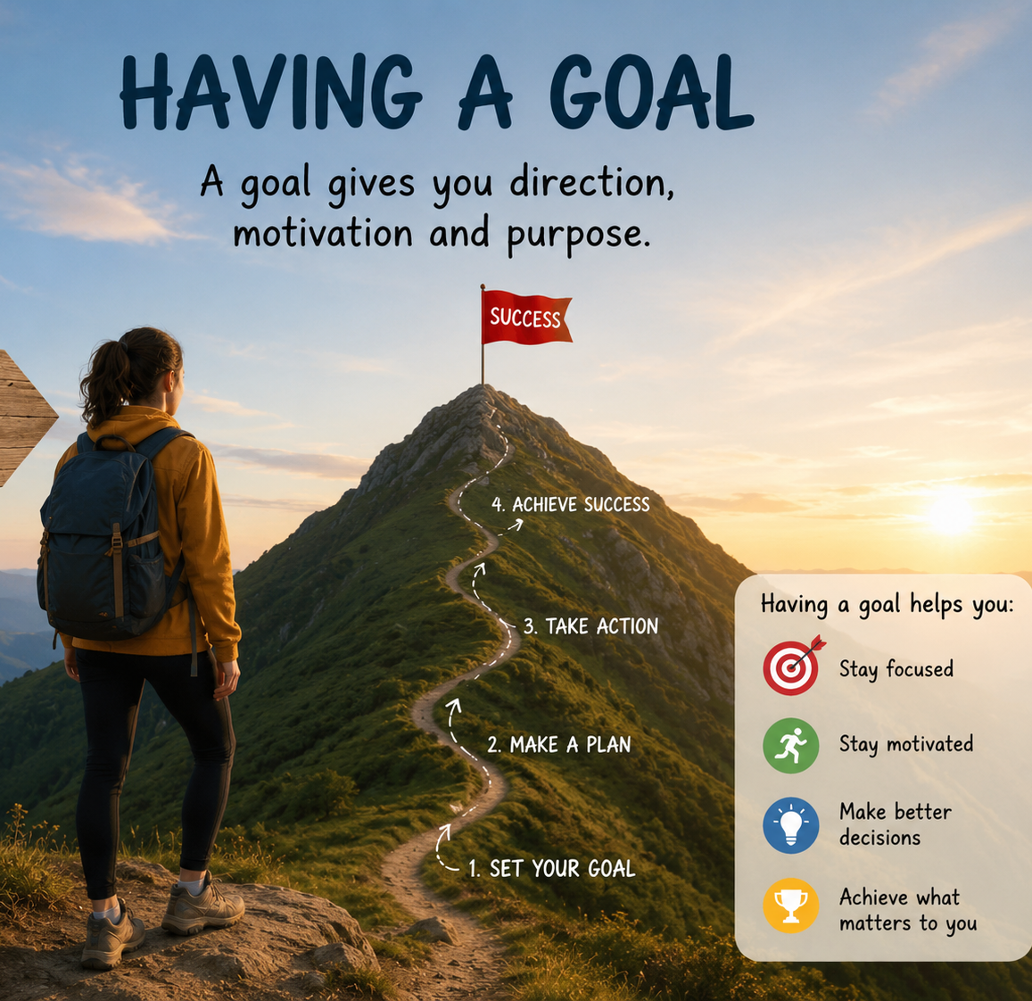
Key Message
Good subject choices consider:
interests
abilities
skills
strengths
weaknesses
Notes:
Slide 11: Today, we learnt that subject choices should not only be based on career requirements. Learners should also consider their interests, abilities, skills, strengths and weaknesses.
You need to understand that having a clear career goal changes your daily attitude in the classroom. When you don't know where you are going, a difficult subject feels like a punishment. When you have a goal, that difficult subject becomes a bridge you are willing to build.

Slide 12

Activities
Notes:
Slide 12: Allow time for any questions learners may have.
Learners can now use the remainder of the lesson to complete Activity 1 (Lesson 3 – Worksheet).
Answers are available in the Lesson 3 – Worksheet MEMO.
Also assign Activity 2 (Lesson 3 – Worksheet) as homework.

