Slide 1


GRADE 10
Development of the Self in Society
Term 3
Lesson 2: Physical changes during adolescence
Notes:
Note to teacher: Make sure the class is divided into six groups. Each group should have about 4–6 learners.
Slide 1: Welcome back, Grade 10s. In the previous lesson, we focused on changing life roles and responsibilities as adolescents move towards adulthood.
Today, we will focus on the physical developmental changes that happen during adolescence.

Slide 2
Quick Recap
Different life roles
Responsibilities linked to life roles
How life roles affect relationships
Changing life roles
Influence of culture and society on life roles
Notes:
Slide 2: Before we move on, let’s see how much you can remember. Turn to your peer. One of you will be the "learner" and the other will be the "tutor". The tutor will have two minutes to share as much as possible from the previous lesson. The learner must think of three questions they would like to understand better from the last lesson. Focus on the following:
Different life roles
Responsibilities linked to life roles
How life roles affect relationships
Changing life roles
Influence of culture and society on life roles
Well done, Grade 10s. It is good to hear that most of you remember the foundation of last week’s lesson.

Slide 3
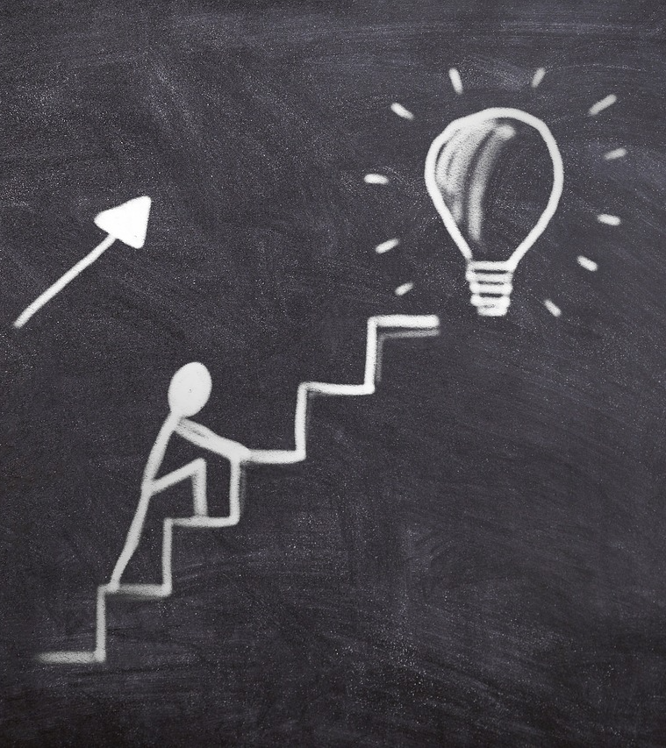
By the end of the lesson, you should be able to:
Explain hormonal changes during puberty.
Identify common secondary sex characteristics that may occur during adolescence.
Distinguish between primary changes, secondary sex characteristics and other common physical changes during adolescence.
Describe how physical changes during puberty can affect self-esteem, body image and interactions with others.
Notes:
Slide 3: By the end of the lesson, you should be able to:
Explain hormonal changes during puberty.
Identify common secondary sex characteristics that may occur during adolescence.
Distinguish between primary changes, secondary sex characteristics and other common physical changes during adolescence.
Describe how physical changes during puberty can affect self-esteem, body image and interactions with others.

Slide 4
What is puberty?
Puberty is the process of changing from a child into an adult.
Hormones trigger physical changes:
Testosterone (males) – causes changes such as sperm production, growth of the testicles, a deeper voice and increased body hair.
Oestrogen (females) – causes changes such as breast development, widening of the hips and the start of the menstrual cycle.
Notes:
Slide 4: Why do you think your body starts changing? (Allow a couple of responses.)
That's right. Your body is developing from a child’s body into a more adult body. This is called puberty.
I am sure the learners who take Life Sciences can tell us more about the physical changes and processes.
During puberty, hormones act as chemical messengers in the body. These hormones tell different parts of the body to grow, mature and change.
In males, testosterone plays an important role in changes such as sperm production, growth of the testicles, a deeper voice and increased body hair.
In females, oestrogen plays an important role in changes such as breast development, widening of the hips and the start of the menstrual cycle.
These hormonal changes lead to two main types of physical changes: secondary sex characteristics and primary changes in the body.

Slide 5
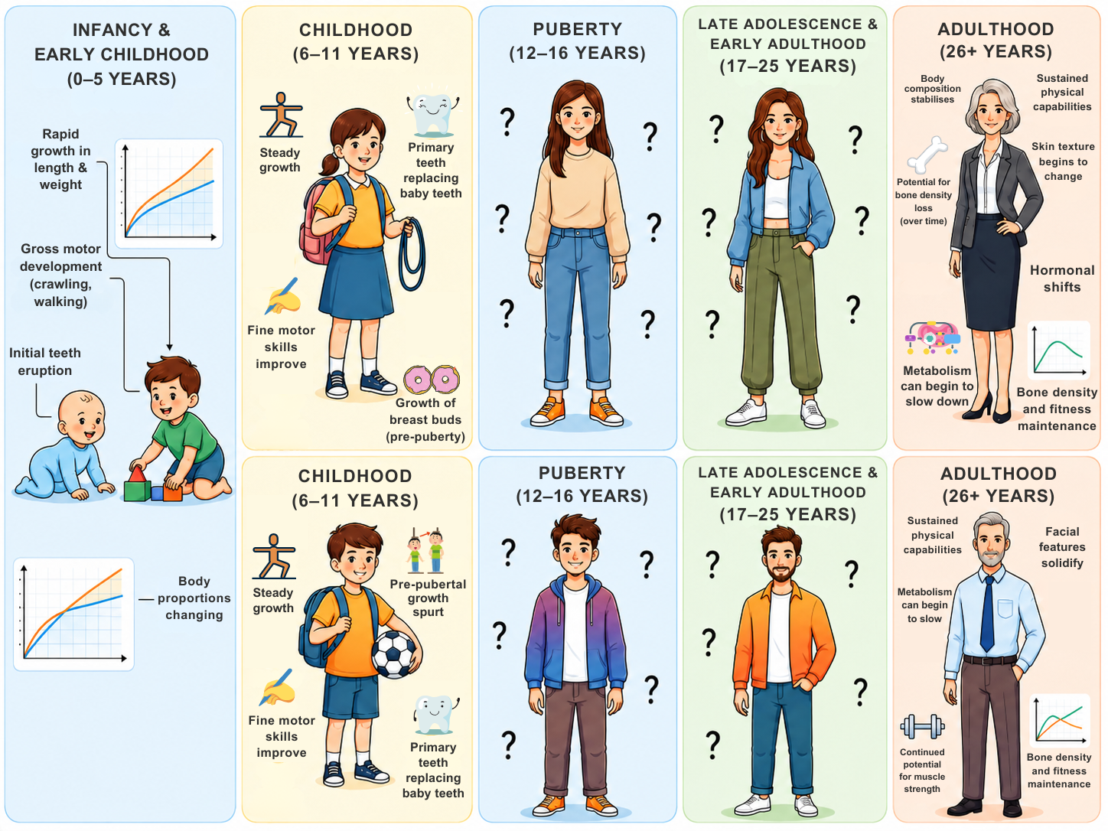
Secondary Sex Characteristics
The physical journey from birth to adulthood in males and females
Physical signs that the body is maturing – not directly involved in reproduction.
Notes:
Slide 5: Many teenagers experience rapid physical growth. They may grow taller, gain weight, develop more body hair and notice changes in body shape.
These visible changes are called secondary sex characteristics because they show that the body is maturing, but they are not directly involved in reproduction.
I am sure that you already know quite a bit about the physical changes that take place in both males and females during adolescence. Let’s see how well you know your "adolescence general knowledge".
Together with your peer, complete Activity 1 (Lesson 2 – Worksheet). (Allow five minutes to complete.)
Note to teacher: Answers are available in the Lesson 2 – Worksheet MEMO, but you may also use Slide 6 to mark the answers.

Slide 6

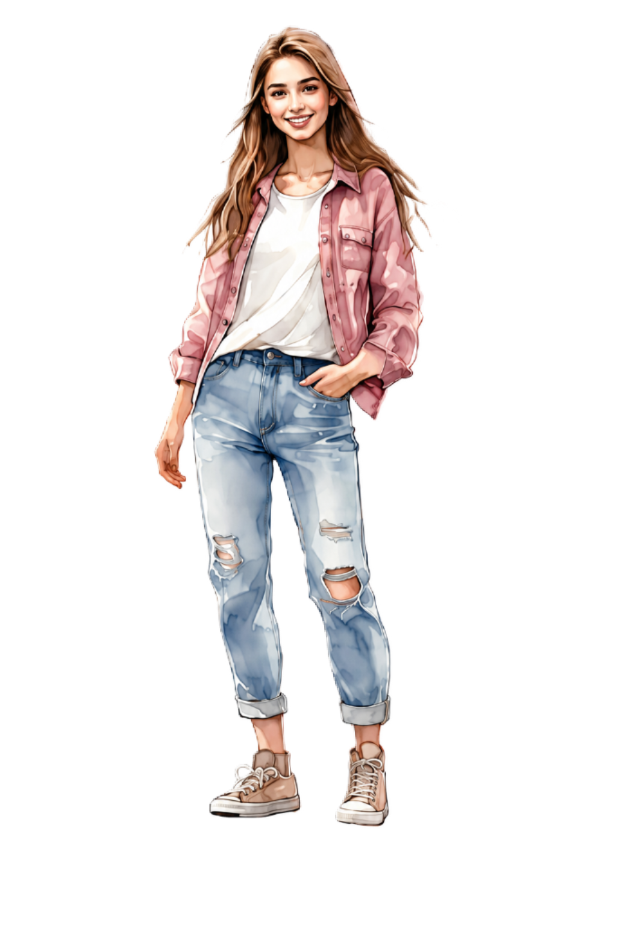
Activity Feedback
Males only:
Voice deepens and becomes lower
Facial hair may grow (beard or moustache)
Erections may occur
Wet dreams may occur
Females only:
Breasts develop and hips widen
Menstruation begins (monthly periods)
Ovulation (release of eggs) begins
The body becomes able to become pregnant
Males and females:
Rapid increase in height (growth spurts)
Skin becomes oily and pimples/acne may develop
Body hair increases (underarms and pubic area)
Weight may increase
Body odour and sweating may increase
Notes:
Slide 6: Let’s see if you were able to group the changes into the correct list. (Work through answers on the slide.)

Slide 7
Primary Changes
Females
Ovulation
Menstruation
Males
Sperm production
Erections
Wet dreams
Changes involving the reproductive system.
Notes:
Slide 7: Earlier, we said that hormones cause the body to grow, mature and change. Some of these changes happen in the reproductive system. These are called primary changes. Primary changes include the growth and maturation of the genital organs.
In females, this includes ovulation and menstruation.
In males, this includes sperm production, growth of the testicles and wet dreams.

Slide 8
Other Common Changes
Many teenagers experience:
Acne
Oily skin
Increased sweating
Body odour
These changes are normal during puberty.
Notes:
Slide 8: Some changes do not fit neatly into male-only or female-only categories. Many teenagers may experience skin problems, acne, sweating and increased body odour. These are common changes linked to hormones and active sweat/oil glands.
This is normal and does not mean that anything is wrong with you. Simple daily habits can help, such as washing regularly, using deodorant if available or needed, wearing clean clothes and asking a trusted adult for advice if skin problems become difficult to manage.

Slide 9
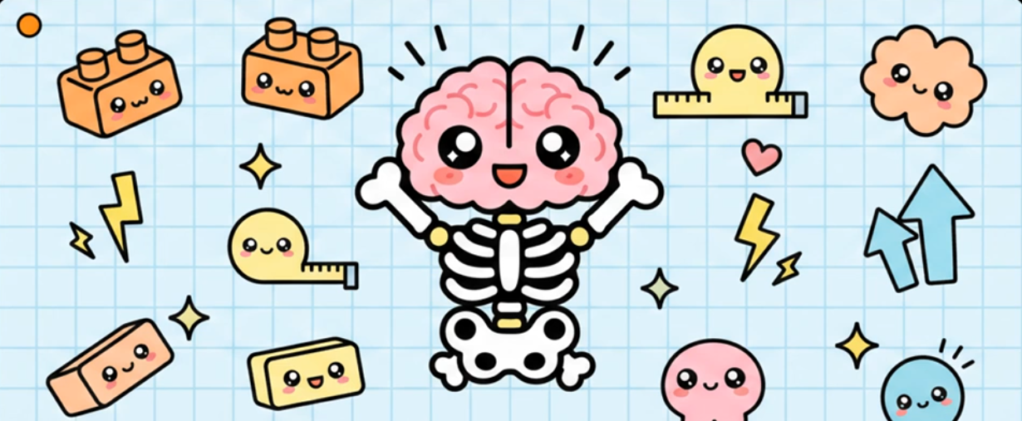

Watch: Decoding Puberty
LINK (timestamp)
Notes:
Slide 9: Let's watch a video that summarises what we've covered so far.
Watch video:
Decoding Puberty
LINK (timestamp)

Slide 10
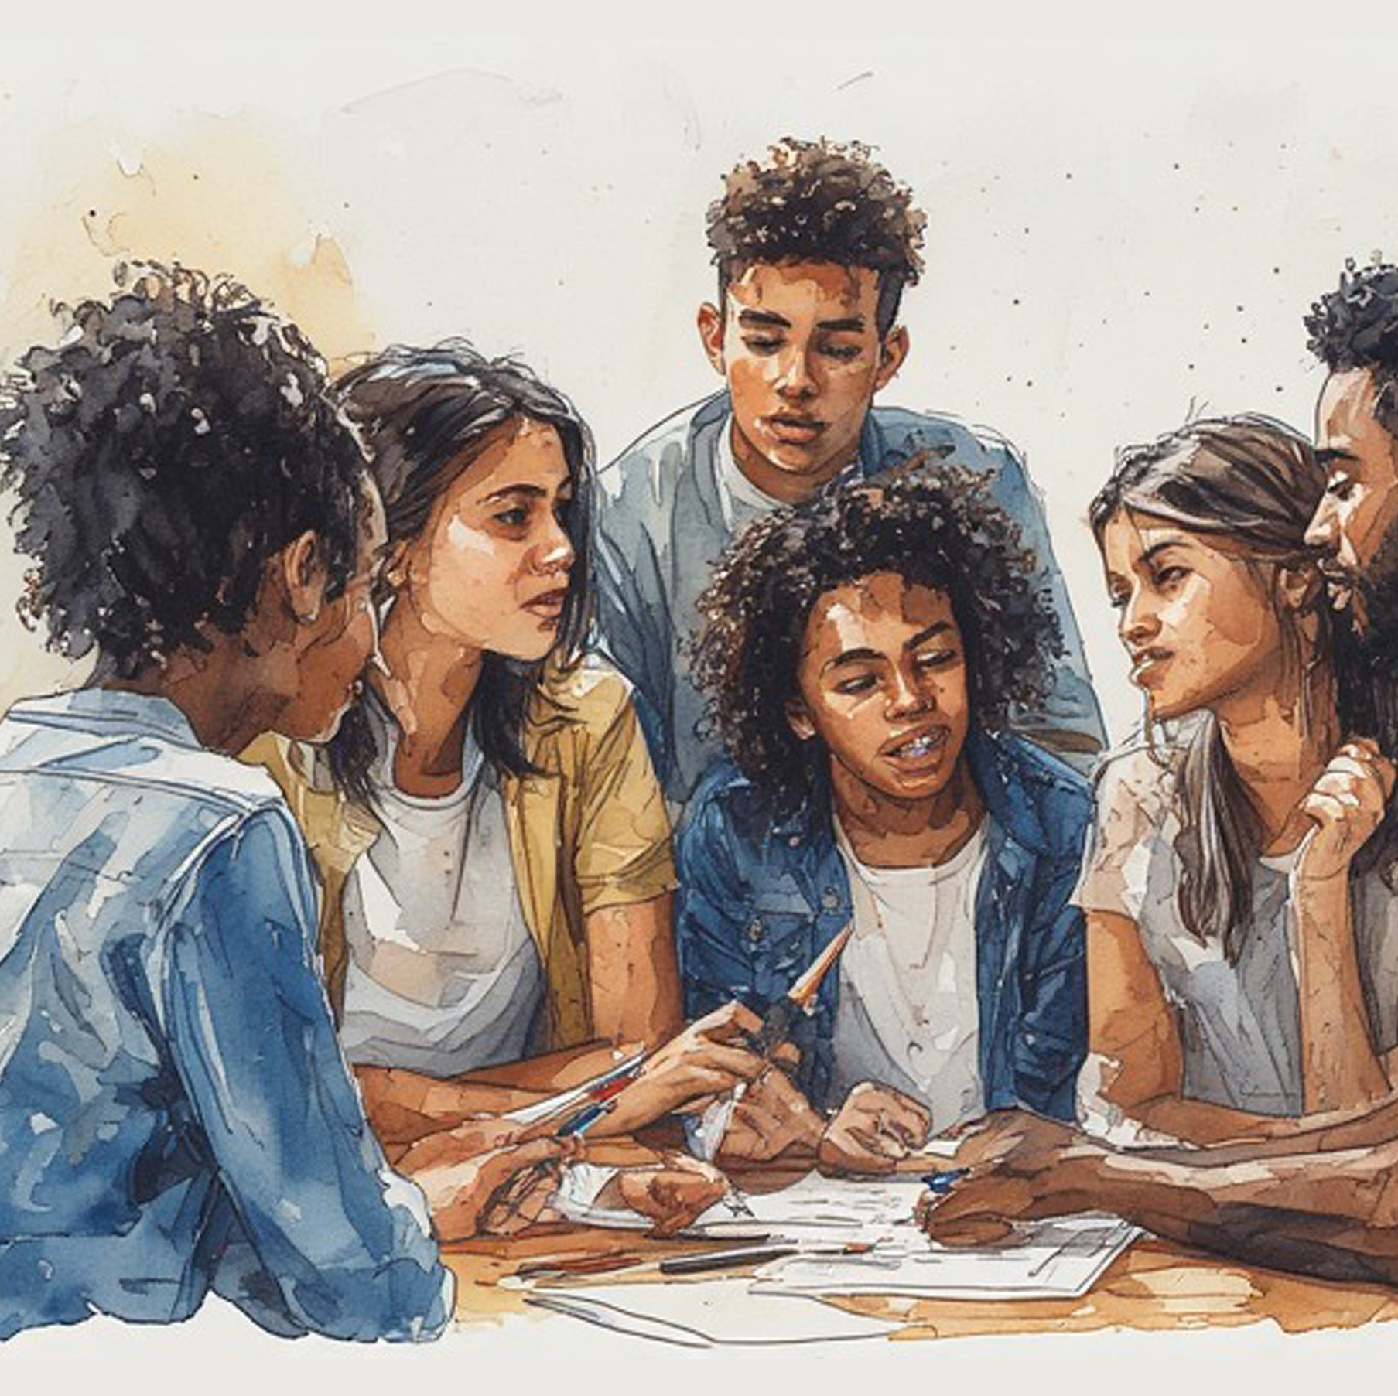
Group Activity
Create a poster showing:
  Primary changes
  Secondary sex characteristics
  Other common changes
Notes:
Slide 10: This may feel like a lot of information in one clip, but it is important to understand the primary and secondary changes that take place in both the male and female body during puberty.
One way to remember these changes is to brainstorm the main points. Using the notes from the video in Activity 2 (Lesson 2 – Worksheet), work with your group to create a poster about the physical changes that occur in males and females during adolescence. Your poster should show the difference between primary changes, secondary sex characteristics and other common changes.
Complete this on the Lesson 2 – Poster template.
When your group is finished, write your names on the back and hand it to your teacher. Your teacher will choose some of the best posters to display on the classroom gallery wall.

Slide 11
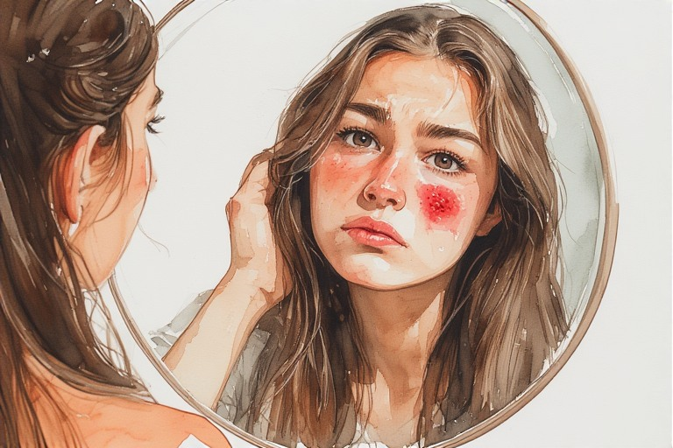
Physical changes can affect:
Self-confidence
Emotions
Relationships
Notes:
Slide 11: These physical changes not only affect how a teenager’s body looks and feels, but can also affect how they feel about themselves and how they interact with others.
Discuss the questions in Activity 3 (Lesson 2 – Worksheet) with your peer. Complete the activity as homework.
Learners can mark their answers using Lesson 2 – Worksheet MEMO.

Slide 12

Reflection
Notes:
Slide 12: Today, we looked at the physical changes that may take place during adolescence.
To see how well you understood this lesson, complete Activity 4 (Lesson 2 – Worksheet).

