Slide 1


GRADE 10
Development of the Self in Society
Term 3
Lesson 5: Responsible decisions in relation to sexuality & lifestyle
Notes:
Note to teacher: Make sure the class is divided into six groups. Each group should have about 4–6 learners.
You will use the cards from the Lesson 4 – Game Cards again in this lesson. Pack one set of the Lesson 4 – Game Cards for each group and add one pack of the Lesson 5 – Skill Cards to each group.
For the introduction activity, each pair of learners will need one A4 sheet of paper. This can be scrap or recycled paper.
Slide 1: Good morning, Grade 10s. We are now in Lesson 5 of our series from Adolescence to Adulthood. We have covered a lot of content over the last few weeks.
We are going to do a quick “brain dump” to see how much you remember. With your peer, write down as many words or ideas as you can remember when I say each phrase. Let’s see which pair can fill their page the most.
Are you ready?
Teacher reads the following phrases and allows about 30 seconds for each one (allow 2 minutes in total):
Life roles
Adolescence: physical changes
Adolescence: emotional changes
Adolescence: social changes
Values and strategies to prevent risky sexual behaviour
Right, lift your page and look around the room at how much each pair has written. Well done. It is impressive to see how much you have learned so far.
Can one pair volunteer to share their responses? If your pair has the same response, give yourself a mark. Let’s see who has similar answers. (Ask pairs for feedback. This will give you, as the teacher, insight into how well learners understand the content.)
In the last lesson, each group presented a role-play about different potentially dangerous situations that required careful decision-making. You had to think about how to prevent yourself from ending up in a situation you wanted to avoid.
We learned that having strong values can help you set boundaries and avoid behaviour that could lead to sexual intercourse, teenage pregnancy, sexual abuse or rape.
Sometimes it can be difficult to make decisions in these situations. It may feel as if you are being pulled in two directions. As an adult, I can tell you that life has taught me skills to use in difficult situations.
At this stage, you may feel that you do not have all the skills you need yet, because we are not born with all these skills.
Today, we will start developing these skills.

Slide 2

By the end of the lesson, you should be able to:
Recognise that values influence decision-making in situations linked to sexuality and lifestyle choices.
Elaborate the skills needed to make responsible decisions about sexuality and lifestyle, including self-awareness, critical thinking, decision-making, problem-solving, communication, assertiveness and negotiation.
Apply decision-making skills to challenging scenarios.
Notes:
Slide 2: By the end of this lesson, you should be able to:
Recognise that values influence decision-making in situations linked to sexuality and lifestyle choices.
Elaborate the skills needed to make responsible decisions about sexuality and lifestyle, including self-awareness, critical thinking, decision-making, problem-solving, communication, assertiveness and negotiation.
Apply decision-making skills to challenging scenarios.
Are you ready? Let’s get started.

Slide 3


Pair Activity
Notes:
Slide 3: For the next six slides, you will see six “Would you rather?” questions. For each question, you and your peer must choose either A or B.
You will have 30 seconds to discuss your choice and give a brief reason. Do not overthink it. You will only have 1 minute per slide.
Write your agreed response in Activity 1 (Lesson 5 – Worksheet).
Ask the rapid “Would you rather?” questions linked to decision-making:

Slide 4
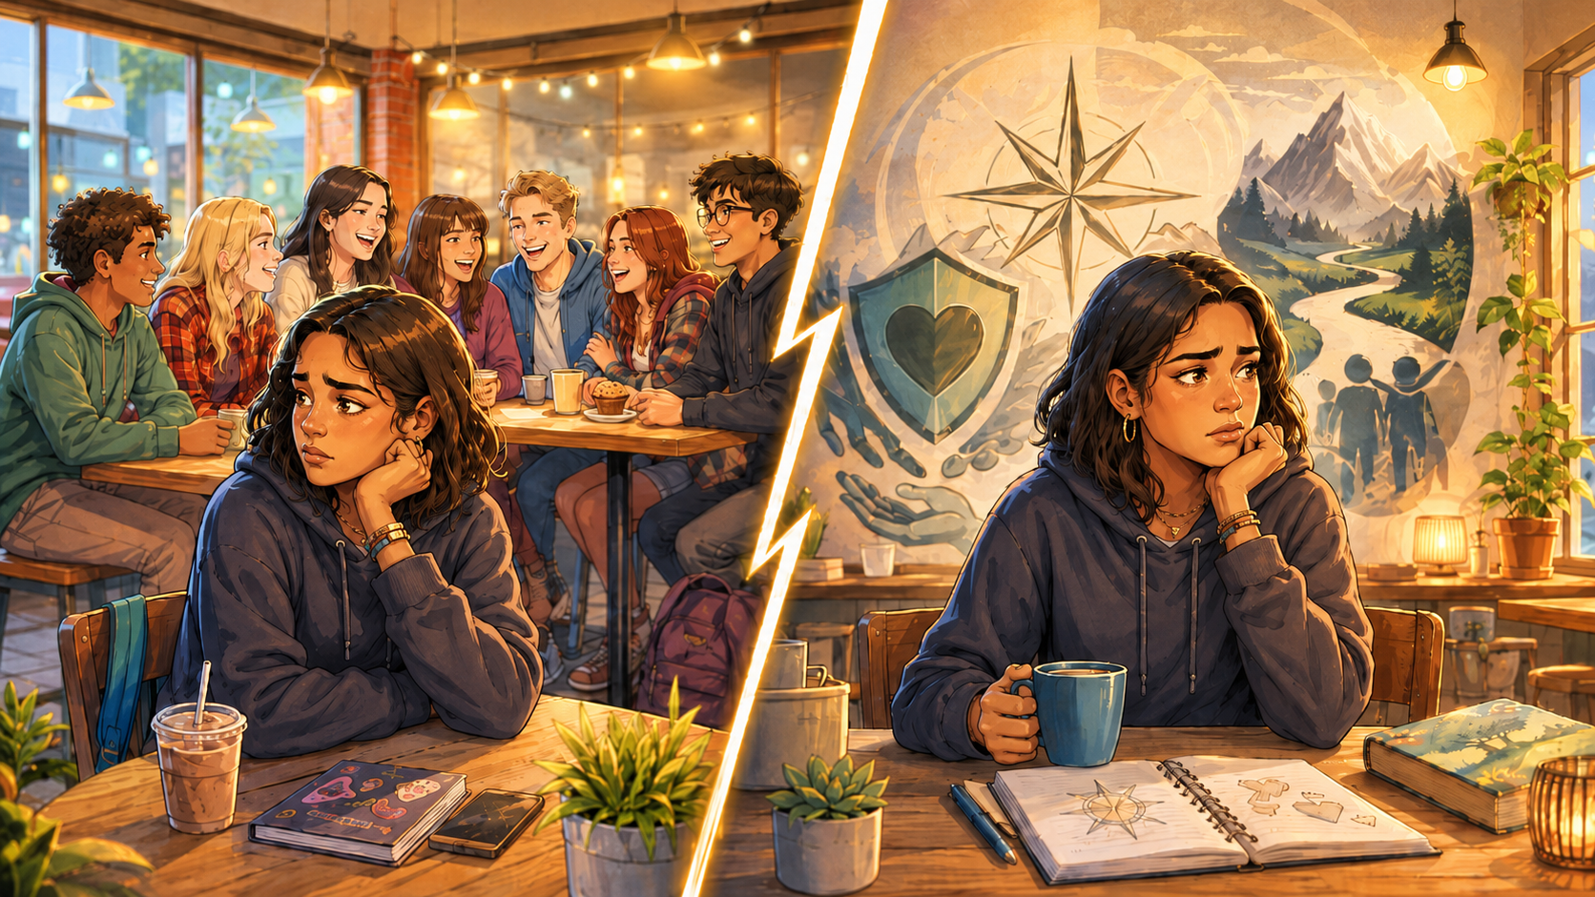
Would you rather:
A. lose friends
B. break your values?
Notes:
Slide 4: Would you rather:
A. lose friends
or
B. break your values?

Slide 5
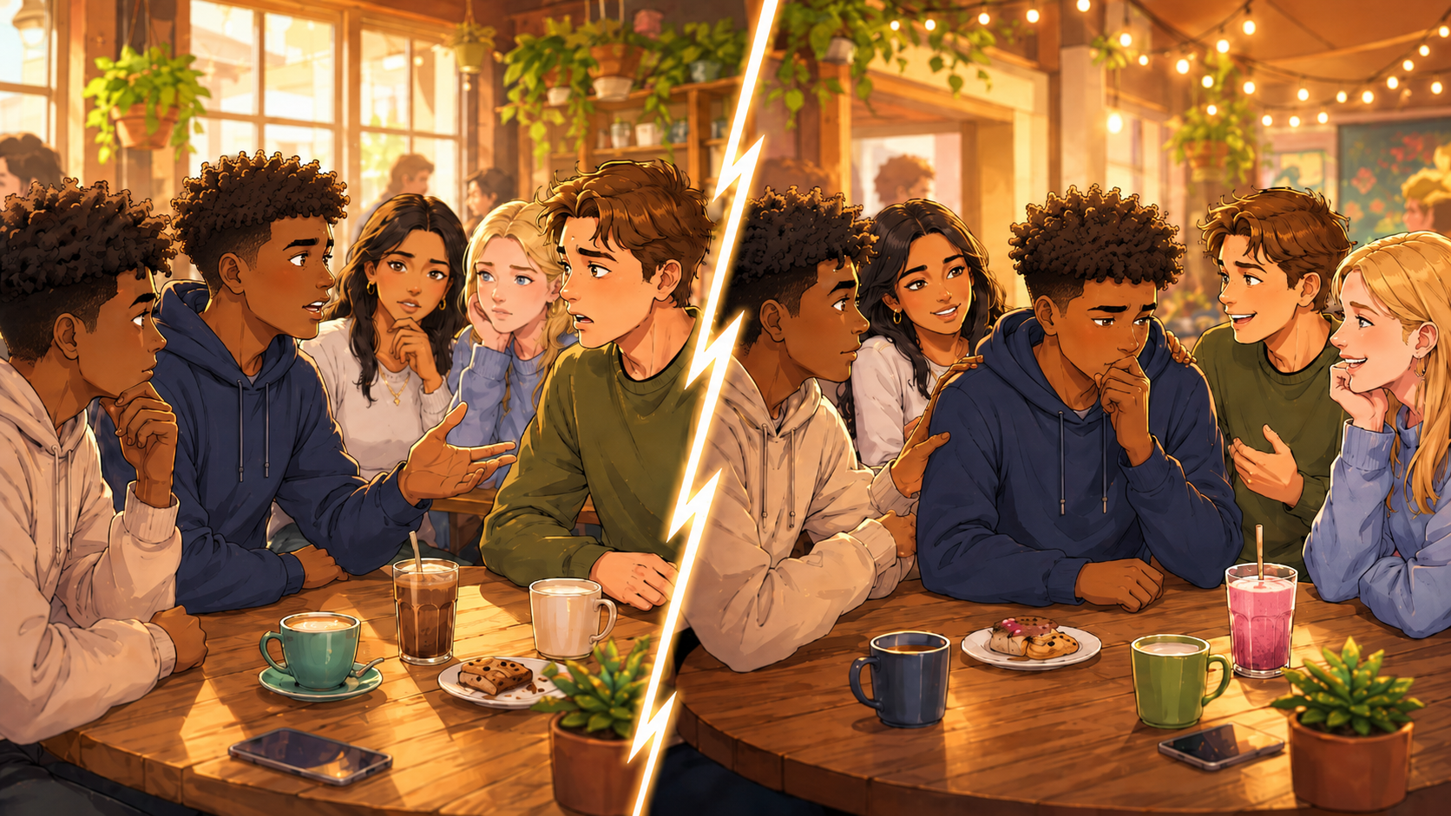
Would you rather:
A. tell a friend an uncomfortable truth that might upset them
B. keep quiet to protect their feelings?
Notes:
Slide 5: Would you rather:
A. tell a friend an uncomfortable truth that might upset them
or
B. keep quiet to protect their feelings?

Slide 6
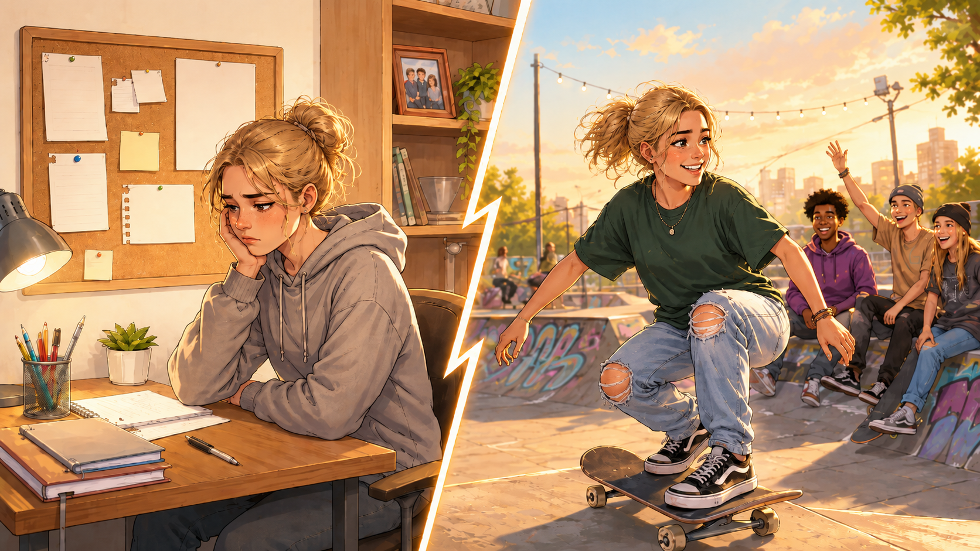
Would you rather:
A. follow strict rules at home for your safety
B. have more freedom with less guidance?
Notes:
Slide 6: Would you rather:
A. follow strict rules at home for your safety
or
B. have more freedom with less guidance?

Slide 7
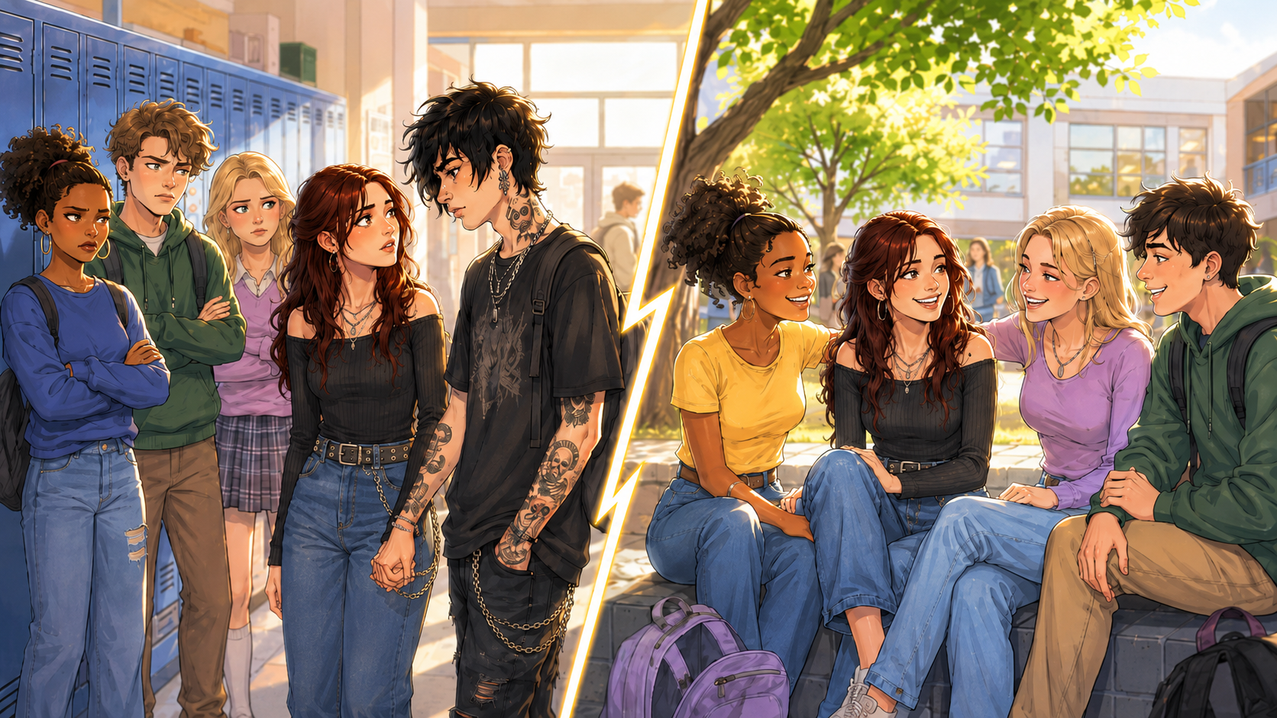
Would you rather:
A. date someone your friends do not approve of
B. end the relationship to keep your friendships?
Notes:
Slide 7: Would you rather:
A. date someone your friends do not approve of
or
B. end the relationship to keep your friendships?

Slide 8
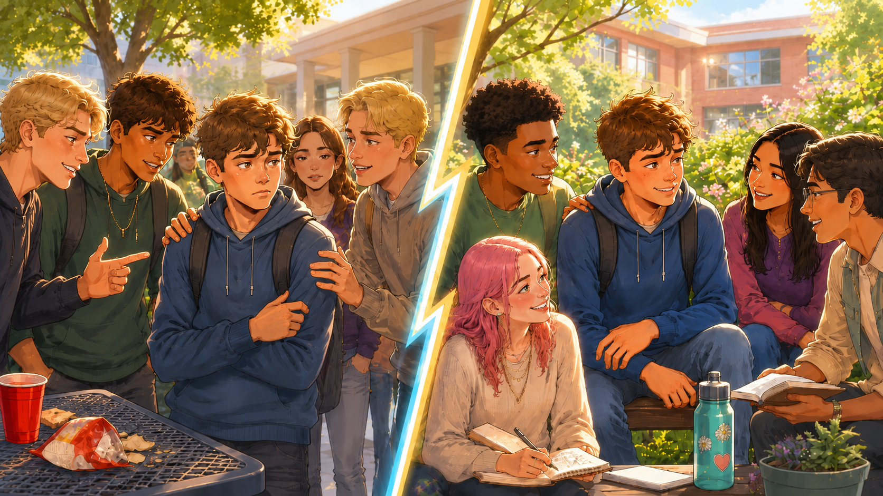
Would you rather:
A. stay with a group you have known your whole life, even if you do not fully agree with them
B. find another group and stay true to your values?
Notes:
Slide 8: Would you rather:
A. stay with a group you have known your whole life, even if you do not fully agree with them
or
B. find another group and stay true to your values?

Slide 9
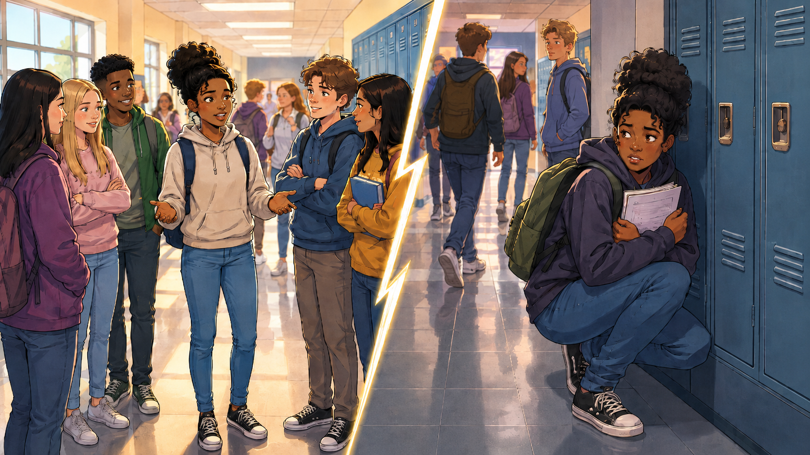
Would you rather:
A. admit publicly that you made a mistake
B. hide it and hope no one finds out?
Notes:
Slide 9: Would you rather:
A. admit publicly that you made a mistake
or
B. hide it and hope no one finds out?

Slide 10
Decision-Making Skills
Different situations require different skills.
Tools that help you make responsible choices regarding sexuality and lifestyle.
Notes:
Slide 10: Did you notice that you and your peer may not always have agreed on which option to choose? This is because people may have different values and may respond differently in the same situation.
We can also use different skills in different situations to help us make lifestyle decisions, especially when we are not sure what the best outcome should be.
Imagine that each of these skills is a card in a game. Each card gives you special tips or guidance on what choice to make for your next move.
Let’s see what each of these skills means.

Slide 11
Self-awareness
Knowing yourself, your values and your goals.
Questions to ask:
What are my values?
What are my boundaries?
Does this choice fit who I want to become?
Notes:
Slide 11: Self-awareness
Self-awareness means knowing yourself well. You can develop self-awareness by keeping a journal or reflecting weekly on who you are and where you are going in life. You can also reflect on your views about sexuality, sexual intercourse and general lifestyle choices.
For example, a friend invites you to a party at his house. You know you are the only girl invited, there will be many boys there, and no adults will be present. If you are self-aware, it will be easier to say “no” because you know your values and choose to be cautious.

Slide 12
Critical Thinking
Think before you act:
  Analyse the situation.
  Consider advantages and disadvantages.
  Think about short- and long-term consequences.
  Make logical, not impulsive, decisions.
Notes:
Slide 12: Critical thinking skills
Critical thinking is the ability to step away from a situation and analyse and evaluate the information. Using these skills means that you make a logical decision, instead of an emotional or impulsive one. You weigh up the advantages and disadvantages and consider the impact of your decision now and in the future.

Slide 13
Decision-Making
Choose the best option after evaluating your choices.
Good decisions involve:
gathering information
comparing options
considering future goals
Notes:
Slide 13: Decision-making skills
Once you have used critical thinking skills to evaluate your options, you use decision-making skills to choose the best action plan. This means you have gathered information, compared the effects of your choices and chosen the best option.
For example, it is your dream to study engineering one day, but as a Grade 10 learner, you realise that you are struggling with Mathematics and are barely passing. Your teachers recommend that you change from Mathematics to Mathematical Literacy, but you know this will prevent you from studying engineering.
A responsible choice may be to get a tutor or extra help to improve your marks. A poor choice may be to change subjects without carefully considering how this could affect your future goals.

Slide 14
Problem-Solving
Identify the problem.
1
Think of possible solutions.
2
Consider the consequences.
3
Choose the best solution.
4
Take action.
5
Notes:
Slide 14: Problem-solving skills
Sometimes difficult decisions require a plan. You can use problem-solving skills by following these steps:
Describe the problem
Suggest possible solutions
Think about the effects of each solution
Choose the best solution
Act on the solution

Slide 15
Communication
Good communication helps you:
express your feelings honestly
prevent misunderstandings
communicate boundaries clearly
Notes:
Slide 15: Communication skills
Once you have made a decision, it is important to communicate your choice clearly. Some people struggle to communicate because they fear what their friends will say. Good communication helps prevent misunderstandings. It also allows you to express your honest feelings and be clear about what you will and will not do.

Slide 16
Assertiveness
Standing up for yourself
1
Communicating honestly and respectfully
2
Saying "no" clearly when necessary
3
Notes:
Slide 16: Assertiveness
Being assertive means standing up for your rights and needs. You communicate honestly, openly and respectfully. You explain how you feel, what decision you have made, and show understanding of the other person’s point of view, even if you do not agree with them.
It is important to communicate your decision clearly. Saying "no" to sex must be clear and non-negotiable. This means facing the person, using eye contact and standing with your body facing them so that your words and body language both say "no".

Slide 17
Negotiation
Listening to others
1
Staying calm
2
Discussing solutions
3
Reaching an acceptable agreement
4
Notes:
Slide 17: Negotiation skills
Negotiation means discussing an issue with another person until you reach an acceptable solution. This skill works well in conflict situations. It is important not to respond only with emotion, but to remain calm, listen to one another and work together to resolve the conflict.

Slide 18
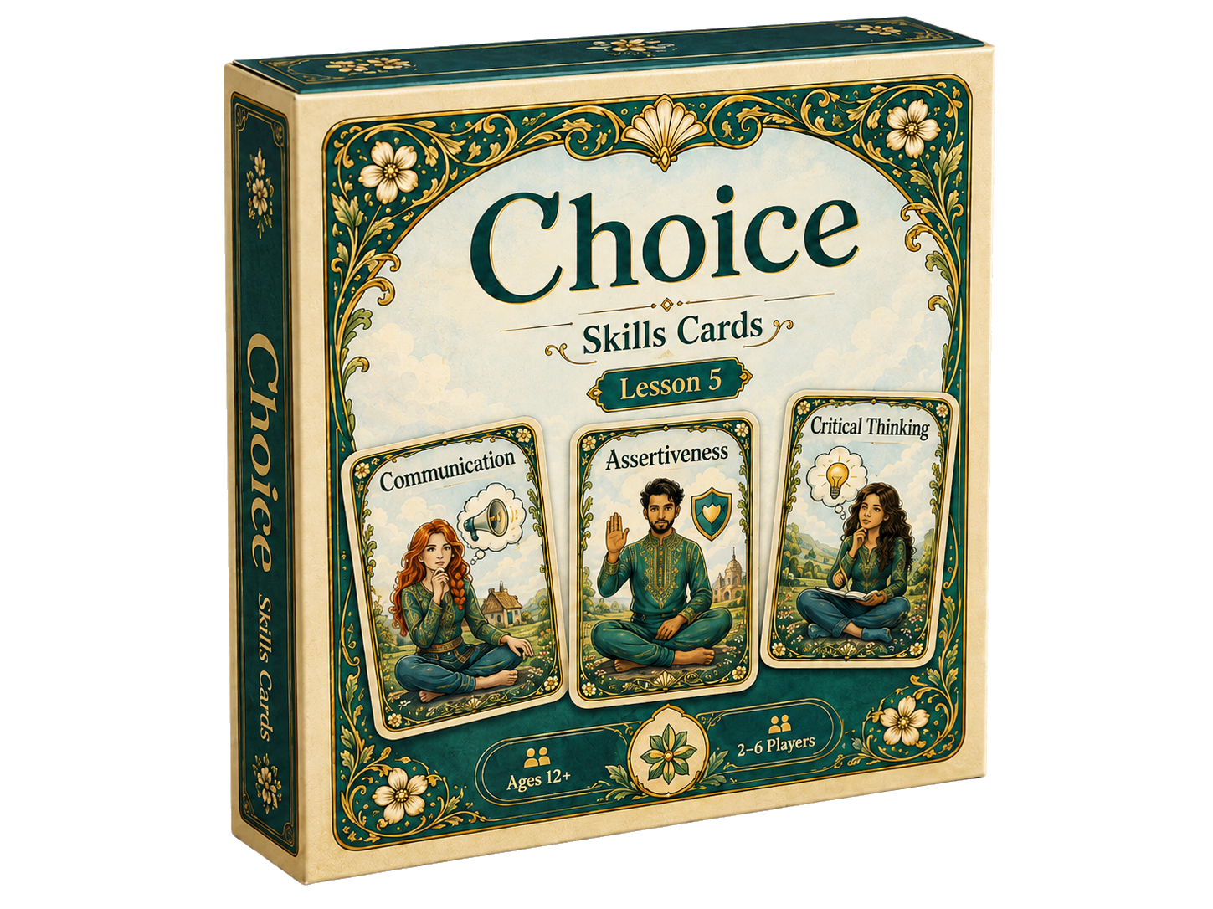
Let's Play CHOICE
Set-up
Choose a Group Leader.
Place Skill Cards face up.
Game
Draw a fact or fiction card.
Present your scenario.
Choose the best Skill Card as group.
Explain your choice.
Suggest a solution.
Reflection
Which skill was used most?
Which skill was hardest to use?
Rules
Respect others.
Listen carefully.
No teasing or judgement.
Notes:
Let’s Play “CHOICE” (16 min) (Slide 18)
Slide 18: I am sure your brain is buzzing from all that information. You will now have an opportunity to see which of these skills you would use in a challenging situation.
Listen carefully to the instructions.
Read the instructions on Slide 18.
Allow 10 minutes for Part 1, 3 minutes for Part 2 and 3 minutes for Part 3.
Refer to detailed instructions in the Lesson Preparation document.

Slide 19
Pause and Evaluate Strategy
When under pressure: Pause → Evaluate → Decide
Ask yourself:
Do I really want to do this?
Does this fit my values?
How could this affect my future?
Notes:
Slide 19: In the game, you used different skills to work through difficult situations. In the previous lesson, we also spoke about strategies such as saying "no", protecting yourself, taking responsibility and setting clear boundaries.
One practical strategy you can use when making a difficult decision is the Pause and Evaluate Strategy. This means that you do not make decisions in a rush. When you feel under pressure, pause. Move away from the situation if you need to, so that you can think clearly.
Then evaluate the situation by asking yourself: Do I really want to do this, or am I only doing it to please someone else? Does this choice fit with my values and boundaries? Could this decision affect who I want to become in the future?
If you still cannot decide, leave the situation. You can always come back to the decision later when you have had time to think clearly.
If it is an important decision, such as "Should I have sex?", remember that someone who truly cares about you should be willing to wait. They should respect you and honour your choices.
We do not have much time left, so you may start Activity 2 (Lesson 5 – Worksheet) now and complete it for homework. (Allow 5 minutes.)
Answers are available in the Lesson 5 – Worksheet MEMO.

Slide 20

Reflection
How confident are you in using these skills in real-life situations?
Notes:
Slide 20: Sometimes it is easier to give advice to others than to think about how well we would handle a similar situation ourselves.
In Activity 3 (Lesson 5 – Worksheet), reflect on how well you have developed the skills we discussed today.

