Slide 1


GRADE 10
Development of the Self in Society
Term 3
Lesson 3: Social and emotional changes during adolescence
Notes:
Note to teacher: Make sure the class is divided into groups of 4–6. For the Popcorn Challenge, you can remind learners of the Lesson 2 posters displayed on the “Gallery Wall” and encourage them to walk past them as they enter the classroom. This will help them remember the content covered in the previous lesson.
Slide 1: Welcome back, Grade 10s. In the previous lesson, we covered a lot of content on physical changes during adolescence. Looking at the posters you created, I am impressed with your summaries and notes.
Let’s see how much you remember. We are going to do the Popcorn Challenge to refresh your memory.
Turn to your peer to start the challenge. One person will make a statement about something they remember from the previous lesson. The other person must then finish the sentence with as much detail as they can remember. You will take turns starting and finishing sentences until I say stop. (Allow 2 minutes in total for discussion.)
Well done, Grade 10s. Some of you have a great memory.
As we mentioned last week, puberty brings about many changes in your body. Some of these changes are easy to see on the outside. However, there are also emotional and social changes that take place. These changes can make us feel different, and they are often the changes we struggle to understand. We will discuss these changes in today's lesson.

Slide 2

By the end of the lesson, you should be able to:
Reflect on how adolescence can influence personality development, emotional responses and self-understanding.
Identify emotional changes that may take place during adolescence.
Explain social changes that may take place during adolescence.
Understand how changing relationships with family, social groups and peer groups can influence teenagers.
Notes:
Slide 2: By the end of the lesson, you should be able to:
Reflect on how adolescence can influence personality development, emotional responses and self-understanding.
Identify emotional changes that may take place during adolescence.
Explain social changes that may take place during adolescence.
Understand how changing relationships with family, social groups and peer groups can influence teenagers.

Slide 3
Maturing personality
During adolescence, you may:
begin to understand yourself better
develop stronger opinions
question what you believe
make more independent choices
Dependent → Independent → Interdependent
Notes:
Slide 3: During adolescence, your personality starts to mature. You may begin to understand yourself better, develop stronger opinions, question what you believe, and make choices that show the kind of person you are becoming.
This stage is about moving from being dependent (needing others) to independent (doing it yourself) and eventually interdependent (working healthily with others).

Slide 4
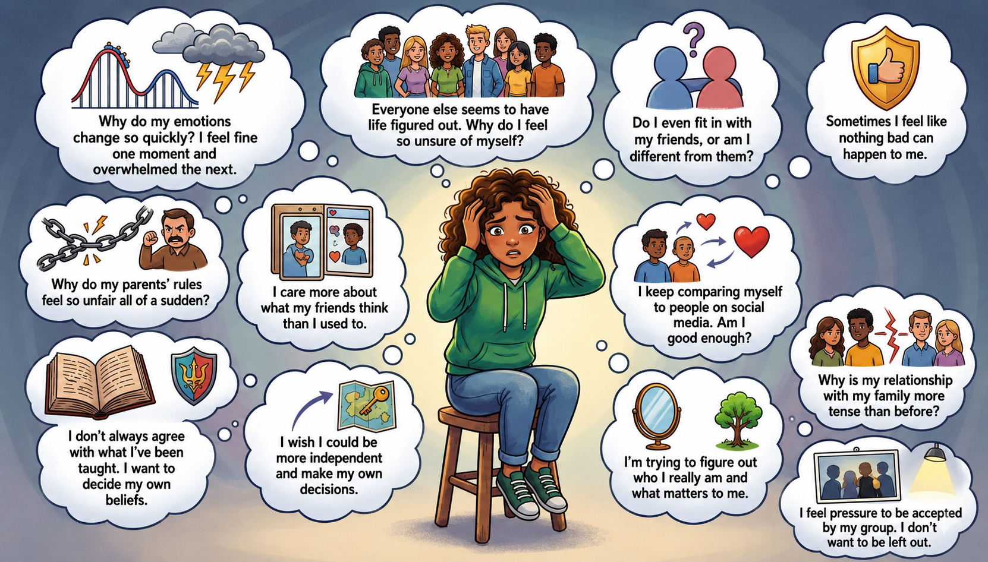
Notes:
Slide 4: As you are trying to understand yourself better, you may also experience strong emotions, confusion or sudden changes in how you feel.
Have you ever felt happy one moment, and then 10 minutes later you feel sad, without knowing why?
Look at the other statements on the image on Slide 3. Have you ever had some of these thoughts?
Complete Activity 1 (Lesson 3 – Worksheet), where you will rate which of these thoughts you struggle with the most. You do not have to share your answers with anyone. (Allow 4 minutes.)
If I asked the class for feedback, we would probably find that everyone has struggled with some of these thoughts at some point. You are not alone.
Hormonal changes, which we spoke about last week, can also affect your emotional responses. They can even change how you respond to the people around you.

Slide 5
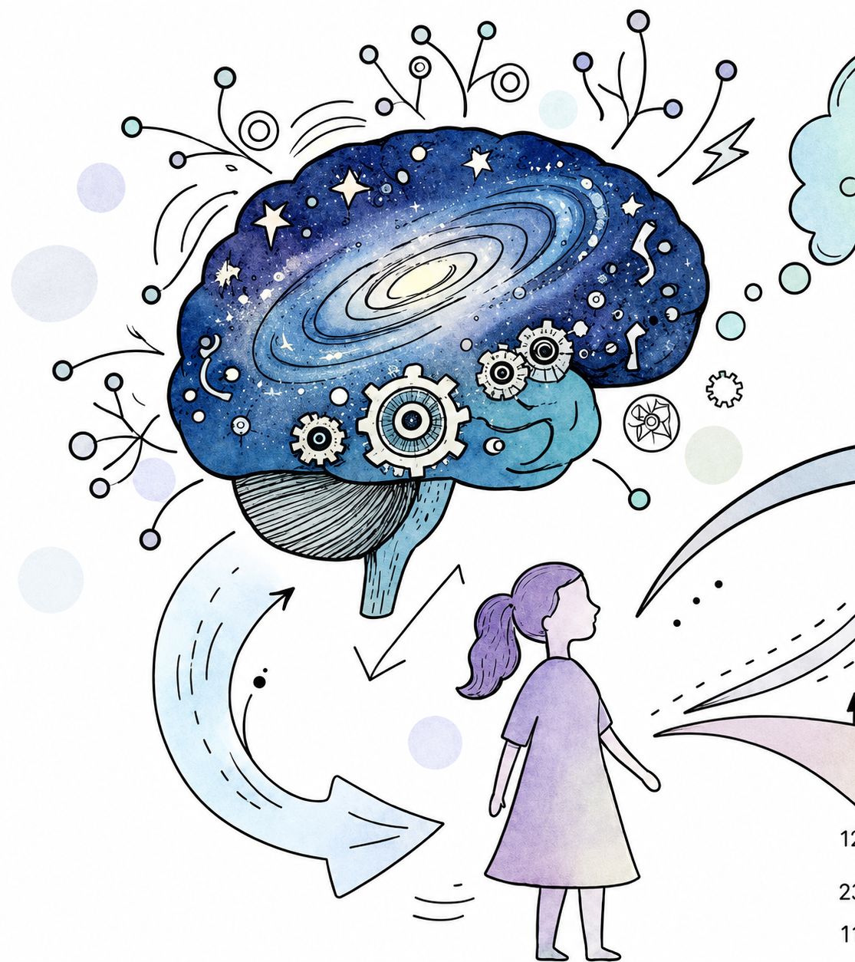

Emotional shifts in teenagers
Intense emotions
Mood swings
Insecurity
Feeling invincible
Challenging authority
Changing beliefs and values
Watch: Emotional Shifts in Teenagers
LINK (Pause the video at 3 min 36 sec)
Notes:
Note to teacher: This video covers both emotional and social changes. Learners will need to complete Activity 2 after watching the section on emotional changes. Pause the video at 3 min 36 sec so that they can finish the activity.
Slide 5: Let’s watch a video on emotional shifts in teenagers, including intense emotions, mood swings, feelings of insecurity, feeling "invincible, challenging authority and changing beliefs and values.
Note to teacher: The Content Summary contains notes on this information, which learners may use for studying purposes at a later stage.
While watching the video, listen for the emotional changes that teenagers may experience during adolescence. Pay attention to the images and examples used to explain each idea.
Watch video:
Emotional Shifts in Teenagers
LINK (Pause the video at 3 min 36 sec)
Pause the video at 3 min 36 sec.
Allow 2 minutes for learners to complete Part 1 of Activity 2 (Lesson 3 – Worksheet).
As mentioned earlier, all these changes that are happening in your body can also begin to affect your relationships with the people around you.
Have you ever noticed that since starting high school, you may prefer spending time with your friends rather than your parents? Or that you can tell your friends almost anything, but find it more difficult to speak openly with your parents?
This is completely normal.
Let’s watch the second part of this clip. (Watch the last 3 minutes.)
Learners to complete Part 2 of Activity 2 (Lesson 3 – Worksheet).

Slide 6

Social changes during adolescence
Relationships may change with:
parents and guardians
friends
peer groups
Possible experiences:
conflict
greater independence
positive and negative peer pressure
Group Activity
Notes:
Slide 6: Relationships with parents or guardians may begin to change. Teenagers may want more independence, while parents or guardians may still want to guide and protect them. This can sometimes lead to more arguments or disagreements. Parents may feel disrespected, while teenagers may feel that they are not being heard.
Social groups become more important during adolescence. Teenagers may spend more time with friends and may be influenced by their interests, opinions and behaviour. These groups can shape how teenagers think, dress, speak and make decisions.
The need to be accepted by a peer group can sometimes lead to peer pressure. A teenager may feel pushed to do something they do not really want to do in order to fit in. However, peers can also have a positive influence. Good friends can make you feel heard and supported, encourage you to study harder, help you make responsible choices, or stop you from doing something unsafe or harmful.
Hand out one scenario from the Lesson 3 – Scenarios document to each group. Learners to complete the questions in Activity 3 (Lesson 3 – Worksheet).
Each group should appoint one spokesperson to summarise their feedback in 30 seconds.
Answers are available in the Lesson 3 – Worksheet MEMO.

Slide 7

Reflection
Notes:
Note to teacher: Learners will need to refer back to their responses in this reflection activity at the start of the next lesson.
Slide 7: As we finish this lesson, complete the statements in Activity 4 (Lesson 3 – Worksheet).

