Slide 1


Grade 11
Careers and Career Choices
Term 3 | Lesson 3: Interview skills and work ethics
Notes:
Note to teacher: This lesson includes a group activity where learners will interview one another in pairs. There will be some noise during this activity, but it is one of the most effective ways for learners to develop interview skills. Manage the time carefully to ensure that each learner has an opportunity to be interviewed. If a learner does not have a partner, you, as the teacher, can interview them.
Slide 1: Welcome back, Grade 11s. I’m excited to review the CVs you created and printed for homework.
Show your CV to a partner in your group. Identify ONE aspect of your CV that you feel you still need to improve now that you have completed it. For example, you might realise that you do not have enough experience, and that you could improve this by doing job shadowing or volunteering during the school holidays. (Allow 2 minutes for peer reflection.)

Slide 2
By the end of this lesson, you should be able to:
Explain the purpose of an interview and identify appropriate preparation and conduct for a job interview.
Demonstrate interview skills through a mock interview role-play.
Explain the importance of workplace ethics, responsibility and accountability in the workplace.
Reflect on and evaluate your own interview performance and communication skills.
Notes:
Slide 2: By the end of this lesson, you should be able to:
Explain the purpose of an interview and identify appropriate preparation and conduct for a job interview.
Demonstrate interview skills through a mock interview role-play.
Explain the importance of workplace ethics, responsibility and accountability in the workplace.
Reflect on and evaluate your own interview performance and communication skills.

Slide 3

What is an Interview?
A meeting where employers ask questions to learn more about you
Shows the employer was interested in your CV
Helps employers decide if you are a good fit
Interviews can feel stressful, but practice improves confidence
Not getting the job does not mean failure
Notes:
Slide 3: One of the most exciting and often nerve-wracking parts of applying for a job is being called for an interview.
An interview is a meeting between people, either face-to-face or online, where one person asks questions to gather information, usually for the purpose of employment.
If you are called for an interview, it means the employer was impressed by your CV and would like to meet you to determine whether you would be a good fit for their company.
If you are not called for an interview, it is important to reflect and ask yourself: Was there something within my control that I could improve?
The interview is often the final step in selecting the most suitable candidate. However, if you are not successful, it does not necessarily mean that you are not suitable for the job. It may simply mean that another candidate was better suited on that particular day. It is important to learn interview skills so that you give yourself the best possible chance of success in the interview. The more interviews you attend, the more comfortable you will become with the process.

Slide 4

Personal Appearance
Dress neatly and appropriately
Clothes do not need to be expensive
Keep hair and appearance tidy
Avoid overdressing or strong perfume
First impressions matter
Notes:
Slide 4 (Personal appearance)
Plan in advance what you will wear. Dress appropriately for the job you are applying for. Your clothing does not need to be expensive, but it should be clean and neat. Ensure your overall appearance is tidy, including your hair. Avoid overdressing or wearing strong perfume.

Slide 5

Watch: Top Interview Tips: Common Questions, Nonverbal Communication & More | Indeed bit.ly/48HDbKF (4 min 57 sec)
Notes:
Slide 5 (Conduct and preparation for typical questions)
Let's watch the following video that explains how you should conduct yourself during an interview and how you can prepare for typical questions.
Watch video:
Top Interview Tips: Common Questions, Nonverbal Communication & More | Indeed
bit.ly/48HDbKF (4 min 57 sec)
Note to teacher: The content from this video is captured in detail in the Content Summary, which learners can refer to at a later stage.
Learners to complete Activity 1 (Lesson 3 – Worksheet).
Answers are available in the Lesson 3 – Worksheet MEMO.

Slide 6
Mock Interview
Notes:
Slide 6: Being able to interview well comes from both preparation and practice.
You will now have 8 minutes to prepare for a mock interview with one of your classmates.
Imagine that you have been called for an interview for the part-time job you chose when creating your application letter in Lesson 1 (Activity 2, Lesson 1 – Worksheet).
You may be creative in your answers, but your responses should still sound realistic and professional. Use the information from your CV to help answer the interview questions.
Use the questions in Activity 2 (Lesson 3 – Worksheet) to prepare your answers. Remember, you are only making brief notes to help you remember what you would say during the interview. (Allow 8 minutes for learners to prepare.)
Now that you are ready, turn your chairs so that you are facing your partner. You will each have an opportunity to role-play the interview.
One learner will act as the interviewer, and the other learner will act as the applicant.
Keep your notes with you during the activity. Remember to focus on body language, eye contact, and speaking clearly and confidently.
You will have 3 minutes before swapping roles.

Slide 7
Work Ethics
Principles that guide appropriate behaviour at work.
Employees should:
treat others with respect
communicate professionally
manage emotions appropriately
Transparency means honest and open communication.
A whistleblower reports unethical behaviour or fraud.
Employees should show:
responsibility by doing their work properly
accountability by taking ownership of their actions and decisions
Notes:
Slide 7 (Work ethics)
When you enter the workplace, you are not only expected to do your job and earn a salary, but also to behave ethically and professionally.
Workplace ethics are a set of principles and standards that guide how employees should behave at work. For example, if you are unhappy with the quality of a colleague’s work, it would be inappropriate to shout or swear at them. Instead, you should treat others with respect and manage your emotions professionally.
It is also important to work with transparency. Transparency means valuing open and honest communication rather than hiding information. In some workplaces, employees may witness unethical behaviour or fraud. A person who reports this behaviour to the appropriate authority is known as a whistleblower.
Employees are also expected to practise responsibility and accountability in the work assigned to them. Being responsible means carrying out your duties properly and following the organisation’s rules, safety procedures and ethical guidelines. Being accountable means being able to explain, justify and take responsibility for your actions and decisions.

Slide 8
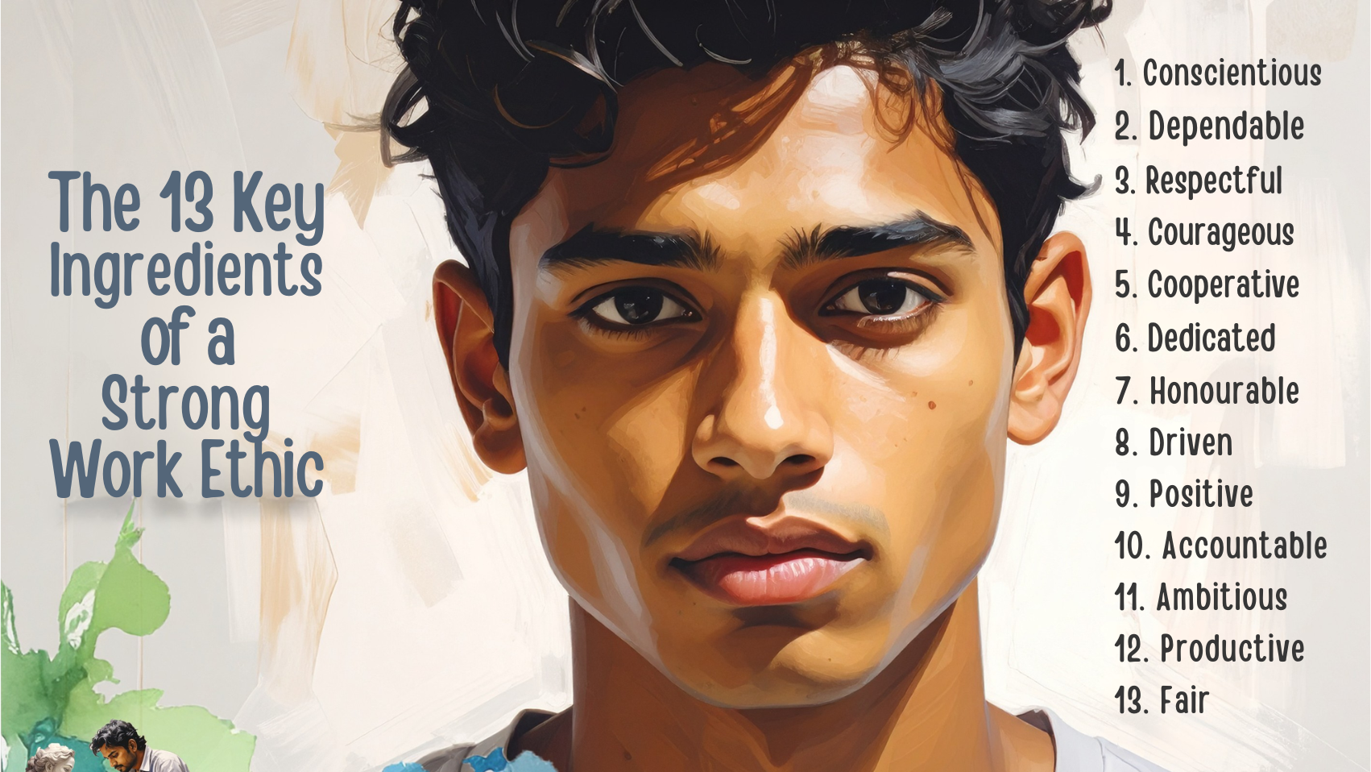
Notes:
Slide 8: Learners to complete Activity 3 (Lesson 3 – Worksheet).
Note to teacher: Question 2 may be used as an informal assessment. Answers are available in the Lesson 3 – Worksheet MEMO.

Slide 9

REFLECTION
Notes:
Slide 9: As we finish off this lesson, reflect on your role play interview by completing the self-assessment in Activity 4 (Lesson 3 – Worksheet).

