Slide 1
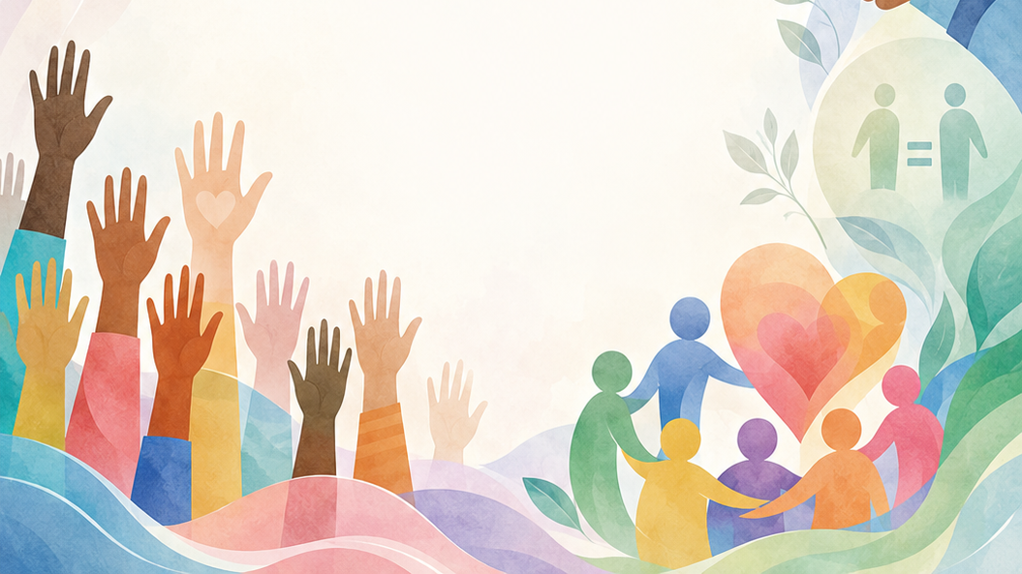

Grade 8
Term 4 Constitutional Rights and Responsibilities
Lesson 3: Gender-Based Violence
Notes:
Slide 1: Good day, Grade 8s. In Lesson 1, we discussed human rights violations and briefly looked at gender-based violence as one example of a human rights violation. In Lesson 2, we focused on gender equity, especially in sport. Today, we are going to build on these ideas as we move into a more serious topic: gender-based violence (GBV).
This is a very sensitive topic, but it is an important issue that affects countries around the world, including South Africa. The purpose of this lesson is not to make anyone feel uncomfortable.
Gender-based violence is not something to joke about or make light of. It is a serious human rights issue, and we need to approach the lesson with maturity, empathy and respect for others.

Slide 2
By the end of this lesson, you should be able to:
Define violence and gender-based violence and identify different forms of violence.
1
Understand who can experience GBV and why it may happen.
2
Identify how GBV and rape can impact a person emotionally, physically and socially.
3
Notes:
Slide 2: By the end of this lesson, you should be able to:
Define violence and gender-based violence and identify different forms of violence.
Understand who can experience GBV, why GBV may happen.
Identify how GBV and rape can impact a person emotionally, physically and socially.

Slide 3
What is violence?
Hurting or threatening to hurt another person physically, emotionally or psychologically.
Violence can affect individuals, groups and communities.
Notes:
Slide 3: Before we define gender-based violence, we first need to understand the word 'violence'. (Ask learners to define the term.)
Violence means hurting or threatening to hurt another person, group or community physically, emotionally or psychologically.

Slide 4
Forms of violence
Physical violence
Hitting, kicking, pushing
Emotional violence
Insults, humiliation, threats
Psychological violence
Intimidation, manipulation, stalking, bullying
Violence can become a cycle if people do not receive help and support.
Notes:
Slide 4: Forms of violence
Physical violence: hurting someone’s body, for example, hitting, kicking or pushing.
Emotional violence: hurting someone’s feelings, confidence or self-worth, for example, insults, humiliation or threats.
Psychological violence: making someone feel scared, controlled or unsafe, for example, intimidation, manipulation, stalking or bullying.
Violence can sometimes become a cycle. This means that people who are hurt may, in some cases, hurt others if they do not receive help and support.

Slide 5

What is GBV?
Gender-based violence (GBV) is violence directed at a person because of their:
  sex (biologically male or female)
  gender identity (how a person identifies)
  sexual orientation (whom a person is attracted to)
Notes:
Slide 5: What is GBV?
Gender-based violence (GBV) is any form of violence directed at any person based on their sex, gender identity or sexual orientation.
Let’s briefly differentiate between these terms. Allow learners to share their understanding.
Sex refers to whether a person is biologically male or female.
Gender identity refers to how a person understands or identifies themselves.
Sexual orientation refers to who a person is emotionally or romantically attracted to.

Slide 6
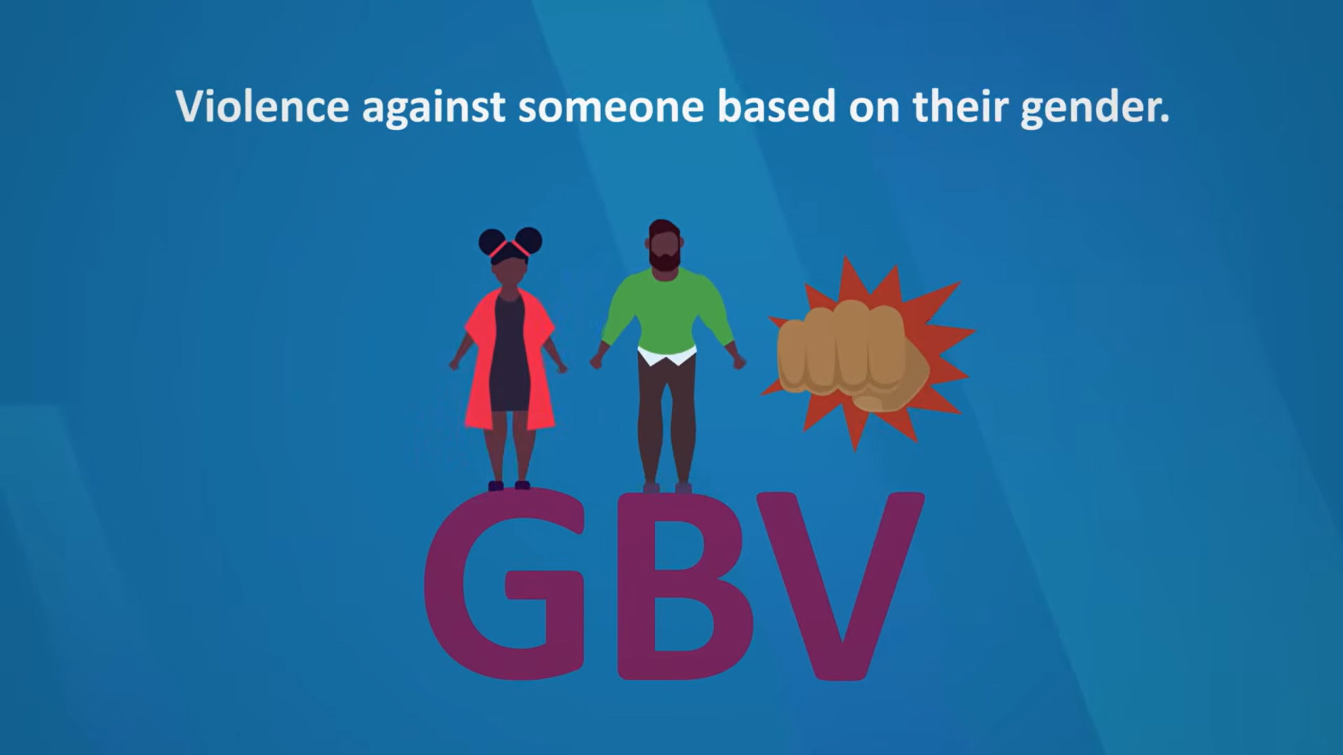
Watch:
What is GBV? bit.ly/4dDpT3m (1 min 34 sec of 1 min 59 sec)
Notes:
Slide 6: GBV can take different forms
Let's watch the following video on the different forms of GBV.
Watch video:
What is GBV?
bit.ly/4dDpT3m (1 min 34 sec of 1 min 59 sec)
Remember, GBV is considered a human rights violation because it harms a person’s safety, dignity and freedom.

Slide 7
Who can experience GBV?
GBV can happen to anyone:
any age
any gender
any race or background
Women and girls are often more affected, but men and boys can also experience GBV.
GBV can happen:
at home
at school
at work
in public spaces
Notes:
Slide 7: Who can experience GBV?
GBV can happen to anyone, regardless of age, gender, race, religion or social background. Although women and girls are often more affected by GBV, men and boys can also experience it.
GBV can happen in different types of relationships, families and places (e.g. at home, at school, in the workplace or in public spaces).

Slide 8
Why does GBV happen?
There is NEVER an excuse for GBV.
Unequal power in relationships or communities
Harmful gender beliefs
Learnt behaviour
Negative media influence
Substance abuse
Notes:
Slide 8: Why does GBV happen?
There is NEVER an excuse or justification for GBV. However, understanding why it happens can help us prevent it.
Unequal power between people: This means that one person may try to control, threaten or harm another person because they believe they have more power in the relationship, family or community.
Harmful gender beliefs: When people believe unfair ideas about how people are "supposed" to behave according to their gender.
Learnt behaviour: In some families or communities, violence may be seen as "normal" if people have grown up witnessing it often. This does not make it right, but it can cause harmful behaviour to be repeated from one generation to the next.
Negative media influence: Movies, music, social media or online content sometimes show harmful ideas about power, relationships or masculinity. If these messages are not questioned, they can make disrespectful or controlling behaviour seem acceptable.
Substance abuse: Substance abuse can make violent behaviour worse because people may act more aggressively or make unsafe choices. However, alcohol or drugs are NEVER an excuse for GBV. Each person is still responsible for their actions.

Slide 9
Impact of GBV and rape
GBV and rape can seriously affect:
emotional well-being
health
social relationships
Victims need:
support
respect
protection
Complete the brainstorming activity in groups.
Notes:
Slide 9: How can GBV and rape affect people?
GBV and rape can have serious effects on a person’s emotional well-being, health and social life. These effects can last for a long time, especially if the person does not receive help and support.
It is important to remember that GBV and rape are NEVER the victim’s fault. People who experience violence need support, respect and help.
Allow learners to complete Activity 1 (Lesson 3 – Worksheet) in groups, where they brainstorm the impact of GBV and rape on an individual.
Note to teacher: Answers are available in the Lesson 3 – Worksheet MEMO, but you may also use Slides 10–12 to cover the answers.

Slide 10
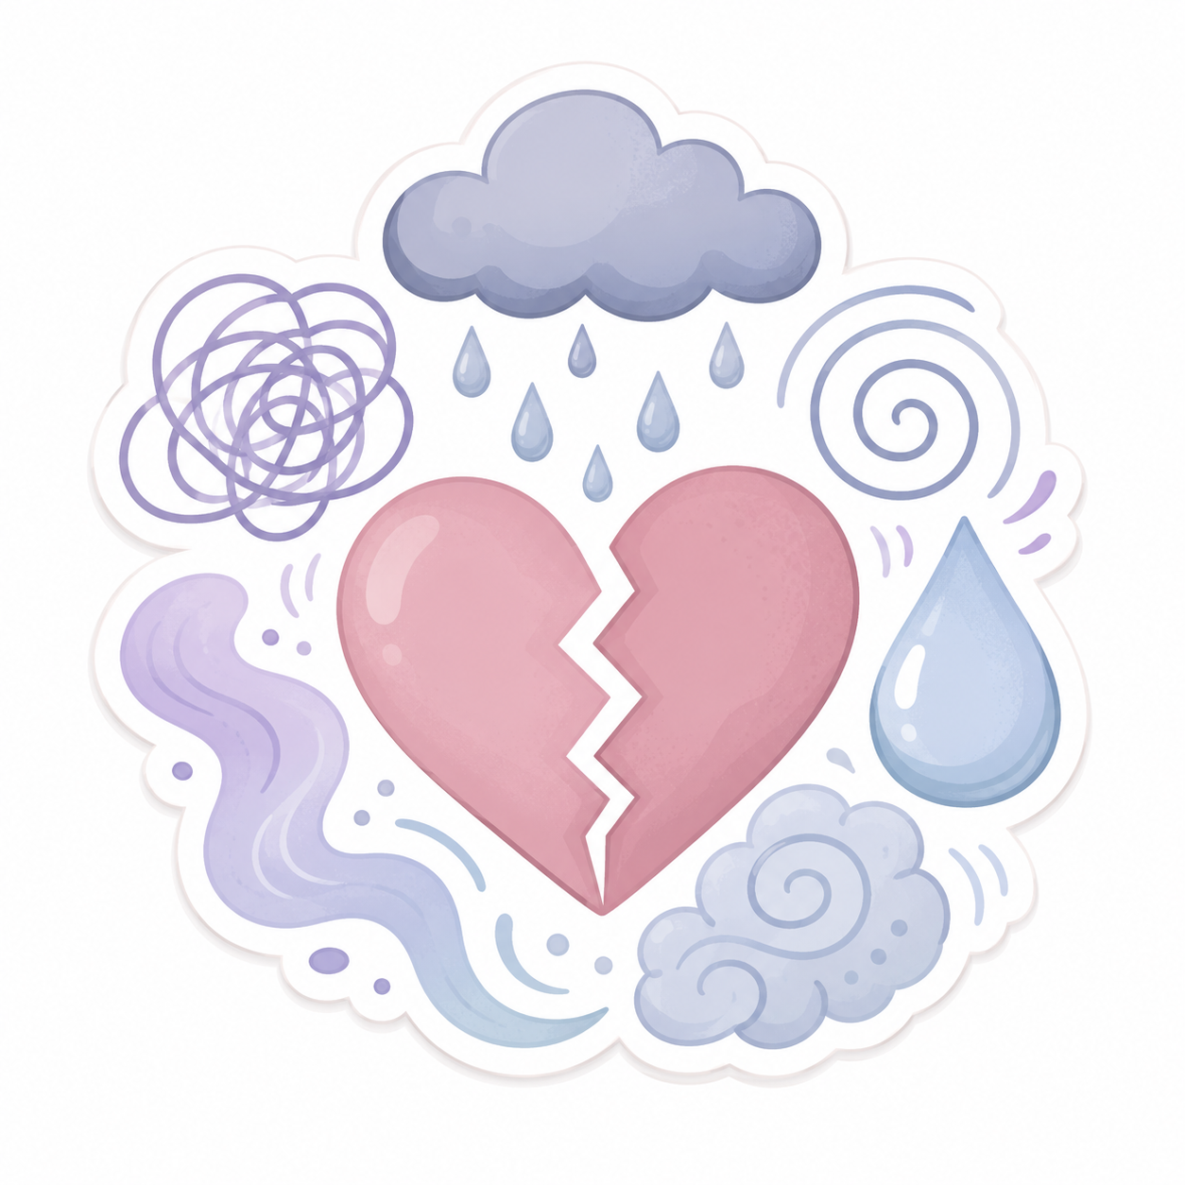
Emotional impact of GBV & rape
fear
shame
anger
anxiety
depression
loss of confidence
difficulty trusting others
Notes:
Slide 10: Emotional impact
A person may feel scared, ashamed, guilty, confused, angry or unsafe. They may lose confidence, struggle to trust others, or feel alone. Some people may experience anxiety, depression, nightmares or flashbacks after violence or rape.

Slide 11
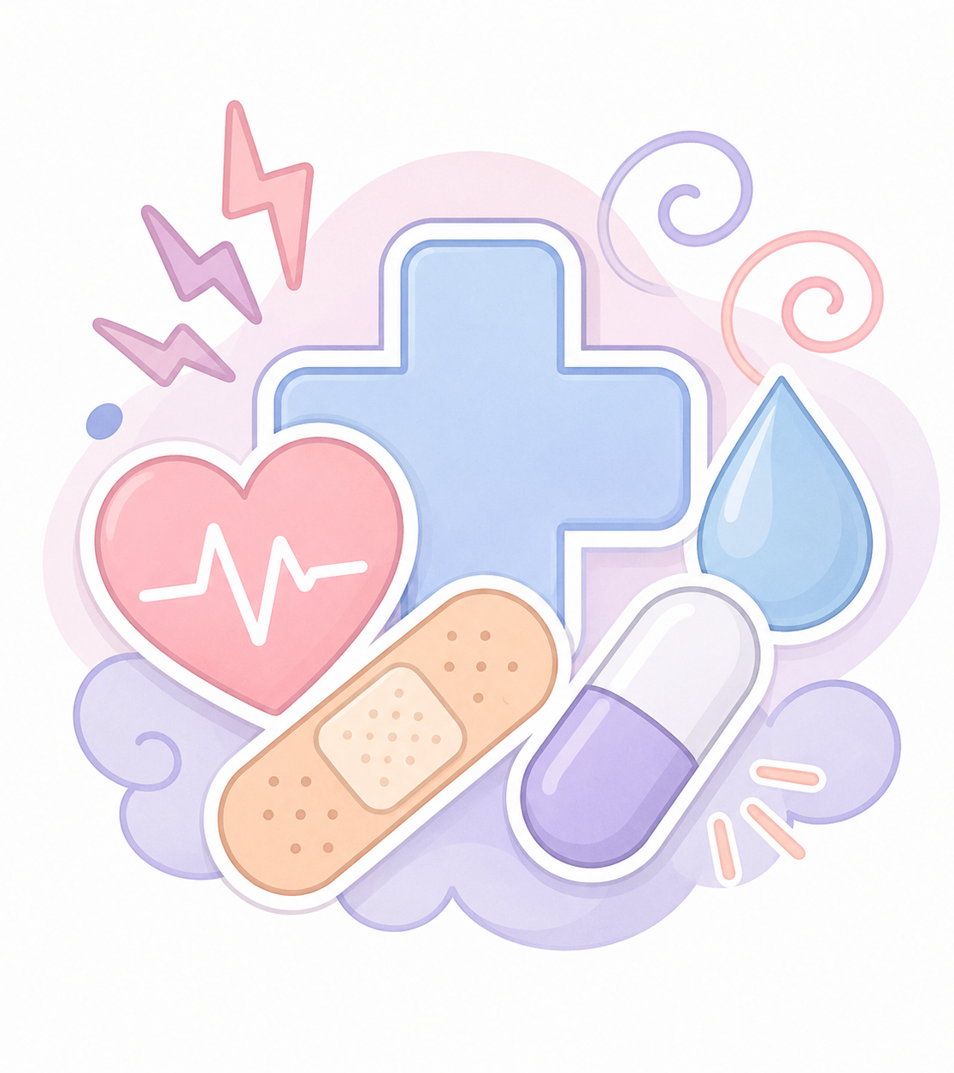
Health impact of GBV & rape
physical injuries
trauma
unwanted pregnancy
STIs, including HIV
Victims may need:
medical care
counselling
emotional support
Notes:
Slide 11: Health impact
GBV and rape can cause physical injuries and serious health risks. Rape can also lead to unwanted pregnancy or sexually transmitted infections (STIs), including HIV. People who experience GBV or rape may need medical care, counselling and emotional support.

Slide 12
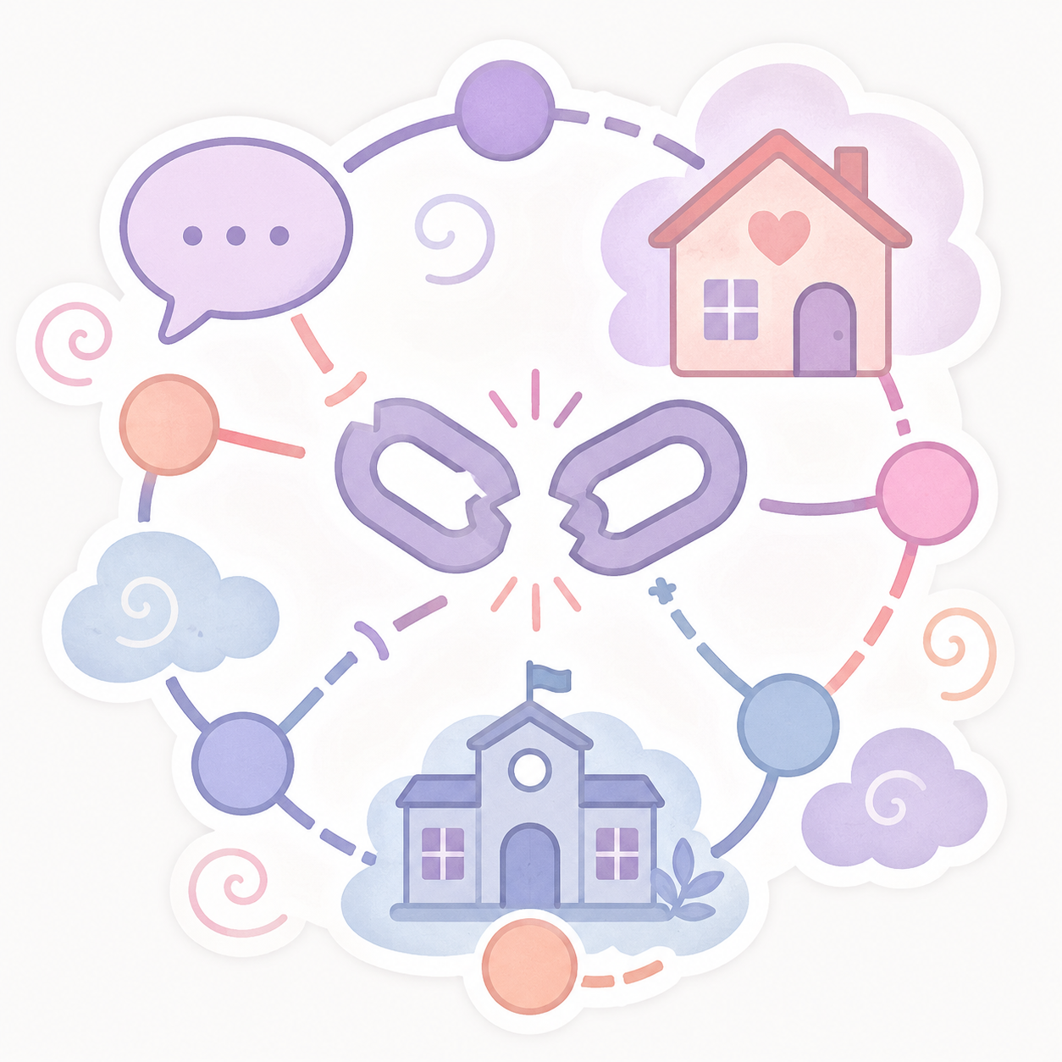
Social impact of GBV & rape
GBV can affect:
relationships
schoolwork
attendance
concentration
participation in activities
Communities affected by GBV may experience:
fear
silence
inequality
Notes:
Slide 12: Social impact
GBV and rape can affect a person’s relationships with family, friends, classmates and colleagues. It may affect their schoolwork, job performance, attendance, concentration or participation in activities. When GBV happens often in communities, it can create fear, silence and inequality.

Slide 13

Conclusion
GBV is a serious human rights issue.
Nobody deserves violence or abuse.
Asking for help is brave and responsible.
Speak to a trusted adult if you feel:
  unsafe
  worried
  upset
Complete Activity 2.
Notes:
Slide 13: As we end today’s lesson, remember that GBV is a serious human rights issue, but people are not powerless. In the next lesson, we will look at how violence against women can be prevented, what the law says about sexual offences, and where girls and women can find help and support.
Today’s lesson may have brought up difficult feelings for some people. If this topic made you feel upset, unsafe or worried about yourself or someone else, please speak to a trusted adult.
No one should have to deal with violence alone. Asking for help is a brave and responsible step.
For the remainder of the lesson, learners complete Activity 2 (Lesson 3 – Worksheet).
Possible answers are available in the Lesson 3 – Worksheet MEMO.

