Slide 1
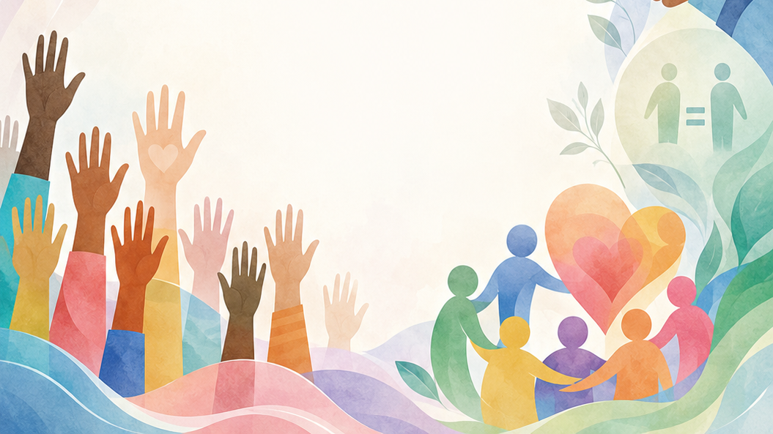

Grade 8
Term 4 Constitutional Rights and Responsibilities
Lesson 2: Gender Equity Issues in Sport
Notes:
Slide 1: Good day, Grade 8s. In the previous lesson, we looked at types of human rights violations and counterstrategies to these violations.
Today, we are bringing that conversation closer to home: the world of sports. If human rights mean everyone should have the same opportunities, why is it that in many sports, men and women are treated differently? Today, we’re exploring gender equity, which isn't just about 'being the same', but about ensuring everyone is treated fairly to succeed in athletic and sport activities.

Slide 2
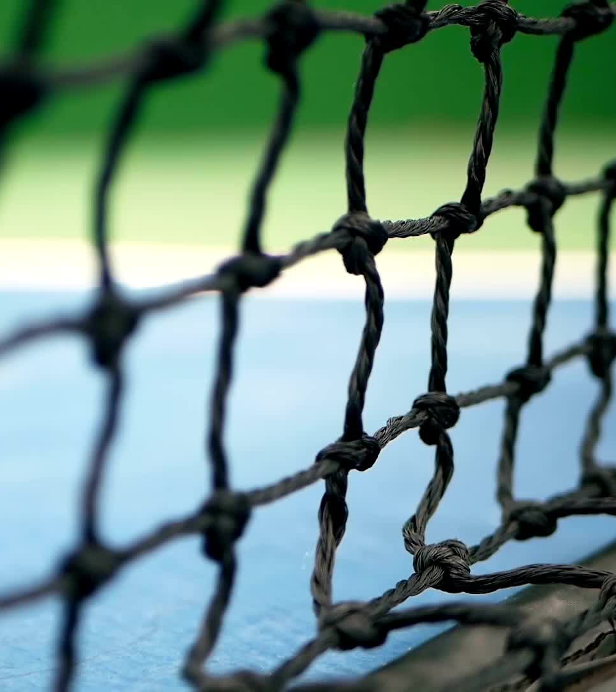
By the end of this lesson, you should be able to:
Explain the difference between equality and equity in sport.
Describe why gender inequity still exists in sport today.
Identify common gender equity issues in sport.
Suggest practical ways to promote gender equity in school and professional sport.
Notes:
Slide 2: By the end of this lesson, you should be able to:
Explain the difference between equality and equity in sport.
Describe why gender inequity still exists in sport today.
Identify common gender equity issues in sport.
Suggest practical ways to promote gender equity in school and professional sport.

Slide 3
Equality vs Equity
Equality: Everyone gets the same support and opportunities.
Equity: People get the support they need to succeed fairly.
Equity recognises past disadvantages and aims to correct them.
Notes:
Slide 3 (Equity vs Equality)
Before we look at gender equity issues, we need to understand the difference between equality and equity.
Ask the learners to differentiate between the concepts before giving the correct definitions.
Equality means treating everyone the same and giving them the same support or opportunities.
Equity means giving people the support they need to have a fair chance by recognising past disadvantages and working to correct them.

Slide 4
Equality in sport
Equality gives all athletes the same rights and opportunities.
However, equal treatment does not always mean fair outcomes.
Example: Both teams may get equal access to a field, but one team may already have better coaching and support.
Notes:
Slide 4: Equality in sport focuses on ensuring that every athlete has the same rights and opportunities, regardless of their gender. If we only focus on equality, we might ignore the fact that different groups start from different positions.
For example: A school announces that the "A-Field" is open to both the boys' rugby team and the girls' soccer team. This is equal access. However, if the boys' team has had a professional coach for 10 years and the girls' team is brand new with no coach, "equal access" to the field doesn't make the competition fair.

Slide 5

Equity in sport
Equity focuses on fairness and support where it is needed most.
Extra support may be needed to help disadvantaged groups catch up.
Example: More funding may be given to women’s sport to help correct past inequalities.
Notes:
Slide 5: Equity in sport is about fairness. It recognises that because of historical "gaps", we may need to provide different resources to different groups to ensure they have an equal outcome.
For example: To achieve equity, a sports club might decide to spend more of its marketing budget on the women’s team this year because they haven't had any advertising for the last decade. Giving them "equal" (the same) advertising money wouldn't help them catch up; giving them "equitable" (fair) money does.

Slide 6
Why does gender inequity exist?
For many years, women were excluded from many sports.
Men’s sport had more time to build:
clubs
facilities
sponsorships
fan support
Notes:
Slide 6 (Why is there gender inequity in sports?)
For a long time, sports were legally and socially reserved for men. In many countries, women were banned from participating in "rough" sports like soccer until as late as the 1970s.
Because men’s sports have had a 100-year head start in building clubs, stadiums and fan bases, they have a massive financial advantage today.

Slide 7
Gender equity issues
Common gaps in sport:
Pay gap: male athletes often earn more
Media coverage: men’s sport gets more attention
Resources: boys’ teams often get better facilities/equipment
Gender stereotype: some sports are seen as “for boys” or “for girls”
Impact:
Discourages participation
Limits opportunities
Prevents talented athletes from succeeding
Notes:
Slide 7 (Gender equity issues: The gaps)
Although there has been a lot of change in recent years, there are still major gender equity issues that require equitable solutions:
The pay gap: Professional male athletes often earn significantly more in salaries and prize money. Often, it is because women's sports haven't been given the same investment to grow
Media coverage: Men’s sports receive about 90% of coverage. While men are highlighted for skill and influence in the media, women are often highlighted for appearance or family life.
Resource allocation: In many schools or clubs, the 'best' fields or the brand-new equipment are often reserved for the boys' teams first, while girls' teams might get the older gear or less convenient practice times.
Gender stereotyping: We still hear people say certain sports are 'too rough' for girls or 'too graceful' for boys. These stereotypes stop talented athletes from even trying a sport they might love.
When we don't use equitable strategies, we lose out on half of the world's talent. It discourages girls from participating in sports or pursuing sports as a career.

Slide 8
Promoting gender equity
Fair pay and support
Equal access to facilities and coaching
Encourage girls’ participation
More women in leadership roles
Better media coverage for women’s sport
Challenge stereotypes
Support women’s teams and events
Notes:
Slide 8: How can we promote gender equity in sport?
Fair pay and support: Men and women should receive fair prize money and support. More money can also be invested in women’s sport to help correct past inequalities.
Equal opportunities at school: Schools should give girls’ and boys’ teams equal access to coaching, equipment, fields, courts and practice time.
Encouraging participation: Girls-only training sessions or clinics in sports such as rugby, cricket or soccer can help girls feel more confident in sports that were often seen as "boys’ sports" in the past.
More women in leadership: More women should be included as coaches, team managers and decision-makers in sport. This helps ensure that the needs and safety of female athletes are considered.
Better media coverage: Women’s sport should be shown more often on television, online platforms and social media. This helps more people see and support female athletes.
Challenging stereotypes: People should avoid phrases such as "you play like a girl" as an insult. Girls and women can be strong, skilled, fast and determined athletes.
Active support: People can support women’s sport by watching matches, attending events, following teams online and encouraging girls to take part in sport.

Slide 9
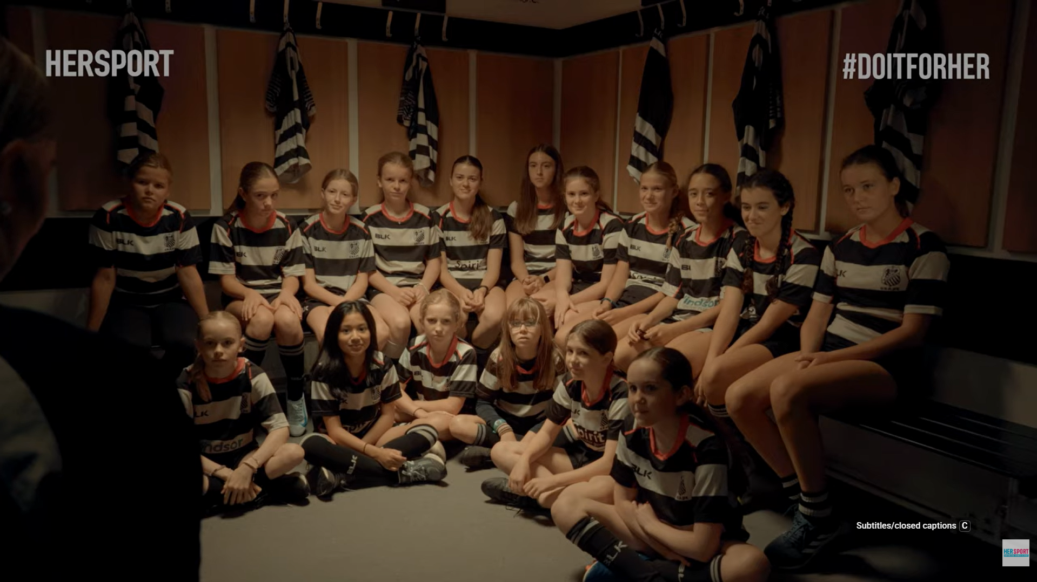
Watch: Keep Her Flame Burning Bright bit.ly/4e5hSWu (3 min 10 sec)
Notes:
Slide 9: Now, let's watch a video that shows why support, visibility and respect matter. While you watch, ask yourself: What barriers do girls and women still face in sport, and what can people do to help change this?
Watch video:
Keep Her Flame Burning Bright
bit.ly/4e5hSWu (3 min 10 sec)

Slide 10

Activity & Homework
Notes:
Slide 10: Allow opportunity for questions from learners before they complete Activity 1 (Lesson 2 – Worksheet).
Answers are available in the Lesson 2 – Worksheet MEMO.
Assign Activity 2 (Lesson 2 – Worksheet) as homework.

