Slide 1
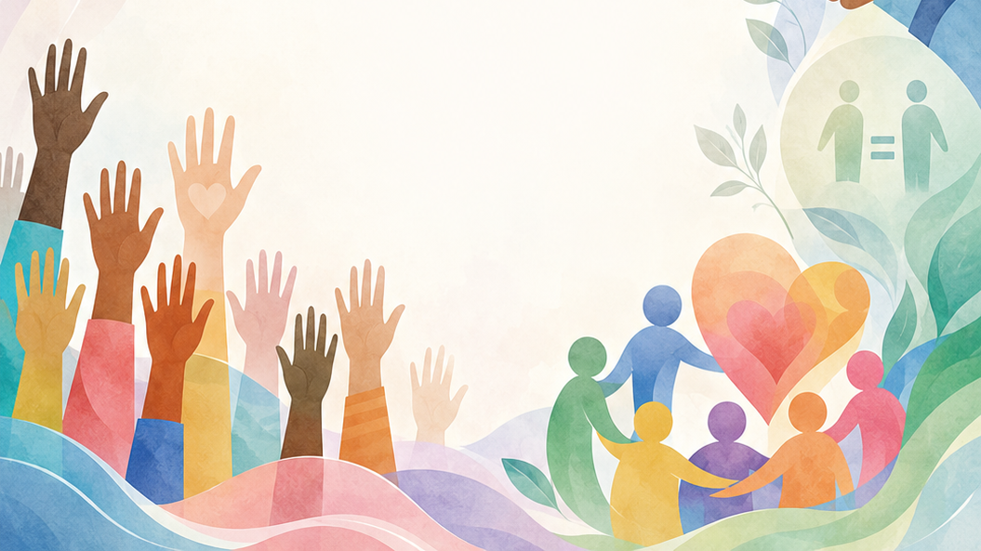

Grade 8
Term 4 Constitutional Rights and Responsibilities
Lesson 1: Types of violations and counterstrategies
Notes:
Slide 1: Good day, Grade 8s. Welcome back as we begin the final term of the year.
Today, we are starting a new topic on Constitutional Rights and Responsibilities. In Grade 7, you learnt about human rights as stipulated in the South African Constitution.
Human rights are the basic freedoms and protections that belong to every person in the world. They apply regardless of where you are from, what you believe or how you choose to live your life.
To refresh your memories, you will work in groups of six to brainstorm as many of the human rights you can remember from the Bill of Rights.
Learners to complete Activity 1 (Lesson 1 – Worksheet). Allow feedback from groups.
Answers are available in the Lesson 1 – Worksheet MEMO.
Another important point to remember from Grade 7 is that, while we all have human rights, we also have a responsibility to respect and protect the rights of others.
When people fail to respect and protect the rights of others, human rights can be violated. This brings us to the focus of today’s lesson: human rights violations.

Slide 2
By the end of this lesson, you should be able to:
Define the term: human rights violation.
1
Identify the types of violations.
2
Discuss counterstrategies to violations of human rights.
3
Notes:
Slide 2: By the end of this lesson, you should be able to:
Define the term: human rights violation.
Identify the types of violations.
Discuss counterstrategies to violations of human rights.

Slide 3
Human rights violations
Discrimination and inequality
Violence and abuse
Violation of privacy
Suppression of free speech
Child labour and abuse
A human rights violation happens when a person, group or government ignores, denies or stops someone from enjoying their rights.
Class discussion:
Can you think of examples from the news, social media or your community?
Notes:
Slide 3: Human rights are not always respected. When a person, group or government ignores, denies or stops someone from enjoying these rights, it is called a human rights violation.
Human rights violations can happen on a small scale (between two people) or a large scale (by a government against its citizens). Here are some of the most common types:
Discrimination and inequality: Treating someone unfairly because of their race, gender, religion, age or disability. This includes denying someone a job or an education based on who they are.
Violence and abuse: This includes physical harm, domestic violence or cruel treatment. In extreme cases, this involves human trafficking, where people are traded or forced into labour against their will.
Violation of privacy: When a person’s personal information or home is invaded without a legal reason.
Suppression of free speech: When people are punished, arrested or silenced for speaking their minds, protesting peacefully or practising their religion.
Child labour and abuse: Forcing children to work in dangerous conditions or denying them the right to go to school and be safe.
Can you think of any examples of human rights violations? Think about stories you may have seen or heard in the news, on the radio, on social media or in your community.
Allow learners to share their ideas. Guide learners where needed.

Slide 4
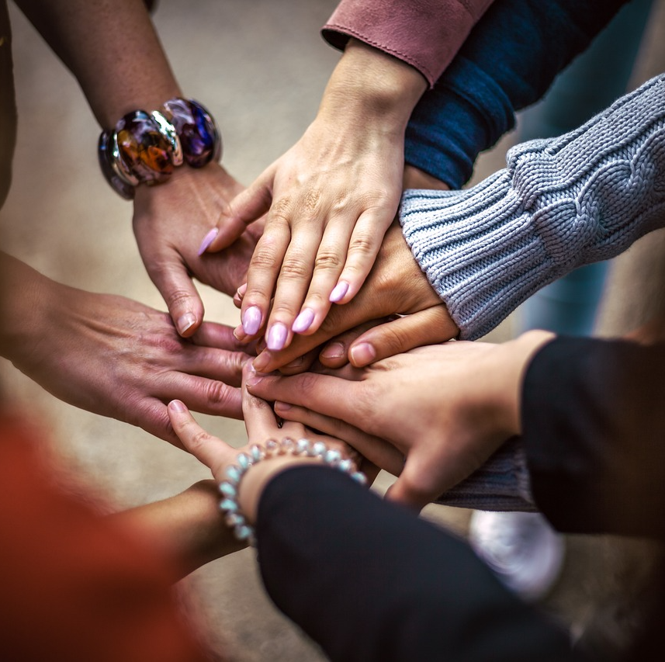
Responding to injustice
Human rights violations should not be ignored.
People can stand up against injustice by speaking out, taking action or helping those affected.
Think about:
What can people do when someone’s rights are violated?
Notes:
Slide 4 (Counterstrategies to violations of human rights)
The next question we need to ask is: What can be done about human rights violations?
Can people stand up against injustice? Can you think of examples where people have spoken out, taken action or helped others whose rights were being violated? Allow learners to share their ideas before moving on.

Slide 5
What is a counterstrategy?
A counterstrategy is a planned action used to oppose, reduce or stop a problem.
Counterstrategies can help:
protect victims
challenge unfair treatment
stop violations from continuing
promote justice and dignity
Notes:
Slide 5: To protect our communities, we must have counterstrategies. A counterstrategy is a planned action or response used to oppose, reduce or stop a problem, such as a human rights violation.
Let's look at some counterstrategies against human rights:

Slide 6
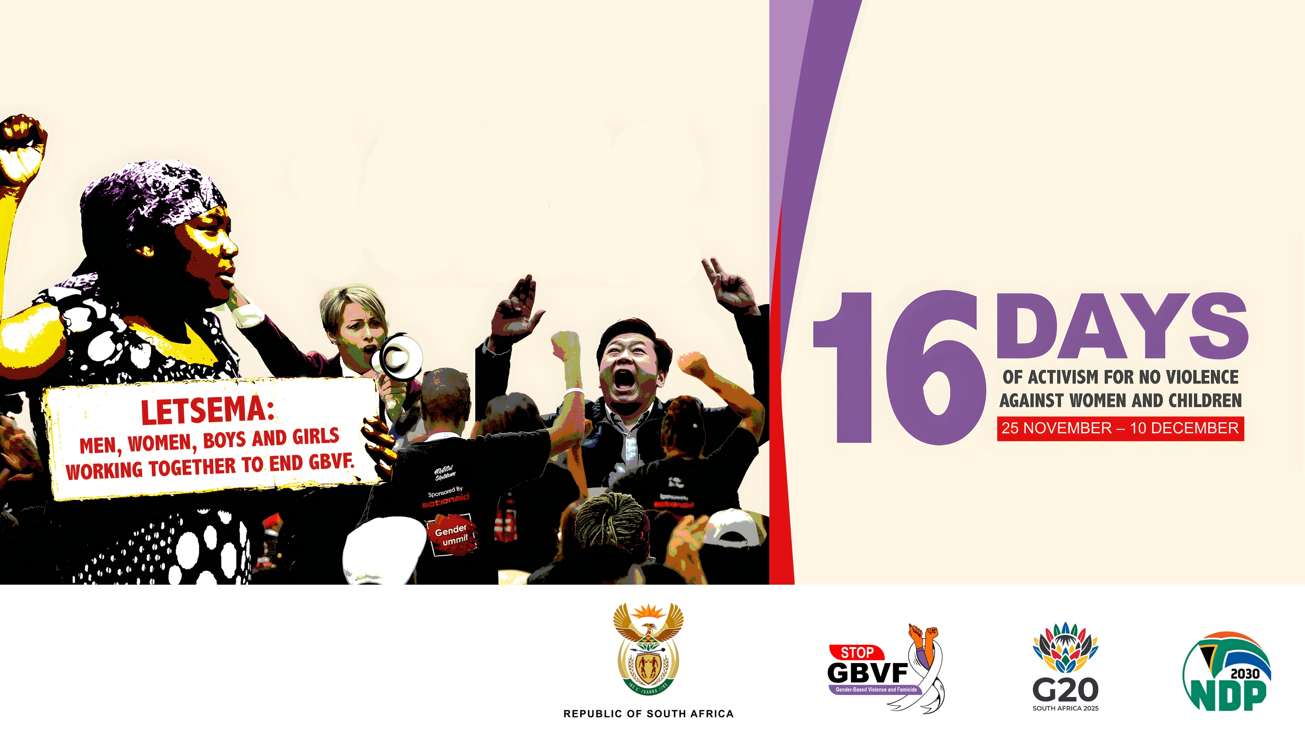
Awareness and education
Education campaigns teach people what they are entitled to under the law.
Notes:
Slide 6: Awareness and education: The first step in stopping a violation is knowing your rights. Governments and schools use education campaigns to teach citizens what they are entitled to under the law. If people don't know their rights, they won't know when those rights are being taken away.
Example: 16 Days of Activism for No Violence Against Women and Children
Every year, from 25 November to 10 December, a worldwide campaign is held to oppose violence against women and children. The goal is to raise awareness about the devastating impact of abuse and to provide people with the information they need to challenge and report it.

Slide 7
Legal action and reporting
Human rights are protected by law.
Victims can report violations to:
police
schools
the Human Rights Commission
other support organisations
Courts can use the Constitution to protect victims and hold offenders accountable.
Notes:
Slide 7: Legal action and reporting: Most countries have laws that protect human rights.
Victims can report abuse to the police or specialised organisations like the Human Rights Commission.
Lawyers and judges can use the Constitution to protect victims and hold those who break the law accountable.

Slide 8
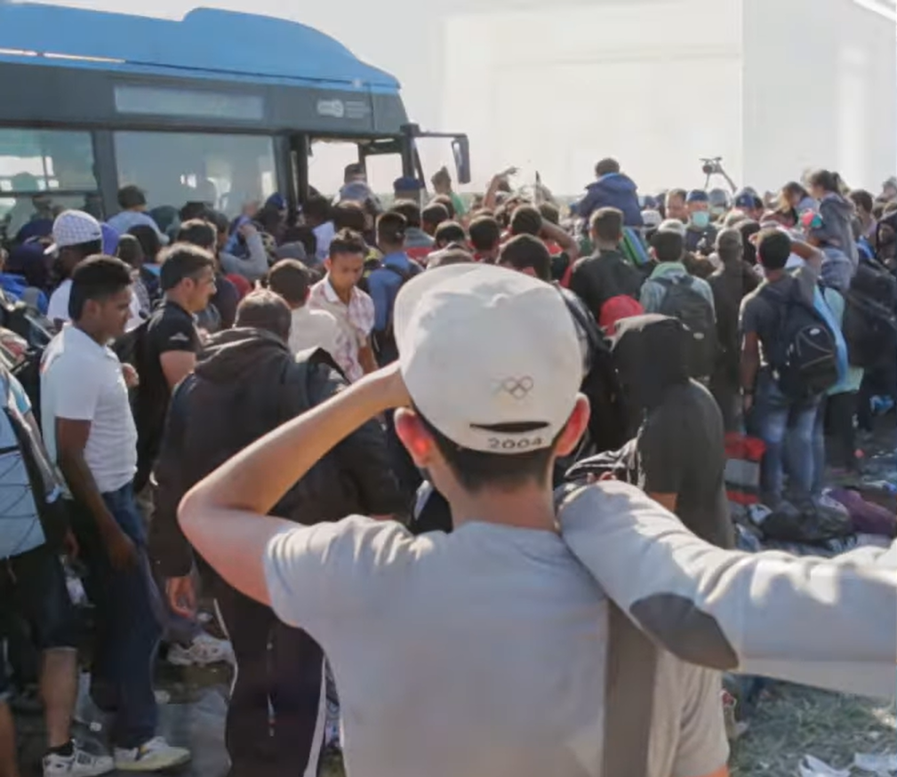
The role of NGOs
Investigate violations
Write reports
Raise awareness
Pressure governments to act
Watch: What is Human Rights Watch?
bit.ly/4uGocJD (2 min 24 sec)
Notes:
Slide 8: The Role of NGOs: Non-Governmental Organisations (NGOs) are groups that operate independently of the government. Organisations like Amnesty International or Human Rights Watch act as "watchdogs". They investigate violations, write reports to let the world know what is happening and pressure governments to change.
Let's watch a video about the work of Human Rights Watch.
Watch video:
What is Human Rights Watch?
bit.ly/4uGocJD (2 min 24 sec)

Slide 9
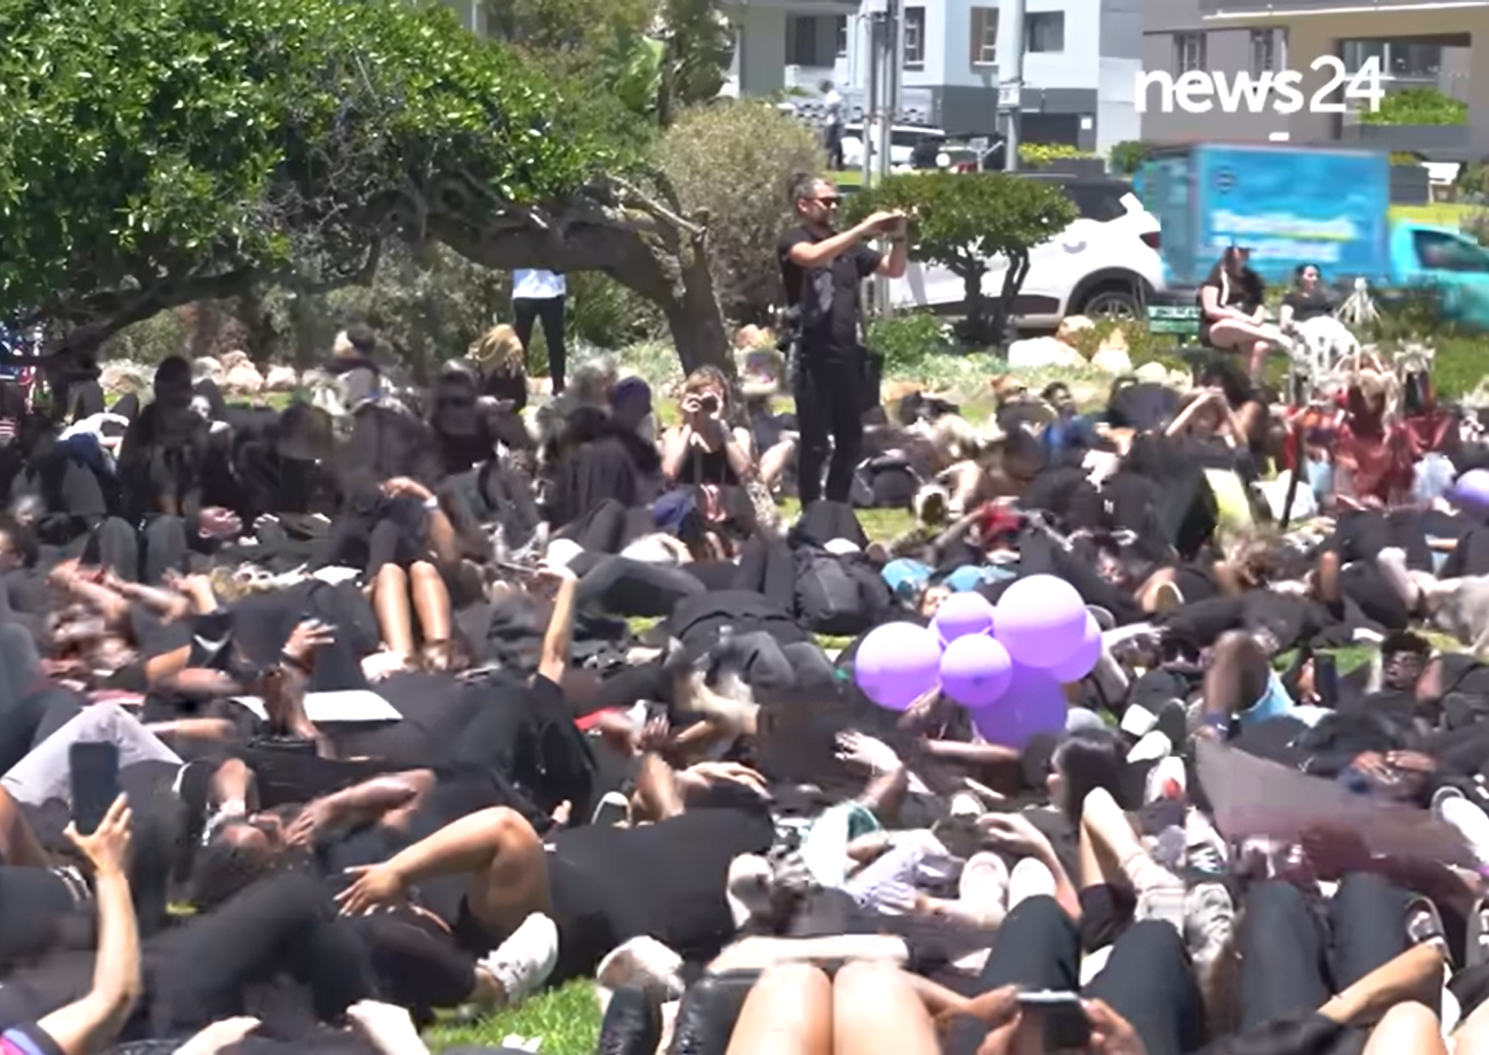
Activism and advocacy
Peaceful protests, petitions and social media campaigns can help people speak up.
Individuals can change history (e.g. Malala Yousafzai, Greta Thunberg)
Watch: Hundreds gather in Cape Town for Women for Change shut down
bit.ly/3Pabe7C (2 min 30 sec)
Notes:
Slide 9: Activism and advocacy: Peaceful protests, petitions and social media campaigns are powerful tools. When many people speak up at once, it becomes very difficult for a violator to continue their behaviour without facing consequences.
As an example, let's watch a video of the #WomenForChange movement in November 2025.
Watch video:
Hundreds gather in Cape Town for Women for Change shut down
bit.ly/3Pabe7C (2 min 30 sec)
While big movements like #WomenForChange involve millions, history is often changed by a single person who refuses to stay silent. These individuals prove that you are never "too young" to challenge a human rights violation.
Example: Greta Thunberg: Greta started a global movement by simply sitting outside the Swedish Parliament with a sign that said "School Strike for Climate." She argued that a damaged planet is a violation of the rights of future generations to a safe and healthy life.
Ask: Greta started her movement as a teenager. What is one issue in your own community that you feel needs a voice?

Slide 10
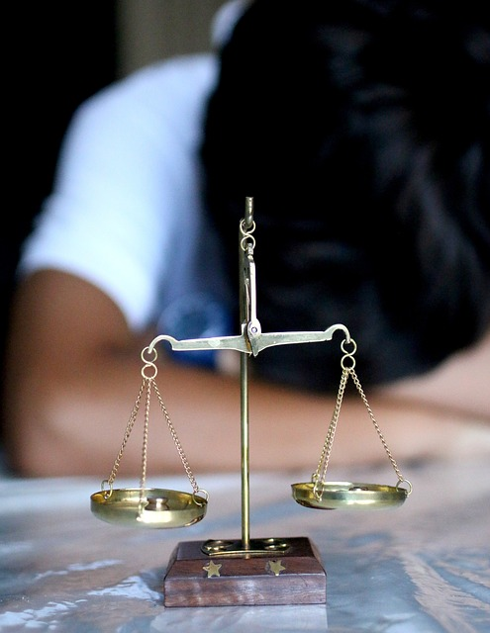
Why should we stand up?
When one person’s rights are violated, the whole community becomes less safe.
Example: Reporting bullying or standing up for a victim is also a counterstrategy.
Notes:
Slide 10: Why should we stand up against human rights violations?
When one person’s rights are violated, it weakens the safety of the entire community. By using counterstrategies, we ensure that the world becomes a place where everyone can live with dignity, freedom and justice.
It’s important to remember that counterstrategies don't always have to be massive protests or international court cases. They start right here. For example, bullying is a direct violation of a learner's right to safety and dignity.
When you see someone being bullied and you choose to tell a teacher (reporting) or stand up for the victim (activism), you are using a real-world counterstrategy.

Slide 11

Activity & Homework
Notes:
Slide 11: Take a moment to think about what you have learnt about human rights violations and how people can respond to injustice. You now have the rest of this lesson to complete Activity 2 (Lesson 1 – Worksheet).
Possible answers are available in the Lesson 1 – Worksheet MEMO.
You also need to complete Activity 3 (Lesson 1 – Worksheet) as homework.

