Slide 1


Grade 11
Careers and Career Choices
Term 3 | Lesson 4: Personal expectations and the labour force
Notes:
Note to teacher: This lesson will often involve discussions with a partner or within groups of six. The first part of this lesson explores the reality of finding work as a young person today. Be sensitive when discussing this topic. The aim is not to discourage learners, but rather to help them understand the realities of the world of work and inspire them to make informed choices while they still have time.
Slide 1: Good day, Grade 11s. Over the last few lessons, we have covered a lot of content on:
writing an application letter,
compiling a CV, and
conducting a successful interview.
We also explored several important concepts related to the world of work.

Slide 2
Terms
Job shadowing
Whistleblower
Accountability
Transparency
Informal job and part-time job
Curriculum vitae (CV)
Testimonial
Work ethic
Notes:
Slide 2: Turn to the members of your group. Each person must choose ONE different term from the list on Slide 2 and provide a definition for it. Work together as a group and see if you can correctly explain all the terms. (Allow 3 minutes for completion.)
Terms:
Job shadowing
Whistleblower
Accountability
Transparency
Informal job and part-time job
Curriculum vitae (CV)
Testimonial
Work ethic
Well done, everyone! Today, we are going to take a closer look at future careers, as well as our expectations and understanding of ourselves in relation to the demands of the world of work and the socio-economic conditions surrounding different careers.

Slide 3
By the end of this lesson, you should be able to:
Evaluate personal expectations and self-knowledge when considering future career choices.
Explain how socio-economic conditions influence career opportunities and employment.
Differentiate between skilled, semi-skilled, unskilled and physical labour careers.
Identify careers and skills that are currently in demand.
Notes:
Slide 3: By the end of this lesson, you should be able to:
Evaluate personal expectations and self-knowledge when considering future career choices.
Explain how socio-economic conditions influence career opportunities and employment.
Differentiate between skilled, semi-skilled, unskilled and physical labour careers.
Identify careers and skills that are currently in demand.

Slide 4
Personal expectations and self-knowledge
Career choices should match:
your interests
strengths
personality
preferred work environment
Good marks and correct subjects are important, but you should also think about:
daily work tasks
working with people
work pressure and environment
Exposure through job shadowing or research can help you decide if a career suits you.
A career may look exciting in theory but feel very different in reality.
Notes:
Slide 4 (Personal expectations and knowledge about self in relation to the demands of the world of work)
With Grade 12 approaching and your future ahead of you, you will soon need to make decisions about studying, employment and possible career paths.
It has been three years since you made your subject choices in Grade 9. Some of you may have selected your subjects with a specific career in mind. Now is a good opportunity to reflect on and evaluate some of your future goals.
However, choosing a career is not only about meeting the subject requirements or achieving good marks. It is also important to understand your personality, interests, strengths and the type of work environment in which you would thrive.
You may, for example, be very interested in studying Sports Science and majoring in Biokinetics because you have developed a passion for sport over the last few years. You take Mathematics and Physical Sciences, and you are achieving averages above 75% in both subjects, so your goals seem realistic and achievable.
However, you may realise that you do not enjoy working closely with people or listening to their injuries and personal challenges. The reality of the day-to-day work involved in that career may therefore not be what you originally expected.
Work with your partner to complete Activity 1 (Lesson 4 – Worksheet).

Slide 5
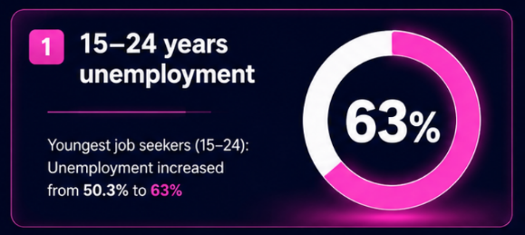
Socio-economic conditions
Notes:
Slide 5 (Socio-economic conditions)
Many young people are concerned about the reality of unemployment in South Africa. This raises important questions: Are there careers that provide more opportunities for future employment? How can you make informed career choices in a challenging economy?
Look at the statistics on Slide 6. They reflect the reality faced by many young people in South Africa today. Approximately 63% of young people between the ages of 15 and 24 who attempted to find work at the beginning of this year were unsuccessful.
Note to teacher: Visit the following website for more information on this topic: https://www.statssa.gov.za/?p=18398

Slide 6
Impact of socio-economic conditions
Socio-economic factors that influence careers:
poverty
limited access to quality education
geographic location
These factors may affect:
further study opportunities
access to jobs
career exposure and experience
Notes:
Slide 6: Socio-economic conditions can have a significant impact on the career opportunities available to young people. Factors such as poverty, limited access to quality education and geographic location may affect a person’s ability to study further, gain work experience or access employment opportunities.
How does this make you feel when thinking about your own future and recognising that this is the current reality in South Africa?
Note to teacher: Allow learners time to express their thoughts and concerns. Be sensitive to learners’ responses and aware of their different backgrounds and personal circumstances, as these may influence how they respond.

Slide 7
Realistic and achievable goals
Research whether careers are:
in demand
linked to employment opportunities
suited to your strengths and interests
Qualifications
Education, skills and qualifications often improve employment opportunities.
A matric certificate alone is often not enough in today’s job market.
Notes:
Slide 7: So, how can you ensure that your expectations, goals and dreams remain realistic and achievable?
It is important to understand the current employment climate for young people in South Africa. Before planning your future, you should consider how your dream career aligns with the needs of the South African economy. For example, if you are interested in a career where there are very limited job opportunities, would you still choose that career, or would you explore related careers with greater employment opportunities?
Learners to complete Activity 2 (Lesson 2 – Worksheet) in groups.
(Allow 6 minutes and then ask groups to provide feedback from their discussions.)
Answers are available in the Lesson 2 – Worksheet MEMO.
One important truth that emerges from this activity is that a person’s level of education often influences their chances of finding employment in South Africa. Generally, individuals with higher levels of education, specialised training or trade qualifications have access to a wider range of career opportunities. A matric certificate alone is often not enough to secure employment in today’s economy.

Slide 8
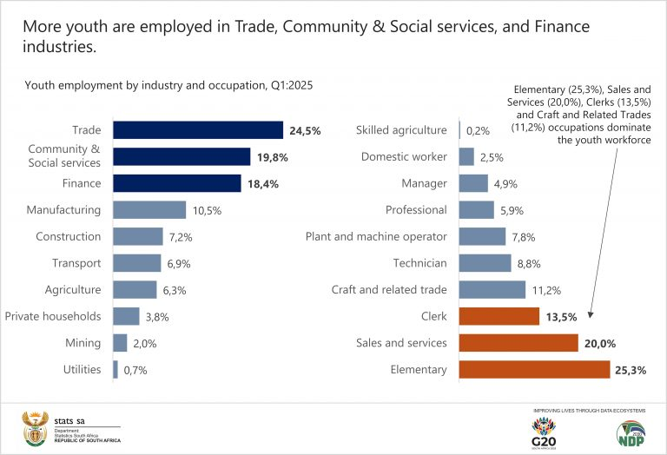
Notes:
Slide 8: In the previous group activity, you may have noticed that the industry with the greatest employment opportunities for young people is the trade and retail sector.
Now look at the summary on Slide 8 showing where young people in South Africa are currently employed. Which industry does your chosen career fall into?
If you study further at a university or college and obtain a professional qualification, you would fall into the category of a professional worker. Take note of the relatively low percentage of young people who are employed as qualified professionals compared to other industries, such as construction and trade.
What kinds of careers would you find in the construction and trade industry? (Allow learners time to respond.) Examples include plumbers, electricians and welders.
These careers require specialised practical skills that are often obtained through certificates or training programmes at a technical university or TVET college.

Slide 9
Labour force categories
Skilled workers:
specialised qualifications or degrees
doctors, teachers, engineers
Semi-skilled workers:
shorter training or courses
teacher assistants, hairdressers
Unskilled workers:
little formal training
cleaners, waiters
Physical labour workers:
mainly practical physical work
gardeners, loaders, builders
Notes:
Slide 9 (Jobs that require skilled, semi-skilled, unskilled and physical labour)
There are employment opportunities in South Africa for both qualified and non-qualified workers. The labour force is divided into different categories. Each category will require different levels of study after school.
Skilled workers: People with specialised training, qualifications, certificates or degrees. Examples include doctors, teachers, engineers, accountants, lawyers and biokineticists.
Semi-skilled workers: People who have completed shorter courses or specific training modules and can assist in certain careers. Examples include teacher assistants, carpentry assistants, hairdressers and machine operators.
Unskilled workers: People with little or no formal training, but who may have gained practical work experience. Examples include waiters, domestic workers and cleaners.
Physical labour workers: Jobs that rely mainly on physical work and may not require formal qualifications, but often require practical experience. Examples include gardening, packing shelves, general building work and loading goods.
So, knowing all of this, what career options are available to you? Let’s take a look at some of the careers that are currently most in demand in South Africa.

Slide 10

Individual Activity
&
Reflection
Notes:
Slide 10: Read the article in Activity 3 (Lesson 4 – Worksheet) and answer the questions that follow.
Answers are available in the Lesson 4 – Worksheet MEMO.
The article mainly focuses on skilled careers. However, these are not the only important career paths in South Africa. While these qualifications may often lead to higher salaries, every career plays an important role in society.
All workers deserve respect, regardless of their career or level of qualification.
As we come to the end of this lesson, take a moment to reflect on what you have learnt.
Learners to complete Activity 4 (Lesson 4 – Worksheet).

