Slide 1
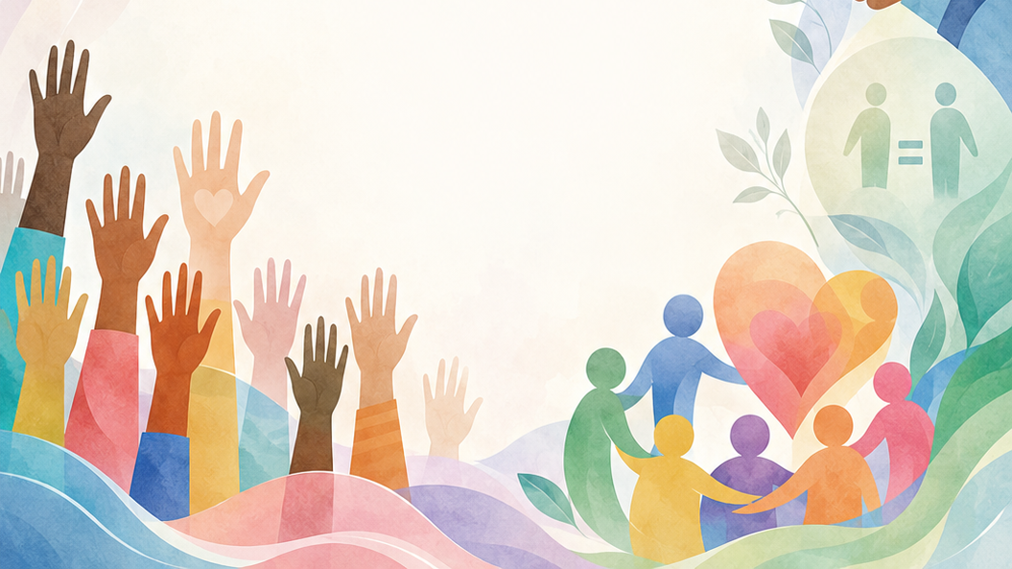

Grade 8
Term 4 Constitutional Rights and Responsibilities
Lesson 4: GBV – Prevention and Support
Notes:
Slide 1: Welcome back, Grade 8. In the previous lesson, we introduced gender-based violence as a serious human rights issue. We looked at what GBV means, why it can happen, and how it can affect people emotionally, physically and socially.
Today, we are going to continue this discussion by focusing on prevention and support. We will look at ways violence against women can be prevented, what the law says about sexual offences, and where people can go for help if they or someone they know feels unsafe.

Slide 2
By the end of this lesson, you should be able to:
Explain
Explain basic rights and protections offered by the law.
Describe
Describe practical ways to help prevent GBV.
Identify
Identify sources of help and support for people affected by GBV.
Notes:
Slide 2: By the end of this lesson, you should be able to:
Explain basic rights and protections offered by the law on sexual offences.
Describe practical ways to help prevent GBV.
Identify sources of help and support for people affected by GBV.

Slide 3

Why victims may not ask for help
Some people may:
fear the abuser
feel ashamed or isolated
worry nobody will believe them
think abuse is “normal”
Reporting violence can also be emotionally difficult.
Survivors should be treated with care, privacy and respect.
Notes:
Slide 3: Ask the learners: Why do victims of GBV not always ask for help? (Allow responses.)
Some people may be afraid to ask for help because they fear the person who is hurting them.
Others may feel ashamed, isolated, or worried that no one will believe them.
Some people may also think abuse is "normal" if they have seen or experienced violence often.
Sometimes reporting violence can be difficult because the person may have to explain what happened again. This can bring back painful feelings. That is why survivors should be treated with care, privacy and respect.

Slide 4

Breaking the silence
GBV should never be ignored or joked about.
Speak to a trusted adult:
parent
teacher
counsellor
nurse
police officer
Do not handle dangerous situations alone.
Notes:
Slide 4: Breaking the silence
GBV should never be ignored or treated as a joke. People who experience GBV need support, respect and help from trusted adults or support organisations.
If you or someone you know feels unsafe, speak to a trusted adult, such as a parent, teacher, counsellor, social worker, nurse or police officer. Do not try to handle a dangerous situation alone.

Slide 5

What does the law say?
Domestic Violence Act
Protects people from domestic abuse
Victims can apply for a protection order
Sexual Offences Act
Protects people from rape and sexual abuse
Ensures survivors receive:
medical support
legal support
emotional support
Notes:
Slide 5: What does the law say?
South Africa has laws that protect people from different forms of GBV.
The Domestic Violence Act 116 of 1998 protects people from domestic abuse and allows victims to apply for a protection order. A protection order is a court order that can tell the abuser to stop harmful behaviour, stay away from the victim, or stop contacting them. The Act is meant to give victims of domestic violence the strongest protection the law can provide.
The Criminal Law (Sexual Offences and Related Matters) Amendment Act 32 of 2007, also known as the Sexual Offences Act, protects people from sexual crimes, including rape and sexual abuse. This law helps make sure that sexual offences are treated seriously and that survivors can receive medical, legal and emotional support.

Slide 6
Rights of survivors
Survivors have the right to:
dignity and privacy
information and medical care
HIV support and PEP treatment
support in court
Young witnesses may receive help from an intermediary during court cases.
Notes:
Slide 6: Rights of survivors
A person who has experienced rape or a sexual offence has the right to:
Dignity and privacy: If someone reports a sexual offence to the police, they should be treated with respect. They should be allowed to speak in a private space where they feel safe and comfortable.
Information and medical help: If someone goes to a public hospital after a sexual offence, they should receive clear information about medical help. This may include information about HIV testing and Post-Exposure Prophylaxis (PEP), which is medicine that can reduce the risk of HIV after possible exposure.
Support in court: If a witness is under 18 and would find it very stressful to speak in court, the court may appoint a trained person, called an intermediary, to help them give their evidence in a less stressful way.

Slide 7
Preventing GBV
Challenge
Challenge harmful jokes and beliefs
Treat
Treat people with respect and equality
Support
Support survivors without blaming them
Promote
Promote healthy relationships
Speak
Speak to a trusted adult if someone is unsafe
Support
Support anti-GBV campaigns
Notes:
Slide 7: How can we help prevent GBV?
The high number of GBV cases in South Africa reminds us that preventing violence is everyone’s responsibility.
This means we should learn to recognise warning signs of abuse, support people who may be experiencing violence, and speak up against harmful attitudes or behaviour.
Ask learners: What actions can young people, schools, families or communities take to help prevent GBV?
Possible responses:
Challenge harmful jokes, comments and beliefs that make violence seem acceptable.
Treat all people with respect, dignity and equality.
Support survivors by listening, believing them and not blaming them.
Encourage healthy relationships based on respect, communication and shared responsibility.
Speak to a trusted adult if someone is unsafe or if you are worried about someone.
Support school or community campaigns that stand against GBV.

Slide 8
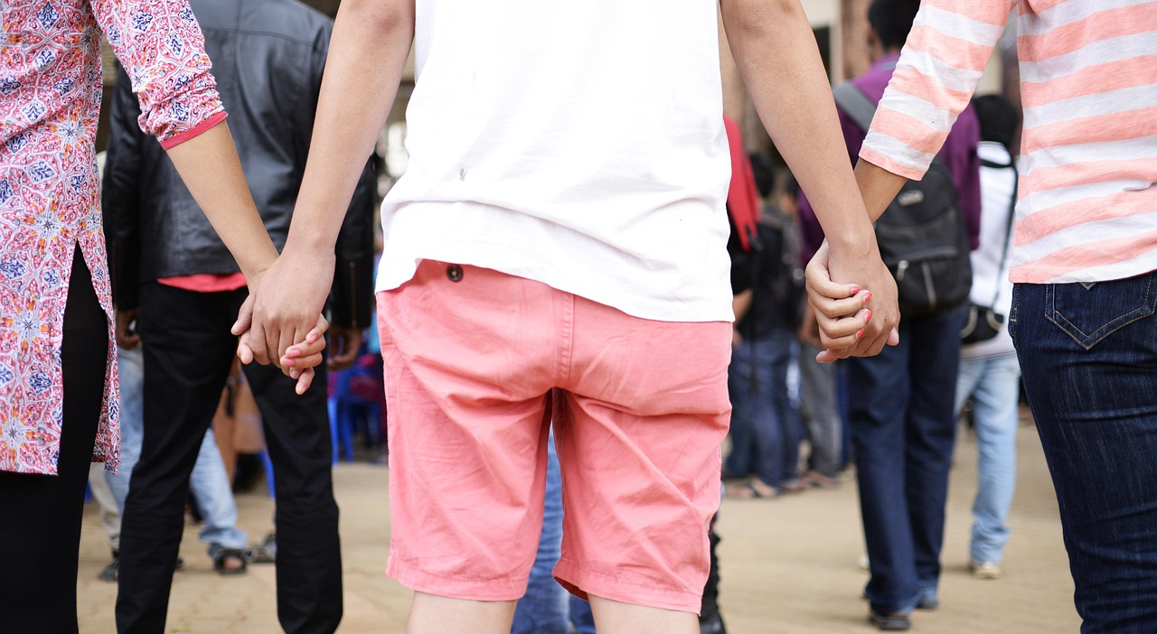
Where can people get help?
trusted adults
teachers or counsellors
clinics and hospitals
police
shelters and safe spaces
helplines and support organisations
legal aid services
Notes:
Slide 8: Where can people get help?
A person who feels unsafe or has experienced GBV can ask for help from:
A trusted adult, teacher, counsellor or social worker
A clinic, hospital or doctor
The police, especially if someone is in immediate danger
A shelter or safe space
A helpline or support organisation
Legal aid or a legal support service
Note to teacher: Learners will find contact details for some of the above organisations in the Content Summary.

Slide 9

Support organisations
POWA
TEARS Foundation
Thuthuzela Care Centres
Rape Crisis Centres
SaferSpaces
Lawyers Against Abuse
Watch: How can I help a survivor of gender-based violence?
bit.ly/4u43suG (2 min 35 sec)
Notes:
Slide 9: Examples of support organisations
Some organisations in South Africa offer support to people affected by GBV. These include organisations such as POWA, TEARS Foundation, Thuthuzela Care Centres, Rape Crisis Centres, SaferSpaces and Lawyers Against Abuse.
Note to teacher: More information on these organisations can be found in the Content Summary.
Let’s watch a short video that explains the services offered by the TEARS Foundation.
This video shows that support is available for people affected by GBV, even when they face barriers.
Watch video:
TEARS Foundation Provides Free Help & Support for GBV Victim
bit.ly/4dNE8CN (1 min 39 sec)

Slide 10
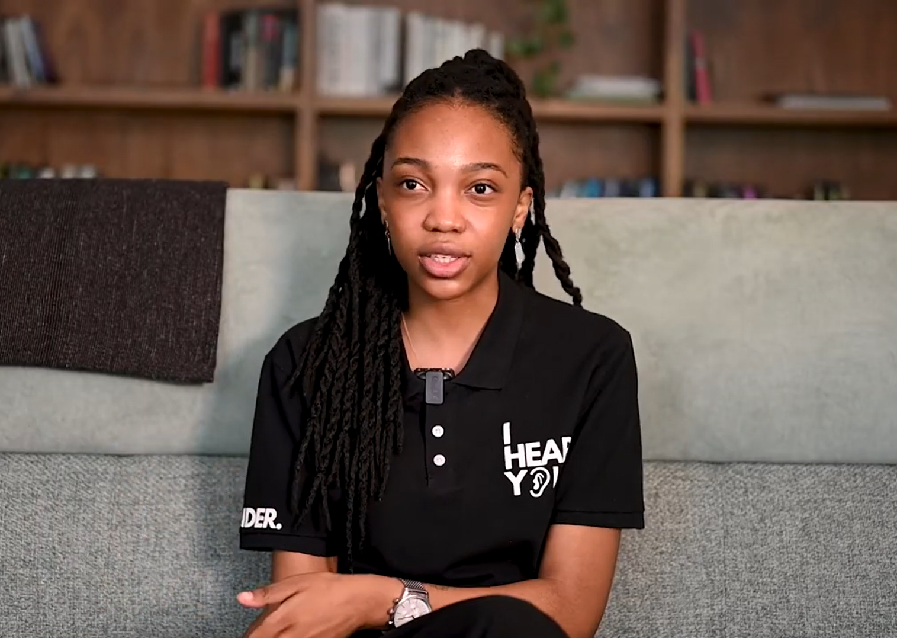
Watch:
How can I help a survivor of gender-based violence? bit.ly/4u43suG (2 min 35 sec)
Notes:
Slide 10: How can you support someone?
If someone tells you about something that has happened to them, how do you think you should react? What could you do or say?
(Let the class brainstorm some ideas before watching the next video clip.)
Watch video:
How can I help a survivor of gender-based violence?
bit.ly/4u43suG (2 min 35 sec)

Slide 11

Conclusion
Violence can be prevented.
The law protects people from GBV and sexual offences.
Help and support are available.
Asking for help is brave and responsible.
Notes:
Slide 11: Today, we learned that violence can be prevented, that the law protects people from sexual offences, and that help is available.
No one should have to deal with violence alone. Asking for help is a brave and responsible step.
If this topic made you feel upset, unsafe or worried about yourself or someone else, you may speak to the teacher privately or write a note after the lesson.
Learners to complete Activity 1 & 2 (Lesson 4 – Worksheet).
Answers to Activity 1 are available in the Lesson 4 – Worksheet MEMO.
Hand out the Content Summary before learners leave the classroom.

