Slide 1
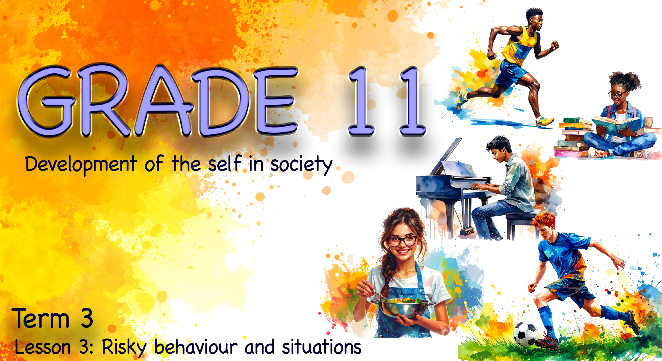

Notes:
Note to teacher: This lesson will operate mainly as a group-based, learner-led activity where learners will generate most of the content themselves (similar to a flipped classroom approach). Your role is to facilitate and fill in any gaps verbally where needed.
Learners will work in five groups and present their findings at the end of the lesson. Divide the class into 5 groups so that approximately 10 minutes can be allocated for presentations.
Please refer to the memo documents for guidelines, expected answers/responses and key teaching points while learners work, so you can steer groups in the right direction and ensure accurate information is shared.
Tip: You can make it more fun by bringing a few simple props to help learners get into character during their presentations.
Slide 1: Welcome back to class. This is our third lesson in this series on developing a healthy and balanced lifestyle. Before we get started, let’s see how well you remember.
Turn to a friend and share:
ONE tip on how to balance your physical health from Lesson 1.
ONE example of how peer pressure can negatively impact your lifestyle choices from
Lesson 2.
Well done! Now that we have our minds back in focus, let’s get started.

Slide 2
By the end of this lesson, you should be able to:
Define risky behaviour and differentiate it from an accident, explaining how risky choices can affect personal safety and the safety of others.
Analyse a risky behaviour scenario, explaining its impact on the individual and community, the role of poor decision-making and socio-environmental factors, and suggesting positive changes.
Reflect on your own lifestyle choices and identify personal changes needed to reduce risk and support your future goals.
Notes:
Slide 2: By the end of this lesson, you should be able to:
define risky behaviour and differentiate it from an accident, explaining how risky choices can affect personal safety and the safety of others.
analyse a risky behaviour scenario, explaining its impact on the individual and community, the role of poor decision-making and socio-environmental factors, and suggesting positive changes.
reflect on your own lifestyle choices and identify personal changes needed to reduce risk and support your future goals.

Slide 3
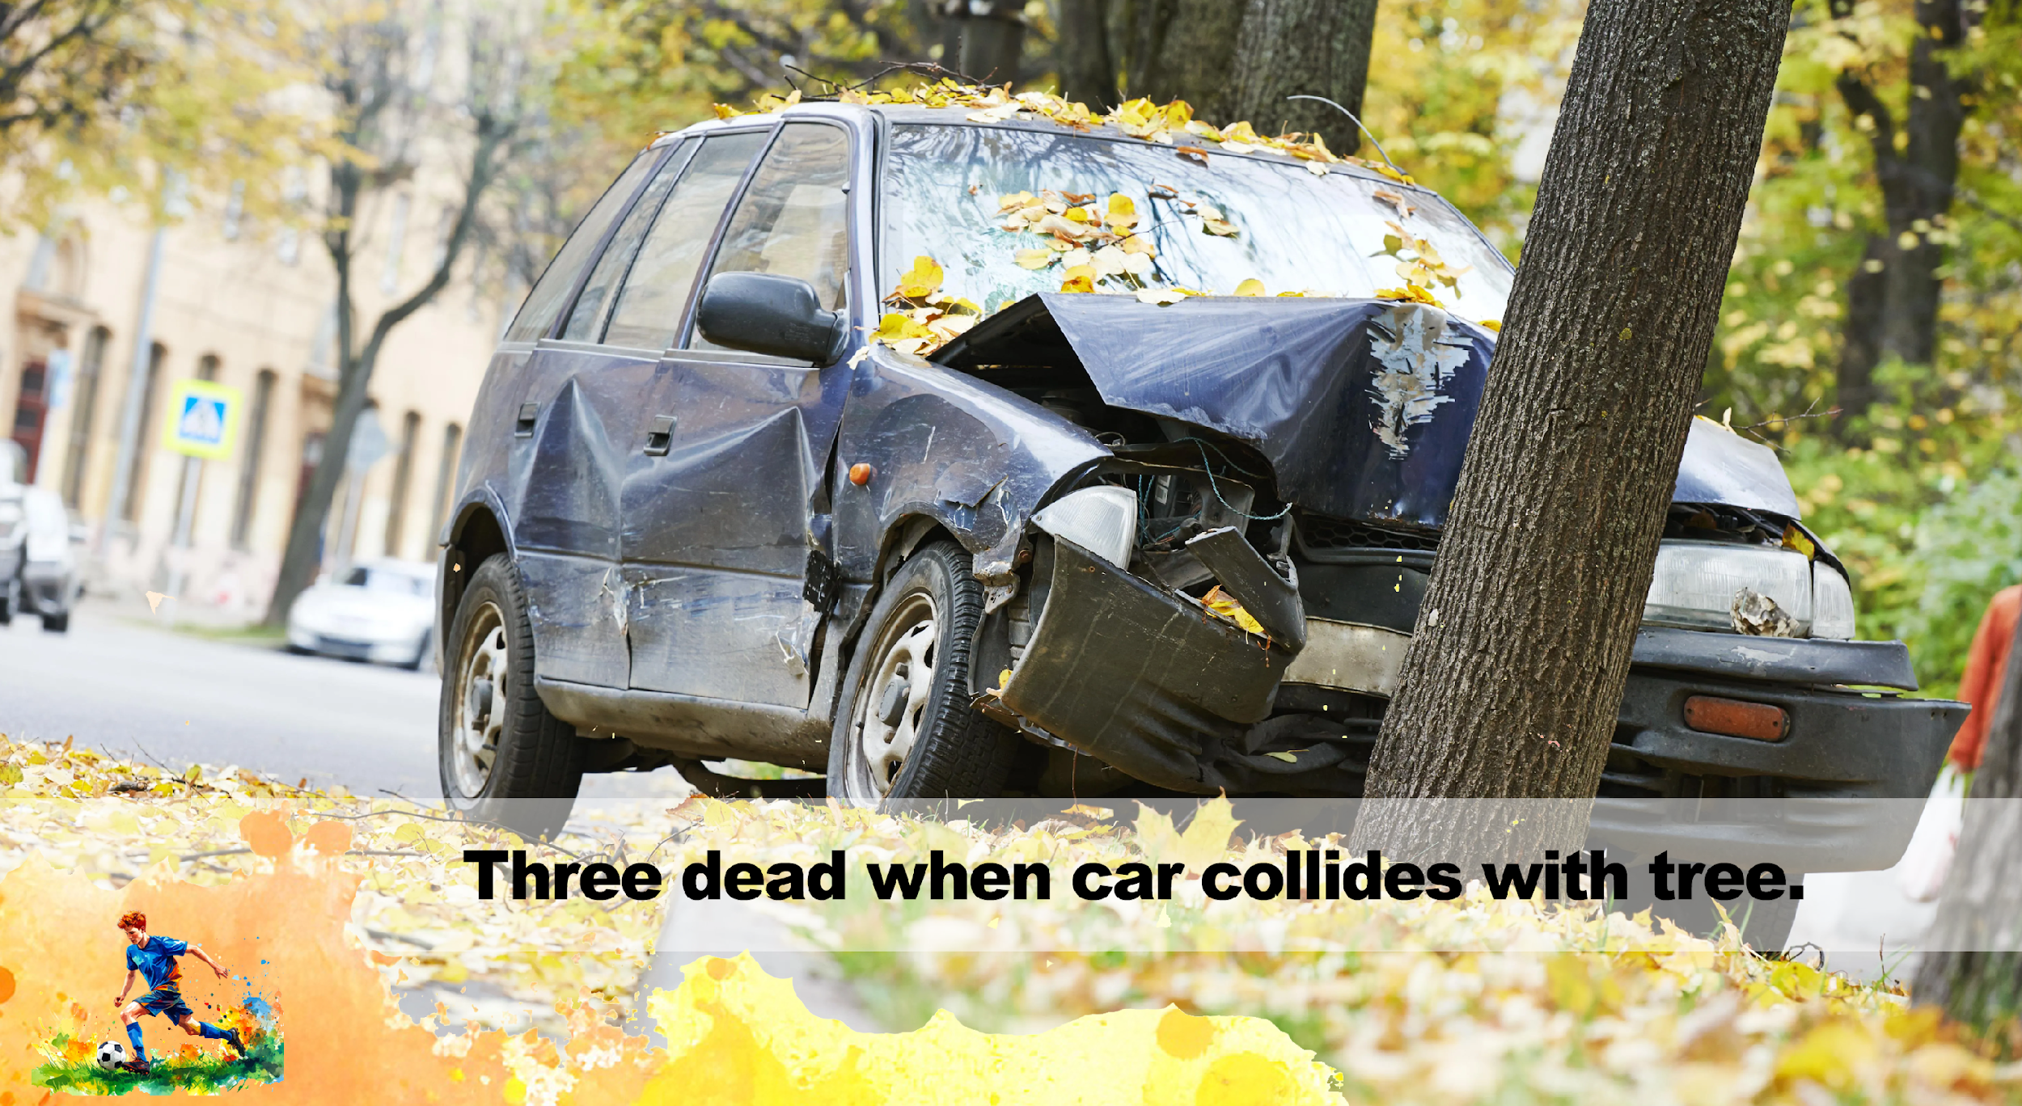
Risky behaviour is a choice or behaviour that increases the chance of harm.
An accident is an event that is out of your control, not planned, and/or causes injury or damage.
Notes:
Slide 3: In the last lesson, we looked at different factors that influence lifestyle choices. We focused on examples of socio-economic influences that you often have little control over.
Today, you will learn about risky behaviour and risky situations, and how these choices can affect your personal safety and the safety of the people around you.
Let’s say you were driving a car with two of your friends after coming back from a party where you had all been drinking. You lost control and the car hit a tree.
What was the impact of your choice to drink alcohol that evening on you and your friends? (Allow 2–3 learners to respond.)
Can you see how this is an example of risky behaviour?
Now, imagine you were a passenger in a car, and a drunk driver drove into your car. In this case, you could not control the accident.
This is an important differentiation: Risky behaviour is choices or behaviour that increases the chance of harm. Risky behaviour affects your personal safety and that of the people around you. An accident is an event that is out of your control, not planned and/or causes injury or damage.

Slide 4
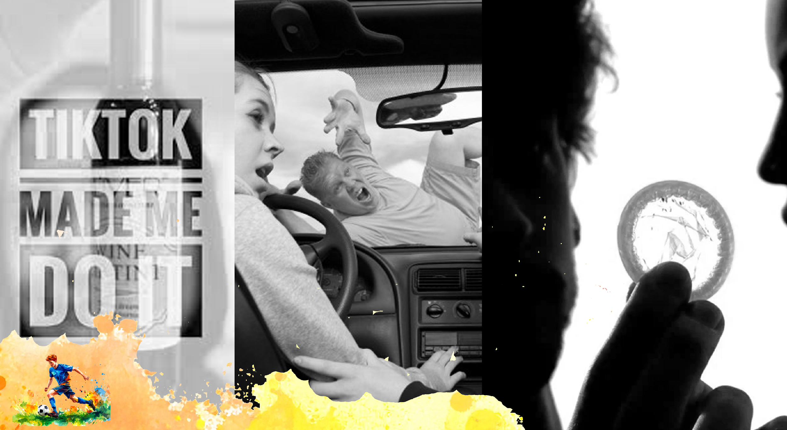
1.
2.
3.
Notes:
Slide 4: Let’s take a look at a few examples of risky behaviour and the negative impact they can have on your lifestyle choices.
Read the three scenarios in Activity 1 (Lesson 3 – Worksheet) with a peer. Complete the questions together.
Refer to the Lesson 3 – Worksheet MEMO for possible answers.

Slide 5

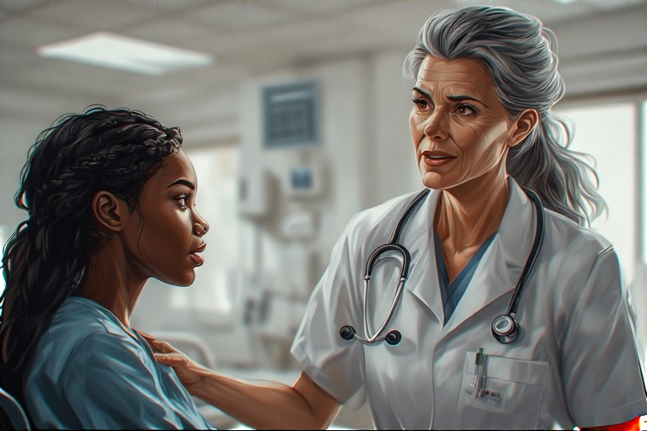
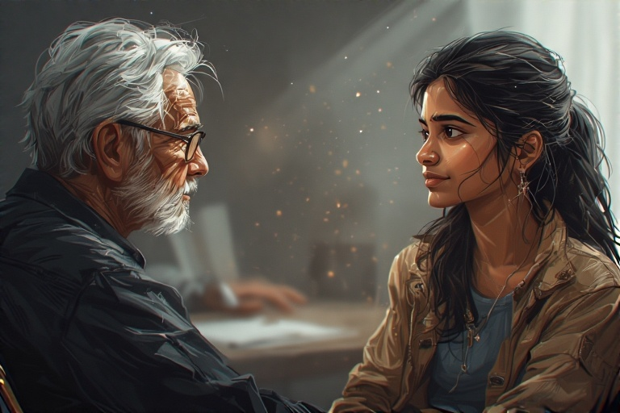
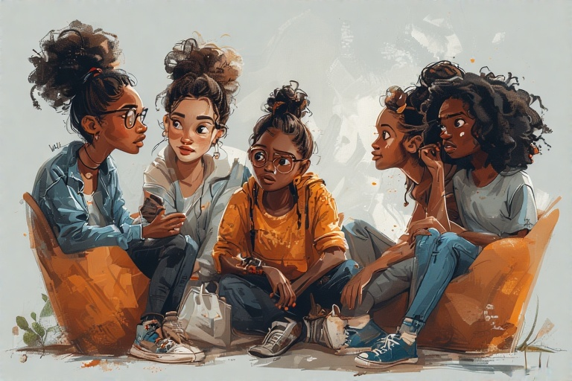
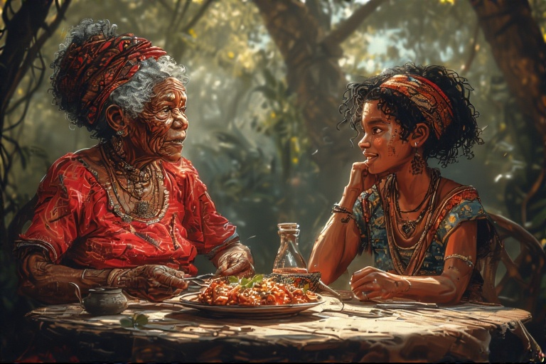
Notes:
Note to teacher: The Lesson 3 – Group Challenge includes five activities. Hand out one activity per group, so that different groups in the class work on different scenarios. Allow 14 minutes for groups to work through the questions and practise their interview, which will be presented live in front of the class.
Slide 5: This lesson will operate a little differently. You will now work in your groups for the next 14 minutes. Each group will receive ONE script to read through.
Use the questions and prompts in the activity to help you prepare for your presentation. Each group must have one News Reporter who will interview two members of the group.
Your presentation should highlight the main issue (risky behaviour) shown in the script, and the impact it has had on the individuals involved and the local community.
Refer to the Lesson 3 – Group Challenge MEMO for guidance.

Slide 6

Notes:
Slide 6: Groups present their interviews to the class. Each group will have two minutes to present. Remember to focus on the key points from your script and include practical suggestions.

Slide 7

Notes:
Slide 7: Much of what you have learnt about today, and in the previous two lessons, has focused on the negative influences on lifestyle choices. Today, we specifically focused on risky behaviour and how the impact of these decisions can affect your future.
The presentations we looked at addressed:
Substance abuse, such as drugs and alcohol
Unsafe sexual behaviour
The risk of teen pregnancy
Poor hygiene
Unsafe road practices
These are not the only examples of risky situations. South Africa is also facing a serious increase in teen suicide, as well as teenagers struggling with unhealthy dietary habits. We will explore the issue of teen suicide in more depth in the next lesson.
In light of all these discussions, you need to choose to “design your destiny.” This means being a person who does not simply follow the crowd, but who chooses to live in a way that will directly influence the success of your future dreams and goals.
On your worksheet, in Activity 2 (Lesson 2 – Worksheet), reflect on the questions and think about what changes you may need to make in your own life.

