Slide 1
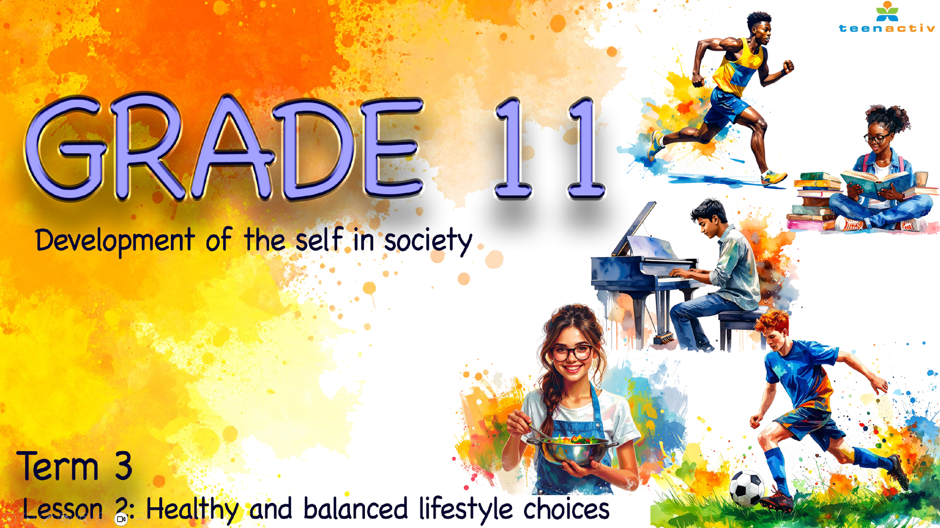
Notes:
Note to teacher: This lesson will start as learners walk into class. Meet them at the door with a smile and encourage them to walk past the wall with the sticky notes from the last lesson, and
to collect any one of the notes. These will be used at the beginning of the lesson as a quick reflection activity. As in the previous lesson, learners will be required to work in their groups of six.
Lastly, this presentation uses animations to increase learner interest and engagement. (Follow the prompts)
Slide 1: Welcome back, Grade 11s. Hopefully, you have all collected a note from the wall as you came in. Anyone who has not collected one, please quickly go and fetch a note and return to your group.
We ended the last lesson with the 3-2-1 reflection activity (Activity 5, Lesson 1 – Worksheet). Can you remember what you were required to write down?
That is correct!
THREE things you learnt.
TWO things you found interesting.
ONE question you still had.
Now, with a peer in your group, read through your notes. See if you can answer the question that was written down by adding a simple, thoughtful response to the note. Also, take a moment to reflect on the things that were learnt and found interesting. (Allow 2 minutes.) Learners to return all notes to the wall or the teacher.
I hope you found our previous lesson helpful, and that you have already been able to implement some small changes to start developing healthier habits.
In the previous lessons, the focus was on what makes up a balanced lifestyle within an individual. You now understand that certain changes are often necessary in order to live a healthy and balanced life. If balance is so important for our well-being, an important question remains: why are so many people still unhealthy?

Slide 2

By the end of the lesson, you should be able to:
identify common myths about nutrition and physical activity, and explain why accurate knowledge is important for making informed lifestyle choices.
explain how poor decision-making can negatively affect lifestyle choices, and apply critical thinking to identify causes of harmful situations and suggest prevention strategies.
describe how attitudes, peer pressure, environment and emotions influence lifestyle choices.
explain how socio-economic factors can limit lifestyle choices, and demonstrate awareness by reflecting on how different life circumstances affect people’s health, safety and opportunities.
Notes:
Slide 2: By the end of the lesson, you should be able to:
identify common myths about nutrition and physical activity, and explain why accurate knowledge is important for making informed lifestyle choices.
explain how poor decision-making can negatively affect lifestyle choices, and apply critical thinking to identify causes of harmful situations and suggest prevention strategies.
describe how attitudes, peer pressure, environment and emotions influence lifestyle choices.
explain how socio-economic factors can limit lifestyle choices, and demonstrate awareness by reflecting on how different life circumstances affect people’s health, safety and opportunities.

Slide 3

Notes:
Slide 3: We’re going to look at the next five slides to decide whether each statement is a myth or true.
Your group will have 30 seconds to discuss each one. After the discussion, the group leader must show:
Thumbs up = True
Thumbs down = Myth
For every correct answer, your group will earn one point. Each group must keep score.
Let’s see which group can get the most points. Here we go!

Slide 4
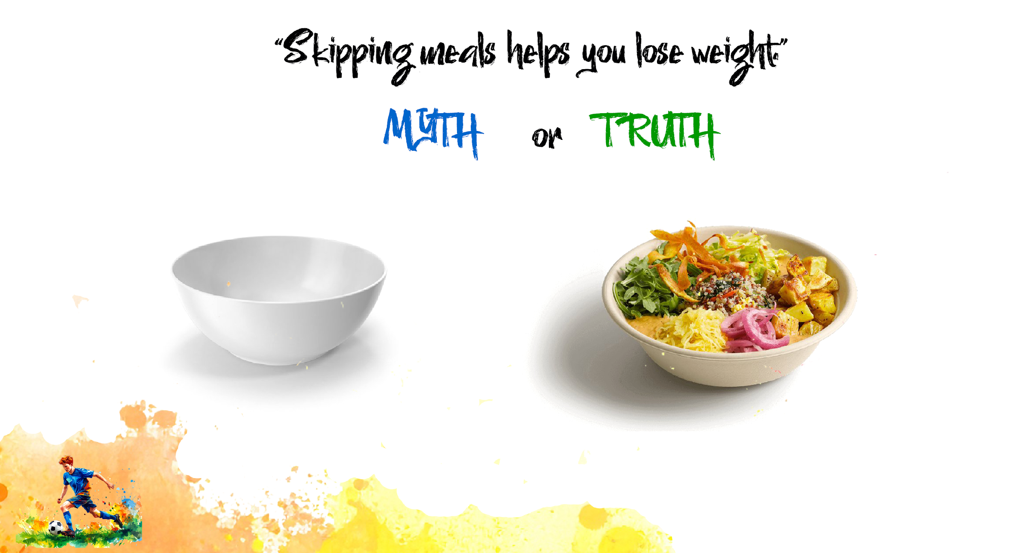
Notes:
Slide 4: Statement: Skipping meals helps you lose weight.
Myth: Skipping meals can slow down your metabolism and lead to overeating later. It may also cause fatigue and poor concentration, especially in learners.

Slide 5
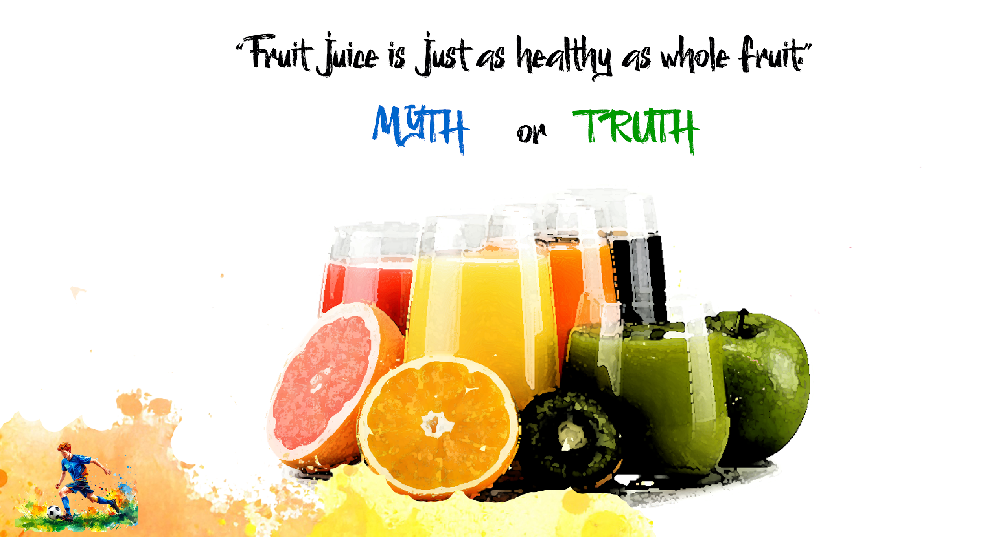
Notes:
Slide 5: Statement: Fruit juice is just as healthy as whole fruit.
Myth: Most fruit juices are high in sugar and lack the fibre found in whole fruits. Drinking juice regularly can contribute to weight gain and tooth decay.

Slide 6
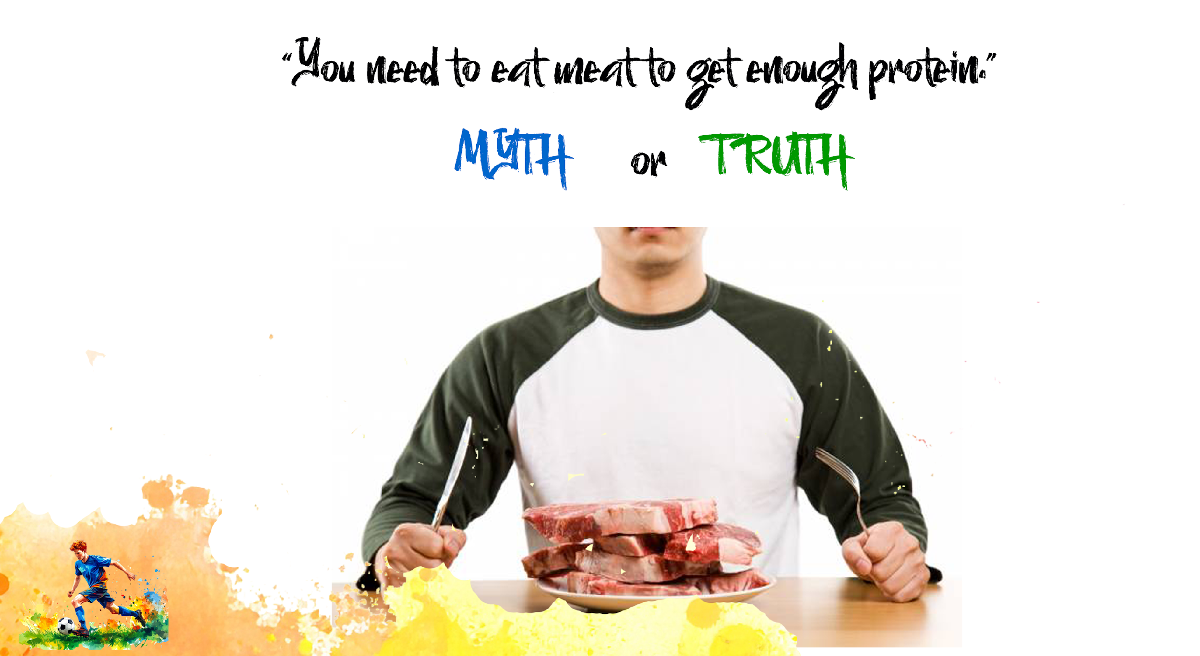
Notes:
Slide 6: Statement: You need to eat meat to get enough protein.
Myth: While meat is a good source of protein, there are many plant-based sources like beans, lentils, tofu, and nuts that are just as effective and often healthier.

Slide 7
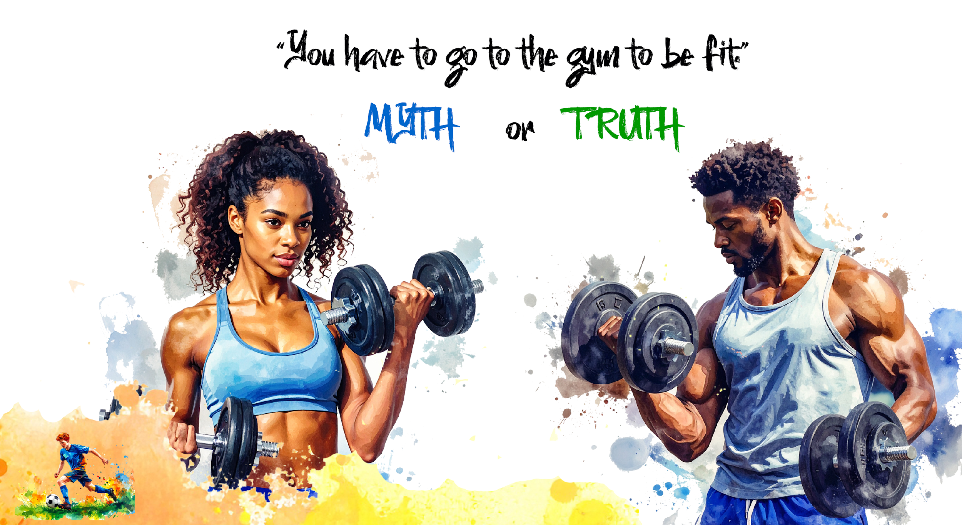
Notes:
Slide 7: Statement: You have to go to the gym to be fit.
Myth: Physical activity can be done anywhere – walking, dancing, playing sports, or doing chores. Consistency matters more than location.

Slide 8
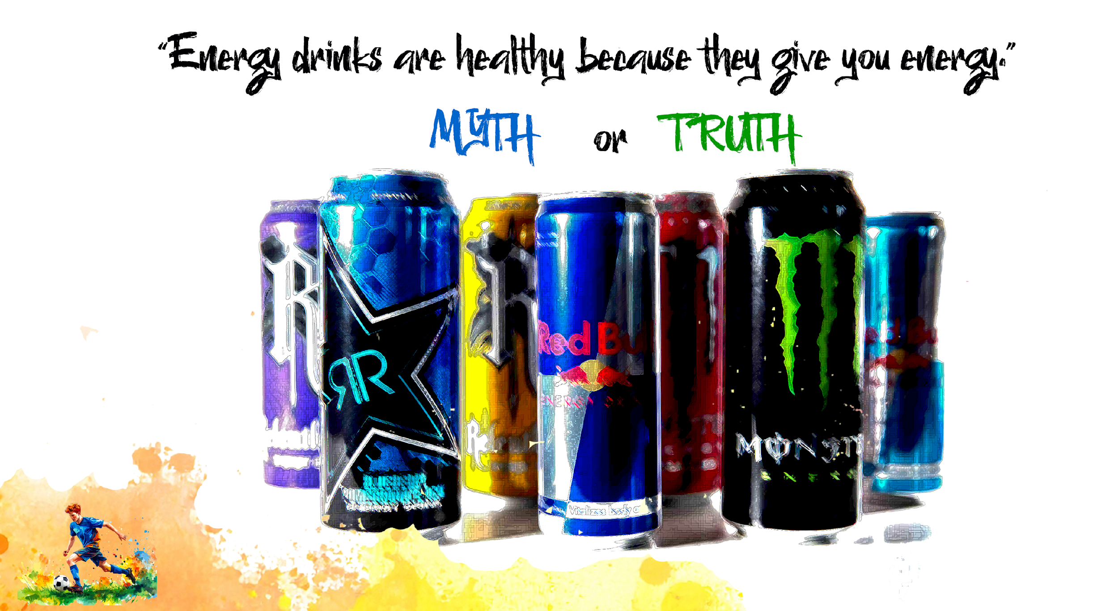
Notes:
Slide 8: Statement: Energy drinks are healthy because they give you energy.
Myth: Energy drinks are high in sugar and caffeine, which can cause heart palpitations, anxiety, and sleep problems. The “energy” is temporary and often followed by a crash.

Slide 9
Lack of knowledge and lifestyle choices
A lack of knowledge can limit a person’s ability to make informed and healthy decisions.
Lifestyle choices made today may have negative effects on health in the future.
Simply following trends or copying others does not always lead to healthy outcomes.
Balanced lifestyle choices require awareness and the ability to evaluate information before acting.
Notes:
Slide 9: As you can see, a lack of knowledge can limit a person’s ability to make informed and healthy decisions. In many cases, the lifestyle choices people make today may have negative effects on their health in the future.
It is therefore important to become an informed individual who understands the factors that influence lifestyle choices. Simply following trends or copying the behaviour of others does not always lead to healthy outcomes. Making balanced lifestyle choices requires awareness and the ability to evaluate information before acting on it.

Slide 10
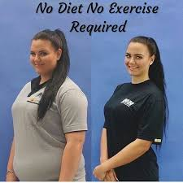


Poor decision-making and lifestyle choices
Poor decision-making can affect lifestyle choices when people act without thinking about consequences.
Today, we are constantly exposed to information through social media and online trends.
You have a responsibility to question whether information is trustworthy before acting on it.
Notes:
Slide 10: Poor decision-making skills can negatively affect lifestyle choices when individuals act without carefully thinking about the consequences of their actions. In today’s world, people are constantly exposed to information through social media and online trends.
Whether you are watching a quick weight-loss clip on Instagram or considering taking a pill that claims you can lose 10 kg in just two weeks, you have a responsibility to yourself to question whether this information is trustworthy.

Slide 11
Examples of poor decision-making
Buying a “miracle” product online without doing research.
01
Choosing greasy takeaway meals for short-term satisfaction without considering long-term health.
02
Avoiding a decision and allowing peers to influence you, for example taking drugs because friends are doing so.
03
Notes:
Slide 11: Here are some examples of poor decision-making skills:
Impulsively clicking on a social media link and paying money for a product, such as a miracle face cream that claims to remove all pimples in one day, without doing any research.
Giving in to greasy takeaway meals for short-term satisfaction rather than considering the long-term impact of such meals on your health.
Individuals who avoid making a decision altogether and allow peers to influence them, such as taking drugs simply because a group of friends is doing so.

Slide 12
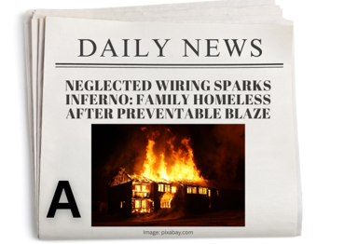
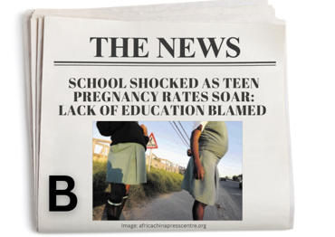
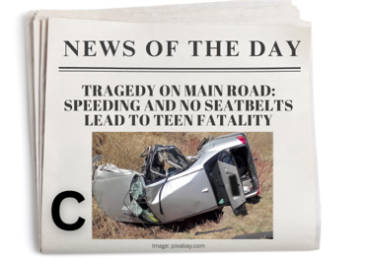
Choices, consequences and preventable accidents
Every choice has consequences.
Negative choices (such as drug use) can lead to serious consequences, including addiction or death.
Positive choices (such as working consistently at school) can lead to positive outcomes.
Some accidents are unplanned, but many can still be prevented.
Notes:
Slide 12: Every choice we make has consequences. Negative choices, such as drug use, can result in serious consequences, including addiction or even death. In contrast, positive choices, such as working consistently at school, can lead to positive outcomes like passing your Grade 11 year.
It is also important to recognise that some events or accidents are unplanned and unintended but may still cause injury or damage. For example, a serious car accident can affect a person’s physical and psychological well-being, which may impact their lifestyle choices.
However, some types of accidents can be prevented, as there are actions individuals can take to reduce risk and avoid harm.
Take a look at the newspaper headlines on Slide 12 and complete Activity 1 (Lesson 2 – Worksheet) by indicating what caused these accidents and how they could've been prevented.

Slide 13
Unsafe attitudes and behaviours
Unsafe attitudes can negatively impact lifestyle choices when people underestimate risks.
When someone believes “it won’t happen to me,” they are more likely to take risks.
This can place health, safety and future opportunities at risk.
Examples include:
Unprotected sex or reckless driving
Believing negative outcomes only happen to others
Normalising unhealthy habits such as smoking or substance use as coping mechanisms
Notes:
Slide 13: Unsafe attitudes and behaviours can negatively impact lifestyle choices when individuals underestimate risks or normalise harmful actions. When people believe that “it won’t happen to me,” they are more likely to take risks without considering the possible consequences. This can lead to behaviours that place their health, safety and future at risk.
Examples of unsafe attitudes and behaviours include:
Engaging in risk-taking actions such as unprotected sex or reckless driving.
Believing that negative outcomes only happen to others.
Normalising unhealthy habits, such as smoking or substance use as a way of coping with stress.

Slide 14

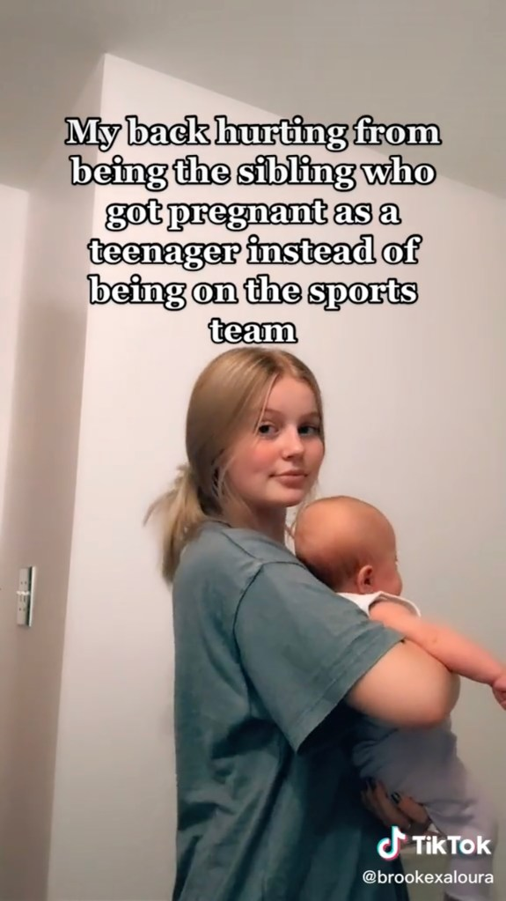
Attitudes and teen pregnancy
In America…
“14 and pregnant: Brooke Morton and other teen moms explode on TikTok”
Social media can create the false impression that teen parenthood is easy or glamorous.
In reality, most teenage parents experience emotional, financial and educational difficulties.
Attitudes about sex can influence behaviour.
Contraception and abstinence are prevention strategies.
What other factors could impact this couple from ending up pregnant?
Peer pressure
Notes:
Slide 14: (This slide uses animations. Click where indicated.)
Among some American teenagers, particularly on social media, there is a growing trend where teen parenthood is portrayed as easy or glamorous. Some teen parents share images of a “perfect life” online, which can create the false impression that teenage parenting has few challenges.
In reality, most teenage parents experience significant emotional, financial and educational difficulties. This example shows how attitudes about sex can influence behaviour. If contraception such as condoms had been used, or if individuals had chosen to abstain from sex, the pregnancy could have been prevented.
Click: What other factors could impact this couple from ending up pregnant? (Ask the class for some responses.)
Click: Well done, class! Peer pressure may play a role in influencing the attitude of this couple.
Peer pressure can negatively influence lifestyle choices when individuals feel compelled to change their behaviour in order to be accepted by others. Friends may encourage risky or unhealthy behaviour, and the fear of being judged, rejected or excluded can make it difficult to say no. As a result, individuals may prioritise fitting in over making healthy and responsible choices.
Wanting to belong is a normal part of adolescence, but when the desire to fit in leads to poor decision-making, it can have serious consequences.

Slide 15

The influence of environment
In South Africa…
“Early pregnancy crisis needs attention: One in every three children under the age of 18 experiences sexual abuse.”
In South Africa, teen pregnancy is often linked to unsafe environments.
Some communities face crime, violence and substance abuse, which can influence behaviour and decision-making.
Gang activity and negative role models can normalise risky behaviour.
The environment plays a major role in shaping lifestyle choices and future opportunities.
Notes:
Slide 15: In South Africa, teen pregnancy is an increasing concern. It’s a different situation from what we see happening in America.
Click on the slide: Many young women are affected by unsafe environments that contribute to this problem. Some live in communities where crime, violence, or substance abuse are common, which can influence behaviour and decision-making.
These environments are often affected by gang activity and the presence of negative role models, which may normalise risky behaviour and lead to poor lifestyle choices. As a result, the environment itself plays a significant role in shaping decisions that can impact a young person’s health and future opportunities.
Turn to a peer in your group and discuss other examples of how an unsafe environment can lead to poor lifestyle choices. (Allow 2 minutes.) Then, allow 2–3 learners to share their examples with the class.
Well done, Grade 11s. Those were some great examples.

Slide 16
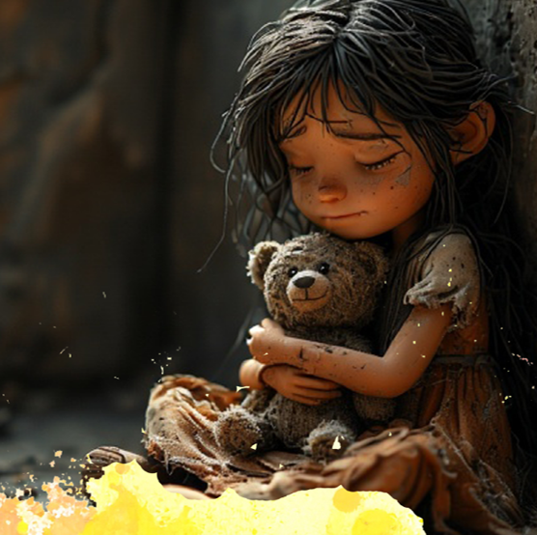
Emotional factors
Emotions can strongly influence lifestyle choices, especially when people struggle to cope.
Stress, anxiety and depression can lead to unhealthy coping mechanisms.
Low self-esteem can cause people to neglect their well-being.
Trauma or grief can disrupt routines and reduce motivation.
Example: Feeling valued for the first time may influence a learner’s judgement and lead to risky choices.
Notes:
Slide 16: Emotional factors can also have a strong influence on lifestyle choices, particularly when individuals struggle to cope with difficult feelings, for example:
Emotions such as stress, anxiety or depression may lead people to adopt unhealthy coping mechanisms.
Low self-esteem can cause individuals to neglect their physical and emotional well-being.
Experiences of trauma or grief can also disrupt daily routines, reduce motivation and make it difficult to maintain healthy habits.
For example, a young teenage girl may struggle with insecurity and negative body image. When she receives attention and flattery from a boy, she may feel valued and accepted for the first time. These emotions can influence her judgment and lead her to agree to sexual involvement without carefully considering the risks.
Can you see how ending up in these situations is often the result of several negative factors influencing a person’s decision-making? The sad reality is that none of us is immune to these influences. However, you are still the one who decides the extent to which you allow them to affect your choices. For example, if you say no to drinking alcohol, you remove the risk of an impaired mind, and you are more likely to make sensible decisions.

Slide 17
Socio-economic factors
The area you live in, access to education, your parents’ income and how you grew up can shape your lifestyle.
Not everyone experiences poverty in the same way, even in a country with widespread economic challenges.
Different circumstances can strongly influence health, safety and opportunities.
Notes:
Slide 17: Socio-economic factors can have a significant impact on lifestyle choices. Sometimes, the area you live in, a lack of education (which may result in poor literacy), your parents’ income, and the way you grew up can influence your lifestyle, even without you realising it or being able to make your own choices.
In South Africa, many people are affected by these socio-economic factors. Some learners may know what it is like to grow up in poor communities and struggle to meet basic needs. Others may never have experienced living in a home that could be damaged by heavy rain or having only one meal a day.
Although we live in a country where economic challenges affect many households, not everyone experiences poverty in the same way. This highlights how socio-economic circumstances differ from person to person and how these differences can strongly influence lifestyle choices and overall well-being.
Note to teacher: This group activity is designed to be almost impossible to solve. Learners may think there is something wrong with the tasks, e.g. the budget sheet cannot balance, the labels are in a different language, or there is insufficient information in the travel plans. This has been done on purpose to highlight the challenges faced in a society affected by poverty, poor literacy and crime. Encourage learners to approach the challenge as though it is entirely possible. This will ensure that, during the discussion questions, learners respond from experiential learning rather than treating it as only an academic exercise.
In this group activity, each group will be given a socio-economic challenge that they must work together to address. Learners should listen to one another in their group and work together to come up with ONE solution per group. They must use only the information provided to solve the challenge. Groups will have eight minutes, after which there will be brief feedback to the class.
If you have more than one class, laminate the task sheets so they can be reused with whiteboard markers.
You will now start Lesson 2 – Group Challenge. (Prepare this activity in advance by placing the task sheet and description cards together in an envelope.) There are three different challenges. Each group should receive one challenge. The aim is to have all three challenges running simultaneously in different groups around the class.
Note to teacher: Keep an eye on the time to allow two minutes for the reflection activity.

Slide 18

Notes:
Slide 18: Take a moment to quietly reflect on your own lifestyle and write down your thoughts in Activity 2 (Lesson 2 – Worksheet).

