Slide 1

Notes:
Slide 1: Welcome to the last lesson in this series on developing healthy lifestyle habits. Over the last five weeks, we have covered a wide range of content. We started this series by focusing on developing skills to help you make the right decisions about your lifestyle, in preparation for Grade 12 and your future.
Before we move on, turn back to your notes from the first lesson and look at your response to Activity 6 (Lesson 1 – Worksheet), then complete Activity 1 (Lesson 6 – Worksheet) by rating how well you have been able to implement the plans you originally put in place.
Do not overthink your answers; be honest. You will only have 3 minutes to complete this activity.

Slide 2
By the end of this lesson, you should be able to:
Identify and discuss different factors that positively influence lifestyle choices.
Explain how role models, values, beliefs, social skills, economic factors and media influence lifestyle choices.
Reflect on personal influences and express how these shape your lifestyle choices.
Notes:
Slide 2: By the end of this lesson, you should be able to:
Identify and discuss different factors that positively influence lifestyle choices.
Explain how role models, values, beliefs, social skills, economic factors and media influence lifestyle choices.
Reflect on personal influences and express how these shape your lifestyle choices.

Slide 3


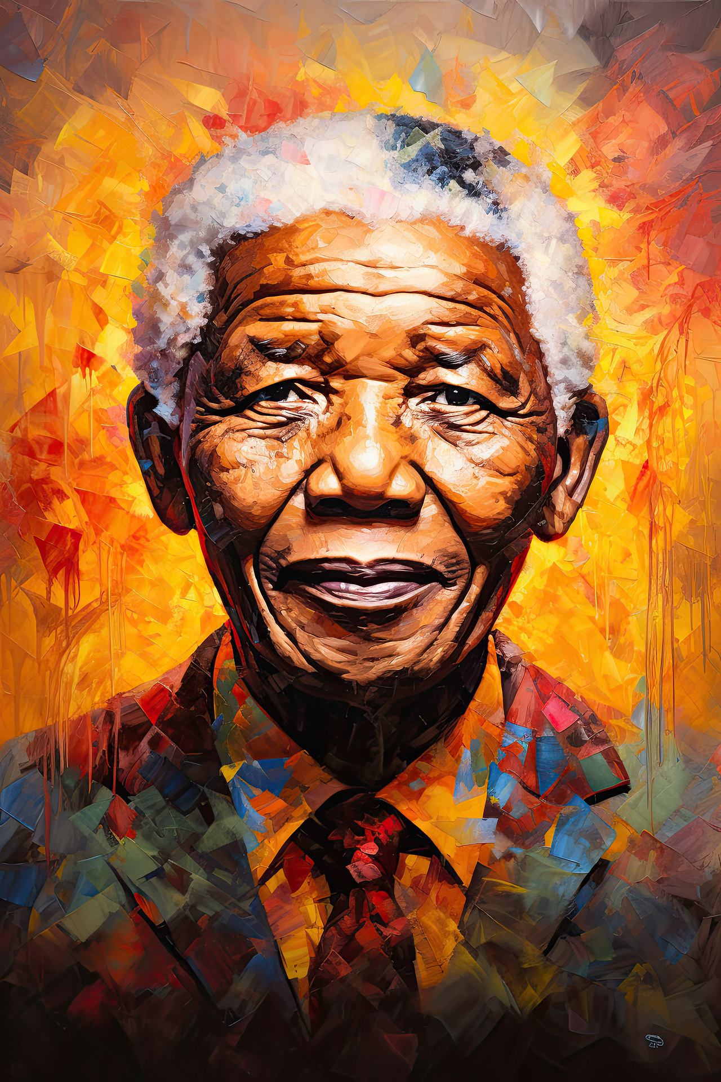
Self-reflection
?
?
Change requires action + consistency
Example:
Joining a gym ≠ change
Going regularly = change
Support from others helps
ME
?
?
Notes:
Slide 3: It is important to self-reflect when you try to implement changes by introducing new habits. This helps you to evaluate what is working and what still needs improvement. Sometimes, we are fortunate to have people around us who inspire us or can advise us on how to implement these changes effectively.
Maybe over the last few weeks, some of you joined a gym with the intention of getting into shape. However, simply joining the gym does not create change.
Real change happens when you actually go to the gym, speak to someone for advice, and even hold yourself accountable to someone there. These actions help to put positive changes in place.
Over time, this could lead to you exercising more regularly and becoming healthier, largely due to the influence and support of the people you meet at the gym.
Take a moment to complete Activity 2 (Lesson 6 – Worksheet).
You will have 4 minutes to complete this activity.
Once you are done, turn to your partner and share: “Who or what has the biggest positive impact on your life?”

Slide 4
Role models
Positive role models:
guide behaviour
influence values
motivate good choices
You can also become a role model
Notes:
Slide 4: It is important to have positive role models – people in your life whom you can look up to or who motivate you to make healthy lifestyle choices. The lifestyle and values of this person can inspire you to become a better version of yourself. When you adopt the positive behaviours, values or actions of these individuals, you can also become a positive influence in your community.

Slide 5

Group Activity
Work in pairs within groups
Notes:
Note to teacher:
This group activity will set the stage for the teaching in the next section. Learners will reflect on and learn from the experiences presented at each station. There are six stations in total. Each group should consist of six learners. The group must divide into three pairs. There are two ways to implement this activity:
Option A:
Each pair will complete three stations (5 minutes per station).
Once completed, allow 5 minutes for the group to share feedback. Each pair should explain:
which stations they completed, and
what they learnt from those stations.
Option B:
Each pair will rotate through all six stations (3 minutes per station).
At the end, each pair must share ONE sentence identifying the station they felt had the greatest impact on their lifestyle choices.
Preparation:
Ensure that the station packs (Lesson 6 – Group Activity) are printed and prepared per group before the lesson.
Be strict with time. Use a timer or alarm so that learners know when to move to the next station.
Slide 5: Class, we know that there are several factors that can have a positive influence on our lifestyle choices.
We are now going to take part in a short activity using six stations. Within your group, you will move through these stations and work with a partner to answer the questions at each one.
You will have a limited amount of time at each station, and I will let you know when it is time to move on.
Remember, the aim of this activity is to help you recognise the different ways in which your lifestyle choices can be positively influenced.
Note to teacher: Learners will have personal responses to this activity. No MEMO answers are provided; however, two stations require specific answers:
Station 1, Question 1:
Mahatma Gandhi: “Be the change that you wish to see in the world.”
Nelson Mandela: "Education is the most powerful weapon which you can use to change the world."
Steve Jobs: “The people who are crazy enough to think they can change the world are the ones who do.”
Cristiano Ronaldo: "Talent without working hard is nothing."
Station 4, Question 1:
Fasting → Islam (e.g. fasting during Ramadan)
Meditation → Hinduism
Veganism → Hinduism (linked to non-violence/ahimsa)
Traditional dancing → Traditional African Religion
Sabbath → Judaism

Slide 6
Key influences
Role models: Influence your behaviour, values and attitudes through their actions (e.g. parents, teachers, leaders, peers).
Values: Personal principles that guide your choices and help you decide what is right or wrong.
Beliefs: Ideas about yourself and the world that shape how you think, react and make decisions.
Culture & religion: Provide moral guidance, traditions and a sense of identity that influence your lifestyle choices.
Social skills: Help you handle peer pressure, communicate effectively and make responsible decisions in social situations.
Economic factors: Can create or limit opportunities (e.g. access to healthy food, education, sport or resources).
Notes:
Slide 6: Let’s recap the factors that impact positively on lifestyle choices.
Positive role models can include sportspeople, public figures or leaders whom you respect. Their behaviour and lifestyle can influence your morals and values based on what they project to the public. They can also be people you interact with regularly, such as your parents, peers, friends, coaches and teachers. These individuals can inspire you to become a better person and may teach you important life skills that help you make responsible decisions.
Your personal values are the principles and standards that guide your behaviour and decision-making. They develop over time and are influenced by your home environment, school, culture and experiences. These values help you decide what is right or wrong and support you in making choices that align with who you are.
Your belief system refers to the ideas and viewpoints you hold about yourself, others and the world around you. It influences how you interpret situations and can strengthen your ability to make responsible choices.
Religion and positive cultural influences can help you manage different aspects of your life and influence the choices you make. They often provide a moral framework that can guide your behaviour and protect you from risky choices.
Social skills help you make decisions in challenging social situations. You learn from others, such as your parents, how to handle these situations. As you become more aware of social cues, such as body language and communication, you are better able to make informed choices.
Economic circumstances can either limit or create opportunities. It is important to understand how financial factors influence your lifestyle choices. For example, having money to buy healthy food or pay for a gym membership can make it easier to maintain a healthy lifestyle. However, not everyone has access to these opportunities.

Slide 7
Media influence
Inspiration can come from social media, movies and series
Media can shape how we think, behave & see the world
It can have a positive or negative influence
Think critically: Not everything you see is realistic or healthy
Manage your media use:
limit screen time
no phones during meals
be present with others
Notes:
Slide 7: Inspiration can come from many different places. Many people spend time on social media or watching movies and series. Movies can shape how we think, what we believe, and how we behave, sometimes without us realising it. But is this influence always positive?
The influence of movies can be both positive and negative, depending on the content and the viewer. While movies can inspire new skills, goals or perspectives, they can also create unrealistic expectations or promote negative behaviour. It is therefore important to critically evaluate the messages we receive from media.
Have you watched a movie that inspired you? Turn to your partner and share the movie and how it inspired you.
Media can positively influence your lifestyle choices. For example:
learning to cook from social media,
following sports heroes, or
gaining new perspectives from series or films.
However, it is important to manage your media use. Set boundaries to avoid wasting time. For example:
no cell phones at the dinner table,
put your phone away when spending time with others.
This highlights the importance of good decision-making skills. Over these six lessons, you have developed skills to evaluate influences and make responsible choices. The station activities focused on real-life issues, helping you apply these skills.

Slide 8

What shapes your lifestyle?
Notes:
Slide 8: Note to teacher: These final two activities serve as the culmination of the six-lesson series. Learners should each receive six pieces of paper and respond to six questions. Allocate a space in the classroom with the heading “What shapes you?”
Learners must write each response from Activity 3 (Lesson 6 – Worksheet) as a separate sentence on each piece of paper.
Allow 4 minutes for learners to write their responses. Thereafter, give them 2 minutes to walk around the space and read what others have written.
Hand out the Content Summary to learners before they leave the classroom.

