Slide 1
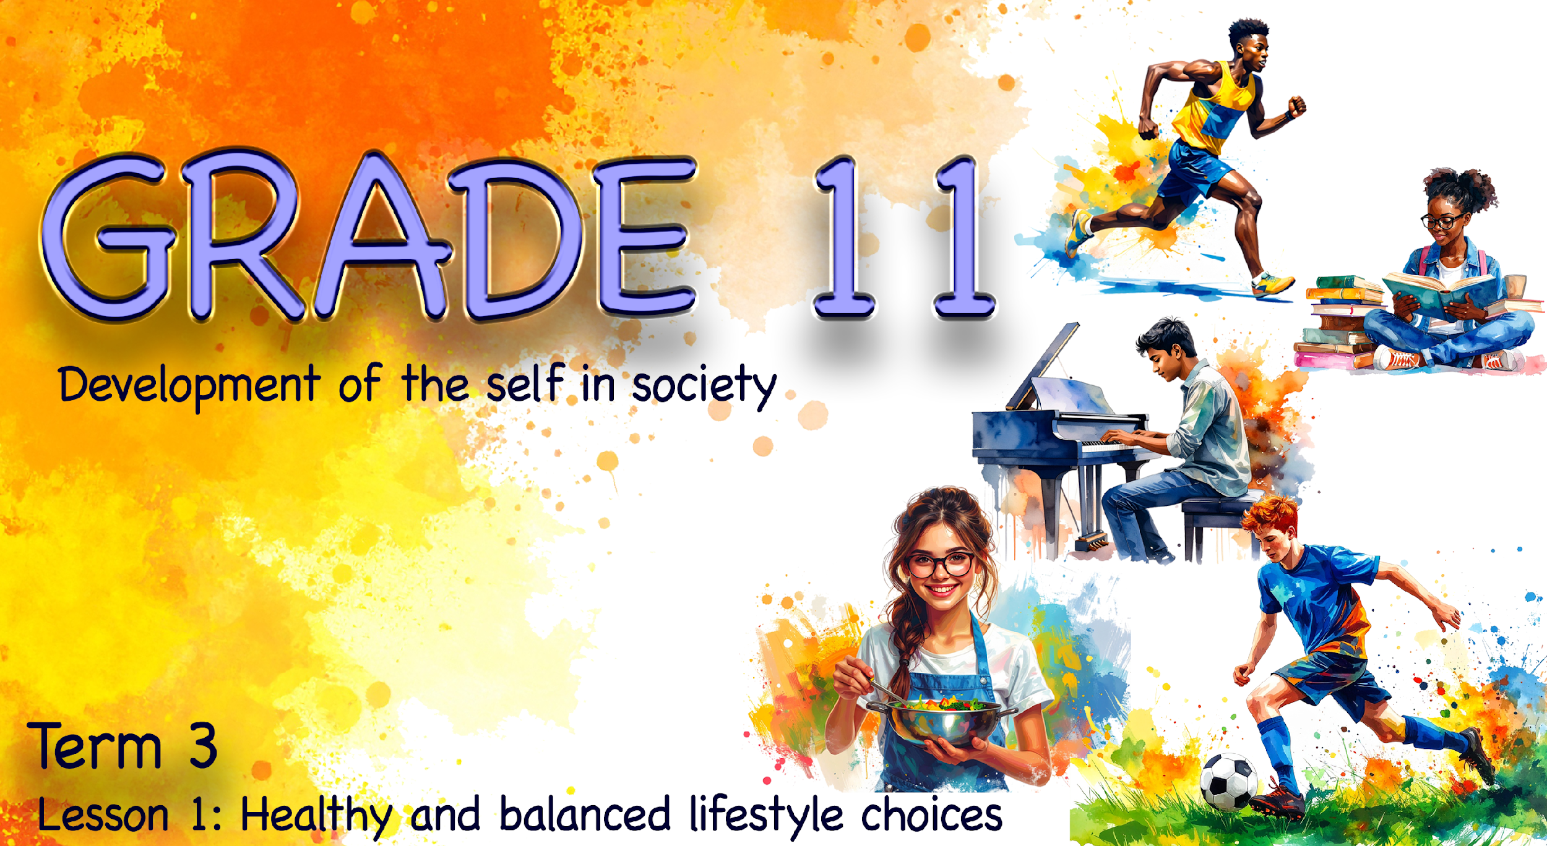

Notes:
Note to teacher: This lesson will often involve discussions with a partner. At the end of the lesson, learners will be required to work in groups of six. The PowerPoint presentation uses animations to increase learner interest. (Follow the prompts indicated in brackets.)
Slide 1: Welcome back to a new term and the start of a new topic. As Slide 1 suggests, we will be looking at healthy lifestyle choices.
Remind learners that they learnt about influences (media, environment, family, culture, etc.) and responses to influences on lifestyle choices in Grade 9 (Term 1, Week 1–4).
Every day, you make choices that influence your overall health and well-being. These choices include the habits you form, the food you eat, how active you are, how you manage stress, and how you connect with others. Together, these choices shape your lifestyle and determine how healthy and balanced it is.
Before we get started, turn to a partner and mention three lifestyle habits you have that are healthy. (Allow one minute for discussion.)

Slide 2
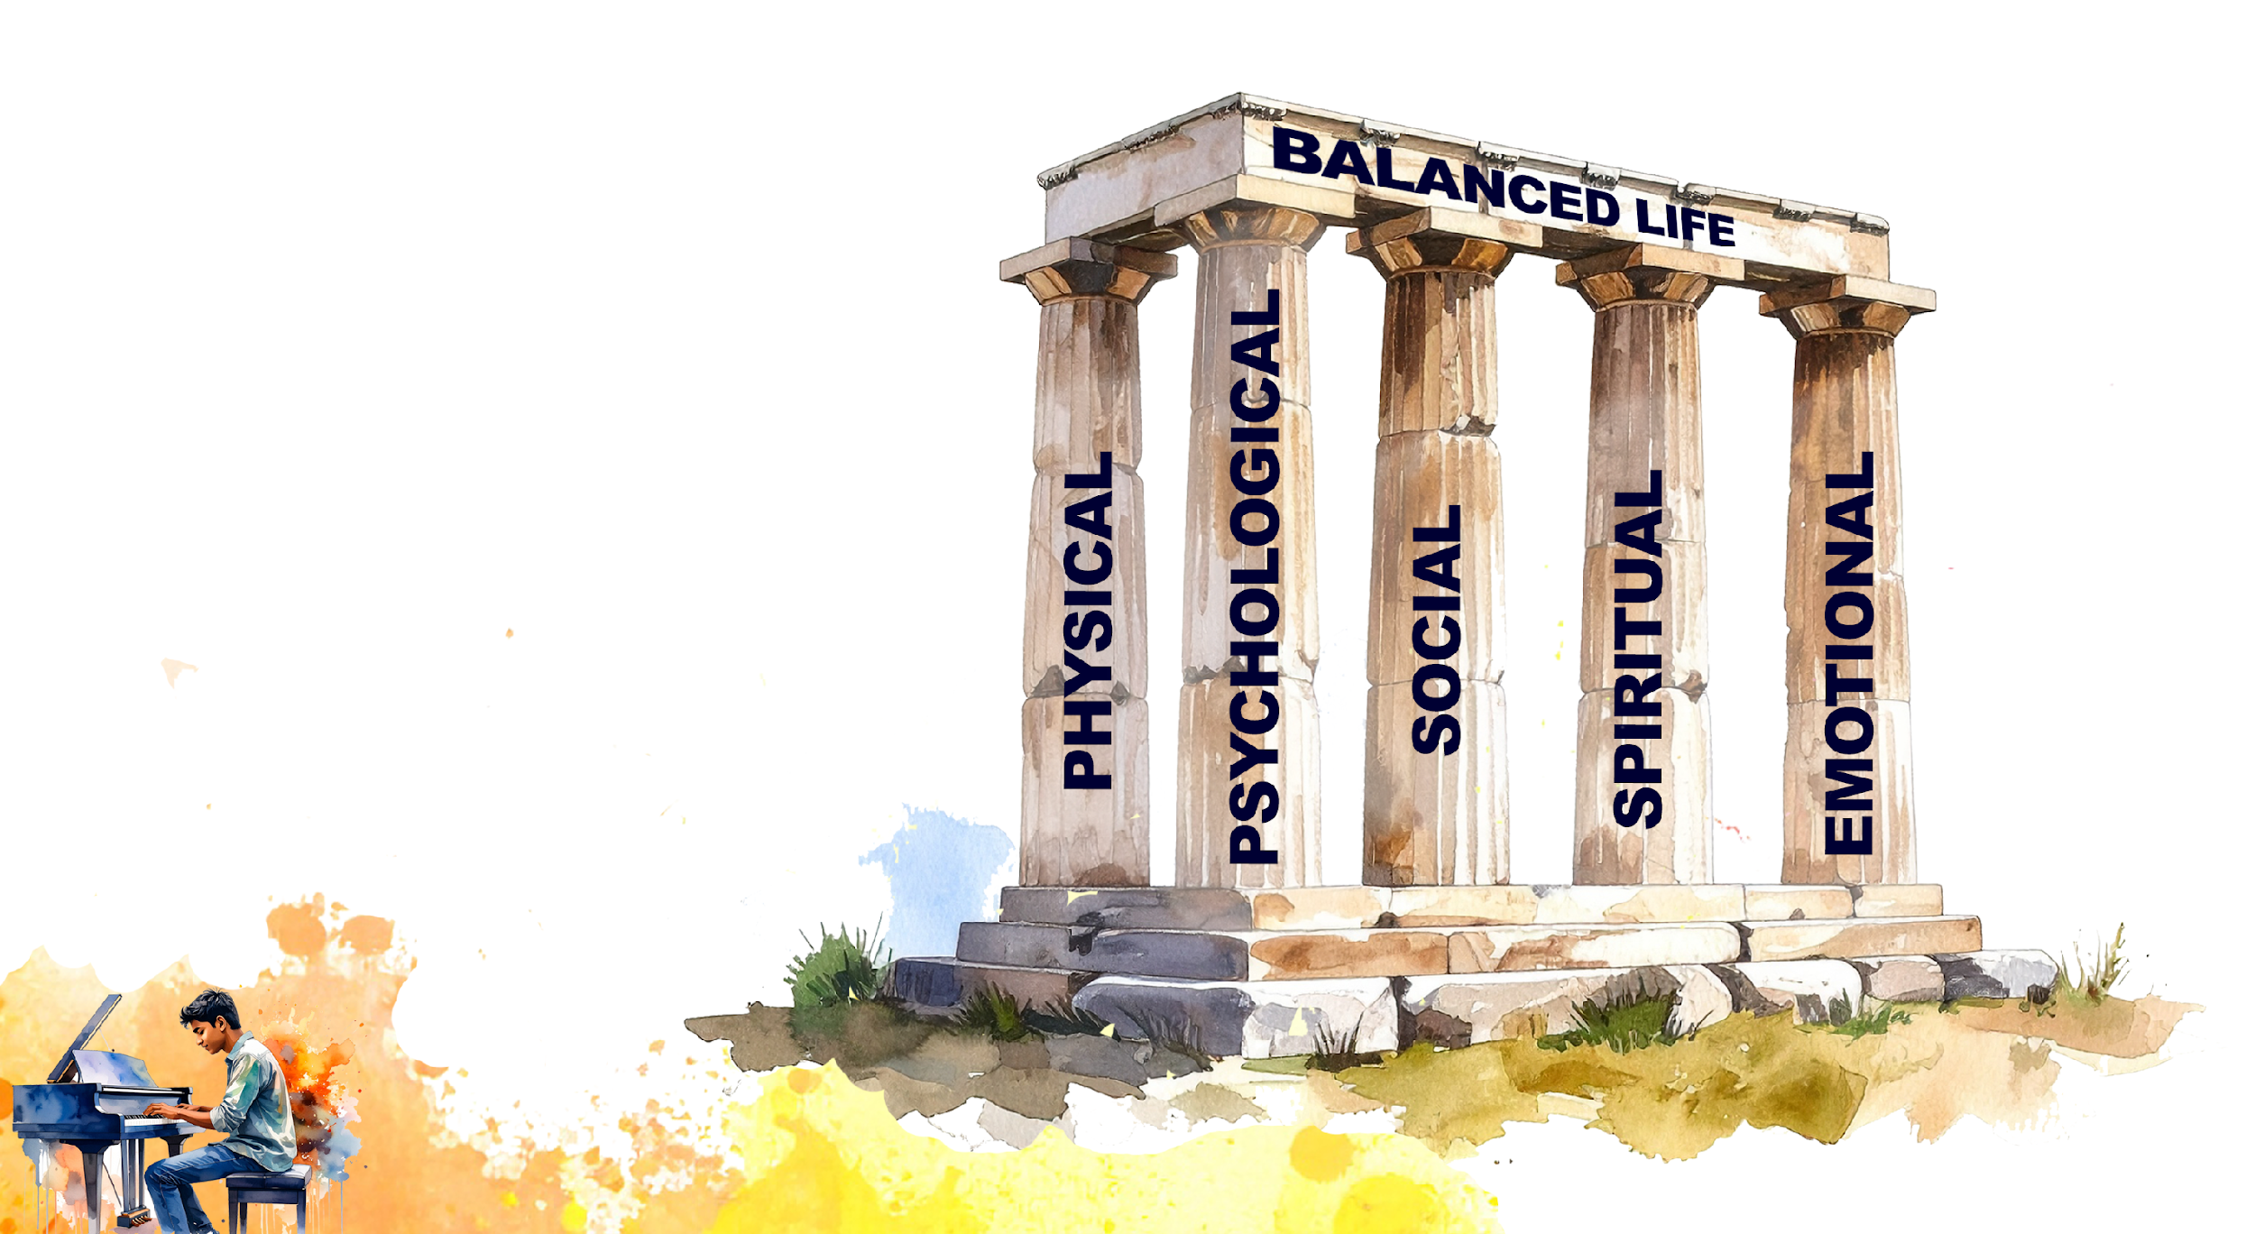
A balanced life is when there is harmony between the different parts of your life.
Notes:
Slide 2: Living a healthy lifestyle is not only about doing one thing well. For example, getting enough sleep is essential for brain function and physical recovery, but sleep alone is not enough to maintain good health. If a person sleeps well but never exercises, eats poorly or neglects their emotional and social well-being, their lifestyle may still be unbalanced.
A truly healthy lifestyle involves maintaining balance across different areas of health, including physical, psychological, social, emotional and spiritual well-being.
The goal of these next few lessons is to teach you how to live a balanced life, regardless of what comes your way. Be honest with yourself during these lessons, and you will come away with a life skill that will benefit you well into the future.

Slide 3
By the end of the lesson, you should be able to:
Understand that a healthy lifestyle requires balance across different areas of well-being.
Identify and explain the five pillars of a balanced lifestyle and reflect on your own level of balance.
Identify practical strategies for improving balance in your own life.
Develop awareness of common misconceptions about exercise and nutrition.
Describe key healthy lifestyle behaviours, including healthy eating, limiting sugar intake and regular physical activity.
Notes:
Slide 3: By the end of the lesson, you should be able to:
understand that a healthy lifestyle requires balance across different areas of well-being.
identify and explain the five pillars of a balanced lifestyle and reflect on your own level of balance.
identify practical strategies for improving balance in your own life.
develop awareness of common misconceptions about exercise and nutrition.
describe key healthy lifestyle behaviours (healthy eating, limiting sugar intake and regular physical activity).

Slide 4
The five pillars of a balanced life
Physical: fitness, healthy eating and enough sleep
Psychological: self-improvement, avoiding risky behaviour, and applying yourself in education
Social: healthy relationships, community involvement and volunteering
Spiritual: a belief system and living according to your values
Emotional: recognising, expressing and managing emotions (emotional intelligence/EQ)
Notes:
Slide 4: Look at the image on Slide 3. Imagine each of these areas as a pillar holding up your life. If one pillar is shorter or weaker than the others, the slab on top – representing a balanced life – will become unstable and may topple over.
(Click on slide): Therefore, we could say that a balanced life is when there is harmony between the different areas of your life.
Every individual’s life is supported by five key pillars. These pillars work together, and balance is achieved when none of them is neglected.
Physical: This refers to your body and includes staying physically fit, eating healthily, and getting enough sleep. Maintaining physical balance is essential for overall well-being.
Psychological: This relates to your mental and emotional state. It includes a desire for self-improvement, avoiding risky behaviour, and applying yourself in your education in order to become the best version of yourself.
Social: This involves building and maintaining healthy relationships with family and friends. It also includes participating in community activities and volunteering when you identify a need.
Spiritual: This refers to following a belief system or religion of your choice. It involves living according to your values and finding peace and hope through practices such as meditation or prayer.
Emotional: This means being able to recognise, explore, express and manage your emotions. It also involves understanding and influencing the emotions of others. This skill is often referred to as emotional intelligence (EQ).
You will now have three minutes to complete Part 1 of Activity 1 (Lesson 1 – Worksheet). Don’t overthink each question. The aim is to get a general idea of where you are in terms of having a balanced life.

Slide 5

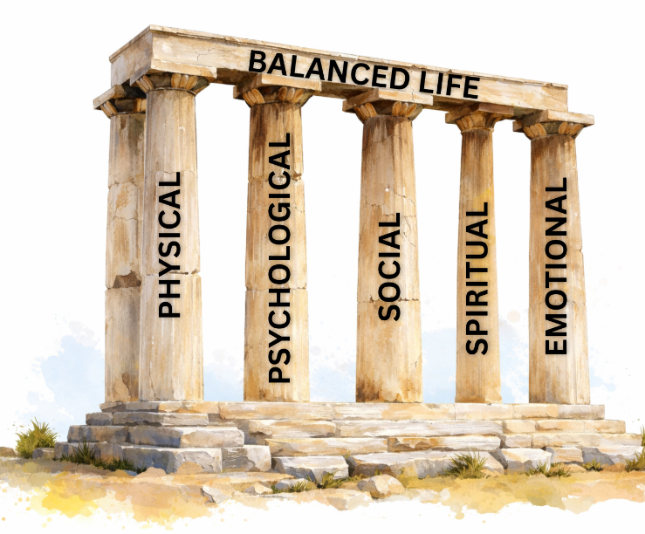
PEER
REFLECTION
Notes:
Slide 5: Now, work with a partner in your group to complete Part 2 of Activity 1 (Lesson 1 –Worksheet). (Allow three minutes for completion.)

Slide 6
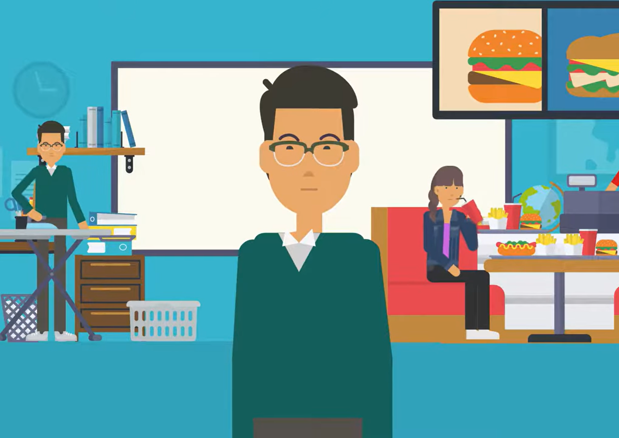
Watch:
Tips for finding balance as a student bit.ly/4qOfeb8
(1 min 45 sec)
Notes:
Slide 6: I’m sure that by talking with your peers, you've noticed that most teenagers struggle with juggling their lives. Hopefully, you got some good advice.
We will now do an individual reflection. Watch the video on getting your life back in balance. Pay close attention to the tips and strategies mentioned.
Watch video:
Tips for finding balance as a student
bit.ly/4qOfeb8 (1 min 45 sec)
Now complete Part 3 of Activity 1 (Lesson 1 – Worksheet).

Slide 7
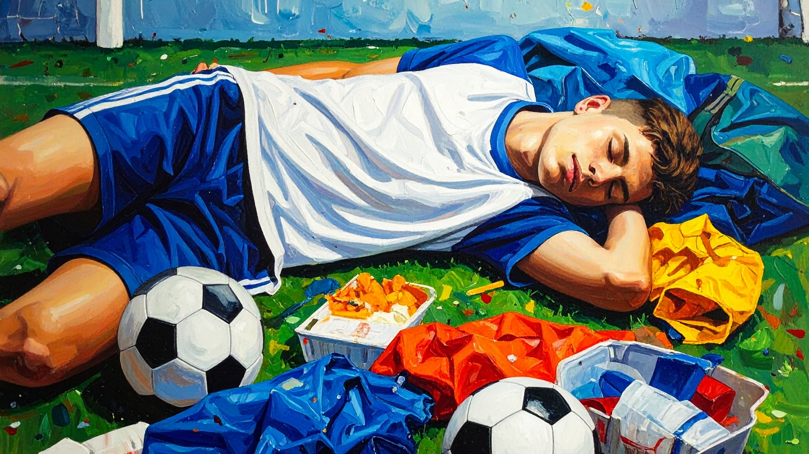
Balance is important for happiness and well-being.
Many people struggle to find balance with exercise and nutrition.
Some people think they need to run 5 km every day and live on lettuce to be healthy.
Many diet trends and “quick fixes” on social media are followed without understanding their long-term effects.
Notes:
Slide 7: We can see that balance in life is necessary for happiness. One area where many people struggle to find balance is exercise and nutrition. Some of us may think that we need to run 5 km every day and live on lettuce to be healthy.
Many people lack the knowledge needed to understand what their bodies really require to function well. Often, new diet trends or “quick fixes” on social media are followed without fully understanding their long-term effects on health and well-being.

Slide 8
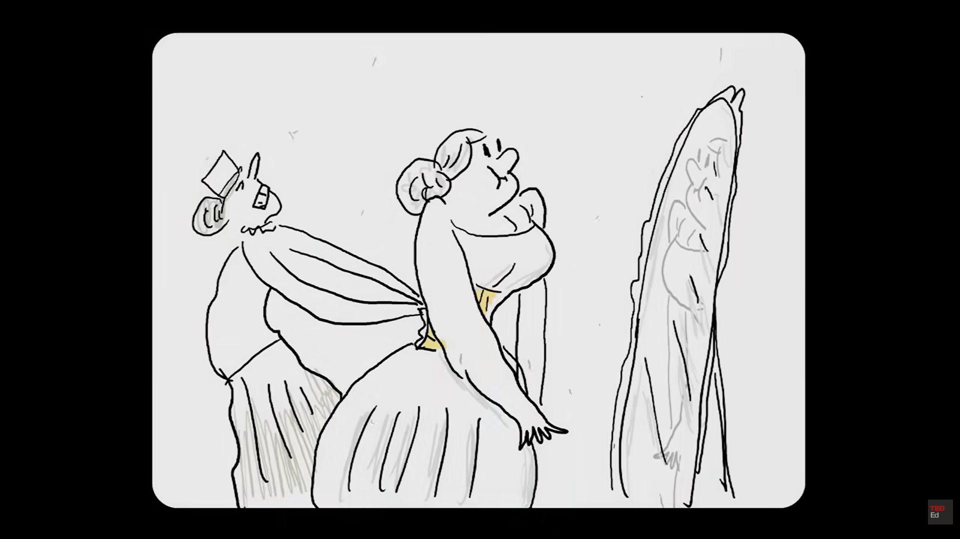
Watch: Is it possible to lose weight fast? bit.ly/3LCvP2E (3 min 03 sec of 4 min 56 sec)
Notes:
Slide 8: Let's watch a video and complete an activity.
Note to teacher: Watch ONLY up until 3 min 03 sec of this clip.
Watch video:
Is it possible to lose weight fast?
bit.ly/3LCvP2E (3 min 03 sec of 4 min 56 sec)
Learners to complete Activity 2 (Lesson 1 – Worksheet) with a peer. (Allow four minutes.)
Answers are available in the Lesson 1 – Worksheet MEMO.

Slide 9
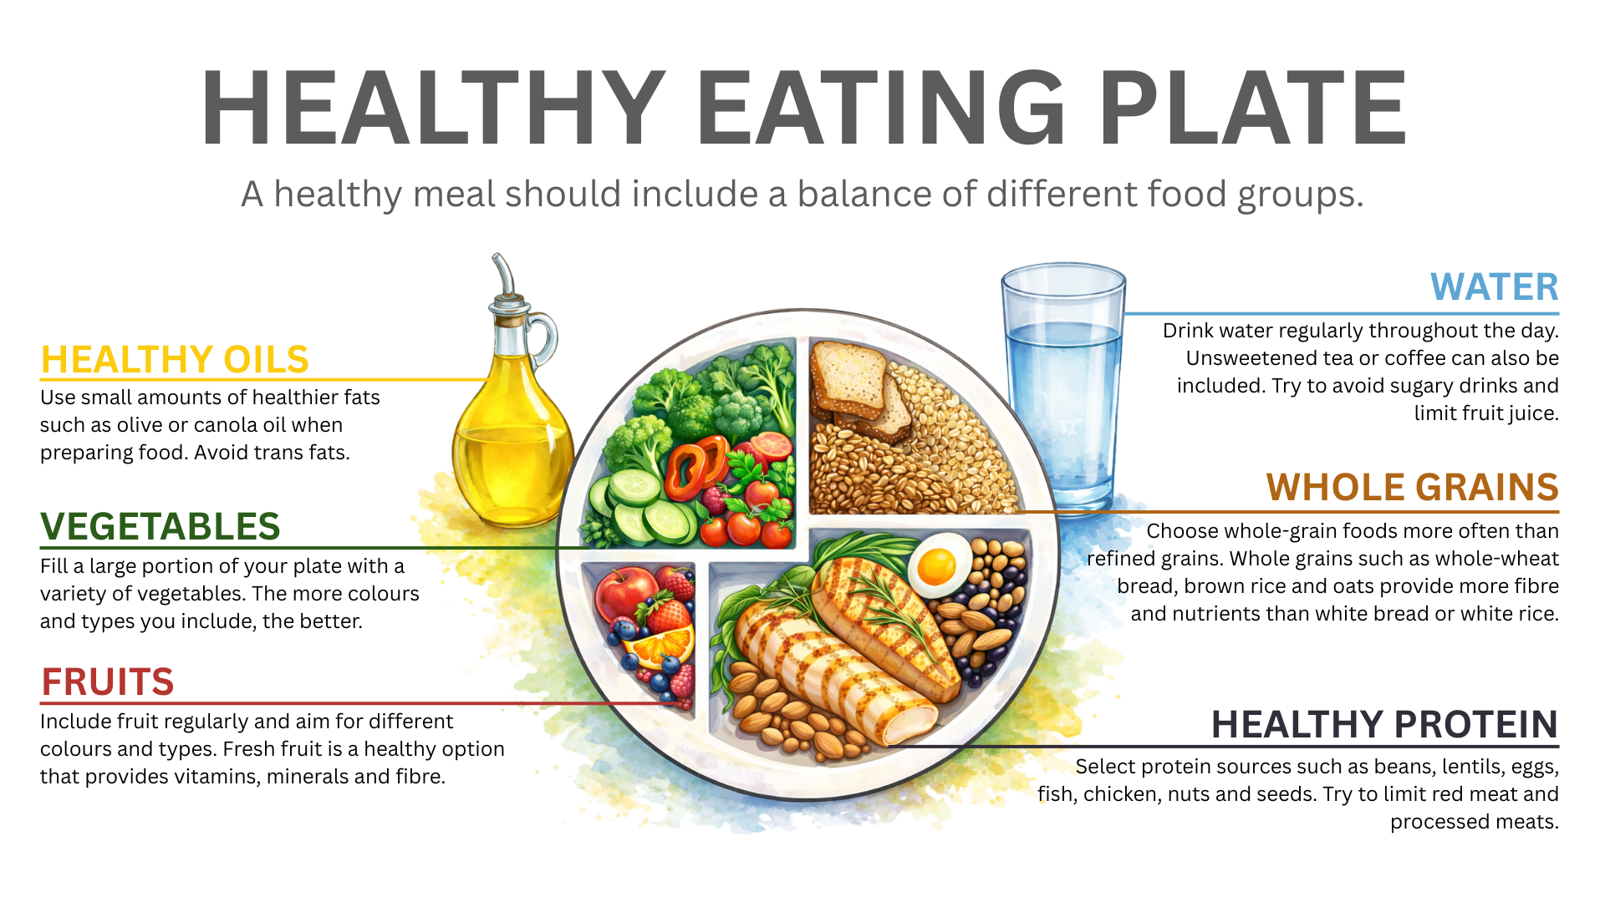
Have you ever wondered how to eat healthy?
Eating three balanced meals a day supports energy, concentration and overall health.
Notes:
Slide 9: Maybe you’re wondering what it looks like to eat healthy? In some cases, unhealthy eating habits develop simply because individuals are unsure of what healthy eating actually looks like.
A helpful way to guide your food choices is to imagine using a medium-sized dinner plate at every meal and dividing it according to the sections shown in the healthy plate model.
These proportions can help you visualise the types and amounts of food your body needs. And remember, eating three balanced meals a day supports steady energy levels, concentration and overall health.

Slide 10
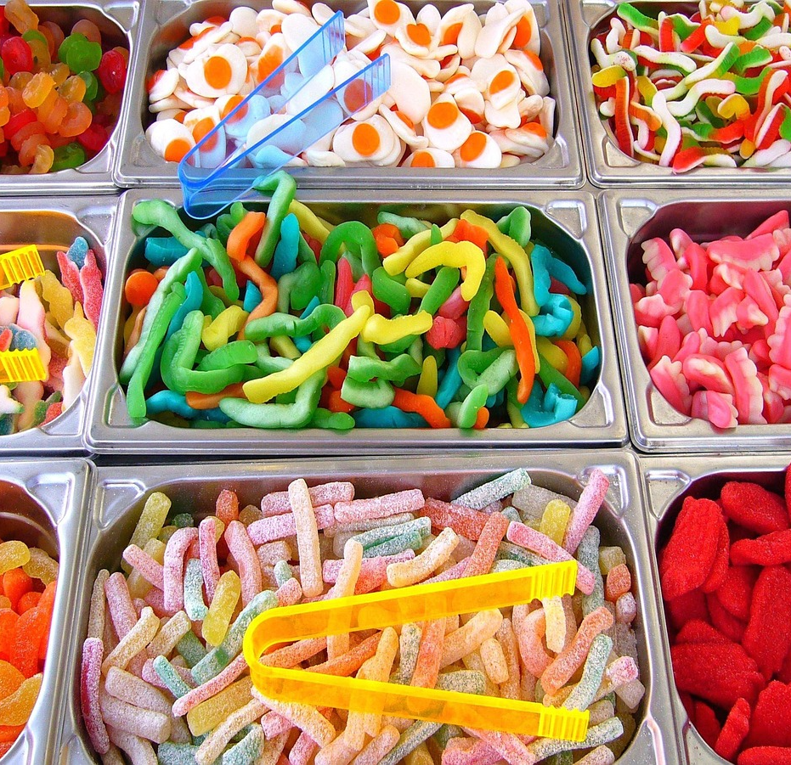
Why too much sugar is harmful
Excessive sugar intake can lead to short-term and long-term problems, such as:
  Blood sugar fluctuations (fatigue, headaches, anxiety)
  Tooth decay
  Cravings and addictive eating patterns
  Weight gain
  Insulin resistance (increasing risk of obesity, Type 2 diabetes and heart disease)
  Increased risk of heart damage
Notes:
Slide 10: Excessive sugar intake can cause negative short-term and long-term health outcomes:
Blood sugar fluctuations (leading to anxiety, fatigue, headaches, etc.)
Tooth decay (leading to pain and bad breath)
Addiction (leading to cravings and addictive eating patterns)
Weight gain
Insulin resistance (can lead to obesity, cardiovascular disease, Type 2 diabetes)
Heart damage (increases risk of heart disease/failure)
More information on sugar intake is available in the Content Summary.
Extension activity: If time allows, learners may complete this activity in class. If not, Activity 3 (Lesson 1 – Worksheet) can be assigned as an extension or homework activity.

Slide 11
Physical activity matters
Being physically active is essential for a healthy and balanced lifestyle.
Physical activity strengthens the body and supports the heart, muscles and bones.
Exercise can improve concentration, self-confidence and stress management.
Being active does not mean spending hours in the gym.
Walking, cycling, dancing, sport and physical education all contribute to an active lifestyle.
The key is consistency and choosing activities that are enjoyable and sustainable.
Notes:
Slide 11: Being physically active is an essential part of living a healthy and balanced lifestyle. Physical activity helps to strengthen the body, improve fitness and maintain a healthy weight. It also supports the proper functioning of the heart, muscles and bones.
Exercise can help you cope better with daily pressures and improve concentration and self-confidence.
Being active does not mean spending hours in the gym. Activities such as walking, cycling, dancing, playing sport or participating in physical education at school all contribute to an active lifestyle. The key is to be consistent and to choose activities that are enjoyable and sustainable.

Slide 12
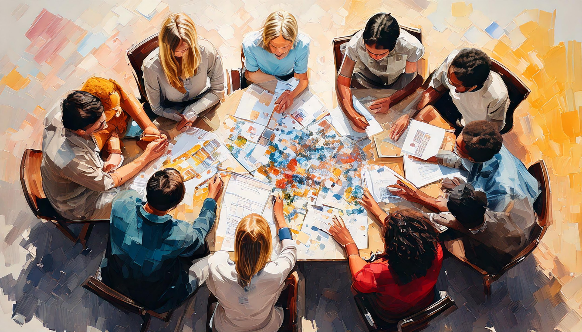
Group Activity
Notes:
Slide 12: Learners to complete Activity 4 (Lesson 1 – Worksheet) in groups.
Possible answers are available in the Lesson 1 – Worksheet MEMO.

Slide 13
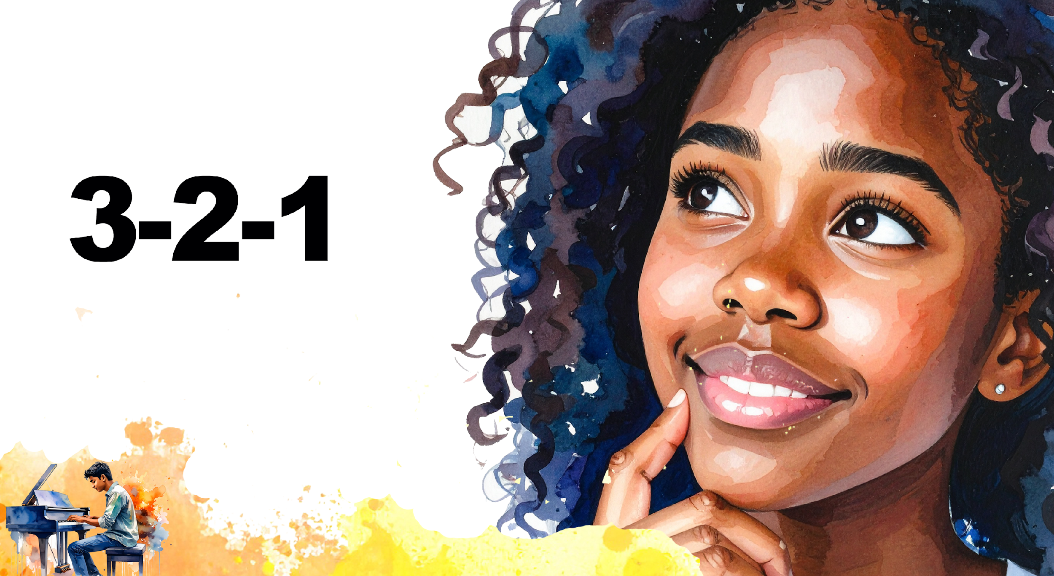
Notes:
Slide 13: Note to teacher: You could hand out recycled paper/Post-it notes for this activity. Allocate a space on the wall where learners can stick their papers. These will be used at the start of the next lesson. Remind learners not to write their names on the Post-it.
As we come to the end of this lesson, let’s take a quick moment to reflect by completing Activity 5 (Lesson 1 – Worksheet).
As you leave class, place your Post-it on the wall. We will use these at the start of the next lesson.

