Slide 1
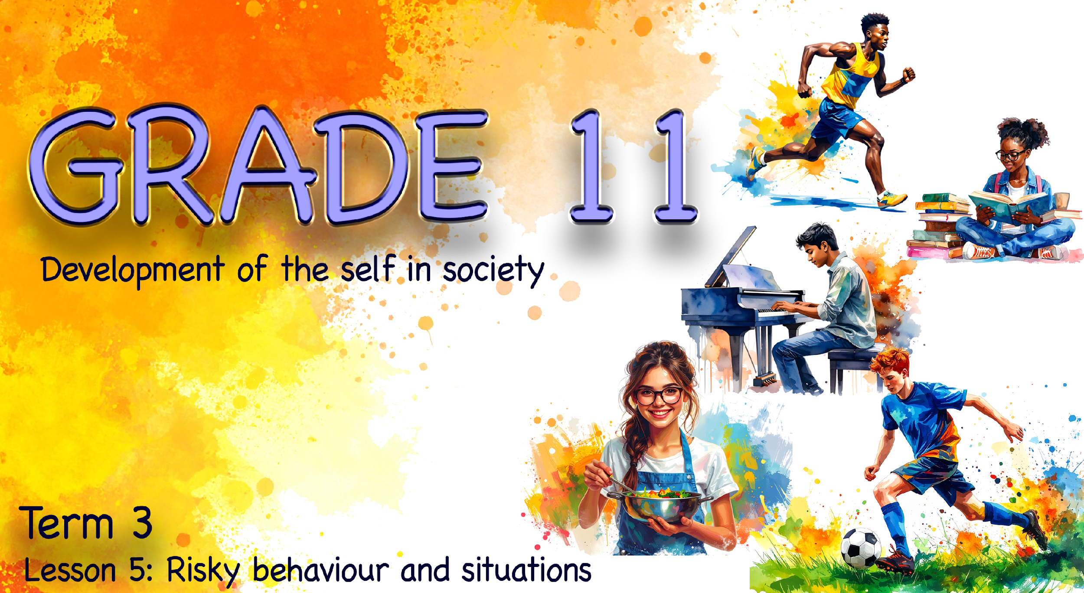

Notes:
Note to teacher: Learners will need to be in groups of six for this lesson. This lesson will take a slightly different approach. Learners will begin by engaging with a card game, which will later inform the group poster they create. Ensure that the card game is laid out on each desk before the lesson begins, as learners will start with this activity.
Slide 1: Welcome back, Grade 11s. Over the last few lessons, we have covered quite a bit about how our behaviour and choices can impact both ourselves and those around us. Let’s refresh our minds.
Each row will have an opportunity to mention examples of how choices can have different types of impacts. (Allow three minutes.)
Row 1: Provide examples of a physical impact.
Row 2: Provide examples of a social impact.
Row 3: Provide examples of an emotional impact.
Row 4: Provide examples of a spiritual impact.

Slide 2
By the end of this lesson, you should be able to:
Recognise that different choices can lead to different consequences.
Understand and apply decision-making steps to make responsible and informed choices.
Identify strategies to prioritise personal safety, change risky behaviour and suggest appropriate sources of support.
Notes:
Slide 2: By the end of this lesson, you should be able to:
Recognise that different choices can lead to different consequences.
Understand and apply decision-making steps to make responsible and informed choices.
Identify strategies to prioritise personal safety, change risky behaviour and suggest appropriate sources of support.

Slide 3

Group Game
Choose between Option A or B
Group guesses your choice
Justify your decision
Choices aren’t always easy
Notes:
Note to teacher: Playing this game may be quite humorous at times, but it also includes some challenging scenarios. Allow for the classroom to be a bit noisy, as a different kind of learning is taking place. This game will also form the foundation for the group decision-making activity at the end of the lesson.
Slide 3: We know that our choices always have consequences. Sometimes those consequences are negative, but the outcome can also be positive. However, when you are in the moment and faced with making a choice, it is not always easy to see what the best outcome might be.
We are going to play a short game called “Would You Rather?”
Each group will receive a pack of cards with different questions. (Lesson 5 – Would You Rather Game) Each person in the group will have a turn to be the reader, and the reader will play two cards.
The reader must choose between Option A and Option B and place the card face down. The rest of the group must then guess which option the reader chose by voting A or B and placing their choice card face down.
The winner of the round is anyone who voted for the same option as the reader. Those who voted incorrectly will have an opportunity to explain why they believe their choice was better. If they manage to persuade the reader to change his or her mind, they win the round.
Winners receive 3 points.
If no one guesses correctly, the reader receives 5 points.
Allow eight minutes for the game. There are 16 different scenarios included in the card pack.

Slide 4

Key Idea
We all make mistakes
Important to:
take responsibility
learn from choices
How do we make better decisions?
Notes:
Slide 4: Well done, Grade 11s. I’m sure many of you found that some of those questions were quite challenging.
The reality is that, as human beings, we will make mistakes. However, it is important to recognise when we have made a mistake so that we can take ownership of it and make things right. This means taking responsibility for our actions and the decisions we make.
Tough decisions, like the ones we saw in the “Would You Rather?” game, may be easier for some people than for others. No one can make these decisions for you. So, how do you make the best decision?
We can use the STOP & ACT approach. These words will help you remember the steps involved in effective decision-making. Let’s take a look.

Slide 5
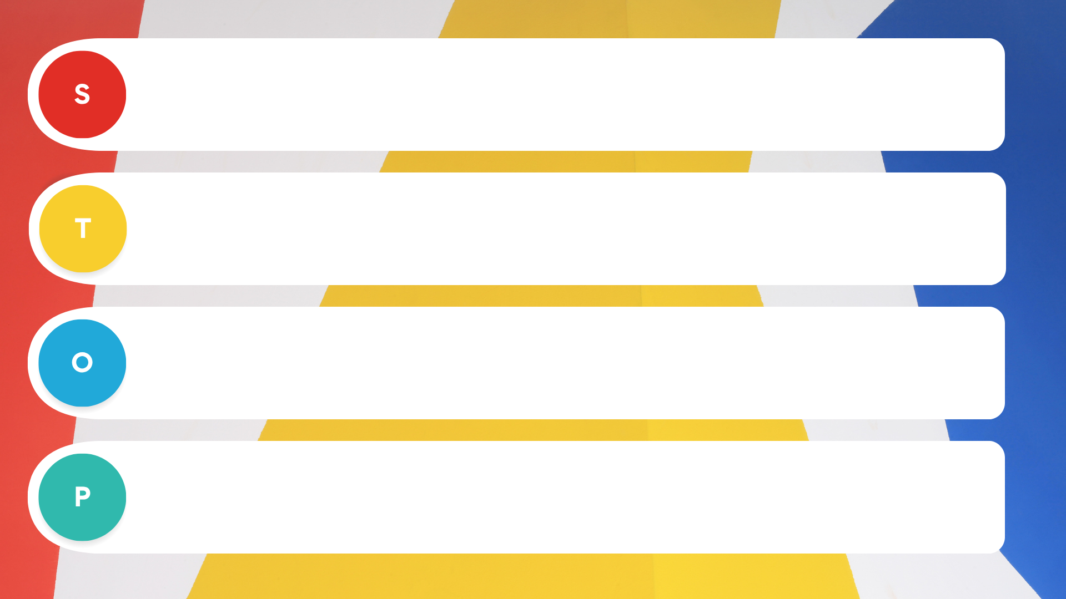
Stop and identify the decision you need to make
Think about the different options or choices.
Outcomes – consider one possible impact or effect of each option.
Pick the best option.
Notes:
Note to teacher: The next two slides use animations to engage learners more effectively. Each click of the mouse will reveal the next letter.
Slide 5: The steps to decision-making are easier when we STOP & ACT.
[Click] S – Stop and identify the decision you need to make.
[Click] T – Think about the different options or choices.
[Click] O – Outcomes – consider one possible impact or effect of each option.
[Click] P – Pick the best option.
This places you in a position where you have made a decision that you are ready to ACT on.

Slide 6
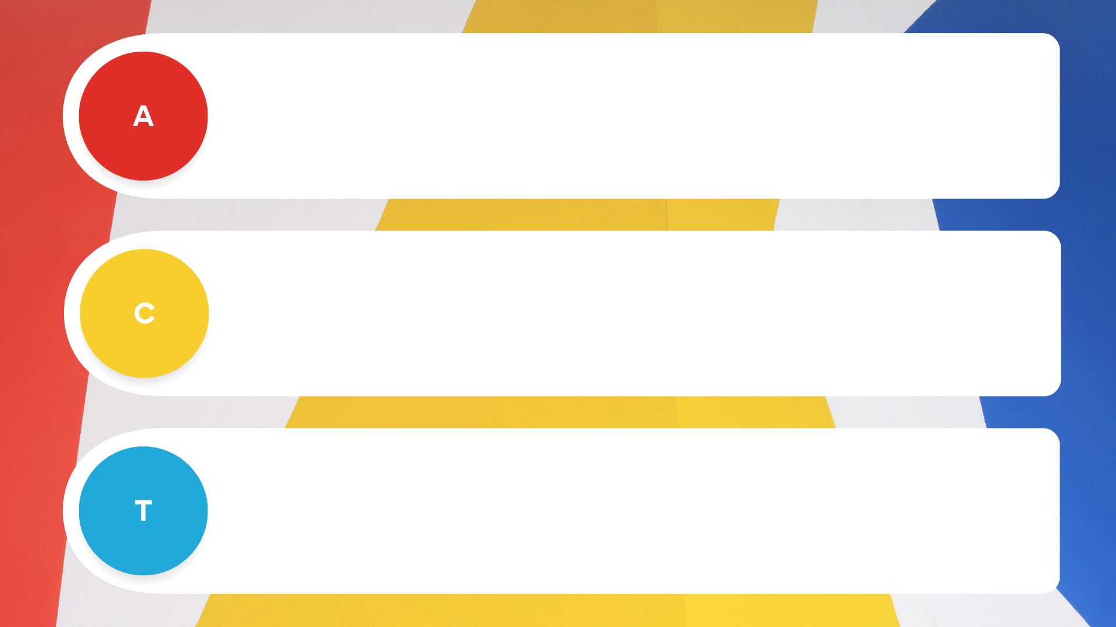
Take action.
Consider the impact that your action has had.
Take stock – reflect on whether you would make the same choice in the future.
Notes:
Slide 6: Now, to ACT means:
[Click] A – Take action.
[Click] C – Consider the impact that your action has had.
[Click] T – Take stock – reflect on whether you would make the same choice in the future.
Now complete Activity 1 (Lesson 5 – Worksheet).

Slide 7
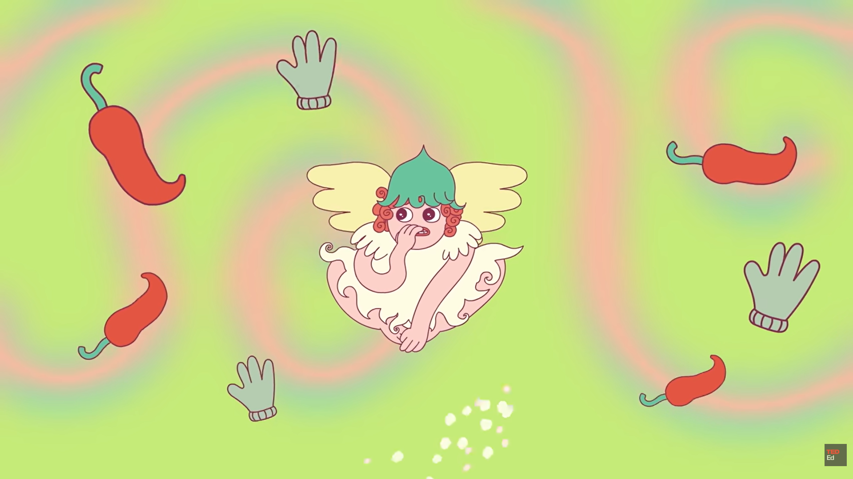
Watch: Why is it so hard to break a bad habit? bit.ly/3QObPMG (5 min 03 sec)
Notes:
Slide 7: A lot of people now use AI spaces to answer questions on anything, even asking AI to determine whether they should see a doctor. The reality is that AI cannot make the tough decisions for you. It will not live with the outcome of your choices; you must learn to make those decisions yourself.
Maybe in the last few lessons, you’ve picked up that you have some behaviours that need to be changed. These could be as serious as a drug habit or as seemingly insignificant as biting your nails. Let’s watch this video to see how we go about changing bad habits into good ones.
Watch video:
Why is it so hard to break a bad habit?
bit.ly/3QObPMG (5 min 03 sec)

Slide 8
Changing Risky Behaviour
Identify triggers:
Notice what causes the behaviour (people, places, emotions or situations).
Prioritise safety:
Avoid risky situations and create distance from harmful influences.
Replace the behaviour:
Choose a healthier action (e.g. exercise, talking to someone, hobbies).
Plan your response:
Decide in advance what you will say or do when faced with pressure.
Seek support:
Ask for help from trusted adults, teachers, counsellors or health professionals.
Notes:
Slide 8 (Advice to change risky behaviour)
If we apply what we have learned from this video, we can change risky behaviour by following these core principles:
Identify the triggers: To change, you must first identify what starts the behaviour. Recognising whether a specific environment, peer group, or emotional state acts as a "trigger" allows you to understand why the behaviour persists.
Prioritise personal safety: Once you know your triggers, create obstacles to make the risky choice harder and the healthy choice easier. This involves creating distance from dangerous situations, changing your daily routines and using life transitions to "reset" your boundaries.
Replace the action: Instead of just stopping a behaviour, replace a harmful action with a safer one. Use healthy coping mechanisms to manage stress and practice assertiveness to ensure you have a pre-planned response when facing pressure.
Seek support: Some risky behaviours are too complex to handle alone. Seeking support from doctors, counsellors or teachers is a sign of strength and a practical way to protect your "one life to live".

Slide 9

Group Poster
Notes:
Slide 9: Hand out one copy per group of the Lesson 5 – Poster.
Learners to complete Activity 2 (Lesson 5 – Worksheet) in groups of six.
Note to teacher:
Each group will have the opportunity to create a poster that can be displayed in the classroom. Explain to learners that the purpose of the poster is to support other learners who may be struggling with the risky behaviours discussed over the past few weeks.
The aim of this activity is to:
provide clear steps for breaking a risky behaviour, and
offer guidance on where learners can find help.
If possible, allow learners access to phones or computers to research local support services. If this is not permitted, the teacher should prepare this information in advance.
Once learners have completed their posters, allocate a space in the classroom where they can be displayed on the wall.

Slide 10

Notes:
Slide 10: Note to teacher: This is an essential part of the lesson, as learners process the content that has been covered. Ensure that enough time is allocated for this activity to be completed before the end of the lesson.
As we finish off this lesson, walk around the classroom to view the different posters created in Activity 2, then complete Activity 3 (Lesson 5 – Worksheet).

