Slide 1
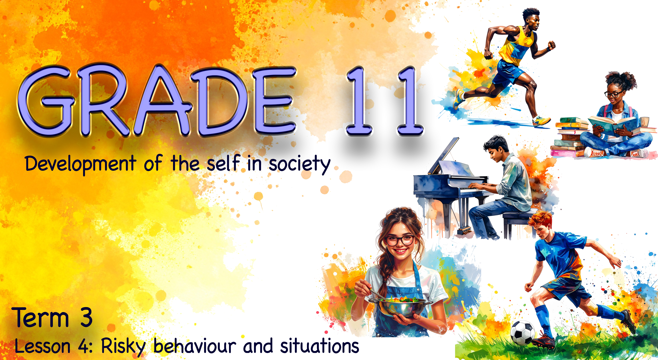

Notes:
Note to teacher: This lesson will often include short discussions with a partner. At times, learners will also be required to work in groups of six. Please note that this lesson includes content related to teen suicide. Handle the topic sensitively, create a respectful classroom environment, and be mindful of learners who may be personally affected.
Slide 1: Welcome back, Grade 11s, to the fourth lesson in this series. In the previous lesson, we saw that there are many different examples of risky behaviour and situations that can impact your health and lifestyle choices.
Turn back to your notes from the last lesson and see if you can name the FIVE risky behaviour situations that were presented in class.
Remember, there were TWO risky situations that are prevalent in South Africa that we did not discuss in class. Can anyone remember what they were? (Allow time for learners to respond.)
The two areas were nutrition/dietary habits and teen suicide.
Suicide not only ends the valuable life of a teenager; it also deeply impacts the lives of everyone around them. Worldwide, we have seen an increase in teen suicide as teenagers face increasing pressures.
Turn to a peer and mention THREE pressures teenagers experience today. (Allow 1 min.)

Slide 2
By the end of this lesson, you should be able to:
Define suicidal thoughts, identify warning signs, and suggest appropriate help-seeking advice, while explaining how the impact of suicide can affect others in the community.
Explain the ripple effect of suicide and identify how positive choices and courage can inspire others and reduce unsafe behaviour.
Describe how unsafe practices can have physical, emotional, social and spiritual consequences.
Apply your understanding of unsafe practices by identifying the physical, emotional, social and spiritual impact of harmful behaviour in a case study.
Evaluate your confidence in understanding and writing about lifestyle choices, negative influences, and risky behaviour in a test or examination.
Notes:
Slide 2: By the end of this lesson, you should be able to:
Define suicidal thoughts, identify warning signs, and suggest appropriate help-seeking advice, while explaining how the impact of suicide can affect others in the community.
Explain the ripple effect of suicide and identify how positive choices and courage can inspire others and reduce unsafe behaviour.
Describe how unsafe practices can have physical, emotional, social and spiritual consequences.
Apply your understanding of unsafe practices by identifying the physical, emotional, social and spiritual impact of harmful behaviour in a case study.
Evaluate your confidence in understanding and writing about lifestyle choices, negative influences, and risky behaviour in a test or examination.

Slide 3
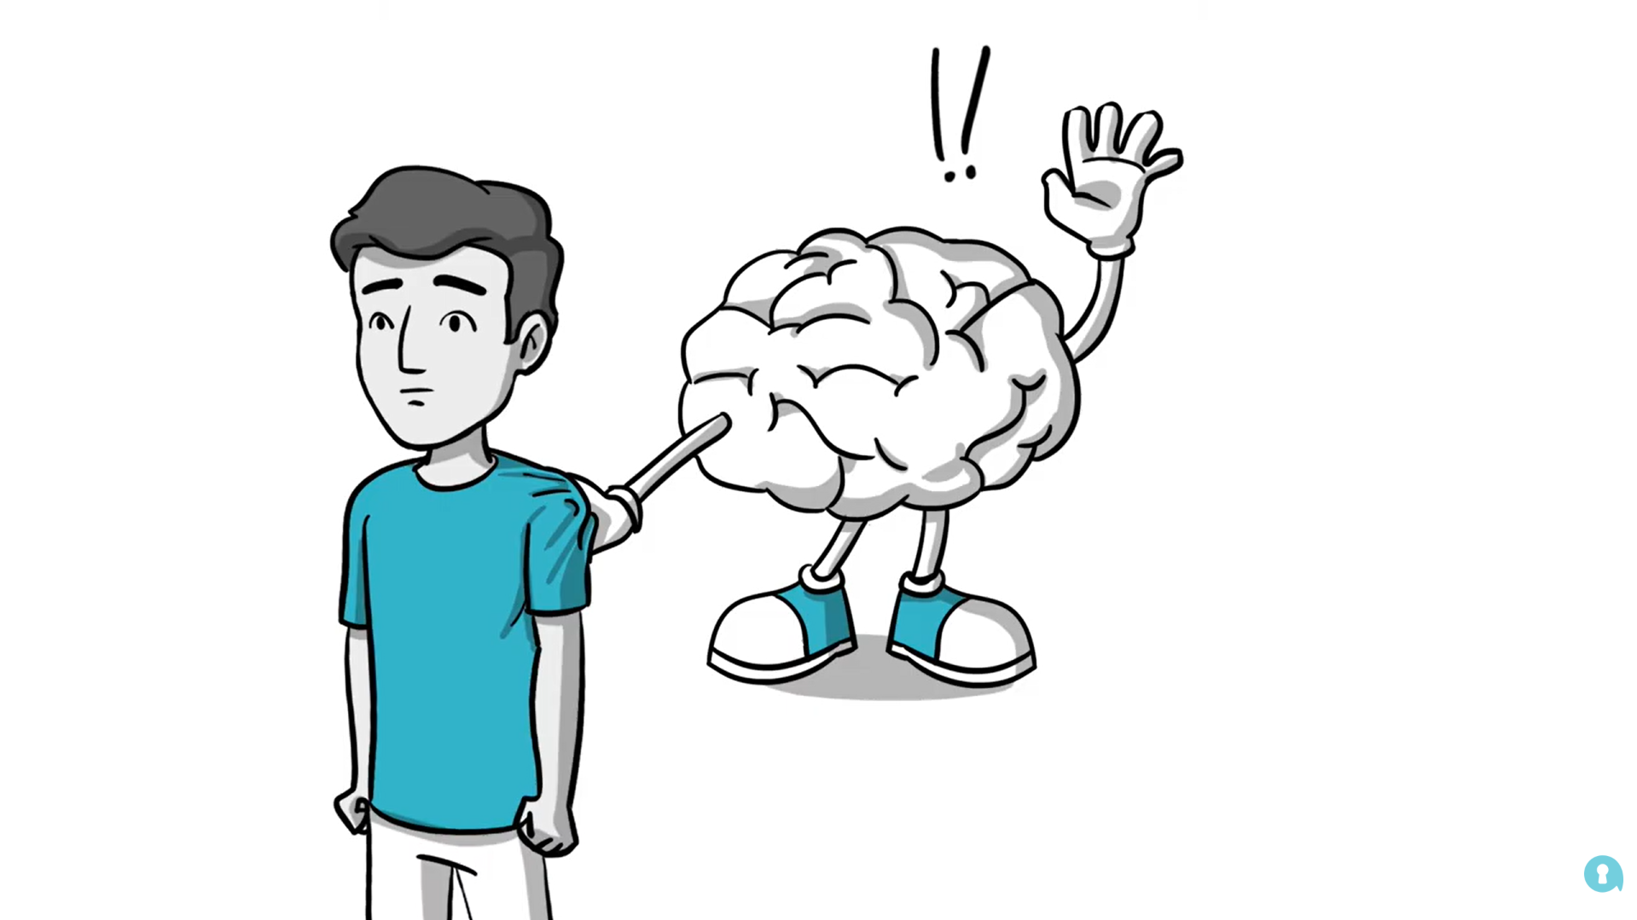
Watch: Understanding teen suicidal thoughts bit.ly/4aNGYqe (2 min 37 sec)
Notes:
Slide 3: Let's watch this clip and then complete the questions in Activity 1 (Lesson 4 – Worksheet).
Possible answers are available in the Lesson 4 – Worksheet MEMO.
Watch video:
Understanding teen suicidal thoughts
bit.ly/4aNGYqe (2 min 37 sec)
Remember, risky behaviour not only affects the person who makes the choice. The impact often spreads outward to friends, family members, teachers, classmates and the wider community. Some effects happen immediately, while others develop over time.

Slide 4

The ripple effect
When people feel overwhelmed, they may not think about how their choices affect others.
One action can create consequences that spread outward to many people.
Notes:
Slide 4: When a person is overwhelmed with hopelessness, they may not consider the impact their decisions will have on those around them.
A helpful way to understand this is the ripple effect. If you drop a pebble into calm water, one small pebble creates ripples that keep moving outward. In the same way, one suicide attempt can create ongoing effects across many people and areas of life.

Slide 5
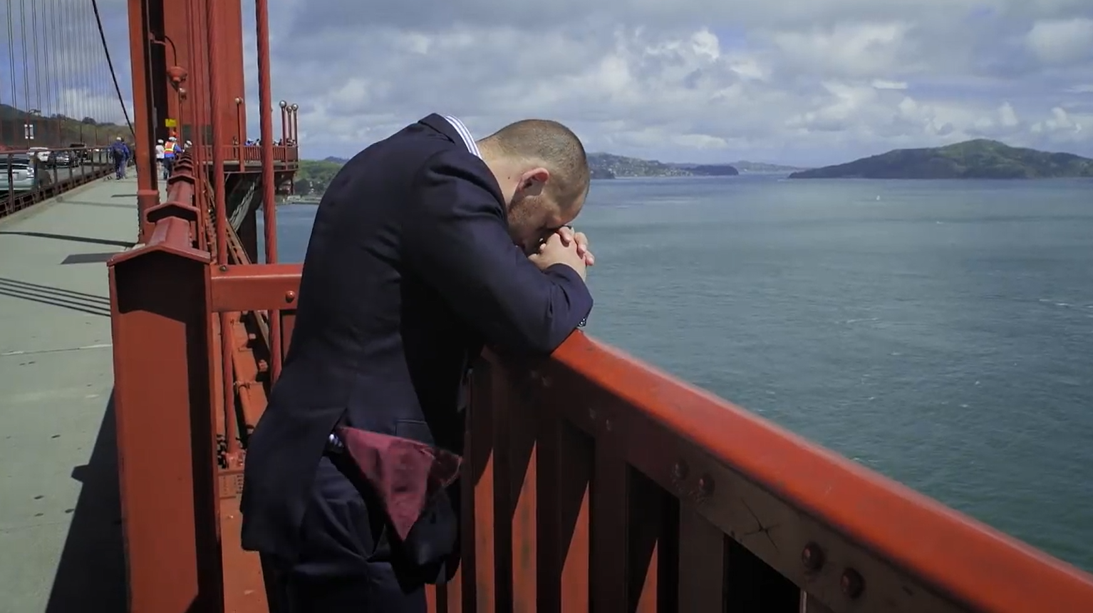
Watch: SUICIDE THE RIPPLE EFFECT | Official Trailer HD bit.ly/4aEFU7X (2 min 33 sec)
Notes:
Slide 5: Up until now, we have focused on the negative ripple effect that risky behaviour and suicide can have. We are now going to shift our focus to the positive ripple effect – how one person’s courage, choices and actions can inspire others and help reduce unsafe behaviour.
Watch the promo of this story of hope from a survivor of a suicide attempt.
Watch video:
SUICIDE THE RIPPLE EFFECT | Official Trailer HD
bit.ly/4aEFU7X (2 min 33 sec)
Turn to your peer and mention THREE things from Kevin’s story that inspire you, and that could inspire others.
In your groups, take some time to complete Activity 2 (Lesson 4 – Worksheet) about the impact that one life can have.
Possible answers are available in the Lesson 4 – Worksheet MEMO.

Slide 6
Impact of unsafe practices
Physically
Injury or illness
Addiction
Fatigue or weakened immunity
Long-term health damage
Emotionally
Guilt or shame
Anxiety or fear
Emotional withdrawal
Feelings of hopelessness
Socially
Friends may withdraw
Families may feel worried or disappointed
Teachers may lose trust
Spiritually
Values and beliefs
Sense of purpose
Identity and self-worth
Notes:
Slide 6: Unsafe practices can affect a person physically, emotionally, socially and spiritually. In many cases, the person engaging in risky behaviour does not consider how far the consequences will spread.
Physical impact: Unsafe practices can place the body under serious strain. Physical impacts may include injury, illness, addiction, weakened immunity, long-term organ damage, fatigue, or health complications that affect daily functioning. In some cases, physical harm can be permanent and may limit future opportunities, such as sport participation, career plans or study goals.
Emotional impact: Risky behaviour often leads to emotional distress. Even when a learner tries to hide the behaviour, emotions such as guilt, shame, fear and anxiety may increase. Learners may also feel overwhelmed, hopeless or emotionally withdrawn. Emotional impact can worsen if the learner is judged, isolated, or afraid of getting caught.
Social impact: Risky behaviour can damage relationships. Friends may withdraw because they do not know how to help. Families may feel hurt, disappointed or worried. Teachers and coaches may lose trust, and learners may experience judgment or stigma from peers. Social impact may also include conflict, isolation and a breakdown of support networks.
Spiritual impact: Spiritual impact refers to the effect risky behaviour has on a person’s beliefs, values and sense of purpose. Unsafe practices may cause inner conflict, especially if the behaviour goes against the learner’s personal morals, religious beliefs or identity. A learner may begin questioning their self-worth or feel that their future has lost direction.

Slide 7

How unsafe practices impact individuals
Notes:
Slide 7: In an interview with a few local teachers who have dealt with many cases of teen misconduct at school, some of the following stories came out of what learners have done over the years, and the reasons learners gave for their misconduct. In each of these stories, we can see an emotional, social and spiritual impact on the individual and the people around them.
Let’s look at one of these stories together.
A group of young girls in Grade 8 wanted to do something to show their commitment to their friendship forever. During break time at school, they cut themselves on their wrists and made a blood pact by pressing their bleeding wounds against one another’s open wounds. All the girls took part.
When questioned one by one about why they did it, these were the responses:
“I didn’t really want to be left out.”
“It’s harmless fun. I know my friends are clean.”
“I want to be close to my friends.”
“They’re closer to me than my sisters.”

Slide 8
Class Discussion
Why is this situation dangerous?
What physical risks are involved?
What emotional impact could it have?
How could it affect friendships and families?
Notes:
Slide 8: Let’s discuss the impact this supposedly harmless situation could have.
Why would this situation be classified as dangerous or harmful?
What impact could this have on the physical well-being of the other girls? (Allow time for the class to respond.)
If one of the girls had a blood disease like HIV, then all the other girls could become infected. What kind of emotional impact would that have on the friends? Do you think this kind of stress would survive their friendship? (Allow time for the class to respond.)
Now, let’s say one of the girls comes from a home where religious beliefs affect decisions about blood transfusions. How could this impact the girl and her family? (Allow time for the class to respond.)
Can you see how a supposedly innocent attempt to cement a friendship could result in multiple negative impacts on a person’s physical, emotional, social and spiritual well-being?

Slide 9

Notes:
Slide 9: Consider the impact of unsafe practices by completing Activity 3 (Lesson 4 – Worksheet) with a peer. You will need to identify the physical, emotional, social and spiritual impact this unsafe practice could have on the individual.
Possible answers are available in the Lesson 4 – Worksheet MEMO.

Slide 10
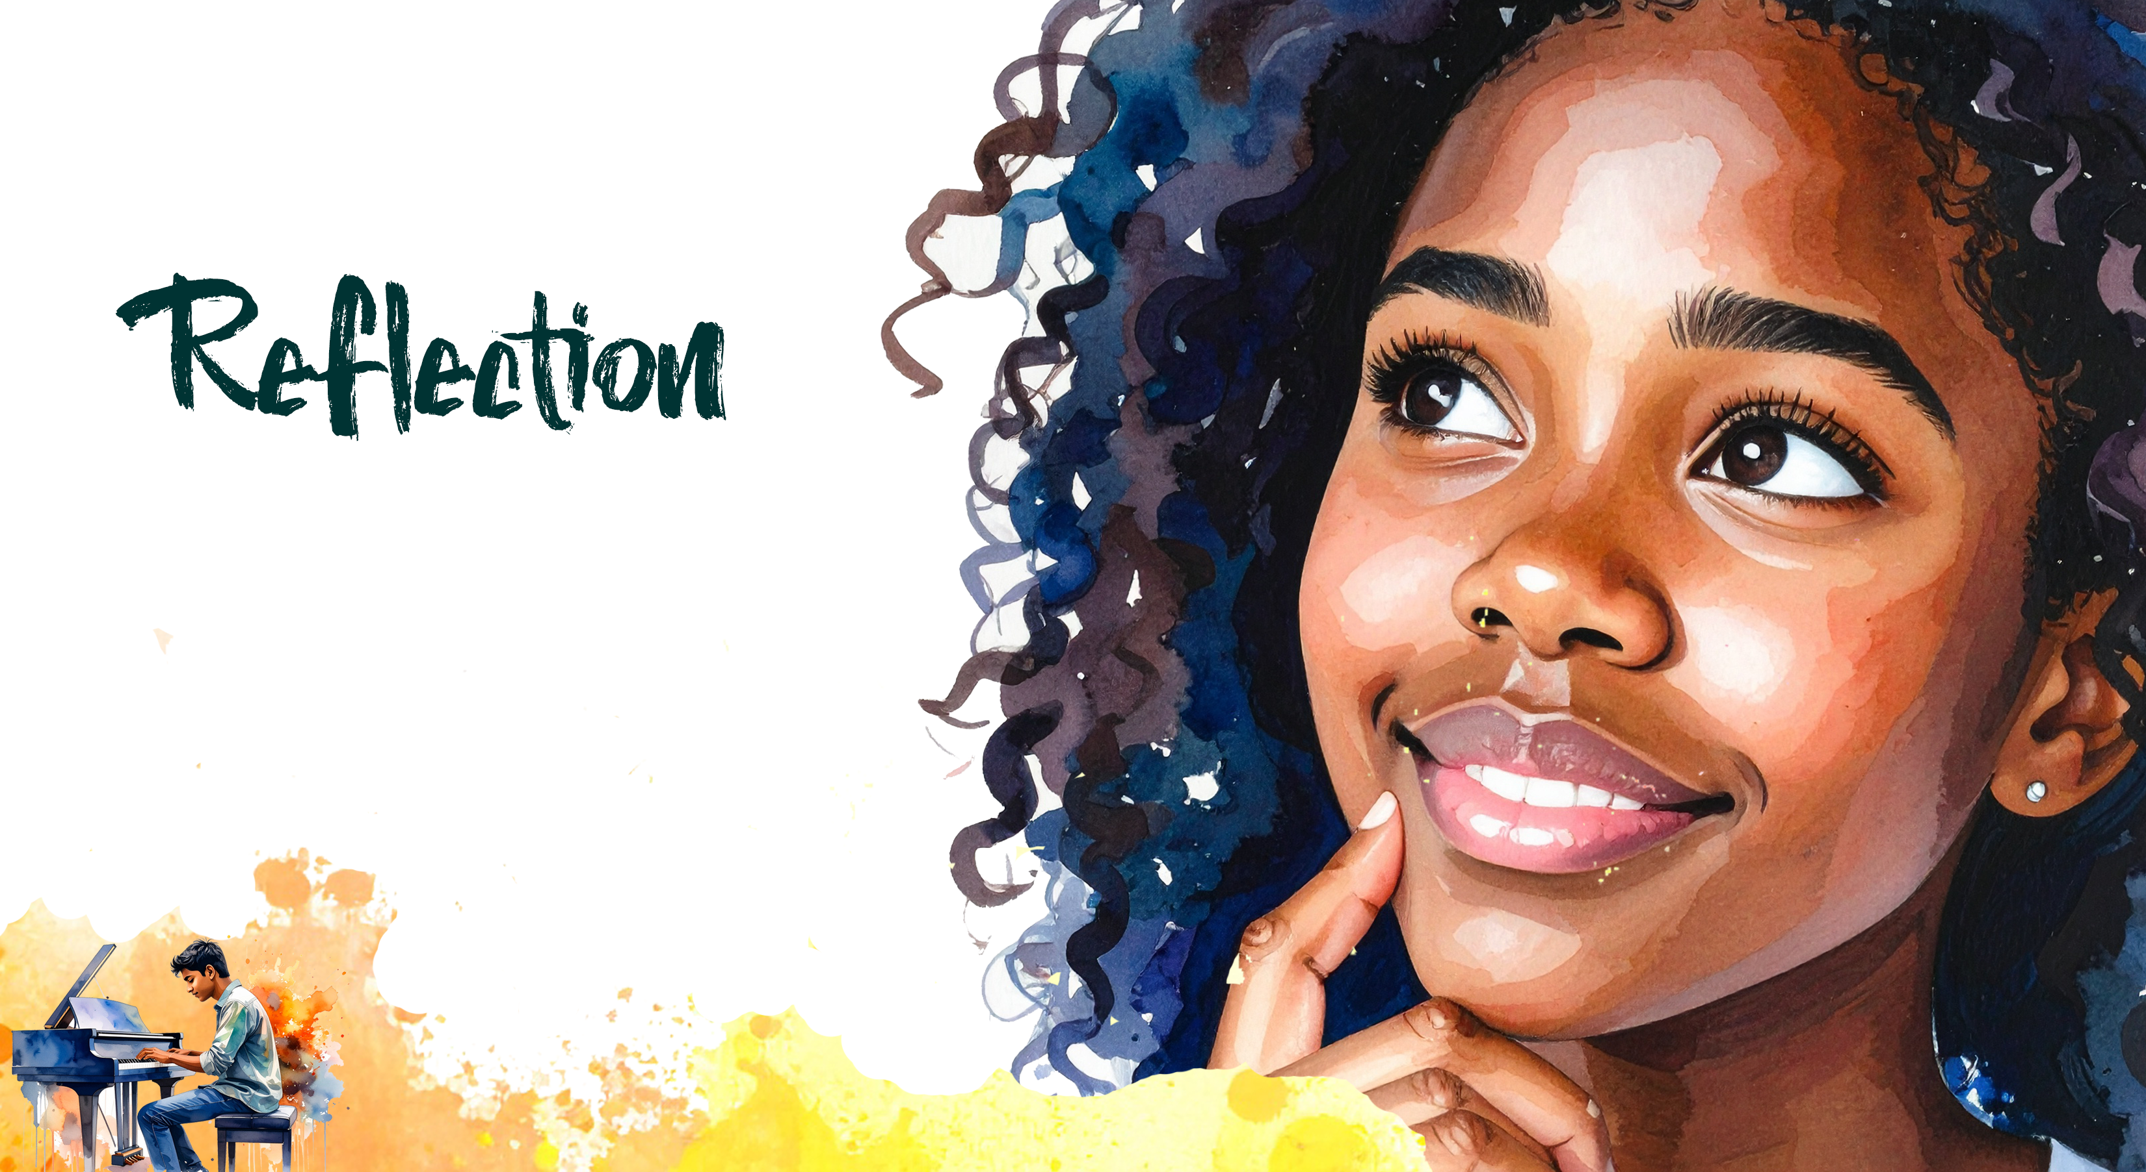
Notes:
Slide 10: We are now a little more than halfway through this series of lessons. In this reflection, you need to respond based on how confidently you feel about both understanding and writing about this content in a test or examination. Complete Activity 4 (Lesson 4 – Worksheet).

