Slide 1


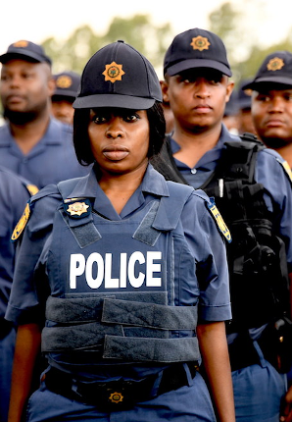

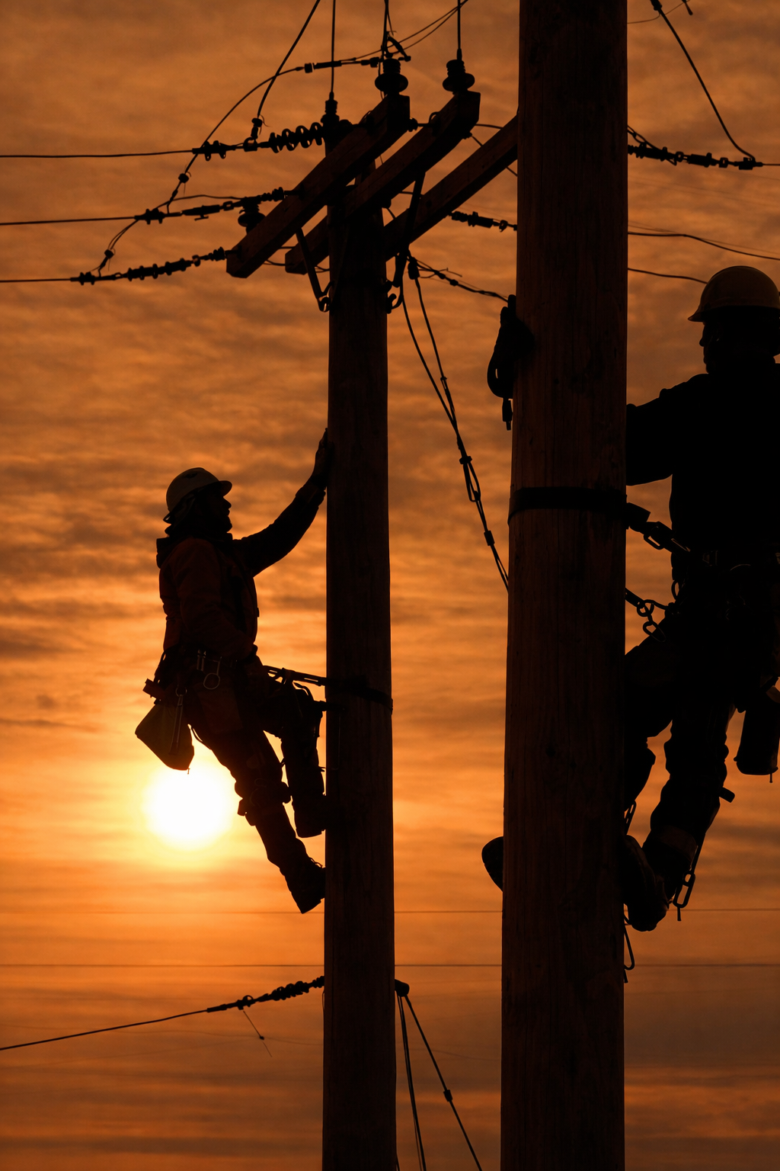
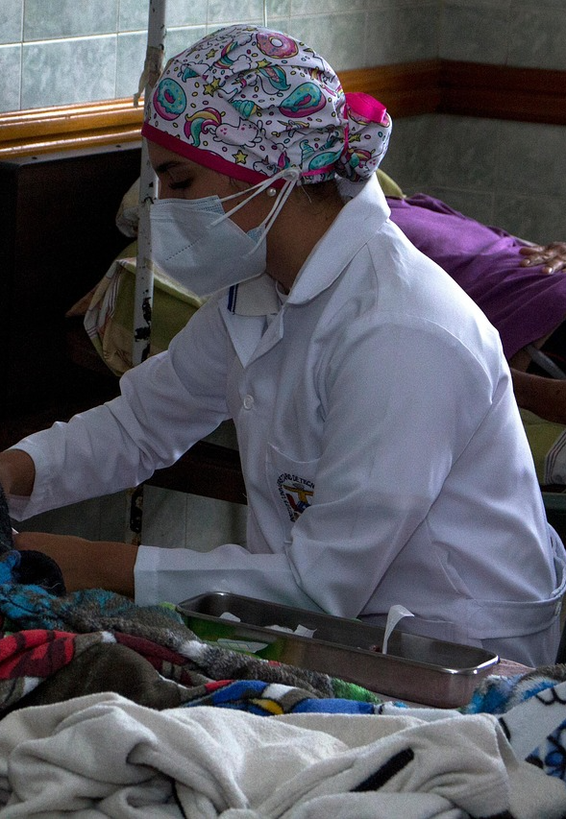
Essential Workers
Who Keeps Our Community Running?
World of Work
Grade 8
Week 3
Notes:
Slide 1: Welcome back, Grade 8s. Today, we’re continuing our lessons on the World of Work topic, with a focus on essential workers and the role they play in our communities.
In the previous lesson, you started thinking about the career categories you might fit into. In this lesson, we’ll delve a bit deeper to discover YOUR specific career category to help you gain a sense of what you may want to do one day.

Slide 2
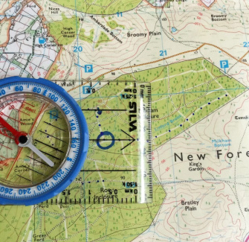
By the end of this lesson, you will be able to:
Explain what an essential worker is.
Identify the career categories of essential workers.
Describe the roles, challenges, and importance of essential workers.
Reflect on your own interests and identify career categories that may suit your strengths and preferences.
Learning Objectives
Notes:
Slide 2: By the end of this lesson, learners should be able to:
Explain what an essential worker is.
Identify the career categories of essential workers.
Describe the roles, challenges, and importance of essential workers.
Reflect on their own interests and identify career categories that may suit their strengths and preferences.

Slide 3

Essential Workers
Jobs needed for daily functioning of society
Continue working during emergencies
Examples:
  Doctors / nurses
  Police / firefighters
  Teachers
  Truck drivers
  Utility workers
Essential workers exist in ALL career categories
Notes:
Slide 3: What is an Essential Worker?
Essential workers are people whose jobs are necessary to keep society functioning every day. These workers provide basic services that communities depend on.
During emergencies such as pandemics, natural disasters, or national crises, essential workers continue working even when others must stay at home.
Essential workers help maintain the stability and well-being of society. Without them, hospitals would close, food supplies would stop, and public safety could be compromised.
Examples:
Nurses and doctors
Police officers
Firefighters
Teachers
Truck drivers delivering food
Utility workers who maintain water and electricity
Learners to complete Activity 1 (Lesson 2 – Worksheet)
Answers are available in the Lesson 2 – Worksheet MEMO.
This activity demonstrates that essential workers can fall into any of the six career categories. Each category contributes to society, whether it’s by helping people, solving problems, creating solutions, organising systems, leading teams, or building things.
Understanding your own personality and interests can help you see how you might fit into roles that are important to the community. This means that people with different interests and strengths can contribute to society.

Slide 4
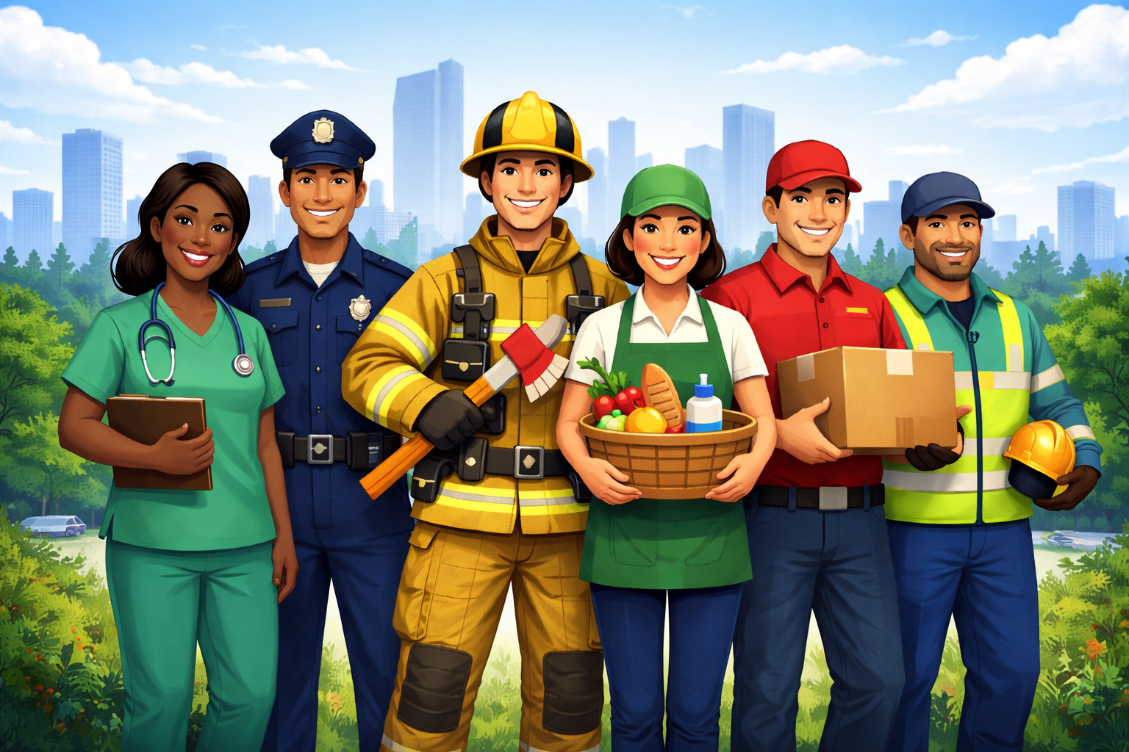
Sectors
Healthcare: doctors, nurses
Safety: police, firefighters
Food: farmers, delivery
Utilities: water, electricity
Transport: drivers
Education: teachers
All help keep society running
Notes:
Slide 4: Sectors in which Essential Workers are involved
Essential workers are found in different sectors that support everyday life. These services are necessary for communities to function.
Healthcare: Doctors, nurses and hospital staff care for the sick and injured.
Emergency and public safety: Police and firefighters protect communities and respond to emergencies.
Food production and distribution: Farmers, shop workers and delivery drivers ensure access to food.
Utilities: Workers maintain electricity, water, sanitation and waste removal.
Transport and logistics: Drivers and transport workers move people and goods.
Education: Teachers and school staff support learning and development.
Essential work includes many different careers that help keep society running.

Slide 5


Essential workers often:
Work long hours
Do demanding jobs
Get little recognition
Work in risky conditions
Respect their work: follow safety rules and show appreciation.
Notes:
Slide 5: Unsung Heroes
Essential workers are often called "unsung heroes" because their work is important but not always recognised or celebrated. Many essential workers:
work long hours (shift work, night duty and overtime)
do physically demanding tasks
receive little public recognition/appreciation
continue working in difficult or risky situations
During the COVID-19 pandemic, people became more aware of how important these workers are, especially those working behind the scenes.
Examples include cleaners, delivery drivers, grocery workers, utility workers, and waste collectors.
These workers help keep basic services running, even in challenging circumstances. Our responsibility is to respect their work by following safety rules and saying thank you.

Slide 6


Watch: Living in Lockdown: Message to nurses, doctors and essential workers in South Africa bit.ly/3PBQHJ4 (1 min 41 sec)
Notes:
Slide 6: Let's watch a short video in which people celebrated essential workers during the COVID-19 pandemic. We should not only appreciate these workers during times of crisis. The work they do is important every day.
Watch Video:
Living in Lockdown: Message to nurses, doctors and essential workers in South Africa
bit.ly/3PBQHJ4 (1 min 41 sec)

Slide 7


Notes:
Slide 7: You will have the next 10 minutes to complete Activity 2 (Lesson 2 – Worksheet). I will put a timer up on the board so you can keep track of the time. You may work with the person sitting next to you and discuss your answers, but make sure that each of you completes your own worksheet.
Possible answers are available in the Lesson 2 – Worksheet MEMO.

Slide 8
Career Categories
Remember:
No “right” category
You may fit into more than one
Goal:
Discover what suits YOU
Notes:
Slide 8: We already learnt that every person has different interests, strengths, talents and personality traits, and that these differences influence the types of careers we may enjoy and succeed in.
It is important to remember:
There are no right or wrong categories.
You may fit into more than one category.
These categories help you understand your strengths and possible career paths.
In Activity 2 (Lesson 2 – Worksheet), you will explore your own interests and preferences to discover which career categories may suit you best.
The goal is to help you learn more about yourself and how your strengths and interests connect to future career choices.
You have the remainder of the lesson to complete Activity 2 in your worksheet.
Note to teacher: If you have a couple of minutes to spare at the end of the activity, ask learners to share which categories they identified with and whether they feel these categories accurately describe them.

