Slide 1


Grade 8
Term 2: World of Work
Lesson 1: Self-management skills
Notes:
Slide 1: In Term 1, you completed your first test series in high school. Some of you may have felt confident about your results, while others may have felt unsure. You may even have thought, "I should have studied differently".
Today's lesson is not about judging how you performed, but about understanding what you can do better going forward.
In this lesson, we will build on our work on learning styles and allow you to reflect on how you manage your own learning.
This will help you start preparing effectively for your Term 2 examinations, so that you feel more confident and in control when the time comes.

Slide 2
By the end of this lesson, you should be able to:
Explain
Explain the concept of self-management.
Explain
Explain the steps of planning, monitoring, and adjusting your learning.
Apply
Apply different learning style strategies (visual, reading/writing, kinaesthetic, and auditory).
Reflect on
Reflect on your own learning habits and develop a simple plan to improve your self-management.
Notes:
Slide 2: By the end of this lesson, you should be able to:
Explain the concept of self-management.
Explain the steps of planning, monitoring, and adjusting your learning.
Apply different learning style strategies (visual, reading/writing, kinaesthetic, and auditory).
Reflect on your own learning habits and develop a simple plan to improve your self-management.

Slide 3
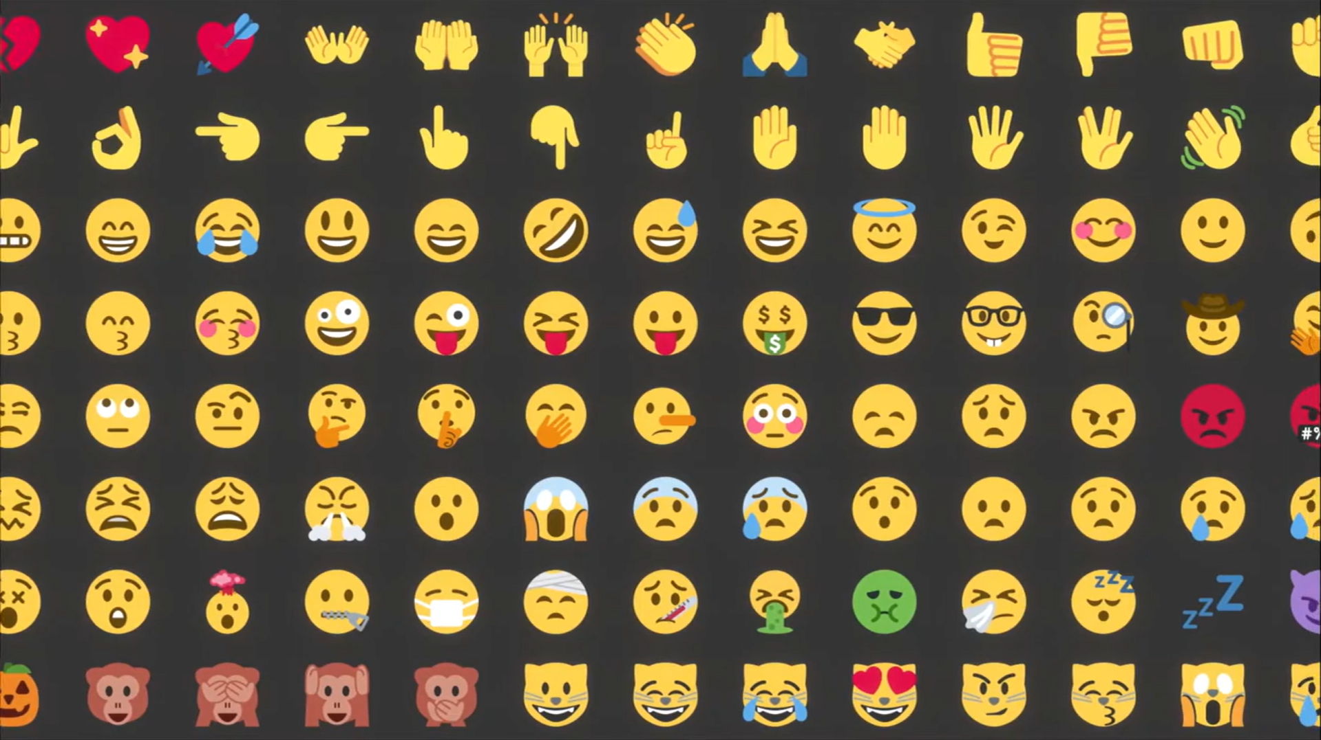
Watch: BUILD Spark Skills: Self-Management bit.ly/4rN9heR (1 min 32 sec)
Notes:
Slide 3: Let's start by watching a short video. While you watch, think about this question: Are you really in control of your own learning? Not your teachers or your parent. YOU.
Watch video:
BUILD Spark Skills: Self-Management
bit.ly/4rN9heR (1 min 32 sec)

Slide 4
What is self-management?
Being in control of yourself
Managing emotions
Improving yourself
Not procrastinating
Responding instead of reacting
Notes:
Slide 4: Ask learners to respond to the following question: What does self-management mean according to the video?
Note to teacher: Reveal the slide content only once learners have shared their answers.
Possible responses:
Being in control of yourself
Managing emotions
Improving yourself
Not procrastinating
Responding instead of reacting
All of these aspects make up self-management, but today we are going to focus on one specific area: Self-management during learning.

Slide 5

Quick reflection
Who has ever said, 'I’ll study later', and then didn’t?
Who has studied but still didn’t understand the work?
Who gets distracted while studying?
Notes:
Slide 5: Ask learners to raise their hands in response to the following questions:
Who has ever said, 'I’ll study later', and then didn’t?
Who has studied but still didn’t understand the work?
Who gets distracted while studying?
That is NOT a knowledge problem; it is a self-management problem.

Slide 6
Self-management during learning
Self-management means:
Taking control of your learning
Using time wisely
Staying organised
You need to:
Plan
Focus
Check understanding
Adjust when needed
Notes:
Slide 6: Let's take a moment to define self-management skills during learning.
Self-management during learning means taking control of how you study, using your time wisely, staying organised, and making choices that help you do better at school.
Many learners experience challenges in school, such as putting off studying, struggling to understand work even after studying, or getting distracted while trying to focus.
These challenges are often not caused by a lack of knowledge, but rather by difficulties with self-management.
Instead of simply hoping that you will understand the work, you need to take an active role in the learning process:
Plan what you’re going to do
Stay focused while you’re doing it
Check if it’s working
Make changes if it’s not working
Let's break it into three simple steps.

Slide 7

Step 1: Plan
Before studying:
Decide what to study
Decide how long
Choose a method that works for you
Same work, different methods:
visual → draw
auditory → explain
Notes:
Slide 7: Step 1: Plan
Planning is what you do before you start studying. Decide what you will study, how long you will study, and which method you will use.
Let's use an example. Say you have a Natural Sciences test tomorrow.
Instead of saying, "I’ll study later", you say: "I will study Natural Sciences for one hour using a method that works for me."
Here is where your learning style(s) becomes important. Different learners should plan differently, for example:
If you are a visual learner, your plan could include studying the digestive system by drawing and labelling a diagram.
If you are an auditory learner, your plan could include explaining the digestive system out loud as if you're teaching it.
Do you see the difference? Everyone is studying the SAME work, but they are planning it in a way that suits how they learn.

Slide 8

Step 2: Monitor
While studying:
Ask: Do I understand this?
If you can’t explain it → may not be appropropriate
Notes:
Slide 8: Step 2: Monitor
Planning is important, but just because you planned something doesn’t mean it’s working.
Check if your study method is working while you are studying.
Ask yourself: "Do I understand this?" If you can’t explain it in your own words, your method may not be appropriate.

Slide 9

Step 3: Adjust
If your method is not working:
Change your strategy
Example:
Reading not working →
draw / explain / practise instead
Try a different method
Notes:
Slide 9: Step 3: Adjust
That brings us to the next step: adjusting.
This is where self-management really shows. Change your study method if it is not helping you understand.
If you’ve been reading your notes repeatedly, and it's not sinking in, you need to adjust your strategy. Instead of reading, you can try to draw it, explain it, or practise it.

Slide 10
Daily self-management
Listening in class → focus
Taking notes → use effective methods
Homework → check understanding
Don’t understand → ask for help or adjust
Notes:
Slide 10: It's important to note that self-management skills are not only used when preparing for tests and exams. You should be using these skills every day at school.
Let’s look at a normal school day.
Your teacher is explaining the work: Are you focused and trying to understand the work being explained? (planning)
You are taking notes: Are you just copying, or are you using a method that helps you understand? (planning)
You sit down to do homework: Are you rushing through it, or are you checking if you really understand the work? (monitoring)
You don’t understand something: Do you ignore it, or do you ask for help or try a different method? (adjusting)

Slide 11
Take control
Don’t wait for motivation; Take action
1
Use different learning styles
2
Combine methods for better learning
3
Notes:
Slide 11: The video we watched earlier said: "Don’t wait. Don’t make excuses. Be a self-starter."
In learning, that means you should not wait until you feel motivated or say, "I’ll do it later". Instead, you need to take action and take control of your learning.
You have already learned about different learning styles in Term 1. Now the important question is: Are you actually using these when you study?
Remember, most learners do not have only one learning style. You may prefer certain methods, but learning is most effective when you use a combination of different strategies. By doing this, you give yourself a better chance of understanding and remembering your work.

Slide 12
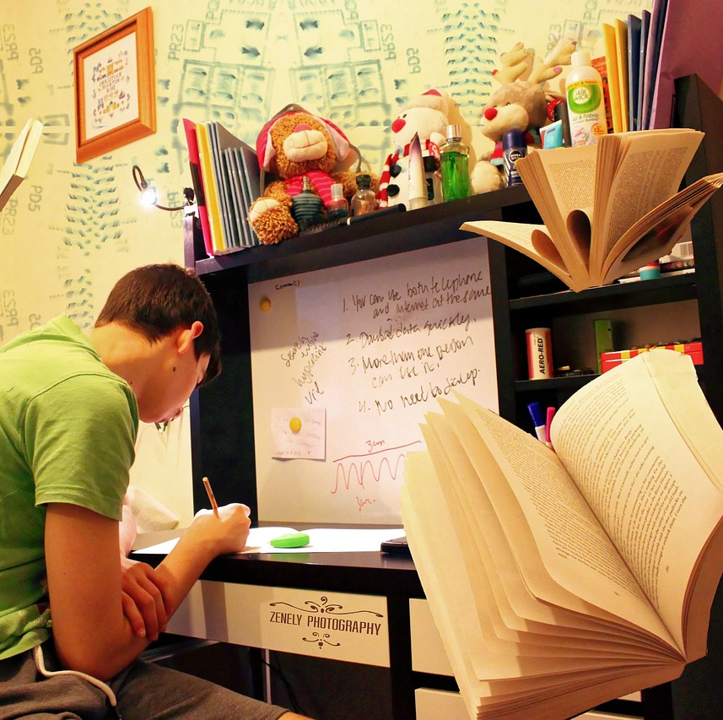
Activity
You will now:
  Apply different learning strategies
  Work individually, in pairs and in groups
  Use different methods on the same content
Try every method properly
Notes:
Slide 12: We are now going to apply different learning style strategies to the same piece of content.
Activity 1 (Lesson 1 – Worksheet) includes individual work, pair work and group work.
You will use different methods to work with the same information. This will help you see which strategies work best for you. It is important that you try each method properly, even if it is not your preferred learning style.
I will guide you through the activity and manage the time for each section. When I say move on, you must move on to the next part.
Note to teacher: The focus is not on the content itself, but on how learners engage with the content using different strategies. Allow learners time to read the extract silently before starting the activity. Allocate approximately four minutes per section. Use a timer and give clear instructions when learners need to move on to the next section.

Slide 13

Reflection
Notes:
Slide 13: Now that you have applied different learning strategies, think about how you can use these to manage your learning and prepare for your Term 2 examinations by completing Activity 2 (Lesson 1 – Worksheet). If learners do not finish the activity in class, they must complete it as homework.
Hand out the Content Summary before learners leave the class.

