Slide 1


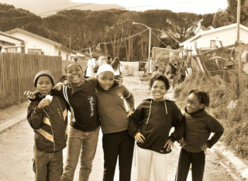
World of Work
Grade 8
Term 2: Week 6
Social and Economic Needs in South Africa
Notes:
Slide 1: Welcome back, Grade 8s. Today, we’re finishing our lessons on the World of Work topic. In this lesson, we explore how your future career fits into the bigger picture of our country.
Having a job or career is about more than just earning a salary to buy things; it is the engine that keeps South Africa running. Every job, from a nurse to a shop owner, helps address a need in our society.

Slide 2


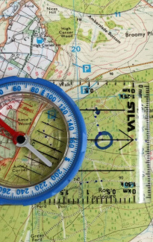

By the end of this lesson, you should be able to:
Differentiate between needs and wants.
Define and give examples of social and economic needs.
Identify social and economic needs in the community and country.
Explain how work helps to meet social and economic needs.
Notes:
Slide 2: By the end of this lesson, learners will be able to:
Differentiate between needs and wants.
Define and give examples of social and economic needs.
Identify social and economic needs in the community and country.
Explain how work helps to meet social and economic needs.

Slide 3

Needs vs Wants
Needs = goods and services you must have to survive and stay healthy
Food, water, shelter, healthcare
Wants = goods and services that you would like to have
Expensive cars, branded clothing, the latest smartphones
Notes:
Slide 3: Understanding wants and needs
Before we can understand how work addresses needs, we must first distinguish between needs and wants.
Basic needs: These are essential goods and services you must have to survive and stay healthy. Without these, your life would be in danger.
Examples: Nutritious food, clean water, basic clothing, healthcare, and safe shelter.
Wants: These are goods and services that you would like to have to make life more enjoyable or comfortable, but you can live without them.
Examples: Expensive cars, branded clothing, the latest smartphones, entertainment subscriptions, or eating out at restaurants.
Allow learners to quickly complete Activity 1 (Lesson 5 – Worksheet).
Answers are available in the Lesson 5 – Worksheet MEMO.

Slide 4

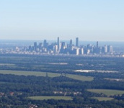
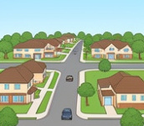

Communities
You belong to many communities:
family, school, neighbourhood, town, province, country
Communities have needs too:
Social
Economic
Notes:
Slide 4: Belonging to communities
You belong to many communities: your family, your school, your neighbourhood, your town, your province and your country.
Just like you have personal needs, these communities have collective needs. We split these into two main groups: Social and Economic.

Slide 5
Social needs (living well)
Focus: well-being of people
Education → schools & teachers
Healthcare → clinics & doctors
Safety → police & emergency services
Support → care for vulnerable people
Notes:
Slide 5: Social needs (living well)
Social needs refer to services and systems that support the well-being of people.
Education: We need schools and teachers so children can learn.
Healthcare: We need clinics and doctors to help us when we are sick.
Safety: We need the police and emergency services to keep us safe.
Social support: We need institutions that care for the elderly and those who are unable to look after themselves.

Slide 6
Economic needs (growing the economy)
Focus: money & growth
Jobs → earning income
Infrastructure → roads, transport
Utilities → water, electricity
Business → support for companies
Notes:
Slide 6: Economic needs (growing the economy)
Economic needs focus on money, jobs, and resources. These are the systems that help people earn an income to support themselves and their families, and help the country grow economically.
Job opportunities: People need places to work so they can earn an income.
Infrastructure: We need good roads, railways, and bridges to move goods from factories to shops.
Utilities: Businesses need reliable electricity, water, and internet to stay open.
Business support: We need a system that helps people start their own small businesses.

Slide 7
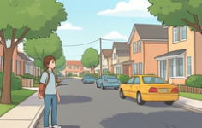


HOW TO IDENTIFY COMMUNITY NEEDS
Look Around You
Observe your area. Are there unemployed people? Is the water clean? Are roads safe?
Talk to People
Ask neighbours and classmates what problems they face and what they wish was better.
Keep a Needs Diary
Write down daily observations like rubbish in the street or long clinic queues to spot patterns.
Notes:
Slide 7: Identifying community needs
In South Africa, many people still face serious challenges such as not having enough food, limited job opportunities, lack of clean water, and unsafe or inadequate housing. These issues affect the wellbeing and quality of life of many communities.
Ways to identify needs:
Observe your area: roads, schools, clinics, jobs.
Talk to people: friends, neighbours, classmates – ask what could be improved.
Keep a Needs Diary: note problems you notice daily or weekly.
Join youth groups where you could help start projects or contribute to solutions.
You will now work in groups to identify social and economic needs within the community and country.
Learners to complete Activity 2 (Lesson 5 – Worksheet) in groups.
Allow groups to provide feedback.
Possible answers are available in the Lesson 5 – Worksheet MEMO.

Slide 8
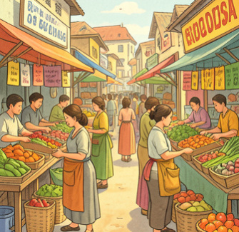
Role of Work
Work connects needs → solutions
Earn income → support yourself and your family
Spend money → support businesses that employ others
Provide services → jobs solve problems
  Examples:
    Farmer → food
    Builder → housing
Notes:
Slide 8: The role of work in meeting needs
Work is the bridge that connects a "need" to a "solution". It helps the country in three main ways:
1. Earning an income and supporting businesses:
When a person has a job, they earn a salary. This helps the economy in two ways:
Independence: It allows people to pay for their own needs (like food, clothes, and rent). This means they can take care of themselves and their families without needing to rely on the government for survival.
Supporting local businesses: When workers spend their money at the grocery store, the hair salon, or the pharmacy, they are putting money back into the community. This helps those businesses stay open, pay their own bills, and hire even more people.
2. Providing a service:
Every job solves a specific problem for society.
A builder solves the social need for housing.
A farmer solves the basic need for food.
A taxi driver solves the economic need for transport.

Slide 9
Tax
Workers & businesses pay tax
Government uses tax for:
schools
hospitals
roads
Work helps fund public services
Notes:
Slide 9:
3. The role of tax
When people work and businesses make a profit, they pay tax to the government. The government uses this tax money to pay for social and economic needs, like building public hospitals or paying police officers. Without people working and paying taxes, the government would not have enough money to fix roads or run schools.
By identifying needs in your community, you can explore careers that help to meet these needs and make a positive difference.

Slide 10
Unemployment
Not enough jobs
Skills may not match jobs
Businesses are expensive to start
Result:
People struggle to meet needs
Notes:
Slide 10: The challenge: Unemployment in South Africa
If work is so important, why doesn't everyone have a job? South Africa faces a big challenge called unemployment. This happens because:
There are not enough jobs for everyone who wants to work.
Some people do not have the right skills or education for the jobs that are available.
It is expensive for new businesses to get started.
When people are unemployed, they struggle to meet their basic needs. This is why it is so important for the government and businesses to work together to create more opportunities.

Slide 11
Volunteering
Helping without pay
Examples:
Tutoring learners
Soup kitchens
Clean-ups
Helps meet needs
Builds experience
Notes:
Slide 11: Volunteering
Sometimes, there aren't enough jobs or government funds to solve every problem. Volunteers step in to fill these gaps. Volunteering is when you give your time, skills, and energy to help others without being paid.
For example:
A volunteer might tutor younger learners after school (education), help out at a soup kitchen (nutrition), or join a neighbourhood watch (safety).
Volunteers might organise a beach or park clean-up to keep the community healthy and beautiful.
For young people, volunteering is a powerful way to start making a difference before you even have a full-time job. It provides you with the opportunity to work towards meeting social and economic needs right now, rather than waiting until you are an adult.

Slide 12
Conclusion
Needs ≠ wants
Communities rely on:
social needs
economic needs
Work helps meet these needs
Everyone can contribute
Notes:
Slide 12: Now that we have explored needs, communities, and the role of work, let’s summarise what we have learned.
People have both needs and wants, but needs are essential for survival, while wants are additional comforts.
Communities depend on both social needs (such as healthcare, education, and safety) and economic needs (such as jobs and income) to function well.
As members of a community, it is important to recognise these needs and understand how work, employment, and government services help to meet them.
Everyone has a role to play. Even young people can contribute by being aware of challenges, helping others, and developing skills that will allow them to make a positive impact in their community and the economy.
You have the remainder of this lesson to complete Activity 3 (Lesson 5 – Worksheet).
Answers are available in the Lesson 5 – Worksheet MEMO.
Hand out the Content Summary before the learners leave the classroom.

