Slide 1


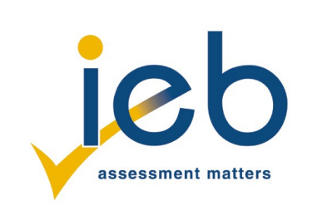
NATIONAL SENIOR CERTIFICATE EXAMINATION 2026
LIFE ORIENTATION
COMMON ASSESSMENT TASK: PART A
Notes:
Understanding the Concept of Ethics, Mind Dump: Personal Reflections on Ethics, Exploring Ethics Through Inquiry, Why Study Ethics?

Slide 2
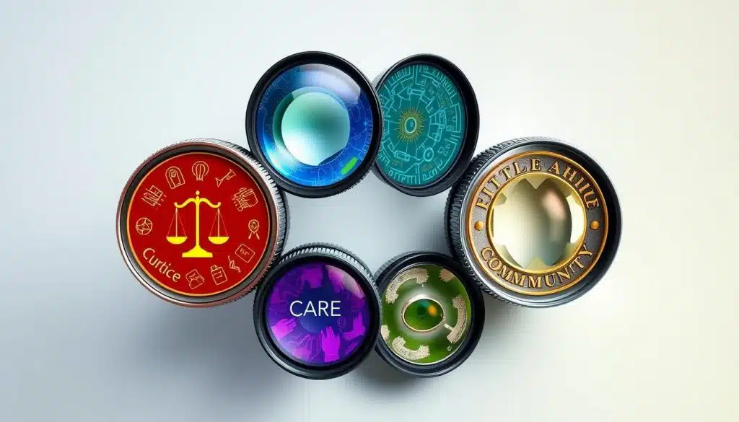
FOCUS OF THE 2026 CAT
The 2026 Life Orientation CAT will engage learners with the theme of Ethics in a Changing World. It will address:
• An understanding of the concept of ethics and why it is central to human decision-making.
• Ethical dilemmas that arise from technological, political and social change.
• How ethical principles can guide learners to act responsibly and compassionately in a complex world.
• The application of ethics in different contexts, such as:
medicine
business
sports
food production
fast fashion
environmental responsibility
governance

Slide 3
NB: ASSESSMENT REQUIREMENTS
Questions 3 (20 marks) and 4 (60 marks) are compulsory questions for assessment.
Please work through Question 1 and Question 2 with your classmates and your teacher, and carefully note the comments and observations made. These will give you insight into the multiple perspectives of each contextual source that you may not have previously considered. This will aid you in providing quality answers in CAT A and B.
Regarding your responses in both CAT A and CAT B, please ensure that you provide sufficient detail in your answers. You are required to think deeply about each question and ensure that your opinions and thoughts are supported by valid reasoning.

Slide 4

Question 1: What is Ethics
Ethics: Concepts, Theories, and Decision‑Making
{{{{{
Understanding moral principles guiding human behavior

Slide 5
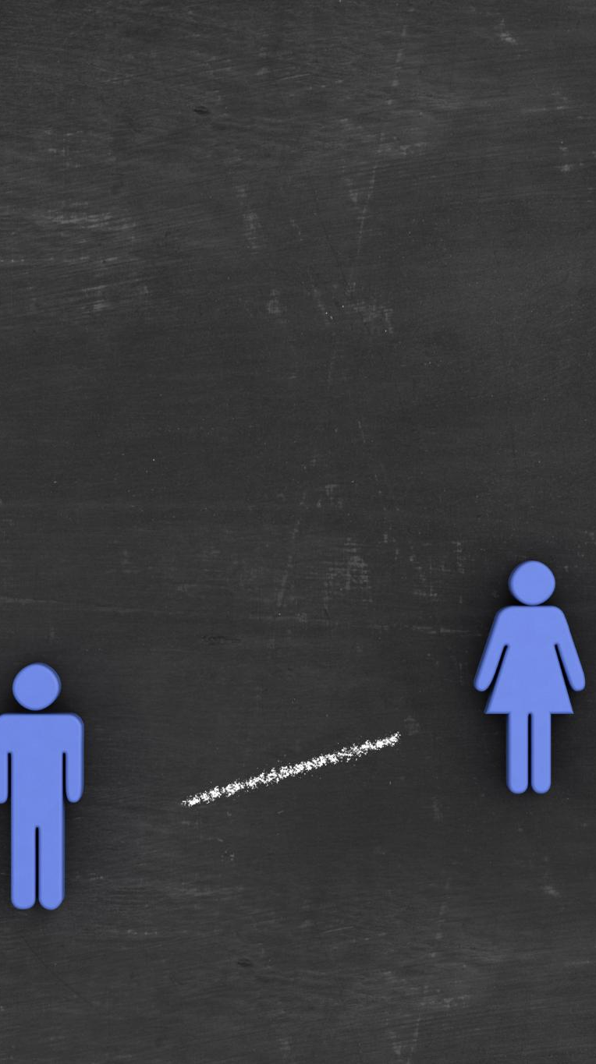
1.1 Read the extract
Understanding the Concept of Ethics
Definition and Core Questions
  Ethics studies moral principles guiding right and wrong and asks fundamental questions about living and choices.
Ethical Dilemmas
  Ethical inquiry challenges people to evaluate complex dilemmas like honesty, wealth distribution, and harm for greater good.
Applied Ethics and Social Impact
  Ethics examines applied issues such as war, medical research, and societal responsibilities across diverse contexts.
Ethics and Morality Relationship
  Ethics and morality often overlap, providing frameworks to evaluate human actions and societal functioning.
Notes:
1.1 Exploring Ethics
Ethics refers to the study and application of moral principles which help individuals distinguish right from wrong in a structured and reflective way. At its core, ethics asks fundamental questions such as how we should live, whether happiness or virtue should guide our choices, and how to treat others in situations of moral tension. For example, ethical inquiry challenges people to evaluate dilemmas like whether dishonesty is ever justified, whether wealth is morally defensible in the face of global poverty, or whether it is acceptable to harm one person in order to save many. These questions illustrate the depth and complexity of ethical reasoning. Ethics also examines applied issues, such as war, medical research, and responsibilities towards future generations, highlighting its relevance across social, political, and scientific contexts. Importantly, ethics is not limited to personal choices but extends to systems of principles that define how societies function and how individuals relate to one another. Although ethics and morality historically had distinct meanings, modern usage often treats them interchangeably, using both terms to refer to frameworks for evaluating human actions. By studying ethics, individuals can better understand the foundations of judgment, the mechanisms of decision-making, and the consequences of actions, not only on themselves but also on the wider world.

Slide 6

Mind Dump: Personal Reflections on Ethics
Question1.1.1
Purpose of Mind Dump
  Mind dumps capture raw thoughts on ethics without self-editing to reveal true beliefs and emotions.
  For 10 – 15 minutes, in silence, write down your thoughts on the topic of ethics. A few prompts:
  • What do you think of when you hear the term ethics?
  • Why do you think ethics developed?
  • Are ethics universal or specific to certain groups of people/specific industries? • In what way do you consider yourself an ethical person and in what way do you think you are not? Justify your response
Ethics Concepts
  Common ideas about ethics include fairness, honesty, responsibility, and societal expectations shaping behavior.
Universality vs Culture
  Ethics may be universal like avoiding harm or shaped by cultural norms, traditions, and beliefs.
Self-Reflection for Growth
  Examining personal ethics helps identify inconsistencies and motivates ethical self-improvement.
Notes:
Question 1.1.1
A mind dump is an introspective exercise designed to capture raw, unfiltered thoughts about a topic, in this case, ethics, without pause or self‑editing. This process helps individuals surface assumptions, beliefs, and emotional reactions that influence their ethical perspectives. When reflecting on what comes to mind when hearing the term ethics, people often think about fairness, honesty, responsibility, and societal expectations. Considering why ethics developed, one might note that humans needed shared rules and norms to cooperate, reduce conflict, and promote community well‑being. Another reflective prompt concerns whether ethics are universal or culture‑specific. Some argue that ethical principles such as avoiding harm transcend cultures, while others point out that social norms, traditions, and religious teachings shape differing ideas of right and wrong. Thinking about oneself as an ethical person requires examining personal actions, motivations, and inconsistencies. For instance, an individual may consider themselves honest yet realise they sometimes bend rules for convenience. Justifying such reflections helps build self‑awareness, which is essential for ethical growth. The exercise concludes with a group discussion where participants compare insights, challenging and expanding their understanding of the complexity of ethical reasoning.

Slide 7

Question 1.1.2: Read the extract in your notes
Exploring Ethics Through Inquiry
Fundamental Ethical Questions
  Exploring right and wrong reveals personal morals, cultural influences, and philosophical viewpoints shaping decisions.
Societal Organisation for Ethics
  Inquiry considers how laws, equity, and community structures promote ethical functioning in society.
Personal Ethical Contributions
  Reflecting on actions like helping others and sustainable choices fosters responsibility for making the world better.
Living Well and Values
  Examining well-being, purpose, and relationships encourages living in alignment with personal and shared values.
Think, Pair, Share
Notes:
Question 1.1.2 – Think, Pair, Share.
Ethical inquiry involves asking guiding questions that reveal values, beliefs, and priorities influencing everyday decisions. The Think‑Pair‑Share exercise encourages learners to explore fundamental questions such as the difference between right and wrong, which invites consideration of personal moral standards, cultural influences, and philosophical viewpoints. Another critical question concerns how society could or should be organised to ensure ethical functioning: whether through laws, equitable systems, or community‑based structures. Learners also reflect on their contributions to making the world a better place, identifying concrete actions such as helping others, making sustainable choices, or advocating for justice. The final question – what it means to live well – prompts individuals to examine well‑being, purpose, relationships, and evidence that they are living according to their values. Sharing ideas with a partner deepens understanding by exposing learners to diverse perspectives and interpretations. This inquiry strengthens analytical skills, supports empathy development, and emphasises that ethical reasoning is not fixed but evolves through dialogue and introspection.

Slide 8

Question 1.2: Why Study Ethics?
Read the article and answer the questions that follow in your notes
Authenticity and Integrity
  Ethics fosters authenticity by encouraging consistent principles that build trustworthiness and reliable personal identity.
Long-term Success
  Ethical individuals develop stronger relationships based on honesty and respect, benefiting both personal and professional life.
Inner Peace and Emotional Stability
  Acting ethically reduces internal conflict and guilt, resulting in greater emotional stability and mental clarity.
Societal Cohesion and Fairness
  Ethical behavior supports social cohesion, fairness, and mutual respect, essential for stable communities and democracies.
Notes:
Question 1.2 – Why study ethics?
Studying ethics is essential because it equips individuals with the tools needed to navigate complex moral situations and live with integrity. One core benefit is authenticity: ethics encourages people to develop and adhere to consistent principles, fostering trustworthiness and reliability. This alignment between values and actions helps form coherent personal identity. Ethics is also linked to long‑term success, as ethical individuals tend to build stronger relationships based on honesty and respect: qualities valued in both personal and professional contexts. Another benefit is inner peace; ethical behaviour reduces internal conflict, guilt, and shame that often accompany harmful or selfish actions. When individuals act according to their moral values, they experience greater emotional stability and clarity. At a societal level, ethical behaviour contributes to social cohesion, fairness, and mutual respect, which are essential for functioning democracies and stable communities. Without a strong ethical foundation, societal relationships deteriorate, leading to mistrust and instability. Additionally, some people study ethics for spiritual reasons, believing that living ethically leads to reward in the afterlife, though this varies across religious traditions. Ultimately, ethics shapes how individuals understand themselves, their responsibilities to others, and their roles in broader social systems.

Slide 9

Ethical Theories and Their Application

Slide 10
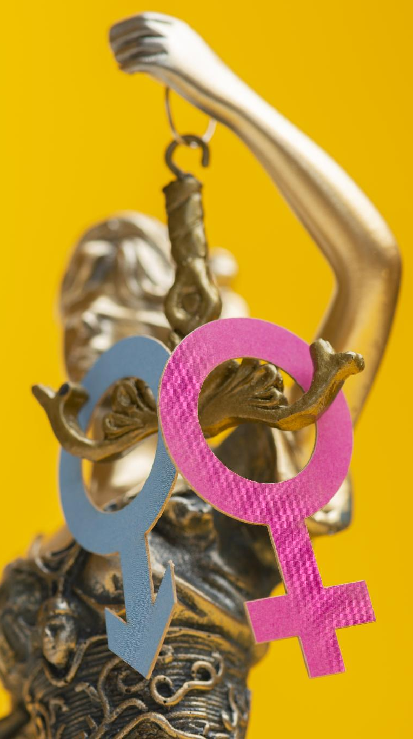
Question 1.3:
Ethical Theories and Their Applications
Overview of Major Ethical Theories
Virtue Ethics
  Focuses on moral character, cultivating virtues like courage and wisdom while avoiding vices such as greed or jealousy.
Utilitarianism
  Emphasises maximising happiness and minimising suffering for the greatest number, sometimes justifying rule-breaking for better outcomes.
Kantianism (Deontology)
  Prioritises moral duties and universal laws, respecting individuals as ends rather than means to an end.
Contract Theory and Care Ethics
  Contract theory stresses fairness through social agreements; care ethics highlights empathy and nurturing relationships.
Answer the questions in your notes
Notes:
Question 1.3 – Ethical theories
Ethical theories provide structured ways to distinguish right from wrong and help individuals analyse moral dilemmas. Virtue ethics emphasises moral character, arguing that ethical behaviour arises from cultivating virtues such as courage, compassion, and wisdom while avoiding vices like greed or jealousy. Utilitarianism focuses on outcomes, asserting that the right action is the one that maximises happiness and minimises suffering for the greatest number. This approach sometimes supports breaking traditional rules if doing so results in better consequences. Kantianism, or deontology, prioritises moral principles and duties over consequences. It argues that ethical action stems from following universal moral laws, such as respecting individuals as ends in themselves rather than means to an end. Contract theory views morality as a set of agreements that rational individuals would make to ensure fairness, security, and cooperation within society. This perspective evaluates whether actions align with principles that people would collectively endorse. Care ethics shifts the focus to relationships, empathy, and emotional connection, asserting that ethical behaviour is grounded in nurturing and sustaining relationships. Comparing these theories highlights different dimensions of ethics – character, consequences, principles, agreements, and relational responsibility – allowing learners to better understand their own values and reasoning.

Slide 11
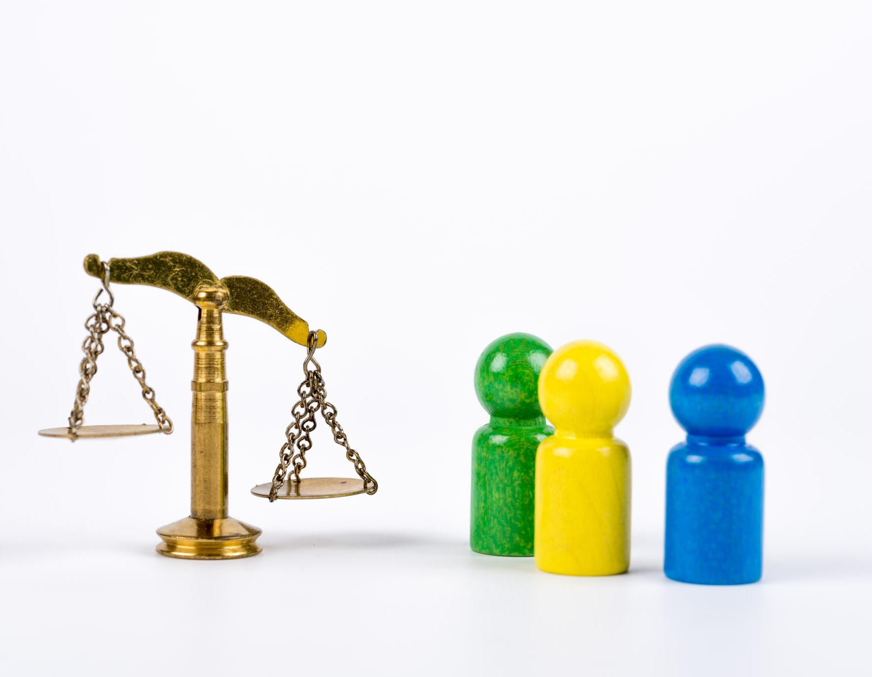
Universal Principles and Cultural Differences
Universal Ethical Principles
  Shared values such as dignity, honesty, justice, and compassion underpin ethical frameworks worldwide.
Cultural Variations in Ethics
  Ethical priorities vary with culture, influenced by history, religion, economy, and politics.
Individualism vs Collectivism
  Individualistic societies stress autonomy, while collectivist cultures emphasise community welfare and harmony.
Ethical Understanding in Global Context
  Recognising shared values and cultural differences fosters empathy and better ethical decision-making globally.
Notes:
Across ethical frameworks, several universal principles emerge that reflect shared human values. These include respect for human dignity, honesty, justice, accountability, compassion, integrity, and the commitment to avoid harm while promoting good. Such principles appear across cultures, religions, and moral traditions because they support social harmony, cooperation, and human flourishing. However, ethical principles may still differ across cultures due to historical experiences, religious beliefs, economic conditions, and political systems. For instance, individualistic societies may prioritise autonomy and personal rights, while collectivist cultures emphasise community welfare, social harmony, and responsibility for others. These differences reflect unique worldviews rather than moral superiority. Understanding cultural variation is essential for ethical reasoning in a globalised world, as it encourages individuals to appreciate diverse perspectives, challenge stereotypes, and avoid ethnocentrism. By recognising both universal values and cultural nuance, learners develop a more flexible, empathetic, and context‑sensitive approach to ethical decision‑making.

Slide 12
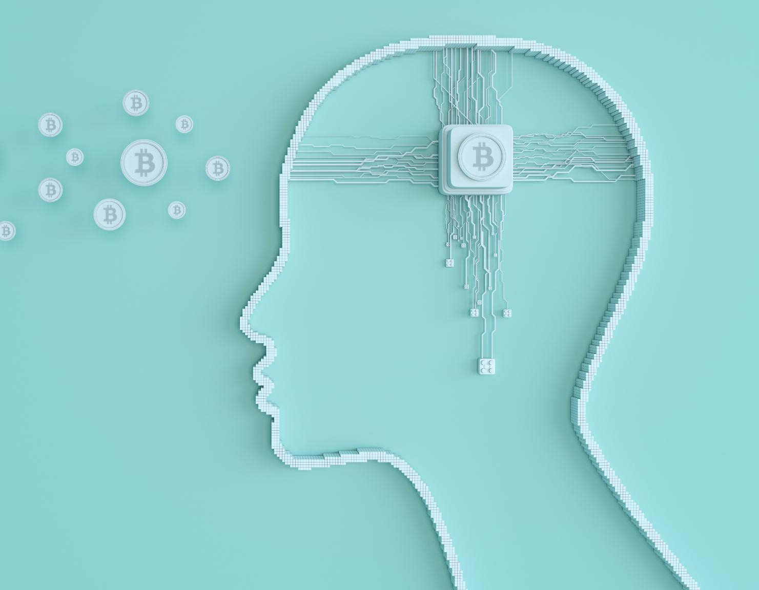
Question 1.4:
Ethical Decision‑Making and Bias
Bias and Its Impact on Ethical Decisions
Watch
Would you sacrifice one person to save five? – Eleanor Nielson (4,55 min) https://www.youtube.com/watch?v=yg16u_bzjPE&list=PLJicmE8fK0EhWPEDSksryaxiDvIKysnSR&index=15
Write notes on the questions posed in your notes
Nature of Bias
  Bias can be conscious or unconscious, shaped by culture, experiences, and societal messages.
Cognitive Shortcuts
  Bias often works through heuristics like availability, anchoring, and confirmation bias distorting information.
Addressing Bias
  Self-reflection and exposure to diverse perspectives help recognise and reduce bias in ethical decisions.
Ethical Frameworks Role
  Frameworks like utilitarianism and deontology provide structured methods to counterbalance bias.
Notes:
Question 1.4 – Ethical decision-making
1.4.1 Watch
Ethical dilemmas such as the trolley problem reveal the complexities of moral decision-making. In the classic trolley scenario, individuals must decide whether to pull a lever to divert a train, sacrificing one person to save five. Responses vary depending on whether a person values utilitarian logic – maximising lives saved – or deontological concerns about directly causing harm. In the bridge version of the dilemma, people are asked whether they would push a bystander off a bridge to stop the trolley, a scenario where personal involvement increases moral discomfort. Research suggests that men may be more likely to choose the utilitarian option due to social conditioning that emphasises rational problem-solving over emotional reluctance, while women – often socialised to prioritise empathy and care – may hesitate due to emotional and relational considerations. People may also be more willing to sacrifice groups of men rather than women due to gendered perceptions influenced by cultural norms regarding vulnerability, protection, and social roles. These dilemmas show how emotional, cultural, and psychological factors shape moral choices and highlight the need for reflective, intentional ethical reasoning.
Bias can significantly distort ethical decision‑making by influencing how individuals perceive situations, people, and choices. Bias may be conscious or unconscious, developing from cultural norms, personal experiences, or societal messaging. Because ethical behaviour requires fairness, impartiality, and critical reflection, bias acts like a force that pulls moral judgment away from these standards. For example, unconscious bias can cause someone who believes in equality to make unfair decisions without realising it. Bias often operates through cognitive shortcuts, such as the availability heuristic, anchoring, or confirmation bias, each of which warps the interpretation of information. Recognising and addressing bias involves self‑reflection, exposure to diverse perspectives, and willingness to question assumptions. Ethical frameworks – such as utilitarianism, deontology, or virtue ethics – can counterbalance bias by providing structured decision‑making methods that emphasise fairness, duty, outcomes, or character. Reducing bias requires humility, openness, and ongoing learning, helping individuals align their actions more closely with their ethical beliefs.

Slide 13
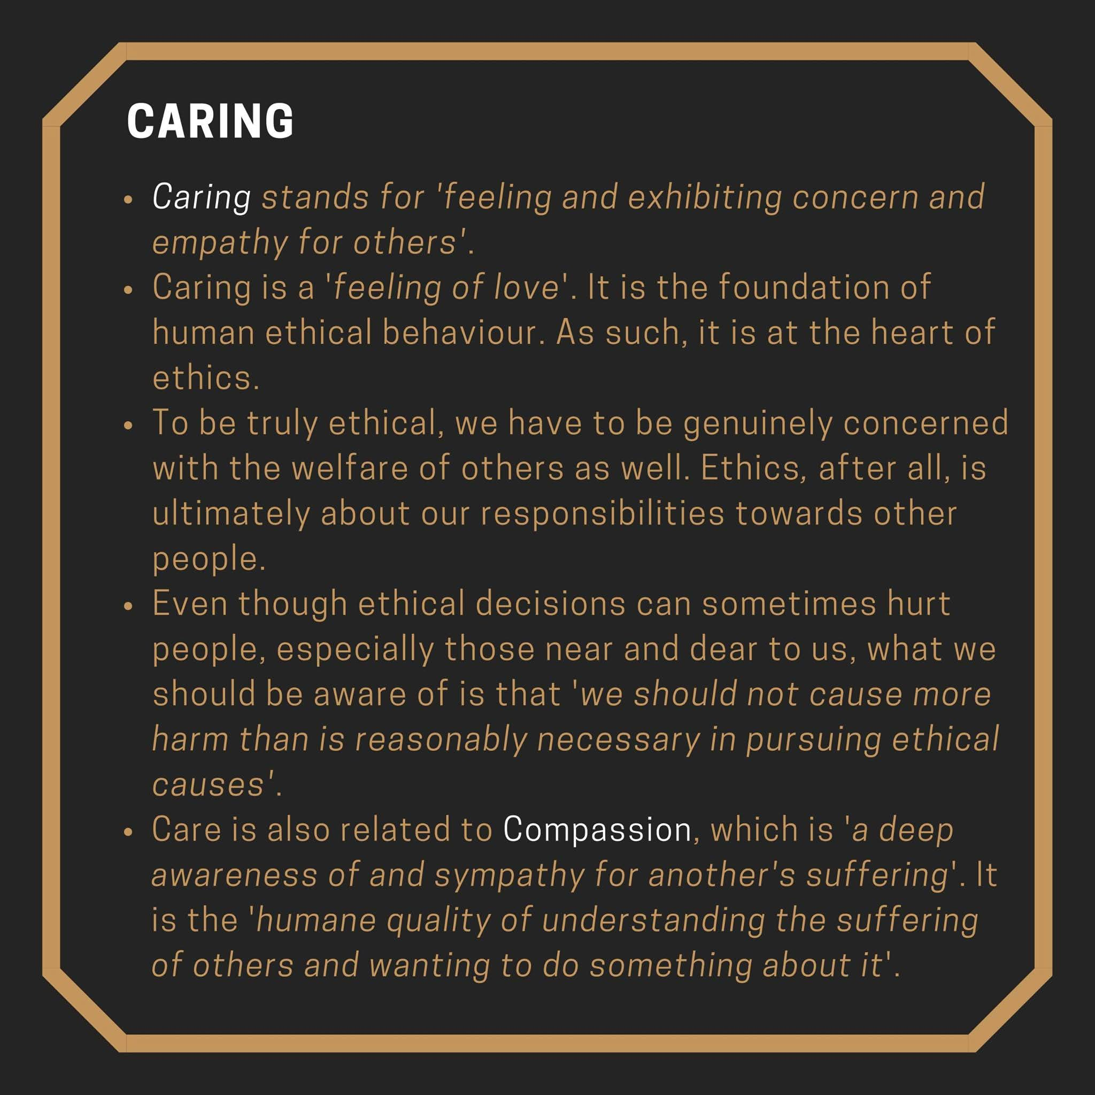



Slide 14

Read the extract on page 9 and 10.
Sometimes we are unaware of our unconscious biases. It is therefore helpful to consciously reflect on our decisions and interrogate the reasons for our behaviour. It is also helpful to take credible tests that can make us aware of our blind spots.
Project Implicit is an independent 501(c)(3) nonprofit and an international network of researchers studying implicit cognition – those fast, automatic thoughts and feelings that quietly shape perception, judgment, and behaviour. For 25 years, we've helped millions of people better understand how their minds work
1.4.2.1 Take the test: Go to https://implicit.harvard.edu/implicit/
Follow the instructions in your notes.
Answer the questions that follow in your notes.
Notes:
1.4.2.1 Get leaners to do the test following the instructions given in their notes. Thereafter they complete the questions that follow.
Being aware of our biases enables us to make better ethical decisions.
NOTE TO THE EDUCATOR – There are a number of tests available on the Project Implicit website. They do take 10 – 15 minutes to complete and so if you are under time constraints, you might choose to ask your learners to complete a few of the tests at home and then facilitate a class discussion around the results. NB!! A few of the learners may receive results that are disconcerting because unconscious biases are highlighted. It is recommended that you talk through the possibility of cognitive dissonance before you ask your learners to complete the tests. [Cognitive dissonance is a psychological term that describes the discomfort you feel when your beliefs don't line up with your actions. Or it could refer to the tension of holding two conflicting beliefs at once.]

Slide 15
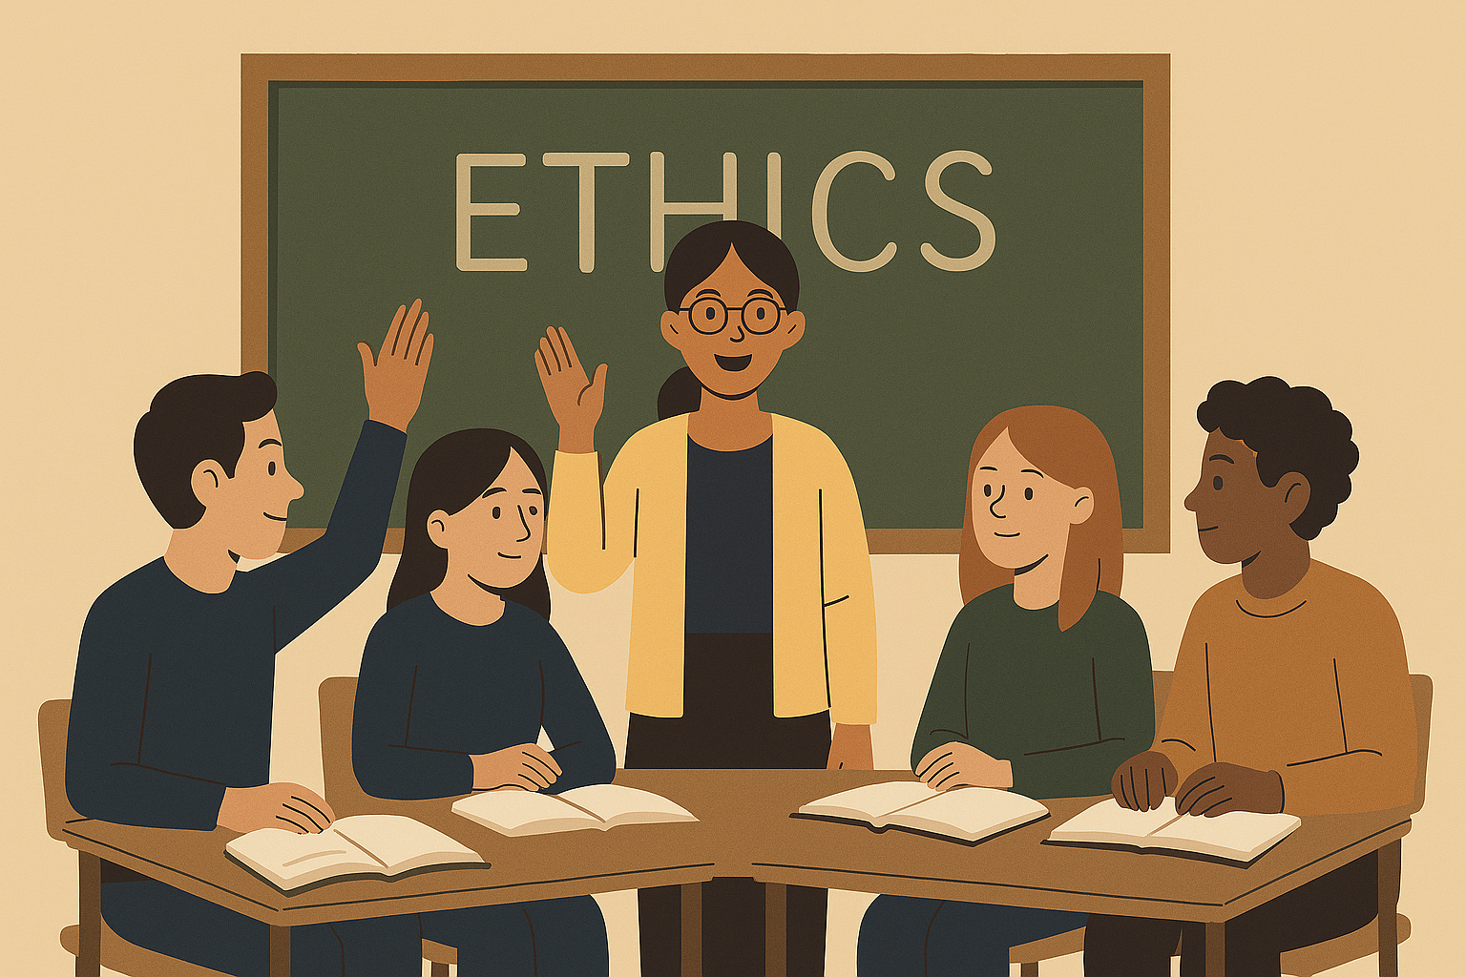
1.4.2.2 Research and make notes on the following common forms of bias. Include strategies to mitigate each of the biases.
- Anchoring bias
- Actor-Observer bias
- Availability Heuristic
- Confirmation bias
- The Halo Effect
- Status Quo bias
Notes:
1.4.2.2 Learners research and make notes on the following common forms of bias, including strategies to mitigate each of the biases.
Possible answers:
Anchoring bias Anchoring bias occurs when people rely too strongly on the first piece of information they receive when making decisions. This initial 'anchor' influences later judgements, even when it is irrelevant or inaccurate. Once the anchor is set, people often fail to adjust their thinking sufficiently, leading to distorted conclusions. Anchoring can result in unfair decisions if early information shapes outcomes too strongly. For example, first impressions of a person can influence expectations, even when later evidence suggests otherwise. Strategies to mitigate: - Pause decision making to allow time for reflection - Seek additional information before reaching conclusions - consider how judgements might change if information were presented in a different order
- Actor-Observer bias This bias refers to the tendency to explain our own behaviour based on our intensions and external circumstances, while explaining others' behaviour as a result of their personality or character. This bias often leads to harsh judgements of others and leniency towards ourselves. This bias can undermine fairness and empathy. It may result in blaming individuals without considering their context, reinforcing stereotypes or unjust treatment. Strategies to mitigate: - Consider situational factors that may influence behaviour - Apply the same standards when judging oneself and others - Practice perspective taking to understand different contexts - Avoid making quick character-based judgements
- Availability Heuristic Availability heuristic occurs when people judge the likelihood or importance of something based on how easily examples come to mind. Events that are recent, emotional, or widely reported in the media are often seen as more common as they actually are. This bias can lead to fear-based or reactionary decisions, such as overestimating risks or unfairly targeting certain groups. Ethical decision making required evidence-based reasoning rather than emotional responses. Strategies to mitigate: - Rely on reliable data rather than recent or emotional examples - Question whether examples are representative or simply memorable - Consult multiple sources of information - slow down decision making to rescue emotional reactions
- Confirmation bias Confirmation bias is the tendency to seek out, interpret and remember information that supports existing beliefs while dismissing information that challenges them. This bias reinforces existing viewpoints and limits critical thinking. Confirmation bias can lead individuals to justify unethical behaviour or ignore injustice because it conflicts with their beliefs or group identity. Strategies to mitigate: - Actively seek out opposing viewpoints - Evaluate evidence objectively, separating facts from opinions - Question assumptions and consider alternative explanations - Remain open to revising beliefs when presented with credible evidence
- The Halo Effect The Halo Effect occurs when one positive characteristic of a person influences how they are judges overall. This can cause people to overlook flaws or mistakes because of traits such as attractiveness, confidence or popularity. This can lead to unfair advantages and unequal treatment, undermining principles of fairness and merit. Strategies to mitigate: - Assess specific behaviours or skills independently - Base evaluations on evidence rather than personal impressions - Use objective criteria when making judgements - Reflect on whether similar standards are applied consistently to all individuals
- Status Quo bias Status quo bias is the preference for keeping things the same, even when change may be beneficial. People often fear loss, uncertainty or effort associated with change, which leads to resistance. This bias can slow social progress and maintain unfair systems or traditions. Ethical decision making sometimes requires challenging existing norms to promote justice and equality. Strategies to mitigate: - Evaluate existing practices critically rather than accepting them automatically - Compare current options with possible alternatives - Weigh the costs and benefits of change objectively - Support change when it promotes ethical values such as fairness and justice

Slide 16

Question 1.4.3:
Steps for Making Ethical Decisions
Watch Ethical Decision Making (3,29 mins)
https://www.youtube.com/watch?v=n0uwTBrgqxI
Complete the questions that follow
1.4.4
Identify Ethical Issues
  Recognise who may be harmed or benefited and any conflicting values involved in the situation.
Gather Relevant Facts
  Collect accurate and complete information to clarify uncertainties and support sound decisions.
Evaluate Alternatives Ethically
  Assess possible actions through various ethical lenses like fairness, rights, consequences, and community impact.
Reflect and Learn
  Review the decision outcome to improve ethical judgment and guide future decision-making.
Watch: Let's Talk about Ethics - Youth Collective
https://youtu.be/TUt_TCXQdXs?feature=shared
Notes:
1.4.3 Watch Ethical Decision Making (3,29 mins)
Learners complete the questions that follow – 1.4.3 – 1.4.4.
A structured framework enhances ethical decision‑making by providing a clear process for examining dilemmas from multiple angles. The first step is to identify the ethical issues, determining who might be harmed or benefited and whether the situation involves conflicting values or obligations. Next, gathering all relevant facts helps clarify uncertainties and ensure that decisions are grounded in accurate information. Identifying stakeholders reveals whose interests are affected and which concerns carry the most weight. Generating a set of possible actions encourages creativity and prevents premature conclusions. Evaluating alternatives through various ethical lenses – rights, fairness, consequences, community impact, character, and relationships – allows for balanced reasoning. After selecting the best option, individuals should test it by considering whether they could justify their choice publicly to someone they respect. Implementation requires sensitivity and attention to those affected. Finally, reflecting on the outcome helps individuals learn from the experience, strengthen their ethical judgment, and adjust future decisions. This framework encourages deliberate, thoughtful decision‑making rather than impulsive or biased reactions.

