Slide 1



Role Models: Shaping Our Future
Grade 9
Term 2: Constitutional Rights & Responsibilities
Lesson 2
Notes:
Slide 1: Welcome back, Grade 9s. Before we continue with our lessons on Constitutional Rights and Responsibilities, I want you to take out your homework from last week: Activity 3 (Lesson 1 – Worksheet).
In this activity, you thought about how constitutional values can guide your behaviour in different parts of your life, such as at home, at school, toward the environment, and in your community.
Turn to the person sitting next to you and briefly share: ONE example of how you said you could uphold a constitutional value in one of these areas of your life. (Allow learners a minute to share.)
If we think about it, we often learn how to behave in these situations by watching the people around us. For example, we may learn values like respect, responsibility, and fairness from our parents, caregivers, teachers, coaches or community leaders.
These people are called role models: individuals whose behaviour influences the choices we make and the values we practise.
In today’s lesson, we will explore:
Positive and negative role models
How the people we look up to can influence us to make good choices, act responsibly, and treat others with respect.
How role models can uphold constitutional values in everyday life and guide us in applying these values in daily life.

Slide 2
By the end of this lesson, learners should be able to:
Define
Define a role model and distinguish between positive and negative role models based on their behaviour and influence.
Discuss
Discuss how role models influence the choices, values, and behaviour of young people.
Describe
Describe how role models can promote constitutional values through their actions and leadership.
Suggest
Suggest practical ways in which constitutional values can be applied in everyday situations.
Reflect on
Reflect on role models and becoming responsible role models themselves.
Notes:
Slide 2: By the end of this lesson, learners should be able to:
Define a role model and distinguish between positive and negative role models based on their behaviour and influence.
Discuss how role models influence the choices, values, and behaviour of young people.
Describe how role models can promote constitutional values through their actions and leadership.
Suggest practical ways in which constitutional values can be applied in everyday situations.
Reflect on role models and becoming responsible role models themselves.

Slide 3

What is a role model?
A role model is someone we admire and whose behaviour we would like to copy.
Role models influence our:
behaviour
attitudes
values
decisions
Role models can include:
parents or caregivers
teachers or coaches
community leaders
celebrities or sports stars
Notes:
Slide 3: What is a role model?
A role model is someone we look up to and admire, often as a person whose behaviour we would like to copy.
People observe and learn from role models by watching how they behave and how they treat others.
Role models can be famous people, such as celebrities or sports stars, but they can also be people closer to us, such as parents, teachers, religious leaders, or community members.
Because role models influence how people think and act, they impact the choices, behaviour, values, and attitudes of young people.

Slide 4



Positive role models:
act responsibly and ethically
show honesty and kindness
work hard to achieve goals
Persevere through challenges
respect others
contribute positively to society
They encourage others to develop good habits and make good choices.
Notes:
Slide 4: Positive role models
Positive role models are individuals who inspire others to behave responsibly and ethically.
They demonstrate qualities such as honesty, kindness, perseverance, and respect for others.
Positive role models lead by example by showing how to set goals, work hard, overcome challenges, and contribute positively to their communities.
Through their behaviour, they encourage others to develop good habits and make responsible decisions.
Invite learners to share examples of positive role models in their lives and explain how these people have influenced their choices, behaviour, values, or attitudes. (Allow two to three responses.)

Slide 5

Negative role models
Not all role models have a positive influence.
Negative role models may show:
disrespect
dishonesty
unfair behaviour
disregard for rules
These behaviours can influence others to:
cheat
bully others
engage in risky behaviour
Think carefully about whose behaviour you copy.
Notes:
Slide 5: Negative role models
Not all role models have a positive influence. Some individuals may demonstrate behaviour that can influence others in harmful ways.
Negative role models may show behaviours such as disrespect, dishonesty, unfairness, or disregard for rules and social norms.
Their actions may encourage others to make poor decisions, such as cheating, bullying, or engaging in risky behaviour (substance abuse, unsafe sex, etc).
This shows why it is important to think carefully about who we choose to look up to and which behaviours we choose to follow.
Ask learners:
What kinds of behaviour might make someone a negative role model?
Why is it important to think carefully before copying someone else’s behaviour?
Note to teacher: Guide learners to focus on behaviours rather than naming specific people, as this helps keep the discussion respectful and constructive. Emphasise that even if someone is talented, popular, or successful, their behaviour may still send negative messages to others. Encourage learners to think critically about the actions they choose to copy and to follow role models who demonstrate positive values.

Slide 6

Watch: Role Models: Definition and Importance bit.ly/4sqJt8W (2 min 44 sec)
Notes:
Slide 6: Let's watch a video that recaps what we've just spoken about. Thereafter, you will complete an activity with a peer.
Note to teacher: Learners can move straight into the activity if you do not wish to watch the recap video.
Watch video:
Role Models: Definition and Importance
bit.ly/4sqJt8W (2 min 44 sec)
Learners to complete Activity 1 (Lesson 2 – Worksheet) in pairs.
Possible answers are available in the Lesson 2 – Worksheet MEMO.

Slide 7
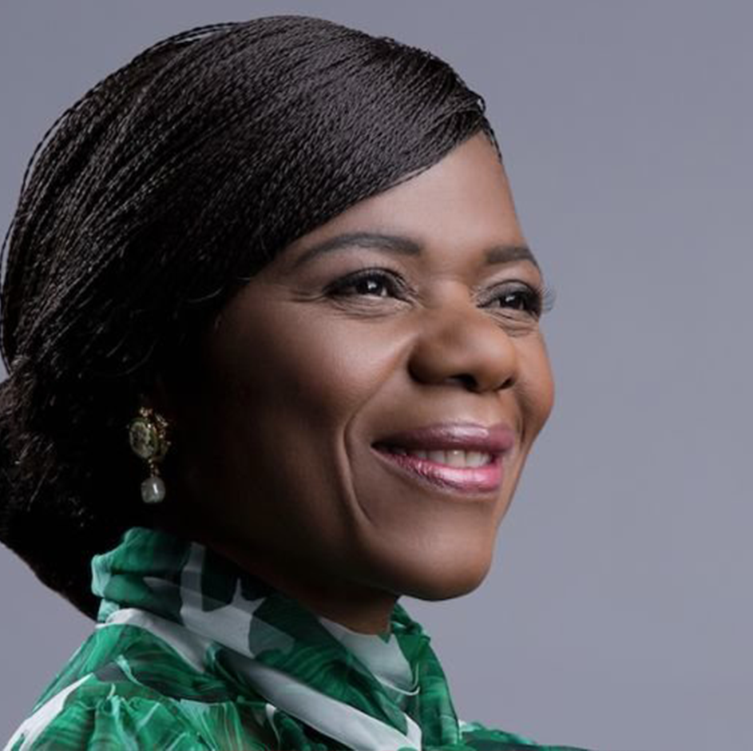
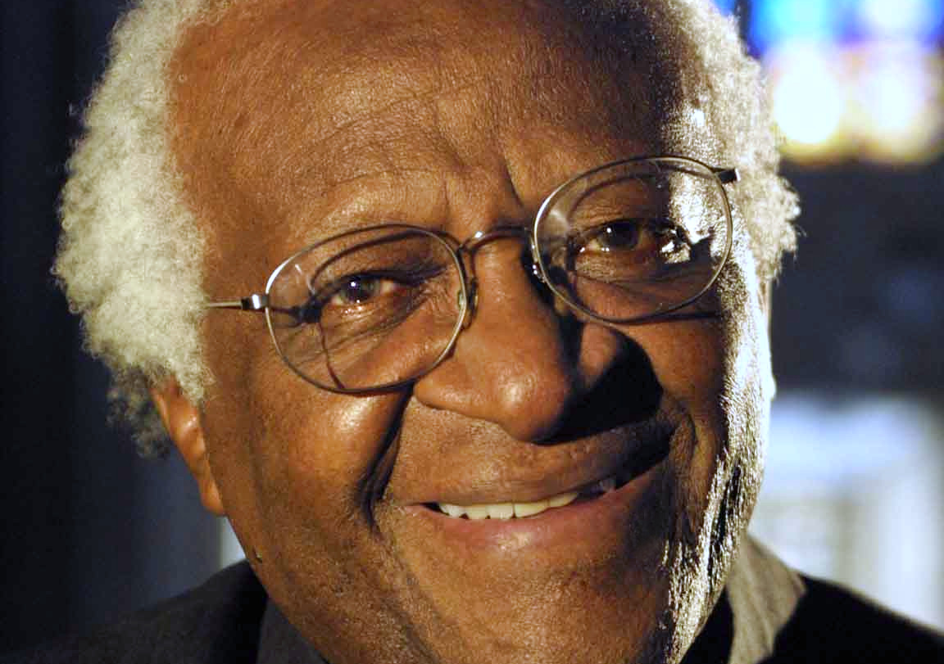
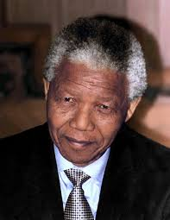
Role models and constitutional values
Positive role models are not only famous leaders.
Young people can also make a difference.
Role models can promote constitutional values by:
showing respect and dignity
promoting equality
standing against discrimination
encouraging unity
Example: Nelson Mandela
promoted reconciliation and equality
helped lead South Africa to democracy
Notes:
Slide 7: Role models who uphold constitutional values
Role models who uphold constitutional values lead by example by promoting respect, equality, and justice in society.
They demonstrate ethical behaviour by treating others with dignity and opposing discrimination.
South Africa has several examples of leaders who have upheld constitutional values. The most famous one is Nelson Mandela, who helped lead South Africa from apartheid to democracy and became the country’s first democratically elected president in 1994. Instead of seeking revenge after apartheid, he promoted racial equality, forgiveness, and national unity.

Slide 8
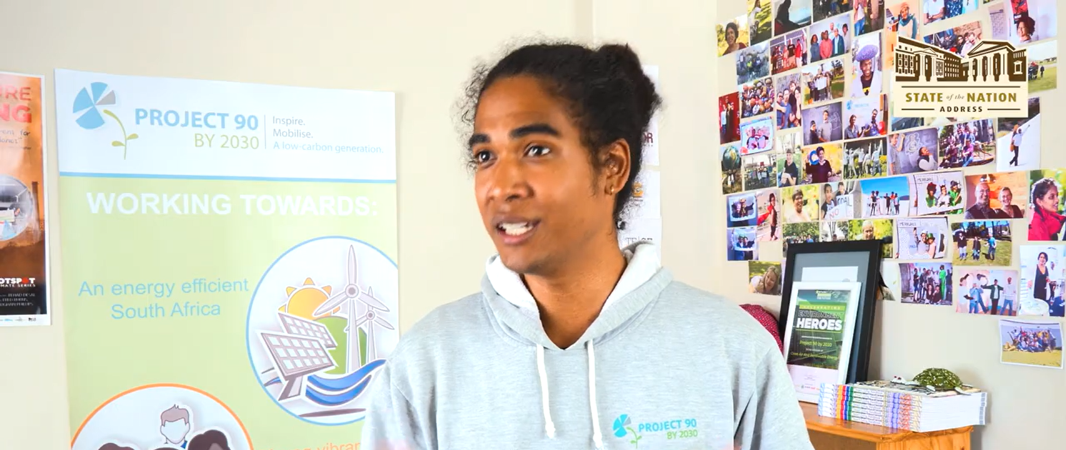
Watch: #SONA2026: Expectations from Project 90 by 2030 – Gabriel Klaasen bit.ly/4uqA8jt (2 min 22 sec of 6 min 07 sec)
Notes:
Slide 8: There are also many young South Africans who are working to make the country a more just and fair society for everyone.
Let’s watch a short video about the work of Gabriel Klaasen. Gabriel Klaasen is a South African youth climate and social justice activist from Cape Town. He works with organisations to educate young people about environmental issues and to encourage communities to take action to protect the environment and build a more sustainable future.
Watch video:
#SONA2026: Expectations from Project 90 by 2030 – Gabriel Klaasen
bit.ly/4uqA8jt (2 min 22 sec of 6 min 07 sec)
Other than important societal leaders and activists, these role models could also include ordinary citizens, such as parents, teachers, community leaders, religious leaders, and public officials.

Slide 9
Applying constitutional values
How can we apply constitutional values in daily life?
Human dignity
Equality
Freedom
Nation-building
Commitment to family
Environmental responsibility
Responsible citizenship
Notes:
Slide 9: Applying constitutional values in daily life
Constitutional values guide how people behave and interact with others in everyday situations. Positive role models show these values through their actions.
In the centre of the board, write: 'Applying constitutional values in daily life'
Draw branches from the centre for the following constitutional values:
Human dignity
Equality
Freedom
Nation-building
Commitment to family
Environmental responsibility
Responsible citizenship
Ask learners to suggest practical actions that show how these values can be applied in daily life. Write their responses around the relevant branch.
Possible examples:
Human dignity
Treat others with kindness and respect
Use respectful language
Stand up against bullying
Equality
Treat people fairly regardless of their background or abilities
Avoid discrimination
Include others in activities
Freedom
Respect others’ opinions and beliefs
Express your views respectfully
Vote in elections when eligible
Nation-building
Work together with people from different backgrounds
Participate in activities that strengthen the community
Commitment to family
Respect and support parents and family members
Environmental responsibility
Protect natural resources
Avoid littering and pollution
Responsible citizenship
Follow laws and school rules
Lead by example and contribute positively to society
Conclude by explaining that constitutional values become meaningful when people practise them in their daily lives. These actions help build a fair, respectful, and democratic society.

Slide 10
Remember:
Role models influence our choices and behaviour.
Positive role models inspire responsible actions.
We should choose good role models and strive to be positive role models ourselves.
Notes:
Slide 10: Learners to complete Activity 2 (Lesson 2 – Worksheet).
Possible/Model answers are available in the Lesson 2 – Worksheet MEMO.
Today we learned that role models have a big impact on our choices and behaviour.
Positive role models inspire us to work hard, act responsibly, and treat others with respect, while negative role models can lead us down the wrong path. We also saw how role models who uphold constitutional values guide us to be fair, kind, and responsible citizens. Remember, we can choose good role models and also strive to be positive role models for others.
With that in mind, you now have to complete the reflection (Activity 3, Lesson 2 – Worksheet).
If learners don't have enough time to finish the activity in class. It must be completed as homework.
Hand out the Content Summary before learners leave the classroom.

