Slide 1

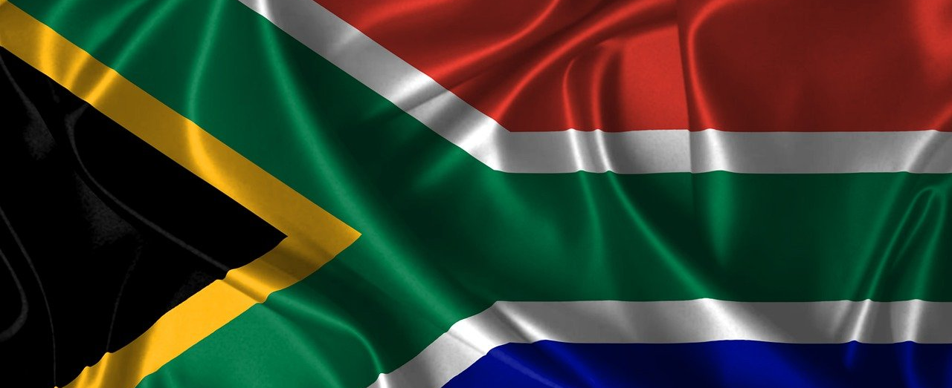
Grade 11 | Term 1
Democracy and Human Rights | Lesson 2
Notes:
Slide 1: Allow the learners to settle down and get their learning materials ready.
Ask learners to take out their homework from last week (Activity 2, Lesson 1 – Worksheet) and mark it together using the Lesson 1 – Worksheet MEMO.
Explain that today’s lesson covers democratic structures, how they function and how they serve the interests of civil society.
Emphasise: These structures influence your rights, your services, your community, and one day, the decisions you make as an adult voter.

Slide 2

By the end of this lesson, you should be able to:
Understand the constitutional framework that dictates the powers, limitations, and interaction of the THREE tiers of government.
Recognise the avenues through which the democratic structures present opportunities to participate in the democratic processes.
Understand the purpose and importance of constitutions.
Explain the importance of public participation in elections.
Understand key democratic processes after elections, including mandates, representation of constituencies, lobbying and advocacy.
Notes:
Slide 2: Say: By the end of this lesson, you should be able to:
Understand the constitutional framework that dictates the powers, limitations, and interaction of the THREE tiers of government.
Recognise the avenues through which the democratic structures present opportunities to participate in the democratic processes.
Understand the purpose and importance of constitutions.
Explain the importance of public participation in elections.
Understand key democratic processes after elections, including mandates, representation of constituencies, lobbying and advocacy.

Slide 3

Democratic structures
Power is divided so no one group controls everything.
Structures have different roles but work together (interrelated + interdependent).
Parliament makes laws; Executive implements; Judiciary checks constitutionality.
Provincial + local government help deliver services.
Supports a united, democratic, non-racial, non-sexist society.
Notes:
Slide 3: Government power is divided into different structures to make sure that no single group or person has too much control. Each structure has its own role and responsibility, but they are interrelated and interdependent. This means they work together and rely on one another to serve the people effectively.
For example, Parliament makes laws, the Executive carries out the laws, and the Judiciary checks that laws and government actions are constitutional. Provincial and local governments also work with the national government to implement laws and deliver services.
These democratic structures support the values of a society that is united, democratic, non-racial and non-sexist, where all people are treated fairly and have a voice in decision-making.

Slide 4
National government handles issues affecting the whole country:
Parliament |  | The Executive (Cabinet)
The national law-making body that is made up of the National Assembly and the National Council of Provinces (NCOP). It represents the people, makes laws and oversees government. |  | Led by the President, the Cabinet develops national policies, implements laws and manages government departments.
The Judiciary (Courts) |  | Independent bodies (Chapter 9 institutions)
Independent courts that ensure all laws and government actions follow the Constitution and protect citizens’ rights. |  | Organisations created by the Constitution to strengthen democracy, such as: The Public Protector The Human Rights Commission (SAHRC) The Electoral Commission (IEC)
Notes:
Slide 4: The national government deals with matters that affect the whole country. Go through the main structures on Slide 4.

Slide 5
Each province has its own government that handles provincial matters:
Provincial Legislatures |  | Provincial Executive
Makes laws on provincial matters (like health, education and housing) and oversees the work of the provincial government. |  | Led by a Premier and Members of the Executive Council (MECs), who implement laws and run provincial departments.
Notes:
Slide 5: Each of the nine provinces in South Africa has its own government. Provincial governments manage issues that directly affect their province. Go through the main structures on Slide 5.
Ask: Which provincial department affects your daily life the most? (Possible responses: Education, Health, Transport.)

Slide 6
Local government is closest to the people:
Municipalities |  | Local Executive
Found in cities, towns and rural areas. They are responsible for services such as water, electricity, sanitation and waste removal. |  | Led by mayors and councillors, who make decisions for the municipality and manage service delivery.
Notes:
Slide 6: The local government is the level closest to the people. It provides basic services and ensures that communities are clean, safe and well managed. Go through the main structures on Slide 6.
Ask: Do you know who your mayor and ward councillor are? Do you and/or your parents know which channels to use to contact these representatives if there is an issue with a local service?
Note to teacher: Allow learners a couple of minutes to research this information. If your school policy does not allow devices, or your learners don't have internet access at school, ask them to find out for homework.

Slide 7

Civil society
Government structures must serve the people.
Civil society includes ordinary citizens, NGOs, community groups, faith-based organisations and the media.
These groups help hold government accountable and push for change.
Watch video: I am an Equaliser
bit.ly/3LVFBNo (3 min 17 sec)
Notes:
Slide 7: Government structures must serve and respond to the needs of the people. Civil society, which includes ordinary citizens, community groups, NGOs, faith-based organisations and the media, plays an active role in holding government accountable and influencing decisions.
Watch the video about the high school learners involved in the civil society group Equal Education.
Watch video:
I am an Equaliser
bit.ly/3LVFBNo (3 min 17 sec)
Ask the learners to mention other civil society groups making a difference in South Africa. (Examples: Gift of the Givers, OUTA, Corruption Watch, community clean-ups.)

Slide 8
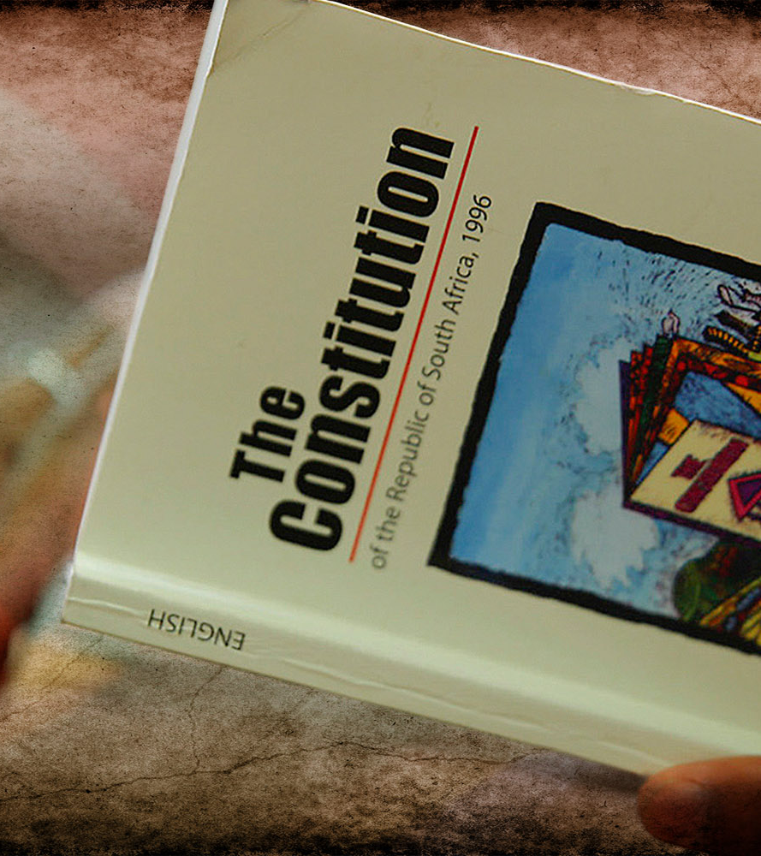
Constitutions
A constitution is a framework that explains how a country (or organisation) is run.
In a democracy, all laws and government decisions must follow the Constitution.
South Africa’s Constitution is the supreme law.
It protects citizens’ rights (e.g. education, equality, safety, freedom of expression).
It also sets out citizens’ responsibilities and how government must operate.
Notes:
Slide 8: Constitutions are basic frameworks that explain how something works, whether it’s a country, an organisation, a club, a school or even an online platform.
In a democracy, every law, policy and government decision must follow the principles of the Constitution.
Because the Constitution is the supreme law of South Africa. It protects your basic rights (such as the right to education, equality, safety and freedom of expression), but it also explains the responsibilities that come with those rights. It sets out how government must work, and how citizens should act responsibly in a democratic society.

Slide 9
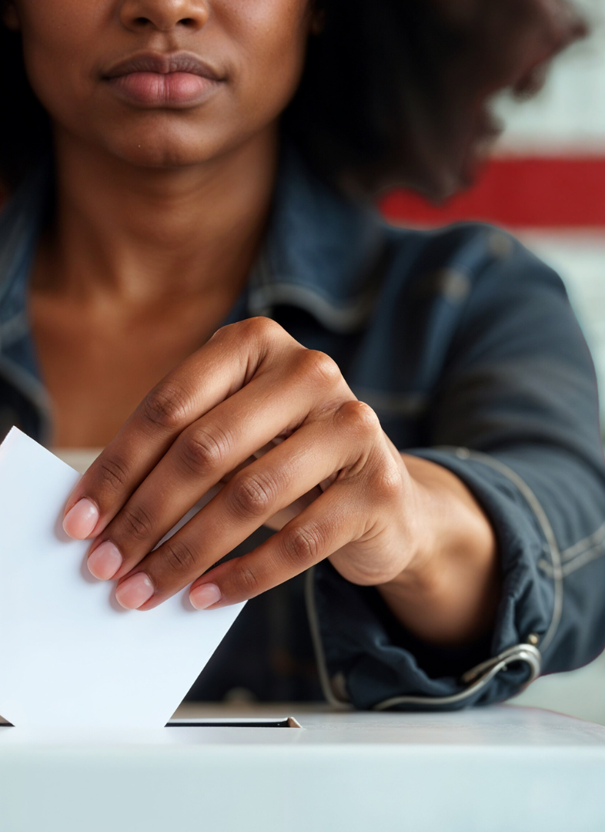
Elections
Elections allow citizens to choose their leaders at all levels of government.
These leaders shape the future you will enter as an adult.
When you turn 18, you gain the right and responsibility to vote.
Learn about different parties/candidates before voting.
Notes:
Slide 9: Elections allow citizens to choose their leaders at the national, provincial and local levels. They are among the most important ways people can participate in democracy.
The leaders who are elected make important decisions about the kind of future you will enter as an adult.
Once you turn 18, you have the right and responsibility to vote. It is important to use this right wisely by learning about the different political parties or independent candidates and understanding what they stand for before making your choice.

Slide 10

How elections work
The IEC oversees elections to ensure they are free, fair and transparent.
National elections: every 5 years to elect Parliament.
Provincial elections: held at the same time as national elections to elect provincial legislatures.
Local elections: every 5 years (two years after national); you vote for:
  A ward councillor
  A political party for the municipal council
By-elections: held when a councillor’s seat becomes vacant.
Notes:
Slide 10: Explain how elections in South Africa work: The Electoral Commission (IEC) oversees all elections to make sure they are free, fair and transparent.
National elections are held every five years to elect members of the National Assembly in Parliament.
Provincial elections are held at the same time as national elections to elect representatives to each provincial legislature.
Local government elections also happen every five years, but two years after the national and provincial elections. Voters cast two votes – one for a ward councillor (an individual who represents your area) and one for a political party to decide how many seats each party gets on the municipal council.
A by-election is held when a municipal seat becomes vacant between regular elections, for example, if a councillor resigns, passes away or is removed from office. This allows a community to elect a new representative.

Slide 11
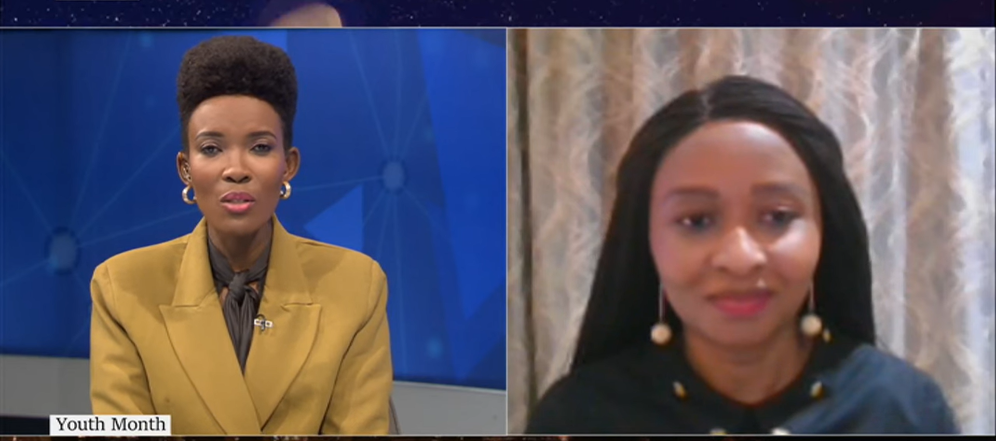
Watch video: Why is it important for the youth to vote: IEC's Moagisi Sibanda bit.ly/3M9IMkq (8 min 00 sec)
Notes:
Slide 11: With the local government elections coming up in 2026, watch the following video on the importance of youth voting.
Note to teacher: This video is fairly long but offers valuable insight. You may stop it after the first four minutes if time is limited. However, it is recommended that learners watch the full video. If you cannot play the entire video in class, share the link with learners and encourage them to watch the remainder at home.
Watch video:
Why is it important for the youth to vote: IEC's Moagisi Sibanda
bit.ly/3M9IMkq (8 min 00 sec)
Learners to complete Activity 1 (Lesson 2 – Worksheet).
Answers are available in the Lesson 2 – Worksheet MEMO.

Slide 12
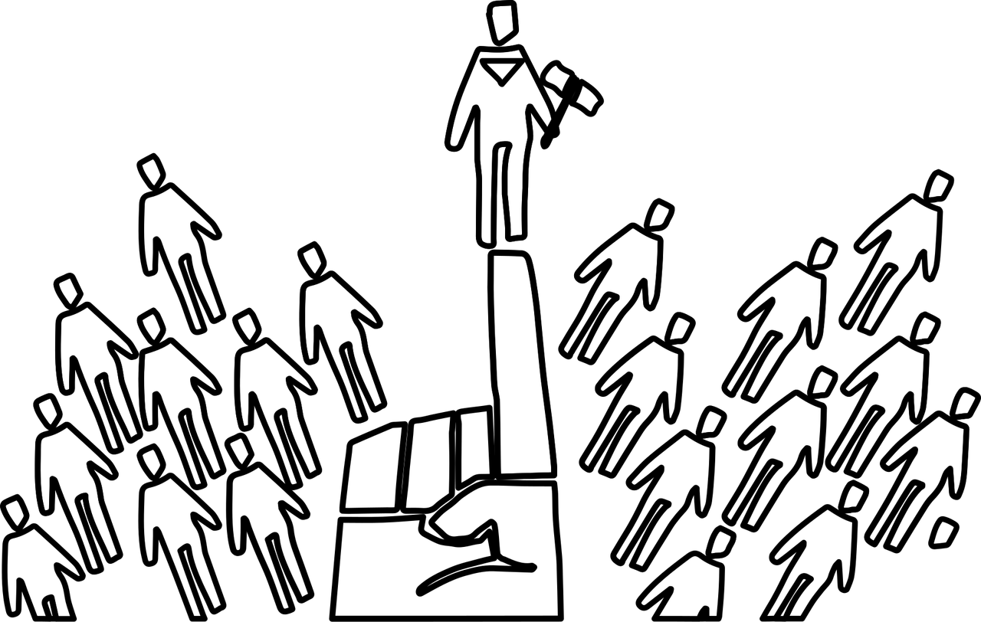
Mandates
When citizens vote, they give leaders a mandate – permission to act on their behalf.
Mandates are based on election promises.
Voters should hold leaders accountable if they fail to deliver.
Staying informed helps you become a responsible voter.
Notes:
Slide 12: Tell learners that you will now look at a few important processes that take place after leaders have been elected, including mandates, constituency representation, lobbying and advocacy.
When citizens vote in an election, they give their chosen leaders a mandate – the authority to make decisions and act on their behalf.
This mandate is based on the promises political parties make in their election campaigns. It is important that voters pay attention to these promises and hold leaders accountable if they fail to deliver.
As a young person, following current events and understanding how government decisions affect your daily life helps you become an informed, responsible voter in the future.

Slide 13


Constituency representation
Leaders represent specific communities (constituencies).
They raise local issues (safety, housing, transport, service delivery) in decision-making structures.
You can engage by attending meetings or participating in youth forums.
Notes:
Slide 13: Elected representatives speak on behalf of the people who voted for them.
Each area or community, known as a constituency, has representatives who bring local issues to Parliament, provincial legislatures or municipal councils.
This ensures that citizens’ concerns, such as school safety, housing or service delivery, are heard where decisions are made.
You can play a part by learning who represents your community and by engaging respectfully through public meetings or youth forums when you want to see change.

Slide 14
Lobbying
Lobbying = trying to influence government decisions.
This can include writing letters, meeting officials, organising campaigns or sharing research.
Example: youth lobbying for better sports facilities or safe study areas.
Notes:
Slide 14: Lobbying happens when individuals or groups try to influence government decisions.
This can be done by meeting with policymakers, writing letters, sharing research, or organising campaigns to draw attention to specific issues.
For example, a youth group might lobby the local municipality to create more sports facilities or safe study spaces.
Lobbying shows that democracy is not only about voting, but also about continuing to participate and shape decisions that affect the community.

Slide 15

Advocacy
Advocacy = speaking up or taking action for a cause.
Examples: petitions, marches, awareness campaigns.
Advocates work for justice, fairness and improved rights (e.g. against bullying or GBV).
Learners can practise advocacy at school by supporting initiatives that make their environment safer.
Notes:
Slide 15: Advocacy means speaking up or taking action for a cause that protects people’s rights or improves their lives.
Advocacy can take many forms, from peaceful marches and petitions to awareness campaigns on issues such as gender-based violence, bullying or environmental protection.
It gives citizens, including young people, the opportunity to promote fairness, equality and justice.
Even at school, learners can practise advocacy by standing up against unfair treatment or by supporting initiatives that make their environment safer and more inclusive.
Pose the following questions, and invite learners to share their opinions:
Who in our school would you describe as an advocate against bullying?
Who is a champion for inclusion/learner safety/fairness?

Slide 16

Pop Quiz
Notes:
Slide 16: To test the learners' knowledge on this section of the work, they should complete Activity 2 (Lesson 2 – Worksheet).
Answers are available in the Lesson 2 – Worksheet MEMO.

Slide 17
Homework
Complete Activity 3 (Lesson 2 – Worksheet).
Review the learning outcomes.
Ask for help if you are unsure about any content.
Notes:
Slide 17: Assign Activity 3 (Lesson 2 – Worksheet) as homework.
Remind learners of the learning outcomes introduced at the beginning of the lesson.
Encourage them to identify any areas where they still feel uncertain. If they are unsure about any part of the content, they should reach out so that you can work together to plan an appropriate intervention or support strategy.

