Slide 1

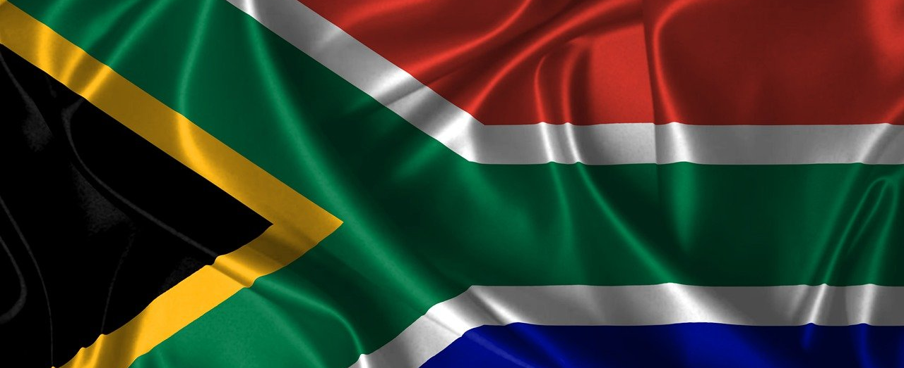
Grade 11 | Term 1
Democracy and Human Rights | Lesson 1
Notes:
Slide 1: Allow the learners to settle down and get their learning materials ready.
Tell them that they will investigate: i) how South Africa’s democracy works, ii) the principles that guide it, and iii) how citizens can participate in it.

Slide 2

By the end of the lesson, you should be able to
Explain
Explain how a democracy benefits its citizens.
Discuss
Discuss why the rule of law and good governance are essential in a democratic society.
Assess
Assess how law-making processes, representation, accountability, transparency and public participation ensure that laws are fair and protect citizens’ rights.
Explain
Explain the significance of public participation in a democracy and describe how citizens can use (online) petitions to hold government accountable.
Notes:
Slide 2: Say: By the end of this lesson, you should be able to:
Explain how a democracy benefits its citizens.
Discuss why the rule of law and good governance are essential in a democratic society.
Assess how law-making processes, representation, accountability, transparency and public participation ensure that laws are fair and protect citizens’ rights.
Explain the significance of public participation in a democracy and describe how citizens can use (online) petitions to hold government accountable.

Slide 3
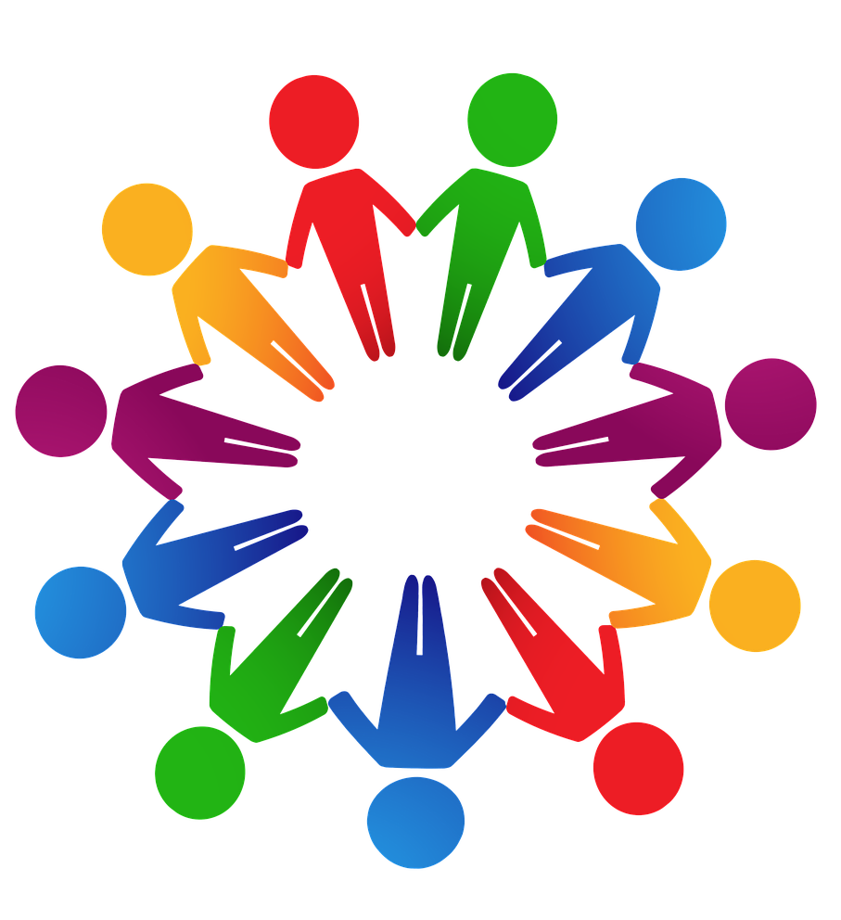
Understanding democracy
Where in your daily life do you make collective decisions?
We practise democracy when we make shared decisions or consider the needs of others.
Power belongs to the citizens, who choose leaders through free and fair elections.
South Africa’s democracy is built on national, provincial and local structures.
Understanding democracy helps citizens to monitor government performance, hold leaders accountable, and take action when service delivery is poor.
Notes:
Slide 3: Ask: Where in your daily life do you make collective decisions? (Answers may include: voting for RCL/SRC, choosing class or team leaders, participating in youth forums.)
Explain that a democracy is not only a political system. It is also a way of life. We practise democratic principles whenever we make shared decisions, vote or consider the needs of others in our daily environments.
Ask the learners to explain their understanding of 'democracy' in the context of government.
Explain: A democracy is a system of government in which power belongs to the citizens of a country. Instead of one person or a small group making all the decisions, the citizens choose leaders through free and fair elections.
South Africa’s democracy is built on different structures (formal organisations and systems) that ensure the government is accountable to the people. These include national, provincial and local government.
Note to teacher: Tell the learners that they will learn more about the democratic structures in Lesson 2.
Understanding how democracy works is important because it helps citizens to monitor government performance, hold leaders accountable, and take action when service delivery is poor.

Slide 4

Principles of democracy
Principles are the basic ideas or values that shape how government works.
These principles promote majority rule while protecting the rights of individuals and minority groups.
Key terms:
  Majority rule: decisions based on what most people want.
  Minority groups: smaller groups that differ in culture, language, religion or race.
Notes:
Slide 4: Explain that a democracy needs guiding principles to function properly.
Say: Principles are the basic ideas or values that guide how a system works. In a democracy, these principles form the foundation of government and shape how decisions are made and how people are governed. The principles of democracy are written into a country’s laws to promote majority rule while also protecting the rights of individuals and minority groups.
Ask learners to define 'majority rule' and 'minority groups'. Definitions:
Majority rule: Decisions that are made based on what most people want.
Minority groups: Smaller groups within a population that differ from the majority in terms of culture, language, religion or race.

Slide 5
Eight guiding principles/processes
Rule of law
Governance
Law-making process
Representation
Accountability
Transparency
Democratic participation
Petition process
Notes:
Slide 5: Tell the learners that you will look at eight guiding principles/processes:
Rule of law
Governance
Law-making process
Representation
Accountability
Transparency
Democratic participation
Petition process

Slide 6
Rule of law
When the rule of law is followed, citizens can challenge unfair decisions through legal channels and expect government officials to be held responsible if they break the law.
Everyone, including government leaders, must obey the law.
The same laws apply to all people.
This principle:
prevents misuse of power
ensures fairness and equality
protects rights
makes justice accessible
Notes:
Slide 6: Ask the learners if they know what is meant by 'rule of law'.
Explain: The rule of law means that everyone, including government leaders, must obey the law. No one is above the law, and the same laws apply equally to all people.
In a democracy, the rule of law is the foundation that keeps government accountable and society fair.
Ask learners to explain why this principle is important in a democracy. Answers may include:
It prevents misuse of power by government officials.
It ensures fairness and equality before the law.
It makes justice accessible to everyone.
It protects people’s rights and freedoms.
When the rule of law is followed, citizens can challenge unfair decisions through legal channels and expect government officials to be held responsible if they break the law.

Slide 7
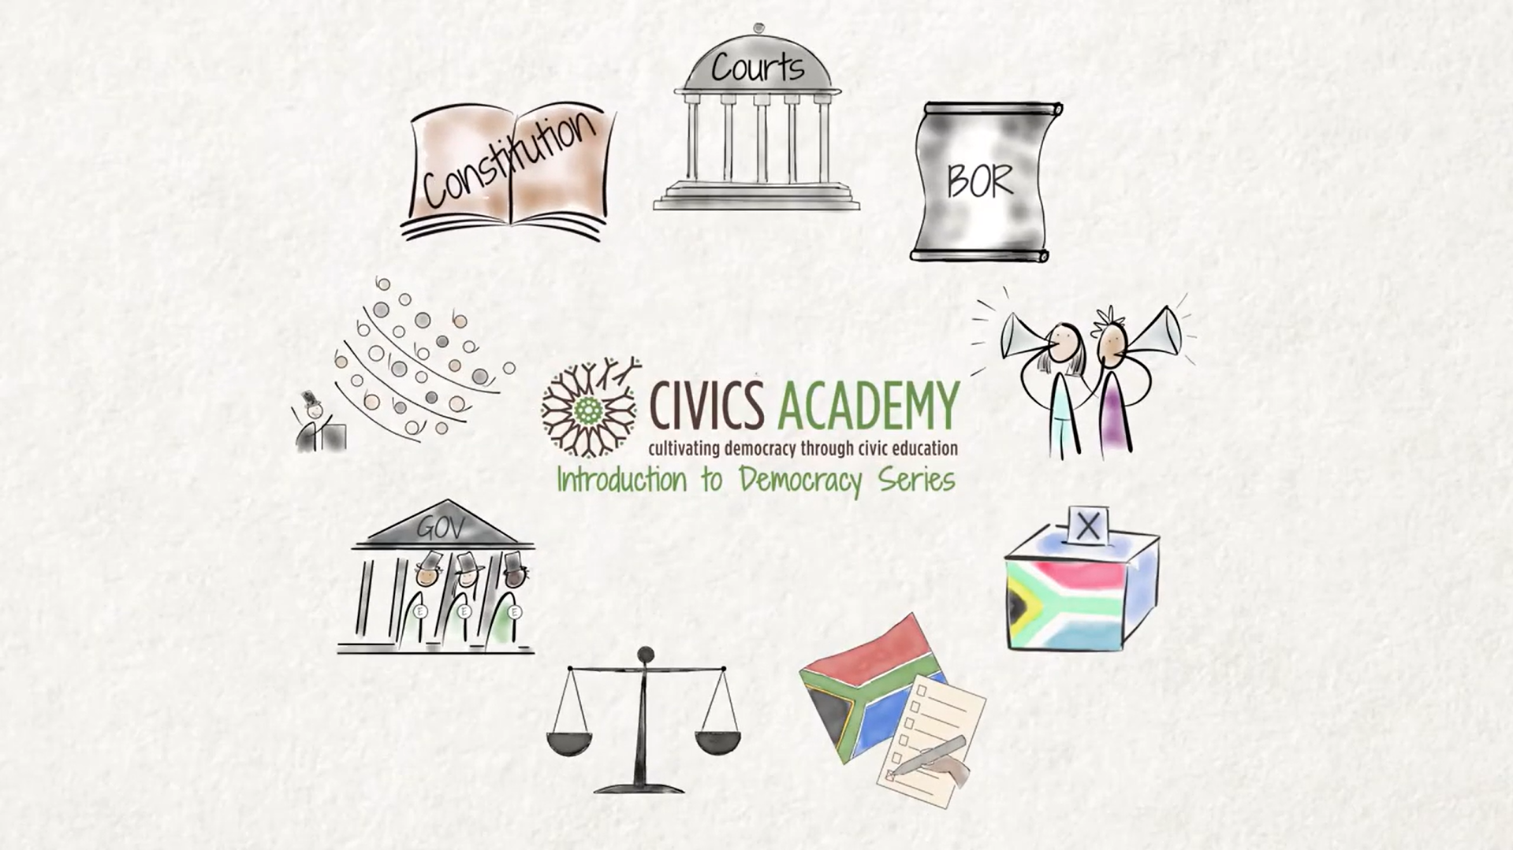
Watch video: What is the Rule of Law? https://bit.ly/4olIqop (5 min 40 sec)
Notes:
Slide 7: Optional video
Note to teacher: If time allows, you may watch the following optional video that explains the rule of law in South Africa in detail; however, there is quite a lot to get through in the lesson, so you might want to revert to it at the end of the lesson.
Watch video:
What is the Rule of Law?
bit.ly/4olIqop (5 min 40 sec)

Slide 8
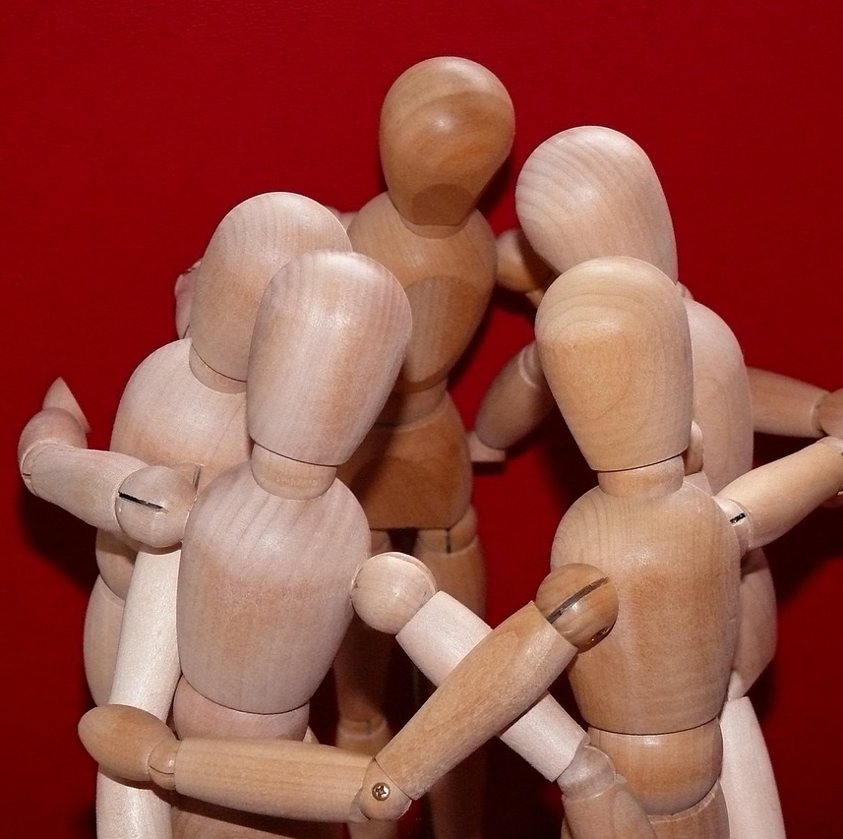
Understanding governance
Governance refers to how a country is run and how decisions are made and carried out.
It must follow the Constitution and the rule of law.
Citizens can be involved by giving input on service delivery and policies.
The Constitution is the highest law that sets out people’s rights and explains how government is structured.
Notes:
Slide 8: Ask the learners if they know what is meant by the term 'governance'.
Explain: Governance refers to the way a country is run by the people in power, and how decisions are made and carried out.
It must always follow the Constitution and the rule of law, and citizens have the right to be involved, for example, by giving input on service delivery and government policies.
Remind learners that they looked at the Constitution and constitutional values in Grade 9 (Term 2, Week 4–5). Ask them if they can recall what the Constitution is. Definition: The highest law of a country that sets out people’s rights and explains how the government is structured and must operate.

Slide 9
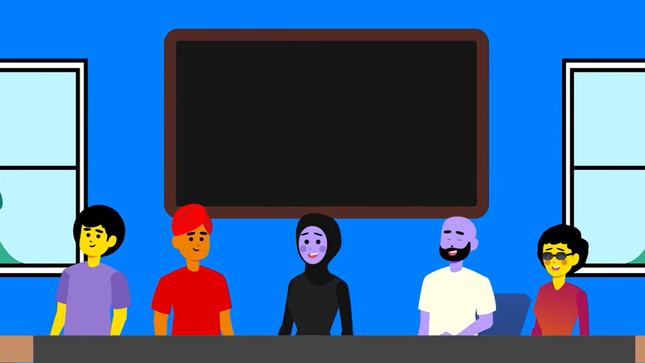
Watch video: Principles of good governance https://bit.ly/4iq8xJt (2 min 52 sec)
Notes:
Slide 9: Tell learners that all South African organisations, including schools, should strive to operate under the democratic principle of good governance. While watching the following video on 'good governance', ask learners to think about how this information applies to their school.
Watch video:
Principles of good governance
bit.ly/4iq8xJt (2 min 52 sec)

Slide 10
Good governance means that government:
Allows people to take part in decision-making and keeps them informed.
Delivers basic rights such as healthcare, education and housing.
Takes responsibility for its actions.
Solves problems within a reasonable time.
Protects the environment now and for the future.
Ensures equity and inclusivity by treating all people fairly.
Communities have the right to hold leaders accountable if good governance is not practised. Citizen responsibility is vital.
Notes:
Slide 10: Explain: Good governance means that the government:
Allows people to participate in decision-making and keeps them informed.
Delivers basic human rights, such as healthcare, education and adequate housing.
Takes responsibility for its actions and decisions.
Solves problems and addresses issues within a reasonable time.
Protects the environment for current and future generations.
Ensures equity and inclusivity by treating all people fairly.
Communities have the right to hold leaders accountable when good governance is not practised. However, it is important to remember that rights also come with responsibilities. Responsibility does not rest only with government. Citizens also need to take responsibility in their communities by caring for themselves, those around them, and the environment.

Slide 11

Law-making process
Laws are made to protect rights, maintain order, and improve society.
Laws usually start as a bill drafted by government or lawmakers.
The bill is discussed, debated, and improved by the relevant legislature.
The process includes public participation (public hearings and written submissions).
This helps ensure laws are fair, transparent, and not made in secret.
Lawmakers vote on the bill, and if it is approved, it is signed into law.
Notes:
Slide 11: Explain that laws are made to protect people’s rights, maintain order and improve society. In South Africa, the Constitution gives Parliament, provincial legislatures, and municipal councils the power to make laws at different levels of government.
A law usually begins as a proposal (bill) that is drafted by the government or lawmakers. The bill is then discussed by the relevant legislature, where it can be debated, changed and improved.
Importantly, the process includes opportunities for public participation, such as public hearings and written submissions, so that citizens and organisations can share their views. This ensures that laws are not made unfairly or in secret.
Once the bill has been carefully reviewed, lawmakers vote on whether it should be approved. If it is passed, it is signed into law and becomes an official part of South Africa’s legal system.
Explain that making a rule at school is like a mini version of law-making. For example, before a new cell phone policy is implemented, it would go through similar steps: proposal → discussion → consultation → decisions → implementation.

Slide 12
Representation
Chosen leaders who are meant to represent the public's interests should be held accountable if they fail to do so.
Electing people to speak and make decisions on behalf of citizens.
Citizens choose parties or independent candidates at all levels of government.
Representatives must express the needs and views of the people who voted for them.
Schools also use representation through the RCL or SRC.
Notes:
Slide 12: Ask the learners if they know what is meant by the term 'representation'.
Explain: Representation means that citizens choose people to speak and make decisions on their behalf in government.
This happens through free and fair elections:
Citizens vote for political parties or independent candidates at national, provincial and local levels.
Representatives are expected to express the views, needs and interests of the people who voted for them when making laws or decisions.
Chosen leaders who are meant to represent the public's interests should be held accountable if they fail to do so.
Remind learners that schools also use the democratic principle of representation. This is why schools have structures such as the Representative Council of Learners (RCL) or Student Representative Council (SRC). Learners vote for these leaders so that their views, concerns and best interests can be represented in school decision-making.

Slide 13
Accountability
Government leaders must answer to the people.
If they fail to serve the public, misuse their power or break the law, they can be:
Removed from their position.
Charged or prosecuted if they break the law.
Exposed by the media or official inquiries.
Reported to watchdog bodies such as the Public Protector or Human Rights Commission.
Accountability is important because it allows citizens to question leaders, monitor their performance, and demand better service delivery.
Notes:
Slide 13: Explain: Accountability means that government leaders must answer to the people for their actions and decisions. They are responsible for using power honestly, fairly and according to the law. If leaders fail to serve the public, misuse their power or break the law, they can be:
Questioned or investigated by Parliament or the courts.
Voted out of office in the next election.
Removed from their position.
Faced with criminal charges or prosecuted in a court of law.
Publicly exposed through media reporting or official inquiries.
Reported to watchdog organisations such as the Public Protector or the Human Rights Commission.

Slide 14

Transparency
Transparency means government actions, decisions and processes must be open and accessible.
Citizens should be able to see how decisions are made and how public money is used.
Examples include:
Open parliamentary sessions (broadcast on TV or online).
Public reporting of budgets and spending.
Independent media investigating government activity.
Public hearings and consultations.
Notes:
Slide 14: Ask the learners to explain the term 'transparency' in the context of government.
Explain: Transparency means that government decisions and actions are open and easy for the public to access and understand. Citizens should be able to see how decisions are made and how public money is spent. Transparency is important because it helps people identify corruption and hold government accountable.
In South Africa, transparency is supported through:
open parliamentary sessions (often broadcast on TV or online)
public reporting of budgets and spending
independent media that investigates government actions
public hearings and consultations

Slide 15
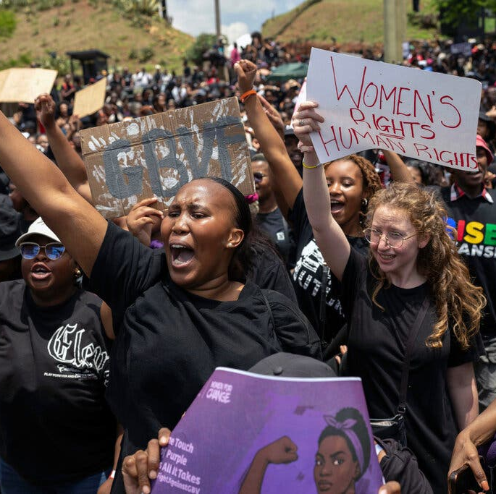
Democratic participation
Democratic participation gives people the chance to be heard and influence decisions.
Ways citizens can participate include:
Voting in elections.
Attending community meetings or public hearings.
Joining civil society or community organisations.
Peaceful protests or marches.
Contacting leaders directly through letters, emails or social media.
Source: NY Times bit.ly/48BaFup
Notes:
Slide 15: Explain: Democratic participation or public participation gives people the chance to have their voices heard and to influence decisions. In this way, the choices made in government reflect the will of the people rather than the views of a few leaders.
Mention the nationwide protest against GBV in 2025, which led the government to declare GBV a national state of disaster.
Public participation is important because it gives citizens ways to raise concerns, monitor government performance, and push for improved service delivery.
Ask learners to list ways citizens can participate in democracy. Answers may include:
Voting in elections to choose representatives for national, provincial or local government.
Attending public hearings or community meetings to share your views on laws or projects.
Joining civil society organisations or community groups: to support causes such as health, education or the environment.
Peaceful protests or marches to raise awareness of issues affecting communities.
Engaging with leaders directly by writing letters, sending emails or using social media to communicate with representatives.

Slide 16

Petition process
Formal written request signed by people to ask government to address a problem.
Submitted to Parliament, provincial legislatures, or municipal councils.
Helps citizens hold government accountable and demand action.
Can also be online, allowing many people to sign and share quickly.
Online petitions still need to be sent through the correct official channels.
For service delivery issues, report the problem to the municipality first before submitting a petition.
Notes:
Slide 16: Explain: If citizens are unhappy with how the government is functioning or believe that their needs are not being met, they have the right to submit a petition.
A petition is a formal written request signed by individuals or groups to draw the government’s attention to a specific problem or demand. It can be submitted to Parliament, provincial legislatures or municipal councils, depending on the issue.
Petitions are a practical way for citizens to hold government accountable and demand action.
In modern society, petitions can also be created and shared online. An online petition is a digital version of a petition that allows people to support a cause by signing electronically.
Online petitions are useful because they:
make it quicker and easier for large numbers of people to sign.
allow people from different areas to support the same issue.
help to raise awareness through social media and online sharing.
However, online petitions are not always automatically accepted by the government. For this reason, the petition must be submitted through the correct official channels (such as Parliament, even if it was signed online.
Emphasise the following: Before submitting a petition about a service delivery problem, make sure you have first used the correct channels to report the issue to your municipality. Many problems can be resolved through direct communication with the relevant department. Visit your local municipality’s website to find contact details for different service delivery departments in your area and follow their reporting procedures.

Slide 17
Activities
Complete Activity 1 to test your understanding.
Activity 2 is homework. We will mark it together at the start of the next lesson.
Identify any areas where you still feel unsure and ask for support if needed.
Remember today’s learning outcomes
Notes:
Slide 17: Learners complete Activity 1 (Lesson 1 – Worksheet) to test their knowledge of the concepts taught in this lesson.
Answers are available in the Lesson 1 – Worksheet MEMO.
Assign Activity 2 (Lesson 1 – Worksheet) as homework. Tell learners that you will mark the answers together in the first few minutes of the next lesson.
Remind learners of the learning outcomes introduced at the beginning of the lesson.
Encourage them to identify any areas where they still feel uncertain. If they are unsure about any part of the content, they should reach out so that you can work together to plan an appropriate intervention or support strategy.

