Slide 1
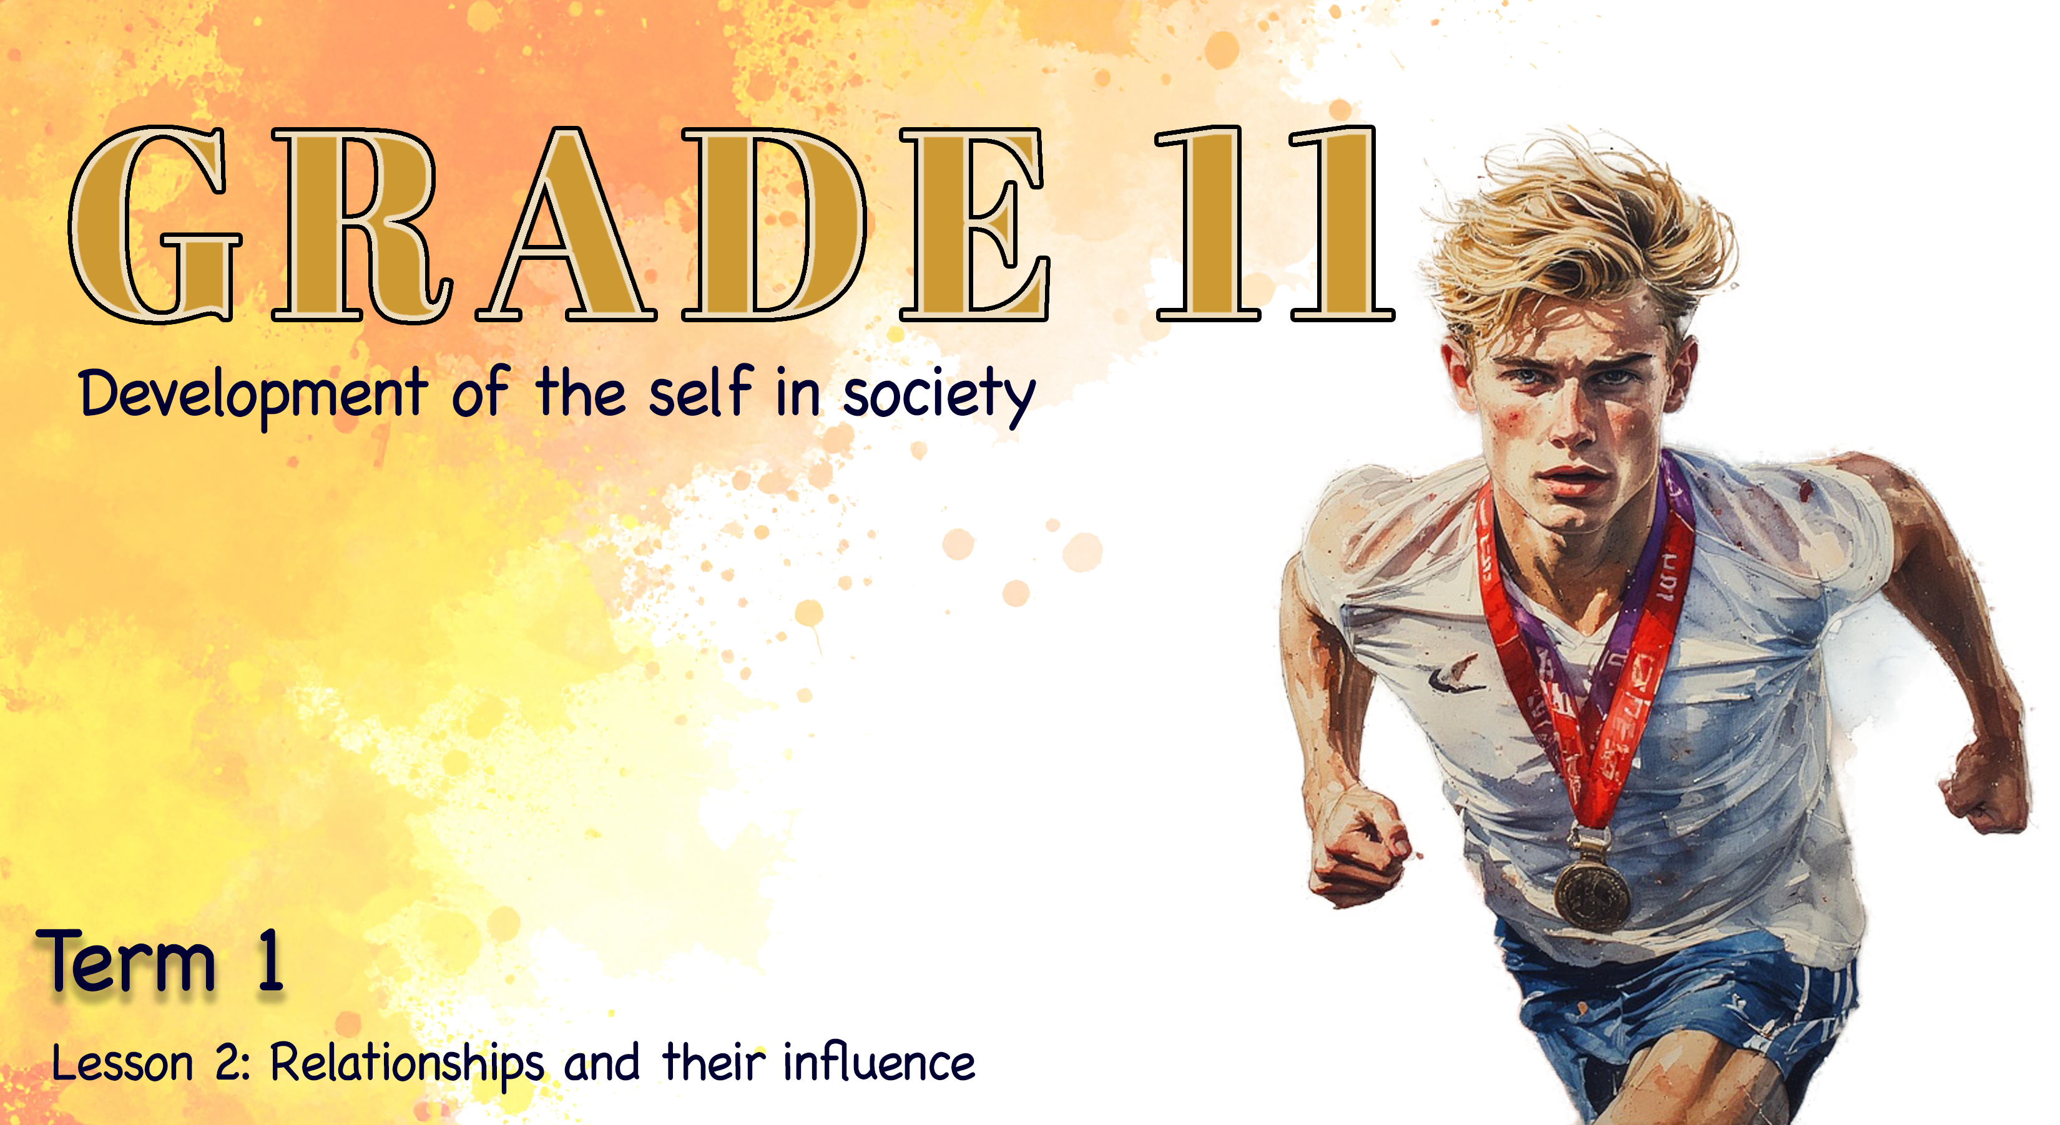

Lesson 3: Factors that impact relationships
Notes:
Slide 1: Good day Grade 11s! Welcome back to the last lesson in this series on goals, relationships and well-being – where we examine not only how the people in your life influence your well-being, but also how your own well-being influences the quality of your relationships.

Slide 2
By the end of the lesson, you should be able to identify:
Factors that contribute to relationships that are detrimental to well-being
Rights and responsibilities in relationships
Societal and cultural views that influence and/or affect relationships
Qualities required in different relationships
Individuality in relationships
Critically analyse the impact of the media on values and beliefs about relationships
Notes:
Slide 2: Today, we will identify the relationship factors that have a positive and negative impact on well-being. By the end of the lesson, you should be able to identify:
Factors that contribute to relationships that are detrimental to well-being
Rights and responsibilities in relationships
Societal and cultural views that influence and/or affect relationships
Qualities required in different relationships
Individuality in relationships
Critically analyse the impact of the media on values and beliefs about relationships

Slide 3
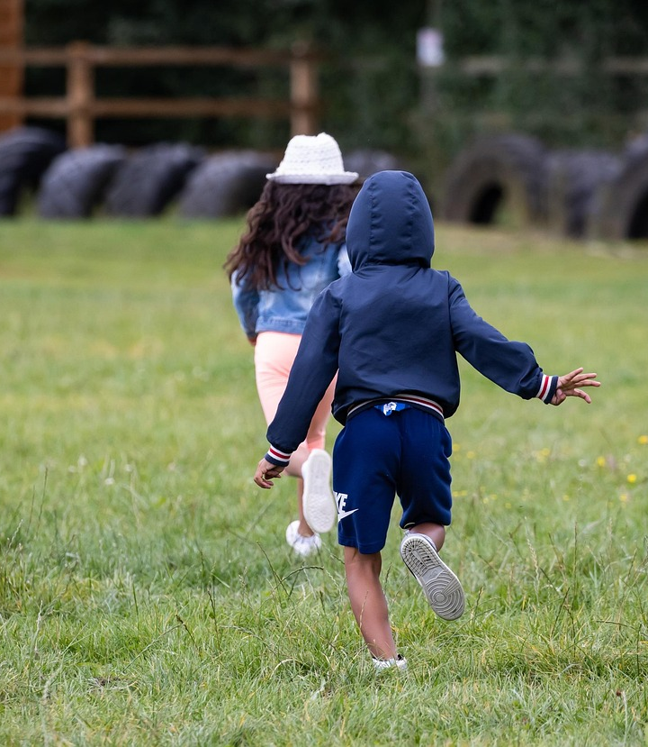
Recap: Relationships change over time
Think back: Can you remember your best friend at five years old?
Many friendships change or drift apart over time.
As you grow, your values, priorities and interests change.
Some childhood friends may still be in your life, but you may not have much in common anymore.
Notes:
Slide 3: How many of you can remember who your best friend was when you were five years old? (Allow learners to respond.)
I’m impressed! Now, how many of you still have the same best friend today? Take a look around – this shows us that relationships don’t always stay the same over the years.
As we learnt in the previous lesson, relationships change because you change. Your values, priorities and interests develop as you grow, and sometimes old friendship groups naturally drift apart. Some of you may still be in contact with those childhood friends, but you may not have much in common anymore.

Slide 4
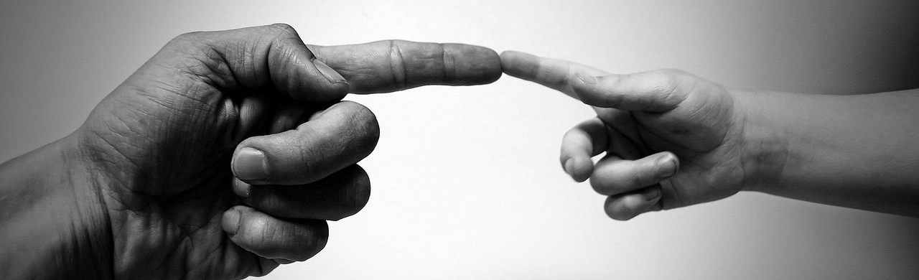
Recap: Positive contributions
In the previous lesson, you planned actionable steps to improve a relationship.
Turn to a peer: share what you planned in Activity 4 (Lesson 2) and what the outcome was.
Notes:
Slide 4: We also discussed the positive contributions you can make to a friendship, and in the reflection activity, you were asked to identify actionable steps you could take to improve a relationship. Turn to your peer and share what you planned to do in Activity 4 (Lesson 2 – Worksheet), and what the outcome was. (Allow two minutes.)

Slide 5
Detrimental/toxic relationships
Some relationships harm your well-being over time – these are detrimental or toxic.
Examples:
Competition and sabotage
Carrying all the emotional burden
Manipulation through guilt or pressure
Disrespect for boundaries and values
Jealousy and possessiveness
Lack of support when you need it
These patterns often appear gradually, so it’s important to recognise the warning signs.
Notes:
Slide 5: Well done, class! It’s wonderful to hear how some of you have genuinely tried to strengthen your relationships. But have you ever been in a friendship where you feel like you’re always making the effort, while the other person hardly tries? Or maybe they only contact you when they want something. How does it feel to be in a friendship like that? (Allow time for responses.)
We often end up feeling unappreciated, and sometimes even insecure, wondering whether we did something wrong.
And sometimes, it’s not such a bad thing when a friendship ends. Have you ever been in a friendship that had a deeply negative impact on your well-being?
Detrimental or 'toxic' relationships are those that slowly harm your well-being. These relationships may look different on the surface, but they often share the same pattern: one person’s behaviour negatively affects the other person’s emotional, social or even physical health.
We refer to these kinds of relationships as detrimental to your well-being, or as examples of a toxic relationship. Some examples include:
Competition and sabotage, where one person feels the need to appear superior.
Emotional burden, where one person carries all the emotional weight. They act as the caretaker while the other offers little support in return.
Manipulation, where someone controls decisions or feelings through guilt or pressure.
Disrespect, where boundaries are ignored or personal values are dismissed.
Jealousy and possessiveness, which restrict independence or friendships.
Lack of support, where achievements are minimised, or struggles are not taken seriously.
These relationships can be difficult to recognise at first because negative patterns often appear gradually. Understanding the signs can help you reflect on whether your relationships contribute positively to your well-being or whether they cause stress or harm.

Slide 6

Peer Activity
Notes:
Slide 6: Read the scenarios in Activity 1 (Lesson 3 – Worksheet) with your peer and formulate answers that the two of you have discussed.
Answers are available in the Lesson 3 – Worksheet MEMO.

Slide 7
Factors in negative relationships
Many of you may know someone like Ethan and Liam or Sarah and Jessie.
Ethan & Liam: show how competition and sabotage can damage a friendship.
Sarah & Jessie: show how emotional dumping creates a one-sided relationship.
These factors can slowly harm emotional and social well-being.
Notes:
Slide 7: The sad reality is that many of you have probably known someone who has faced challenges similar to Ethan and Liam, or Sarah and Jessie. In each of their stories, different factors contributed to a negative relationship.
In Ethan and Liam’s case, we see how competition and sabotage can harm a friendship. One person uses the relationship to feel superior or quietly undermine the other’s success, which negatively affects well-being.
In Sarah and Jessie’s story, we see the danger of emotional dumping. The relationship becomes one-sided, with one person acting only as a caretaker or "therapist" while receiving little or no support in return.

Slide 8
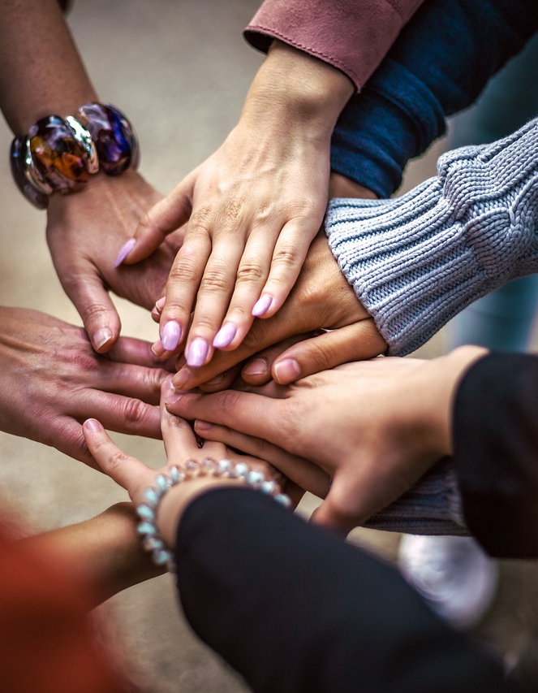
Rights in relationships
A healthy relationship is a space where everyone benefits.
A right in a friendship is an expectation you can reasonably hold toward your friend.
You have rights in a friendship/relationship, for example:
  Right to respect
  Right to honesty
  Right to support
  Right to independence (your own interests, boundaries and friendships)
When rights are consistently unmet, the relationship begins to suffer.
Notes:
● Slide 8: A healthy friendship is a space where everyone involved benefits from the relationship. In other words, a relationship should have both rights and responsibilities.
● A right in a friendship is an expectation you can reasonably hold toward your friend. When these rights are consistently unmet, the friendship often suffers. Here are a few examples of rights:
- Right to respect: The right to be treated with dignity, have your privacy honoured, and not be judged or broken down.
- Right to honesty: The right to expect your friend to be truthful with you, even when the truth is difficult.
- Right to support: The right to be listened to, encouraged and helped during tough times.
- Right to independence: The right to maintain your own interests, relationships and boundaries without excessive control or jealousy from your friend.
• This is not a complete list of rights. Can anyone think of another right you should have in a romantic relationship, for example, with your boyfriend?
• (Allow time for learners to respond. Possible answers may include: the right to privacy, the right to say no to premarital sex, etc.)

Slide 9
Responsibilities in relationships
A responsibility is an obligation you have toward your friend to uphold the positive nature of the relationship.
You also have responsibilities towards others, for example:
Responsibility to be trustworthy
Responsibility to communicate and listen
Responsibility to validate your friend’s feelings
Responsibility to set and respect boundaries
If you have the right to honesty, you also have the responsibility to be honest.
Healthy relationships exist when both people respect each other’s rights and responsibilities.
Notes:
Slide 9: A responsibility is an obligation you have toward your friend to uphold the positive nature of the relationship. It's the active work you put in. Here are a few examples of responsibilities:
Responsibility to be trustworthy: The obligation to keep your friend's secrets and follow through on your commitments.
Responsibility to communicate: The obligation to check in, actively listen, and constructively express your feelings or concerns.
Responsibility to validate: The obligation to acknowledge and respect your friend's feelings, even if you don't fully agree with their perspective.
Responsibility to set boundaries: The obligation to clearly communicate your own limits so the friend knows how best to interact with you, preventing misunderstandings.
In other words, if you have the right to honesty (to receive it), you also have the responsibility to be honest (to give it). A healthy friendship exists when both people fulfil their responsibilities, which in turn grants the other person their rights within the relationship.

Slide 10
Society and culture
Relationships are shaped by society and culture.
Influences include:
Cultural beliefs and traditions (roles, decision-making, dating/marriage expectations)
Family expectations (who you should befriend/date, how to handle conflict)
Gender norms (ideas about how boys and girls “should” behave)
Peer group norms (what friends say is “normal” in relationships)
These factors can affect how you communicate, choose partners and set boundaries.
Notes:
Slide 10: It's important to note that relationships do not exist in isolation. They are shaped by the society and culture we grow up in. The beliefs, values and expectations around us influence how we communicate, how we show respect, who we choose to form relationships with and what we expect from those relationships. Some of the main societal and cultural factors that can influence or affect relationships are:
Cultural beliefs and traditions
Determine expected roles in relationships (e.g. leadership, decision-making).
Influence who individuals may date or marry, based on family or community expectations.
Family expectations
Families may have strong opinions about who their children should befriend or date.
Influence how individuals handle conflict, responsibilities and boundaries.
Gender norms in society
Define how males and females "should" behave (e.g. boys being emotionally reserved or girls being nurturing).
Can reinforce stereotypes that affect communication and equality in relationships.
Peer group norms
Friends often influence what is considered "normal" in a relationship.
Pressure to fit in may affect choices about dating, friendships or behaviour.
You will find more information on this in your Content Summary that will be handed out at the end of the lesson.

Slide 11
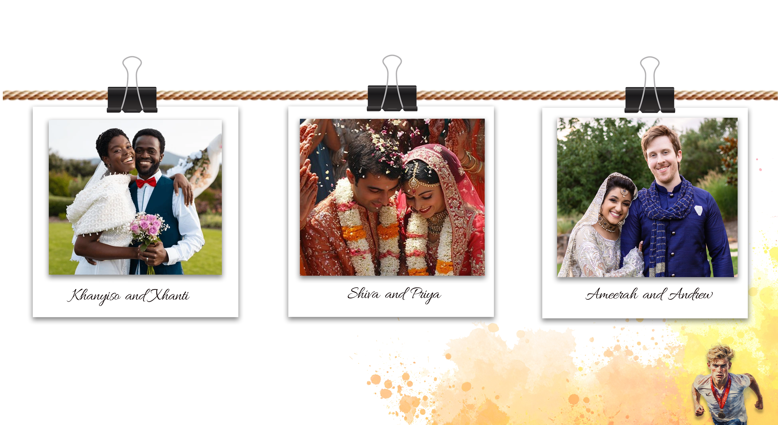
Group Discussion
Notes:
Slide 11: In some cultures, it may be acceptable for a man to hold authority over a woman within a marriage, which can limit her rights. In these societies, relationships are guided more by social roles and expectations than by the individual’s needs and feelings.
Let’s look at these examples of weddings. Each was shaped by cultural norms in different ways: the first is a Xhosa wedding, the second a traditional Hindu wedding, and the third a cross-cultural Muslim wedding. In the Hindu wedding, the marriage was arranged, and the couple only met on the day of the ceremony.
In your groups, discuss how cultural norms might influence the rights and responsibilities within these different marriages. Use both your general knowledge and imagination. What challenges could these couples face in their relationships because of their cultural backgrounds?
Allow five minutes for discussion and two minutes for group feedback.
It’s fascinating to see how our ideas about love and marriage differ. This activity shows that love can look very different depending on the cultural norms shaping the relationship. But culture isn’t the only influence on what we believe relationships should look like.
Who can tell me what is arguably the most significant influence on teenagers’ perceptions of relationships today?
That’s right – social media.

Slide 12
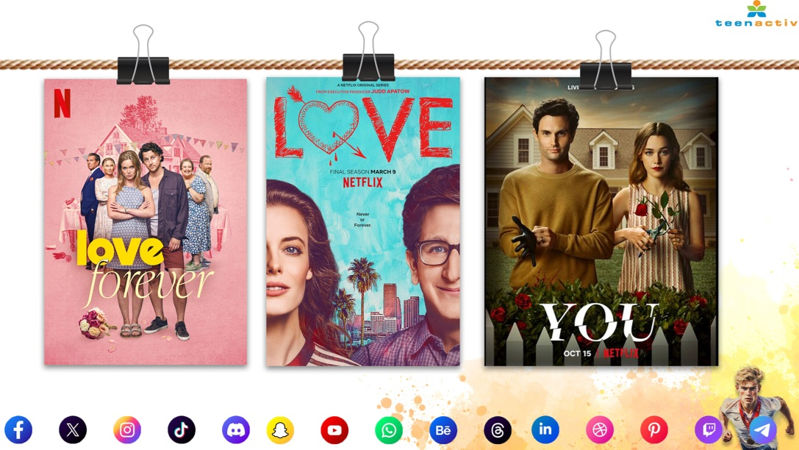
Notes:
Slide 12: Media plays a powerful role in shaping how young people think about friendships, dating, family relationships and even their own self-worth.
Media platforms such as television, movies, music, magazines, influencers and social media apps constantly present messages about what relationships should look like. These messages can strongly influence values and beliefs, often without us realising it.
If we focus only on the idea of love, we can see that social media presents many different versions of what love should look like.
For example, imagine you’ve grown up in a family with strong religious beliefs that teach the importance of abstaining from sex until marriage. But almost every series you watch on Netflix presents sex as a normal and expected part of getting to know someone you’re interested in. How might this influence your beliefs?
You can now start with Activity 2 (Lesson 3 – Worksheet). You will only have about six minutes. Please complete the rest for homework.
Answers are available in the Lesson 3 – Worksheet MEMO.
Note to teacher: Learners will start this activity in class, but need to finish it for homework. Ensure that the memo is shared with them to mark their answers.

Slide 13

Empathy
Loyalty
Patience
Forgiveness
Encouragement
Honesty
Discreetness
Active listening
Respectful of time
Kindness
Accountability
Good humour
Maturity
Generosity
Friendship
Family
Authority
Notes:
Slide 13: We have covered a great deal about relationships in the last two lessons. As we come to the end of this lesson, let’s pause and reflect.
Look at the list of qualities on this slide. Each of these qualities or values plays an important role in friendships and other relationships.
Choose ONE quality for each category (friendship, family and authority) that you feel is most important to you, then turn to your peer and explain why these qualities matter so much in your relationships.

Slide 14
Individuality in relationships
It is important to contribute positively to relationships.
But it is just as important not to lose your individuality.
There is only one YOU, and you have the right to protect your value and identity.
A healthy relationship does not expect you to change who you are just to please someone else.
Notes:
Slide 14: Remember, while it is important to contribute positively to a relationship, it is just as important not to lose your individuality. There is only one YOU, and you have so much to give those around you. If you’re in a relationship that constantly makes you question your value, then it's not healthy for you. You have a right to make choices to protect yourself and your individuality. Good friends will celebrate and enjoy you for who you are and not expect you to change just to please them.

Slide 15
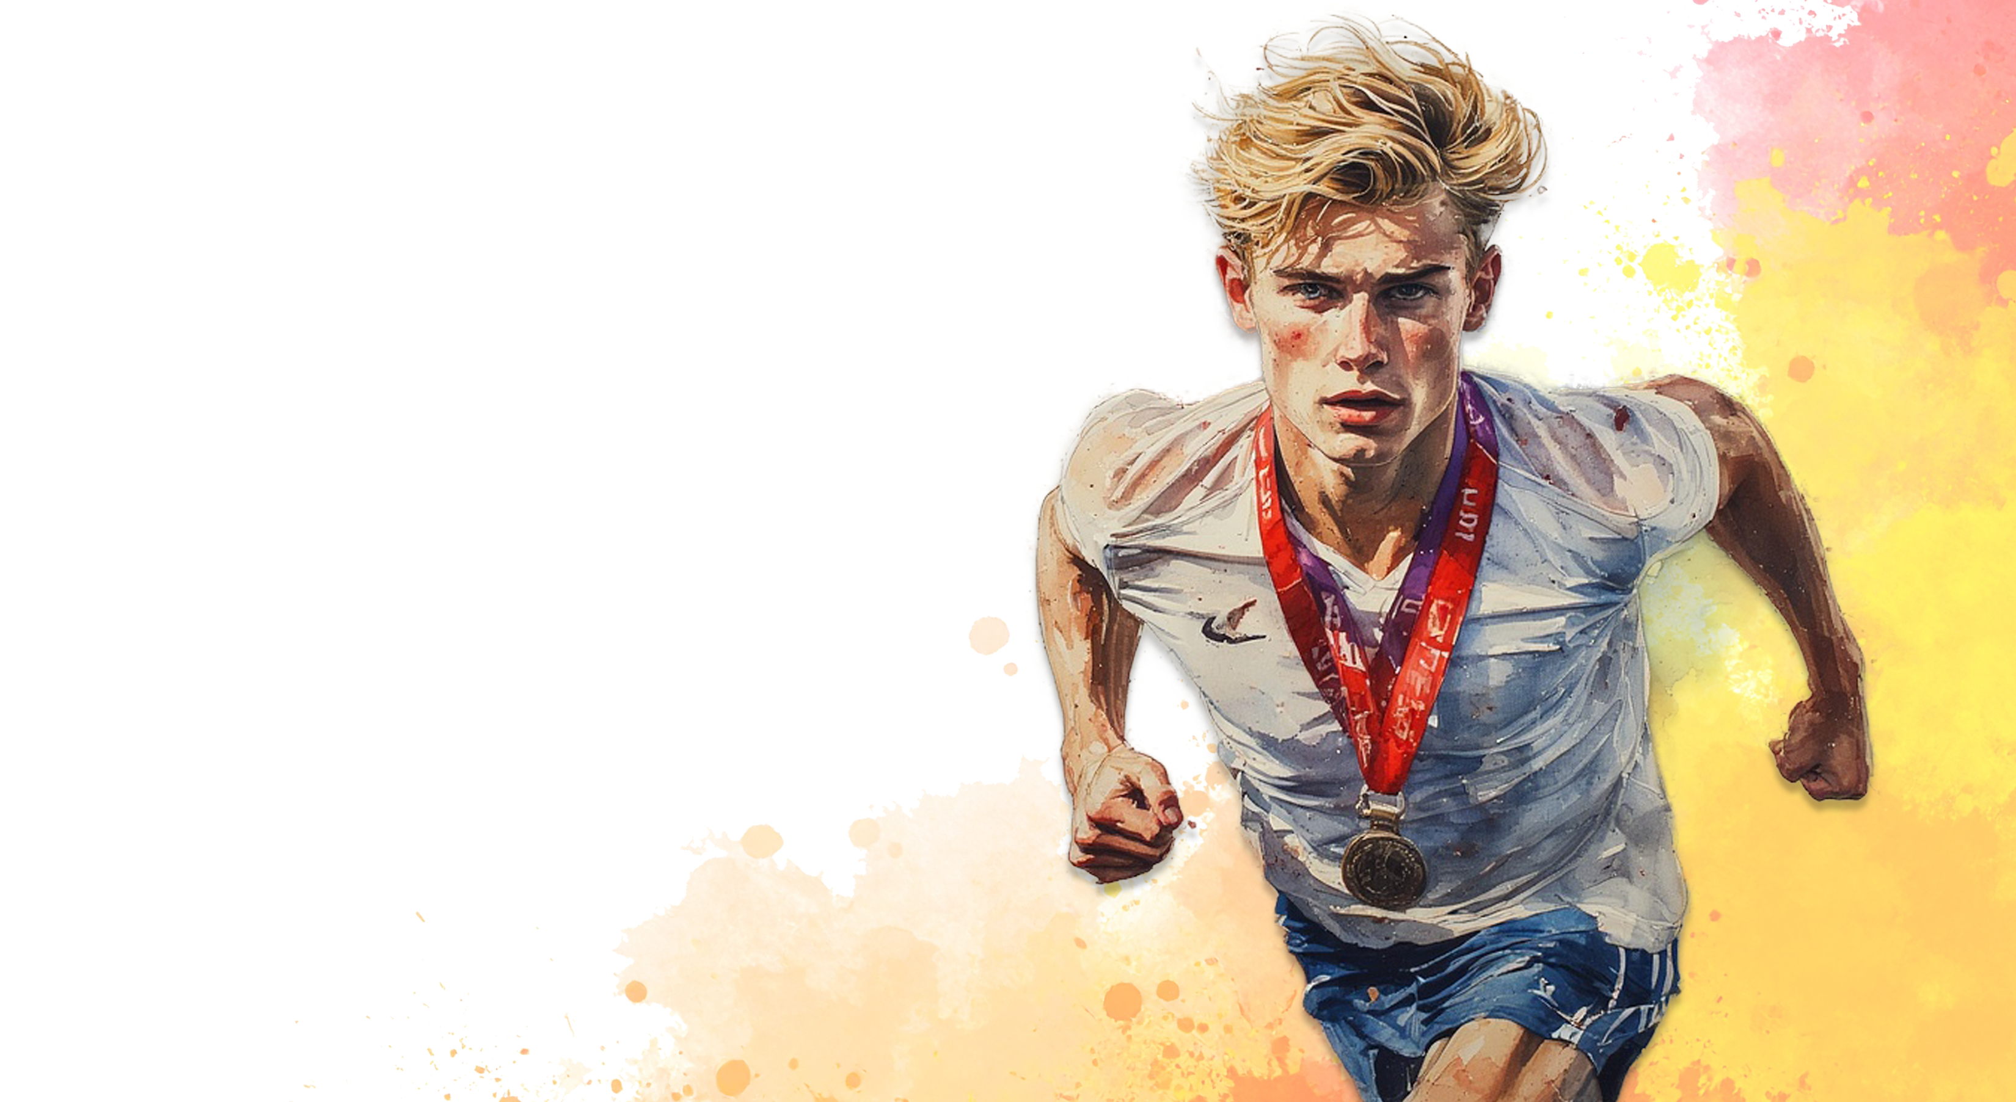
Reflection
Notes:
Slide 15: We have now reached the end of this section on goals, relationships and the influence of social media on how we connect with others.
As we conclude, take a few moments to reflect on what you will carry forward from these lessons, and how you can apply these insights in your own life by completing Activity 3 (Lesson 3 – Worksheet). If you don't finish in class, please complete the activity for homework.
Hand out the Content Summary.
Note to teacher: Remind learners to finish off Activity 2 for homework.

