Slide 1
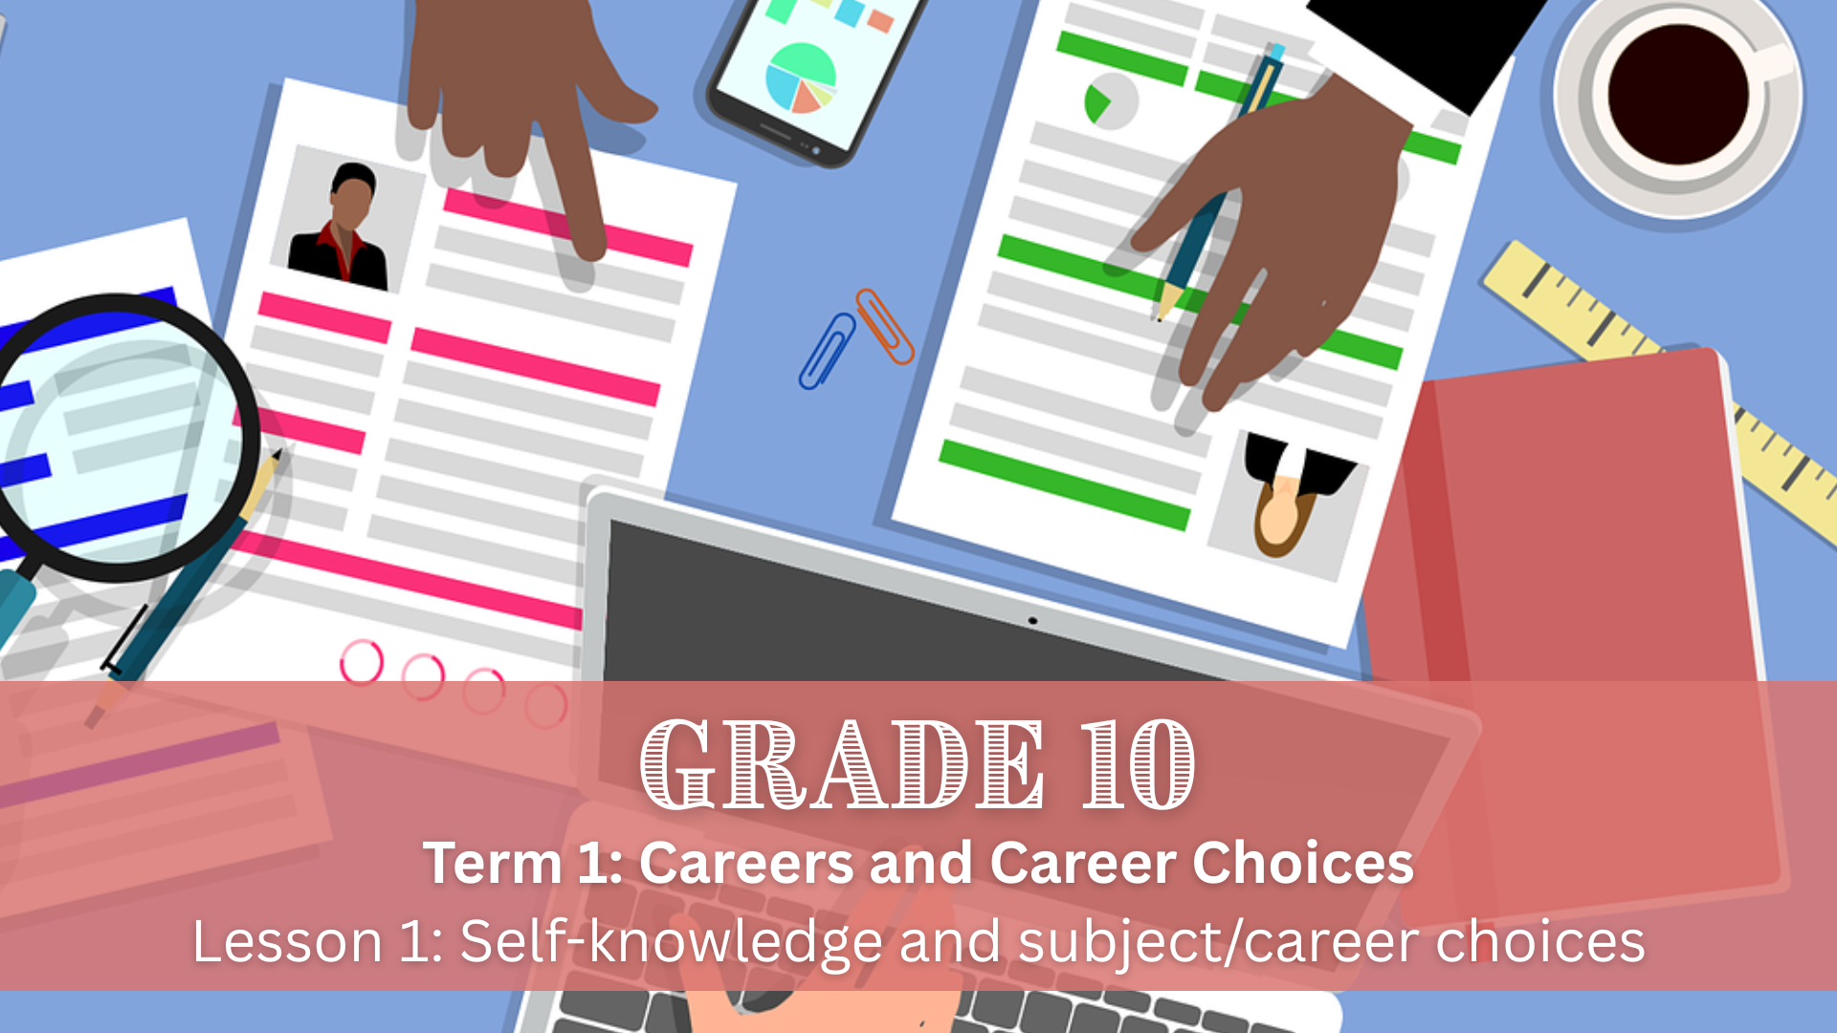

Notes:
Slide 1: Good day, Grade 10s. Today, we’re starting our next block of lessons on the topic of Careers and Career Choices. Making decisions about future careers requires more than just knowing what options are available. It also requires self-knowledge. This lesson focuses on helping you recognise how your interests, abilities, strengths and values relate to the subjects you take at school, the career fields you may explore, and the study choices you will make after school.

Slide 2
Define self-knowledge and explain why it is important
Identify your own interests, strengths, weaknesses, abilities talents
Differentiate between a job, occupation, career and career field
Develop a career portfolio
By the end of this lesson, you should be able to:
Notes:
Slide 2: By the end of this lesson, you should be able to:
Define self-knowledge and explain why it is important
Identify your own interests, strengths, weaknesses, abilities and talents
Differentiate between a job, occupation, career and career field
Develop a career portfolio

Slide 3

What is Self-Knowledge?
The understanding of who you are as an individual.
It includes being aware of your interests, strengths, weaknesses, abilities and talents.
Self-knowledge develops over time through self-reflection and life experiences.
It helps you understand how you think, feel and behave in different situations.
Notes:
Slide 3: Let's start by defining self-knowledge. Can anyone tell me what they think this means? (Allow learners to respond.)
Self-knowledge is the understanding of who you are as an individual. It includes being aware of your interests, strengths, weaknesses, abilities and talents.
Self-knowledge develops over time through self-reflection and life experiences, and it helps you understand how you think, feel and behave in different situations.

Slide 4
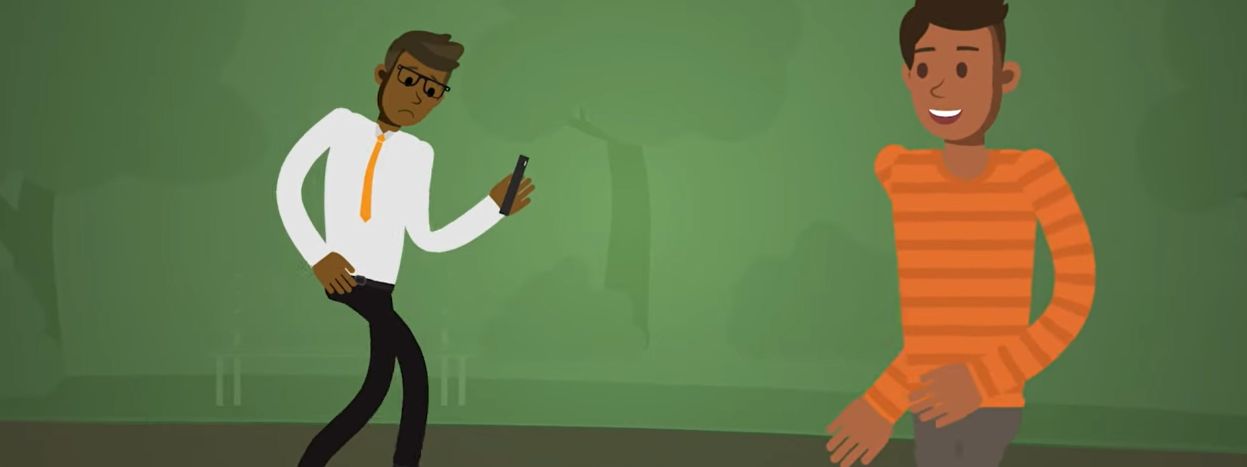
Watch: Professional Skills: Self-Awareness bit.ly/3LANack (2 min 17 sec)
Notes:
Slide 4: In our lessons on Development of the Self in Society in Week 1 of Term 1, we talked extensively about self-awareness. Self-awareness forms part of self-knowledge. Let's watch a video that explains how self-awareness is applicable in the workplace.
Watch: Professional Skills: Self-Awareness
bit.ly/3LANack (2 min 17 sec)

Slide 5
Components of self-knowledge
Interests
Activities or topics that capture your attention and make you want to learn more.
Ask yourself: What do I enjoy spending my time on?
Abilities
Skills or capacities that help you perform tasks well, developed through practice.
Ask yourself: What am I capable of doing successfully?
Talents
Natural gifts or aptitudes that come easily to you.
Ask yourself: What do I seem naturally good at?
Strengths
Areas where you consistently perform well over time.
Ask yourself: What skills or abilities help me succeed at school or in daily life?
Weaknesses
Areas where you struggle or need improvement.
Ask yourself: Which areas do I find challenging despite trying?
Notes:
Slide 5: Now that we understand how important self-knowledge and self-awareness are in the workplace, let's break down the different components of self-knowledge.
Note to teacher: For each of the following components, first ask learners to explain their understanding and give examples before explaining the content on the slides.
Interests: Activities, topics or subjects that capture your attention and make you want to learn more.
Examples: Enjoying painting, playing a sport or solving puzzles.
Ask yourself: What activities or subjects do I enjoy and like to spend my time on? (Allow learners to think introspectively about this question for a couple of seconds.)
Abilities: Skills or capacities that allow you to perform tasks well. These can be natural or developed through practice.
Examples: Being able to write clearly, solve math problems or play an instrument.
Ask yourself: What am I capable of doing, and which tasks can I complete successfully with practice?
Talents: Natural gifts or aptitudes that come effortlessly. Often, something you are born with.
Examples: Singing naturally well, drawing, or having a good sense of rhythm.
Ask yourself: What natural abilities do I have that seem to come easily to me?
Strengths: Areas where you consistently perform well, combining your knowledge, skills and talents.
Examples: Being a good communicator, problem solver or leader.
Ask yourself: What skills or abilities have I developed over time that help me do well at school or in everyday life?
Weaknesses: Areas where you struggle or need improvement.
Examples: Difficulty with public speaking, memorising facts or managing time effectively.
Ask yourself: Which areas do I find challenging or need to improve in, and where do I often struggle despite trying?

Slide 6
Why self-knowledge matters
Self-knowledge is essential for subject, career and study choices.
It helps you choose subjects that suit your interests, abilities and strengths.
This can improve motivation, performance and confidence at school.
Self-knowledge helps you identify career fields that match your personality and values.
It supports realistic study choices, such as university, TVET colleges or other training options.
Notes:
Slide 6: Self-knowledge is of utmost importance for subject, career and study choices.
Self-knowledge allows you to choose subjects that suit your interests, abilities, talents and strengths. This can improve motivation, performance and confidence at school.
By knowing what you enjoy and what you are good at, you can identify career fields that match your personality, skills and values. This reduces the risk of choosing a career based only on pressure, trends or unrealistic expectations.
Self-knowledge helps you make realistic decisions about further study by considering your academic ability, work ethic and goals. This allows you to choose appropriate study pathways, such as university, TVET colleges or other training opportunities.

Slide 7
Understanding world of work terms
Career field
A broad area of work with related occupations.
Examples: Health sciences, engineering, education
Occupation
A specific profession or type of work.
Examples: Nurse, electrician, teacher
Career
A long-term journey of learning, working and progressing over time.
Example: Becoming a teacher, gaining experience, and advancing to a senior position
Job
A specific position held at a particular time to earn an income.
Example: Grade 10 teacher at a local high school
Notes:
Slide 7: In Grade 9 (Term 3 Week 1–4), you learnt about different careers, how subjects are related to specific careers, as well as the qualities (strengths, weaknesses, interests and abilities) relating to different careers and subjects.
Before exploring career options in detail, it is important to understand the different terms used when discussing the world of work. Words such as career field, occupation, career and job are often used interchangeably, but they have different meanings.
Note to teacher: For each of the following terms, first ask learners to explain their understanding and give examples before explaining the content on the slides.
Career field: A broad area of work that includes many related occupations and careers.
Examples: Health sciences, engineering, education
Occupation: A specific type of work or profession that a person is trained to do.
Examples: Nurse, electrician, teacher
Career: The long-term journey of learning, working and progressing in one or more occupations over time.
Example: Becoming a teacher, gaining experience, and advancing to a senior position
Job: A specific position or role a person has at a particular time to earn an income.
Example: Grade 10 teacher at a local high school

Slide 8
Using self-knowledge to explore careers
Start by identifying career fields that match your interests and strengths.
Then explore specific occupations within those fields.
As you learn more, you can think about possible career paths over time.
Finally, consider the different jobs that form part of this journey.
Notes:
Slide 8: Once you understand the difference between a career field, occupation, career and job, you can begin to use your self-knowledge to explore your future options:
Start by identifying broad career fields that match your interests and strengths.
Note to teacher: The following steps will be explored in more detail in Term 3 (Week 10).
You can then narrow your focus by exploring specific occupations within those fields.
As you learn more about these occupations, you will be able to think about possible career paths and how you might progress over time.
Finally, you can consider the types of jobs that form part of this journey.

Slide 9
Career field | Occupations | Interests | Strengths
Agriculture, Environmental & Natural Sciences | Farmer, environmental scientist, conservationist | Nature, sustainability, outdoor work, food production | Observation, responsibility, scientific thinking, resilience
Creative Arts, Media & Design | Graphic designer, photographer, actor, journalist, filmmaker | Creativity, storytelling, self-expression, media | Creativity, communication, originality, adaptability
Business, Finance & Management | Accountant, entrepreneur, manager, marketer, HR officer | Money, leadership, decision-making, entrepreneurship | Organisation, numeracy, strategic thinking, communication
Education & Training | Teacher, lecturer, tutor, education specialist | Working with people, helping others learn, sharing knowledge | Communication, patience, organisation, leadership, empathy
Science, Technology, Engineering & IT | Engineer, software developer, IT technician, data analyst | Technology, problem-solving, innovation, systems | Logical thinking, maths skills, attention to detail, creativity
Health & Social Services | Doctor, nurse, psychologist, social worker, physiotherapist | Helping people, science, health, community wellbeing | Empathy, problem-solving, responsibility, emotional resilience
Retail, Sales & Customer Service | Sales consultant, store manager, client liaison | Working with people, business, persuasion | Communication, confidence, problem-solving, adaptability
Notes:
Slide 9: Let's pause for a minute and investigate career fields in a bit more detail. Each career field has related interests and strengths. Let's look at some examples:
Note to teacher: Go through a few examples on Slide 9. This table is available in the Content Summary, which learners can reference at a later stage.

Slide 10
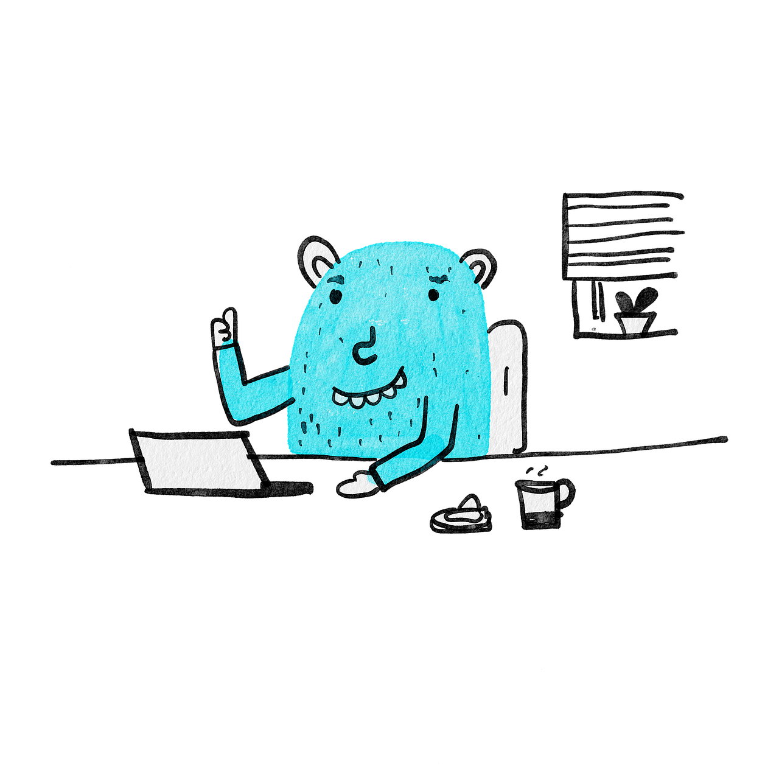
Individual activity
Notes:
Slide 10: Let's see how well you grasped the content we have covered so far by completing Activity 1 (Lesson 1 – Worksheet).
Allow learners a couple of minutes to complete the activity.
Answers are available in the Lesson 1 – Worksheet MEMO.

Slide 11

Career portfolio
Now that you understand the theory, it’s time to reflect on your own qualities.
This activity forms part of building a career portfolio.
A career portfolio is a personal collection of information that tracks your interests, strengths, achievements and goals.
It supports informed subject, career and study choices over time.
Notes:
Slide 11: Now that you understand the theory, you need to do some introspection to discover your own qualities in relation to subject, career and study choices.
The next activity is a crucial part of developing a career portfolio.
A career portfolio is a personal collection of information and evidence that helps you keep track of your interests, strengths, achievements and career goals. It is a tool that you build over time to support informed subject, career and study choices.

Slide 12
Why a career portfolio is usefuL
A career portfolio helps you organise what you learn about yourself and the world of work.
It allows you to reflect on progress and identify areas for growth.
It becomes a useful reference for subject changes, further study, bursaries or job applications.
Notes:
Slide 12: A career portfolio is important because it helps you organise what you learn about yourself and the world of work.
By keeping records of your achievements, skills and experiences, you are better able to reflect on your progress, identify areas for growth and make realistic decisions about your future. It also becomes a useful reference when applying for subject changes, further study opportunities, bursaries or jobs later on.

Slide 13
Building your career portfolio
In Grade 10, your career portfolio may include:
Subject results
Self-reflection activities
Career research
Skills assessments
Certificates or awards
In Grades 11 and 12, your portfolio can be expanded as your goals become clearer.
Notes:
Slide 13: In Grade 10, you can start compiling a career portfolio by collecting simple but meaningful information. This may include subject results, self-reflection activities, career research, skills assessments, certificates, awards, and notes on career fields or occupations that interest you. As you move through Grades 11 and 12, your career portfolio can be expanded and updated as your interests and goals become clearer.
Note to teacher: Learners should be issued a Khetha Resource Pack developed by the Department of Education. The activities in this resource pack should be completed and kept as part of learners' career portfolios, as they guide them through important career decision-making steps.
Let's get started with the activity that can be included as part of your career portfolio.
Learners to complete Activity 2 (Lesson 1 – Worksheet).
Assign Activity 3 (Lesson 1 – Worksheet) as homework reflection.

