Slide 1


Notes:
Slide 1 : Intro and peer activity 4min
Note to teacher: Make sure the class is divided into six groups in total. Learners per group average 4-6.
"Good morning, everyone! Welcome to the first LO class for the year. You’re now in the first year of the FET or Further Education Training of your high school journey. You will find that this year seems like more work, the assessments seem a bit tougher and its almost like more is expected from you. All this is to help you prepare for finishing grade 12 in three years. The content and skills you will cover in Life Orientation over the next three years will help you not only prepare to write you final exam in matric but more importantly give you some life skills that will prepare you for life as an adult outside of school. So, to get the most out of this subject, be present, engage in discussions and be ready to always learn.
Let’s get started!
Maybe you’re sitting next to a friend right now or maybe it’s someone you don’t really know all that well. Either way, we’ll be doing “peer activities” and you’ll work with the same person throughout. Turn to this person and tell the person FIVE characteristics about yourself that you really like and FIVE that you don’t like. Discuss whether it was easier to share the positive or negative list. You will each have 1min to share. (Allow 2min for this activity.
Well done class. I’m sure many of you might have struggled a bit talking about the characteristics that you like about yourself. Maybe you found it quite difficult to say something positive or affirming about yourself.
Today we’re going to talk about something that affects every single one of us—how you see, think, and feel about yourself . This is called self-awareness. Self-esteem is how much you appreciate and like yourself regardless of the circumstances. These two things play a huge role in the choices we make, the goals we set, and even how we interact with others. Think about this for a moment: “What influences the way you see yourself? Is it your friends? Your family? Social media? Celebrities? Maybe even the comments people make online? The truth is, there are many factors that shape our self-image—some positive, some negative—and understanding them is the first step to building confidence and making healthy decisions.
By the end of today’s lesson, you’ll be able to identify these factors, including the role the media plays, and reflect on how they impact your own self-awareness and self-esteem. This is not just about theory—it’s about YOU and your everyday life. So, let’s dive in and start exploring what really shapes the person you see in the mirror."

Slide 2
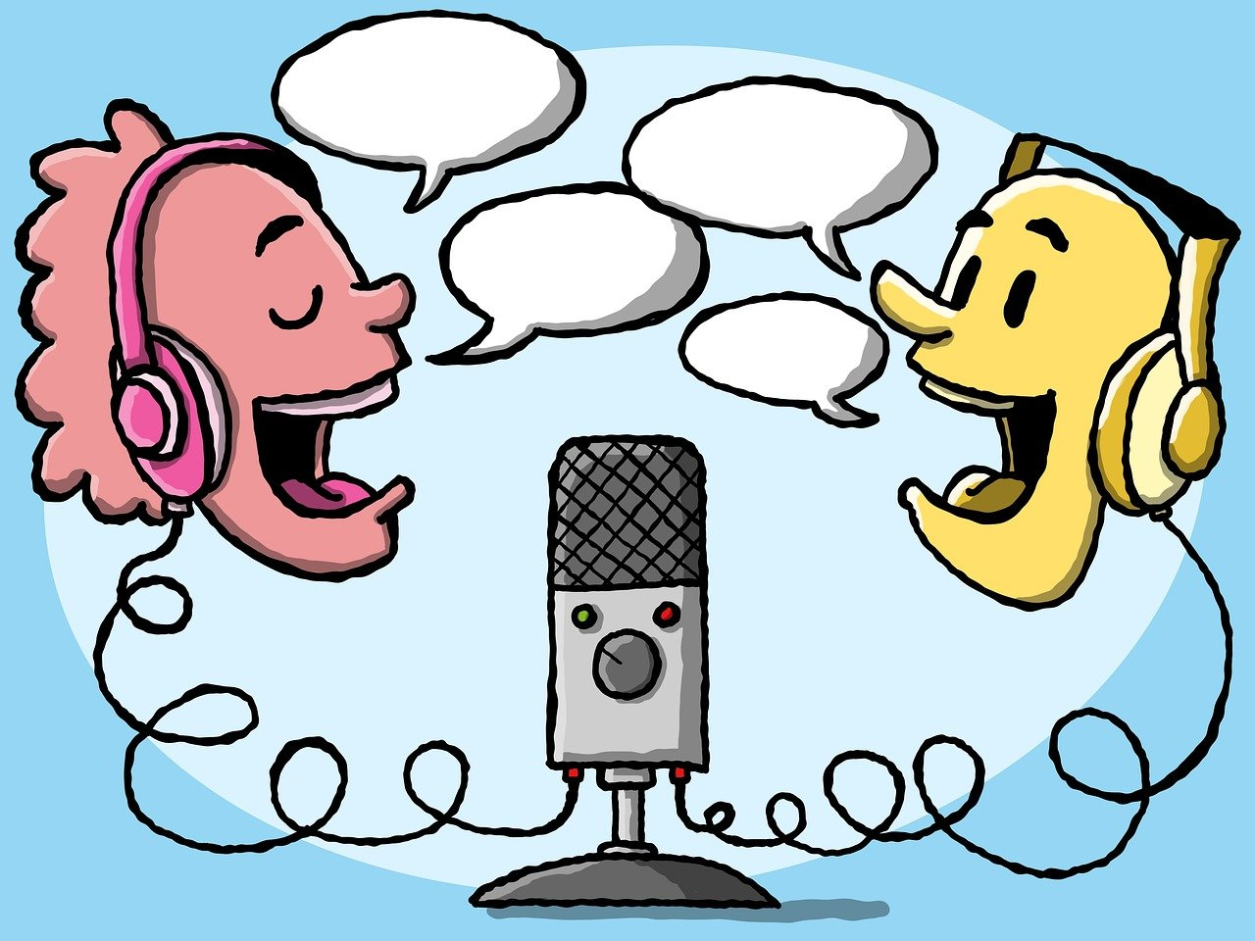
Peer Activity
Share with your partner:
  Five characteristics about yourself that you really like
  Five characteristics that you do not like
One minute each.
Which was harder to list (positive or negative)?

Slide 3
What is self-awareness?
Self-awareness is understanding your own:
emotions and thoughts
strengths and weaknesses
values
how you come across to others
It includes all the parts of yourself: physical, emotional, psychological, social, and your interests/passions.

Slide 4
What is self-esteem?
Self-esteem is how much you appreciate, value and like yourself; how you see yourself – positive or negative.
It is your overall sense of personal worth, regardless of circumstances.

Slide 5
What influences self-image?
Self-awareness and self-esteem affect: choices, goals, and relationships.
What influences how you see yourself?
friends, family, community/culture
social media, celebrities
comments people make online
Influences can be positive or negative.
Understanding these influences helps build confidence and make healthy decisions.

Slide 6
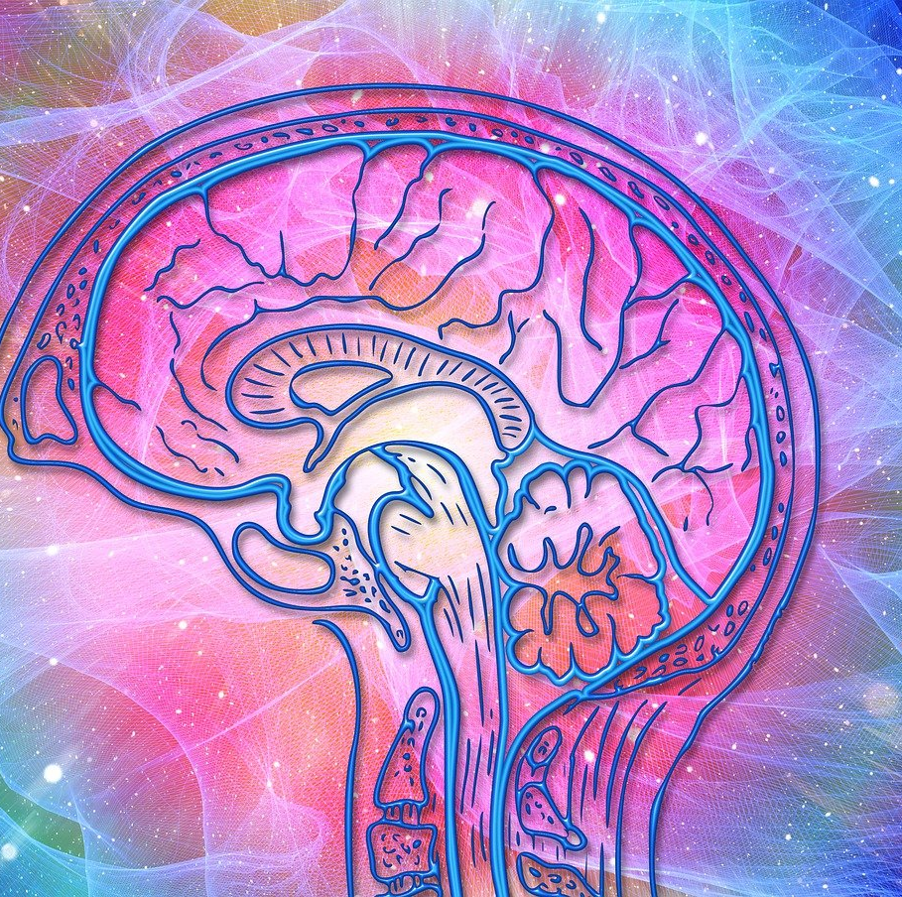
Self-awareness is important because it can help you:
Feel more confident and build healthy self-esteem
Choose goals that match your real abilities, interests and values
Resist pressure by knowing what you stand for
Identify weaknesses and develop needed skills

Slide 7
By the end of the lesson, you should be able to:
Identify factors that may influence self-awareness and self-esteem, including the media
Identity strategies to enhance self-awareness, self-esteem and self-development
Develop strategies to build confidence in self and others
Acknowledge and respect the uniqueness of self and others and respect differences regarding, e.g. race, gender, individual abilities, personal preferences

Slide 8
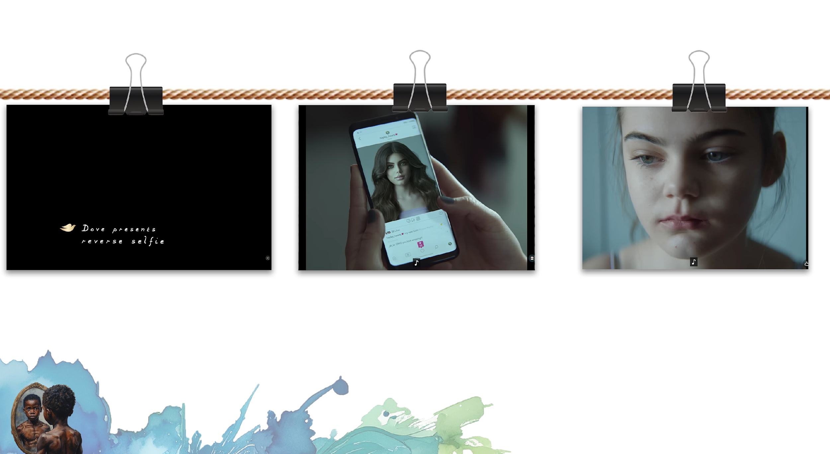
What impacts your Self-Esteem?
Watch: Reverse Selfie: Social Media's Impact on Girls' Self-Esteem | Dove
bit.ly/4oZiAac (1 min 0 sec)
Does what you see online truly reflect reality?
How does what you see online affect your overall sense of personal worth?
Notes:
Slide 2: (Quick 30 seconds – questions; 1 minute - Dove Selfie clip; 3 mins 30 seconds – Think-Pair-Share and Feedback) – 7 Minutes
Let’s watch this short (60-second) video by Dove called Reverse Selfie, which shows a “selfie” being unedited in reverse, revealing the unfiltered reality behind it. This is part of a campaign in which Dove is raising awareness about how social-media editing can affect self-esteem, especially for young girls. Watch carefully and think about what changes in the image and how this makes you feel. (Play the Clip - Reverse Selfie” – by Dove https://www.youtube.com/watch?v=z2T-Rh838GA )
Complete Part 1 of in your worksheets/ workbooks requires you to reflect on the two questions on the slide. Take 1 minute to think about your responses to the questions Activity 1 (Lesson 1_Worksheet) and then share them with your peer in PART 2 of Activity 1 (Lesson 1_Worksheet) . You will have 5min in total.
After that we are going to have a quick class recap.
Does what you see online truly reflect reality?
How does what you see online affect your overall sense of personal worth?
(Here are the kinds of authentic, typical responses teenagers might give to those two questions. These are based on common patterns seen in classrooms, youth discussions, and Life Orientation themes.)
1. “Does what you see online truly reflect reality?” — Possible Teen Responses
Some teens will say no, it’s unrealistic:
“No, most people post only their best moments. It’s filtered and edited.”
“Influencers stage everything. It’s not real life.”
“People hide their problems, so online looks perfect but real life isn’t.”
“Photos are edited, and bodies are changed. It’s fake.”
Some teens might say sometimes:
“Some things are real, but you never know what’s true and what’s not.”
“There are some honest accounts, but you have to be careful.”
“News and facts can be real, but personal posts are often exaggerated.”
A few might say yes, depending on what they follow:
“If you follow real people or educational pages, it can be real.”
“Some pages show real struggles or real stories.”
2. “How does what you see online affect your overall sense of personal worth?” — Possible Teen Responses
Negative effects (most common among teens):
“It makes me feel like I’m not good enough.”
“I compare myself to others and feel insecure.”
“People online look perfect, and it makes me feel bad about my body.”
“Seeing others’ achievements makes me feel like I’m behind.”
“Likes and followers make me question my value.”
Mixed feelings:
“Sometimes I feel inspired, but other times I feel jealous.”
“It motivates me, but also stresses me out.”
“It depends on the day. Some days I handle it well, some days not.”
Positive effects (smaller group):
“I follow motivational pages, so it helps me feel better.”
“I feel connected when I see others going through what I’m going through.”
“Posting my art or achievements makes me feel proud.”

Slide 9
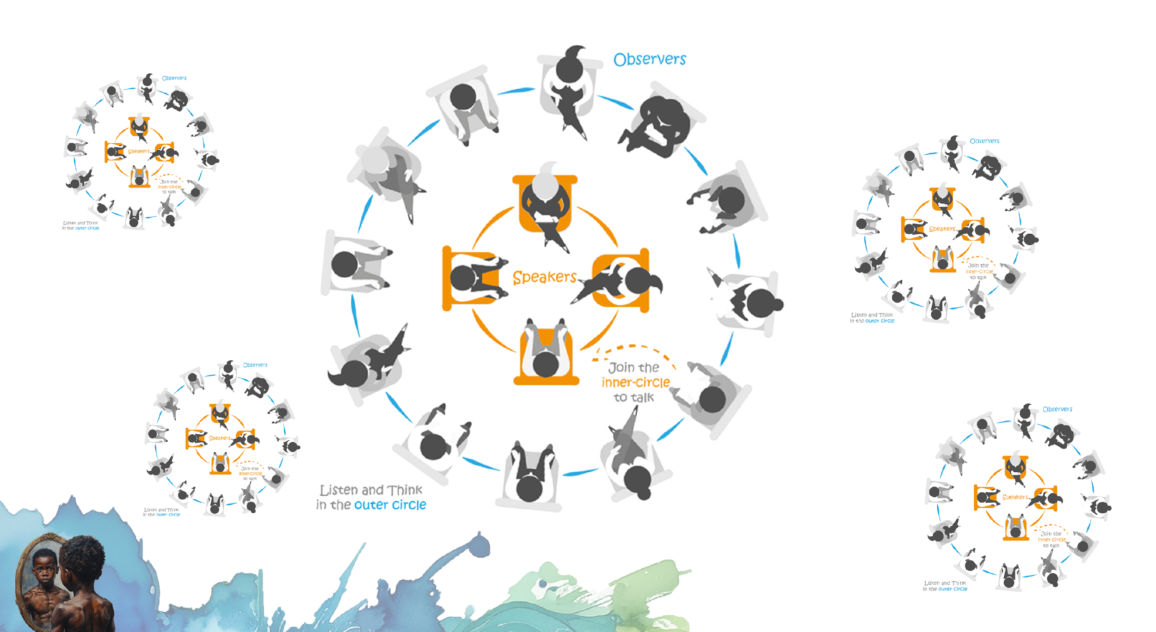
Notes:
Slide 3: Group Fish Bowl Discussion 5min +6min (12min)
Note to teacher: Learners will engage in a fishbowl activity to discuss several different influences on self-esteem and self-awareness. The success of this activity requires managing the time. Recommended is a timer and alarm. As it’s the first time learners will engage in something like this, you’ll have to guide them. Use the slide as an illustration of how it will work. Ensure that you have handed out at the start of this activity, the GROUP TOPIC to each group. Divide the class into groups of 4; 5 or 6 given the class size. Two groups pair up – (+- 10 Learners.) - Group A and Group B. Group A discuses, B listens and takes notes. Then they swop. Then each group, compiles a summary of notes and appoints a spokesperson to give feedback to the class. One person per group gives feedback to class. Total time 12min
It’s obvious from the last activity that social media plays quite a large role in impacting our self awareness and self-esteem. The reality is that social media is not the only factor that influences how we feel about ourselves. Let’s look at a few other possibilities and come up with some ideas on how to manage these influences.
We’re going to do something new! Have you ever been in a fish bowl discussion? It’s quite fun and everyone in the group needs to be involved and listening or talking throughout. Look at the slide, you’ll see that group A is in the middle and they will be given a specific topic to discuss. They will have 2min for the discussion. Group B will sit around you, observing, listening and making notes. Then the group will swop, Group B will discuss their topic and group A will observe. Once the time is up, each group will need to summarise what the other group discussed. Choose one spokesperson to present to the class.
The topics given are as follows:
Topic 1: MEDIA/ SOCIAL MEDIA
Group A: “Influencers on Social Media are like Celebrities – we observe them and follow them, but their effect on our lives is limited”
What do you observe about social media influencers that makes you want to be like them?
Have any of them inspired you to change A: in terms of your personal style/ appearance OR B: to incorporate habits into your life-style?
Group B- “Social Media/ Media is just entertainment, nothing more.”
What do you find entertaining/ inspiring about musicians, actors/ actresses or other public figures?
How much has the music you listened to influenced your ideas on love/ friendships/ relationships with parents/ dreams?
Topic 2: PEER PRESSURE
Group A- “Peer pressure can be a positive tool to help us live better lives.”
Discuss a friendship that has inspired you to be a better person.
Share an example of how a peer friendship group has negatively influenced your behaviour.
Group B- “Because family life in South Africa has become so chaotic – our peers have become family.”
Have there been instances where your peers have supported you and your family couldn’t?
Why do you think its easier to talk to your peers about sensitive issues rather than your parents?
Topic 3: BULLYING/ CYBERBULLYING
Group A- “Cyberbullying is more harmful than face-to-face bullying.”
Why would cyberbullying be more harmful than face-to-face bullying?
How does cyberbullying impact your daily life at school?
Group B- “Discrimination in schools is mostly hidden.”
Give examples of how you experience discrimination in school?
Why do people generally not want to talk about bullying at school?
Well done grade 10’s! We can see that once we open up this discussion, it’s quite an eye opener how many things impact the way we feel about ourselves. I think sometimes it could feel like this is never going to change or sometimes people even think of extreme measures to end it. I know that many of you have overcome some of these challenges and would have some great advice for others still struggling. We know we cannot change the people around us but we can make an effort and change ourselves. What strategies could you implement to protect yourself from these negative influences? (Allow the class time to reply.) What strategies could you implement to enhance your self-awareness? (Allow the class time to reply.) Well done grade 10’s! you’ve shared some great ideas. Let’s look at a few more examples in the next slide.

Slide 10
Discussion feedback
Many factors influence how we feel about ourselves.
We cannot always change people/situations, but we can change how we respond.
What strategies protect you from negative influences?
What strategies enhance self-awareness?

Slide 11
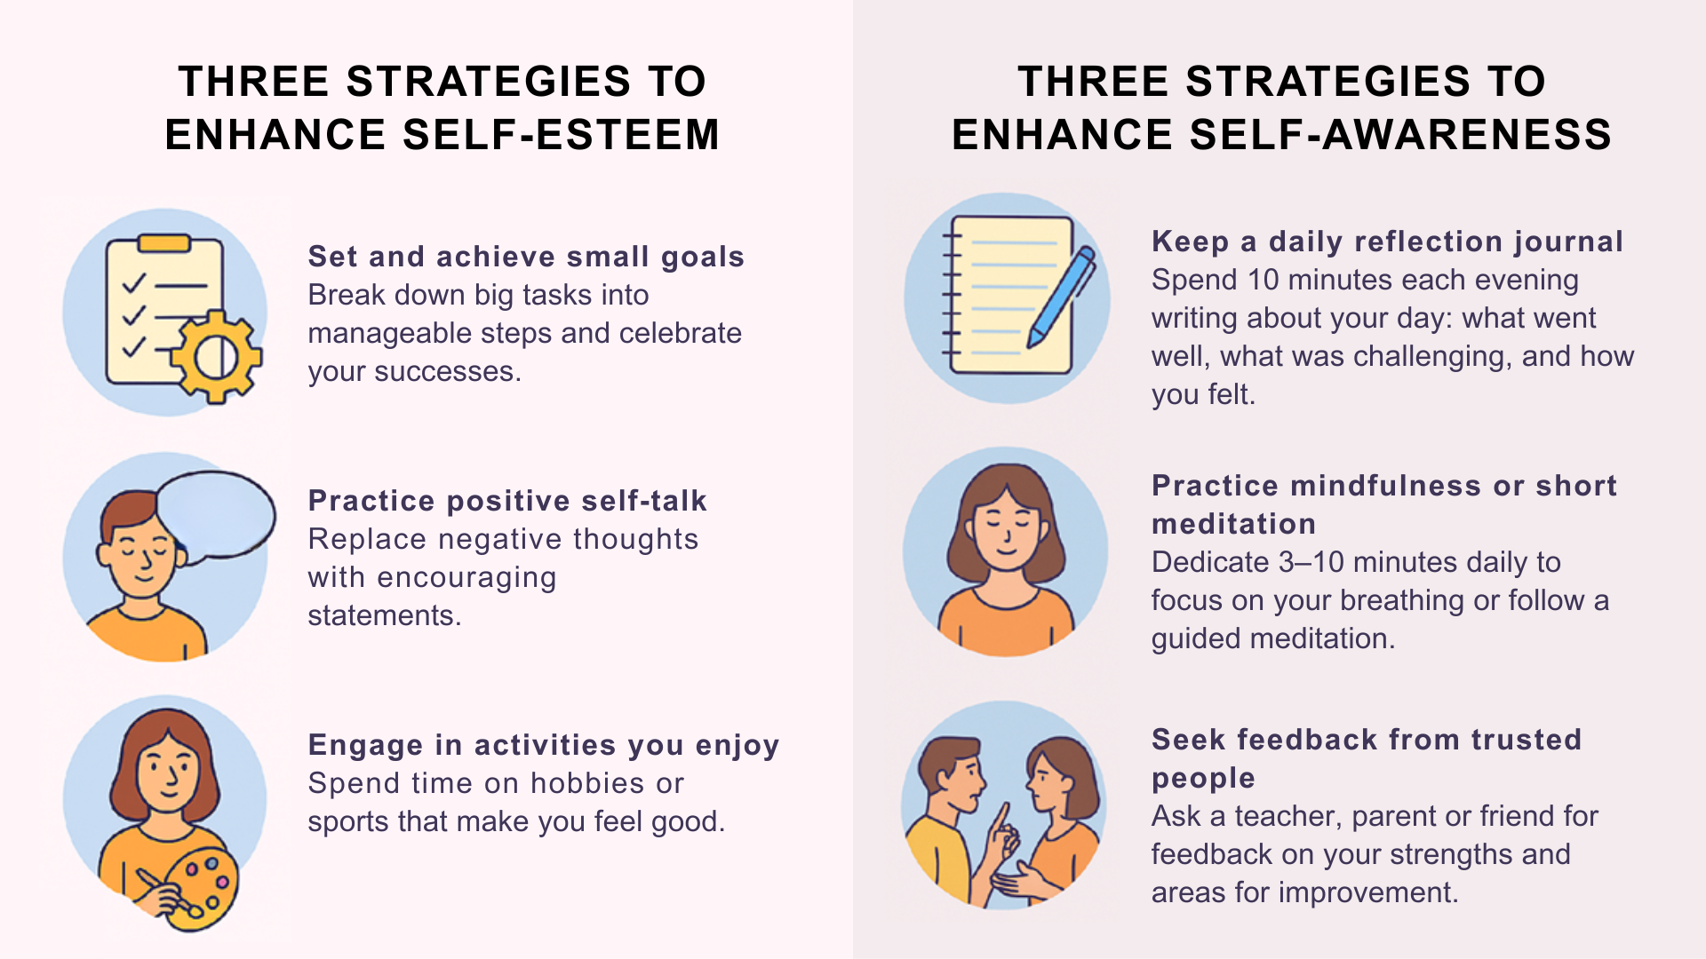

Slide 13
Strategies to enhance self-development
Set
Set personal growth goals (skills/qualities + simple action plan).
Try
Try new experiences (activities/subjects/responsibilities).
Build
Build healthy habits (weekly routines that support growth).

Slide 14
Self-awareness, self-esteem and self-development help build confidence.
Build confidence by:
Being assertive (clear, respectful, confident posture, polite)
Making good decisions (consider options and consequences, act responsibly)
Developing communication skills
Managing time and meeting deadlines

Slide 15
Building confidence in others
Support others by recognising effort and celebrating achievements.
Listen without judgment and respect differences.
Show belief in others’ abilities to create a safe environment.
Join community organisations to build teamwork and belonging.

Slide 16
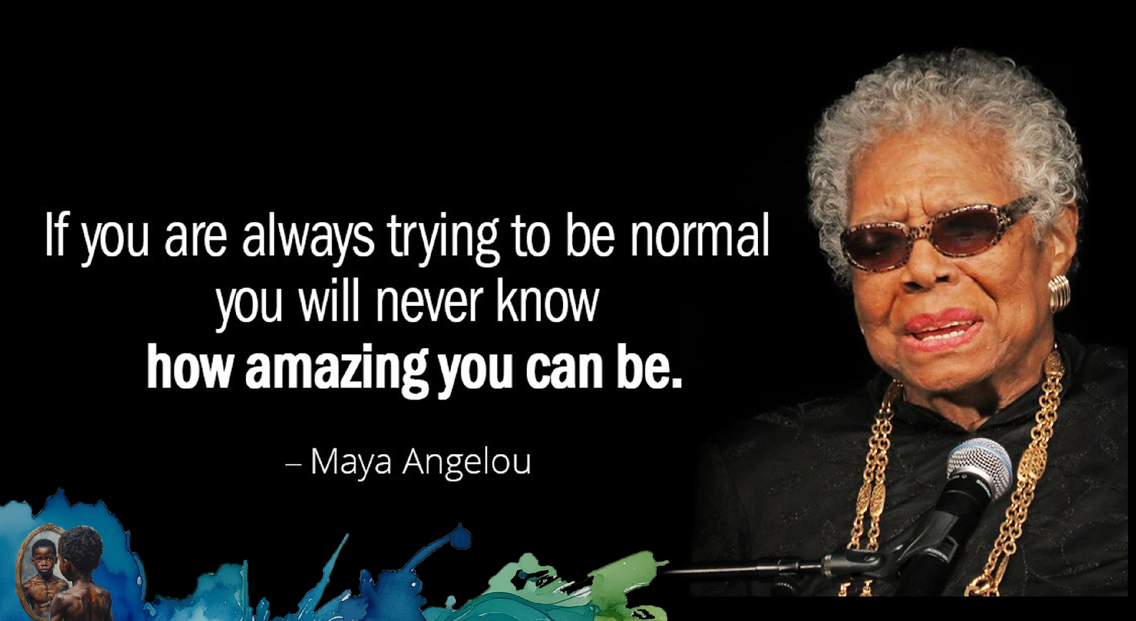
Notes:
Slide 5: Teach and Emogi YOU 3+4 min
To respect others means to show consideration or take into account other peoples’ dignity, feelings, humanness, etc. when interacting with them in various contexts, namely, at school, home, etc. It means treating people with concern, value, and high regard.
I am a looking for 8 volunteers who would be willing to be part of a human barcode illustration. (Place learners in the front of the class in a line with their backs to the class. Leave enough room for them to take steps forward as they respond to questions.)
When you hear a statement that you feel is true for you, take one step forward. Hold your position and wait for the next question. Here we go:
Step forward if you have cultural traditions or a primary home language that is different from your peers in class right now.
Step forward if you learn best by doing things with your hands, rather than just listening or reading.
Step forward if you have ever felt misunderstood because of people’s assumptions about your gender (or lack thereof).
Step forward if you prefer spending time alone to recharge, even though you enjoy your friends.
Step forward if you consider yourself skilled in a subject or hobby outside of the mandatory school curriculum (e.g., coding, baking, martial arts, graphic design).
Step forward if you know someone standing in this room right now that you have never had a real conversation with.
Right, now turn around where you are standing. Can you see everyone is standing in completely different places. You are part of the Human Barcode. But just like a barcode has different lines and different numbers, you all share certain characteristics but each of you are unique. Nobody is standing exactly where you are. Thank you for your willingness to help and be part of this demonstration. Lets clap and give them a hand to say thank you!
Respect is not about liking everything someone does; it's about acknowledging their unique code. Society and especially the media sometimes highlights the differences in race, gender, disabilities. This is not helpful as it tends to focus on stereotypes rather than indivduals. (We’ll look at this next lesson in more detail.) We need the introverts, the creatives, the hands-on learners, and the diverse cultural backgrounds to make the world—and this classroom—strong and rich.
So, what makes you unique? You are part of this classrooms barcode. We want to celebrate you. You will now have a few minutes to complete Activity 3 (Lesson 1_Worksheet) . Your teacher will hand out and emoji to you to complete this activity on. Create an emogi that has your unique qualities. Write down three things unique to you. (Allow 4min)

Slide 17
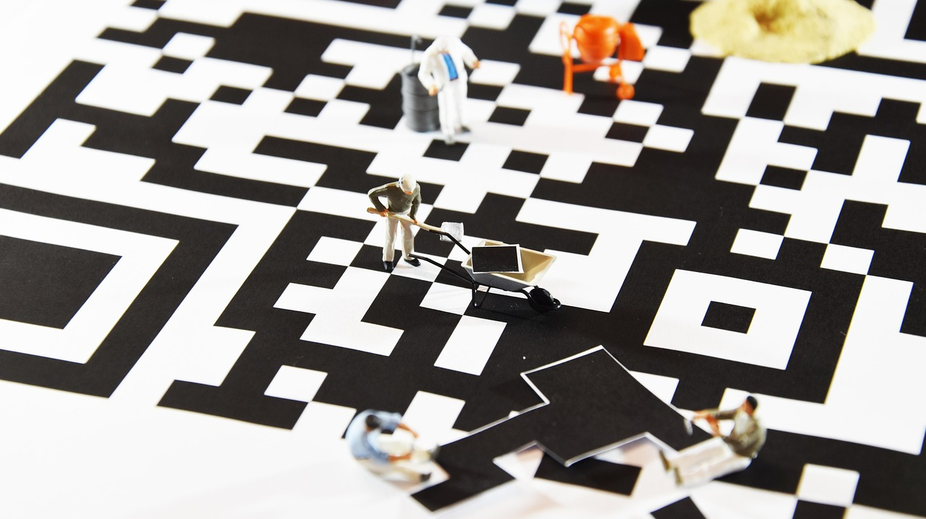
Human barcode activity

Slide 18
Respecting uniqueness
Respect is not about liking everything someone does.
It is about acknowledging their unique “code”.
Media sometimes reinforces stereotypes (race, gender, disability).
This is unhelpful because it focuses on generalisations, not individuals.
A diverse society needs different kinds of people.

Slide 19

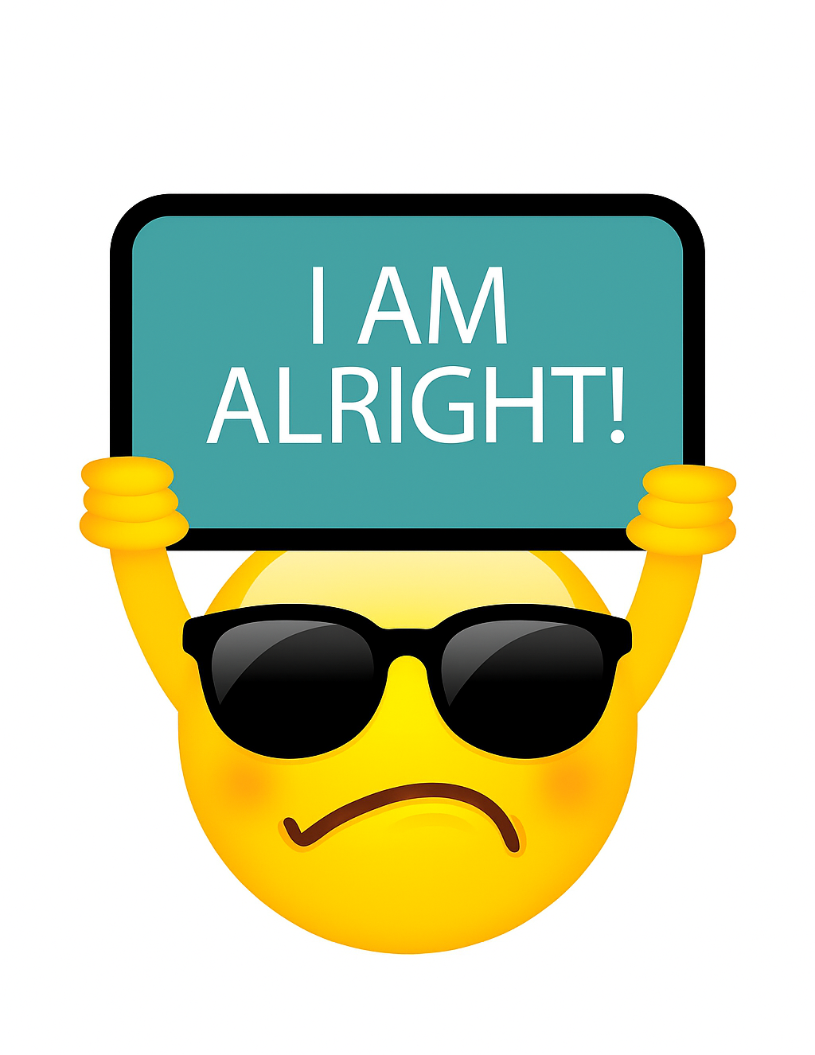

Self-respect and check-in posters

Slide 20
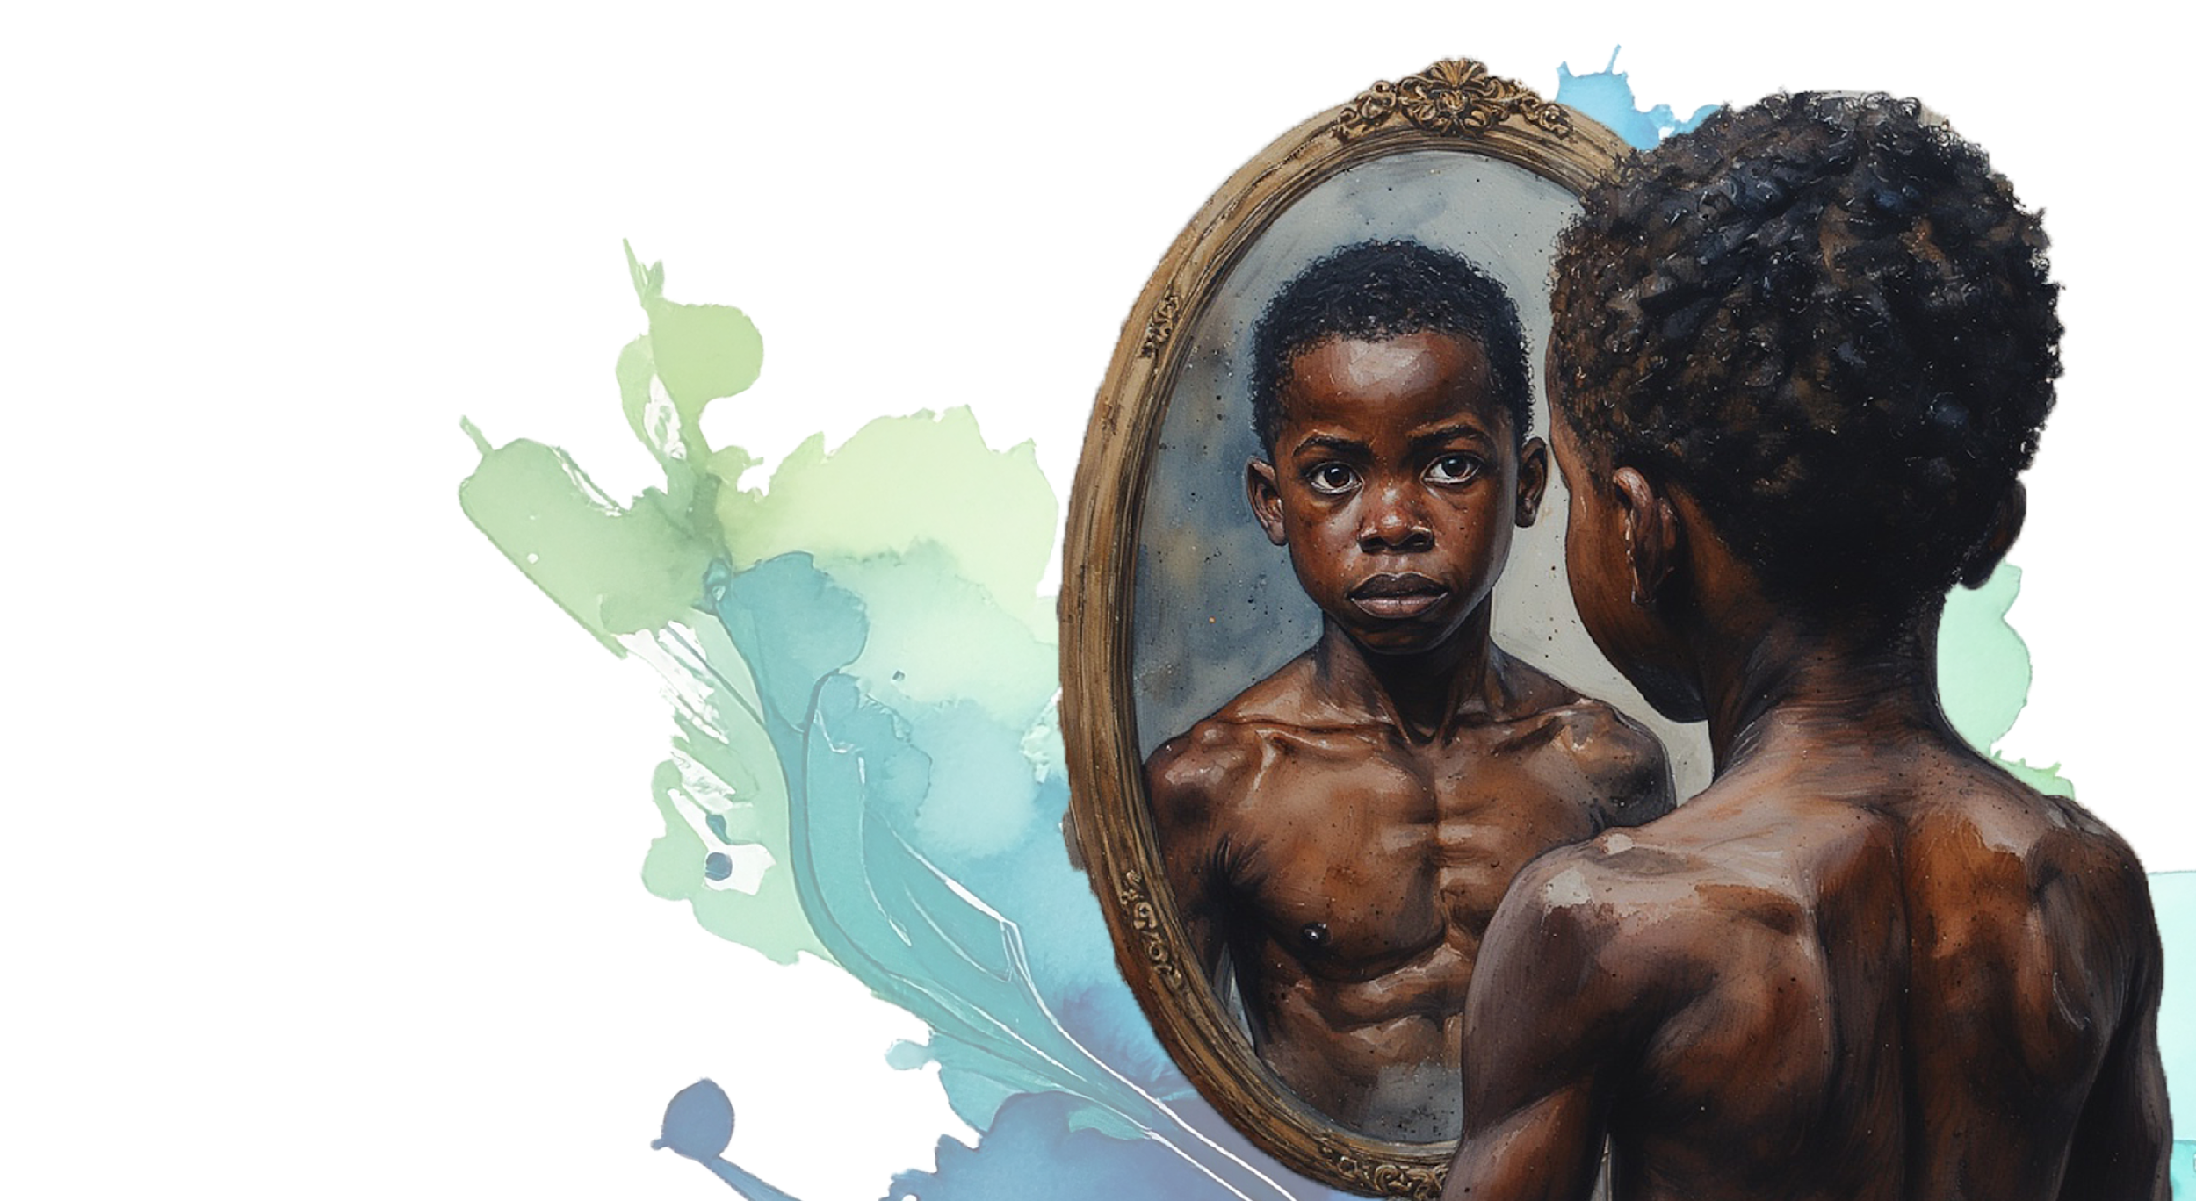
Homework:
Respect
Challenge
Notes:
Slide 7: 1min to explain Respect- Homework
As we end this lesson. I have a homework challenge for you over the next week. On your worksheet you will find the RESPECT CHALLENGE. Look at the list of 15 challenges and choose a challenge per day over the next week. Write this challenge onto the challenge poster. Once you finish the challenge, write down a sentence on what you learnt about yourself and others. Bring your poster along to the next lesson.
Questions can also be found on Activity 4 (Lesson 1 – Worksheet

