Slide 1
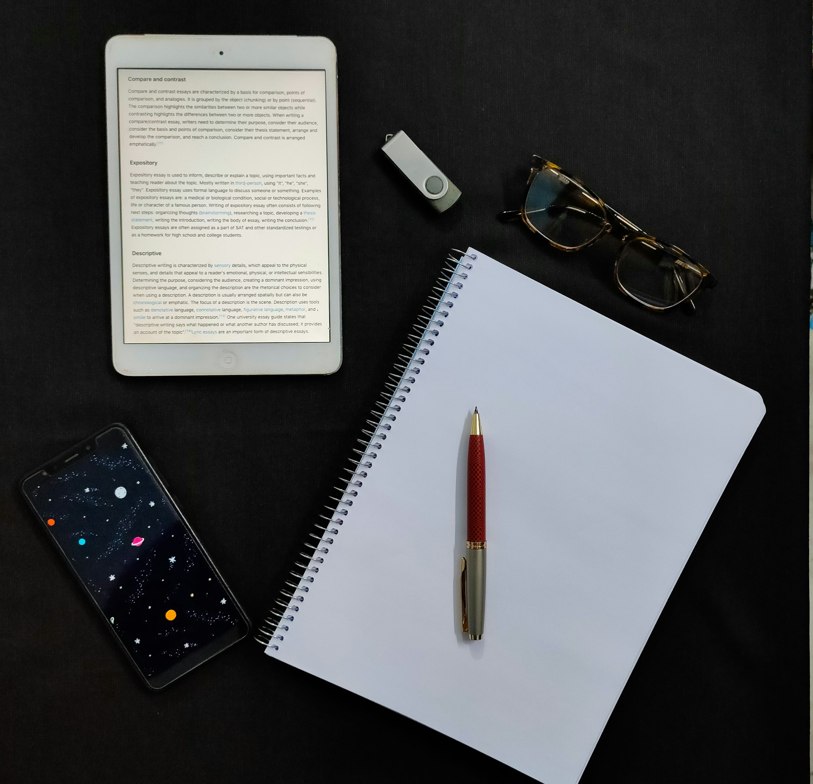

LESSON 3: READING & WRITING FOR DIFFERENT
PURPOSES
World of Work
Grade 9 | Week 8-11
Notes:
Introduction (3 min) (Slides 1-2)
Slide 1: Good Morning Grade 9s. In the next lesson of this series, we will explore reading and writing for different purposes.

Slide 2
READING AND WRITING
Reading and writing are the foundation of communication.
We read and write for different reasons:
• To study and learn
• For information or relaxation
• To express ideas and opinions
Reading = interpreting letters and symbols into words and sentences.
Writing = sharing thoughts and ideas using symbols and words.
In today’s digital world, these skills are vital for:
• Social media and online platforms
• Education and work
• Everyday life (menus, instructions, messages).
Notes:
Slide 2: When you think about reading and writing, what is the first thing that comes to mind?
(Learner answers/input will be a good starting point for the importance of both reading and writing.)
Maybe you’re an avid reader or you enjoy writing? Maybe you prefer one over the other? Maybe you make use of e-books or digital resources? Apps that transcribe voice recordings, so you have access to them later on.
There are different reasons to read and write, all of which serve varying purposes.
Reading and writing are fundamental skills that create the foundation of communication. Mastering these abilities helps us understand the world and engage meaningfully with others.
Reading and writing go beyond just schoolwork; they serve multiple purposes. It's not just about studying, reading a paragraph, or writing an essay. At its core, reading is the process of interpreting symbols and letters to form words and sentences we can understand. But it’s much more than that – we read for information, relaxation, or to learn. Reading allows us to gather knowledge independently, without relying on others. For example, reading a menu helps us see what’s available at the tuckshop and know the prices, saving us from asking about each item.
In today’s digital age, reading and writing have become the primary modes of communication, especially with the rise of social media and online platforms used for entertainment, shopping, work, and education. Proficiency in these skills is vital for everyday life, allowing individuals to connect with family, express their thoughts and opinions, and expand their knowledge across various subjects.

Slide 3

Watch: The importance of reading and writing https://www.youtube.com/watch?v=Gjbx98KZqkE
(1 min 12 sec)
Notes:
Teaching & Watch Video (32 min) (Slides 3-11)
Slide 3: Watch: Importance of Reading and Writing https://www.youtube.com/watch?v=Gjbx98KZqkE (1 min 12 sec)

Slide 4
EXAMPLES OF READING AND WRITING
WRITING
Journals
Messages
READING
For INFORMATION
Meaning of words
Public information
Labels
For LEISURE
Books and novels for enjoyment
Graphic Novels
Interests
Study Notes
Instructions
Summarising:
Bullet Points
Memories
Tables + Pictographs
Mind maps
Keywords
For LEARNING
Instructions
World News
Studying
Notes:
Slide 4: Examples of writing for different purposes could be:
Journals
Messages
Study Notes
Instructions
Summarising
Bullet Points
Memories
Tables + Pictographs
Mind maps
Keywords
We also read for different reasons as well:
For INFORMATION
Meaning of words
Public information
Labels
For LEISURE
Books and novels for enjoyment
Graphic novels
Interests
For LEARNING
Instructions
World news
Studying

Slide 5

THE PROCESS OF READING
Our eyes see letters, spaces, and punctuation.
Our brain translates them into words, sentences, and meaning.
Reading can be silent (to yourself) or aloud (to others).
Reading is a receptive skill – it helps us gather information.
It can also be a productive skill – when we pronounce words, we share information too.
Notes:
Slide 5: When we read, our eyes take in letters, punctuation marks, and spaces, while our brain translates them into words, sentences, and paragraphs that convey a message.
Reading can be done silently (in our minds) or aloud (so others can hear).
As a receptive skill, reading allows us to gather information. However, reading also involves speaking skills, as we need to pronounce the words we encounter. In this way, reading can be seen as a productive skill, as we both absorb and transmit information – even if it's just to ourselves.

Slide 6

REASONS FOR READING
Reading for information – looking things up, finding something out
Reading for relaxation – enjoying a book, reading up on a hobby or interest
Reading for learning – building knowledge, improving your comprehension
Notes:
Slide 6: Reading for information is a way of looking things up and accessing information to find something out. Examples of these texts include instructions, letters or brochures.
Reading for relaxation could involve enjoying a book, learning about sporting or cultural heroes, discovering new hobbies or pastimes, or even reading a comic or graphic novel. Many people use reading to escape their current situations and explore new worlds or experiences different from their own.
Reading for learning can open endless avenues of knowledge and doesn't have to be limited to schoolwork. It enhances our vocabulary, improves comprehension, and offers valuable insights. Beyond just acquiring knowledge, it can be highly beneficial and enriching in many aspects of life.

Slide 7
READING STRATEGIES
READING STRATEGIES
SKIMMING: Get the overall idea by looking for a cue to deduce ideas.
INTERACTING: Return and refer back to the text frequently.
VISUALISING: Convert words to images to understand events, settings and characters.
SCANNING: Look for specific information in a large amount of text.
FOCUSING: Read every work accurately as every word has equal importance.
Notes:
Slide 7: Reading also requires different skills, such as:
SKIMMING: Get the overall idea by looking for a cue to deduce ideas.
SCANNING: Look for specific info in a large amount of text.
INTERACTING: Return and refer to the text frequently.
FOCUSING: Read every work accurately as every word has equal importance.
VISUALISING: Convert words to images to understand events, settings and characters.
Reading skills are essential for learners to comprehend, analyse, and evaluate texts across different disciplines.

Slide 8
THE PROCESS OF WRITING
Writing = using letters, punctuation, and spaces to share ideas.
Reasons we write:
Lists
Notes
Instructions
School assignments
Writing is a key communication skill used in:
School and academics
The workplace
Personal life and record keeping
Notes:
Slide 8: Writing is the process of using symbols (letters of the alphabet, punctuation, and spaces) to communicate thoughts and ideas in a readable form. Like reading, writing can also be done for different reasons. We often write something down: maybe you are making a list, writing notes, giving instructions, or completing a school assignment. Writing is a form of communication and a very important skill – it is used in the workplace, in academics, for personal reasons, and in record keeping.

Slide 9

TYPES OF WRITING
Narrative writing: tells a story (fiction or nonfiction). Uses characters, setting, and plot.
Descriptive writing: paints a picture with words. Uses vivid language to describe people, places, or events.
Expository writing: explains or informs using facts, definitions, or processes (e.g. articles, encyclopedias).
Argumentative writing: persuades using evidence, logic, and reasoning (e.g. essays, speeches).
Notes:
Slide 9: Let's take a look at different types of writing:
Narrative writing tells a story and can be either fiction or nonfiction. Narrative texts typically have a beginning, middle, and end, and use characters, setting, and plot to create the story.
Descriptive writing creates a picture with words, using vivid language to describe people, places, things, or events. Descriptive text can be found in many genres, including essays and poetry.
Expository writing explains or informs by presenting facts, definitions, or processes concisely. Expository text can be found in many genres, including news articles and informational books for children, e.g. visual encyclopaedias and pictorial information books such as the DK Encyclopaedias and National Geographic series.
Argumentative or opinion writing persuades the reader to agree with a particular point of view, by using evidence, logic, and reasoning to support the claims. Argumentative text can be found in essays, editorials, and speeches.

Slide 10

SUMMARISING
Summarising = putting the key points of a text into your own shorter words.
Why it’s important:
• Helps focus on main ideas
• Easier to remember information
• Improves clear and concise writing
Summaries are useful for:
• Studying smarter
• Reviewing quicker
• Organising your thoughts.
Notes:
Slide 10: Another important tool for writing is being able to summarise information.
Summarising means taking the key points of a text and putting them into your own words, but in a much shorter form. It’s not just about cutting out parts. It’s about understanding and clearly sharing the main ideas.
Why is it important?
Better understanding: It helps you focus on the most important ideas and ignore unnecessary details.
Improved memory: Summarising makes it easier to remember what you’ve read.
Boosted writing skills: It helps you communicate clearly and concisely.
You can use summaries to study smarter, review quicker, and even organise your thoughts better. Summarising is a valuable skill for all subjects, helping you learn more effectively and think critically about the information you read.

Slide 11

BUILDING BLOCKS OF COMMUNICATION
Reading and writing work together as building blocks of communication.
They help us:
• Learn more about the world
• Communicate effectively
• Connect with others.
Notes:
Slide 11: As you can see, reading and writing are essential skills that work together to form the building blocks of communication.
Being able to read and write allows us to learn more about the world around us and to interact effectively with others.

Slide 12

ACTIVITY: EXAM PRACTICE
Notes:
Conclusion (5 min) (Slide 12)
Slide 12: You have an Exam Practice (Activity 1, Lesson 3 – Worksheet) to work on for the remainder of your lesson. Whatever you do not complete, must please be completed for homework.
Possible answers are available on Lesson 3 – Worksheet MEMO.

