Slide 1

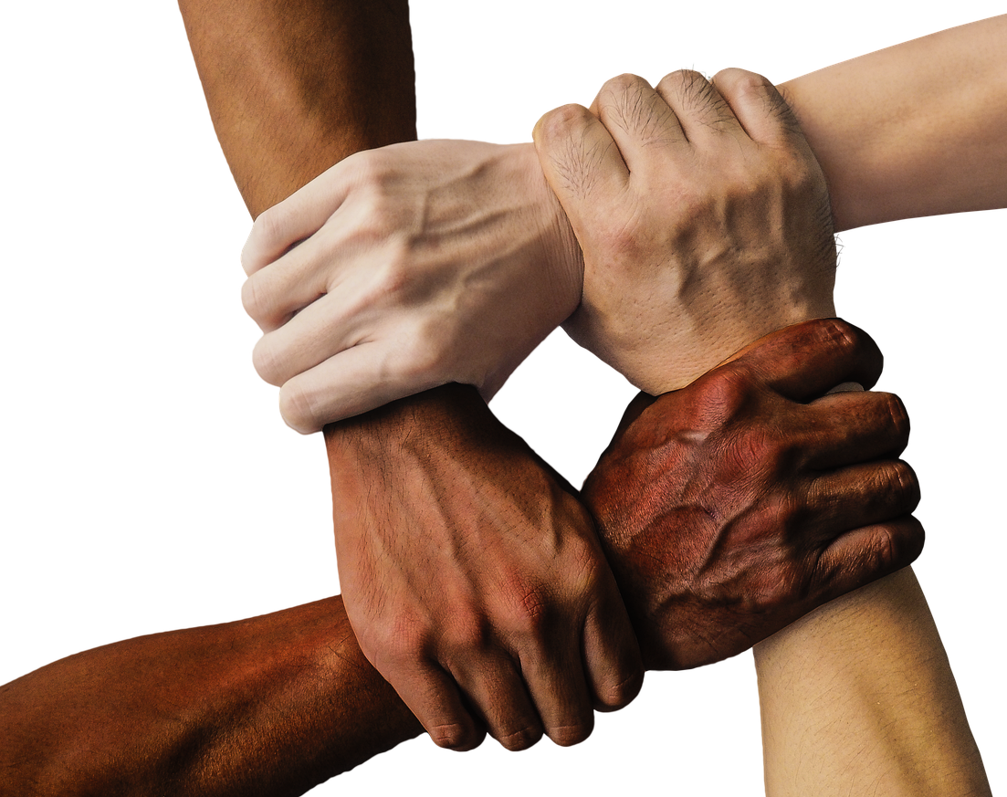
Term 2: CRR
Lesson 2: Respect for rights of others
Notes:
Introduction (2 min)
Welcome back, Grade 9s! In our last lesson, we focused on the concept of Human Rights and what it means to us. This week, we’re taking it a step further by looking at the rights of others: What it means to respect those rights and consider people who may be different from us.

Slide 2
By the end of this lesson, you should be able to:
Understand
the importance of respect and tolerance in fostering an inclusive and peaceful society.
Recognise
how personal values influence behaviour and decisions while balancing them with the rights of others.
Demonstrate
awareness of disability rights and etiquette.
Differentiate
between being infected and affected by HIV/AIDS and explain how to respect and support individuals in both situations.
Identify
ways to support and advocate for individuals living with HIV/AIDS.
Notes:
By the end of the lesson, you should be able to:
Understand the importance of respect and tolerance in fostering an inclusive and peaceful society.
Recognise how personal values influence behaviour and decisions while balancing them with the rights of others.
Demonstrate awareness of disability rights and etiquette.
Differentiate between being infected and affected by HIV/AIDS and explain how to respect and support individuals in both situations.
Identify ways to support and advocate for individuals living with HIV/AIDS.

Slide 3
Respect
Respect builds trust, safety, and well-being in any relationship.
Everyone wants to be respected – and when you show respect, others are more likely to respect you.
Respect is a small word with a BIG meaning behind it.
Notes:
Last lesson, we explored the importance of respect and tolerance. Now, let’s take a closer look at what respect really means. Respect means accepting someone for who they are, regardless of differences.
In any relationship, respect builds trust, safety, and well-being. Everyone wants to be respected, and when you treat others with respect, they are more likely to do the same for you. Respect is a word with a BIG meaning behind it.

Slide 4
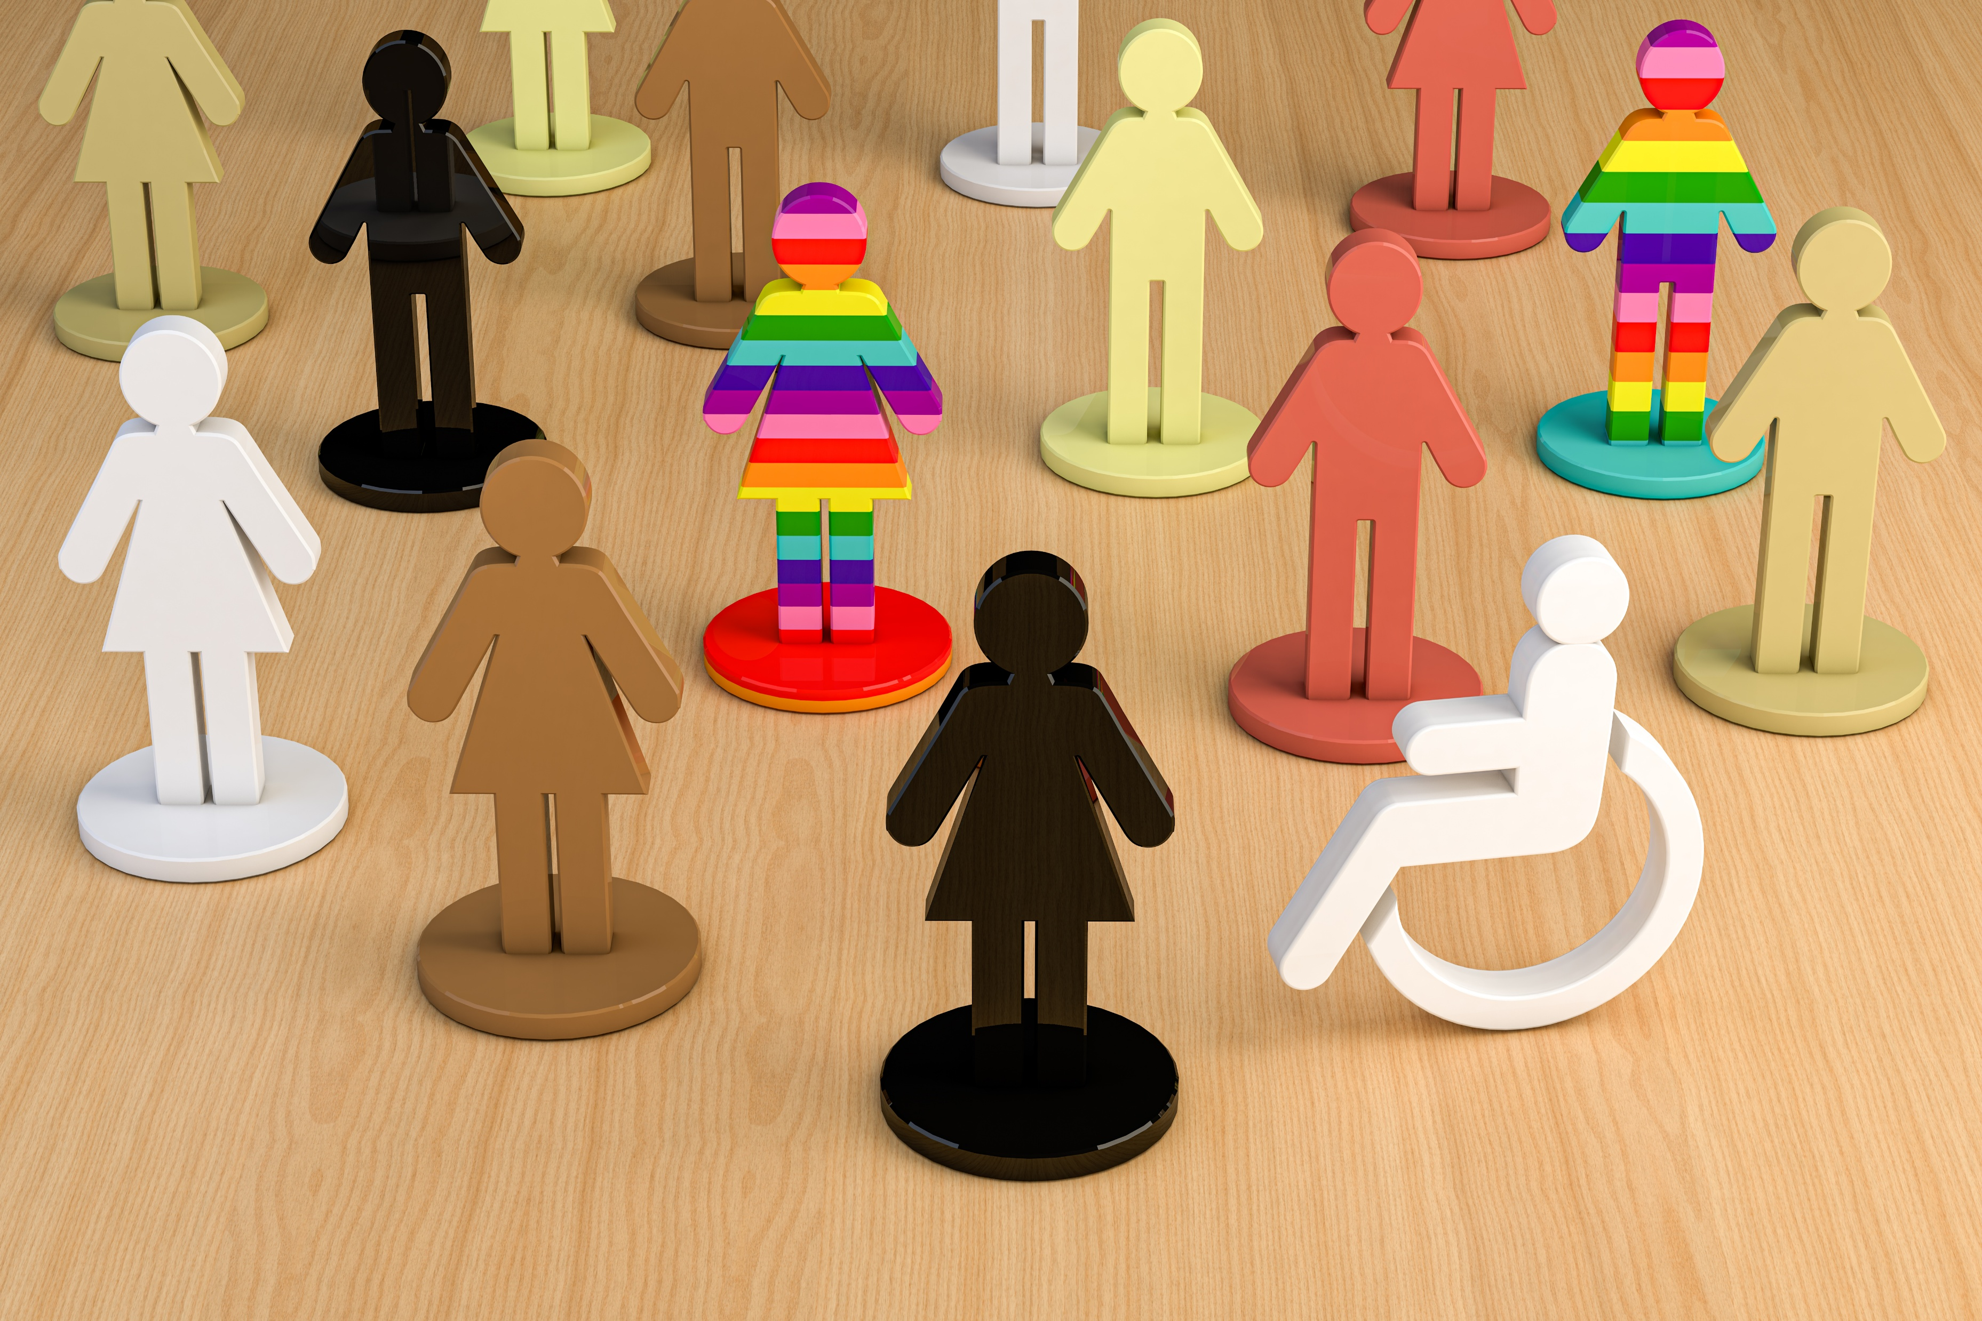
The importance of respect
Respect helps us build strong relationships, communicate better, and create a peaceful environment.
Being respected while growing up teaches us how to respect others.
Respect is not something we are born with – it is something we learn.
Notes:
Respect is important because it helps us build strong relationships, communicate better, and create a peaceful environment.
Being respected by important people in our lives growing up, teaches us how to be respectful towards others. Respect doesn’t come naturally (we are not born with it) – it is something you learn.

Slide 5

Respect and tolerance
Watch: Respect and Tolerance
https://www.youtube.com/watch?v=1vL6oPm3z90
(1 min 39 sec)
Notes:
Let's watch a short video on how we can be respectful toward others.
Watch: Respect and Tolerance
https://www.youtube.com/watch?v=ArNrrmprUZ0 (1 min 39 sec)
Respect and tolerance foster a peaceful, inclusive society by promoting understanding and reducing conflict. History shows that intolerance has led to attacks on people, their faiths, and communities.
How wonderful would it be if everyone expressed themselves decently and respectfully, with tolerance? Our world is full of diversity, and that is what makes it so beautiful – especially in our country. Without diversity, the world would be dull and uninteresting.

Slide 6
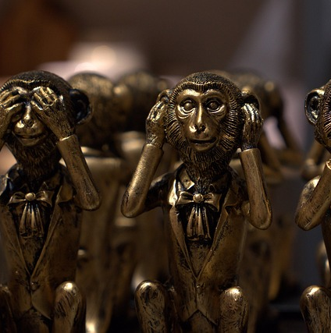
Personal values
Personal values guide our behaviour and decisions (e.g. honesty, respect, compassion, religion, culture).
In a diverse society, we must balance our values with the rights of others.
Staying true to your values while respecting others requires fairness, empathy, and mutual respect.
Our values shape how we respond to challenges, including injustice or discrimination.
Sometimes our values are tested – we must decide whether to speak up, take action, or remain silent.
Notes:
Teaching & Activity (2 + 5 min)
Personal values are the principles that guide our behaviour and decisions, such as honesty, respect, compassion, religion, and culture. In a diverse society, balancing personal values with others' rights is essential. Staying true to your values while respecting others requires mutual respect, fairness, and empathy.
Our values influence the way we respond to challenges, including moments when we witness injustice or discrimination. Sometimes, we may find ourselves in situations where our values are tested – where we must decide whether to speak up, take action, or remain silent.
To help us think about this, let’s look at a scenario that raises important questions about respect, fairness, and human rights.
Learners to complete Activity 1 (Lesson 2 – Worksheet).
Note to teacher: Due to time constraints, you might want to assign this activity as homework.
Possible answers are available on the Lesson 2 – Worksheet MEMO.

Slide 7
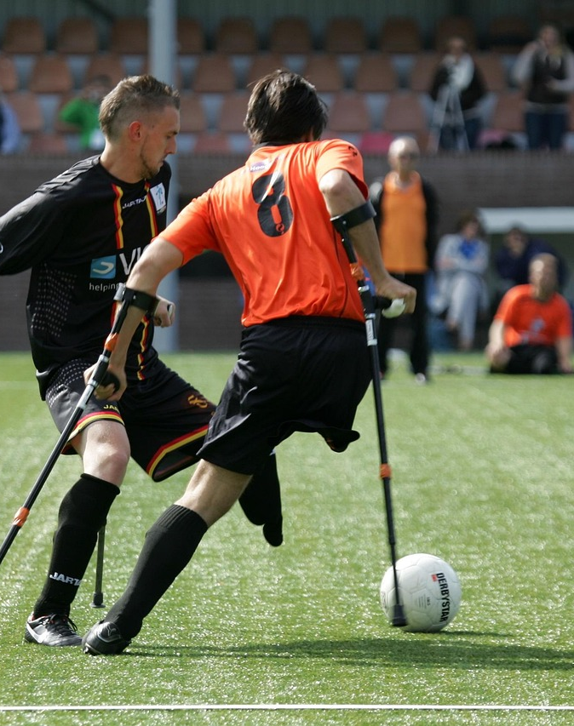
Disabilities and disability etiquette
A disability is a condition that can limit activities and interactions (physical, mental, intellectual, or sensory).
Barriers can prevent full participation in society.
People with disabilities should be treated the same as everyone else. Focus on the person, not their disability.
Disability etiquette means treating people with goodwill and respect. This promotes inclusion and equality for all.
People with disabilities have the same rights as everyone else, plus added protections against harm and discrimination.
They are no different from you and me – their abilities are simply different.
Can you provide examples of disability etiquette?
Notes:
Teaching & Watch Video (8 + 2 min)
We will now look at how we can respect the rights of people living with disabilities. A disability is a condition that can limit a person’s activities and interactions with the world. It includes long-term physical, mental, intellectual, or sensory impairments, which, combined with barriers, may hinder full participation in society.
People who have never interacted with a person with a mental or physical disability may feel intimidated or unsure about what to say or do. These concerns are understandable, but it’s important to remember that people with disabilities should be treated the same as everyone else.
The key to interacting with someone who has a disability is to see the person for who they are, rather than focusing on their disability. Ultimately, it comes down to having disability awareness and practicing disability etiquette.
Disability etiquette promotes goodwill and respect among all people. It helps make society more inclusive for everyone. At some point in our lives, most of us will either develop a disability, know someone who has one, or both.
Ask learners to provide examples of disability etiquette.
Examples may include:
Use respectful language – Say "person with a disability" instead of "disabled person." Avoid offensive terms.
Ask before helping – Don’t assume someone needs help; always ask first.
Speak directly – Talk to the person, not their assistant or companion.
Be patient and understanding – Give time for communication or movement without rushing them.
Respect personal space – Don’t touch mobility aids (wheelchairs, canes) without permission.
Disability can affect anyone – all ages, genders, ethnic and cultural backgrounds. People with disabilities have the same fundamental rights as anyone else to ensure full equality under the law. They have some additional rights to protect them from harm or discrimination. They are no different from you and me, their abilities are just different.

Slide 8
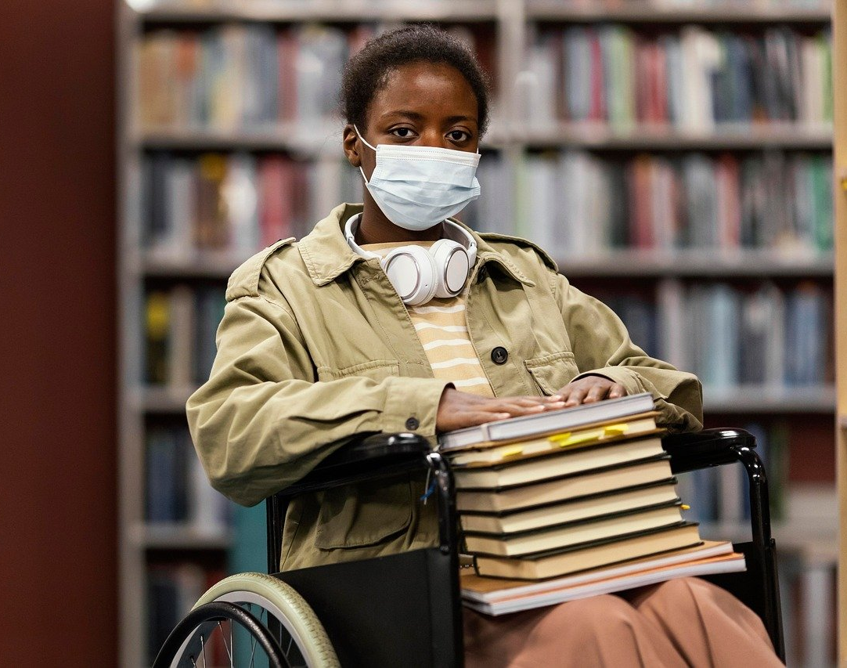
Disability
Watch: Disabilities: How to cope with them & support others
https://www.youtube.com/watch?v=hjvmAUbfXdw (2 min 23 sec)
Notes:
Let's watch a video that explains how we can support people living with disabilities.
Watch: Disabilities: How to cope with them & support others
https://www.youtube.com/watch?v=hjvmAUbfXdw (2 min 23 sec)
Creating an inclusive environment in schools, workplaces, and public spaces by eliminating barriers and promoting equal opportunities is essential for a more supportive society.

Slide 9

Living with HIV and Aids
Recap from Grade 8:
HIV (human immunodeficiency virus) attacks the immune system
A weaker immune system makes it harder to fight infections
With early diagnosis and medicine, people can live long, healthy lives
What is AIDS?
AIDS (acquired immune deficiency syndrome) develops after many years of HIV
The immune system is severely weakened → serious infections and health problems
Medicines (ART) can prevent HIV from progressing to AIDS
Today, with ART, many people living with HIV never reach the AIDS stage
Impact on others:
Friends and family may feel fear, confusion, or sadness
Counselling and professional guidance can provide support
Reliable help: doctors, clinics, pharmacies, community or faith leaders
HIV is not a reason to distance yourself – support and understanding make a real difference
Notes:
Teaching & Discussion (5 min)
We also need to consider how to respect the rights of people infected or affected by HIV/AIDS. Ask the learners: What is the difference between being infected and being affected by HIV/AIDS?
Infected refers to individuals who have HIV in their bodies.
Affected refers to those impacted by HIV/AIDS indirectly, such as family members, friends, or communities who support or care for someone with the virus.
You learned about HIV/AIDS in Grade 8, so let’s do a quick recap.
HIV (human immunodeficiency virus) is a virus that attacks the immune system. The immune system becomes weaker, making it harder for the body to fight off infections. Most people who are diagnosed early and take medicines for HIV can live long, healthy lives.
What is AIDS: AIDS (acquired immune deficiency syndrome) happens after someone has had HIV for many years. In AIDS, the immune system is severely weakened. Serious infections and health problems happen. Medicines can help prevent HIV from developing into AIDS.
AIDS (acquired immune deficiency syndrome) develops after a person has had HIV for many years. At this stage, the immune system becomes severely weakened, making the body vulnerable to serious infections and health complications. However, medications can help prevent HIV from progressing to AIDS.
In the early years of the HIV epidemic, AIDS was a defining feature before antiretroviral therapy (ART) became widely available. Today, with increased access to ART, many people living with HIV can prevent the progression to AIDS.
Friends and family members of a person with HIV may experience feelings of fear, confusion, or sadness. It is important for them to seek professional counselling for guidance and support. Many counsellors and healthcare professionals are available to listen and provide advice to those supporting a loved one with HIV. Reliable sources of information include family doctors, local clinics, pharmacies, or even community and faith leaders. There is no reason to distance yourself from someone simply because they have HIV. Support and understanding can make a meaningful difference in their lives.

Slide 10
HIV does not discriminate
HIV does not discriminate – anyone can be infected, regardless of gender, race, age, or wealth.
HIV and AIDS affect not only the person diagnosed, but also their families and loved ones.
People living with HIV can still live at home and maintain a normal social life.
The virus is not spread through casual, daily, or non-sexual contact – family members and friends are not at risk.
Society, however, often discriminates because of myths and fears.
Stigma and discrimination can discourage people from getting tested, seeking treatment, or disclosing their status.
Notes:
HIV does not discriminate based on gender, race, age, or wealth – it can happen to anyone. What matters is how we support those around us and within our communities. HIV and AIDS impact not only the person diagnosed but also their families and loved ones.
However, people with HIV can live at home and maintain a normal social life. Since the virus is not spread by casual, day-to-day, nonsexual contact, family members, roommates, and visitors are not at risk of becoming infected.
Whilst the virus does not discriminate, society often does. Many individuals living with HIV face stigma and discrimination due to myths and fears surrounding the virus. This can discourage people from getting tested, seeking treatment, or disclosing their status.

Slide 11
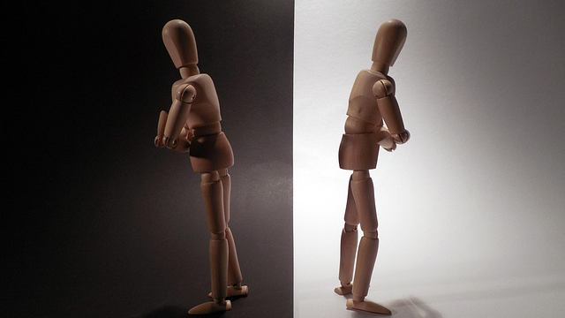
HIV Stigma
HIV stigma refers to the negative attitudes and misconceptions about people with HIV
Examples of HIV stigma
Believing that only certain groups of people can get HIV.
Making moral judgments about people who take steps to prevent HIV transmission.
Feeling that people deserve to get HIV because of their choices.
Notes:
HIV stigma refers to the negative attitudes and misconceptions about people with HIV. These incorrect beliefs or ideas often lead to unfair labelling and discrimination, reinforcing the idea that certain groups are socially unacceptable.
We all have a role to play in ending HIV stigma through our words and actions. By showing support and understanding in our daily lives, we can lead by example and encourage others to do the same.
Examples of HIV stigma
Believing that only certain groups of people can get HIV.
Making moral judgments about people who take steps to prevent HIV transmission.
Feeling that people deserve to get HIV because of their choices.

Slide 12
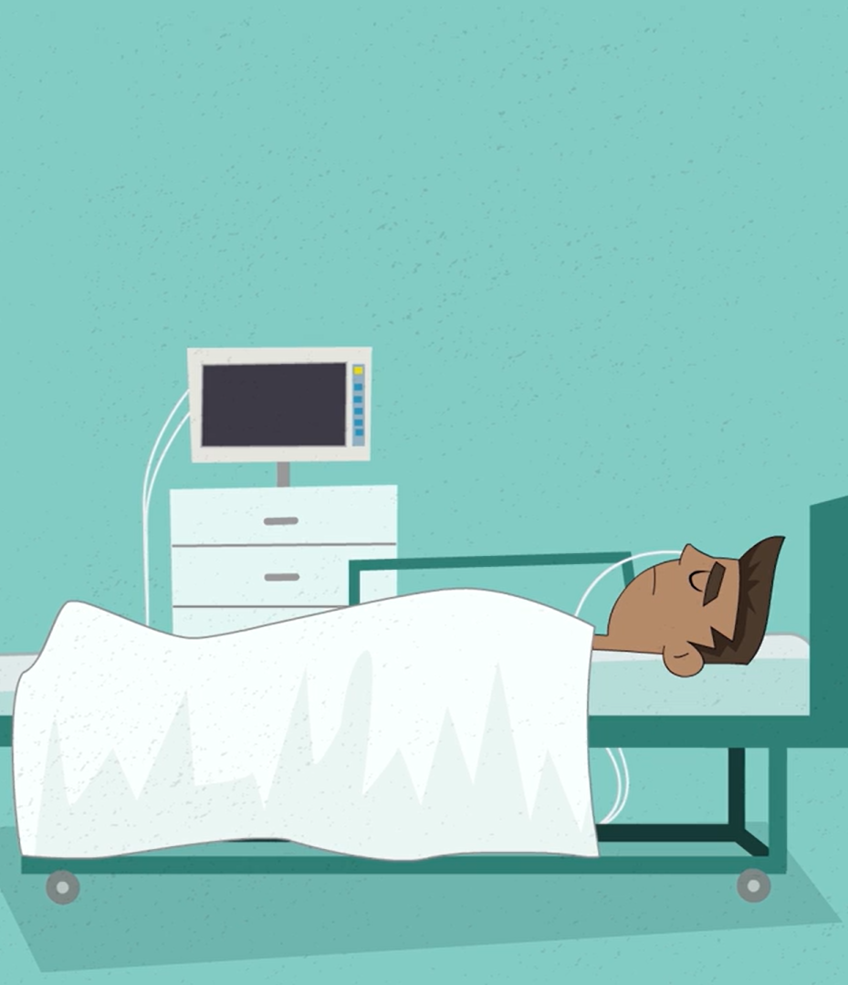
HIV and health disparities
Watch: HIV And Health Disparities
https://www.youtube.com/watch?v=B6gKFoIGBeE (3 min 21 sec)
Notes:
The stigma surrounding HIV is a major problem that prevents people from their right to getting tested, seeking treatment, and living without fear of discrimination.
Let's watch a video that explains this.
Watch: HIV And Health Disparities
https://www.youtube.com/watch?v=B6gKFoIGBeE (3 min 21 sec)
People with HIV should not face discrimination in healthcare, workplaces, or social settings. Laws and policies must protect their rights to ensure that they are treated equally.

Slide 13
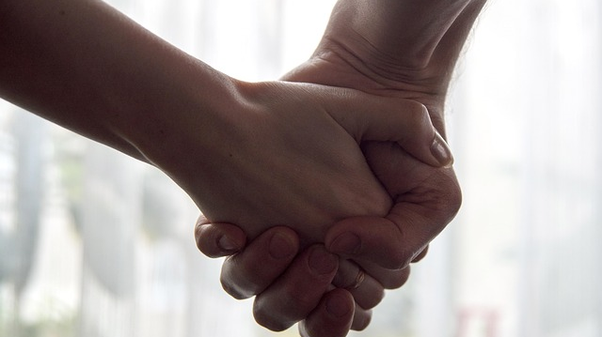
How can we provide support to a person who is HIV-positive?
Notes:
Conclusion & Homework (2 min)
To end the lesson, we will look at how we can provide support to a person who is HIV-positive. Ask the learners to provide examples.
Possible answers:
Treat them with kindness and compassion, just as you would anyone else.
Know the facts about HIV/AIDS and have open, informed conversations to help dispel myths and reduce stigma.
Help your friend or loved one establish and maintain a medication routine
Provide emotional support and assist in minimising stressful situations.
Support them in maintaining a balanced, nutritious diet and overall well-being.
Encourage them to seek treatment if they become ill. Most infections can be easily treated and cured, even for someone living with HIV.

Slide 14

Homework Activity
Notes:
Assign Activity 2 (Lesson 2 – Worksheet) as homework.
The Lesson 2 – Worksheet MEMO provides possible answers to Activity 2.

