Slide 1


Study Skills & Study Methods
Term 2: Week 6 & 7
Lesson 2
Notes:
Slide 1
Welcome back Grade 10s.
This week we are continuing with Study Skills. We will look at other skills that are necessary in studying as well as types of assessment and how to plan your study time.

Slide 2
A critical thinker can...
Understand the links between ideas
Determine which arguments or ideas are most important and relevant
Build and evaluate arguments
Identify errors or inconsistencies in reasoning
Solve problems in a consistent, systematic way
Reflect on their own assumptions, beliefs, and values
Notes:
Slide 2
CRITICAL THINKING SKILLS
Critical thinking is a kind of thinking in which you question, analyse, interpret, evaluate, and make a judgement about what you read, hear, say, or write. Good critical thinking is about making reliable judgements based on reliable information.
Applying critical thinking does not mean being negative or focusing on faults. It means being able to clarify your thinking so that you can break down a problem or a piece of information, interpret it and use that interpretation to arrive at an informed decision or judgement.
These are attributes which are learnt and improved through practice and application.
To become a better critical thinker, you need to learn how to:
clarify your thinking purpose and context.
question your sources of information.
identify arguments.
analyse sources and arguments.
evaluate the arguments of others and
create or synthesise your own arguments.
Critical thinking is the ability to think clearly and rationally, understanding the logical connection between ideas. Someone with critical thinking skills can:
Understand the links between ideas.
Determine the importance and relevance of arguments and ideas.
Recognise, build, and appraise arguments.
Identify inconsistencies and errors in reasoning.
Approach problems in a consistent and systematic way.
Reflect on the justification of their own assumptions, beliefs, and values.

Slide 3

Creative Thinking Skills
Ability to come up with unique, original solutions.
Look at things differently and find new ways of solving problems.
Tap into the creative ‘right brain’ thinking to bring a new perspective to problem-solving.
Also known as creative problem-solving.
Notes:
Slide 3
CREATIVE THINKING
Creative thinking is the ability to come up with unique, original solutions. Also known as ‘creative problem-solving’
Creative thinking means to look at things differently and find new ways of solving problems. i.e. to think ‘outside the box’. Creative thinking skills are not just for ‘creative types’ like artists and musicians. Everyone can benefit from creative thinking from time to time.
Regardless of whether you view yourself as a creative type or not, you can learn some useful skills and techniques which will enable you to tap into that creative ‘right brain’ thinking and bring a new perspective to innovation, problem-solving and managing change.

Slide 4




Let’s put some creative thinking skills to the test
Notes:
Slide 4
Let’s practice some of those skills and see how you do.
What do you think the following pictures mean?
Being able to figure it out means using your critical and creative thinking skills.
Answers:
Reading between the lines
I'm in the middle of something
Arch Bishop
First in the queue

Slide 5


Problem-Solving
The ability to identify problems, brainstorm and analyse answers, and implement the best solutions.
Linked with better retention and recalling of information.
Notes:
Slide 5
PROBLEM-SOLVING
Problem-solving skills are the ability to identify problems, brainstorm and analyse answers, and implement the best solutions. An employee with good problem-solving skills is both a self-starter and a collaborative teammate; they are proactive in understanding the root of a problem and work with others to consider a wide range of solutions before deciding how to move forward.
Students who learn problem-solving skills may see an improved ability to retain and recall information. Specifically, being asked to explain how they reached their conclusions at the time of learning, by sharing their ideas and facts they have researched, helps reinforce their understanding of the subject matter.

Slide 6

Let’s put some problem-solving skills to the test
What get’s wetter the more it dries?
What goes up and never comes down?
What has to be broken before you can eat it?
What belongs to you but is used by others?
Railroad crossing, watch out for cars. Can you spell that without any ’r’s?
How can a man go 8 days without sleep?
What kind of coat can only be put on wet?
Timonthy’s mother had 3 children. The first was named April, the next was named May, what was the name of the third child?
Notes:
Slide 6
Let’s practice some of those skills and see how you do.
What get’s wetter the more it dries?
What goes up and never comes down?
What has to be broken before you can eat it?
What belongs to you but is used by others?
Railroad crossing, watch out for cars. Can you spell that without any ’r’s?
How can a man go 8 days without sleep?
What kind of coat can only be put on wet?
Timonthy’s mother had 3 children. The first was named April, the next was named May, what was the name of the third child?
Answers:
A towel
Your age
An egg
Your name
THAT
He sleeps at night
Timothy

Slide 7
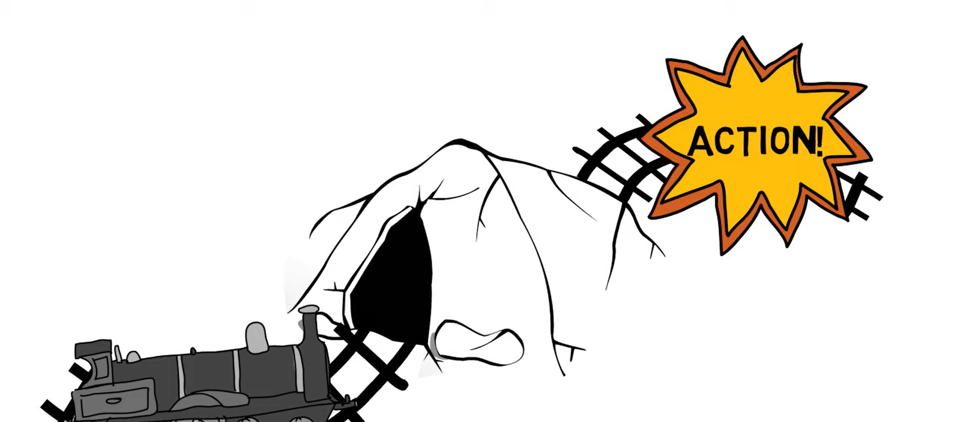
WATCH: What is Creative Problem Solving? https://www.youtube.com/watch?v=QbxyiUG5RRI (3 min 16 sec)
Notes:
Slide 7
WATCH: What is Creative Problem Solving?
https://www.youtube.com/watch?v=QbxyiUG5RRI (3 min 16 sec)

Slide 8
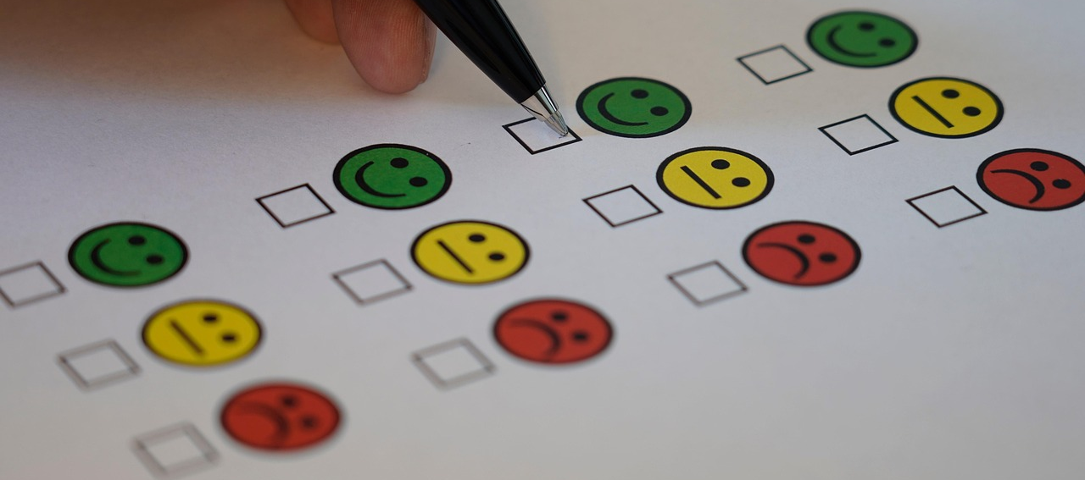
Assessment at school
Notes:
Slide 8
Assessment at School:
Have you ever stopped and wondered; how are you are assessed at school? Is it just the exams coming up or is there more to it?

Slide 9
What examples can you give of assessment that you have experienced?
Notes:
Slide 9
Assessment is the term given to collecting evidence that helps you and teachers see how you are performing in your subjects and how much of the content you understand and can apply in different situations.
What examples can you give of assessment that you have experienced?

Slide 10

Classroom Assessment
Used by teachers to determine how much and how well students are learning.
Either Internal or External.
Notes:
Slide 10
ASSESSMENT
Assessments can either be Internal or External

Slide 11
Internal vs External Assessments
INTERNAL ASSESSMENT | EXTERNAL ASSESSMENT
Internally set assessment are ones that you may do in class, set by your teacher or from your textbooks or workbooks. | Externally set assessments are fully standardised and are taken and written by all students (e.g. Provincially or Nationally)
These are not fully standardised and can be given in class, throughout the school year to provide a snapshot of your skills in a specific area at any given time. | External assessments are standardised tests. The same assessment is administered to all students at the same time. These can be set by the Department of Education or by professional bodies.
Example: class tests or worksheets, summative assessments, exam practice. | Example: formal examinations like National Senior Certificate Exams or Common Exams.
Notes:
Slide 11
Internal vs External Assessments:
INTERNAL ASSESSMENT
Internally set assessment are ones that ypu may do in class, set by your teacher or from your textbooks or workbooks.
These are not fully standardised and can be given in class, throughout the school year to provide a snapshot of your skills in a specific area at any given time. Often set by teachers or within schools.
Example: class tests or worksheets, summative assessments, exam practice.
EXTERNAL ASSESSMENT
Externally set assessments are fully standardised and are taken and written by all students (e.g. Provincially or Nationally)
External assessments are standardised tests. The same assessment is administered to all students at the same time. These can be set by the Department of Education or by professional bodies.
Example: formal examinations like National Senior Certificate Exams or Common Exams.

Slide 12

Which one is more important?
Notes:
Slide 12
What is more important?
Both are equally as important – and both need to be done to the best of your ability.
The one prepares you for the other.

Slide 13

Developing a study plan
The importance of having a study plan:
Increased productivity
Less stress
Beter results
Things to consider to have a smooth schedule:
Set study goals
Determine study timelines
Gather study material beforehand
Notes:
Slide 13
Developing a study plan
Study plan helps you to stay on top of all your notes and it will help you prepare for your tests.
Why have a study plan:
Increased productivity: with a study schedule you’ll know exactly what to do and when to do it.
Less stress: you won’t have to cram or stress. You’ll be able to study at a reasonable pace.
Better results: starting earlier will give yourself more time to memorise your work.
There are a few things that you will need to consider so you have a smooth schedule:
Study goals: Knowing what you want to achieve at the end will make it easier to work towards.
Timing: determines how much time you can spend on studying and how much time you must focus on other things that require your attention.
Study materials: you can’t study without study materials. Gather all your materials ahead of time
Following a schedule isn’t as easy as it seems. But with dedication and determination you can make it work.
Study schedule app
Various study schedule apps are available for free download straight onto your phone. This way you will have it on you for easy reference wherever you go.

Slide 14
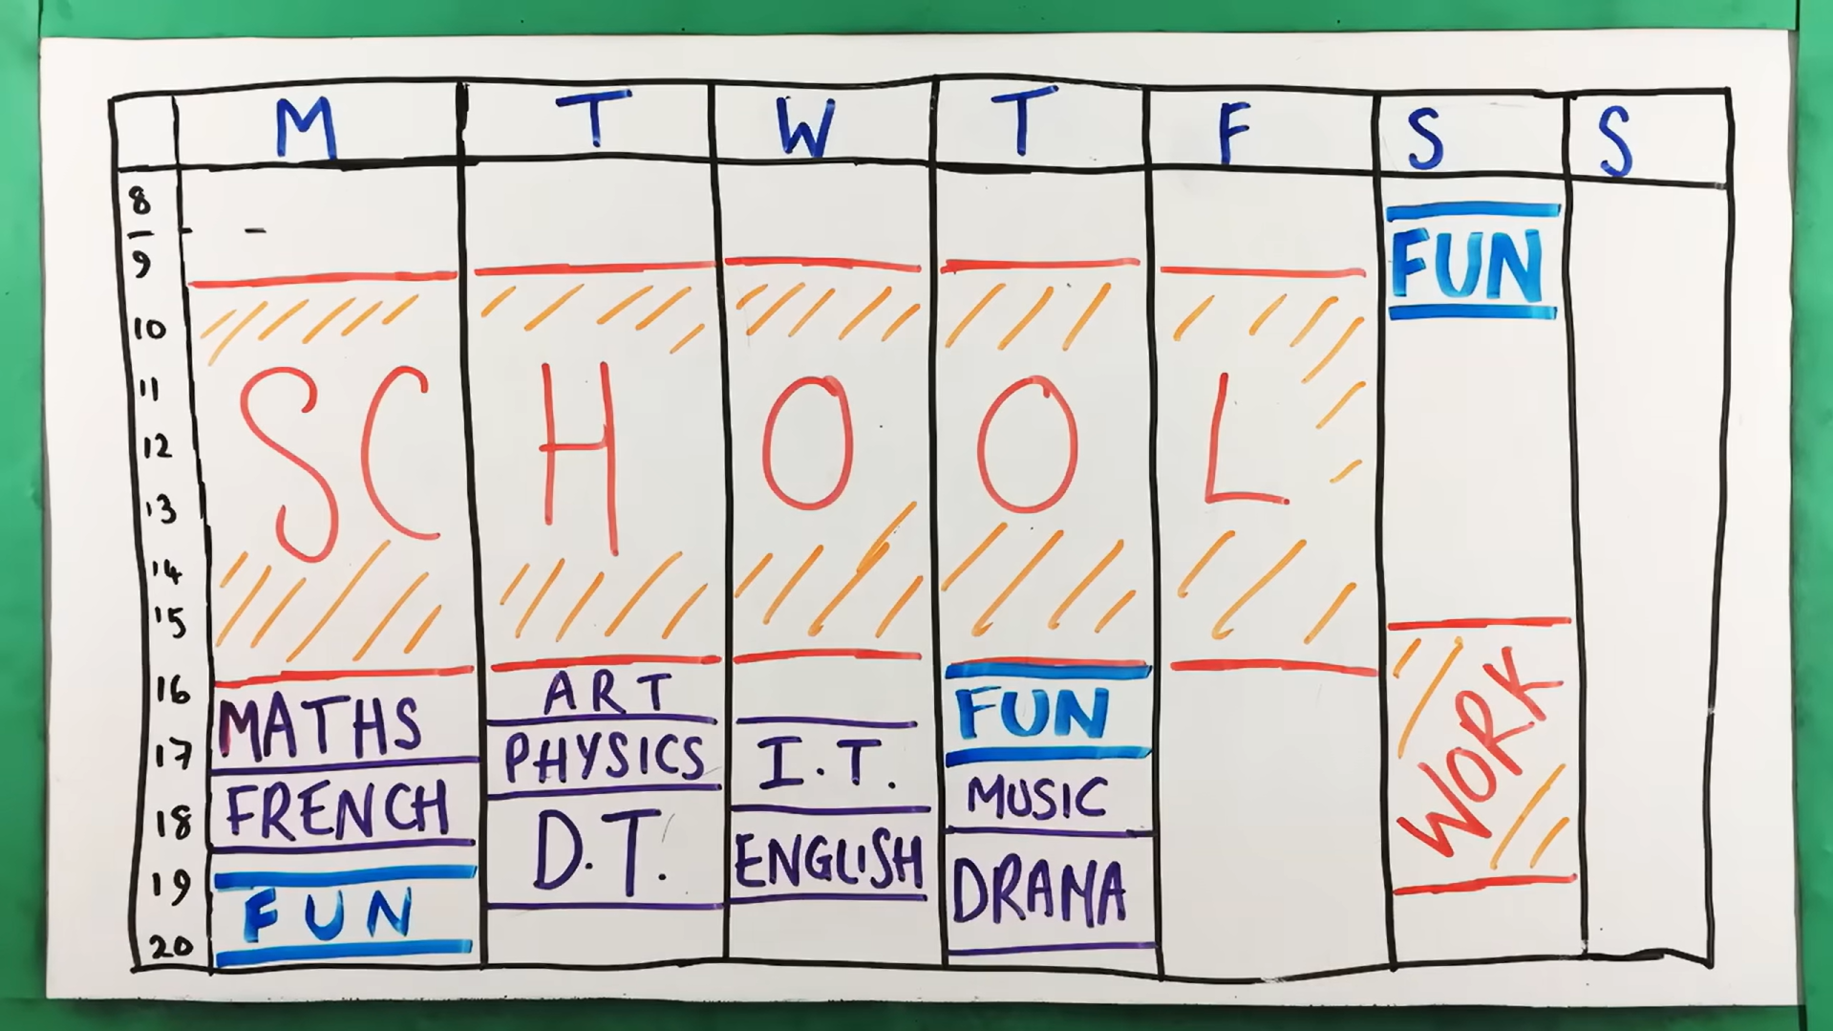
WATCH: How To Make An Effective Study Timetable | Study Effectively https://www.youtube.com/watch?v=687p04jRDd4 (4 min 44 sec)
Notes:
Slide 14
WATCH: How To Make An Effective Study Timetable | Study Effectively
https://www.youtube.com/watch?v=687p04jRDd4 (4 min 44 sec)

Slide 15

Final Thoughts & Reflection
Notes:
Slide 15
Final thoughts and reflection
Use this time to complete your activities on Lesson 2 – Worksheet.

