Slide 1

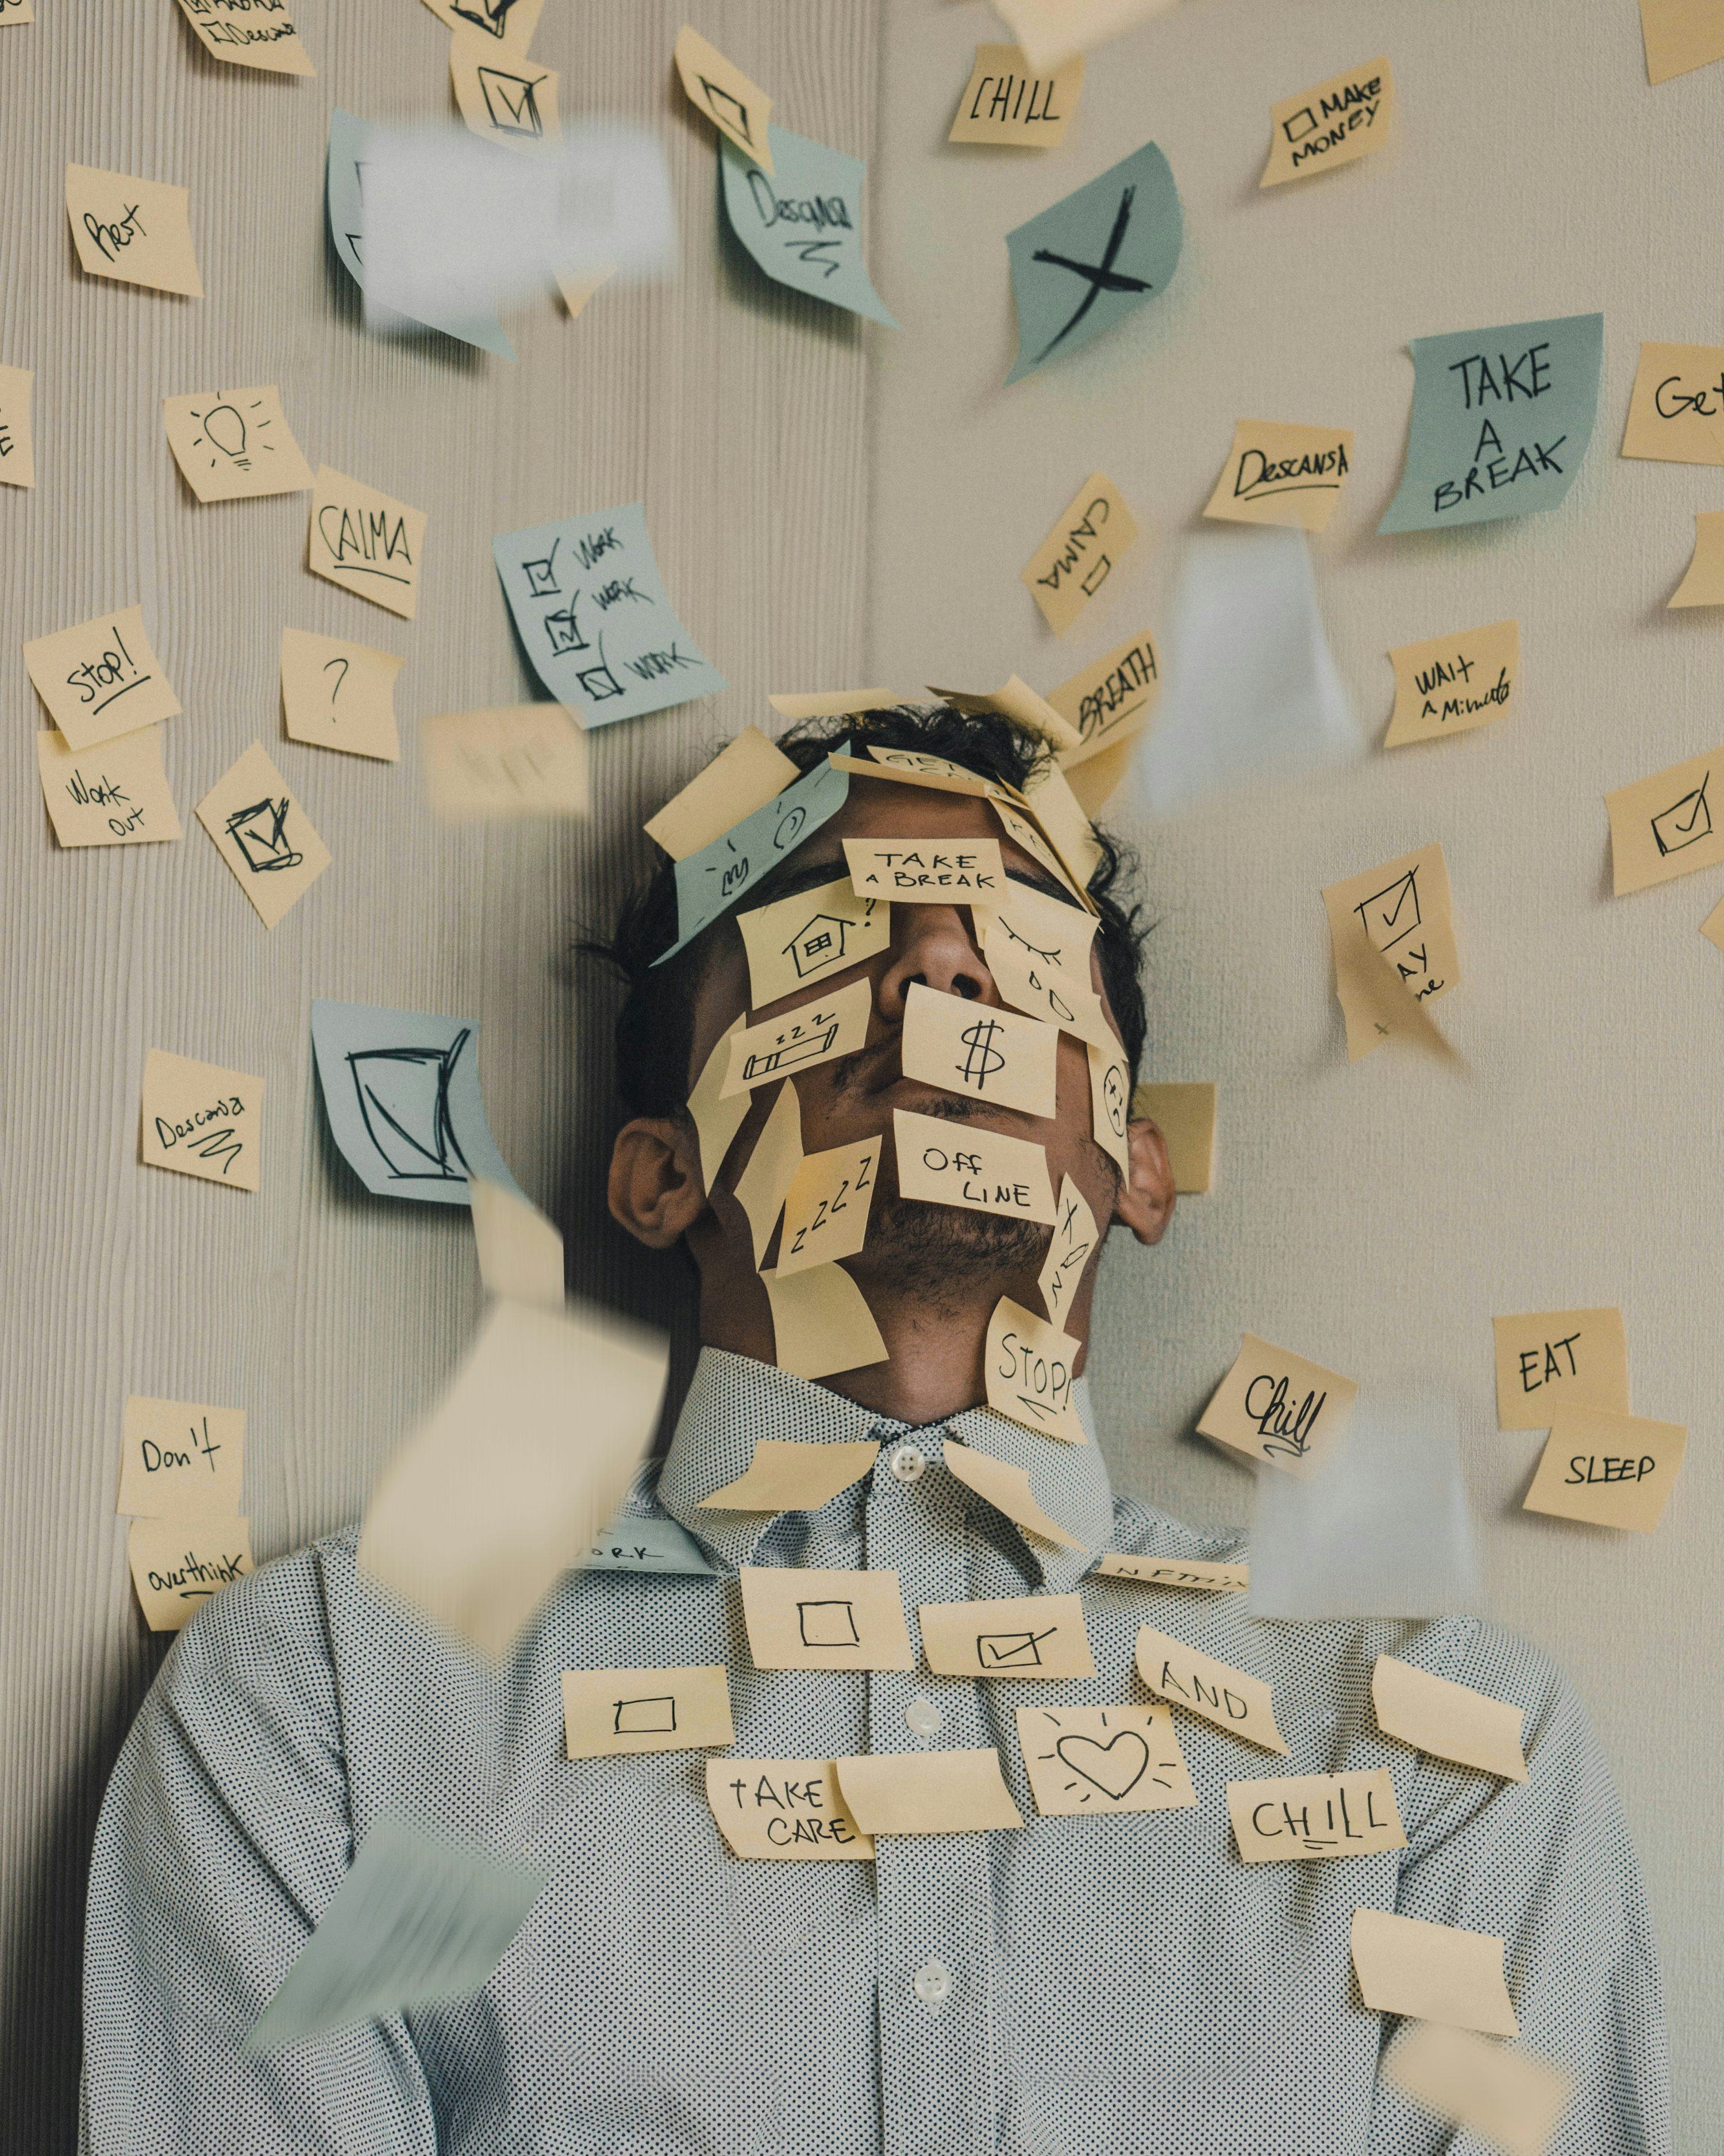
Grade 12
Development of the self in society
Term 1
Lesson 1: Stress
Notes:
Slide 1
Welcome to your first Life Orientation lesson for Grade 12. Congratulations! You have made it to your final year of school. I know it's probably been a crazy start to the year already, but let’s just take a moment to congratulate yourself on making it this far. (Using your right hand, tap your left shoulder. Well done! ☺)
Partner Activity: Turn to a partner in your group and mention something you remember of your first day in Grade 8. Allow learners only 1 minute each.
I’m sure many of you can look back now and laugh about your Grade 8 year. It was a year full of firsts at high school. Grade 12 will be full of your lasts. The reality is that you will face a very fast-paced year in almost all of your subjects at the same time that you’re grappling with the emotions of your last year at school. So how is it possible to manage this year successfully and achieve the goals you set for yourself?
As Grade 12s, during your schooling you have lived through an international pandemic, and many of you attended class online for the first time. You’ve learned to adapt and how to cope with change more than any Grade 12 year before. Don’t stop now! This year you need to focus on your OWN development. Continue to challenge yourself, evaluate how you are doing, and decide what you need to change to achieve your goals.
We’re going to start off with an overview of the content for this year.

Slide 2
The year at a glance
Getting Ready for Your NSC Exam
You will cover key topics (DSS, SS, CCC, DHR) throughout the year.
Life Orientation is not about memorising – you must be able to apply what you learn to real situations.
This requires the right attitude from the start.
Your Responsibilities
Pay attention in class/online and take notes.
Join discussions and participate in activities.
Ask questions if you don’t understand.
Reflect on how the information applies to your life.
Listen respectfully to peers and try to understand their experiences.
Stay informed – watch the news, read articles, and form opinions on current events in South Africa.
Notes:
Slide 2
Throughout the year you will need to cover content on these major topics (i.e. DSS, SS, CCC, and DHR) in preparation for your NSC examination at the end of the year. Life Orientation is not a subject you can just memorise a whole lot of content and then think you are ready to write your final paper. You need to be able to assimilate / apply the information to many different situations. This requires a certain attitude from the beginning.
You are responsible to:
Pay attention in class or online and take notes.
Get involved in the discussions and activities.
Ask questions when you don’t understand.
Reflect on how this information can be applied in your own life.
Listen to the stories your peers tell, respect their responses and try to understand their situations.
And lastly watch the news, read articles and develop an opinion on South African current news.
Let’s get started!

Slide 3
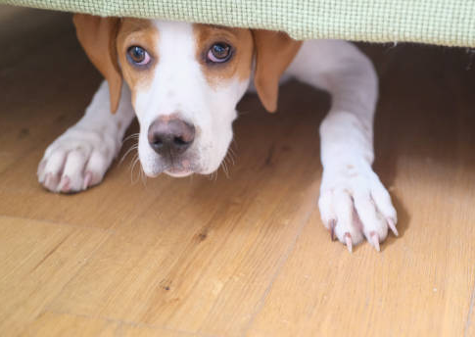
What fears do you have for this year?
Notes:
Slide 3
I wonder how many of you the night before school started this term, found yourself nervous and struggled to get to sleep. Just thinking about all the expectations and fears of the year ahead. This is perfectly normal. (Especially if you want to do well this year). This means acknowledging those fears.
What fears do you have for this year? Take a moment to write down the 5 major things that come to mind in 1.1 of Activity 1 (Lesson 1 – Worksheet). (Give 2 min) Sometimes these fears seem to overwhelm us and we experience stress.
What is the difference between fear / anxiety and stress? (Ask learners’ opinions.)

Slide 4
Stress, Anxiety & Stressors
Stress: Feelings of fear, but there is an additional ongoing, increasing or new pressure or demand. When you feel overwhelmed you may experience anxiety.
Anxiety: Fear or anxiety is an emotion that causes you to feel unease and nervousness.
Stressors: The pressures that lead to stress are called stressors. They can be physical, social, emotional or environmental.
Notes:
Slide 4
Fear or anxiety is an emotion that causes you to feel unease and nervousness.
Stress includes feelings of fear, but there is an additional ongoing, increasing or new pressure or demand. When you feel overwhelmed you may experience anxiety.
The pressures that lead to stress are called stressors. They can be physical, social, emotional or environmental.
In 1.2 of Activity 1 (Lesson 1 – Worksheet) include examples in your own life where you have experienced fear / anxiety and stress.

Slide 5
Do you remember the five areas that make up an individual?
Physical: Your body and being physically fit
Psychological: Your mental and emotional state, the desire to improve yourself
Social: Your relationships with friends and family, and the community you belong to
Emotional: Your ability to control, express and explore your emotions
Spiritual: Your religious belief, values, and how you find peace in life
Notes:
Slide 5
Let’s take a moment to think back to Grade 11. Do you remember the FIVE areas that make up an individual? Ask learners to list them again.
These include:
Physical - This refers to your body and being physically fit, eating healthily and sleeping enough. You should try to maintain this balance.
Psychological - This refers to the mental or emotional state of a person. It also includes the desire to improve yourself by avoiding risky behaviour and applying yourself in your education to be the best person you can be.
Social - You have a good relationship with your family and friends. You take part in community events and volunteer where you see a need.
Emotional - You are able to explore, express and control your emotions.
Spiritual - You follow a religious belief that you have chosen. You follow the values of your religious belief and find peace and hope in meditating and praying.
Can you see how stress can impact the balance of these different areas in your life? Remember last year we learned that a healthy person is a balanced person? Let’s take a look at HOW stress impacts some of these areas.

Slide 6
Defining stressors in your life
Physical stressors: Cause stress that impacts your body. E.g. lack of exercise, physical abuse, overtiredness.
Social stressors: Your relationships with family, friends and society in general. E.g. Divorce in the family.
Emotional stressors: Your feelings, reactions to life experiences and how you feel about yourself. E.g. teen pregnancy.
Environmental stressors: Everything around you. It could be where you live, attending school, etc. E.g. air pollution caused by traffic.
Notes:
Slide 6
Work through these definitions with the class. Allow time for learners to add to the examples on Activity 2 (Lesson 1 – Worksheet) into their notebook.
PHYSICAL STRESSOR - Physical factors cause stress that impacts your body. E.g. lack of exercise, physical abuse, and overtiredness.
This includes unhealthy lifestyle choices, alcohol abuse, caffeine addiction, and sexual promiscuity.
EMOTIONAL STRESSOR - Emotional factors include your feelings, reactions to life experiences, and how you feel about yourself.
Life crises that are stressors include teen pregnancy, the death of a parent, unemployment in the home, etc.
Change can also be a stressor like moving house or moving schools in your matric year.
SOCIAL STRESSORS - This includes your relationships with others from family, friends and society in general. This includes divorce in the family, gender discrimination in society, bullying amongst peers, and breaking up friendships or relationships.
ENVIRONMENTAL STRESSOR - This refers to everything around you. It could be where you live, attend school, etc. This includes pollution caused by traffic, natural disasters like fire or floods, lack of privacy in your home, lack of sunlight, etc.
I’m sure many of you can relate to these stressors. These stressors could be summarised as an external factor that has an impact on you by increasing your stress. When these factors exist for a long period of time and increase in pressure they could be called chronic stress. The increased impact over an extended period of time could result in mental health sickness or physical illnesses like ulcers or IBS (Irritable Bowel Syndrome).

Slide 7

Group Activity – Say NO to School Dropout!
South African schools face high dropout rates due to:
Economic recession
Youth unemployment
Substance abuse
As Grade 12 learners, you have valuable advice to share with younger learners who might consider dropping out.
Notes:
Slide 7
(Note to teacher: This activity will offer learners an opportunity to make suggestions that will educate other learners on the impact of stress in a school environment. This activity includes FOUR different group questions on the same article titled: ‘This is the school dropout rate in South Africa’
(Lesson 1 – Group Activity).
The aim is to have learners discuss their focus questions in their group and give feedback to the class. Hand out the Lesson 1 – Poster Template for learners to put their suggestions on. It would be helpful to put these up somewhere in the class as a reminder to others to “Say NO to school dropout!”
The Lesson 1 – Group Activity MEMO provides answers to the questions for your guidance)
With the impact of an economic recession, an increase in unemployment amongst the youth and an increase in substance abuse, it is no wonder that South African schools are experiencing the greatest dropout rate ever. These increasing numbers are a major concern should the numbers keep rising. Being one of the few who have made it to Grade 12, you have a wealth of wisdom to share with those learners who are younger than you and tempted to drop out.
As a group, read the article on your group case study (Lesson 1 – Group Activity) and reflect on the questions as a group and write your responses on the poster template (Lesson 1 – Poster Template). Choose one person to give feedback to the class.

Slide 8

Homework
Notes:
Slide 8
We will not have time now to start the homework. Activity 3 (Lesson 1 – Worksheet) will give you an opportunity to work through the type of question that prepares you for the way in which this content could be assessed in a Controlled Test. Please complete these questions and bring them to class next week.

Slide 9
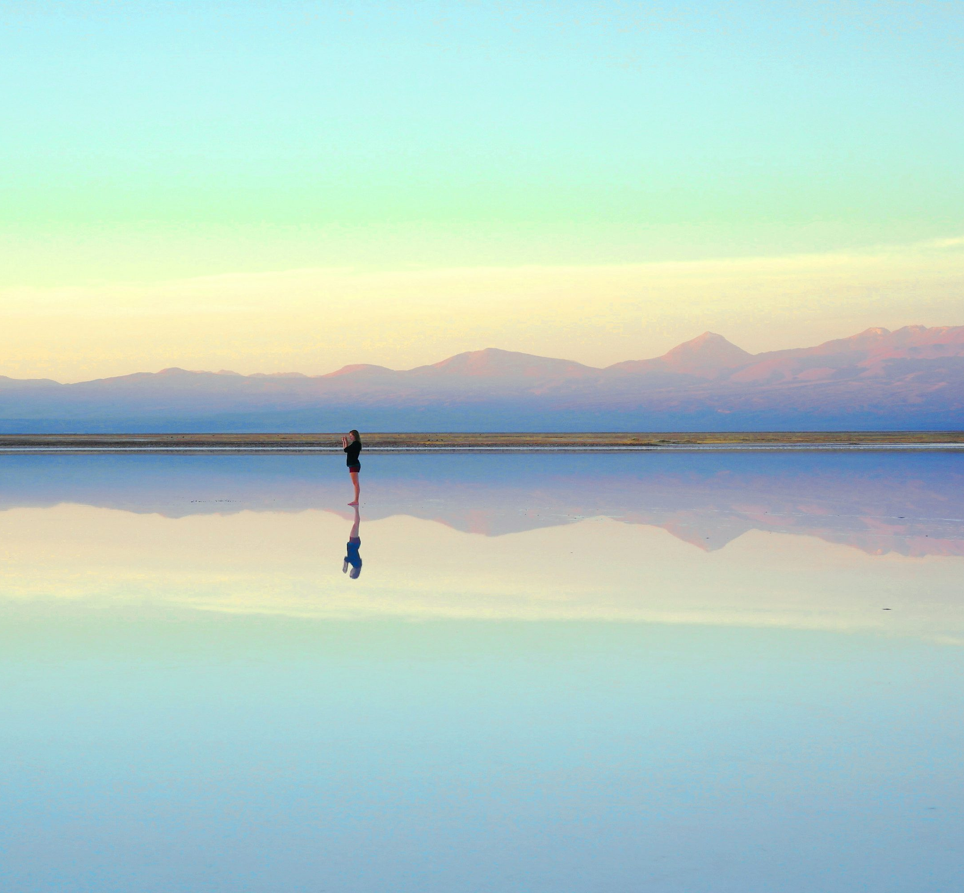
Reflection
What advice would you give someone showing signs of physical/emotional stress?
How can you contribute to creating a calm, stress-free atmosphere in the classroom?
Was there any content covered in today’s lesson that you need to revise?
Notes:
Slide 9
As we come to the end of this lesson, reflect on the following questions in Activity 4 (Lesson 1 – Worksheet).
What advice would you give someone showing signs of physical / emotional stress?
How can you contribute to creating a calm, stress-free atmosphere in the classroom?
Was there any content covered in today’s lesson that you need to revise?

