Slide 1
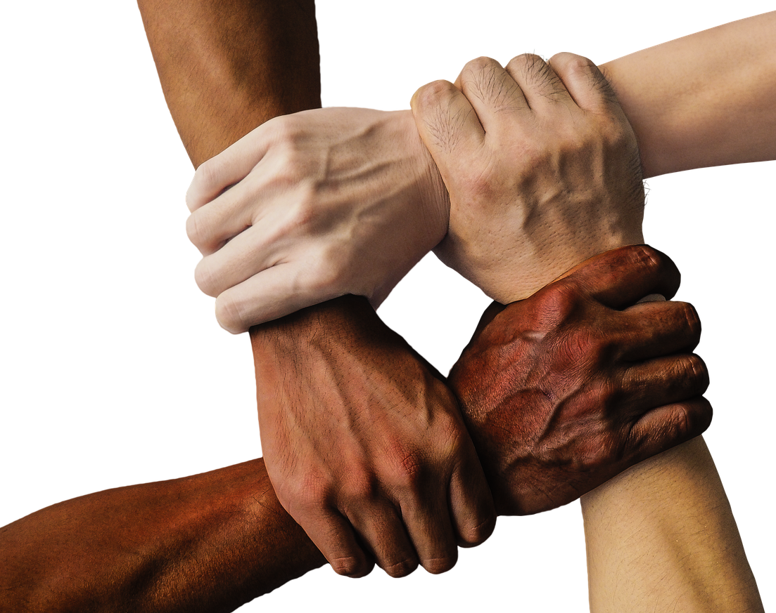

Term 2: CRR
Lesson 1: Issues relating to citizens’ rights & responsibilities
Notes:
Introduction & Activity (1 + 5 min)
Good day, Grade 9s. Today we are starting a new topic, and we will be exploring issues surrounding our rights and responsibilities.

Slide 2
By the end of this lesson, you should be able to:
Explain what human rights are, why they are essential, and how they promote dignity, equality, and freedom in society.
1
Distinguish between rights and responsibilities.
2
Identify instances where human rights are disrespected and discuss ways to challenge discrimination.
3
Understand how the South African Constitution safeguards human rights and promotes democracy, respect, and tolerance in society.
4
Notes:
By the end of this lesson, you should be able to:
Explain what human rights are, why they are essential, and how they promote dignity, equality, and freedom in society.
Distinguish between rights and responsibilities.
Identify instances where human rights are disrespected and discuss ways to challenge discrimination.
Understand how the South African Constitution safeguards human rights and promotes democracy, respect, and tolerance in society.

Slide 3

Activity
Notes:
Before we begin – let’s start with Activity 1 on Lesson 1 – Worksheet. You have THREE questions about Human Rights – you have just a few minutes to jot down your thoughts before we unpack these questions. (Give learners 3 to 4 minutes to answer these questions.)
Note to teacher: Try using the recommended Stopwatch Timer link to help learners complete the activities in time: https://www.online-stopwatch.com/countdown-clock/full-screen/

Slide 4
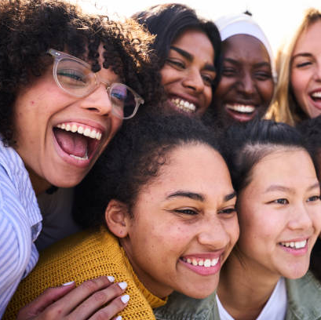
Human Rights
Watch: What are human rights?
https://www.youtube.com/watch?v=6e8m8L9BFa4
(2 min 38 sec)
Notes:
Watch Video & Teaching (3 + 3 min)
In this video, we will learn what human rights are and why they are important.
Watch: What are human rights?
https://www.youtube.com/watch?v=6e8m8L9BFa4 (2 min 38 sec)

Slide 5

The importance of human rights
Human rights promote dignity, equality, and freedom
They hold governments accountable and prevent abuse
Guarantee access to education, healthcare, and shelter
Help societies become fairer, safer, and more peaceful
In simple terms, human rights:
Ensure basic needs are met
Protect vulnerable groups
Support freedom of speech and expression
Allow freedom of religion (or no religion)
Give people the right to love who they choose
Provide access to education
Encourage care for the environment
Notes:
As we learnt from the video, human rights promote dignity, equality, and freedom by holding governments accountable and preventing abuse. They also guarantee access to basic needs like education, healthcare, and shelter, helping people live better lives. When human rights are respected, societies become fairer, safer, and more peaceful.
To put it in simple terms, human rights:
ensure people have their basic needs met.
protect vulnerable groups from abuse.
encourage freedom of speech and expression.
give people the freedom to practice their religion (or not practice any).
allow people to love who they choose.
give people access to education.
ensure we all work towards protecting the environment.

Slide 6
Rights and responsibilities
Rights:
making your own choices, forming opinions, access to education, religion, and freedom of speech
Responsibilities: duties we must follow, such as obeying rules and laws
Important to remember:
Rights and responsibilities go hand in hand
Example: You have a right to a neat classroom → Your responsibility is not to litter
Notes:
Teaching & Discussion (3 + 6 min)
Let's take a moment to differentiate between rights and responsibilities. A right is the ability to make your own choices, form your own opinions, and be entitled to fundamental aspects such as education, religion, and freedom of speech, while responsibilities are duties or something an individual should do, such as following the law and rules.
There is a common misconception about the interpretation of rights and responsibilities. At first glance, it may look like the two terms are interchangeable. However, they are not. For example: You have a right to a neat classroom or school, BUT your responsibility would be not to litter in the classroom or leave papers and litter around your school. (Learners need to understand that the TWO go hand in hand.)
Possible discussion points:
Can you think of times when a human's rights have been disrespected and why do people behave in this way?
Can people avoid behaving unfairly and disrespecting people's rights?
What do you think are important rights for learners in the classroom? (The class could then collectively decide what their responsibilities should be within the classroom.)

Slide 7
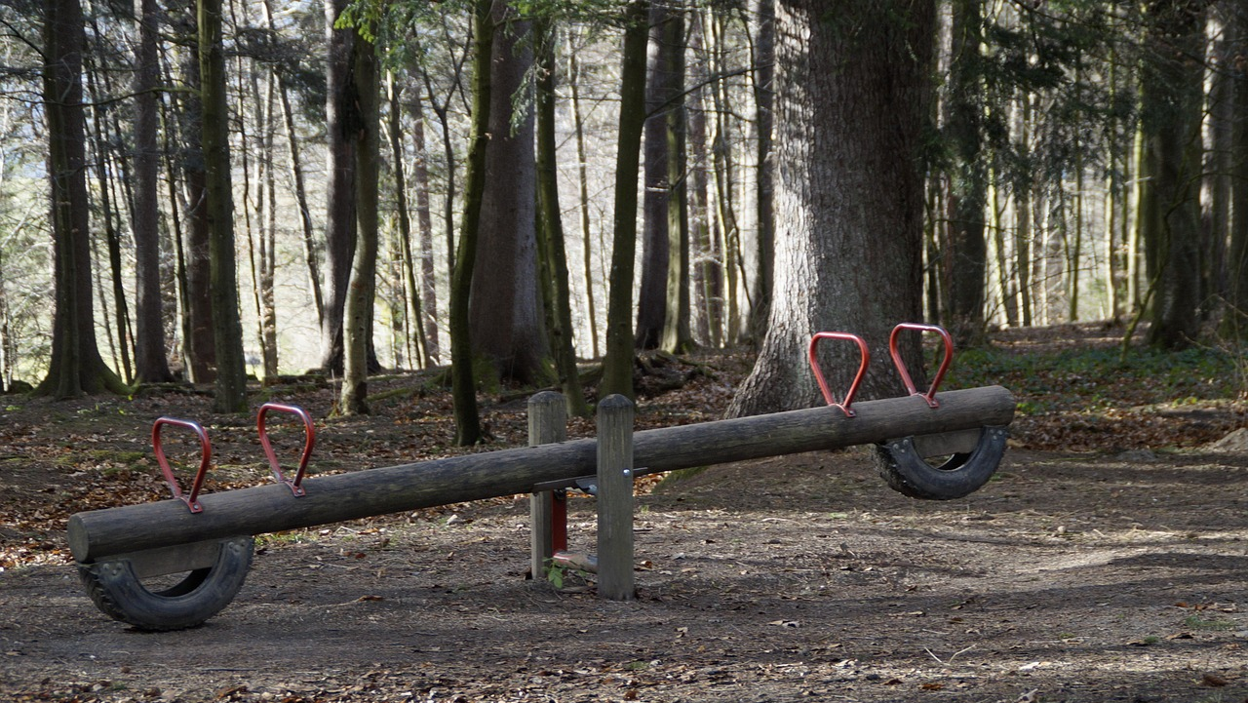
How does it all fit together?
When people fulfil their responsibilities, they help safeguard the rights of others, creating a balanced and just society.
Notes:
When people fulfil their responsibilities, they help safeguard the rights of others, creating a balanced and just society.

Slide 8

Watch: Episode 1: South Africa’s Constitution https://www.youtube.com/watch?v=q7LKSns5TiU
(3 min 29 sec)
Notes:
Watch Video & Discussion (4 + 5 min)
Everything we’ve discussed (our rights and responsibilities) comes from our Constitution. This next clip will explain what the Constitution is and where our rights come from.
Watch: Episode 1: South Africa’s Constitution
https://www.youtube.com/watch?v=q7LKSns5TiU (3 min 29 sec)
Our constitution is highly regarded because it is one of the most progressive and inclusive in the world. It was crafted through extensive public participation and reflects a strong commitment to democracy, human rights, and social justice.

Slide 9

Respect and tolerance
Respecting one another’s rights is vital to uphold the Constitution. Respect is key to building a better society.
Tolerance means:
  Respecting others and treating all as equal citizens
  Accepting different viewpoints and beliefs
  Understanding disagreements are normal, but respect must remain
Many South Africans dedicated their lives to fighting for human rights. We must honour their work and continue building a culture of human rights.
Notes:
To ensure that we uphold the Constitution, it is of the utmost importance that we have respect for one another and for the rights of others and not only ourselves. Respect is one of the most important elements in society. If people simply had a little more respect for themselves and each other, the world would be a better place to live in. Something that goes hand in hand with respect is tolerance.
Ask the learners to explain their understanding of tolerance before sharing the following: Tolerance means respecting other people, being accommodating, recognising all people as equal citizens and human beings, and valuing different viewpoints. Disagreements about values and beliefs are inevitable – and acceptable – as long as we maintain mutual respect for one another as equals.
Many South Africans have dedicated their lives to the fight for human rights. It is important to honour their work and foster a culture of human rights in South Africa.

Slide 10

Activity
Notes:
Conclusion Activity & Reflection (10 min)
Slide 10: You will now complete Activity 2 and Activity 3 on the Lesson 1 – Worksheet. These activities are fairly short – you can start them now and continue for homework.
Lesson 1 – Worksheet MEMO provides suggested answers to activities.

