Slide 1


Study Skills & Study Methods
Term 2: Week 6 and 7
Lesson 1
Notes:
Slide 1
Hand out Lesson 1 – Worksheet at start of lesson
Welcome back Grade 10s.
This week we will be looking at Study Skills. I know it’s something you think you know and things that you don’t need to learn. But there are key elements that we will be covering and some things that will be beneficial. You covered the concept of goals for lifelong learning at end of Grade 9.
Refer to the Concept Map (Activity 1) on your Lesson 1 – Worksheet as we go through the Lesson 1 - PowerPoint slides and fill in the necessary information.

Slide 2

Controlled Tests & Exams
WATCH: Why do we need study skills?
https://www.youtube.com/watch?v=cM_-a7jxJLs (2 min)
Notes:
Slide 2
You are just a few weeks away from your first set of exams / controlled tests for Grade 10.
Exams can be very stressful if you are not well prepared.
On the other hand, they can also be very rewarding when you are well prepared.
We are going to discuss Study Methods and Study Skills. Hopefully something that you learn today will help you prepare for those exams in the coming weeks.
WATCH: Why do we need study skills?
https://www.youtube.com/watch?v=cM_-a7jxJLs (2 min)

Slide 3
Let’s reflect on your study habits in the past
Were you prepared for your exams?
Did you do as well as you hoped?
Notes:
Slide 3
Take a moment and think back…
(Ask learners:)
Take a moment to think back on some of your study habits in the past…
Were you prepared for your exams?
Did you do as well as you hoped?
This will get the discussion going for the coming slides.

Slide 4

Study Skills & Study Methods
Key Difference
Study skills = the approaches or techniques you use when studying.
Study methods = the ways or means of studying.
Both work together for effective learning.
Important to Remember
Everyone has different methods – find what works best for you.
These skills are valuable for life, not just for school.
Notes:
Slide 4
Study Skills & Study Methods
To start with – are study skills and study methods the same thing?
A common misconception is that they are the same, but in fact they are two very different concepts.
How a learner studies plays a crucial role in their academic success. An understanding of study skills and study methods improves their chances of performing well.
The key difference between study skills and study methods is that study skills are the approaches that are used by learners to do their studies, while study methods are the means and ways of studying. Both study skills and methods are used to gain successful and effective learning.
Both study skills and study methods are used together when studying. It’s important to remember that each person has their own methods. It is important to find what suits you because what works for one person may not work for another.
Study Skills and Study Methods are skills that will be used long after you have finished school. They are not just something you need to know for now.

Slide 5
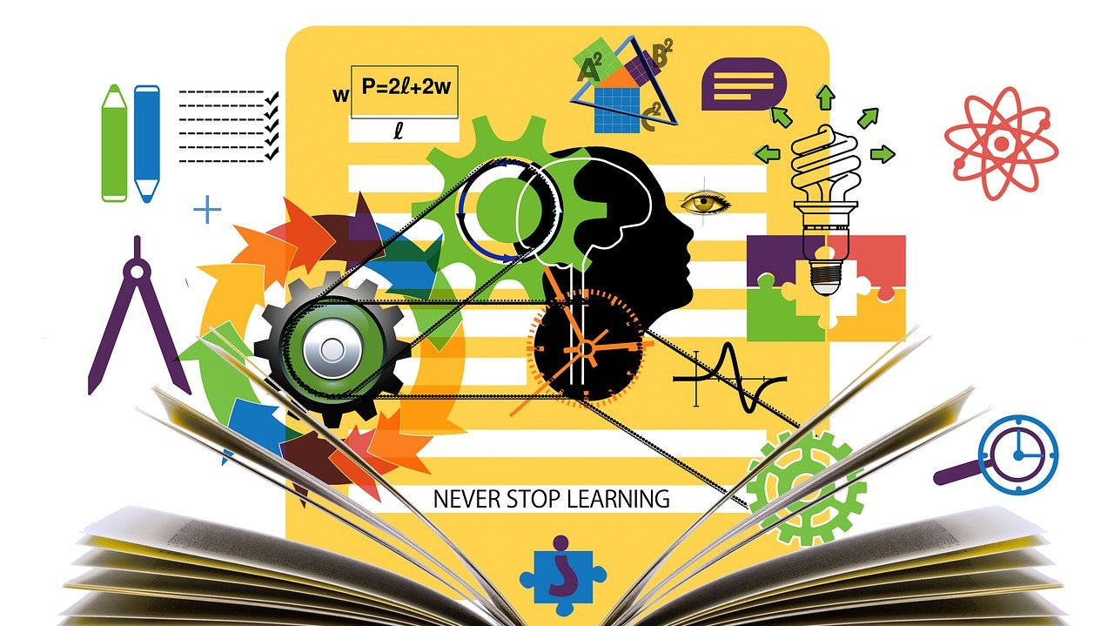
Study Skills
Notes:
Slide 5

Slide 6
Study Skills
What are study skills?
Skills that help you study and learn efficiently
Involve listening, reading, understanding, concentrating, and organising content
Techniques for processing, retaining, and applying information
Why are study skills important?
Help you develop your personal approach to learning
Work across all subjects (not subject-specific)
Need practice to improve confidence and awareness
Organisation, time management, analysis, problem-solving, self-discipline – transferrable skills for life after school
Notes:
Slide 6
What are Study Skills?
Study skills are the skills you need to enable you to study and learn efficiently. They are an important set of life skills. It is your ability to listen, read, understand, concentrate and organize content.
Study skills are an array of skills which tackle the process of organizing and taking in new information, retaining information, or dealing with assessments. They are techniques that can be learnt and applied to most fields of study.
Importance of study skills:
You will develop your own personal approach to study and learning in a way that meets your own individual needs. As you develop your study skills you will discover what works for you, and what doesn’t.
Study skills are not subject specific - they are generic and can be used when studying any area. You need to understand the concepts, theories and ideas surrounding your specific subject area. To get the most out of your studies, however, you’ll want to develop your study skills.
You need to practise and develop your study skills. This will increase your awareness of how you study, and you’ll become more confident.
Study skills are transferable - you will take them with you beyond your education into new contexts. For example, organisational skills, time management, prioritising, learning how to analyse, problem solving, and the self-discipline are all skills that you will apply in your life after school and into your career one day!

Slide 7

Listening
The ability to receive and interpret messages accurately.
Essential for effective communication – without it, messages are misunderstood and communication breaks down.
Benefits of good listening:
More friends and stronger social networks
Better self-esteem and confidence
Higher academic performance
Improved health and well-being
Listening ≠ Hearing
Hearing: physical process – sounds enter your ears automatically.
Listening: requires focus, attention, and effort.
To listen effectively, pay attention to:
What is said
How it is said (voice, tone, language)
Non-verbal cues (body language, facial expressions)
Active Listening
Listening is not passive – you should be as engaged as the speaker.
Active listening = fully concentrating, understanding, responding, and remembering.
Notes:
Slide 7
LISTENING
Listening is the ability to accurately receive and interpret messages in the communication process.
Listening is key to all effective communication. Without the ability to listen effectively, messages are easily misunderstood. As a result, communication breaks down and the sender of the message can easily become frustrated or irritated.
Benefits of being a good listener include a greater number of friends and social networks, improved self-esteem and confidence, higher grades at school and in academic work, and even better health and general well-being.
Listening is Not the Same as Hearing:
Hearing refers to the sounds that enter your ears. It is a physical process that, provided you do not have any hearing problems, happens automatically.
Listening, however, requires more than that: it requires focus and concentrated effort, both mental and sometimes physical as well.
Listening means paying attention not only to the story, but how it is told, the use of language and voice, and how the other person uses his or her body. In other words, it means being aware of both verbal and non-verbal messages. Your ability to listen effectively depends on the degree to which you perceive and understand these messages.
Listening is not a passive process. In fact, the listener can, and should, be at least as engaged in the process as the speaker. The phrase ‘active listening’ is used to describe this process of being fully involved.

Slide 8

Reading
Effective reading = focusing on what’s relevant, understanding, and remembering it
Break reading into manageable chunks (chapters, topics) for clear goals
Why is reading important?
  Strengthens comprehension and processing
  Essential for gaining knowledge
Notes:
Slide 8
READING
When you are studying, it is important to be able to read effectively and efficiently.
Reading efficiently and effectively means reading what is relevant, without wasting time and being able to understand, use and remember what you have read.
Before starting, break the reading down into manageable chunks, such as a chapter or topic. This will help set achievable goals.
Why is reading an important study skill?
Reading gets the mind working across different areas. For starters, it involves comprehension to process the words you read.
It is difficult to acquire knowledge without strong reading skills.

Slide 9
Reading – SQ4R Method
Step 1: Survey – browse chapters, titles, summaries, visuals
Step 2: Question – turn headings into questions
Step 3: Read – search for answers and engage with the text
Step 4: Respond – close the book and answer questions
Step 5: Record – make your own notes of the content
Step 6: Review – go over notes weekly to reinforce learning
Notes:
Slide 9
What is SQ4R?
A method of reading and studying textbooks. It’s an acronym for: Survey, Question, Read, Respond, Record, and Review.
When using this method, complete all the steps initially, then choose which are most effective for you and your courses.
The SQ4R method may seem time consuming at first, but it's an effective method for reading, understanding, and remembering information from your textbooks.
Benefits of using SQ4R:
It’s an active learning strategy that can be adapted to suit an individual’s study preferences. It provides a strategy to retain a lot of factual detail, reducing the amount of information that must be relearned for exams. It prompts the creation of study material to be used when preparing for exams. It helps to identify errors or areas of confusion.
THE METHOD:
Step 1: Survey the textbook and chapters. Read the preface and introduction to the text and browse through the table of contents and the index. This will describe the main topics and the basic organizational structure of the book. Read the introduction and conclusion in each chapter and subsection. Scan the titles and subtitles. Study the pictures, charts, or graphs. Read the summary and any chapter questions.
Step 2: Start with a question. Take the section title, subtitle, or the first sentence of each paragraph and turn it into a question. For example: “Functions of the spinal cord” becomes “What are the functions of the spinal cord?”
Step 3: Read actively. Read carefully and actively by creating a “dialogue” with the text.
Try to find the answer to the question you created and ask questions as you read.
Be careful not to skim the text looking for the answer, as you might miss other important information.
Step 4: Respond to your question. Close the textbook and answer the question you created in your own words. If you can’t answer the question, reread the section until you can.
If, after a few tries, you still can’t answer the question, go on to the next few sections and see if things become clearer. If that doesn’t help, you may need to change your question. Try making it broader or narrower. If changing your question doesn't help, get some assistance.
Step 5: Record your notes. Once you understand the material and can summarize it in your own words make a record of it. Common methods are highlighting and/or marking the text, or taking notes, or some combination of both. Whichever methods you choose, it's critical to read and understand the material first, and then go back and record.
Step 6: Review your notes: Do a thorough review of notes weekly. Make weekly review periods effective by starting from the beginning of the course in each review session. Though the volume of review material increases as the semester progresses, the amount of time needed to review older material decreases. After you've reviewed the first week's material a few times, it will take only minutes to skim over it and recall the key points.

Slide 10
Comprehension
Skim-reading: quick overview, choose main themes
Scanning: looking for specific facts or names
Reading for detail: close reading of every line and description
Each technique has its place in studying and exams
Notes:
Slide 10
COMPREHENSION
Many of us read the words on a page without taking the time to understand what is going on. When you take the time to comprehend and pay attention to what you are reading, it means analysing what is being read and making sense of it. Reading for comprehension requires you to pay attention to what is on the page or in you book.
Effective reading comprehension, which is based on reading for gist and not concentrating on individual words, but on the sense of what you are absorbing.
Techniques for reading efficiently:
Skim-reading: looking at a text quickly and trying to pick out the main themes and sentences. This ability can be improved with practice and is particularly helpful when you are faced with a mountain of texts to go through in a limited period.
Scanning: looking at a text to find a particular fact, person, reference etc. When you are examining a list of items, or trying to track down a name or fact, you are using the scanning approach.
Reading for detail: which is something we do when reading novels, such as an English set work, going through each line, every description and piece of the text. All these techniques have their own place in reading comprehension, and in exams. Sometimes you will be asked to discover who did a particular thing (scan), on other occasions you may be asked to compare two ideas (skim, and then read for detail).
Improving your reading comprehension takes time.

Slide 11

Concentration
Concentration is focusing your attention on one task and ignoring everything else.
It helps you use your mental resources better, solve problems more efficiently, and remember information.
Staying focused is linked to future success – many successful people (like Steve Jobs and Bill Gates) credit focus as a key to achievement.
Why Concentration Matters
Helps you achieve better results by focusing on the present.
Reduces the chance of missing important information.
Makes learning and memorising easier.
Improving Concentration
Eliminate distractions
Avoid multitasking
Practice mindfulness
Get enough sleep
Focus on the present moment
Notes:
Slide 11
CONCENTRATION
Concentration is important in everyday life. Scientists discovered that the ability to stay focused can be an important indicator of a person’s future success. Many influential and hugely successful people like Steve Jobs or Bill Gates stressed the power of simplicity and focusing on priorities.
As an old Zen proverb says, “When walking, walk. When eating, eat”. This quote is about walking or eating. It describes an approach to life. It simply states that the most important thing is to focus your attention on present activity. This is the way to achieve the best results.
Concentration is the ability to think carefully about something you are doing and nothing else. It means controlling your attention. It is the ability to focus the mind on one subject, object or thought and at the same time exclude any other unrelated thoughts, ideas, feelings, and sensations.
Concentration allows you to better use your resources and approach problems more efficiently. When you are concentrating it is less likely that you will miss important information. Staying focused helps you memorise things more easily.
We all can concentrate some of the time. But at other times our thoughts are scattered, and our minds race from one thing to another. To deal with such times, we need to learn and practice concentration skills and strategies. To concentrate, we must learn a skill, and as with any skill this means practice repeated day after day until we achieve enough improvement to feel that we can concentrate when we need to.
Ways to improve your concentration (refer to Content Summary for more detail):
Eliminate distractions
Reduce multitasking
Practice mindfulness and meditation
Get enough sleep
Choose to focus on the moment
Taking short breaks
Connect with nature
Train your brain
Exercise
Music
Eat well
Create a workspace
Use a timer

Slide 12

Memory
Allows you to store and retrieve the information that you have learnt.
Short-term (working) memory: holds info while using it, before discarding or transferring.
Long-term memory: stores information for longer periods, sometimes years.
Notes:
Slide 12
MEMORY
Memory is essential to all learning, because it lets you store and retrieve the information that you learn. Memory is basically nothing more than the record left by a learning process.
There are two types of memory, short-term and long-term:
Short-term memory is generally considered to be your day-to-day memory. Also known as ‘working memory’, it is where you keep information while you are using it, and until you either discard it or transfer it to your long-term memory.
Long-term memory is related to what you did in the past, sometimes going back years. But some of what is stored in your long-term memory may relate to more recent events. It is probably better considered a place where your brain stores information that it wants to keep.
In other words, if you can’t remember something, you have not learnt it.

Slide 13

Organisation & Time Management
Organisation: keep workspace tidy, stay free from distractions
Make use of SMART goals
Time management
Plan, set goals, deadlines, and priorities
Spend the right time on the right activity
Strategy should be easy to plan, use, and maintain
Benefits
Less stress with assignments and exams
More time to do the things you like doing
More balance and control in life
Notes:
Slide 13
Organisation & Time Management:
The ability to remain focused on a task plays a big part in managing your time efficiently.
But that can be tough when the desktop, laptop or tablet required to complete an assignment is the same piece of technology that is the source of some the biggest time distractions in our lives.
ORGANISATION & TIME MANAGEMENT
There are two sides to being organised – being physically organised in the space you are in. Is your desk tidy and ordered? Is everything where it needs to be? On the other side we have mental organisation, being free from distractions and paying attention to what you are doing. Trying to work or study in a cluttered space can be very difficult, being organised can help you stay on track and get through what needs to be done.
Set yourself SMART goals and work on your skills: these must be Specific, Measurable, Achievable, Relevant and Time-bound.
Once you have broken the task down into its various steps, create a timetable, using realistic action plans – and follow it.
Time management is about ensuring that you have complete control of your time and that you are allocating it effectively so that you can get everything done that you NEED to get done – but also get done the things you WANT to get done.
Time Management includes:
Effective Planning
Setting goals and objectives
(Think back to when you learnt about GOAL SETTING and how that can help us in figuring out where we are going and what we want to achieve.)
Setting deadlines
Prioritizing activities as per their importance
Spending the right time on the right activity
An effective time management strategy needs to be: EASY to plan, implement and maintain.
Benefits of Time Management:
Less stress in completing assignments.
Less stress due to better prepared for exams.
If you’re organized, you can fit more into your life.
More time to do the things you would prefer to be doing over schoolwork.
More balance and control in your life.

Slide 14
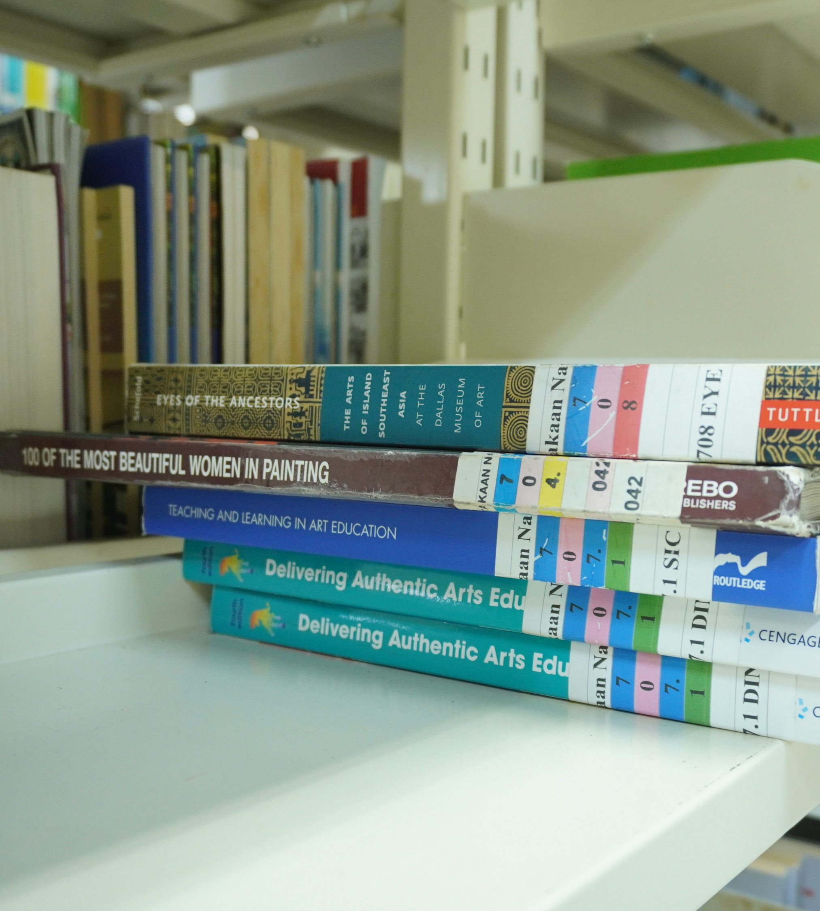

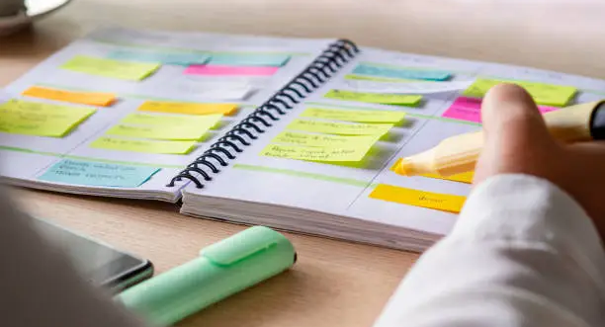
Study Methods
Methods and strategies you can use to study and increase your chances of success.
Some people may like to study in a visual way, while others may be reading or listening.
Notes:
Slide 14
Study methods
Study methods refer to methods and strategies a learner can make use of when studying. Studying requires strategies that can be used to increase the chances of success.
Some people may like to study in a visual way, others be reading or listening.

Slide 15

Taking Notes
Taking Notes
The practice of recording key information from lessons, books, or other sources.
Helps you remember important points without relying only on memory.
Why Note-Taking Matters
Keeps you alert and focused
Engages your mind
Organises and emphasises information
Improves understanding and memory
Tips for Effective Note-Taking
Draw a margin on the left of your page.
Use this space to write main points or keywords after the lesson.
Review and condense your notes to make studying easier.
Notes:
Slide 15
Taking notes
Note-taking is the practice of recording information from different sources and platforms. By taking notes, you record the essence of the information, freeing the mind from having to recall everything.
Keeps you alert. Notetaking keeps your body active and involved and helps you avoid feelings of drowsiness or distraction.
Engages your mind and keeps you thinking while you are busy.
Emphasizes and organizes information, by taking notes your brain can ‘file’ things away for later.
Creates a condensed record for study and helps with the studying process later on.
Note taking helps you to pay attention and helps you focus in class (or while reading a textbook). It helps you learn. Studies have shown that actively engaging with the topic by listening and then summarising what you hear helps you understand and remember the information later.
Draw a margin down the left of your page. Use this space to put the main points once you have taken notes. This is very helpful with subjects where lots of notes need to be written down in a lesson.

Slide 16
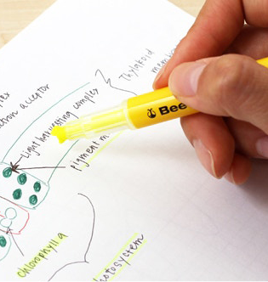
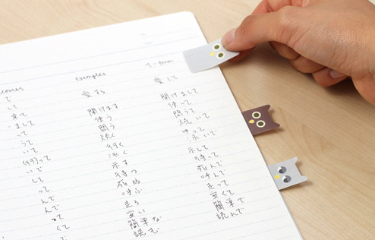
The use of colour and an index
The use of colour in diagrams or summaries:
Emphasises the importance of certain terms.
This is also helpful when analysing what is being asked in a particularquestion.
Use an index for your notes:
Handy when you have lots of notes and you want to organise how to find them.
Can be used to cross-reference between sections.
Notes:
Slide 16
Use colours when working with diagrams or summaries to emphasise the importance of certain terms. This is also helpful when analysing what is being asked in a particular question.
An index comes in handy when you have lots of notes and you want to organise how to find them. You could also use an index to cross reference between sections.

Slide 17
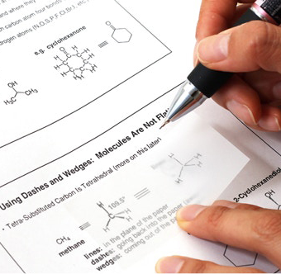
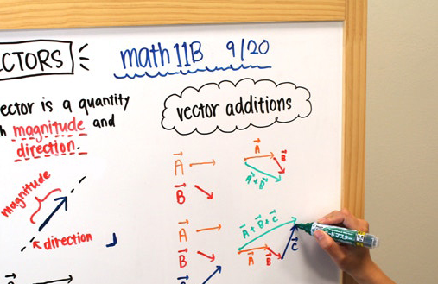
Whiteboards, Markers & Tracing Paper
Use a whiteboard and markers
Helpful to practice exercises in subjects that require working out or drawings.
Use tracing paper
Really helpful when you want to record certain diagrams and put them into your notes.
You could then practice labelling on the tracing paper.
Notes:
Slide 17
A whiteboard can be very helpful to practice exercises in things like maths or subjects where there is some working out or drawings.

Slide 18
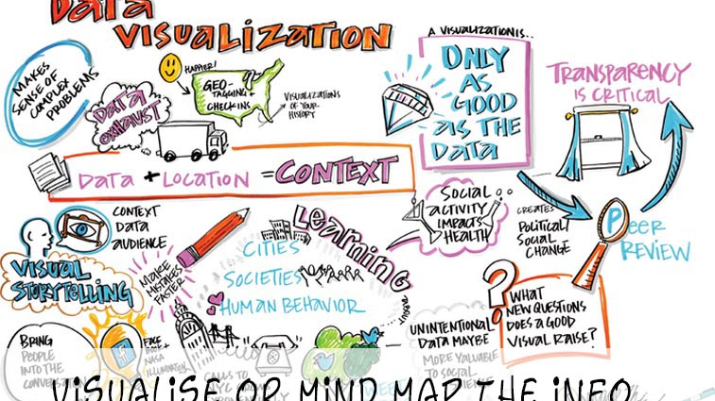
Mind Mapping
Helps learning, recording info, linking ideas, and creative problem-solving
Shows structure of a subject and connections between facts
Combines words and images for strong memory links
Useful for brainstorming, planning, revising, and essay writing
Mirrors how the brain organises information
Notes:
Slide 18
MIND MAPPING:
Mind Mapping is a useful technique that supports learning, improves information recording, shows how different facts and ideas are related, and enhances creative problem solving.
Mind maps can give you an effective method of taking notes and planning essays. Mind Maps will help you see the structure of a subject, the important facts and how they are linked. Your Mind Maps are yours alone. Once you understand how to make them you can develop your own ways to take things further.
Mind maps use words and images to create strong associations that help you remember what you're studying. Some people use mind mapping as a more 'natural' form of note-taking. You can use mind maps to brainstorm, plan, revise and more.
A mind map is a diagram used to represent words, ideas, tasks, or other items linked to and arranged around a central key word or idea. Mind maps are used to generate, visualize, structure, and classify ideas, and as an aid to studying and organizing information, solving problems, making decisions, and writing.
The elements of a given mind map are arranged intuitively according to the importance of the concepts, and are classified into groupings, branches, or areas, with the goal of representing semantic or other connections between portions of information. Mind maps may also aid recall of existing memories.
In a mind map, information is structured in a way that mirrors how the brain functions

Slide 19

Brainstorming
WATCH: What is Mind Mapping
https://www.youtube.com/watch?v=Elkd8D9stbQ (2 min 12 sec)
Notes:
Slide 19
Brainstorming: is another word for mind mapping – it is a VISUAL representation of information and useful when linking topics together.
WATCH: What is Mind Mapping
https://www.youtube.com/watch?v=Elkd8D9stbQ

Slide 20

Summarising
Summarising
Condenses learning material to make studying quicker and easier.
Helps you focus on the most important ideas and leave out what’s not necessary.
Can be used in any subject area.
Why Summarising Matters
Improves understanding and memory of what you read.
Shows you how to identify key points and ignore irrelevant details.
Helps check if you’ve really understood the content.
In Simple Terms
Summarising = telling the main ideas in your own words, briefly.
It’s a skill that develops over time as you read more complex texts.
Notes:
Slide 20
SUMMARISING
We usually make summaries to study for a test or an exam. The purpose is to condense learning material so that it can be readily assimilated, thereby reducing study time.
Summarising teaches students how to discern the most important ideas in a text, how to ignore irrelevant information, and how to integrate the central ideas in a meaningful way. Teaching students to summarize improves their memory for what is read. Summarization strategies can be used in almost every content area.
In student-friendly terms, summarising is telling the most important parts of a text, in your own words, in a much shorter way. Teaching summarising shows students how to discern the essential ideas in a text, how to ignore irrelevant information, and how to integrate the central ideas in a meaningful way. Teaching students to summarize improves their memory for what they read and acts as a check for comprehension. Summarising is a complex skill that will continue to develop over time, as students read increasingly complex texts.

Slide 21
Selecting important concepts
Ask: Who, What, Where, When, Why, How? → write a summary sentence
01
Form a question that the paragraph answers → the main idea
02
Focus on key nouns (concepts), leave out extra words
03
Textbooks may not always highlight concepts – look for terms central to the theme
04
Notes:
Slide 21
SELECTING IMPORTANT CONCEPTS
Identifying the concepts or main ideas in a chapter of text can be challenging.
Identify these from the paragraph: Who, What, Where, When, Why, and How and list them. Then write a sentence or two using these terms. That can get you the main idea.
Read the paragraph, then think of a question you could ask that would be answered by that paragraph. The question will be the main concept.
Identify the main concepts in your research question by selecting nouns important to the meaning of your question. Leave out words that don't help the search, such as adjectives, adverbs, prepositions and, usually, verbs.
Key concepts indicate the main concepts, themes, and/or ideas. Many of these concepts in textbooks are bold or italicized; however, not all of them are. One way to think of key concepts are the words or phrases that contribute to the overall idea.

Slide 22

Final Thoughts
Both study skills and study methods are used together when studying.
It is important to find what skills and methods work best for YOU.
Notes:
Slide 22
Final Thoughts:
Studying requires strategies that can be used to increase the chances of success.
It’s important to remember that each learner has their own methods. It is important to find what suits YOU! What works for one person may not work for another.

