Slide 1

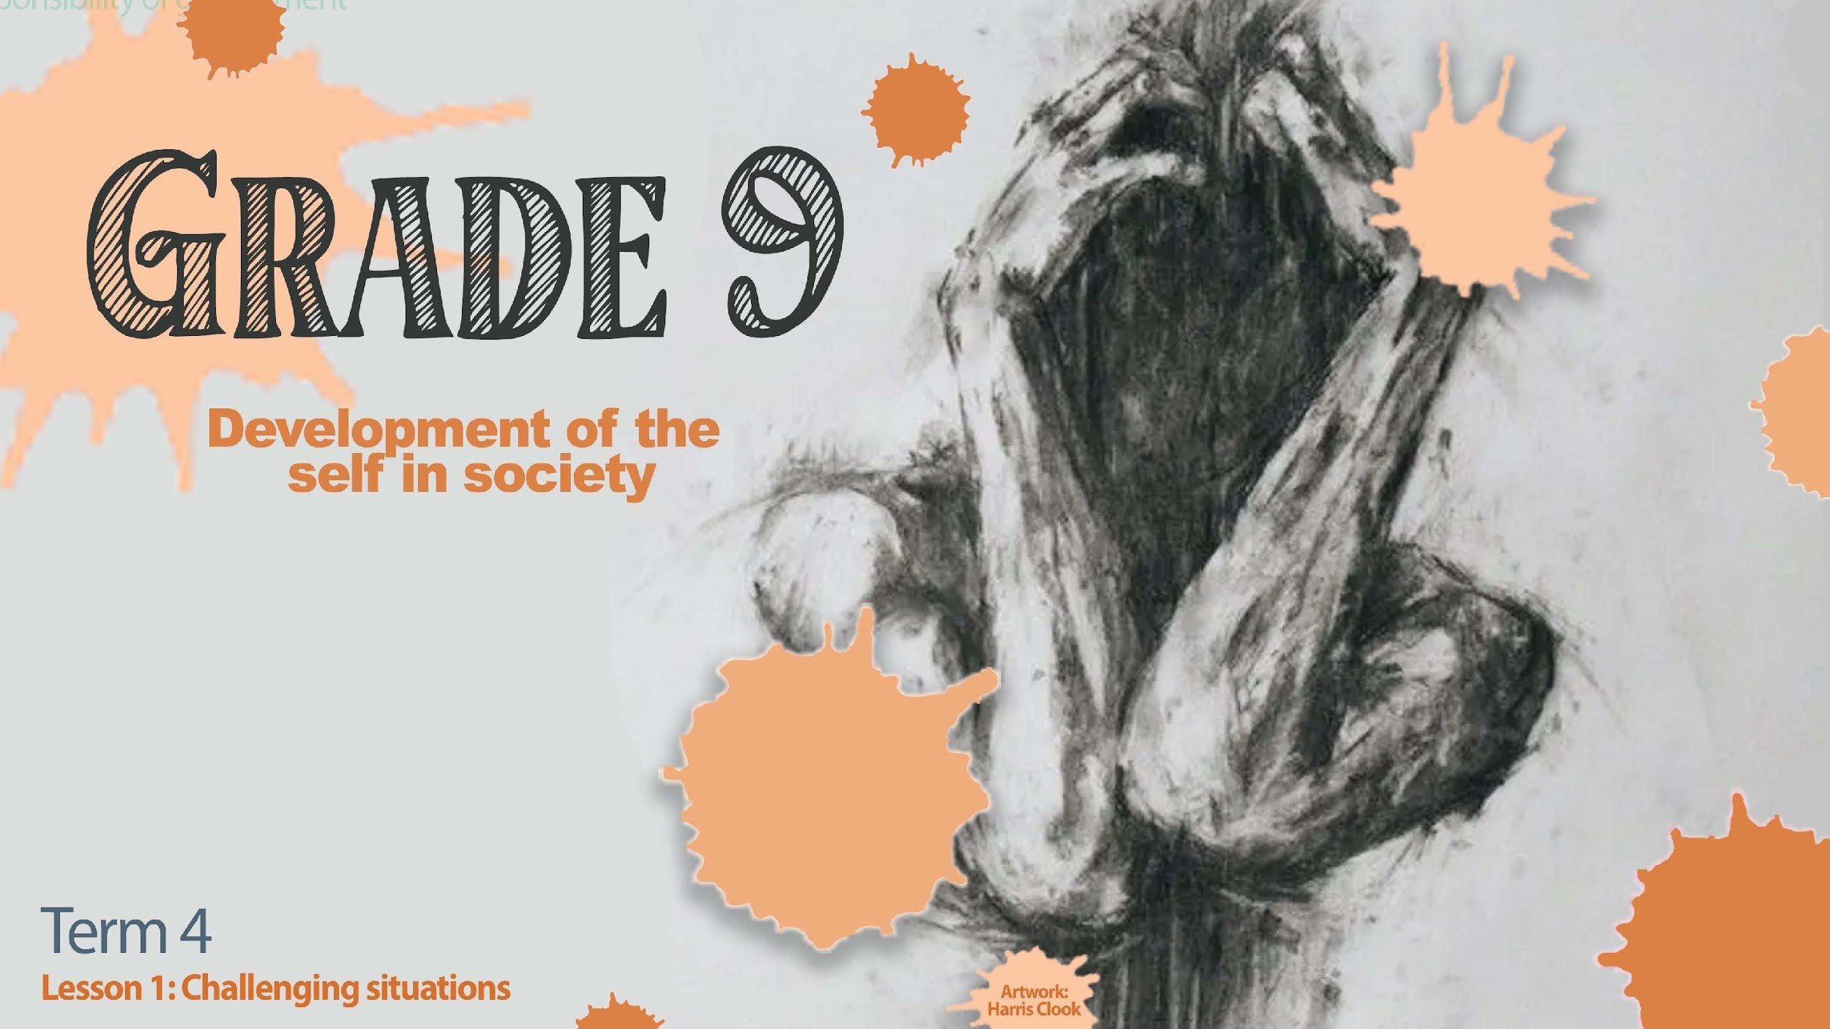
Notes:
Slide 1:
(Note to teacher- this series of lessons will work with learners arranged in groups of FOUR for each of the lessons. Lessons 1 and 2 might seem as though they overlap slightly. The content is not the same.)
Good day, Grade 9s! We start a new series of lessons this week. I’m sure if I had to ask you to share a memory of a time this year that you felt happy or excited you would quickly think of a memory. But if I had to ask you to think of a memory this year that caused you tremendous sadness, it would make you feel sad all over again. We as human beings naturally struggle with how to cope in situations that cause us pain.
In the next few lessons, we are going to learn how to identify what is going on in our bodies emotionally and physically when challenging situations come our way. Sometimes if we hear a story that is similar to something that we have experienced, we suddenly feel very sad and remember that bad experience. We would call this story a “trigger” as it reminds us of our own experiences. As we go through these lessons, if at any stage you feel that you experience a “trigger”, do not just keep quiet and go through this alone. The journey to healing is talking through this kind of pain with someone who can help. If you experience a trigger, you could also make a note of what happened - so that you know what to discuss with someone for help. Let’s keep that in mind over the next few lessons.
Right, let’s begin today’s lesson!

Slide 2

Challenging Situations
Losing a close friend to death
Parents getting divorced
Being diagnosed with a serious illness
Constant bullying at school
Experiencing domestic violence
Being in a car accident and seriously injured
Being the victim of a crime
Notes:
Slide 2:
The reality is that throughout our lives we are going to experience different challenging situations. Here are a few examples:
Losing a dear friend to death.
Parents getting divorced.
Being diagnosed with a serious illness.
Being constantly bullied at school.
Experiencing domestic violence (violence that takes place in the home).
Being in a car accident and seriously injured.
Being the victim of a crime like a robbery.

Slide 3

Physical Trauma
Example of physical trauma:
You train hard to qualify for the provincial athletics team.
The day before the race, you fall and break your ankle.
You cannot run in the race and need weeks of physiotherapy.
Discussion:
What emotions do you think you would experience in this situation?
Notes:
Slide 3:
Trauma is an emotional response to a terrible event. We can experience physical and emotional trauma. Let’s have a look at the difference between these two types of trauma.
Physical trauma - Let’s say you were a sprinter training towards a goal to make the provincial athletics team. You had been working hard for months training everyday and you knew that you had a very good chance to make the provincial team. The day before the race, you fall down the last few stairs at home and break your ankle. Not only will you not be able to run in the race and make the team, but you will need to go through weeks of physiotherapy after the break heals just to strengthen the muscles again.
Let’s hear from the class. What emotions do you think you will be experiencing? (The class might say frustration, anger, sadness, embarrassment – NOTE: depression is not an emotion, it is a diagnosable emotional illness.)
Now, let’s say after your ankle has healed and you’ve been through all the physiotherapy to make it better, you find that every time you walk down stairs you are a little fearful. In fact, you avoid stairs as much as possible because of the trauma of the injury.
We would refer to this as an example of physical trauma. Remember, physical injuries can be seen on the outside of the body.
Turn to the members of your group. Each group member can share an example of a physical injury and your experience of how it made you feel. Each group member has only 30 seconds.
(Allow 2 min for the group discussion)

Slide 4
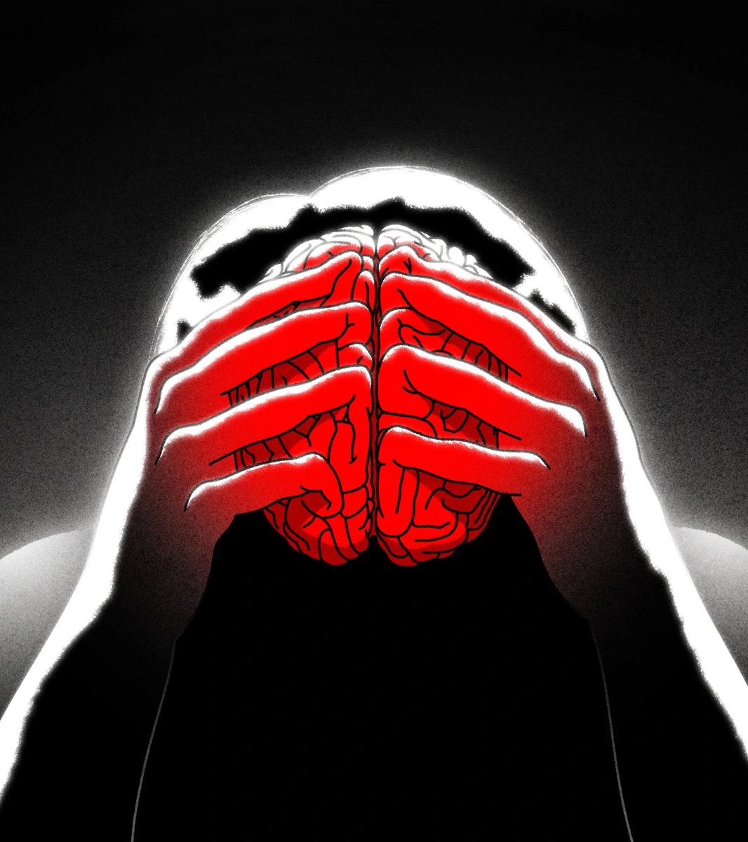
Non-Physical Trauma
Emotional/psychological trauma can be more severe than physical injuries.
It is often hard to identify, and many people don’t get treatment.
Four common types:
  Depression
  Grief
  Loss
  Crisis
Notes:
Slide 4:
When our feelings are deeply hurt or we feel bad about ourselves, we could experience non-physical (emotional / psychological) trauma. In many cases, these kinds of internal injuries are more severe than physical injuries. Sometimes people struggle to identify that they are experiencing a non-physical injury and often don’t get treatment for it.
Let’s look at the four most common non-physical injuries, namely:
Depression
Grief
Loss
Crisis

Slide 5
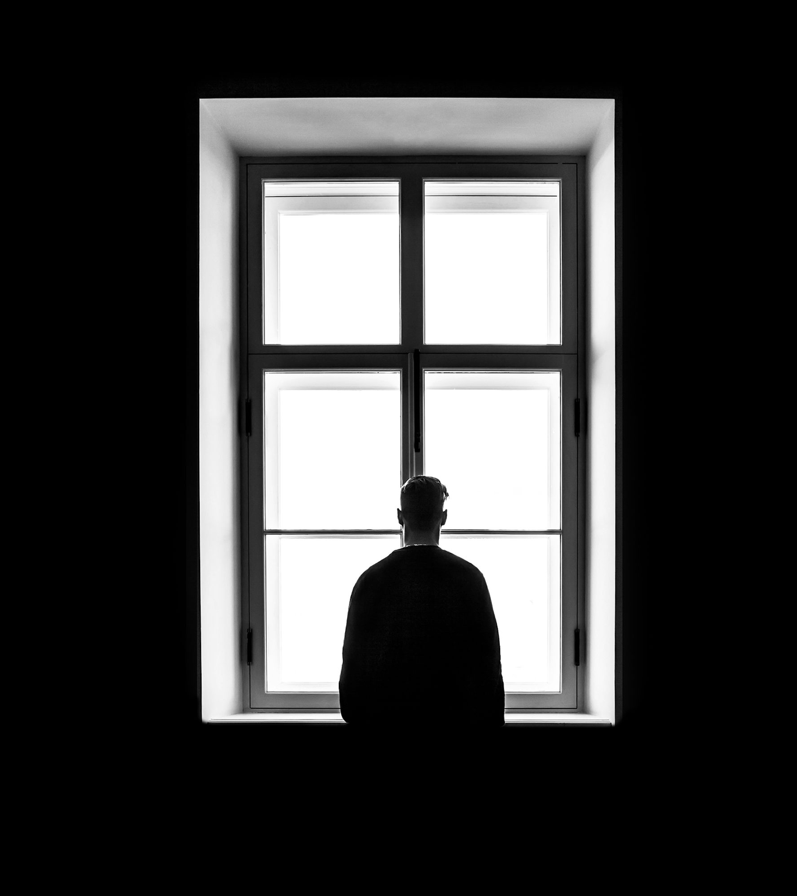
Watch: Depression | Animated Short Film
https://www.youtube.com/watch?v=qC8SUmYcOvs
(2 min 56 sec)
Notes:
Slide 5: 2:56 & 8 min
Watch the clip (https://www.youtube.com/watch?v=qC8SUmYcOvs) to give you some tips on how to answer the questions in Activity 3 (Lesson 1 – Worksheet).
Allow learners 8 min to answer this question.

Slide 6
Reflection
Was there any time in this lesson that you felt you experienced a “trigger”?
Draw an emoji to define how you are feeling now.
Try to describe the feelings of the emoji you drew
Notes:
Slide 6: Reflection Activity (2 min)
As mentioned at the beginning of this lesson, we want to help you develop the skills to process your emotions in challenging situations. At the beginning of this lesson, we referred to the term “triggers”. In these last two minutes, complete the THREE questions on the reflection activity (Activity 4, Lesson 1 – Worksheet).
Namely:
Was there any time in this lesson that you felt you experienced a “trigger”?
Draw an emoji to define how you are feeling now.
Try to describe the feelings of the emoji you drew
Note to teacher: It is important to be mindful and check on the learners before ending the lesson.

