Slide 1


LESSON 1: TIME MANAGEMENT
World of Work
Grade 9 | Term 1 | Week 8-11
Notes:
Introduction (1 min)
Slide 1: Good Morning Grade 9s. Our next lesson series is centred around the importance of Time Management, how it helps us stay accountable and organised and things we can do to improve reading and writing skills.
You have a Concept Map (Activity 1, Lesson 1 – Worksheet) to complete as we go through this lesson – the questions in the concept map must be answered as we go, so jot down your answers.

Slide 2
CONCEPT OF TIME
Time is a strange concept – sometimes we wish for more, other times it feels like we have too much.
It helps us measure, compare, and order events.
One day is made up of:
24 hours
1 440 minutes
86 400 seconds
Sounds like a lot, but is it really?
We all get the same 24 hours – so why do some people achieve more?
What activities help them use time more effectively?
Notes:
Introduction (1 min)
Slide 2: Time is such a strange concept – something we sometimes wish we had more of, and sometimes we may feel like we have so much time on our hands. It helps us quantify, measure, and compare the duration of events, the intervals between them, and even sequence them in order.
Let’s look at what one day is made up of:
One day is the equivalent of 24 hours…
Which is 1440 minutes...
And that equates to 86 400 seconds...
It may sound like a lot when we break it down into hours, minutes and seconds doesn’t it? But is it really?
We all get the same 24 hours – so why do some people seem to achieve more with their time than others? What kind of activities do they do to get things done easier and how?

Slide 3


Scenario Investigation
Your class has been given an assignment to do, and you have a week to complete it…
Let’s analyse the work habits of two different learners.
Notes:
Explanation (4 min) (Slides 3-6)
Note to teacher: On the Lesson Breakdown (Page 1), you’ll notice time allocations marked in RED. The times for slides 3 to 10, with a discussion point on slide 11, have been intentionally reduced. This is a deliberate demonstration of the concept of time management.
Slide 3: Think about this: Your class has been given an assignment to do and you have a week to do it.
Let’s analyse the work habits of two different learners.

Slide 4
LEARNER A
Learner A thinks, “I’ll work on it later when I get to it.” However, the week quickly flies by, and suddenly the deadline is tomorrow. They scramble to complete the task and submit it on time, but deep down, they know it’s not their best work.
Notes:
Slide 4: Learner A thinks, “I’ll work on it later when I get to it.” However, the week quickly flies by, and suddenly the deadline is tomorrow. They scramble to complete the task and submit it on time, but deep down, they know it’s not their best work.

Slide 5
LEARNER B
Learner B takes a different approach by starting with their diary, planning their week, and deciding when and how to tackle the task. They work methodically, completing the task well ahead of the deadline. This gives them time to double-check their work, and they feel confident and satisfied when handing it in, knowing they did their best.
Notes:
Slide 5: Learner B takes a different approach by starting with their diary, planning their week, and deciding when and how to tackle the task. They work methodically, completing the task well ahead of the deadline. This gives them time to double-check their work, and they feel confident and satisfied when handing it in, knowing they did their best.

Slide 6

Which learner is more effective? Why?
Notes:
Slide 6: Begin this discussion by asking the learners to explain which learner they think is more effective. Then ask them to give reasons for their answer.

Slide 7

THE ANSWER?
Good Time Management
Notes:
Teaching (24 min) (Slides 7-13)
Slide 7: The answer to our question: GOOD TIME MANAGEMENT. What does that mean to you?

Slide 8

TIME MANAGEMENT
The process of organising and planning how to divide your time between different activities.
Notes:
Slide 8: Time management is the process of organising and planning how to divide your time between different activities.

Slide 9

TIME MANAGEMENT SKILLS
Being able to manage your tasks within a given timeframe to make your time and workload more manageable.
Work smarter, not harder, to manage school work, meet deadlines, and achieve your best marks.
Notes:
Slide 9: Time management skills are skills that allow you to manage your tasks within a given timeframe to make your time and workload more manageable.
In high school, you’ll have a lot of work for multiple subjects, making time management a vital skill. Each subject comes with different demands, so effectively managing your time is crucial. Mastering this skill allows you to work smarter, not harder, completing more in less time – even when deadlines are tight and pressure is high. Top achievers excel at managing their time efficiently.

Slide 10
TIME MANAGEMENT SKILLS INCLUDES:
Plan ahead:
Make a daily to-do list, start with important tasks, finish one before starting another, and take short breaks to stay motivated.
Set goals and deadlines:
Have clear, realistic goals and own your deadlines. Use a planner to track progress.
Prioritise wisely:
Know what’s urgent vs. important and focus on what truly matters.
Use time effectively:
Do the right task at the right time. Good planning prevents wasted effort.
Notes:
Slide 10: Let’s break down Time Management and what it includes:
Effective Planning.
Setting goals and objectives. (Think back to when you learnt about GOAL SETTING and how that can help you figure out where you are going and what you want to achieve.)
Setting deadlines.
Prioritising activities as per their importance.
Spending the right amount of time on the right activity.
Planning your day well in advance: Prepare a To-Do List or a “TASK PLAN”. Jot down the important activities that need to be done in a single day against the time that should be allocated to each activity. High-priority work should be at the top, followed by those that do not need to be focused on right now, but at a later stage. Complete pending tasks one by one. Do not begin fresh work unless you have finished your previous task. Tick the ones you have already completed. Ensure you finish the tasks within the stipulated time frame. Even though planning our time is important, it is just as important to have balance and time to do the other things you enjoy. A break can do wonders for our motivation!
Setting goals and objectives: (Think back to when you learnt about GOAL SETTING and how that can help you figure out where you are going and what you want to achieve.) Working without goals and targets would be like a ship captain losing his way in the sea. Yes, you would be lost. Set targets for yourself and make sure they are realistic and achievable.
Setting deadlines: Deadlines can help you strive hard to complete tasks ahead of the deadlines. Do not wait for your teachers or tutors to ask you every time. Learn to take ownership and responsibility for your work. The one person who can best set deadlines and timeframes is you. Ask yourself how much time needs to be devoted to a particular task and for how many days. Use a planner to mark the important dates against the set deadlines.
Prioritising tasks: Prioritise tasks as per their importance and urgency. Know the difference between important and urgent work. Identify which tasks should be done within a day, month, etc. Most important tasks should be done earlier.
Spending the right amount of time on the right activity: Develop the habit of doing the right thing at the right time. Work done at the wrong time is not of much use. It’s the same as needing to be somewhere important at a certain time but missing your bus or train because you don't have the correct information or haven’t planned properly. Planning what you’re doing and how long things should take is important.

Slide 11

TIME MANAGEMENT IN PERSPECTIVE
Bad planning:
No clear plan for a task
Forget needed materials, steps, or time required
Can cause delays, stress, or messy results
Poor time management:
Not using time effectively
Spending too much time on one thing, distractions, or procrastination
Leads to stress, rushing, and unfinished tasks
Notes:
Slide 11: Time Management in Perspective:
Ask the class how they have experienced the last few slides and the work that has been covered – were they able to follow it, keep up with the pace etc.? (Potential answers: it was too fast, I could not focus, missed work etc.)
Their answers will be the basis for explaining how your brain may feel when you rush something due to bad planning and not using time effectively.
Bad planning happens when you don’t create a clear plan for completing a task, like a school project or chore. You might overlook what materials you need, the steps to follow, or how much time it will take. This can lead to difficulties finishing the task or a messy result.
Poor time management is when you don’t use your time effectively. You might spend too much time on one thing, get distracted, or procrastinate. This can leave you feeling stressed and rushed and may result in not completing everything you need to do.
Both make it harder to get things done and can lead to frustration.

Slide 12
ADVANTAGES OF EFFECTIVE TIME MANAGEMENT
Less stress
Time to exercise, sleep and eat properly
Improvement in your marks
You won’t miss any important deadlines
Prepares you for studies and life after school
Notes:
Slide 12: How could time management be an advantage to a Grade 9 learner?
The advantages of TIME MANAGEMENT:
Less stress: If your time is managed well, you will be less stressed and do less rushing around to try and get things done. By dedicating time to your tasks, you can complete them properly, have time for yourself, and be able to spend time with friends and family. This will help you find balance in all aspects of your life.
Time to exercise, sleep and eat properly: When you manage your time well, you will have time for other activities and ensure a balanced lifestyle. Being on track with tasks, homework and exercise will mean you can fit more activities in and still do the things you enjoy.
Improvement of your marks: Submitting tasks and assignments on time and thoroughly completing the required work can potentially improve your marks.
You won’t miss any important deadlines: Planning in advance means you will have time to complete things and prevent tasks and jobs from piling up and reaching the point where you are scrambling to do everything last minute. Proper planning counts towards being proactive, thinking ahead and doing things on your terms, in a way that suits you best. Things will be easier for you and keep your relationships with family and friends healthy. You won’t have to worry about anyone nagging or checking up on you because you will always have everything under control.
Prepares you for life and studies after school: Once you leave school, it is expected that you can manage your time, whether at college, university, Technikon or in the workplace – managing your time will make things less stressful. By managing your time well, you have the freedom to be the creator of your destiny. You decide what you get to do and what you say YES to. Poor time management can cause your "to-do list" to take control of your day, leaving you feeling like you're missing out because you're forced to say "no" when you'd rather say "yes." Developing effective time management skills is essential to avoid this.

Slide 13
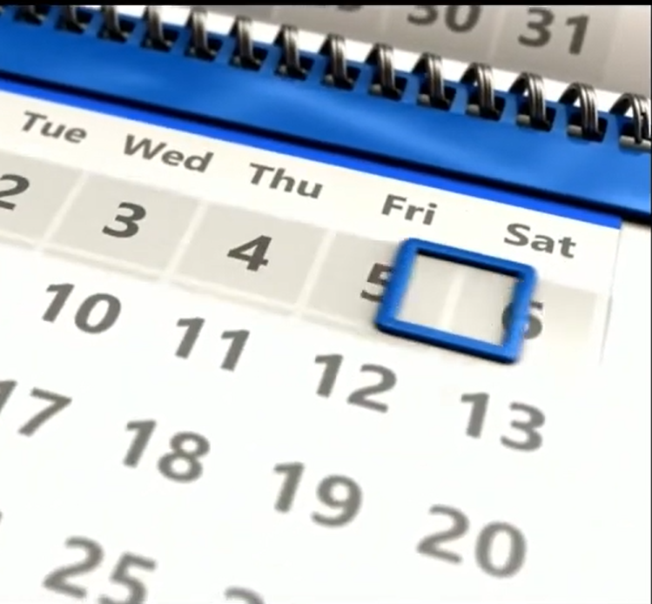
How can time management help you?
Watch: Time Management Hacks for Teens
https://www.youtube.com/watch?v=js8AE4VXJow
(2 min 28 sec)
Notes:
Slide 13: Let’s watch this short clip about managing your time:
Watch: Time Management Hacks for Teens (2 min 28 sec) https://www.youtube.com/watch?v=js8AE4VXJow
How can time management help you?

Slide 14

PAIR ACTIVITY
Notes:
Conclusion (10 min) (Slide 14)
Slide 14: Now you have time to complete Activity 2 (Lesson 1 – Worksheet) with a partner.
Possible answers are available on Lesson 1 – Worksheet MEMO.
Teacher Note: The three questions in Activity 2 resemble a Section C exam question.
The first question asks where the individual is going wrong (time management) and its impact. This involves lower-order thinking as it focuses on identifying issues.
The second question addresses how to fix the issue (the area of struggle), requiring middle-order thinking where learners must apply their understanding.
The final question asks how to prevent the problem from happening again, encouraging learners to propose higher-order solutions by applying good habits and strategies.

