Slide 1
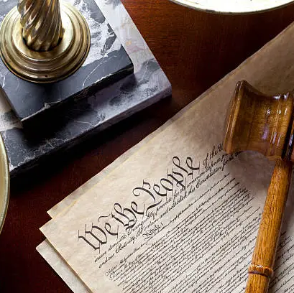

Constitutional Values
Constitutional Rights and Responsibilities
Grade 9
Week 4: Lesson 1 - PowerPoint 1
Notes:
Good morning Grade 9s, welcome back.
Our next two lessons are a follow on from where we started this term. Recall we spoke about disabilities, rights and celebrating national days.
Complete Activity 1 on the Lesson 1 – Worksheet as we move through this first part of the lesson.
Today, we will be talking about the Constitution but also constitutional values.

Slide 2
Recap: What is the Constitution?
After apartheid, South Africa needed a democratic government to protect human rights, dignity, freedom, and equality.
A Constitution is a set of rules and values that guide both government and citizens.
It applies to everyone: government, businesses, and individuals.
The 1996 Constitution is South Africa’s highest law.
• Protects the rights of all citizens
• Holds leaders accountable
• Promotes democracy and justice
Notes:
In our previous lesson – we touched on what the CONSTITUTION is and what it is about.
Think back – what do you remember??
In South Africa’s history - there was the need to set up a democratic government to uphold human rights, dignity, freedom, and equality of all people. Democracy is best implemented and guaranteed by a Constitution. South Africa is what we call a constitutional democracy.
The Constitution of a country is a set of rules and values for those who govern and those who are governed.
Simply put, the Constitution applies to everyone, all the laws, everything anyone ever does in South Africa. This includes the government, businesses, and all of us as individuals must be in line with the Constitution.
The South African Constitution of 1996 is the supreme legal document of the Republic of South Africa. It protects the rights of citizens and holds political leaders accountable, in line with democratic values and principles.

Slide 3
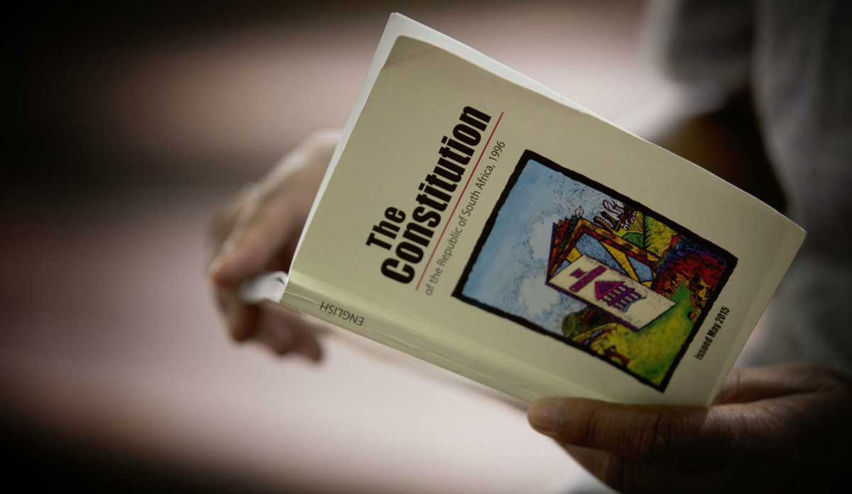
South Africa’s Constitution
Watch: Is South Africa's Constitution the best in the world?
https://www.youtube.com/watch?v=xBQbO5fFBMc (1 min 46 sec)
Notes:
South Africa’s Constitution is said to be one of the most progressive in the world as human rights are given clear importance in the Constitution.
The Constitution was formally approved by the Constitutional Court on 4 December 1996 and took effect on 4 February 1997.
The Constitution is the supreme law of the land. No other law or government action can take the place of the provisions within the Constitution.
Watch: Is South Africa's Constitution the best in the world?
https://www.youtube.com/watch?v=xBQbO5fFBMc (1 min 46 sec)

Slide 4
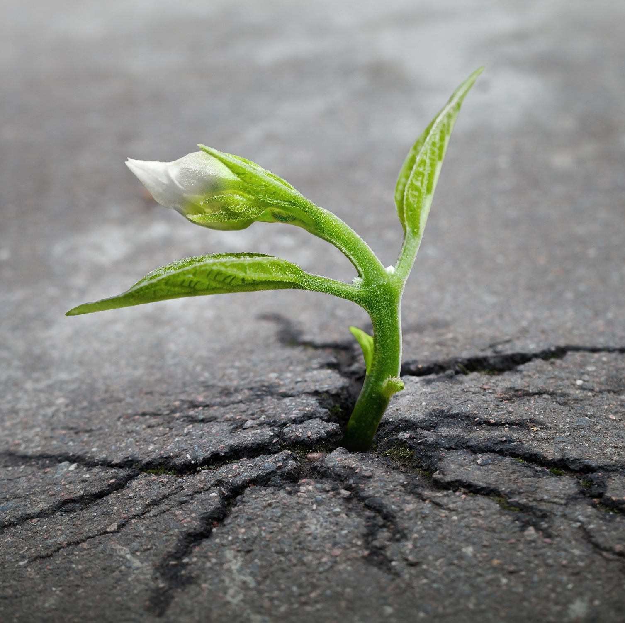
The Constitution aims to:
Heal the divisions
Improve the quality of life
Lay foundations for a democratic and open society
Build a united and democratic South Africa.
The rights contained in Chapter 2 of the Constitution protect the rights and freedoms of individuals.
Notes:
The Constitution aims to:
heal the divisions of the past and establish a society based on democratic values, social justice and fundamental human rights.
improve the quality of life of all citizens and free the potential of each person.
lay the foundations for a democratic and open society in which government is based on the will of the people, and in which every citizen is equally protected by the law.
build a united and democratic South Africa that can take its rightful place as a sovereign state in the family of nations.
Fundamental rights
The rights contained in Chapter 2 of the Constitution protects the rights and freedom of individuals. The Constitutional Court safeguards these rights and determines whether actions by the state are in agreement with what the Constitution states.

Slide 5

What are values?
Values are beliefs that guide how we act.
They help us decide what is right or wrong.
Most people learn values from their families and cultures.
Values are also shared by society - shaping ideas of what is good or bad, and how people should behave.
Notes:
Let’s unpack the term VALUES and what they mean before we move on.
Can anyone tell the class what the term VALUES means?
How can we define values?
Values are individual beliefs that motivate people to act one way or another.
They serve as a guide for human behaviour.
Generally, people are predisposed to adopt the values that they are raised with. People also tend to believe that those values are “right” because they are the values of their culture.
Values are society’s shared beliefs about what is good or bad and how people should act.

Slide 6
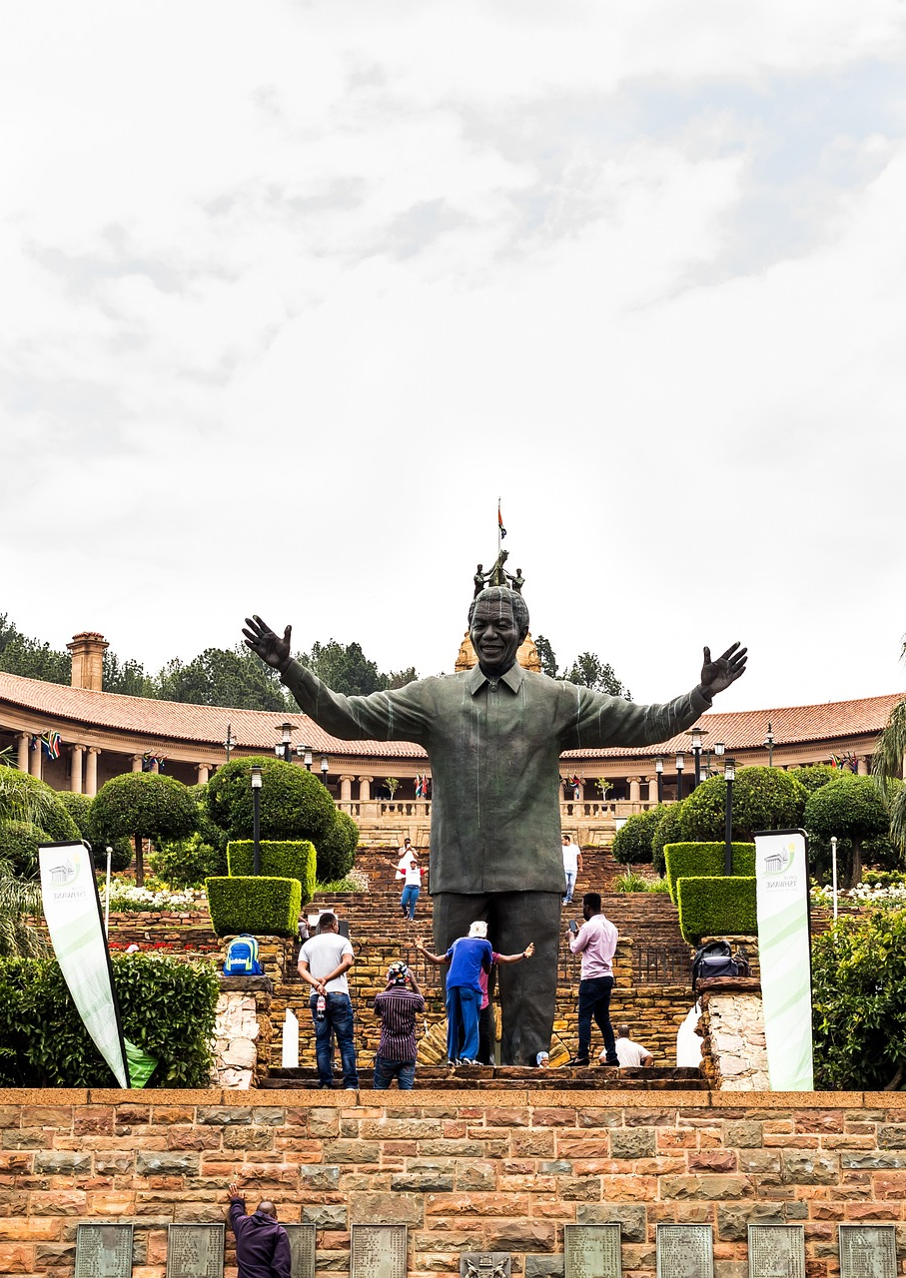
Constitutional values
  Human dignity, equality, freedom.
  Non-racialism, non-sexism.
  Supremacy of the Constitution.
  Universal adult suffrage, a national common voters’ roll, regular elections, and a multiparty system of democratic government to ensure accountability, responsiveness and openness.
Watch: South African Constitutional Values
https://www.youtube.com/watch?v=HpGodwo0gAU (1 min 59 sec)
Notes:
Constitutional Values:
Constitutional values enabled South Africa to overcome its history and create a new national identity based on equality, freedom and dignity.
Constitutional values that come from the Constitution include:
human dignity, the achievement of equality and the advancement of human rights and freedom.
non-racialism and non-sexism.
supremacy of the Constitution.
universal adult suffrage, a national common voters’ roll, regular elections, and a multiparty system of democratic government to ensure accountability, responsiveness and openness.
Watch: South African Constitutional Values
https://www.youtube.com/watch?v=HpGodwo0gAU (1 min 59 sec)

Slide 7
Three main constitutional values we uphold:
Human dignity
Treat other people with respect
Language should be appropriate
Bullying should be stopped
Be kind and compassionate
Equality
Do not discriminate against anyone who is different
Know your rights
Help your community with community and upskilling
Freedom
Take charge of your own destiny
Take part in democratic processes
Stand up for the freedom of others, respect others’ opinions, religion, cultures and beliefs
Notes:
Three main Constitutional values we uphold:
Human dignity
Treat other people with respect.
Language should be appropriate.
Bullying should be stopped.
Be kind and compassionate.
Equality
Do not discriminate against anyone who is different.
Know your rights.
Help your community with community and upskilling.
Freedom
Take charge of your own destiny.
Take part in democratic processes.
Stand up for the freedom of others, respect others’ opinions, religion, cultures and beliefs.
Constitutional values:
Dignity means that we all have the right to be valued and respected, and to be treated ethically. Everyone has the right to be treated with dignity – but remember for you to be treated that way, you need to treat others that way as well. Every person has value as an individual and is important, and no one deserves to be degraded. The Constitution states that human dignity is something that we all have the right to, and that means that we must treat others with dignity.
Equality is about ensuring that every individual has an equal opportunity to make the most of their lives and talents. It is also the belief that no one should have less chances because of circumstances. Such as where they were born, where they come from, what they believe, or whether they have a disability.
Human rights & freedom: Human rights are rights inherent to ALL human beings, regardless of race, gender, nationality, ethnicity, language, religion, or any other status. Human rights include the right to life and liberty, freedom from slavery and torture, freedom of opinion and expression, the right to work and education, and many more.
Non-racialism and non-sexism:
Our Constitution lays the groundwork for a society that does not discriminate against anyone – meaning that gender and race should not have any bearing on anyone’s rights. Equality for all, regardless of who they are or their origins.
Supremacy of the Constitution:
The Constitution essentially represents the highest authority when it comes to laws. This means that no one can ignore what is stated in the Constitution. This also means that no one is above the law in any way.
Universal adult suffrage means that all citizens (18 years and older) can vote regardless of race, gender, or any restriction. This means the right of all people to vote in elections, without any discrimination, is one of the most fundamental of all human rights and civil liberties. The national common voters roll is a centralised register of all citizens that are registered to vote – in order to be on the roll, you have to be registered and this is linked to your ID number.
South Africa’s national and provincial elections take place every five years. Voters vote for a political party or for an independent candidate. This has been the case since the 2024 National and Provincial Elections. A political party then gets a share of the seats in Parliament in proportion to the number of votes it got in the election.

Slide 8
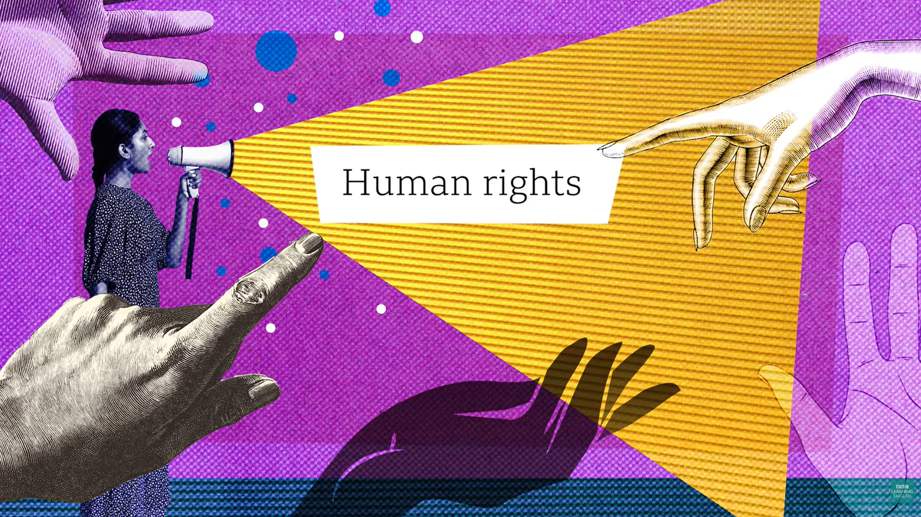
Watch: What are human rights and why do they matter? https://www.youtube.com/watch?v=4PZmVCabmsc (1 min 35 sec)
Notes:
Let’s go back to the very first bullet:
Human dignity, the achievement of equality and the advancement of HUMAN RIGHTS and freedom
What are human rights and why do they matter?
https://www.youtube.com/watch?v=4PZmVCabmsc (1 min 35 sec)
Every single person has the right to have their dignity respected and protected. They also have the right to believe or think what they want, even if their beliefs are different to others. Everyone has the right to practice the religion of their choice and any way they choose provided that their actions do not go against the Constitution. For example, schools, can follow religious practices (like having prayers in the morning) learners cannot be forced to attend or take part.

Slide 9
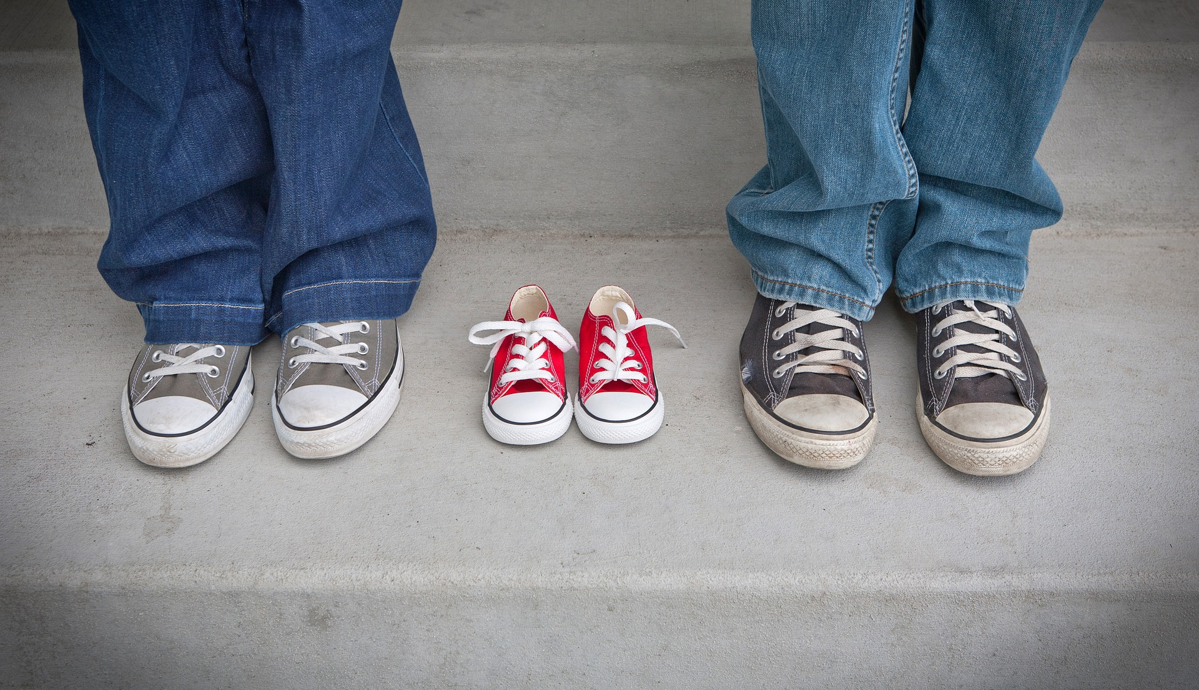
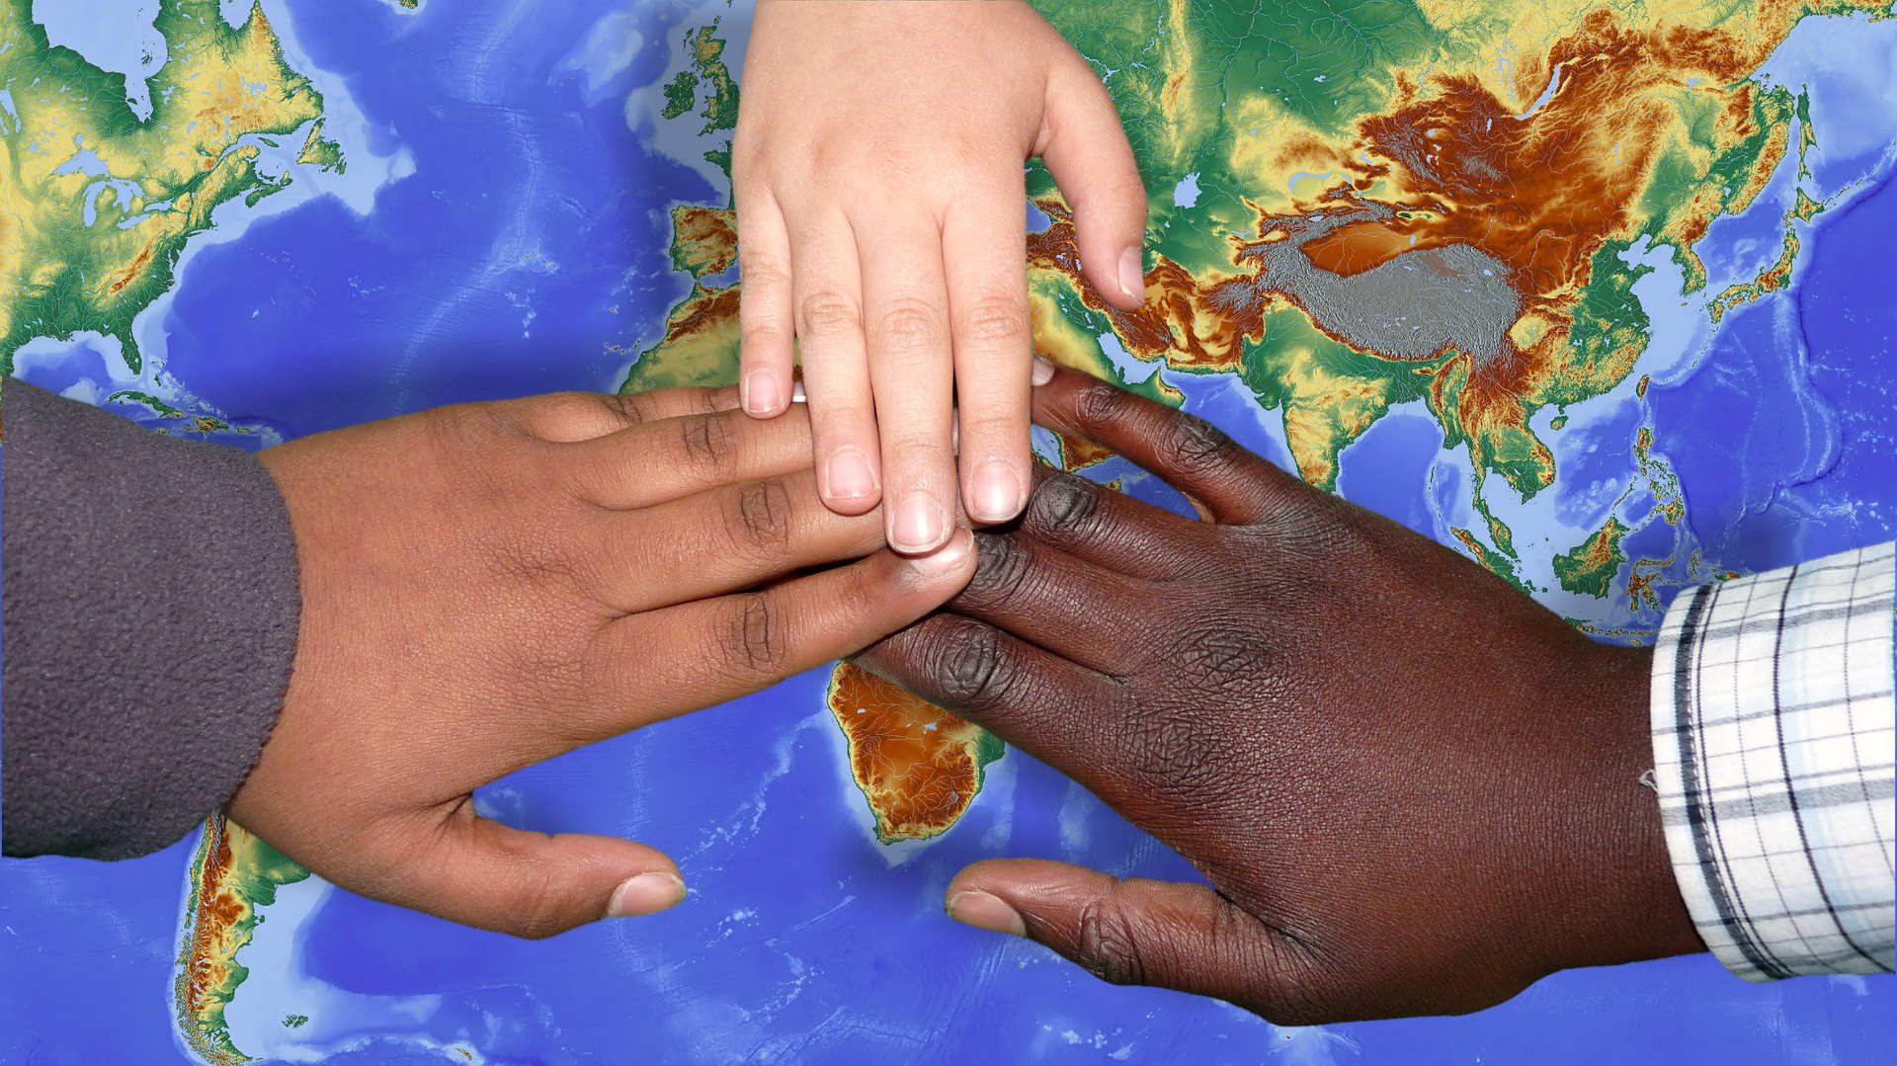
Other values we uphold:
Right to family or parental care: respect, help, and be loyal to your family.
Right to a safe environment: protect nature, prevent pollution, save water and electricity.
Right to citizenship:
• Obey the laws
• Help build a better South Africa
In a democracy:
• Citizens elect leaders to represent them in parliament
• The majority party governs, but everyone has a say in how the country is run.
Notes:
Other values we uphold:
Right to family or parental care means to honour, respect and help your parents, be kind and loyal to your family.
Right to live in a safe environment includes promoting sustainable development, protecting animal and plant life, preventing pollution and not wasting scarce resources like water and electricity.
Right to citizenship includes to:
Obey the laws of our country, ensure that others do so as well.
Contribute to making South Africa a great country.
What this all comes down to is that everyone has a say about how the country is run. In a democracy, the government is put into power by its citizens.
The adult citizens of a democracy elect their government. One way they do this is by choosing people to stand for them in a parliament. In a multi-party system, the party that gets the majority votes governs the country.

Slide 10
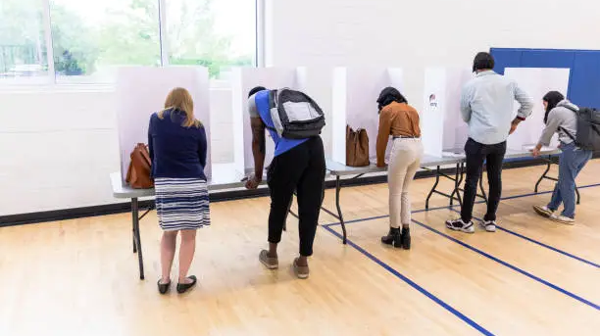
Why should you vote?
Notes:
This is why when it is your turn to vote – you should! It’s your right as a citizen and an important part of our democracy.

Slide 11

Do you have any questions?
Notes:
Thinking back on what we have covered, do you have any questions before we move on?
Whilst you prepare for Lesson 1 – PowerPoint 2, give the class a few minutes to finish off Activity 1 (Lesson 1 – Worksheet)

