Slide 1

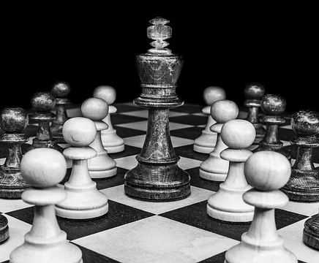
Grade 12
Development of the self in society
Term 1
Lesson 3: Conflict resolution skills
Notes:
Slide 1
(Note to teacher: In order to give learners the opportunity to get the most out of this lesson, they will need to have access to the online link for the quiz and then watch the video on their conflict style. Please note the site is from a family centred online Christian network. The material is very helpful and will give learners an opportunity to reflect on the positives and negatives of their own style.
Note: Only question 11 of the 13 makes any reference to Christianity. Maybe tell learners to all choose option 1 for that question.)
Should you not wish for them to watch the videos, you would need to go into the positives and negatives of each style during the lesson. Maybe watch the videos yourself – to obtain the information that you would then share with the learners for this component of the lesson – if you decide not to watch the videos.
Note: This lesson will delve into coping mechanisms around conflict. Some learners might feel triggered. Keep an eye out for learners feeling uncomfortable.)
Good day Grade 12s. In the last two lessons we looked at the different kinds of stress and different coping mechanisms or techniques that people use to cope with stress.
Many people struggle with any form of conflict situation and find that it leads to stress or anxiety. The reality is that there will always be conflict in life, and we have to learn how to manage and resolve conflict. Conflict can happen in two ways - intrapersonal or interpersonal.

Slide 2

Types of Conflict
Intrapersonal conflict
Happens inside you when you struggle with an inner decision or choice.
Interpersonal conflict
Happens between people when their needs, wants, or opinions clash.
Notes:
Slide 2
Intrapersonal conflict happens inside of you where you struggle with an inner conflict to process or wrestle with a decision. Interpersonal conflict is between different people. e.g., your boyfriend wants you to hang out with him, but your mom wants you to spend the day with them as it's your 18th birthday. Your boyfriend wants you for himself. What will you do?

Slide 3

Understanding Conflict
Sometimes people try to manage stress by lashing out or blaming others, but this is not effective.
Conflict happens when people disagree or have different points of view.
The image is an example of interpersonal conflict: it happens between people.
Conflict Resolution
Conflict resolution = finding a solution or agreement to end the conflict.
The key question is: How do we get there?
Notes:
Slide 3
Have you ever tried to manage your stress like this? Taking out the person causing the stress or screaming at someone? Was it effective?
When disagreements happen between individuals, we have conflict. Conflict is often the result of different points of view. What do you think was the cause of conflict in this image? This image would be an example of interpersonal conflict as it occurs between different people.
In both these situations we need a conflict resolution - this means a solution or agreement that will resolve the conflict. But how do you get there?

Slide 4
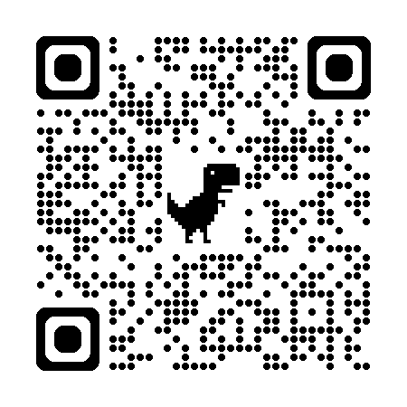
Discover your conflict style
Scan the QR to take the quiz
Avoider – avoids conflict completely
Accommodator – puts others’ needs first
Competitor – wants to win the conflict
Collaborator – works with others to find the best solution
Compromiser – looks for a middle ground
Notes:
Slide 4
Firstly, you need to be aware of how YOU handle conflict. Some of us when encountering a conflict situation would rather hide behind a rock than address the situation, others might run head first, fighting like a rhinoceros. Both these techniques have positive and negative aspects to it.
Are you a/an:
Avoider
Accommodator
Competitor
Collaborator
Compromiser
You will now have an opportunity to complete the online quiz: https://quiz.tryinteract.com/#/61f8b5f77cf1e800184b9298
Your results will tell you which of these conflict styles you are prone to.
Follow the questions in Activity 1 (Lesson 3 – Worksheet). Once you complete the quiz, answer the other questions in the activity.
(Teacher Note: The Lesson 3 – Worksheet MEMO provides examples of answers for each conflict style. Furthermore, additional detailed information on each Different Conflict Style. This should be shared with learners)

Slide 5

Conflict Resolution
Reach out
Engage in conversation
Seek to solve the problem
Open up
Listen intently
Voice solutions
End on a good note
Resolving conflict means focusing on the issue, not the person. The goal is to work together to solve the problem. Your attitude plays a big role in finding a solution.
Notes:
Slide 5
Resolving conflict requires an attitude of accepting that the issue that needs to be addressed is not between you and the person, but actually that the two people work together to resolve the issue. This means that attitude is vital when it comes to resolving conflict. An easy way of remembering is to RESOLVE.
RESOLVE Conflict by:
Reaching out
Engaging in conversation
Seek to solve the problem
Open up
Listen intently
Voice solutions
End on a good note

Slide 6

Communication during conflict
Be assertive
Speak clearly, confidently, firmly, and respectfully without shouting or insulting.
Listen
Hear the other person’s point of view and try to understand their feelings.
Use “I” statements
Focus on your feelings instead of blaming.
Correct: “I felt embarrassed when you arrived late.”
Wrong: “You’re never on time and always embarrass me!”
Practice self-control
Stay calm and manage your emotions.
Count to 10 and breathe before responding.
Notes:
Slide 6
When we open our mouths within a conflict situation we should remember the different ways that we could communicate:
Be assertive - This means that you communicate clearly, confidently, firmly and respectfully. There is no shouting or belittling of the other person.
Listening - While the other person is sharing their reason for the conflict, listen to what they are saying and try to understand why they are offended or hurt.
Use “I” sentences - It’s important to focus on your own emotions and opinions and not accuse the other person. Example:
Correct way: I felt embarrassed when you did not show up to our engagement party on time.
Wrong way: You’re never on time and you always make me feel embarrassed!
Self-control - Manage your reaction in a situation by controlling your emotions. E.g. If you are angry, count to 10 and breathe between each number before responding to the person.

Slide 7

Game: Conflict Charades
Notes:
Slide 7
(Note to teacher: This activity might get a bit loud, however, experiential learning is often one of the most effective ways for learners to learn. It’s important that you as the teacher manage the time overall so each group operates off one big timer / stopwatch. Consider a timer on the board.
The cards (Lesson 3 - Conflict Charades Cards) will need to be printed out and cut BEFORE the lesson.
Each group should receive ONE pack of cards that consists of FIVE cards)
On your Lesson 3 – Worksheet, first complete Activity 2 with a peer. You will have 5 min to come up with FIVE examples of different conflict situations. Then think of which of the following conflict resolution techniques you would like to illustrate for each scenario. You and your friend will need to act out ONE of these situations and illustrate the solution in a game of “conflict charades''. So make sure you know all five scenarios and solutions.
The words on the cards will be the following:
Resolve
Assertive
Listening
Use “I” sentences
Self-control
(Allow learners 5 min to place their scenarios on the cards. Then in their groups, hand out FIVE cards. Place the cards face down in the group.)
The rules of the “Conflict Charades” game are as follows:
One pair will go first in the group and pick a card. They will have 1 min to role play the scenario and then 1 min to role-play the conflict resolution technique. The other pair in the group need to try and guess the term they are acting out. Each team will have an opportunity to go TWICE.
Once completed, encourage the group to discuss with one another the following:
Which of these techniques do you find the most difficult to do and why?
Which of these techniques come naturally to you?

Slide 8

Rate your understanding
Notes:
Slide 8
As we finish the third lesson in this series, rate your understanding of the concepts covered this far by completing Activity 3 (Lesson 3 – Worksheet).

