Slide 1
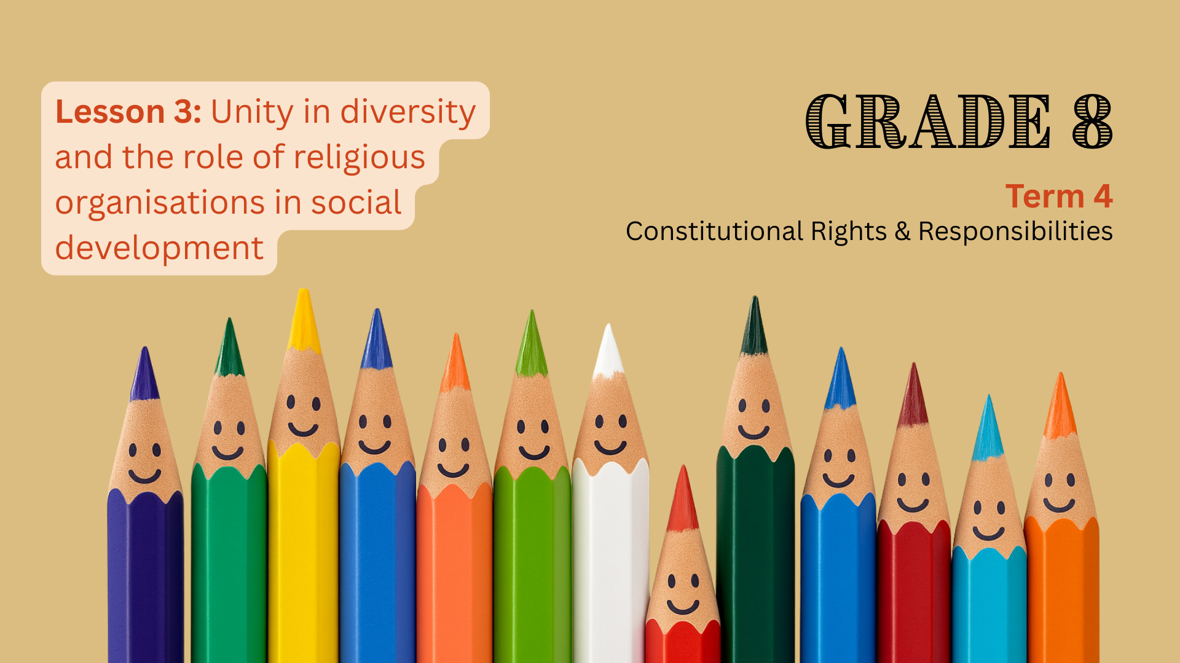

Notes:
1. Introduction (5 min) (Slides 1-2)
Slide 1: Welcome back, Grade 8s. In our last lesson, we explored how cultural norms, values, expectations, practices, and traditions influence how people behave, the attitudes they hold, and the choices they make. We also spoke about how respecting differences in culture, religion, and gender helps build a peaceful and inclusive society. Before we begin today’s lesson, can anyone remind us:
What is a cultural norm or value?
How do cultural norms influence our behaviour or choices?
Why is it important to respect differences in others?
Today, we’ll learn how to celebrate unity in diversity and why it’s important to respect differences and share what we have in common. We’ll also look at how religious organisations help build a better, fairer society.

Slide 2
By the end of this lesson, learners should be able to:
Explain the meaning of unity in diversity and why it is important to celebrate both differences and similarities.
01
Describe ways to celebrate unity in diversity in their schools and communities.
02
Discuss how religious organisations contribute to social development.
03
Reflect on the importance of cultural diversity.
04
Notes:
Slide 2: By the end of this lesson, learners should be able to:
Explain the meaning of unity in diversity and why it is important to celebrate both differences and similarities.
Describe ways to celebrate unity in diversity in their schools and communities.
Discuss how religious organisations contribute to social development.
Reflect on the importance of cultural diversity.

Slide 3


Unity in diversity
Unity in diversity means that, even though we have different cultures, religions, languages, and traditions, we can still stand together as one nation.
Notes:
2. Class discussion (15 min) (Slides 3-5)
Slide 3: Respecting differences is the first step, but to truly strengthen our country, we also need to celebrate both what makes us different and what we share in common.
Ask: Who can tell me what unity in diversity means? (Allow learners to respond.)
(Click in the PowerPoint slide to reveal the definition) Unity in diversity means that, even though we have different cultures, religions, languages, and traditions, we can still stand together as one nation.

Slide 4
Why is it important to celebrate both diversity and similarity?
It helps people understand and respect each other.
It brings people together and builds friendships.
It encourages fairness because everyone’s culture is valued.
It reminds us that, even though we are different, we share common hopes like wanting safety, respect, and opportunities.
It helps create a more peaceful and united country.
Notes:
Slide 4: Ask learners to turn to a partner and discuss: Why is it important to celebrate both diversity and similarity? Give them about 2 minutes to talk, then ask a few pairs to share their ideas with the class.
Possible responses: (Click in the PowerPoint slide to reveal the answers)
It helps people understand and respect each other.
It brings people together and builds friendships.
It encourages fairness because everyone’s culture is valued.
It reminds us that, even though we are different, we share common hopes like wanting safety, respect, and opportunities.
It helps create a more peaceful and united country.

Slide 5
How can we celebrate unity in diversity?
Take part
Take part in cultural days, national holidays (like Heritage Day), and community festivals that showcase different traditions.
Share
Share stories, music, food, and art from different cultures at school or in the community.
Focus on
Focus on similarities, like how most cultures value respect, kindness, and helping others.
Work together
Work together on community projects that include people from different backgrounds.
Invite
Invite guest speakers or organise activities that teach about different cultures.
Notes:
Slide 5: Ask learners to turn to a partner and discuss: How can we celebrate unity in diversity? Give them about 2 minutes to talk, then ask a few pairs to share their ideas with the class.
Possible responses: (Click in the PowerPoint slide to reveal the answers)
Take part in cultural days, national holidays (like Heritage Day), and community festivals that showcase different traditions.
Share stories, music, food, and art from different cultures at school or in the community.
Focus on similarities, like how most cultures value respect, kindness, and helping others.
Work together on community projects that include people from different backgrounds.
Invite guest speakers or organise activities that teach about different cultures.

Slide 6
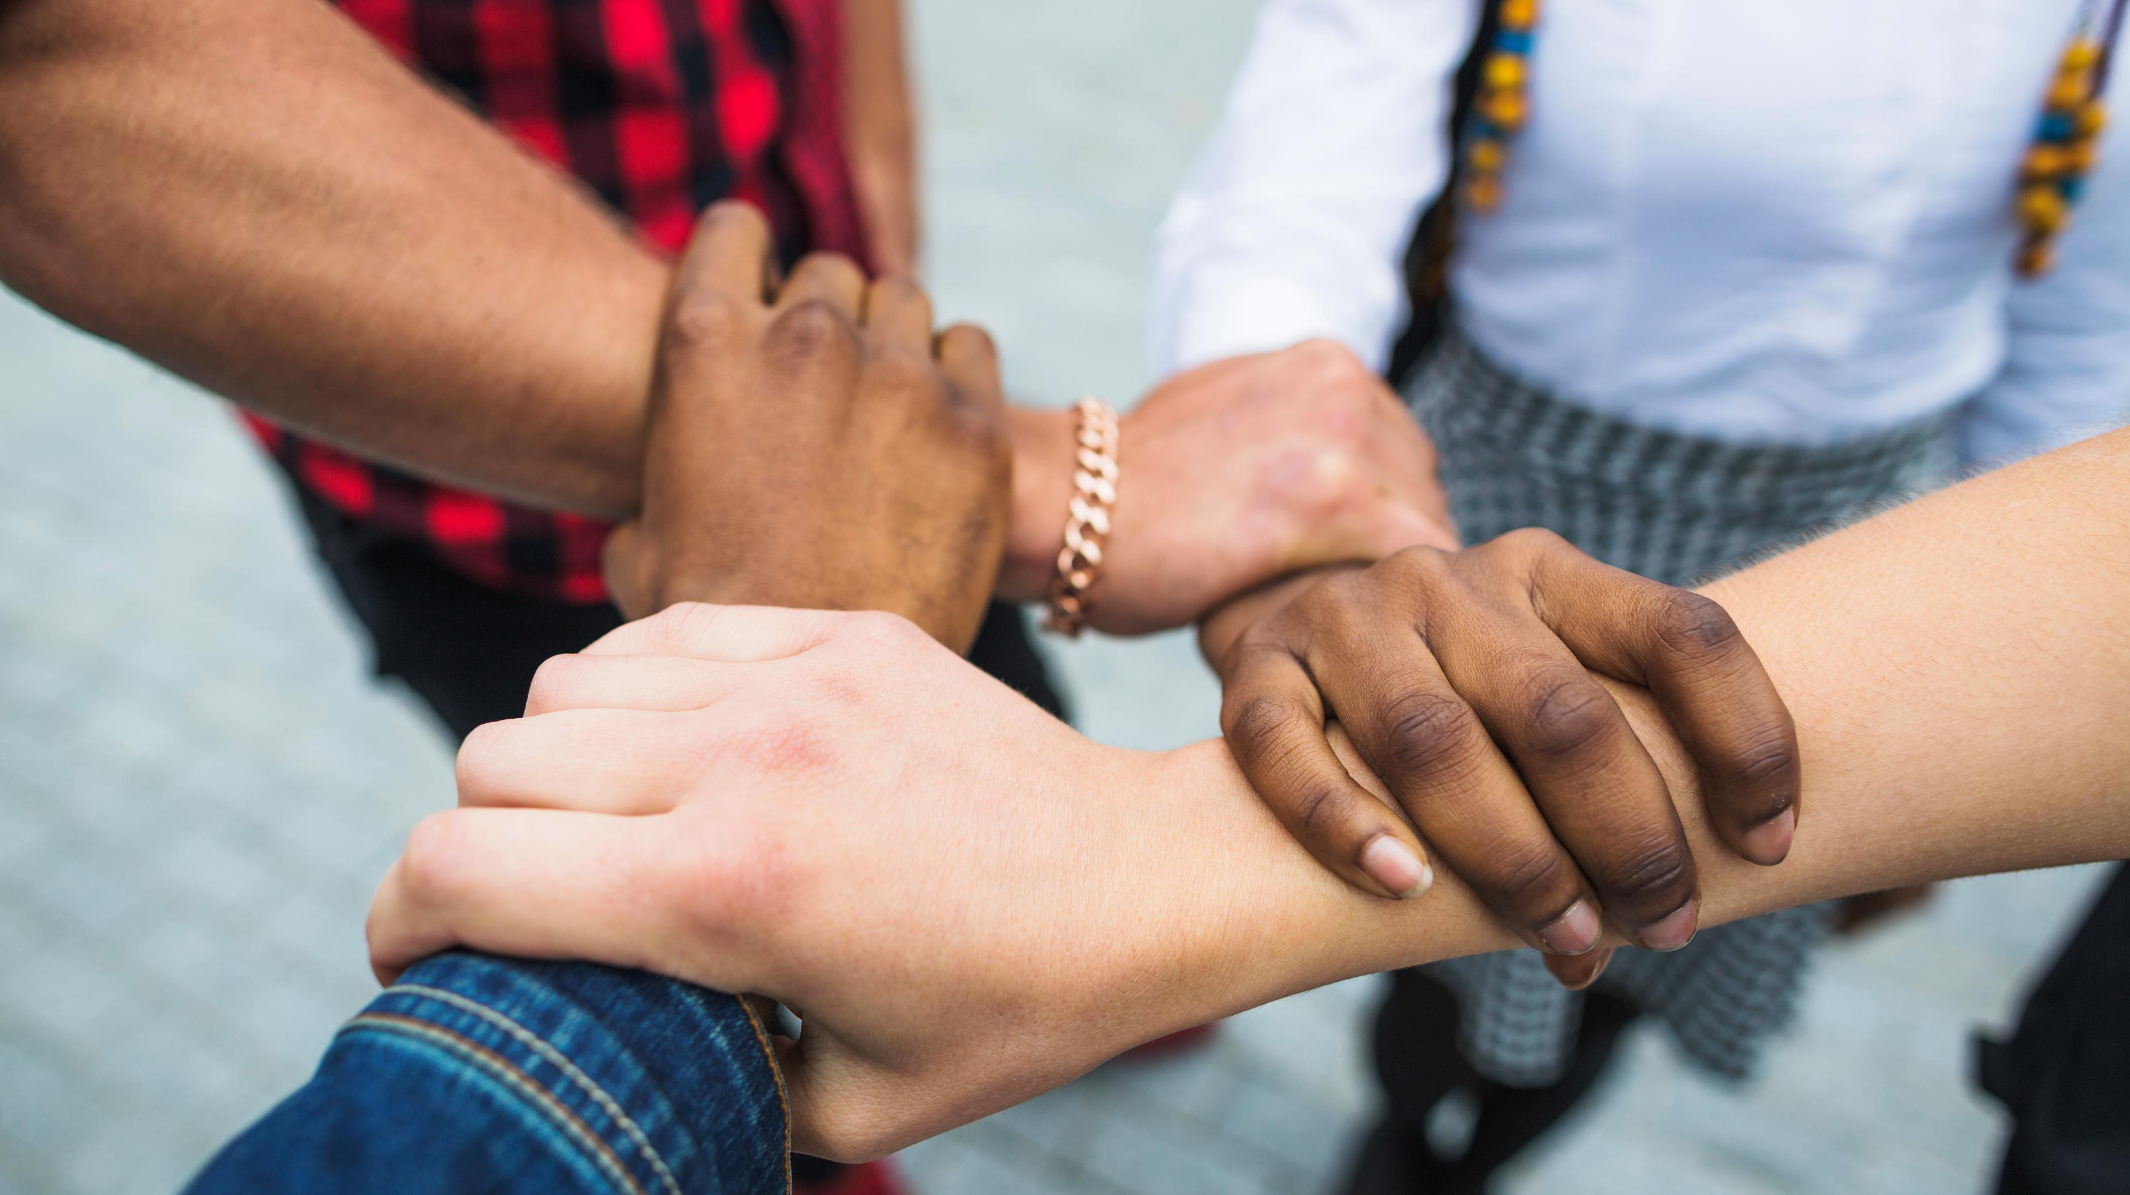
Social development
Source: freepik.com
Notes:
3. Teaching (10 min) (Slides 6-8)
Slide 6: Let’s move on to how religious organisations can contribute to social development. First, who can tell me what social development means? (Allow learners to respond.)
Social development is about improving the well-being of all people in a community or society. It means helping people meet their basic needs and giving everyone a chance to grow, learn, and live with dignity so they can reach their full potential.

Slide 7
The role of religious organisations in social development
Health care
Education
Care for vulnerable groups
Disaster relief
Notes:
Slide 7: In South Africa, many religious organisations play an important role in social development. They often work together with the government and other groups to help communities. One example is the National Religious Association for Social Development (NRASD), which was started in 1997. The NRASD brings together faith-based groups, including Baha’i, Buddhist, Christian, Hindu, Islamic, and Jewish communities, to work for the good of society.
Organisations such as the NRASD contribute to social development in the following sectors:
Health care: Providing support in the fight against HIV and AIDS, malaria, and tuberculosis.
Education: Supporting early childhood education and offering training in life skills, business, and technical skills.
Care for vulnerable groups: Helping families, orphans, the elderly, and people with disabilities through home and community-based care.
Disaster relief: Providing food, shelter, and other emergency support during disasters.

Slide 8




Gift of the Givers – provides disaster relief, food programmes, and education support.
YMCA/YWCA – offers leadership and life skills programmes for young people, addressing issues like gender violence.
Divine Life Society – builds schools and houses and provides meals for disadvantaged communities in KwaZulu-Natal.
The Salvation Army – helps the homeless, abused, and elderly.
Notes:
Slide 8: Let’s look at a few examples of organisations and the type of work that they do. All of these organisations have a religious or faith-based origin or connotation, but serve people from all backgrounds, not just those who share their faith.
Go through the organisations on Slide 8.

Slide 9

Group Activity
Source: freepik.com
Notes:
4. Group Activity (10 min) (Slide 9)
Slide 9: Today, we learned that to build a stronger, more united South Africa, it’s not enough to respect our differences; we should also celebrate what makes us unique and what we have in common. We also saw how religious organisations help improve lives through health care, education, care for vulnerable people, and disaster relief. By working together, we can all help create a fairer, kinder society.
For the final activity in this lesson series, learners will reflect on the importance of diversity by engaging with a poem. Working in their assigned groups of THREE to FOUR, they will discuss and answer questions that explore the benefits of having friends from different cultures, the life skills gained from diversity, and the positive impact of our differences.
Learners to complete Activity 1 (Lesson 3 – Worksheet).
Go through the answers provided in Lesson 3 – Worksheet MEMO.
Hand out the Content Summary before learners leave the classroom.

