Slide 1
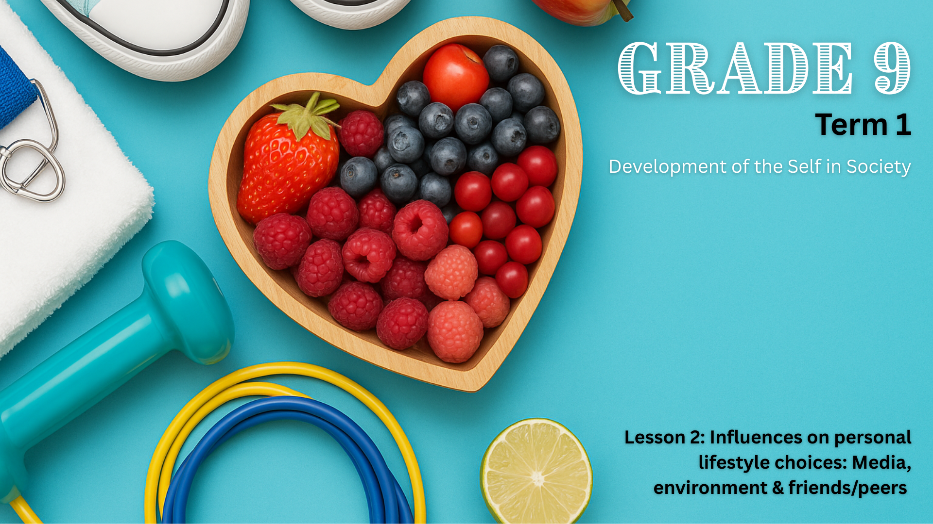

Notes:
Introduction & Watch Video (5 min) (Slides 1-3)
Slide 1: Welcome back, Grade 9s!
Start with a quick recap: "Who can remember what we said lifestyle choices are?" or invite learners to define the term in their own words.
That’s right, lifestyle choices are the choices you make every day that shape the way you live – from what you eat and how active you are, to how you spend your time and who you surround yourself with. But have you ever stopped to think about why you make certain choices?
You don’t make decisions in isolation. Many things around you influence how you live, including your family, friends, culture, religion, the media, your environment, and the community you live in. These influences can have a positive or negative effect on your health, your goals, and your future.

Slide 2
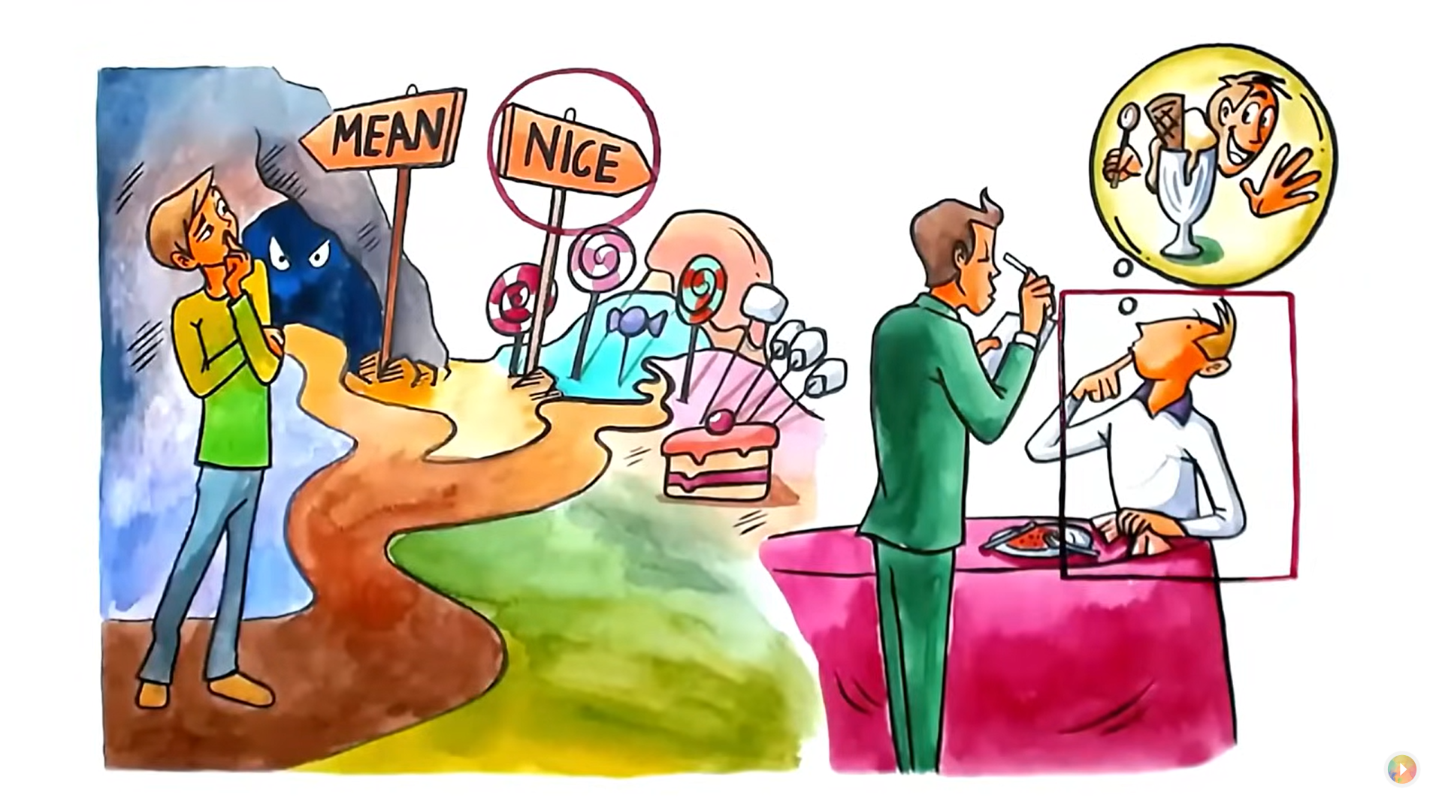
Watch: INVISIBLE INFLUENCE: The Hidden Forces that Shape Behavior by Jonah Berger https://ytubl.ink/3FtU (3 min 20 sec)
Notes:
Slide 2: Let’s watch a video that explains the concept in a bit more detail.
Note to teacher: You can stop the video at 2 min 50 sec.
Watch: INVISIBLE INFLUENCE: The Hidden Forces that Shape Behavior by Jonah Berger
https://ytubl.ink/3FtU (3 min 20 sec)
Today, we will look at three of the “invisible” influences as described in the video: the media, your environment/community, as well as friends and peers.

Slide 3
By the end of this lesson, you should be able to:
Identify external influences on personal lifestyle choices.
Understand the impact of different kinds of media, environment/community, and peers
Recognise the positive and negative effects of these influences.
Reflect on how to manage these influences in healthy ways.
Notes:
Slide 3: By the end of this lesson, you should be able to:
Identify external influences on personal lifestyle choices.
Understand the impact of different kinds of media, environment/community, and peers
Recognise the positive and negative effects of these influences.
Reflect on how to manage these influences in healthy ways.

Slide 4

The media
  Show you what is seen as “normal” or “trendy”
  Create pressure to look or behave a certain way
  Spread unrealistic ideas about beauty, success, and lifestyle
  Expose you to helpful information and inspiring role models
Notes:
Slide 4: Ask learners: What do we mean by “media”? Where do you encounter it every day? (Allow learners to respond.)
Explain: The media includes both print media (such as newspapers and magazines) and electronic media (such as television, radio, music, movies, and digital platforms). This also includes social media platforms like TikTok, Instagram, and YouTube.
Media can:
Show you what is seen as “normal” or “trendy”
Create pressure to look or behave a certain way
Spread unrealistic ideas about beauty, success, and lifestyle
Expose you to helpful information and inspiring role models

Slide 5
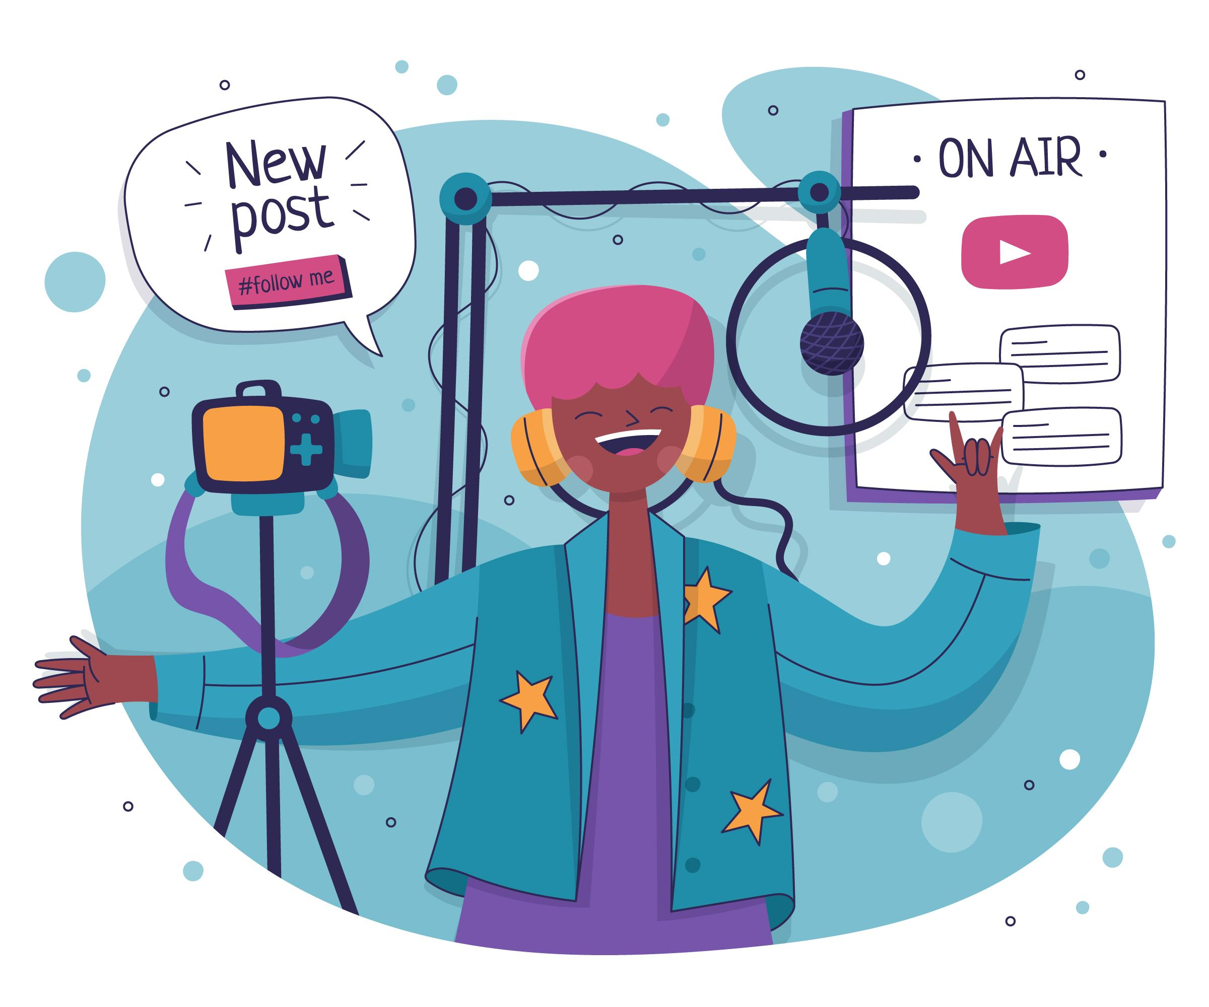
Media influence
Positive influence
A video that encourages body positivity or mental health awareness.
Negative influence
An ad that promotes unhealthy body standards.
Notes:
Slide 5: You might see influencers promoting weight-loss products or expensive fashion. This can affect how you feel about yourself or make you want things that don’t support your goals. On the other hand, media campaigns that promote exercise, healthy eating, or mental health awareness can encourage you to make better lifestyle choices.
Present the information on Slide 5 with positive vs negative media influence and ask learners to suggest another example for each side.

Slide 6
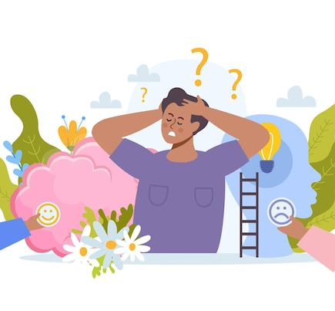
Managing media influence
  Follow pages that share realistic, positive messages.
  Ask yourself: Is this real? Is this helping me or making me feel worse?
  Take breaks from social media when you feel overwhelmed.
Notes:
Slide 6: Discuss how to manage media influence. Ask: Have you ever felt pressured or inspired by something you saw online? What did you do? (Allow learners to respond.)
Media is everywhere, but you don’t have to believe or follow everything you see online or on TV. To manage media influence, you could:
Follow pages that share realistic, positive messages.
Ask yourself: Is this real? Is this helping me or making me feel worse?
Take breaks from social media when you feel overwhelmed.

Slide 7
How can your environment/community make it easier or harder to make good choices?
Notes:
Teaching & Discussion: Environmental/Community influence (8 min) (Slides 7-9)
Slide 7: Explain that your environment includes the physical spaces, people, and conditions where you live, learn, and spend time. This includes not only your home and school, but also the broader community around you. This includes:
Your school
Your home and living conditions
Community resources (e.g. libraries, clinics, parks, sports fields)
Safety, noise levels and cleanliness of your neighbourhood
Access to healthy food, transport, and recreational spaces
The behaviour and attitudes of the people in your area
Ask: How can your environment/community make it easier or harder to make good choices? (Allow learners to respond.)

Slide 8

Environmental/Community influence
Positive influence
A learner who lives in a safe area with access to a library and sports field may be more physically active and perform better in school.
Negative influence
A learner who lives in an area with crime, poor sanitation, or limited resources may struggle to concentrate, stay safe, or make healthy choices.
Notes:
Slide 8: Your environment/community can shape your habits, health, motivation, and overall well-being. A safe, supportive, and clean environment/community can help you focus on your goals, feel more confident, and live a healthy lifestyle. In contrast, a challenging environment/community can create stress, limit your choices, or expose you to harmful behaviour.
Present the positive vs negative examples of environmental/community influence on Slide 8.

Slide 9
Managing environmental and community influence
  Create a small, tidy space to study or relax, even if it’s just a corner of a room.
  Use free or safe resources in your school or neighbourhood, like a library or community centre.
  Join community activities that promote health and learning, like sports or clean-up days.
  Find positive role models who are making good choices in the same environment as you.
  Talk to a trusted adult if your environment feels unsafe or stressful.
Notes:
Slide 9: Introduce tips to manage environmental/community influence: You may not be able to control where you live, but you can take steps to work with what you have and make the best possible choices. To manage environmental and community influences, you could:
Create a small, tidy space to study or relax, even if it’s just a corner of a room.
Use free or safe resources in your school or neighbourhood, like a library or community centre.
Join community activities that promote health and learning, like sports or clean-up days.
Find positive role models who are making good choices in the same environment as you.
Talk to a trusted adult if your environment feels unsafe or stressful.

Slide 10
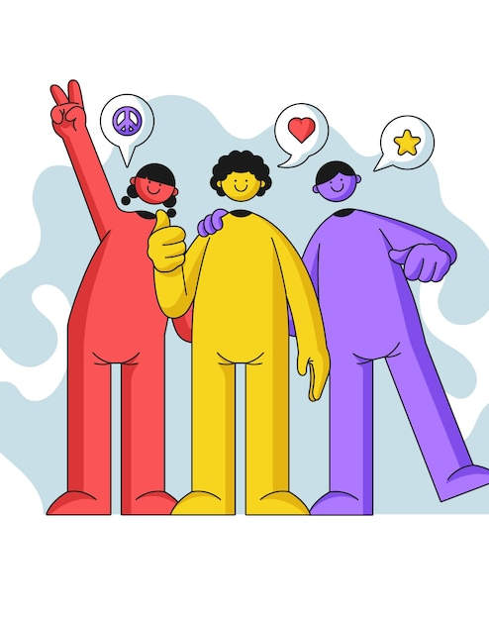
Friends & Peers
  Offer emotional support and make you feel accepted
  Encourage certain behaviours, attitudes, or interests
  Help you try new activities or take healthy risks
  Pressure you into doing things that go against your values or goals
Notes:
Teaching & Discussion: Peer influence (8 min) (Slides 10-12)
Slide 10: Define friends and peers as the people around your age with whom you spend time at school, in your neighbourhood, or online. These relationships are especially important during your teenage years, as you start to form your own identity and make more independent choices.
Friends and peers can:
Offer emotional support and make you feel accepted
Encourage certain behaviours, attitudes, or interests
Help you try new activities or take healthy risks
Pressure you into doing things that go against your values or goals
Ask: What do healthy risks refer to? Can you give examples of healthy risks?
Explain: Healthy risks are positive challenges that help you improve yourself, even if they feel a bit scary at first. For example, trying out for a sports team or making new friends.
Ask: What are values? Can you share some of the values that you have?
Explain: Values are the beliefs that are most important to you and help guide the way you make decisions. They shape what you see as right or wrong, and influence your goals, relationships, and behaviour. Examples include honesty, kindness, respect, responsibility, fairness and goal-setting.

Slide 11
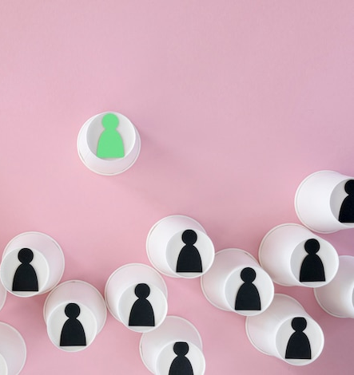
Peer influence
Positive influence
A friend who encourages you to join a school club or exercise regularly.
Negative influence
Friends who pressure you into skipping school or trying harmful substances.
Notes:
Slide 11: Peer influence can be both positive and negative. The key is learning how to choose friends who support your well-being, and how to stay true to your values even when others make different choices. Present the peer influence examples on Slide 11.
Invite learners to add more examples.

Slide 12
Managing peer influence
  Spend more time with people who support your goals and respect your choices.
  If someone pressures you, practise saying “no” or walking away. (More to follow in Lesson 4.)
  Be a role model. Sometimes, you can be a positive influence in your group.
Notes:
Slide 12: Ask learners to mention ways of managing peer influence.
You can’t choose everyone around you, but you can choose your close friends, and how much influence they have on you. To manage peer influence, you could:
Spend more time with people who support your goals and respect your choices.
If someone pressures you, practise saying “no” or walking away. (Inform learners that we will look at this in more detail in Lesson 4.)
Be a role model. Sometimes, you can be a positive influence in your group.

Slide 13
Pair Activity
Notes:
Pair Activity (8 min) (Slide 13)
Slide 13: You can see now that even when we try to make good lifestyle choices that support our goals, there are external factors, like the media, our environment, and our friends, that can influence us. It’s important to be aware of these influences. When we understand them, we’re in a better position to manage them and make decisions that help us live a healthy, positive life and reach our goals.
Let’s apply what we have learnt in this lesson by completing Activity 1 (Lesson 1 – Worksheet) in pairs.
After completion, ask for feedback from learners, and go through the possible answers in Lesson 1 – Worksheet MEMO.

Slide 14
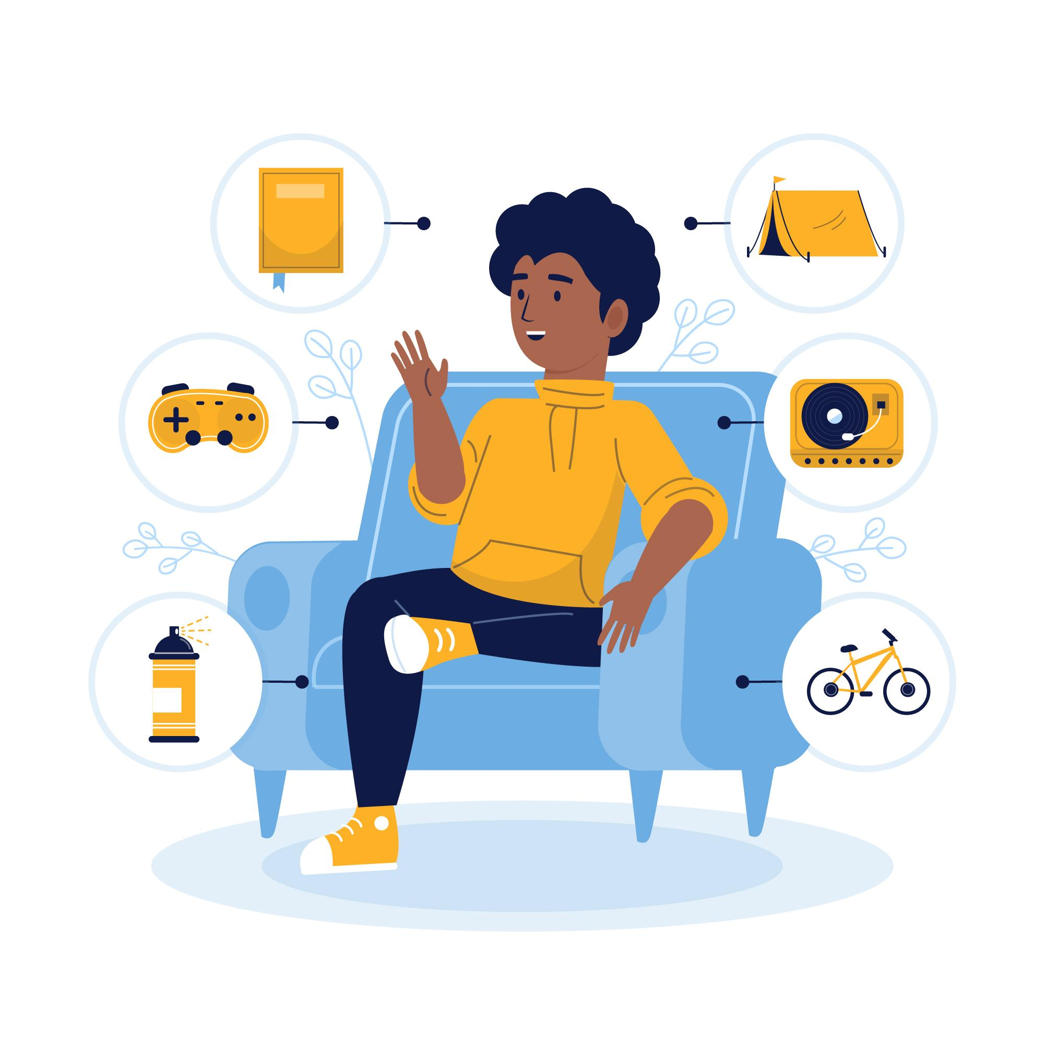
Reflection
"Designed by pikisuperstar / Freepik"
Notes:
Reflection (3 min) (Slide 14)
Slide 14: In the final few minutes of the lesson, ask learners to reflect on the goal they set in Activity 2 (Lesson 1 – Worksheet) and consider how external influences, such as media, environment/community, or peers, might affect their ability to achieve it.
If learners are unable to complete the activity in class, assign it as homework.

