Slide 1
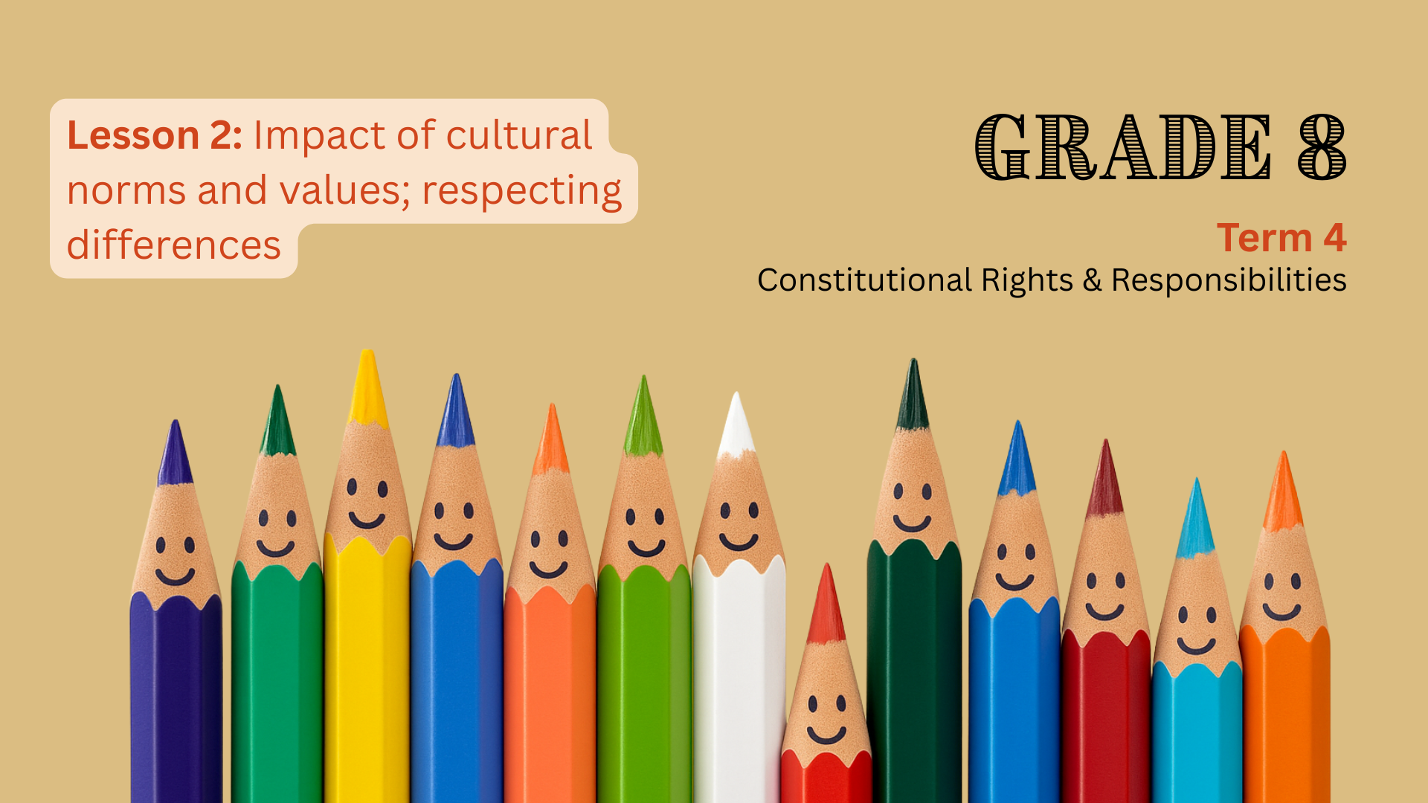

Notes:
1. Introduction (8 min) (Slides 1-3)
Slide 1: Welcome back, Grade 8s. Last week, we learned that South Africa’s cultural diversity is one of our greatest strengths. We saw how cultural norms and values guide our personal choices and help communities work together to solve problems.
Ask learners to give feedback on the reflection activity (Activity 3, Lesson 1 – Worksheet) they completed last week.
Thank learners for sharing and explain that today we’ll further explore the impact of cultural norms and values on individual behaviour, attitude and choice, as well as respecting differences.

Slide 2
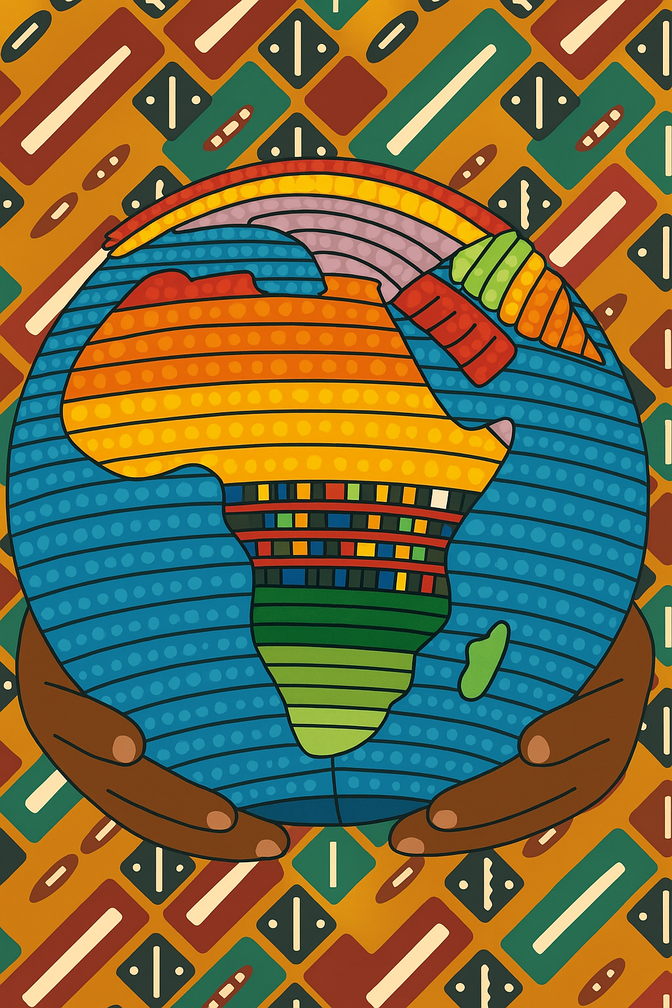
By the end of this lesson, learners should be able to:
Describe how cultural norms, values, expectations, practices, and traditions influence individual behaviour, attitudes, and choices.
Explain the importance of respecting cultural, religious, and gender differences in daily life.
Recognise how cultural diversity enriches South African society and contributes to unity and inclusion.
Link cultural diversity to constitutional rights and the responsibilities that come with these rights.
Identify ways to show respect for different cultures and contribute to a more inclusive school environment.
Notes:
Slide 2: By the end of this lesson, learners should be able to:
Describe how cultural norms, values, expectations, practices, and traditions influence individual behaviour, attitudes, and choices.
Explain the importance of respecting cultural, religious, and gender differences in daily life.
Recognise how cultural diversity enriches South African society and contributes to unity and inclusion.
Link cultural diversity to constitutional rights and the responsibilities that come with these rights.
Identify ways to show respect for different cultures and contribute to a more inclusive school environment.

Slide 3

Individual Activity
Source: freepik.com
Notes:
Slide 3: Let’s start off with a short activity that tests your knowledge on important terminology for this topic. Learners are to complete Activity 1 (Lesson 2 – Worksheet).
Go through the answers provided in Lesson 2 – Worksheet MEMO.

Slide 4
Impact of culture
Expectations
Practices
Traditions
Notes:
2. Teaching & Discussion: Part 1 (8 min) (Slides 4-7)
Slide 4: Cultural norms, values, expectations, practices, and traditions play a big role in shaping how individuals behave, what attitudes they hold, and the choices they make.
Ask learners to explain the terms expectations, practices, and traditions.
Expectations: What a culture or community believes people should do in certain situations
Practices: The usual ways of doing things in a culture, such as daily customs, ceremonies, or habits that people follow.
Traditions: Beliefs, customs, or ways of doing things, often linked to special events or celebrations.
From a young age, people learn what is considered acceptable or respectful in their culture. These lessons guide personal decisions and actions, often without people even realising it.

Slide 5
Impact on individual behaviour
People often behave in ways that show respect for cultural traditions
In some cultures, family or community needs come before personal needs
Notes:
Slide 5: How does this influence individual behaviour?
People often behave in ways that show respect for cultural traditions. For example, showing respect to elders through certain greetings or body language.
In some cultures, individuals are expected to put family or community needs above their own. This shapes how they act in daily life. For example, a young person might choose to help care for younger siblings or elderly relatives before spending time with friends, or they may give part of their earnings to support the family.

Slide 6
Impact on attitudes
Attitudes about gender roles, marriage, education, or success are often based on what their culture teaches as good or right
Cultural values shape how people see the world and what they believe is important
Notes:
Slide 6: How does this influence attitudes?
Cultural values shape how people view the world, what they believe is important, and how they see others.
Attitudes about topics such as gender roles, marriage, education, or success are often influenced by what the culture teaches as good or right.

Slide 7
Impact on choices
Traditions shape participation in activities like sports, ceremonies, or religious practices
Cultural expectations can guide or limit personal choices
Notes:
Slide 7: How does this influence choices?
Cultural expectations can guide or limit personal choices. For example, some cultures may have strong traditions about the type of career or partner that is suitable.
Participation in certain activities, such as sports, ceremonies, or religious practices, is often shaped by cultural traditions.
Explain that sometimes, individuals adjust their behaviour and attitudes when interacting with people from other cultures, to show respect and avoid misunderstanding. For example, a person might learn the correct greeting or form of address when visiting a community with different customs (another word for “practices”).

Slide 8
Understanding diverse cultures and our rights
Learning about different cultures helps us show respect for beliefs, customs, and ways of life.
Diversity strengthens South Africa by encouraging tolerance, respect, and cooperation.
The Constitution protects cultural rights:
Section 15: Freedom of religion, belief, and opinion
Section 16: Hate speech is not allowed
Section 30: Right to use your language and take part in your culture
Section 31: Protection of cultural, religious, and language group rights
Notes:
3. Teaching & Discussion: Part 2 (8 min) (Slides 8-9)
Slide 8: This entire lesson series is about understanding diverse cultures and recognising that they enrich our society. By learning about and recognising different cultures, we can show respect for beliefs, customs, and ways of doing things that may be different from our own
When we understand and accept diverse cultures, we help to build a more peaceful and united society. Diversity enriches South Africa by encouraging tolerance, respect, and cooperation between people from different backgrounds.
REMINDER: We covered the Bill of Rights during the last topic (Grade 8 Term 4 Week 1-4) regarding Human Rights Violations and Gender Equality.
As mentioned at the start of Lesson 1, our Constitution protects the cultural rights of all people in South Africa. For example:
Section 15: Everyone has the right to freedom of religion, belief, and opinion.
Section 16: Hate speech is not allowed.
Section 30: Everyone has the right to use their own language and take part in the cultural life of their choice.
Section 31: The rights of people who belong to cultural, religious, or language groups are protected.

Slide 9
Respecting cultural, religious, and gender differences
We have the freedom to practise our own religion and culture, and the responsibility to respect others.
Respect means treating people fairly, kindly, and accepting different beliefs and customs.
Why does respect matter?
Helps reduce racism, sexism, and discrimination.
Makes it easier for people to live and work together peacefully.
Creates an inclusive, equal society where everyone feels safe and valued.
Notes:
Slide 9: We all must understand and remember that we all have the freedom to practice our own religion and culture. As much as we have that freedom, we must also be respectful of others.
Respecting differences in culture, religion, and gender is about how we act toward others in our daily lives. It means treating people fairly, showing kindness, and accepting that others may have beliefs, customs or ways of doing things that are not the same as ours.
Showing respect can:
help to reduce racism, sexism, and other forms of discrimination.
make it easier for people from different backgrounds to live and work together peacefully.
creates a more inclusive and equal society, where everyone can feel safe and valued.
Ask learners to give examples of how we can show respect for different cultures.
Possible answers:
Listen to and learn from people with different beliefs or ways of life.
Speak and act in ways that show kindness and understanding.
Take part in cultural and community activities with an open mind.
Challenge unfair treatment when we see it, for example, standing up against bullying or discrimination at school.

Slide 10
Pair Activity
Source: freepik.com
Notes:
4. Pair Activity (12 min) (Slide 10)
Slide 10: Learners to complete Activity 2 (Lesson 2 – Worksheet).
Allow learners to provide feedback and discuss the answers provided in Lesson 2 – Worksheet MEMO.
Note to teacher: If time permits, you may wish to incorporate the following optional activity: As a class, draw up a set of diversity guidelines on how to treat one another moving forward.

Slide 11
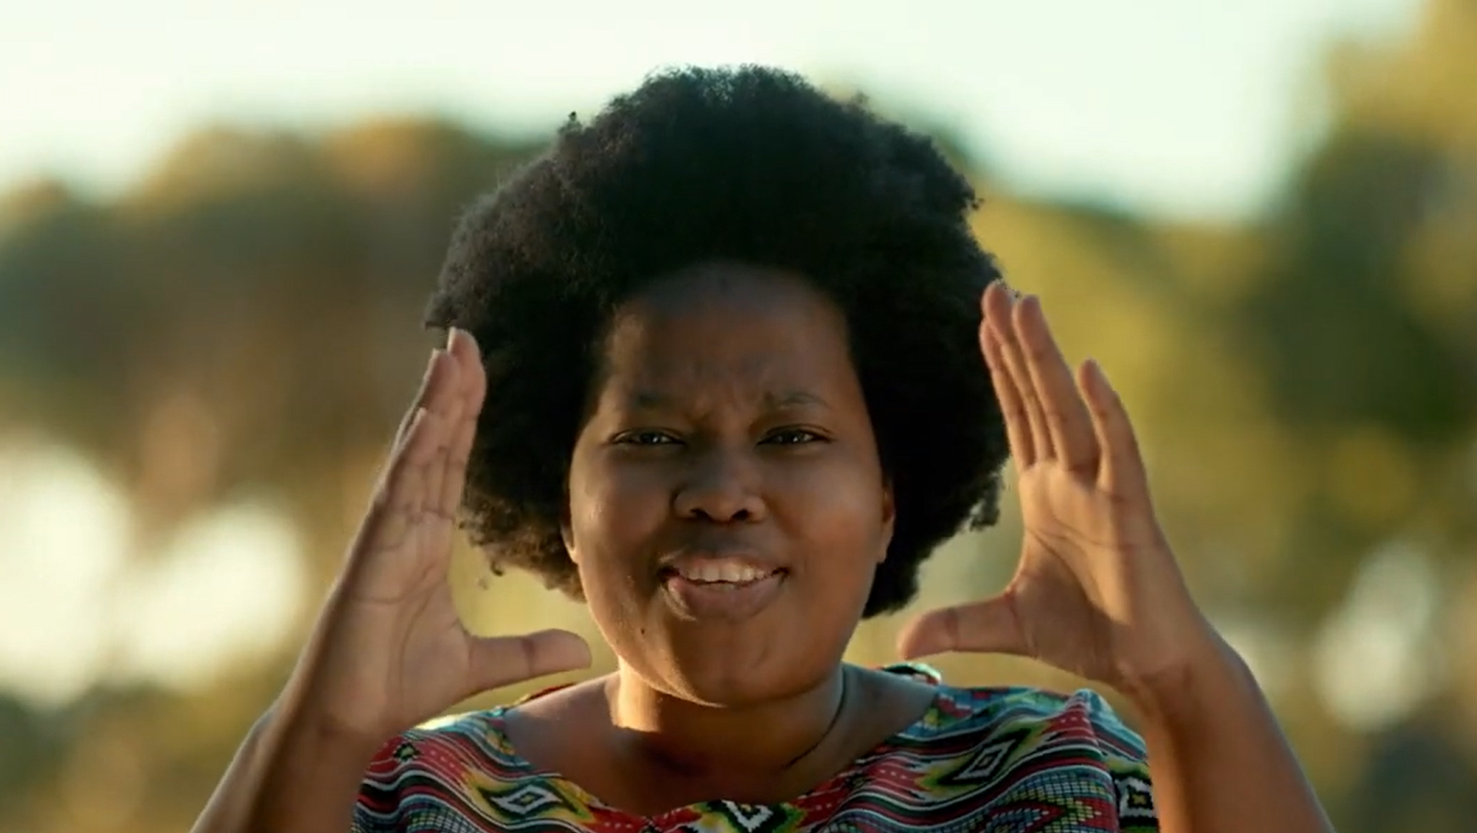
Watch: SOUTH AFRICA: A place of many names bit.ly/45VK3DR (2 min 56 sec)
Notes:
5. Conclusion (4 min) (Slide 11)
Slide 11: We are going to conclude the lesson by watching a video that captures the essence of what it means to be South African.
Siphokazi Jonas creates a love letter to her country, South Africa. She shares why South Africa is the place of many names and how they are connected, whether that is through their ancestors, nature, animals, fashion, writings, sons, skyscrapers, and many more "names" to come.
Watch: SOUTH AFRICA: A place of many names bit.ly/45VK3DR (2 min 56 sec)

