Slide 1
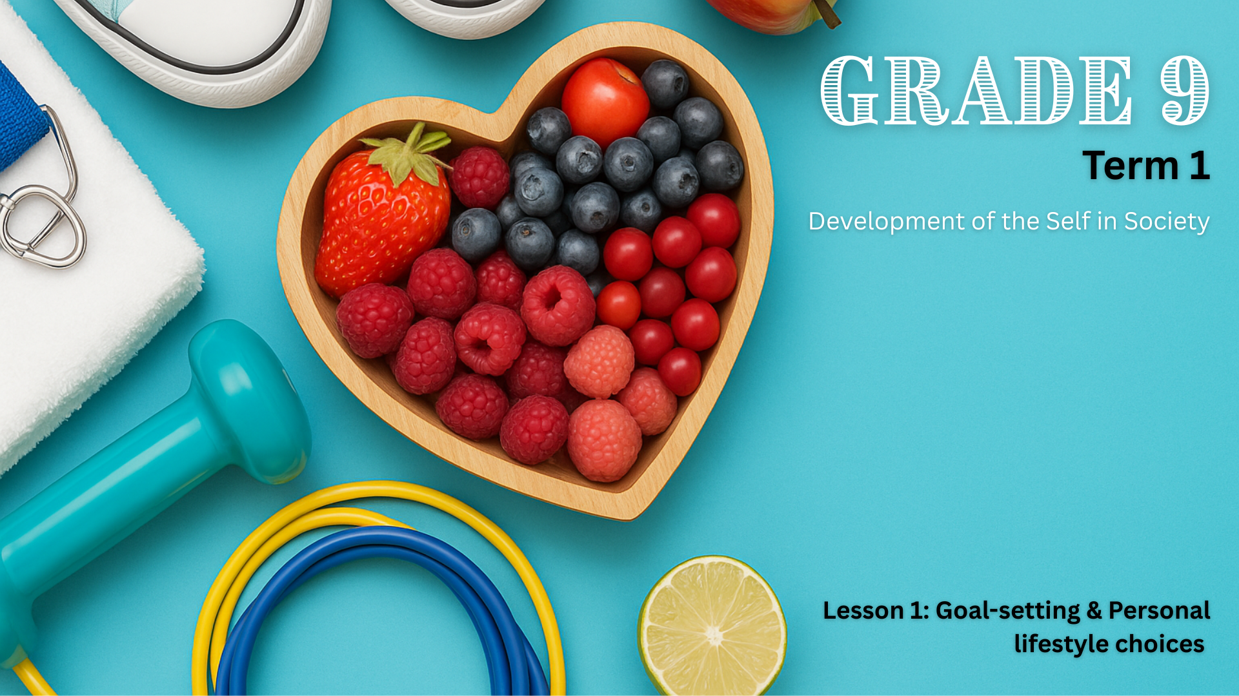

Notes:
Introduction (2 min) (Slides 1-2)
Slide 1: Good day, Grade 9s! Welcome to our first Life Orientation lesson of the year. In this lesson, we’ll look at how your lifestyle choices and the goals you set now can shape your future. This is an important year for you. Soon, you’ll be choosing your subjects for Grade 10, and these choices should be linked to the career paths you’re considering.
We’ll also learn how to set clear and achievable goals using the SMART method, to help you make informed decisions that support both your well-being and your long-term ambitions.

Slide 2

By the end of this lesson, you should be able to:
Define lifestyle choices and goals.
Identify examples of positive and negative lifestyle choices.
Understand the difference between short-term and long-term goals.
Understand and apply the SMART goal-setting method.
Understand the link between lifestyle choices and goal-setting.
Notes:
Slide 2: By the end of this lesson, you should be able to:
Define lifestyle choices and goals.
Identify examples of positive and negative lifestyle choices.
Understand the difference between short-term and long-term goals.
Understand and apply the SMART goal-setting method.
Understand the link between lifestyle choices and goal-setting.

Slide 3
What are lifestyle choices?
Lifestyle choices are the everyday decisions you make about how you live your life. These choices affect your health, emotions, relationships, and future goals.
Notes:
Teaching & Discussion (5 min) (Slides 3-4)
Slide 3: Let’s begin by discussing lifestyle choices.
Ask: What is a lifestyle choice? Can you give an example of a choice you made today that could affect your health or your future? (Allow a few learners to share.)
Define: Lifestyle choices are the everyday decisions you make about how you live your life. These choices affect your health, emotions, relationships, and future goals.
When you were younger, many decisions were made for you. Your parents or caregivers probably chose what you ate for dinner and even who you spent time with. These decisions helped shape your early experiences and your understanding of the world.
Now that you're in Grade 9, things are starting to change. You are beginning to have more say in your life, and with that comes more responsibility. This doesn’t mean you are expected to get everything right. It means you're learning how to think for yourself and to take ownership of your choices.

Slide 4
Examples of lifestyle choices
Positive lifestyle choices | Negative lifestyle choices
Eating healthy food | Skipping meals or eating too much junk food
Exercising regularly (e.g. walking, dancing, playing sports) | Not getting enough physical activity
Spending time with positive, supportive friends | Giving in to peer pressure to do harmful things
Getting enough sleep | Staying up too late on your phone
Studying regularly | Procrastinating or not completing homework
Notes:
Slide 4: The lifestyle choices that we make can be either positive or negative. Let us look at a few examples. Present the two-column table of lifestyle choices on Slide 4. Ask learners to suggest one new example for each side.

Slide 5

What are goals?
A goal is something you aim to achieve. It can give you direction, help you stay motivated, and encourage you to make smart lifestyle choices.
Notes:
Teaching & Discussion (8 min) (Slides 5-6)
Slide 5: We’ll revisit lifestyle choices in a moment. Before that, let's talk about goal-setting.
Ask: What is a goal? Why do you think setting goals is important? (Allow a few answers, then summarise.)
Explain: A goal is something you aim to achieve. It can give you direction, help you stay motivated, and encourage you to make smart lifestyle choices.
Setting goals is more than just dreaming about the future; it’s a skill that helps you take action and stay focused. Whether your goals are big or small, learning how to set them properly can make a big difference in your life.

Slide 6

Short-term goals
Achieved in the near future – days, weeks, or months
Keep you focused on daily habits
Step-by-step progress toward bigger dreams
Examples
Limit sugary drinks to only once per week.
Reduce screen time to under two hours a day during the week.
Read one novel for enjoyment this term.
Notes:
Slides 6-7: To build your goal-setting skills, it helps to understand the difference between short-term and long-term goals. Present the difference between short-term and long-term goals using the information on Slides 6 and 7.

Slide 7

Long-term goals
Take longer – often a year or more
Help you plan your future
Often made up of several short-term goals
Examples
Train regularly and complete a 5 km fun run by the end of the year.
Save up for a second-hand bicycle to improve my fitness.
Notes:
(Present information on the slide)
Who has set a short- or long-term goal this year already? Would you be willing to share? (Allow learners to respond.)

Slide 8

Watch: Setting SMART Goals https://ytubl.ink/3FrL (1 min 48 sec)
Notes:
Watch Video & Pair Activity (4 + 6 min) (Slide 8)
Slide 8: When you set goals, you can use the SMART framework. SMART stands for Specific, Measurable, Achievable, Realistic, and Time-bound. These are five key qualities that make a goal clear and reachable.
Let’s watch a short video that explains how to set effective goals using the SMART framework.
Watch: Setting SMART Goals https://ytubl.ink/3FrL (1 min 48 sec)
Ask: Which part of SMART goal-setting do you think is the hardest? Why? (Allow learners to respond.)
Learners will now apply the knowledge gained from the video to complete Activity 1 (Lesson 1 – Worksheet) on SMART goals in pairs.
Give learners a few minutes to work through the activity together. Afterwards, facilitate a brief feedback session by asking volunteers to share their answers.
Refer to the Lesson 1 – Worksheet MEMO for the correct answers.

Slide 9
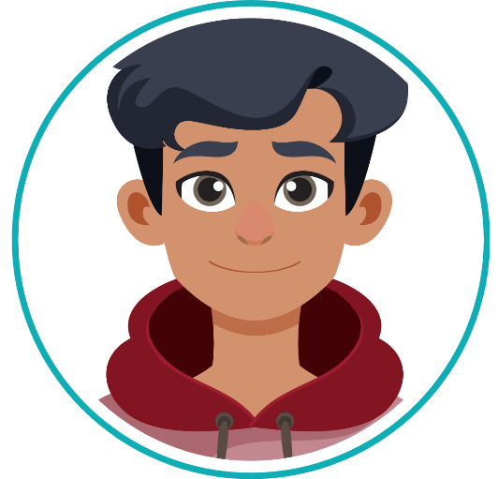
Ziyaad wants to become fitter and stronger so he can feel more confident, join his school’s soccer team, and improve his overall health. But whether he reaches this goal depends on the choices he makes each day.
Positive choices that support his goal
He walks or cycles to school instead of getting a lift.
He drinks lots of water and avoids sugary drinks.
He joins soccer practice twice a week and stays active over weekends.
He chooses to eat more fruits, vegetables, and protein-rich foods.
He goes to bed earlier so he has enough energy for the day.
Outcome
These daily habits help Ziyaad feel stronger and more energised. He’s more likely to reach his goal because his actions support what he wants.
Negative choices that work against his goal
He spends hours playing video games and rarely exercises.
He skips breakfast and often eats chips and sweets instead of healthy meals.
He stays up late scrolling on his phone, which makes him feel tired the next day.
He ignores opportunities to join sports activities at school.
He avoids water and only drinks fizzy soft drinks.
Outcome
Even though Ziyaad says he wants to be fitter, these choices make it harder for him to achieve his goal. His actions don’t match his intentions.
Notes:
Teaching (5 min) (Slide 9)
Slide 9: Now let’s talk about the relationship between lifestyle choices and goals. Your lifestyle choices and your goals are closely connected. The decisions you make every day either move you closer to your goals or take you further away from them.
Remember, your goals are what you want to achieve, and your lifestyle choices are the actions you take every day. When your daily choices support your goals, you're more likely to succeed. When your choices go against your goals, it becomes harder to reach them.
Let’s look at a practical example. Read the Ziyaad scenario on Slide 9 aloud (or have a learner read it).
Note to teacher: This slide contains animations. You will need to click to navigate through the scenario.
Many of us have goals, just like Ziyaad, but we don’t always make the right choices to achieve them. His situation teaches us an important lesson: Your daily habits matter. Your goals give you direction, but your choices are the steps that get you there.

Slide 10
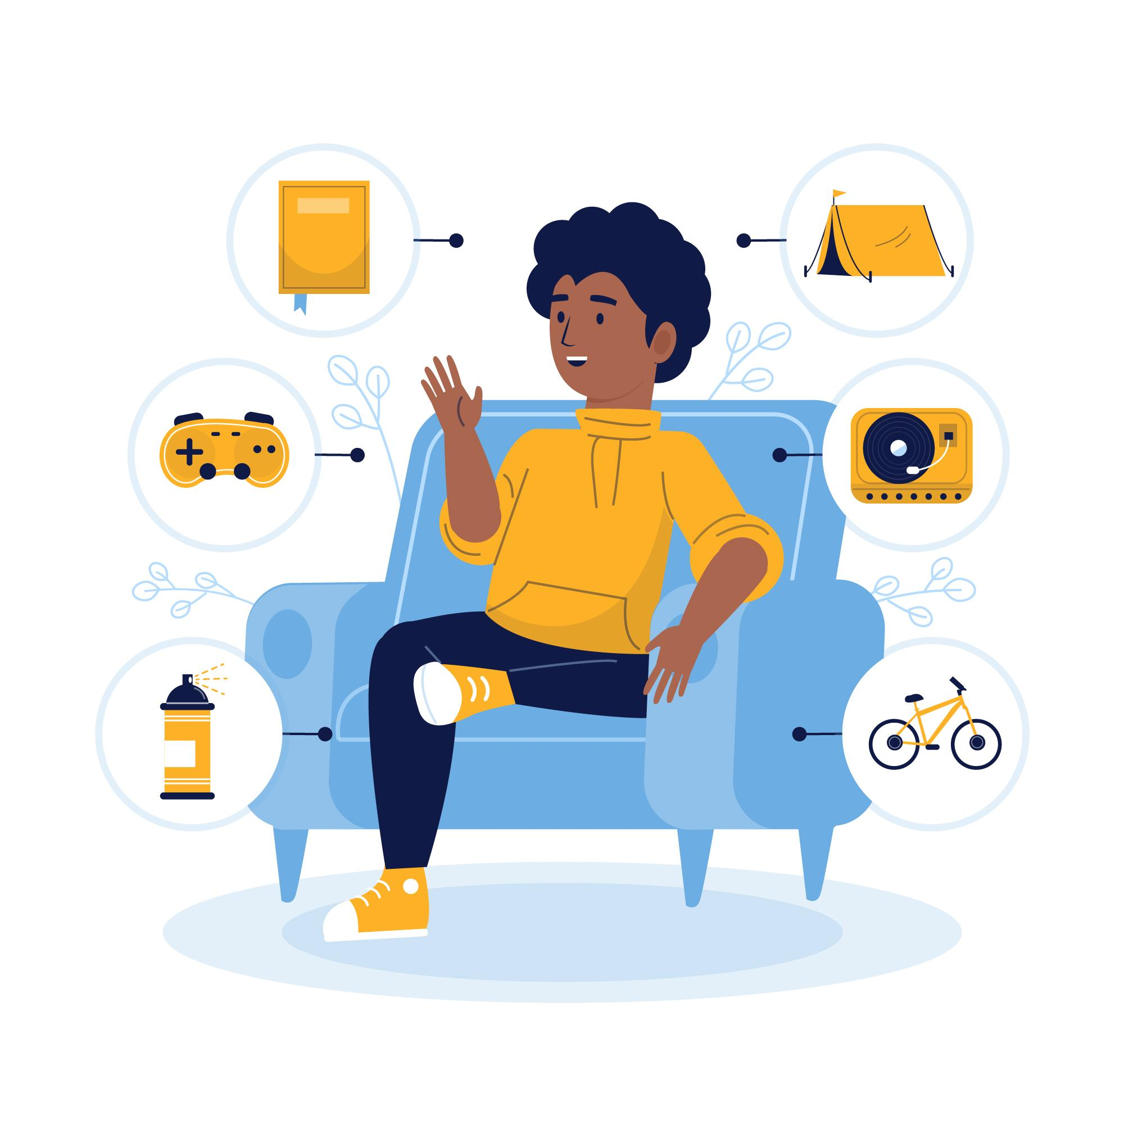
Individual Activity
"Designed by pikisuperstar / Freepik"
Notes:
Wrap-up & Individual Activity (10 min) (Slide 10)
Slide 10: Today, we explored how your everyday choices can impact your goals. We also learned how to take control of your future by setting clear, achievable goals using the SMART method.
Learners will now apply their newly acquired knowledge in Activity 2 (Lesson 1 – Worksheet). If they are unable to complete the activity during class time, instruct them to finish it for homework. Remind learners that they will provide feedback in the next lesson, so the activity must be completed.

