Slide 1
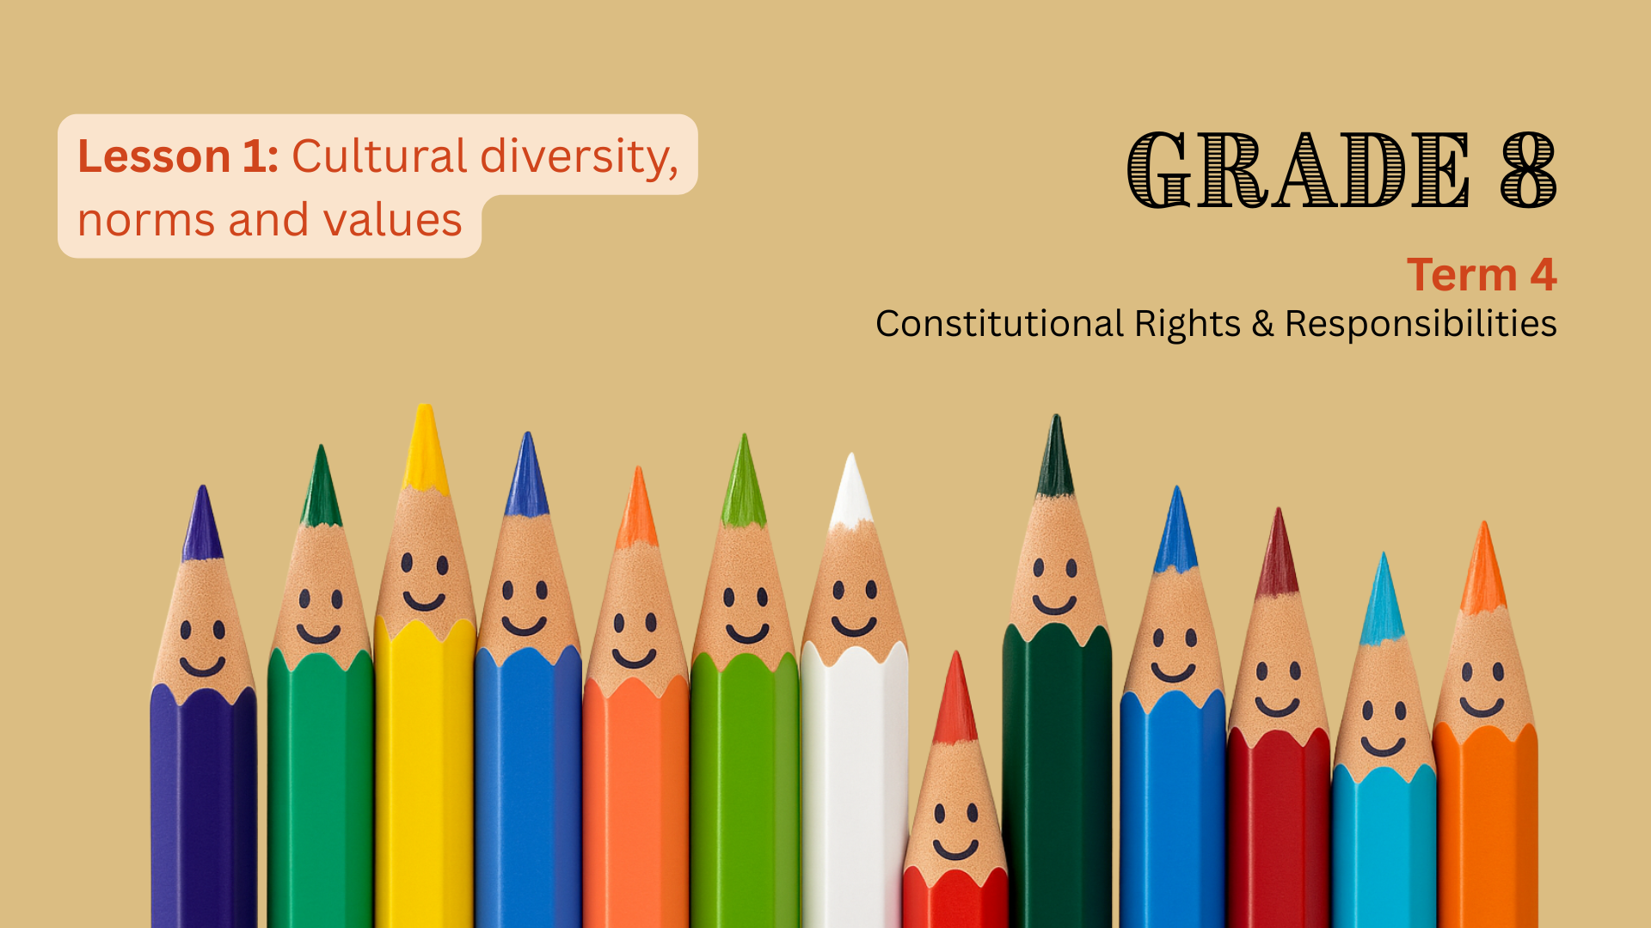

Notes:
Introduction (5 min) (Slides 1-2)
Slide 1: Good day, Grade 8s. Today, we start our last lesson series of the term on constitutional rights and responsibilities. These lessons are going to focus on cultural diversity.
In Term 3, we learnt that South Africa is often referred to as the Rainbow Nation because of the many different cultures, languages, and religions that make up our country.
We do not have one single culture – instead, our national identity comes from a mix of cultures that all play an important role in shaping who we are.
Our diversity gives us strength. The more we understand and respect each other’s cultures, the easier it is to live in peace and unity.
Cultural diversity is protected by the South African Constitution, which gives people the right to practise their own culture, language, and religion. These rights help ensure that everyone can live freely and equally. At the same time, we have the responsibility to respect the rights of others and to help build a united, peaceful society.

Slide 2
By the end of this lesson, learners should be able to:
Define
Define cultural diversity and explain why it is important.
Explain
Explain how cultural norms and values influence personal choices.
Describe
Describe how cultural norms and values guide communities in responding to social issues.
Notes:
Slide 2: By the end of this lesson, learners should be able to:
Define cultural diversity and explain why it is important.
Explain how cultural norms and values influence personal choices.
Describe how cultural norms and values guide communities in responding to social issues.

Slide 3
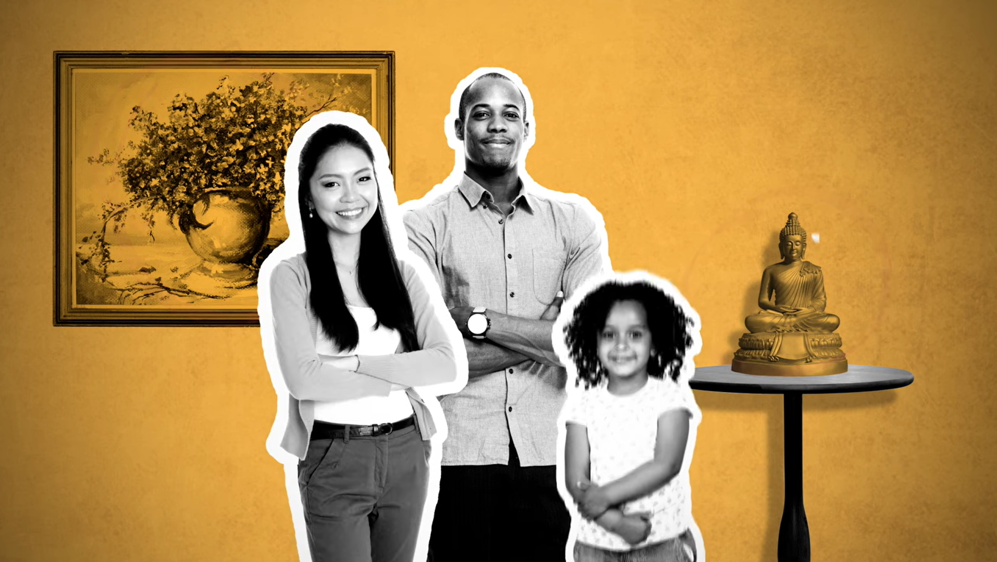
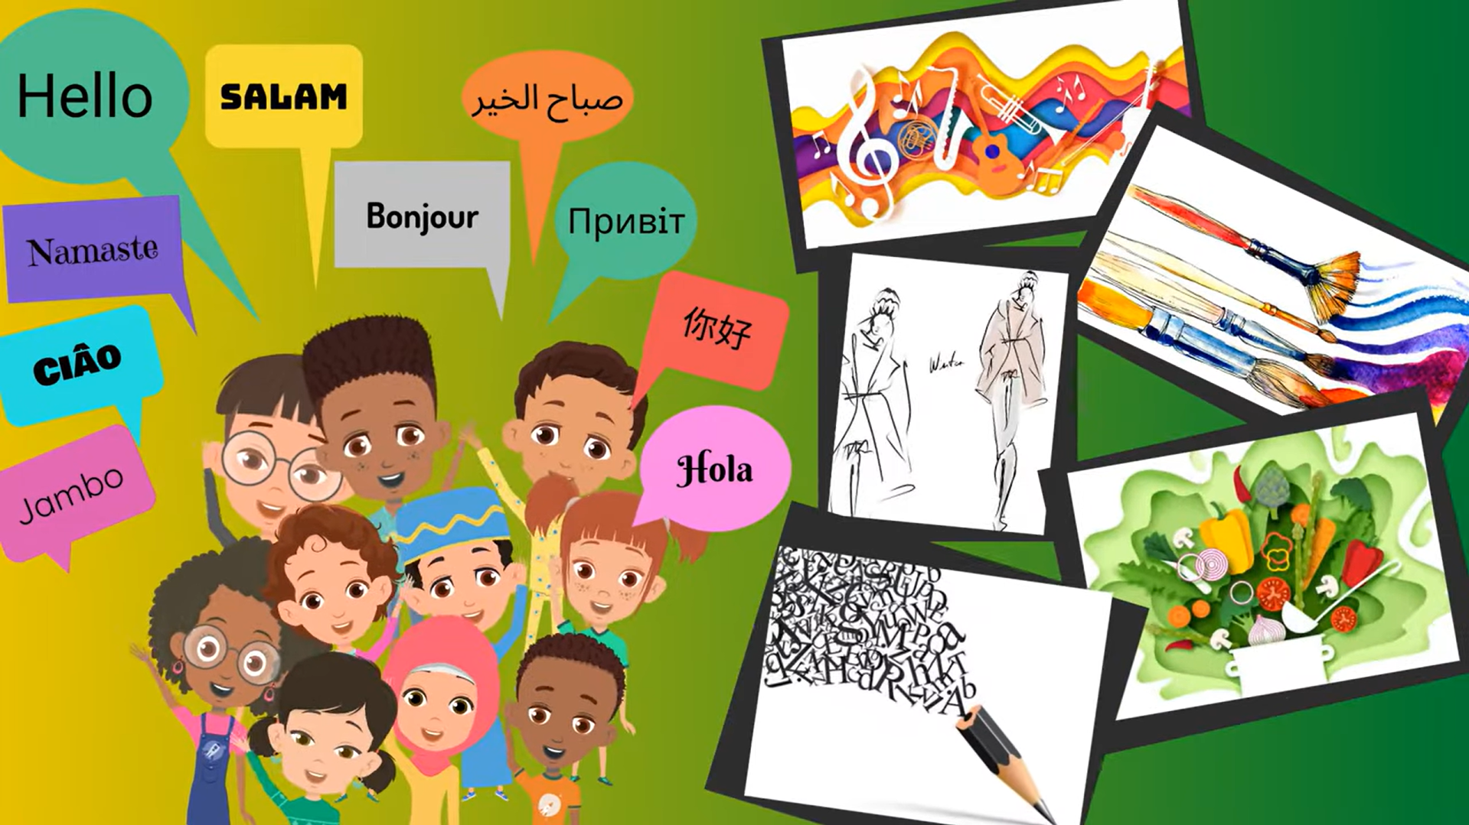
What is culture?
Video Option 1: What is Culture? bit.ly/3G9aHyr (2 min 03 sec)
Video Option 2: What is Culture? bit.ly/4loygSX (2 min 33 sec)
Notes:
2. Watch Videos & Activity (10 min) (Slides 3-5)
Slide 3: Let’s start by watching a video that explains culture.
Note to teacher: There are TWO video options for you to choose from – choose ONE only. Watch the videos beforehand and decide which one best suits your class.
Video Option 1: What is Culture? bit.ly/3G9aHyr (2 min 03 sec)
Video Option 2: What is Culture? bit.ly/4loygSX (2 min 33 sec)

Slide 4
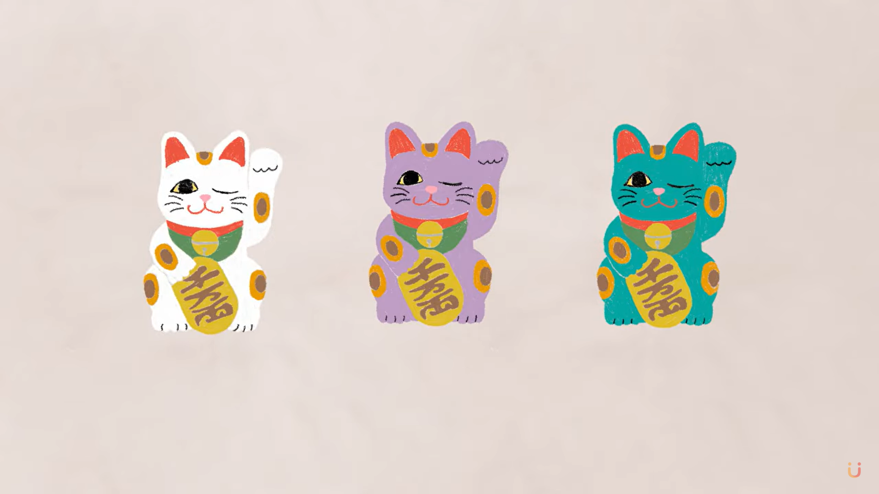
Watch: What is Diversity? bit.ly/4nd6dHA (1 min 10 sec)
Notes:
Slide 4: Now, let’s watch a video that explains diversity.
Watch: What is Diversity? bit.ly/4nd6dHA (1 min 10 sec)

Slide 5

Individual Activity
Source: freepik.com
Notes:
Slide 5: Using the information from the videos, learners complete Activity 1 (Lesson 1 – Worksheet) to define the term cultural diversity.
Ask the learners to provide feedback and go through the answers provided in Lesson 1 – Worksheet MEMO.

Slide 6
Diversity in South Africa
Different groups with their own traditions, languages and beliefs.
Motto on South Africa’s coat of arms, written in the Khoisan language of /Xam is !ke e: /xarra //ke, which means “diverse people unite”.
Why is diversity important?
Culture vs hertitage
Notes:
3. Class discussion (5 min) (Slide 6)
Slide 6: In South Africa, you will find groups like the Zulu, Xhosa, Tswana, Ndebele, Khoisan, Pedi, Afrikaans, Indian, Coloured, Muslim, Hindu, Christian and many others. All of these groups have their own traditions, languages, beliefs, and ways of life. Together, they form the rich cultural heritage of our country.
The motto on South Africa’s coat of arms, written in the Khoisan language of /Xam is !ke e: /xarra //ke, which means “diverse people unite”. This reminds us that even though we are different, we can work together to build a united and peaceful nation.
Ask: Why is diversity important? (Allow learners to provide verbal responses.)
Possible answers:
It helps people feel included and respected, even if they are different.
It gives us new ideas because people see things in different ways.
It brings people together and helps us understand each other better.
It helps us work as a team and solve problems together.
It stops unfair treatment and helps people treat each other equally.
Diversity makes life more interesting and helps everyone have a chance to take part and do well.
Now that we understand what cultural diversity is and why it is important, explain to learners that it is also important to know the difference between culture and heritage. Both are important, but they are not the same. Ask learners to explain the difference: Culture is how people live now, and heritage is what they inherit from the past (like traditions, beliefs, and important objects).

Slide 7
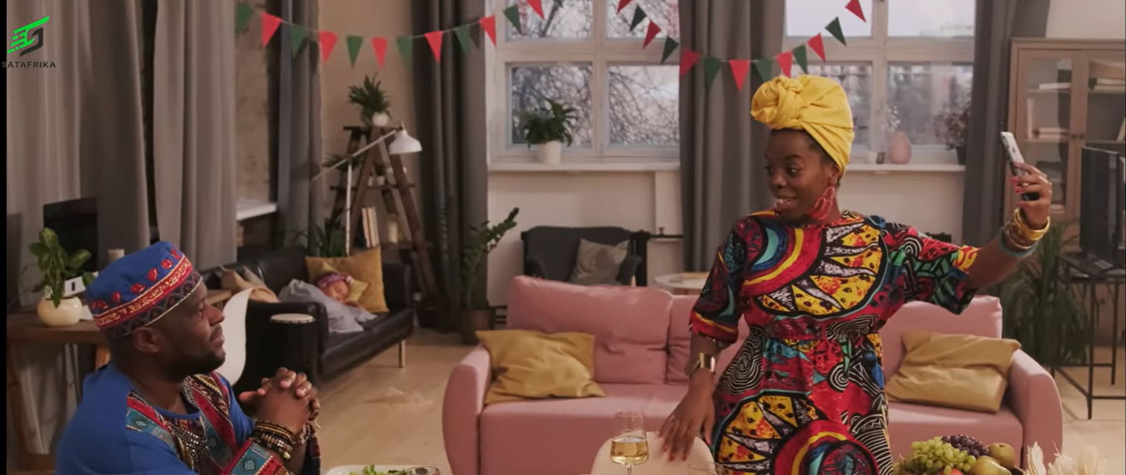
Watch: South Africa: Rainbow Nation, Desmond Tutu, 11 Official Languages, Society bit.ly/4nnxYxt (1 min 18 sec)
Notes:
4. Video Activity (7 min) (Slide 7)
Slide 7: Our next activity is a little different, so please pay close attention. You’re going to learn more about our country, what makes it so diverse, and some important facts about who we are as South Africans.
Watch the following video before learners complete Activity 2.
Watch: South Africa: Rainbow Nation, Desmond Tutu, 11 Official Languages, Society bit.ly/4nnxYxt (1 min 18 sec)
Note to teacher: The video mentions that South Africa has 11 official languages, but this has changed to 12. In 2023, South African Sign Language (SASL) was officially recognised as South Africa’s 12th official language. Inform learners of this fact so they have the most up-to-date information.
Learners to complete Activity 2 (Lesson 1 – Worksheet).
Go through the answers provided in Lesson 1 – Worksheet MEMO.

Slide 8

Cultural norms
Shared rules about how people in a cultural group are expected to behave.
Guide personal choices: Greetings, dress, food, relationships, religious practice.
Shape how we handle personal issues: showing respect, caring for family, big decisions (e.g. marriage, career).
Help us know what is polite, respectful, or correct in a community
Notes:
5. Class Discussion (10 min) (Slides 8-9)
Slide 8: The video on culture that we watched earlier spoke about cultural norms and values. Let’s make sure we understand what these terms mean in relation to personal and community issues.
Cultural norms are shared rules about how people in a cultural group are expected to behave. These norms guide personal choices, such as how we greet others, how we dress, what we eat, how we form relationships, and how we practise religion. They also shape how we handle personal issues, like how we show respect, how we care for family members, or how we make important life decisions (such as marriage or career choices).
Cultural norms are like agreed-upon expectations that help people know what behaviour is seen as polite, respectful, or correct in their community. For example:
In some cultures, making eye contact shows respect.
In other cultures, looking away shows politeness.
Think about your own culture or family background. Can you share one cultural norm that is important in your community? (Allow learners to provide verbal responses.)

Slide 9
Cultural values
Cultural values = beliefs about what is good, right, fair, and important.
Passed down through generations to guide what is acceptable or unacceptable.
Norms and values guide how communities respond to community issues:
Supports those in need
Resolves conflict
Responds to crime
.
Notes:
Slide 9: Cultural values are the beliefs about what is good, right, fair, and important in life. These values are passed down through generations and help people and communities decide what is acceptable or unacceptable. For example:
A culture that values respect for elders may expect young people to listen to and care for older family members.
A culture that values equality may encourage women and men to share community leadership roles.
Cultural norms and values influence how community issues are resolved.
Ask learners to define and give examples of community issues: Challenges or matters that affect many people in an area (e.g., Poverty, hunger, unemployment, conflict, crime, substance abuse, etc.).
Explain that cultural norms can guide how a community:
Supports those in need: In many African cultures, the spirit of ubuntu encourages people to help neighbours and those less fortunate. This can be seen in how communities work together to care for orphans or the elderly.
Resolves conflict: Some communities prefer solving disputes through family or community meetings (such as imbizo or gatherings of elders) rather than going directly to formal courts.
Responds to crime or social problems: Certain cultural groups may have strong views about community safety and take part in neighbourhood watches or other forms of collective action.
That brings us to the end of our lesson. We will delve a bit deeper into cultural norms and values in the next lesson.

Slide 10

Reflection
Source: freepik.com
Notes:
6. Reflection (3 min) (Slides 8-9)
Slide 10: Today, we learned that South Africa’s cultural diversity is one of our greatest strengths. We saw how cultural norms and values guide our personal choices and help communities work together to solve problems. In the next lessons, we will build on this by exploring how we can show respect for different cultures and contribute to unity in diversity.
For the last few minutes of the lesson, complete the reflection questions in Activity 3 (Lesson 1 – Worksheet). If learners are unable to finish the activity in class, it must be completed as homework.

