Slide 1


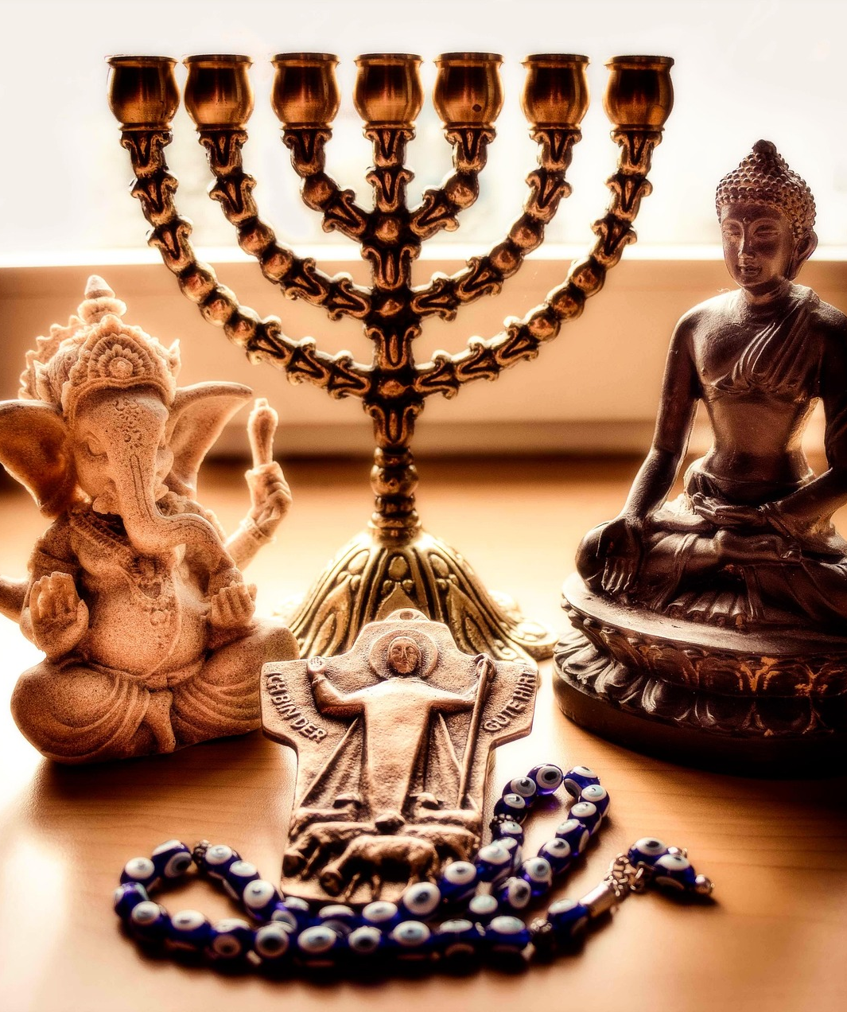
Contributions of various religions in promoting peace
Constitutional Rights & Responsibilities
Term 4 | Week 1-3 | Lesson 1
Notes:
1. Introduction (2 min) (Slides 1-2)
Slide 1: Good day, Grade 9s. Today, we are diving into a new topic within Constitutional Rights and Responsibilities. In this lesson, we will focus on the contributions of various religions in promoting peace.
This topic is important because it helps us understand how different faiths encourage harmony and respect among people. By learning about the peaceful teachings of religions, we develop respect for diverse beliefs and cultures, which is essential in today’s diverse world.
This knowledge also shows us peaceful ways to resolve conflicts and encourages us to work together in unity.
Overall, studying this topic prepares us to be more understanding and peaceful members of society.

Slide 2
By the end of this lesson, you should be able to:
Explain the meaning of external and internal peace.
Describe how religion can promote peace.
Identify key aspects of a culture of peace and how they link to human rights.
Recognise peace‑building values and practices in different religions.
Notes:
Slide 2: By the end of this lesson, you should be able to:
Explain the meaning of external and internal peace.
Identify key aspects of a culture of peace and how they link to human rights.
Describe how religion can promote peace.
Recognise peace‑building values and practices in different religions.

Slide 3
What does peace mean?
Peace is more than just the absence of fighting.
It means:
Living without hate or violence
Solving problems calmly and respectfully
Treating others with love, care, and fairness
A culture of peace includes:
Understanding global challenges (e.g. poverty, war)
Solving conflict without violence
Respecting human rights and all people
Celebrating diversity
Caring for the planet
Notes:
2. Teaching & Watch Video (10 min) (Slides 3-8)
Slide 3: Our starting point for today’s lesson is looking at the concept of peace and the various aspects of it.
Ask: What is peace, and why is peace important? (Allow learners to respond.)
Note to teacher: You may write learner contributions on the board or give learners a chance to write on the board to get the discussion started.
Peace means more than just the absence of fighting. It is about being in a place, or living in a way, where there is no hatred, and where people treat each other with love, care, and respect. When problems do come up, they are solved calmly and respectfully.
A culture of peace will be achieved when citizens of the world:
Understand the problems we face globally (like poverty, inequality, and war)
Learn how to solve conflicts without violence
Live according to human rights and treat others fairly
Appreciate and celebrate different cultures and ways of life
Show respect for the planet and for one another

Slide 4
Peace: Outside and inside
Peace is not just around us, but also inside us
Western cultures: peace = no war or fighting
Other cultures: peace = inner calm & balance
E.g, Mayan tradition: harmony between health, emotions, community & environment
Notes:
Slide 4: Peace isn’t only about what’s happening around us; it also includes what’s happening inside us.
In many Western cultures, peace is mostly seen as something outside (e.g., no war, no fighting).
But in many other cultures, peace also means having inner peace: feeling calm, balanced, and at peace within yourself. For example, in Mayan tradition, peace is linked to overall well-being and a balanced life. It includes harmony between your health, emotions, community, and environment.

Slide 5
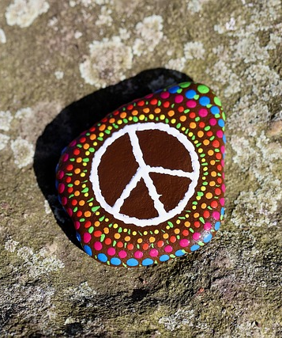
Peace and the SA Constitution
The South African Constitution helps build a peaceful society by:
Protecting human rights
Promoting fairness
Encouraging respect for all people
Peace is more than no violence, it includes:
Freedom from fear
Freedom from poverty
Equality for everyone
Notes:
Slide 5: The South African Constitution helps build a peaceful society by protecting human rights, promoting fairness, and encouraging respect for all. It recognises that true peace means more than just the absence of violence. It includes freedom from fear and poverty, and equality. Peace is closely linked to human rights. The more a society protects and fulfils these rights, the more likely it is to prevent conflict and solve problems peacefully.

Slide 6
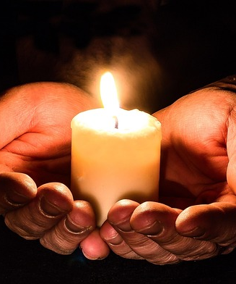
Religious Peace
All major religions teach
Love and kindness
Forgiveness and fairness
Avoiding violence
Respecting others
Solving problems peacefully
Religious groups often:
Help others through charity and education
Promote interfaith dialogue (talking across religions)
Speak out against injustice or violence
Act as peacemakers in society
Notes:
Slide 6: Now, let’s get to religious peace. Religious peace means living in harmony with people who have different beliefs. It also means following the peaceful teachings of your own religion. All major religions teach values like love, kindness, forgiveness, and fairness. These values help people live together peacefully.
Many religions also teach their followers to:
Avoid violence
Respect others
Solve problems in a peaceful way
Religious groups often do good work in communities. They help people through charity, education, and interfaith dialogue (conversations between people of different religions). These efforts show how religion can play a powerful role in creating peace.

Slide 7
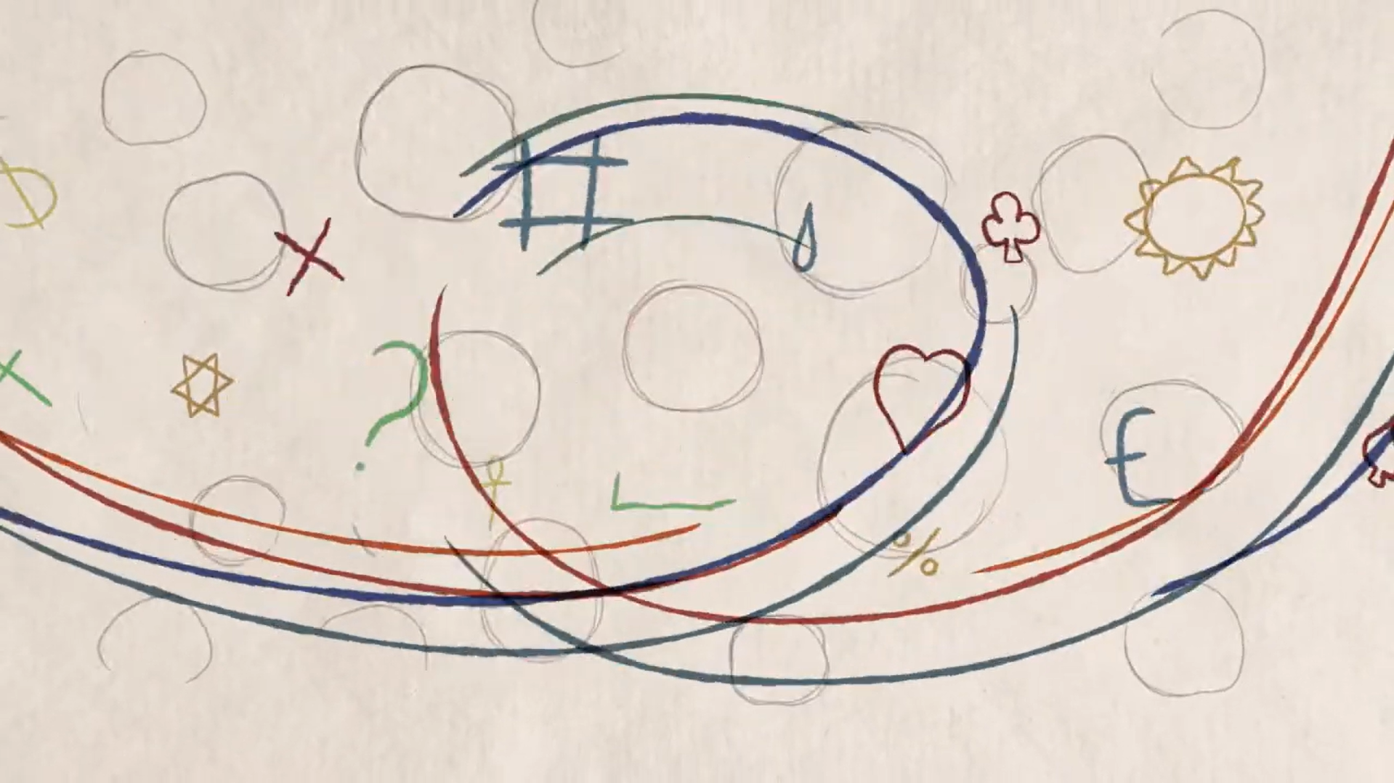
Watch: What is Interreligious Dialogue? https://www.youtube.com/watch?v=YJaeJz9jQU8
(2 min 57 sec)
Notes:
Slide 7: Watch: What is Interreligious Dialogue?
https://www.youtube.com/watch?v=YJaeJz9jQU8 (2 min 57 sec)

Slide 8
Religion and peace-making
All major religions teach peace and caring for others
Many seek inner peace through prayer or spiritual practices
Religious communities speak out against violence & injustice
Leaders help solve conflicts as peacemakers
People trust religious leaders to promote peace & understanding
Notes:
Slide 8: Religion can be a powerful force for peace-making:
All major religions teach people to live in peace and to care for others.
Many religious people also try to find inner peace through prayer or spiritual practices.
Religious communities often speak out against violence or injustice and work to bring people together.
Religious leaders sometimes help solve conflicts by acting as peacemakers between opposing groups.
People trust religious leaders, so they can be helpful in encouraging peace and understanding in society.

Slide 9

How does religion promote peace?
Notes:
3. Teaching & Discussion (18 min) (Slides 9-16)
Slide 9: All religions see peace as extremely important, because spiritual growth and personal development (becoming better, more caring) can only happen in a peaceful environment. Let’s look at the major religions and their contributions to peace.
Note to teacher: After discussing each religion, you may ask learners who follow that particular religion for examples of peace contributions they have experienced in their religious community.

Slide 10
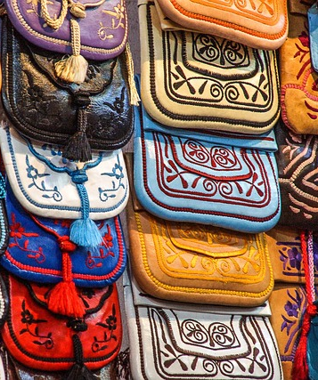
African Traditional Religions
Core beliefs:
Belief in one Creator God and the role of ancestors as spiritual guides.
Peace values:
Harmony, unity, community well-being, and Ubuntu (shared humanity).
Practices that promote peace:
Living in harmony with others, honouring ancestors, respecting nature and elders, and promoting moral behaviour.
Notes:
Slide 10: AFRICAN TRADITIONAL RELIGIONS
Core beliefs: Belief in one Creator God and the role of ancestors as spiritual guides.
Peace values: Harmony, unity, community well-being, and Ubuntu (shared humanity).
Practices that promote peace: Living in harmony with others, honouring ancestors, respecting nature and elders, and promoting moral behaviour.

Slide 11

Bahá’í faith
Core beliefs:
All humans are one family; unity and equality are central.
Peace values:
Unity, fairness, justice, and human dignity.
Practices that promote peace:
Promoting gender and racial equality, interfaith dialogue, rejecting prejudice, and peaceful cooperation.
Notes:
Slide 11: BAHÁ’Í FAITH
Core beliefs: All humans are one family; unity and equality are central.
Peace values: Unity, fairness, justice, and human dignity.
Practices that promote peace: Promoting gender and racial equality, interfaith dialogue, rejecting prejudice, and peaceful cooperation.

Slide 12
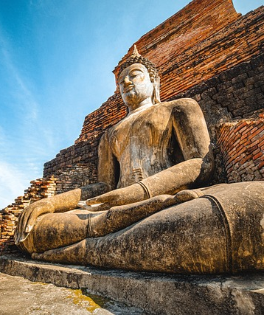
Buddhism
Core beliefs:
Life is full of suffering, but peace can be found through the Eightfold Path and by avoiding harm.
Peace values:
Non-violence, mindfulness, compassion, inner calm.
Practices that promote peace:
Meditation, following moral rules (e.g., not harming others), and showing kindness to all living things.
Notes:
Slide 12: BUDDHISM
Core beliefs: Life is full of suffering, but peace can be found through the Eightfold Path and by avoiding harm.
Peace values: Non-violence, mindfulness, compassion, inner calm.
Practices that promote peace: Meditation, following moral rules (e.g., not harming others), and showing kindness to all living things.

Slide 13

Christianity
Core beliefs:
Belief in one God (Trinity: Father, Son, Holy Spirit). Jesus is the Son of God who taught love and forgiveness.
Peace values:
Love, forgiveness, compassion, inner peace, and justice.
Practices that promote peace:
Following Jesus’ teachings, reading the Bible, praying, promoting kindness, and supporting others.
Notes:
Slide 13: CHRISTIANITY
Core beliefs: Belief in one God (Trinity: Father, Son, Holy Spirit). Jesus is the Son of God who taught love and forgiveness.
Peace values: Love, forgiveness, compassion, inner peace, and justice.
Practices that promote peace: Following Jesus’ teachings, reading the Bible, praying, promoting kindness, and supporting others.

Slide 14
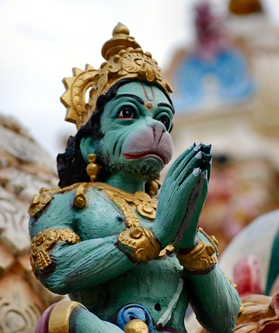
Hinduism
Core beliefs:
Belief in a divine power found in all living things. Life should be lived truthfully and without harm.
Peace values:
Ahimsa (non-violence), Satya (truthfulness), and self-control.
Practices that promote peace:
Meditation, prayer, respectful living, vegetarianism, kindness to all beings.
Notes:
Slide 14: HINDUISM
Core beliefs: Belief in a divine power found in all living things. Life should be lived truthfully and without harm.
Peace values: Ahimsa (non-violence), Satya (truthfulness), and self-control.
Practices that promote peace: Meditation, prayer, respectful living, vegetarianism, kindness to all beings.

Slide 15
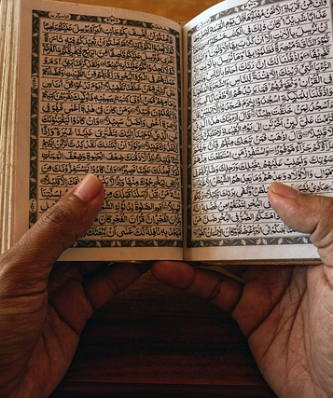
Islam
Core beliefs:
Belief in one God (Allah). Peace is found through submission to Allah’s will and living justly.
Peace values:
Peace, fairness, compassion, justice.
Practices that promote peace:
Daily prayer, charity, greeting others with peace ("As-salaam alaikum"), following the Qur’an and the Prophet Muhammad’s example.
Notes:
Slide 15: ISLAM
Core beliefs: Belief in one God (Allah). Peace is found through submission to Allah’s will and living justly.
Peace values: Peace, fairness, compassion, justice.
Practices that promote peace: Daily prayer, charity, greeting others with peace ("As-salaam alaikum"), following the Qur’an and the Prophet Muhammad’s example.

Slide 16
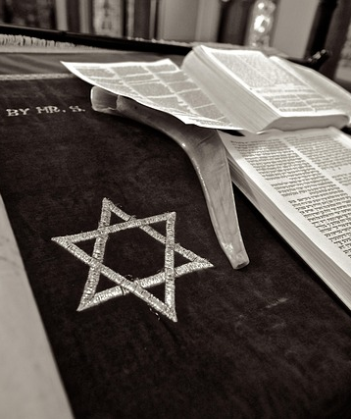
Judaism
Core beliefs:
Belief in one God. Peace is part of living a moral and faithful life according to the Torah.
Peace values:
Shalom (peace), justice, kindness, responsibility.
Practices that promote peace:
Greeting with “Shalom,” following the Ten Commandments, helping others, promoting fairness and respect.
Notes:
Slide 16: JUDAISM
Core beliefs: Belief in one God. Peace is part of living a moral and faithful life according to the Torah.
Peace values: Shalom (peace), justice, kindness, responsibility.
Practices that promote peace: Greeting with “Shalom,” following the Ten Commandments, helping others, promoting fairness and respect.
All of these religions see peace as an important value. They teach their followers to live in harmony with others, to show respect, and to value human life. These teachings help people create peace in their own lives and in the world around them.

Slide 17

Notes:
4. Individual Activity (10 min) (Slide 17)
Slide 17: We have covered a lot of material today, next week will be an exciting lesson, where you get to do a presentation on a peace icon. That means you will need to do some research for homework. Let’s read through the instructions in Activity 2 (Lesson 1 – Worksheet).
If there aren’t any further questions, you now have the remainder of this lesson to complete Activity 1 (Lesson 1 – Worksheet).
Note to teacher: Activity 1 (Lesson 1 - Worksheet) can be done as a class discussion or have learners answer in pairs.
Possible/Model answers are available in the Lesson 1 – Worksheet MEMO.

