Slide 1


Notes:
Introduction (2 min) (Slides 1-2)
Slide 1: Welcome back, Grade 9s! In the last two lessons, we looked at how different people, environments, and traditions influence the choices you make. But what do you do when those influences don’t support your goals or values?
This lesson will teach you how to respond with confidence and clarity, using informed decision-making and assertiveness.

Slide 2
By the end of this lesson, you should be able to:
Define negative peer pressure.
Use the R.E.L.A.X. method to guide decision-making.
Define assertiveness and explain how it differs from being aggressive or passive.
Apply practical tips to communicate decisions clearly and respectfully.
Explain how to make informed decisions when under pressure.
Notes:
Slide 2: By the end of this lesson, you should be able to:
Define negative peer pressure.
Explain how to make informed decisions when under pressure.
Use the R.E.L.A.X. method to guide decision-making.
Define assertiveness and explain how it differs from being aggressive or passive.
Apply practical tips to communicate decisions clearly and respectfully.

Slide 3

Good decisions take thinking, time, and self-awareness.
The best way to respond is with informed decision-making.
Notes:
Teaching, Discussion & Activity (8 + 10 min) (Slides 3-5)
Slide 3: Remind learners that not all influences are harmful – some can be positive – but others, like negative peer pressure, can make it difficult to stay true to your goals or values.
Recap negative peer pressure by asking learners to define: Negative peer pressure is when friends or people your age try to influence you to do something that goes against your values, makes you feel uncomfortable, or could lead to harmful consequences.
Ask learners to define self-awareness and informed decision-making.
Definitions:
Self-awareness is the ability to understand your own thoughts, feelings, and actions, and how they affect you and the people around you.
Informed decision-making means choosing what to do based on facts, careful thinking, and awareness of your values.

Slide 4
Letter | What to do | Example
Recognise | Notice that a decision needs to be made. | "My friends are asking me to join a group chat where people are posting inappropriate photos."
Educate | Learn more about the situation and possible outcomes. | "What could happen if I join? Will I feel okay about this later?"
Listen | Ask for advice or think back to similar situations. | "I remember a friend who got in trouble for joining a similar group. Maybe I should ask my older cousin what she thinks."
Act | Choose the option that matches your values and goals. | "I’ll say no. I want to be respected, not embarrassed."
EXpect the unexpected | Be ready to adapt if things don’t go as planned. | "If they tease me for saying no, I’ll talk to someone I trust."
Notes:
Slide 4: Tell learners that we can use the R.E.L.A.X. method to guide us in making a decision when we're unsure.
Present the R.E.L.A.X. acronym (Table on Slide 3) and walk through each step, using the example of being invited to a harmful or uncomfortable group chat. Discuss what each letter stands for.
Ask: Have you ever had to make a decision where you felt pressure? What helped you?
(Allow a few learners to respond.)

Slide 5

Pair Activity
Notes:
Slide 5: Learners to complete Activity 1 (Lesson 4 – Worksheet) in pairs. Once learners have completed the activity, facilitate a brief feedback session using the possible answers in Lesson 4 – Worksheet MEMO.

Slide 6
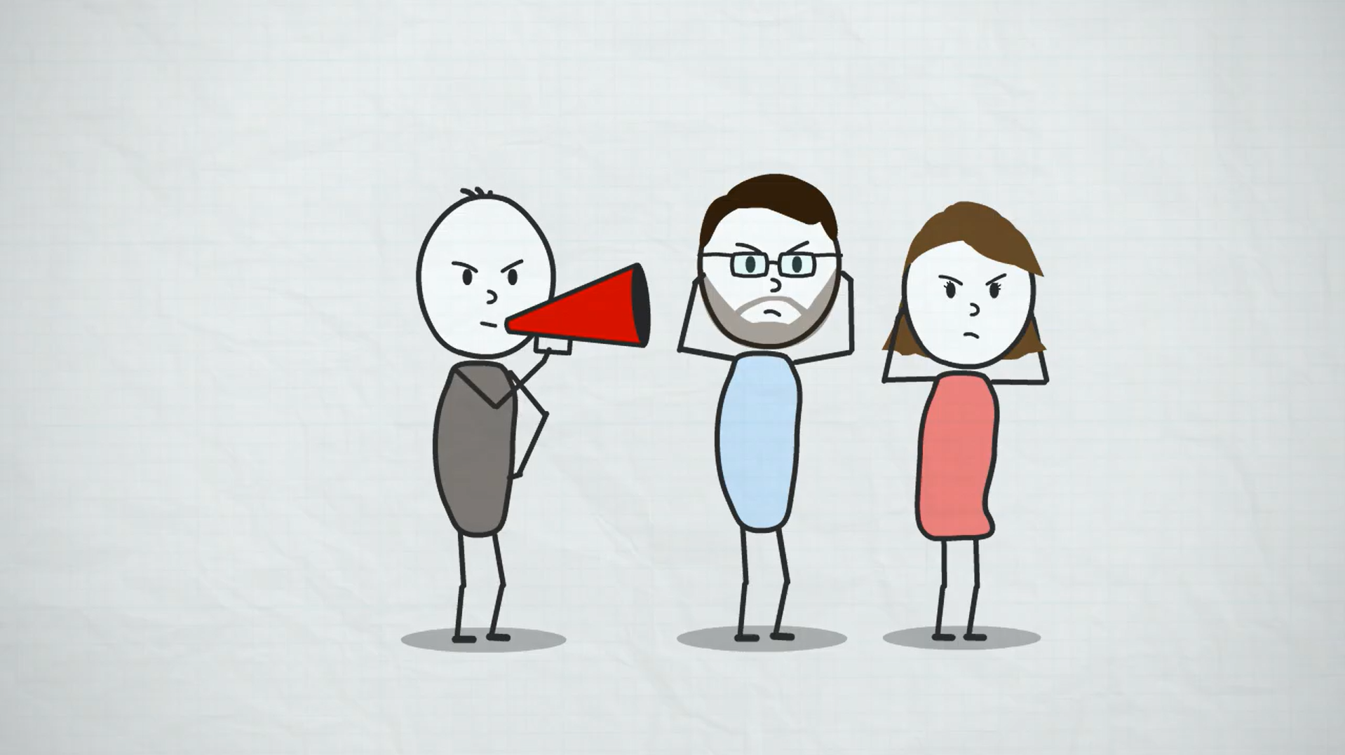
Watch: Be Assertive the Right Way - Course Trailer https://ytubl.ink/3FwK (1 min 55 sec)
Notes:
Teaching, Watch Video & Activity (8 + 7 min) (Slides 6-9)
Slide 6: Explain that once you’ve made your decision, the next step is telling others about it, especially if they disagree. This takes assertiveness.
Let’s watch a short video that briefly explains assertiveness.
Watch: Be Assertive the Right Way - Course Trailer
https://ytubl.ink/3FwK (1 min 55 sec)

Slide 7
Assertiveness means:
Speaking clearly, calmly and confidently
Sticking to your choice, even when others try to change your mind
Respecting others, without giving up your own voice
Assertiveness does NOT mean:
Being aggressive = rude, forceful, or disrespectful
Being passive = staying silent, even when something feels wrong
Notes:
Slide 7: Define assertiveness and contrast it with aggression and passivity as set out in the Table on Slide 7.
Explain the following example: A friend pressures you to vape. You don’t want to.
Aggressive response: “That’s disgusting! Don’t talk to me again!”
Passive response: “I guess… maybe just a little.”
Assertive response: “No thanks, I’m not interested. I’m focusing on staying healthy.”

Slide 8
Assertiveness Tips
Use “I” statements
Instead of blaming others or sounding unsure, express how you feel and what you need. Example: “I don’t feel comfortable going to that party.”
Repeat your message if needed
If someone keeps pressuring you, repeat your decision without changing your answer. Example: “I’ve already said no. Please respect my choice.”
Maintain open body language
Your body says a lot! Stand or sit tall, make eye contact (if culturally appropriate), and avoid crossing your arms or looking down.
Notes:
Slide 8-9: Being assertive takes practice, but the more you use these skills, the easier it becomes to stand up for yourself respectfully and confidently.
Introduce the assertiveness tips on Slide 8 and Slide 9. You may ask volunteers to read the tips aloud.

Slide 9
Assertiveness Tips
Keep a calm and clear tone
Speak in a steady, calm voice – firm but not angry or emotional. If your voice sounds unsure or shaky, others might not take your words seriously.
Know when to walk away
If the situation becomes uncomfortable or someone won’t accept your decision, it’s okay to remove yourself. Example: “I’m not going to keep talking about this. I’ve made my choice.”
Practise ahead of time
Think about situations where you might need to be assertive, then practise what you would say. You could practise in the mirror, role-play with a friend, family member, or even write out your responses.
Notes:
Assertiveness tips (continued)
Learners to complete Activity 2 (Lesson 4 – Worksheet) in pairs. Once learners have completed the activity, facilitate a brief feedback session using the possible answers in Lesson 4 – Worksheet MEMO.

Slide 10

Reflection
Notes:
Slide 10: That brings us to the end of our lesson series about goal-setting and lifestyle choices. Remember, you can’t control every influence, but you can choose your lifestyle choices and responses. With practice, your decision-making and communication skills will grow stronger.
Learners to complete Activity 3 (Lesson 4 – Worksheet).
Hand out the Content Summary before learners leave the classroom.

