Slide 1

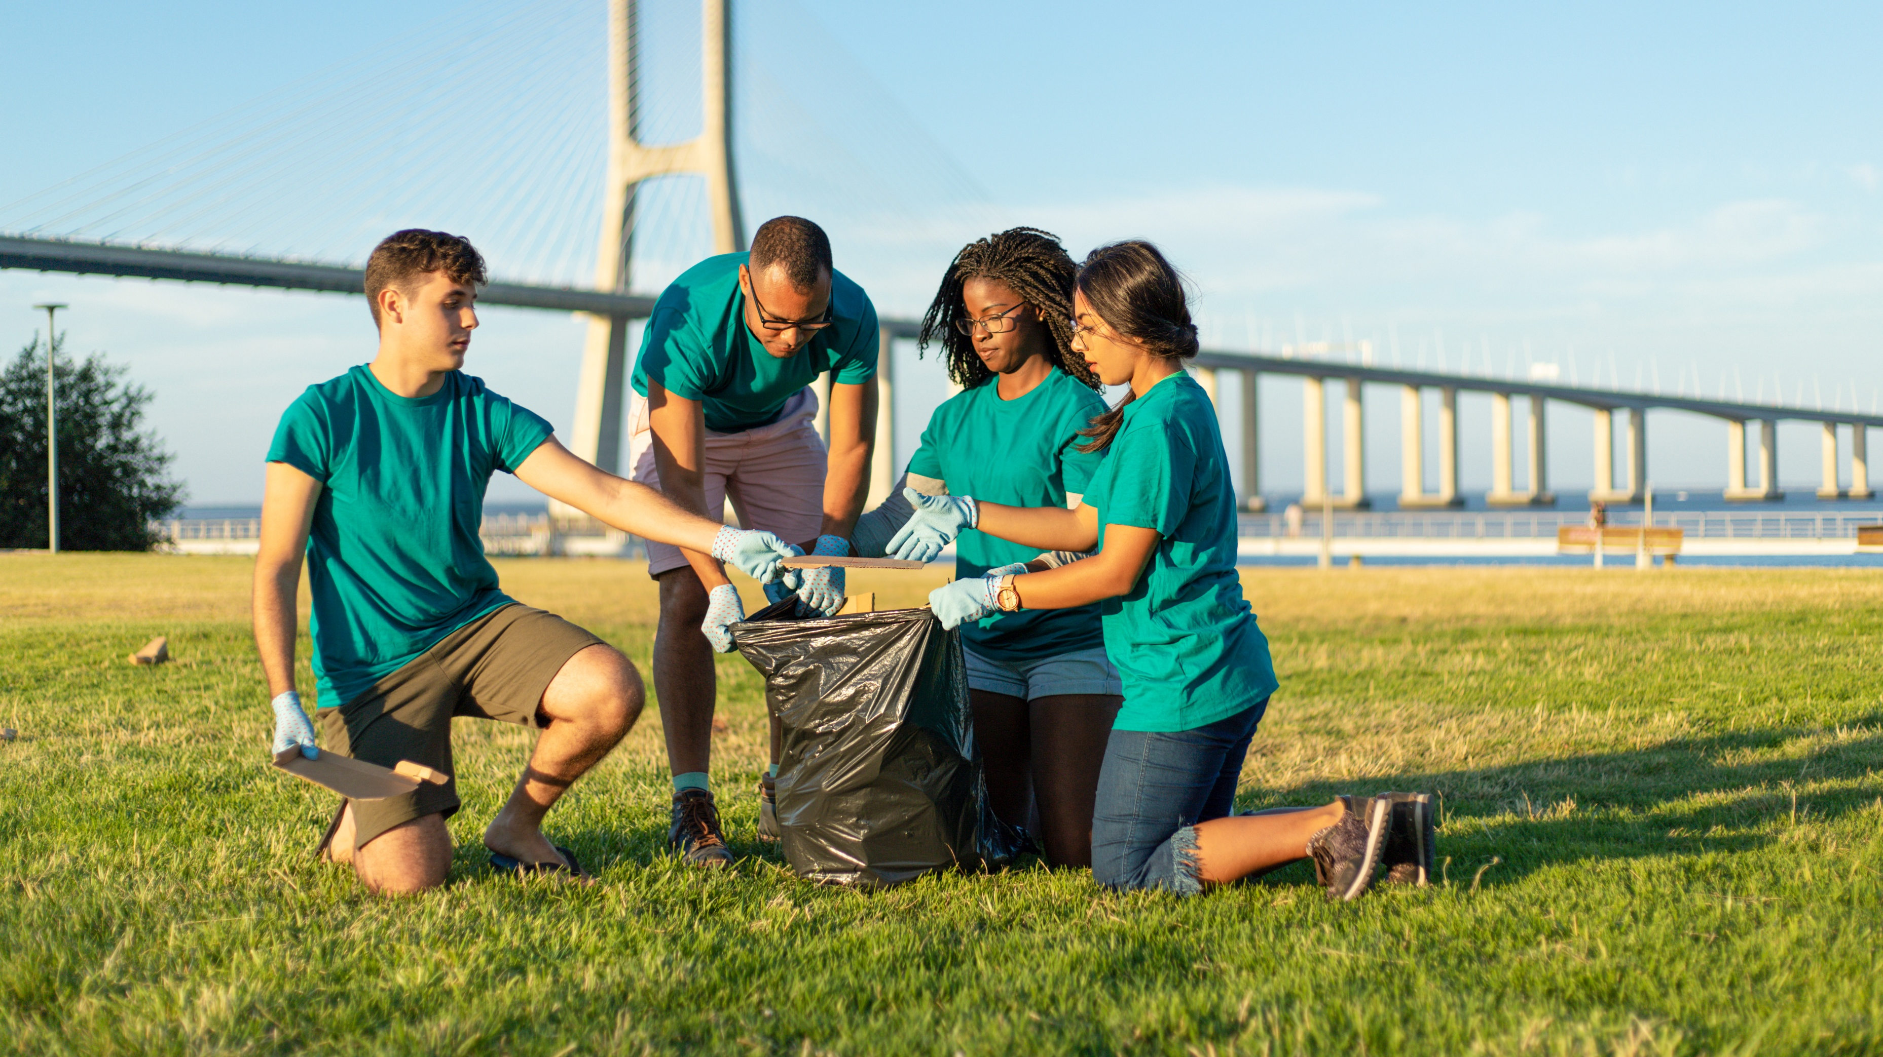
Volunteer Activities
Health, Social & Environmental Responsibility
Term 3: Lesson 3
Notes:
Introduction (1 min)
Welcome back, Grade 9s. Our final lesson for this series is based on different types of volunteer activities.
In our previous lesson, you came up with excellent ideas for volunteer projects. By doing so, you have already answered the first part of today’s lesson: identifying the types of volunteering opportunities available.

Slide 2
Volunteering takes many forms
Anyone can be a volunteer
You can make an impact based on your own interests and skills
Understanding your personality, interests, and career goals can help guide you
Examples:
If you love conservation, try wildlife or marine volunteering
If you care about social issues, get involved in areas like:
Public health
Women’s empowerment
Education
Notes:
Teaching & Watch Video (9 min)
Based on your group activity from last week and what we have covered so far, we know one thing is certain: Volunteerism comes in many different forms, and anyone can be a volunteer.
That’s one of the best things about volunteering; there are a variety of ways for individuals to make an impact according to their interests and skills.
The many types of volunteer opportunities available can be overwhelming, but understanding your personality, interests and career goals can help narrow down the possibilities. For example, if you're passionate about conservation, you could get involved in wildlife or marine conservation efforts, or perhaps you'd prefer to focus on social issues such as public health, women's empowerment, or education.

Slide 3
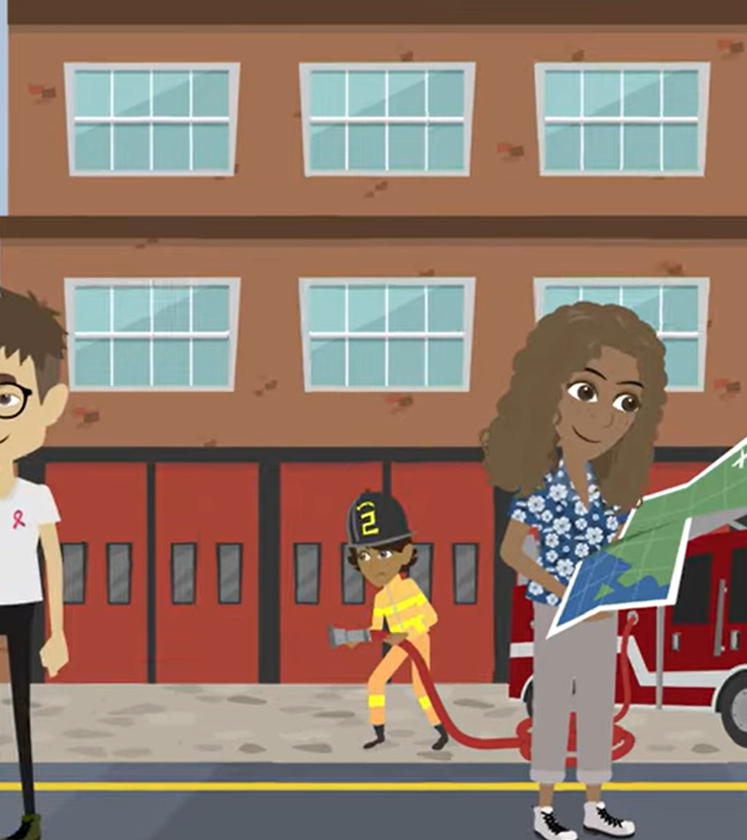
Types of volunteering
Community service: Helping at food banks, shelters, or animal rescues
Environmental activities: Tree planting, beach clean-ups, or conservation work
Tutoring or mentoring: Helping learners who need extra support
Advocacy and awareness: Raising awareness about poverty, equality, or climate change
Healthcare volunteering: Assisting at hospitals or nursing homes
International volunteering: Helping in other countries with education or healthcare
Virtual volunteering: Helping online with translation, admin, or social media
Watch:
Where and how can I volunteer?
https://www.youtube.com/watch?v=Htm5tgOrubg (1 min 42 sec)
Notes:
Let's watch a video that illustrates the diverse range of volunteering.
Watch: Where and how can I volunteer?
https://www.youtube.com/watch?v=Htm5tgOrubg (1 min 45 sec)
To further elaborate, you can discuss the following types of volunteering with the learners, or ask them to list as many types as they can think of.
Community service: Assisting local organisations, such as food banks, homeless shelters, or animal rescue centres.
Environmental activities: Participating in beach clean-ups, tree planting, or environmental conservation projects.
Tutoring or mentoring: Supporting learners or individuals who require academic assistance or guidance.
Advocacy and awareness: Getting involved in campaigns or initiatives to raise awareness about social issues, such as poverty, gender equality, or climate change.
Healthcare volunteering: Assisting in hospitals, nursing homes, or rehabilitation centres to provide support to patients and medical staff.
International volunteering: Engaging in volunteer work abroad, usually in developing countries, to help improve education, healthcare, or infrastructure.
Virtual volunteering: Contributing remotely through online platforms, such as data entry, translation services, or social media management.

Slide 4
Volunteering creates opportunities
Volunteering can help you:
Learn new skills
Explore your interests
Shape future career paths
Examples of volunteering opportunities:
Wildlife conservation
Marine conservation
Teaching
Public health
Women’s empowerment
Sports
Disaster relief
Notes:
Volunteering can also provide people with different opportunities, these opportunities can help you learn more skills, expand your horizons and ultimately shape further careers if you find something you really enjoy and are passionate about.
Here are some examples:
Wildlife conservation: Help to preserve endangered plant and animal species through research and education. You will also have encounters with some of the most incredible wildlife on the planet. By collecting data, examining animal behaviour, mapping habitats, helping to educate local communities, and contributing to biodiversity.
Marine conservation: Help protect the world’s oceans, which includes taking part in biodiversity surveys carried out through snorkelling or diving trips, collecting data that is used to inform marine conservation policies, and environmental education among the local communities.
Teaching: An example could be giving English lessons. Being able to read and write in English can improve an individual’s employability and give them a chance to increase their income and standard of living.
Public health: Focus on preventing illness and injury through education through working to improve nutrition, water security, hygiene, maternal health, or HIV and AIDS awareness.
Women’s empowerment: Promote education, public health, and income opportunities for women and girls, improving community well-being.
Sports: Use physical activity as a tool to improve health, aid with concentration, teach teamwork and respect for guidelines, and boost children’s confidence by coaching or taking part in sporting activities that involve children from local communities.
Disaster relief: Assist in providing emergency aid, shelter, and recovery support to communities affected by natural disasters, helping rebuild lives and infrastructure.

Slide 5
Different ways people make a difference
People who support change in different ways
Philanthropists
Donors
Volunteers
Philanthropists
Give money, time, or influence to causes they care about
Focus on big issues like poverty, health, or the environment
Their support can be a once-off donation or a long-term investment in nonprofit work
Notes:
Teaching (6 min)
PHILANTHROPISTS, DONORS, and VOLUNTEERS all play important roles in driving social change and community development, though they do so in different ways.
Philanthropists: These are people or organisations that contribute money, time, or influence to causes they care about, aiming to tackle large-scale issues like poverty, health, or the environment. Their contributions can be one-time donations or long-term investments in nonprofit work.

Slide 6
Donors, altruism, and working together
Donors
Give money, goods, or services to causes
Often give in smaller amounts than philanthropists
Sometimes donate time or expertise
Their giving is often spontaneous, not long-term or strategic
Altruism
Altruism means helping others without expecting anything in return
Working together for change
Philanthropists fund and support big-picture plans
Donors give what’s needed for smaller projects
Volunteers carry out the work on the ground
Notes:
Donors give money, goods, or services to causes, often in smaller amounts compared to philanthropists. They can also donate their time or expertise, but typically their contributions are less strategic and more spontaneous.
Altruism in Volunteering: Altruism means helping others without expecting anything in return. In volunteering, people give their time and skills to support causes, ranging from local charities to global organisations, driven by a desire to make a positive impact on others' lives
Philanthropists, donors, and volunteers all play essential roles in driving social change. Philanthropists provide funding and strategic support, donors contribute materials or smaller financial gifts, and volunteers dedicate their time and skills. Together, these efforts amplify each other: philanthropists fund nonprofits, donors support specific projects, and volunteers help execute them, creating a stronger, more impactful force for community development and global change.

Slide 7

Word search activity
You have 5 minutes to find as many words as you can!
Some words are from previous lessons
Some are from today’s lesson
First pair/group to finish before time is up = WINNERS
Start the timer: https://time-stuff.com/timer.html
Notes:
Pair Activity (Lesson Breaker) (5 min)
You have covered a lot of new terms in these lessons. In Activity 1 (Lesson 3 -Worksheet) you will now complete a word search. You have 5 minutes to see how many words you can find with the person sitting next to you/in your group (depending on how the classroom is laid out).
The timer will start in just a moment, so grab a highlighter or marker so you can circle the words.
Some of the terms you have already used, and some will have come up in today’s lesson.
The first pair/group to finish before the timer reaches zero is the winner.
You have FIVE minutes.
Timer: https://time-stuff.com/timer.html (no ads)

Slide 8

What is corporate social responsibility (CSR)?
Many companies now support volunteering and match donations
This is part of their Corporate Social Responsibility (CSR)
CSR means:
  A company’s promise to act in an ethical and responsible way
  Focusing on people and the planet
  Giving back to society, not just making money
  Helping through social, environmental, and economic efforts
Notes:
Teaching & Watch Video (14 min)
Many companies now encourage employees to volunteer and match donations as part of their Corporate Social Responsibility (CSR) efforts, helping social causes through both time and money.
CSR is a company’s commitment to operating in an ethical, sustainable, and socially accountable manner. It involves integrating social, environmental, and economic concerns into business operations going beyond profit-making, aiming to make a positive impact on society.

Slide 9
Supporting people with terminal illness or HIV/AIDS
What is a terminal illness?
A disease that cannot be cured and is expected to lead to death
Focus is on managing symptoms and improving quality of life
Examples of terminal illnesses
Advanced cancer
Heart disease
Late-stage HIV/AIDS
How can we help?
Giving care, financial aid, or advocating for rights
Notes:
Helping those less privileged and assisting people affected by HIV/AIDS or terminal illnesses requires a combination of compassion, practical support, and community action.
A terminal illness is a disease or condition that is expected to lead to death and is not curable or reversible. Terminal illnesses typically have a limited life expectancy, meaning that treatments focus more on managing symptoms and improving quality of life rather than attempting to cure the disease. Common examples of terminal illnesses include advanced stages of:
Cancer
Heart disease
Chronic obstructive pulmonary disease (COPD)
Neurodegenerative diseases, such as Alzheimer’s and Parkinson’s
Certain progressive liver or kidney diseases
Late-stage HIV/AIDS (though advancements have made HIV/AIDS manageable for many)
Whether through direct care, financial aid, or advocacy, these efforts can significantly improve the lives of individuals facing tough challenges. By working together, communities can become inclusive and uplift everyone, especially those in need.

Slide 10

Volunteering in hospice and palliative care
Palliative care and hospice care support people with terminal illnesses
They focus on providing comfort, managing symptoms, and offering emotional support
This care also helps the families of patients
Watch:
Valir Hospice: How Volunteers Help
https://www.youtube.com/watch?v=QnM_z9q2IFk (0 min 56 sec)
Notes:
Palliative care and hospice care are often recommended for individuals with terminal illnesses to provide comfort, symptom management, and emotional support for both patients and their families.
Let's watch a video that explains this in a bit more detail.
Watch: Valir Hospice: How Volunteers Help
https://www.youtube.com/watch?v=QnM_z9q2IFk (0 min 56 sec)

Slide 11
How CBOs support people with illness and poverty
Health support and access
Help people get medical care, medication, and resources
Work with clinics to offer free or low-cost treatments
Emotional and social support
Offer counselling, support groups, and social care
Help reduce isolation, stigma, and emotional stress
Education and awareness
Run campaigns on HIV/AIDS prevention and early testing
Teach communities how to support people living with illness
Resources and advocacy
Connect people with grants, social services, and support
Fight for fair policies to protect affected individuals
Notes:
Community-based organisations play a significant role in assisting those affected by poverty, HIV/AIDS, and other terminal illnesses, contributions could include:
Health Support and Access: CBOs offer direct support to individuals affected by HIV/AIDS and terminal illnesses, ensuring they have access to medical care, medications, and necessary resources. They often collaborate with healthcare providers to deliver treatments and services at reduced costs or free of charge for low-income individuals.
Emotional and Social Support: Many CBOs provide counselling services, support groups, and social care for individuals and families impacted by terminal illnesses. These services aim to reduce isolation, stigma, and emotional burden by creating a supportive community network.
Education and Awareness: CBOs raise awareness of HIV/AIDS prevention, treatment options, and the importance of early testing. Their campaigns often aim to reduce stigma, promote safe practices, and educate communities on ways to support affected individuals.
Resources and Advocacy: They help connect people to social services, financial assistance, and other resources while advocating for policies that support the rights and needs of individuals living with HIV/AIDS and other terminal illnesses.

Slide 12

Exam Practice
Notes:
Individual Activity (5 min)
Hand out the Content Summary to the learners.
Great work in this lesson! To wrap up, we’ll do an exam practise activity (Activity 2, Lesson 3 – Worksheet) that you can start and complete as homework
Answers available in the Lesson 3 – Worksheet MEMO.

